Slide 1
Power recycling cavity length and power recycling gain measurements
JGW-G2617195
February 13, 2026
Yuta Michimura
RESCEU, University of Tokyo
Kavli IPMU, WPI, UTIAS, University of Tokyo

Slide 2
Scope
This slide explains recent measurements of - Power recycling cavity length - Power recycling gain - Beam Splitter T and R for s-pol and p-pol using PRX and PRY (and ITMX/Y single bounce)
See klog #36249 and klog #36340
See, also, klog #36283
See JGW-T2617194 for simulations and how to deal with f2-PRCL mismatch

Slide 3
Configuration
s-pol to s-pol or
s-pol to p-pol conversion
klog #14575
ITMY
JGW-L1605744
PRM
PR2
ITMX
BS
PR3
POP_PDA1_DC
POP_SPOL
POP_PPOL
POS_SPOL
POS_PPOL
SR2
SR3
SRM, OMMT1, OMMT2, OFI, OSTM
AS_PDA1_DC
This is basically s-pol power

Slide 4
BS ratios from ITM single bounce
From AS and POS_SPOL, ITM reflectivity of s-pol to s-pol can be measured
Next, using POP_SPOL, BS T:R for s-pol can be measured
Then, using POP_PPOL and POS_PPOL, BS T:R for p-pol and ITM reflectivity of s-pol to p-pol can be measured
Power when ITMX single bounce
ITMY single bounce

Slide 5
BS ratios from ITM single bounce
klog #36249
Results are the following (no significant loss in BS assumed): ITM reflectivity ratio X/Y for s-pol 1.039+/-0.005 BS T/R ratio for s-pol 0.998+/-0.012 BS T for s-pol 0.4995+/-0.0030 BS R for s-pol 0.5005+/-0.0030 BS T/R ratio for p-pol 4.025+/-0.031 BS T for p-pol 0.8010+/-0.0012 BS R for p-pol 0.1990+/-0.0012 ITM p-pol conversion ratio X/Y 0.663+/-0.005
BS T:R=50:50 for s-pol and 80:20 for p-pol consistent with Hirose-san’s characterizations and coating design (JGW-T1503347)
ITM p-pol conversion is 6-7% for X and 9-10% for Y (klog #36283). This asymmetry explains ITM reflectivity asymmetry for s-pol as well.

Slide 6
PRC resonant conditions: Design
PRC in PRFPMI
20FSR
40FSR
anti-resonant
2.251 MHz
45.015898 MHz
Carrier
f2
2*f2
Frequency
PRX/PRY carrier
anti-resonant
2.196 MHz
40FSR
40FSR
POP90 will be the same for X and Y
2.309 MHz
Locked on carrier resonance
Frequency
PRX/PRY sideband
anti-resonant
anti-resonant
POP90 will be the same for X and Y
Locked on f2 resonance
Frequency

Slide 7
PRC resonant conditions: Detuned
PRC in PRFPMI
20FSR
40FSR
anti-resonant
I am not so sure what carrier/sideband lock means in detuned case.
We locked with 3*f2 (REFL135).
Carrier
f2
2*f2
Frequency
PRX/PRY carrier
anti-resonant
40FSR
40FSR
POP90 will not be the same for X and Y
Locked on carrier resonance
Frequency
PRX/PRY sideband
anti-resonant
anti-resonant
POP90 will not be the same for X and Y
Locked on f2 resonance
Frequency

Slide 8
PRGs for PRX and PRY
From power ratio at POP_DC and AS_DC when ITM single bounce and PRX/PRY, carrier PRG for carrier lock can be estimated: Carrier PRG for PRX 0.341+/-0.006 Carrier PRG for PRY 0.330+/-0.009
f2 PRG is given by
klog #36249
Carrier PRG
1.135 MHz
Detuning from Schnupp asymmetry
f2 PRG for PRX
This ratio is measured
f2 PRG for PRY
FSR of PRC
Finesse of PRC
3.71(14) with optical loss of 13(5)%
f2 detuning
f2 detuning
Detuning
(HWHM is therefore ~0.303 MHz)
Optical loss estimated
from carrier PRG for PRX/Y

Slide 9
PRGs for PRX and PRY
From POP90 √(I²+Q²) ratios in PRX and PRY sideband locks, f2 detuning can be estimated: Estimated f2 detuning of PRC 0.0599+/-0.0033 MHz
From this detuning PRC length can be estimated: Average PRC length 66.540+/-0.005 m
Using carrier PRG, f2 PRG can be estimated: f2 sideband PRG for PRX 0.0244+/-0.0017 f2 sideband PRG for PRY 0.0200+/-0.0014
klog #36340
0.34
Carrier PRG
1.135 MHz
Detuning from Schnupp asymmetry
0.0244
f2 PRG for PRX
This ratio is measured
0.0200
f2 PRG for PRY
f2 detuning
f2 detuning
0.0599 MHz
0.0599 MHz
* HWHM is ~0.303 MHz This measurement possible due to large Schnupp asymmetry
* These values do not mean that f2 power is enhanced by these amounts

Slide 10
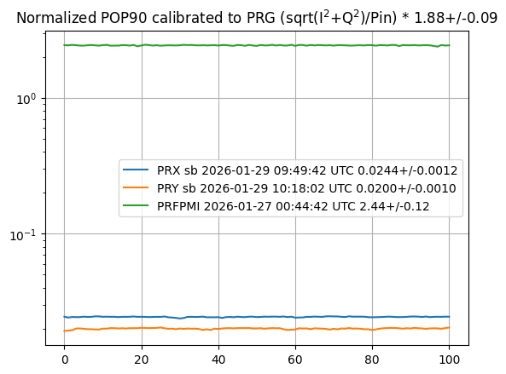
f2 PRG in PRFPMI
Using the estimated f2 sideband PRG for PRX and PRY, calibration factor for POP90 can be estimated to be 1.88(9).
Using this calibration factor, f2 PRG in PRFPMI is estimated to be f2 sideband PRG for PRFPMI 2.44+/-0.12
This is quite low compared with carrier PRG in PRFPMI estimated from TRX and TRY (~13 now)
This is probably mostly due to f2 detuning (see next page)
klog #36340
K1:LSC-POP_PDA2_RF90_I_ERR_DQ
K1:LSC-POP_PDA2_RF90_Q_ERR_DQ
K1:LAS-POW_IMC_DC_INMON

Slide 11
Losses in PRC for PRFPMI
Schnupp asymmetry of (klog #14575) gives loss-less Michelson reflectivity for f2 of
This gives f2 PRG of = 36.62(4), if PRC length is perfectly matched with f2.
The finesse for loss-less PRC is
The FSR for PRC using the measured value 66.540(5) m is = 2.25272(17) MHz.
Using the measured f2 detuning , PRG for detune f2 is
To explain measured f2 PRG in PRFPMI of 2.44(12), additional 12.6-16.1% loss is necessary. This is consistent with loss measurements in PRX and PRY.
klog #36340
* HWHM is ~0.0242 MHz

Slide 12
Next
It would be nice to have an independent method to measure PRC length - Inject auxiliary beam to do cavity scan? - Kick PRM during PRMI lock to do cavity scan?
I first thought carrier PRG and sideband PRG in PRFPMI and arm cavity finesse would give independent measurements of arm losses, PRC losses and ITM reflectivity, but distinguishing these losses seems tricky in current detuned case

