Slide 1
Status report for in-vac RF PDs and RF QPDs
JGW-G2517020
December 9, 2025
Yuta Michimura
RESCEU, University of Tokyo
with Huali Chen, Ryan Yang, Ray-Kuang Lee, Yoichi Aso et al.

Slide 2
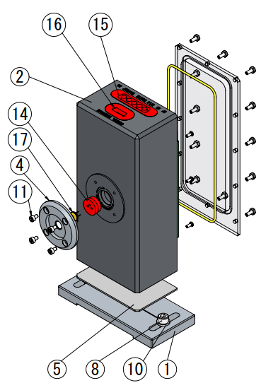
Status of Fabrication
In-vac RF PD enclosure - Drawings JGW-D2416111 (based on LIGO-D1101992 but with a resealable lid) - Ordered April 2025 to Onodenki - Waiting for 5xSMP connectors (⑮ in the drawing) to arrive from WinConn (Ordered SUS version but Al version arrived. Re-ordered in October 2025. Should arrive in February 2026) - ~2 month for the fabrication after the receipt of the connectors
In-vac RF QPD enclosure - Requested the design to Onodenki in November 2025 - Hoping to order in FY2026 - Connectors were already arrived, except for the 5xSMP and DB15
In-vac DC PDs and DC QPDs for TMS - No design yet

Slide 3
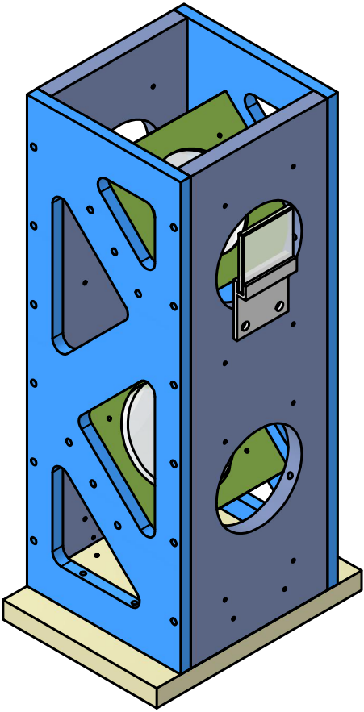
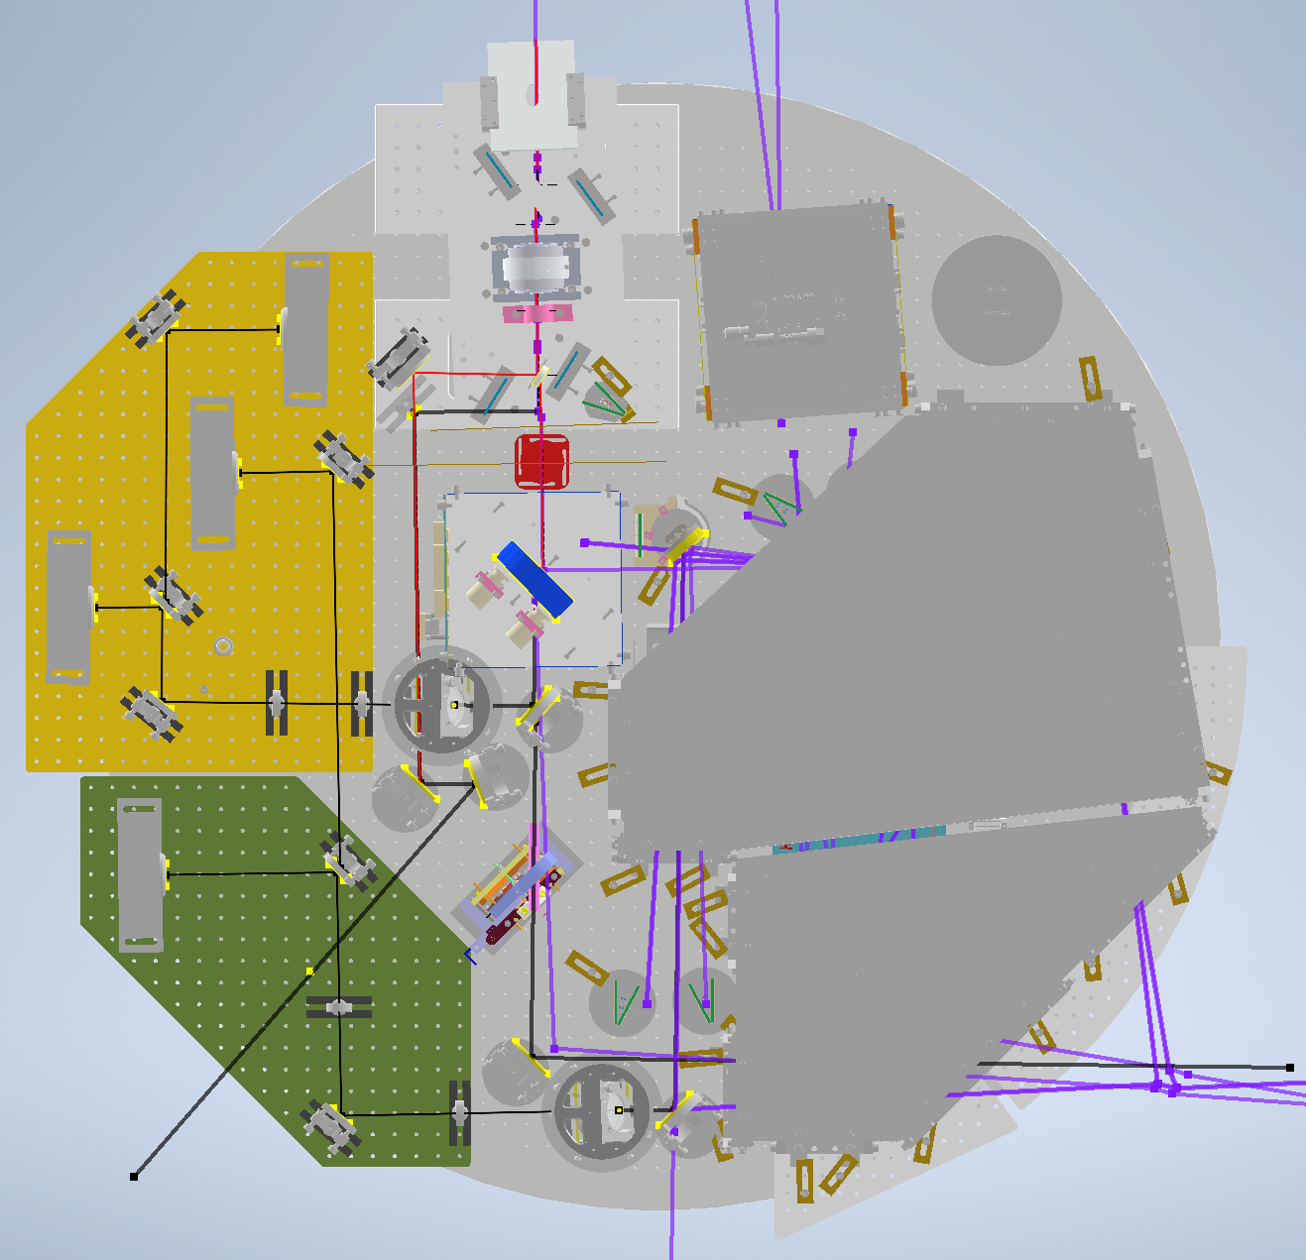
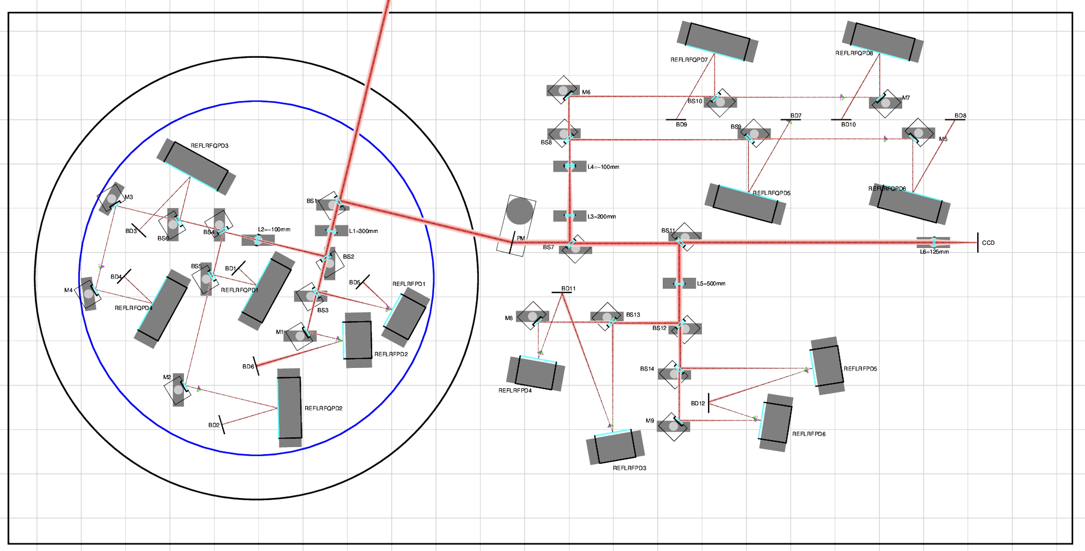
Status of Layout Design
AS / OMC - Basic 3D layout design completed. 3D CAD: JGW-D2516705 - Periscope design, quoting ongoing: JGW-D2517008 - Layout CAD need to be updated to include updated periscope updated baseplates for RF QPDs (to be designed), updated beam diverter (to be designed), beam dumps - Weigh estimated for OMC VIS table design
REFL - Basic layout design completed in 2D. JGW-G2516702 - Uchiyama-san started to consider new vacuum tank (Now assuming φ 800mm tank on REFL table)
POP / POPF / Green X - Started layout design based on JGW-T2416178 - Almost complete except for POP forward path and Green X path

Slide 4
Status of Cabling Design
RF cabling - Started the discussions and quotations: JGW-T2516991 - First meeting on December 1, 2025 - Cabling of the in-air part also needs to be considered
Dsub 9pin and 15pin cabling - Not started

