Slide 1
Status report for in-Vac PD and QPD enclosure and layout design
JGW-G2516769
July 30, 2025
Yuta Michimura
RESCEU, University of Tokyo
with Huali Chen, Ryan Yang, Ray-Kuang Lee, Yoichi Aso et al.

Slide 2
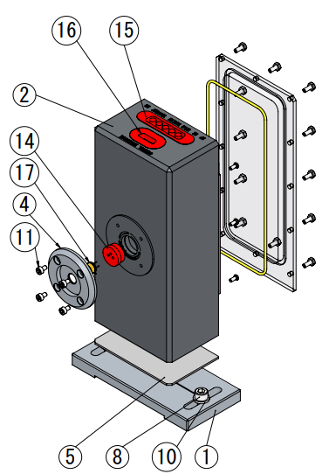
Status of Fabrication
In-vac RF PD enclosure
- Drawings JGW-D2416111
(based on LIGO-D1101992 but with a resealable lid)
- Ordered April 2025 to Onodenki
- Waiting for 5xSMP connectors (⑮ in the drawing)
to arrive from WinConn
(Originally to be shipped on April 2 but delayed multiple times. Last update on July 17 saying they are to be shipped on July 24 but not received yet)
- ~2 month for the fabrication after the receipt of the connectors
In-vac RF QPD enclosure
- No design yet
- Hoping to start this year after the completion of RF PD enclosures
In-vac DC PDs and DC QPDs for TMS
- No design yet

Slide 3
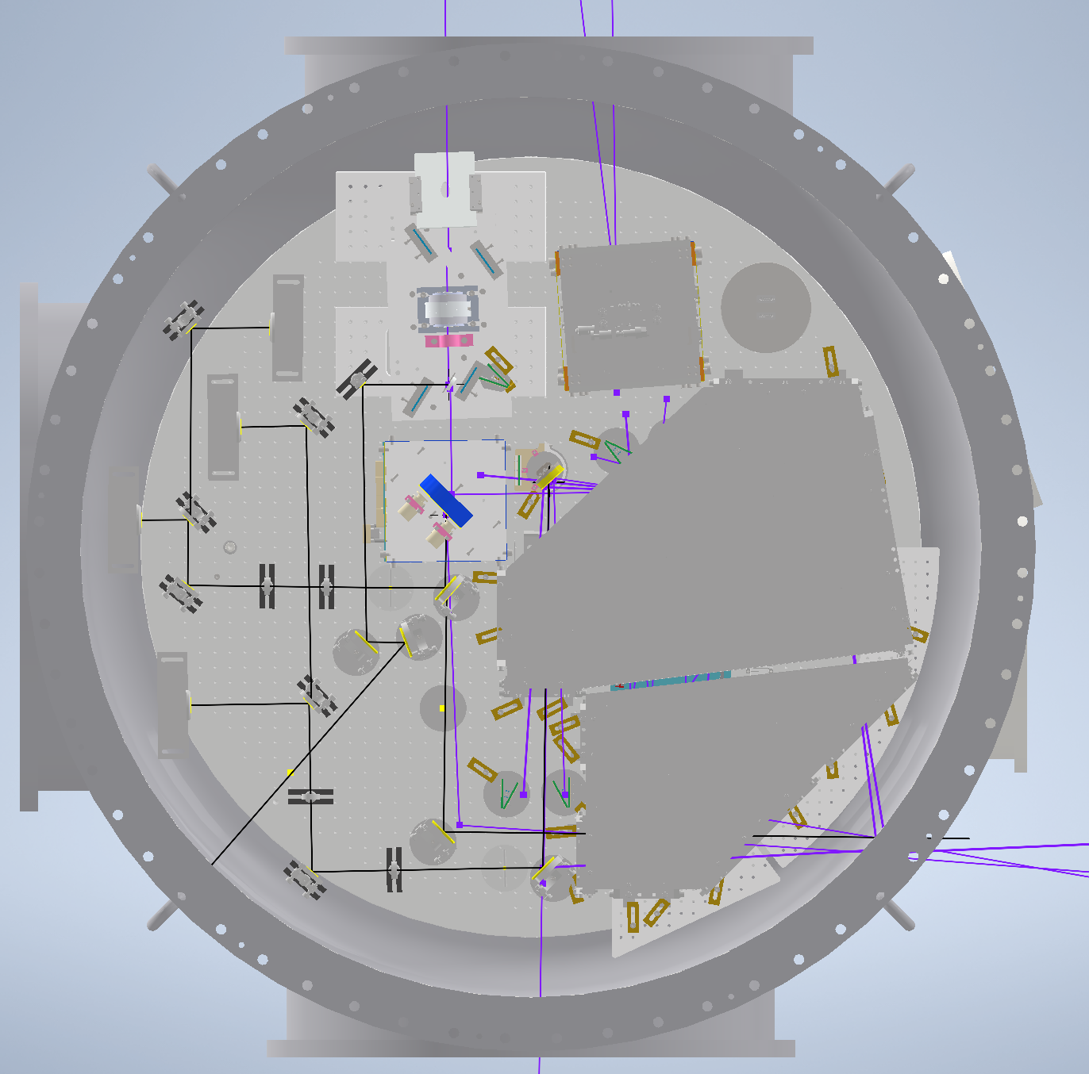
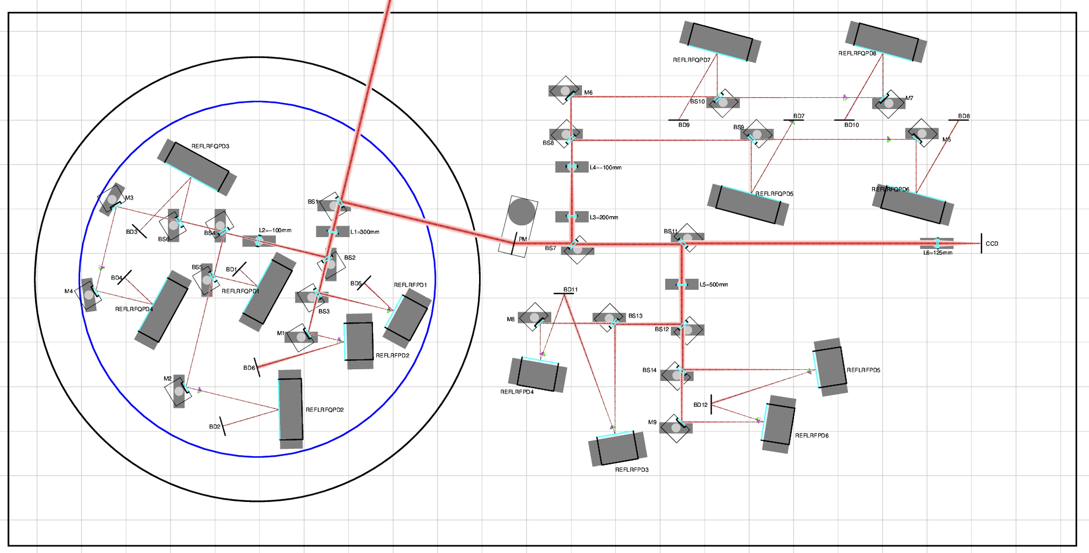
Status of Layout Design
AS / OMC
- Basic 3D layout design completed. 3D CAD: JGW-D2516705
- Periscope design started
(design following LIGO-D1201410)
- Layout CAD need to be updated to include
fast beam shutter (and new OFI location),
beam diverter,
periscopes,
base plate for RF QPD paths,
beam dumps
- Need to align with new OMC vibration isolation table design
REFL
- Basic layout design completed in 2D. JGW-G2516702
- Need to start designing new vacuum tank
(Now assuming φ 800mm tank on REFL table)
POP
- Started layout design based on JGW-T2416178

