Slide 1
Status report for in-Vac PD and QPD enclosure and layout design
JGW-G2516769
July 30, 2025
Yuta Michimura
RESCEU, University of Tokyo
with Huali Chen, Ryan Yang, Ray-Kuang Lee, Yoichi Aso et al.

Slide 2
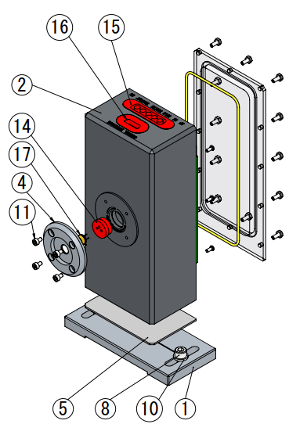
Status of Fabrication
In-vac RF PD enclosure - Drawings JGW-D2416111 (based on LIGO-D1101992 but with a resealable lid) - Ordered April 2025 to Onodenki - Waiting for 5xSMP connectors to arrive from WinConn (Originally to be shipped on April 2 but delayed multiple times. Last update on July 17 saying they are to be shipped on July 24 but not received yet) - ~2 month the for fabrication after the receipt of the connectors
In-vac RF QPD enclosure - No design yet - Hoping to start this year after the completion of RF PD enclosures
In-vac DC PDs and DC QPDs for TMS - No design yet

Slide 3
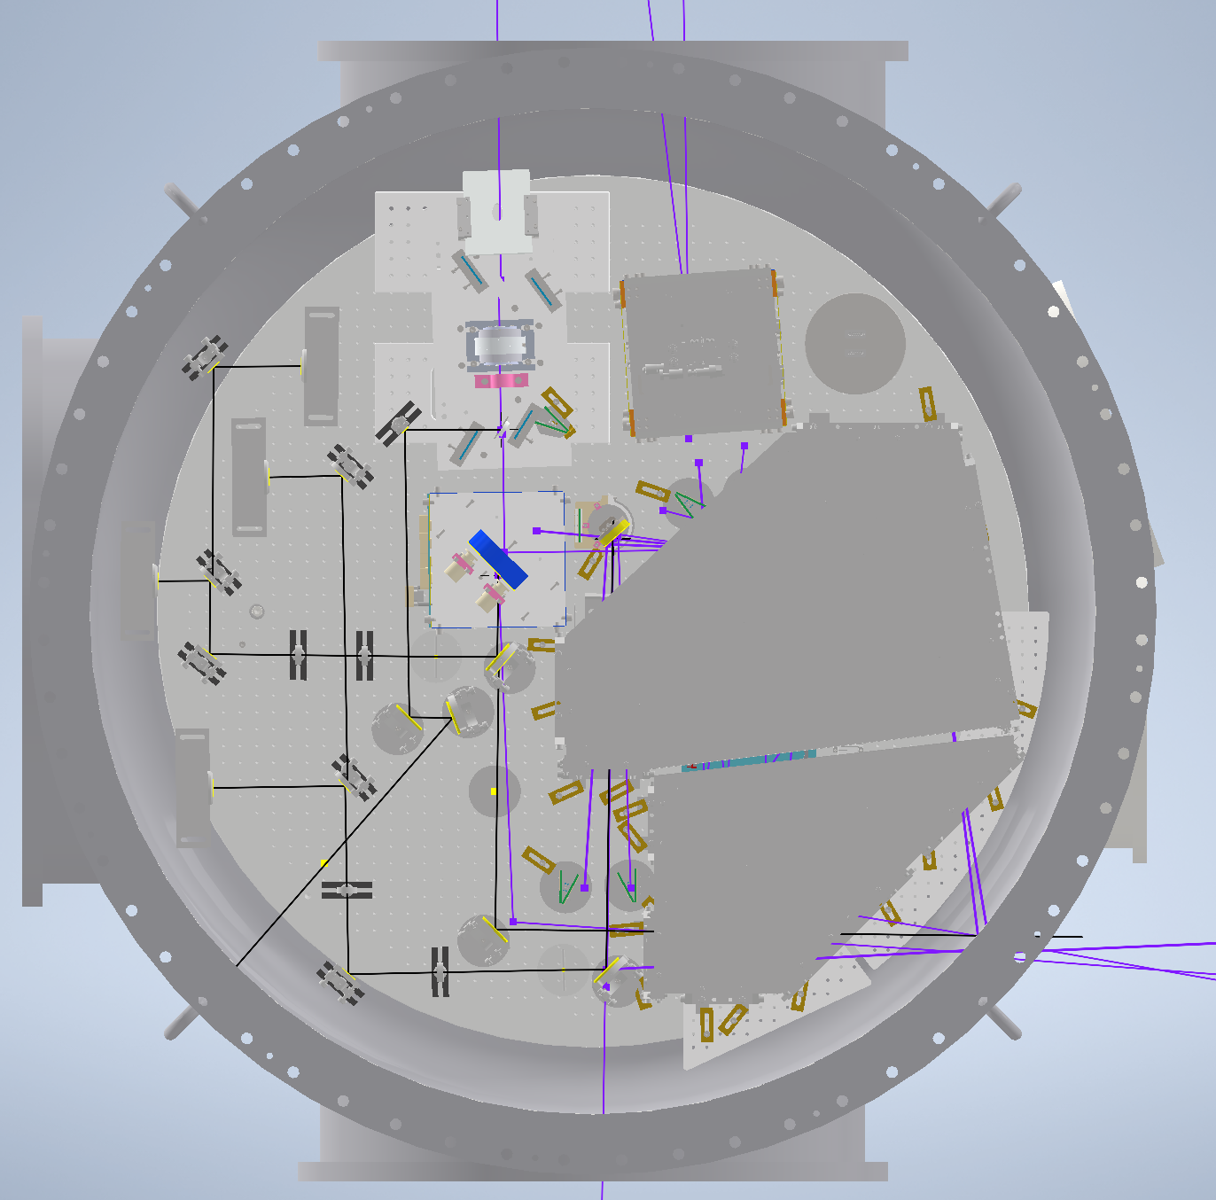
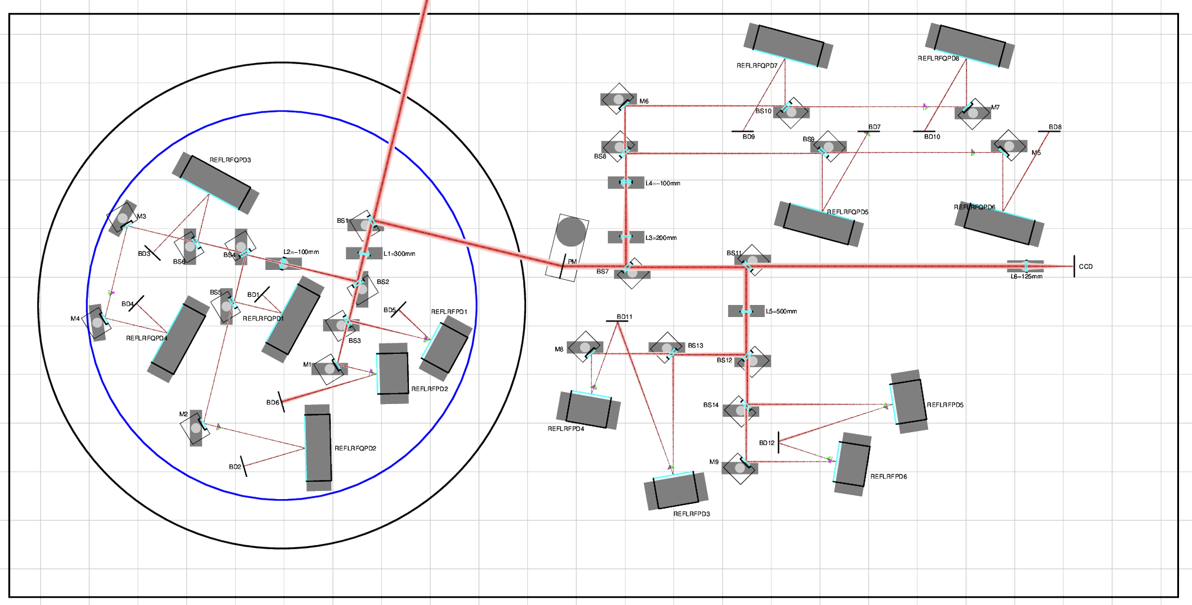
Status of Layout Design
AS / OMC - Basic 3D layout design completed. 3D CAD: JGW-D2516705 - Periscope design started (following LIGO-D1201410) - Layout CAD need to be updated to include fast beam shutter (and new OFI location), beam diverter, periscopes, base plate for RF QPD paths, beam dumps - Need to align with new OMC vibration isolation table design
REFL - Basic layout design completed in 2D. JGW-G2516702 - Need to start designing new vacuum tank (Now assuming φ 800mm tank on REFL table)
POP - Started layout design based on JGW-T2416178

