Slide 1
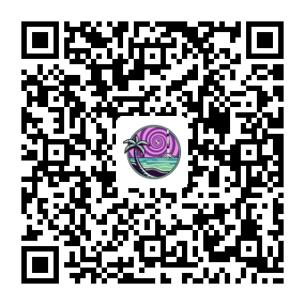
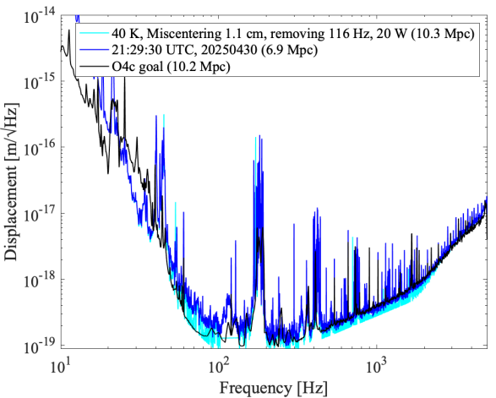
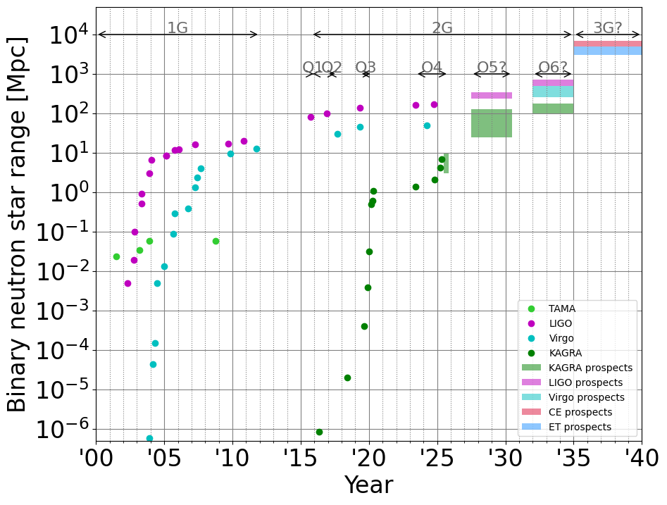
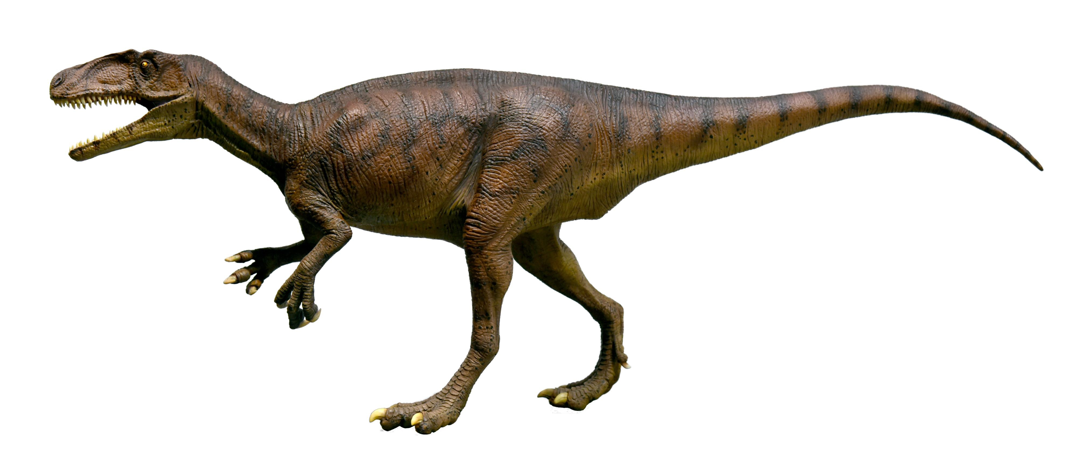
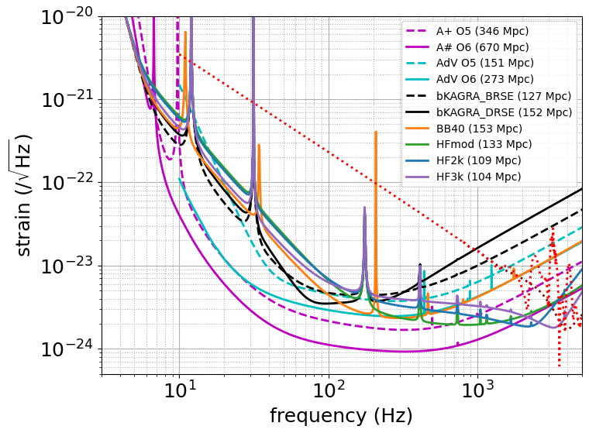
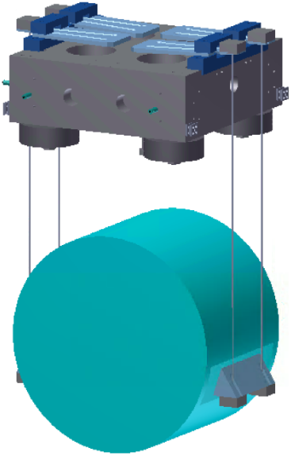
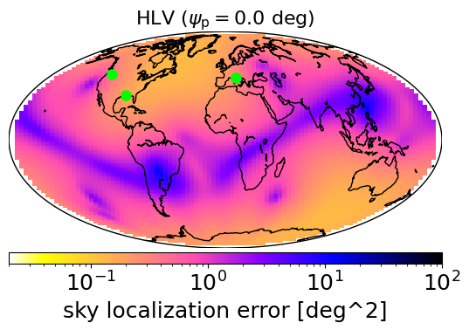
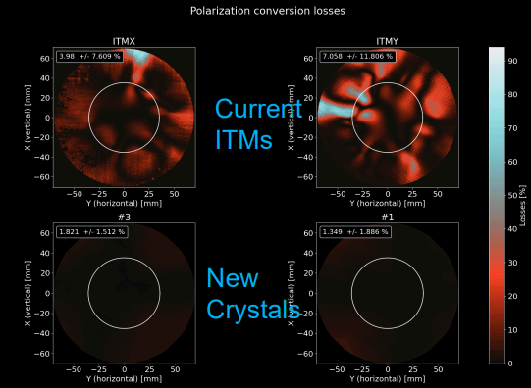
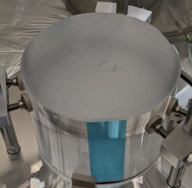
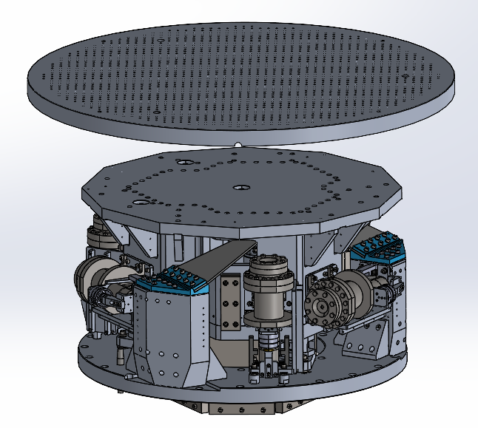
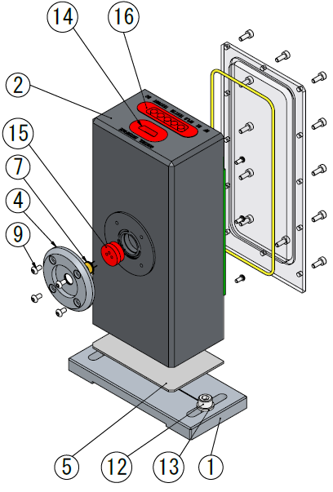
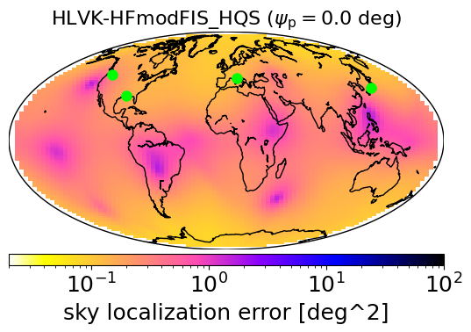
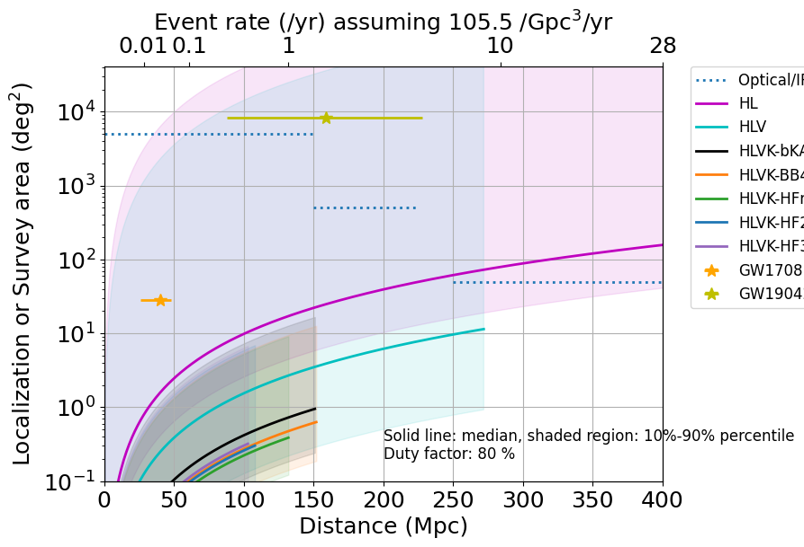
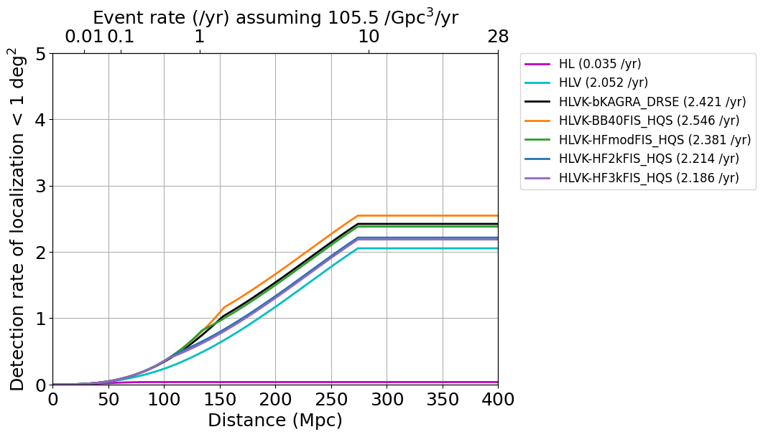
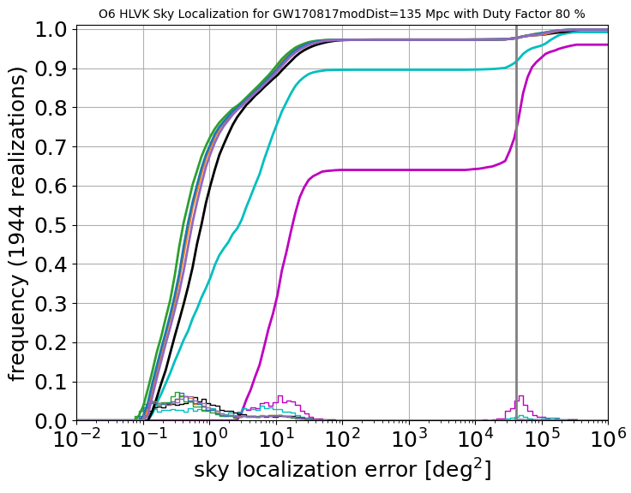
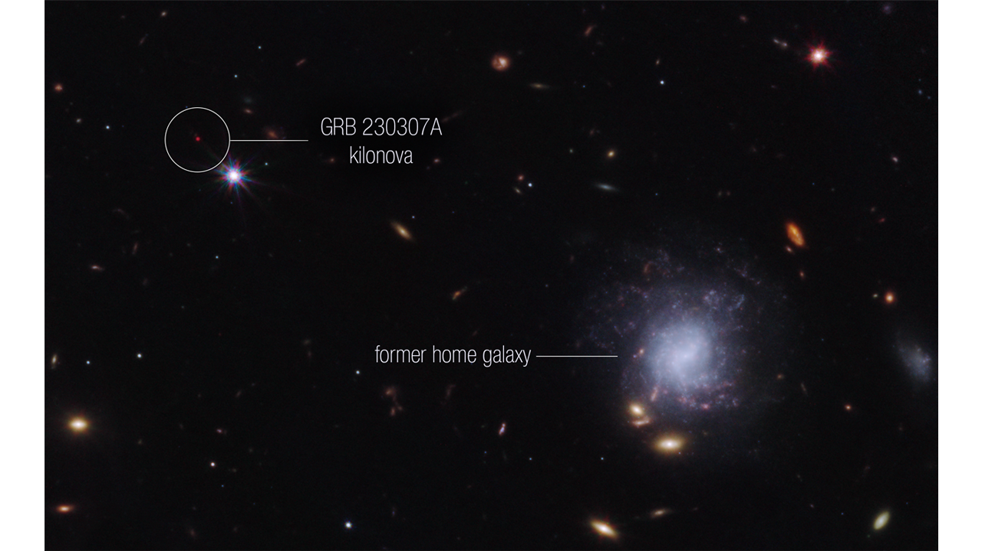
GWADW2025 (Cocoa Beach, Florida, May 18-23, 2025)
Download online
Preparing for the Era of Multi-Messenger Astronomy
Yuta Michimura for the KAGRA Collaboration
RESCEU, University of Tokyo
michimura@resceu.s.u-tokyo.ac.jp
The LIGO-Virgo-KAGRA collaboration has detected over 300 events so far, but multi-messenger observations have only been realized once, with GW170817. GW190425, which is believed to have originated from a binary neutron star (BNS) merger, had poor sky localization, and there have also been events, such as GRB211211A and GRB230307A, that were missed because gravitational wave detectors were not operational at the time. In this context, improving sky localization and increasing the duty cycle of multiple detectors through KAGRA’s operation and upgrades is becoming increasingly important. This will be essential for capturing the rare BNS merger events and achieving the sky localization precision required for electromagnetic follow-up observations.
O4c Target: 10 Mpc
BNS range of 6.9 Mpc achieved with 90 K, 10 W input
10 Mpc target can be achieved by 40 K, 20 W input, removing 116 Hz peak
O4c sensitivity
plot by K. Komori
JGW-G2516670
LIGO
O6?
Violins
Virgo
O5 target:
25-130 Mpc
TAMA
O4 target: 10 Mpc
Input jitter?
Can also be seen at CARM
KAGRA
O5 Target: 25-130 Mpc
LIGO-T1800042
LIGO-T2300041
LIGO-T2000012
Less birefringent ITMs under final polishing
Better OMC vibration isolation and in-vac PD/QPDs under development
Higher Q suspensions and mirrors required for 50+ Mpc
Sapphire blade spring loss angle: 3.6×10⁻⁵ (Design: 7×10⁻⁷)
Sapphire suspension loss angle: 10⁻⁵ to 10⁻⁴ at 80 K (Design: 2×10⁻⁷)
Sapphire mirror loss angle: 1×10⁻⁶ at 80 K (Design: 1×10⁻⁸)
Achieving 127 Mpc would allow us to improve BNS sky localization at 135 Mpc from HLV 1.55 deg² to HLVK 0.81 deg² (median)
KAGRA O5 High
(default design)
1.4-1.4M☉ BNS at 100 Mpc
KAGRA O6 options:
K. Komori, JGW-L2516564
Post-merger signal example R. Harada+, PRD 110, 123005 (2024)
Less than ~0.2 detections/yr. Even if detected, limited signal-to-noise ratios would make extracting neutron star physics challenging.
Sensitivity curves used for sky localization calculations
Comparing upgrade plans for O6
New sapphire crystals for O5
Considering 4 plans (all having designed Q suspensions and mirrors) - bKAGRA DRSE: original design sensitivity as a reference
- BB40: broadband upgrade with 40 kg mirror (all others 23 kg)
- HFmod: high frequency upgrade with higher power - HF2k or HF3k: dips at 2 kHz or 3 kHz with T_{SRM}=0.5%
Frequency dependent squeezing and better coating are not in the baseline plan due to limited resources
We usually assume a 100% single detector duty factor but reducing it to, e.g., 80% significantly alters the sky localization distribution across the sky.
OMC vibration isolation for O5
Adding
KAGRA O6
Large fraction is not well localized in HLV case due to limited duty factor and antenna pattern
but mostly covered by HLVK
In-vac RF PD with a resealable lid
Some are completely missed due to limited duty factor
HLVK covers 90+% of events
GW190425
Hard to EM follow up
(far + not well localized)
BB40 gives best < 1 deg² rate
HLVK
HLV
1 m class telescope
(FoV x100)
HL
HFmod gives best < 1 deg² rate for close events
HLVK
Methods and
Acknowledgements
HL
GW170817
4 m class
8 m class
(Rubin, Subaru)
Single detector detections cannot localize
HLVK
HLV
HLV
Sky localization estimated via Fisher analysis using the IMRPhenomD waveform for a GW170817-like binary at redshift z = 0.03 (135 Mpc), sampled over 1944 uniformly distributed combinations of source location and polarization angle [see YM+, PRD 102, 022008 (2018) for details].
This was repeated for all combinations of detectors, and the resulting sky localization distributions were combined according to the network duty factor to obtain the actual sky localization distribution.
Sky localization as a function of distance was plotted using ΔΩ ∝ (SNR)⁻² ∝ d², up to the BNS range (the sky-averaged distance at which a BNS signal can be detected with SNR = 8).
Event rate was estimated using O3b estimate of 105.5 /Gpc³/yr, multiplied by volume 4π/3*L³ , assuming all the BNS are 1.4-1.4M☉ [LVK, PRX 13, 011048 (2023)]
Treatment of beyond BNS range and BNS mass distribution is of future work.
We would like to thank Masaomi Tanaka for his invaluable input on sky localization requirements from the perspective of optical and infrared follow-up observations.
HL
GRB230307A
GRB211211A
Low rate for HL due to low probability
of < 1 deg² (saturates at ~80 Mpc)
 | HL | HLV | bKAGRA | BB40 | HFmod | HF2k | HF3k
BNS range (1.4-1.4 M☉) | 670 Mpc | 273 Mpc | 152 Mpc | 153 Mpc | 133 Mpc | 109 Mpc | 104 Mpc
Median localization ^{[1]} | 10.6 deg² | 0.55 deg² | 0.37 deg² | 0.28 deg² | 0.23 deg² | 0.27 deg² | 0.30 deg²
< 10 deg² rate ^{[2]} | 1.1 /yr | 5.3 /yr | 5.5 /yr | 5.6 /yr | 5.5 /yr | 5.4 /yr | 5.4 /yr
< 1 deg² rate ^{[2]} | 0.04 /yr | 2.1 /yr | 2.4 /yr | 2.5 /yr | 2.4 /yr | 2.2 /yr | 2.1 /yr
Post-merger rate ^{[3]} | < 10⁻³ /yr |  |  |  | < 0.06 /yr | < 0.1 /yr | < 0.2 /yr
Tidal deformability improvement compared with HL case ^{[4]} |  |  |  | ~25% | ~55% | ~45% | ~30%
Intracavity power per arm |  |  | 0.34 MW | 0.34 MW | 0.75 MW | 1.3 MW | 1.3 MW
ITM Transmission |  |  | 0.4% | 0.4% | 0.4% | 0.2% | 0.4%
SRM Transmission |  |  | 15% (DRSE) | 15% | 4% | 0.5% | 0.5%
Frequency independent squeezing |  |  | 0 dB | 10 dB input | 10 dB input | 10 dB input | 10 dB input
[1] For GW170817-like binary at 135 Mpc [2] Detection rate for 80% duty factor case [3] Detection rate with SNR>5. Depend on neutron star equation of state and BNS event rate. See H. Tagoshi & S. Morisaki, JGW-P2416311 for details. [4] Reduction of estimation error due to addition of KAGRA. See S. Morisaki, JGW-G2516593 for details. |  |  | Which KAGRA O6 plan do you like?

