Slide 1



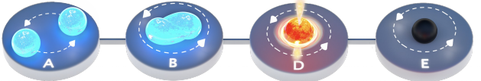
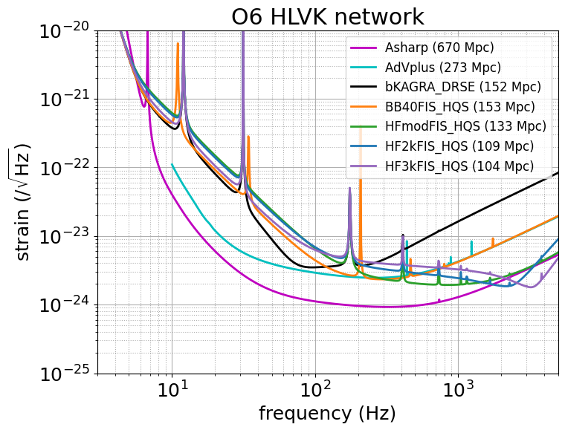
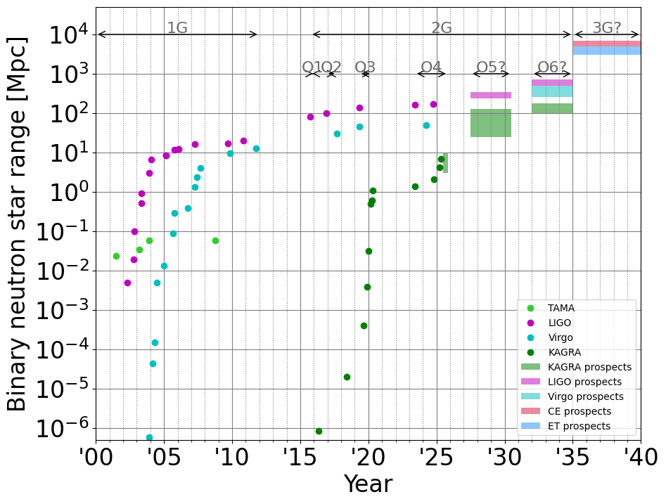
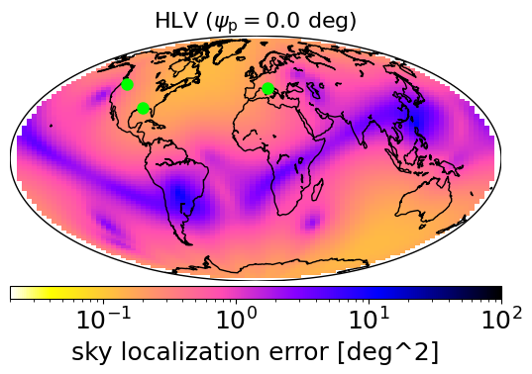
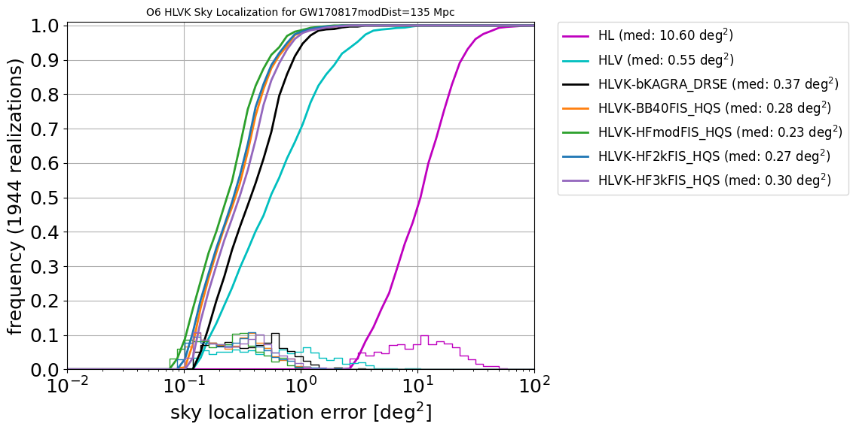
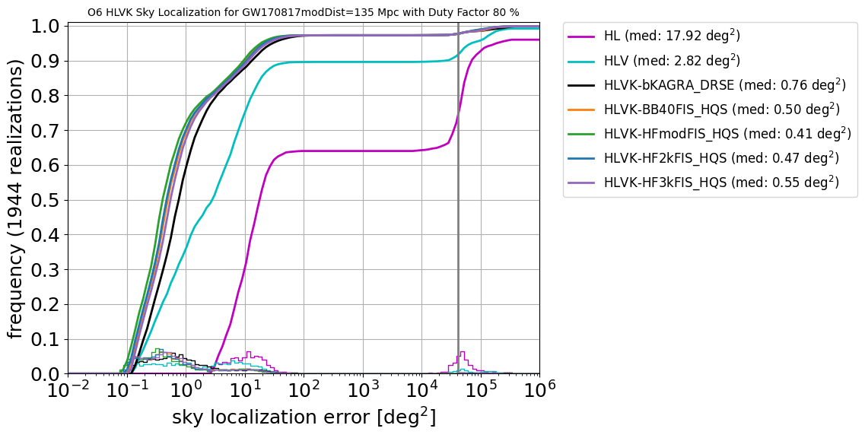
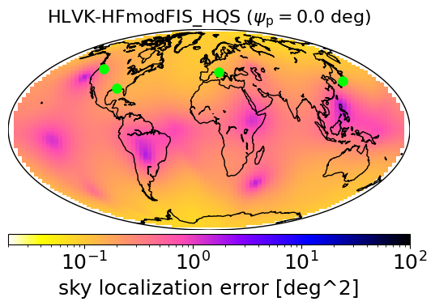
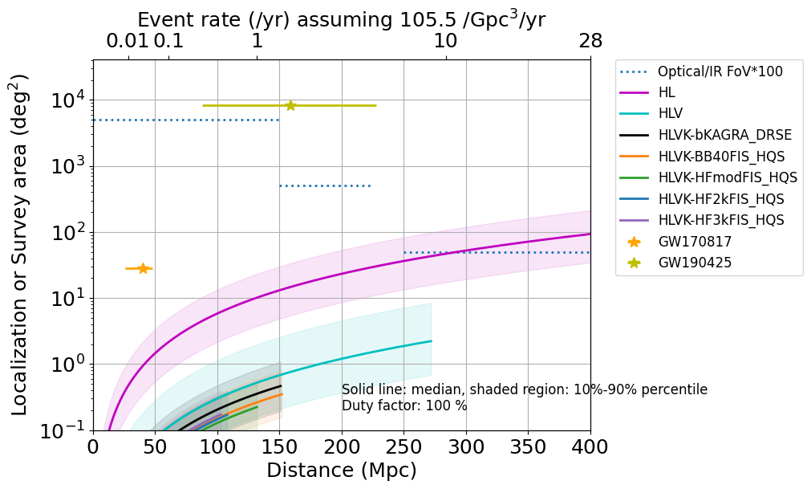
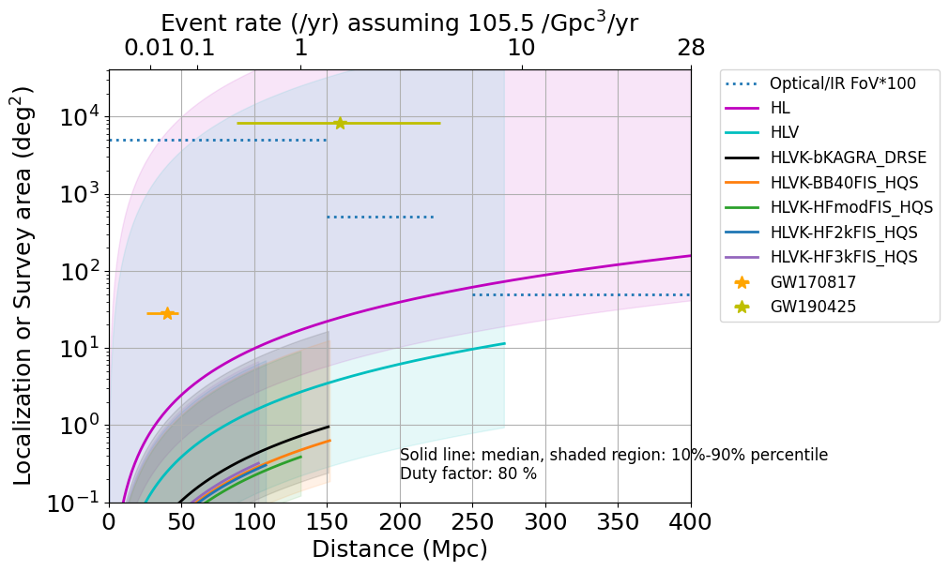
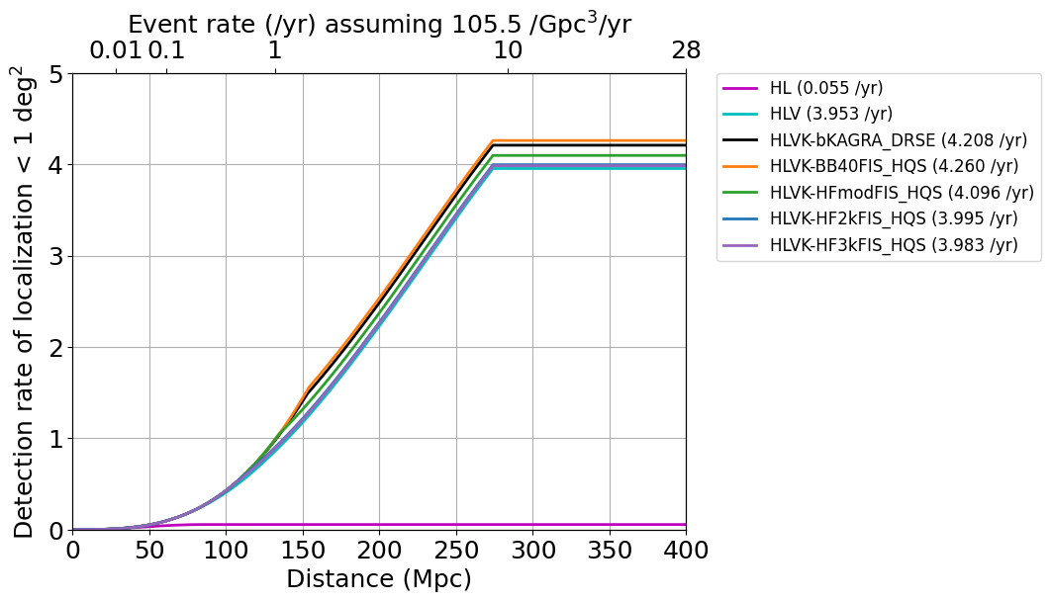
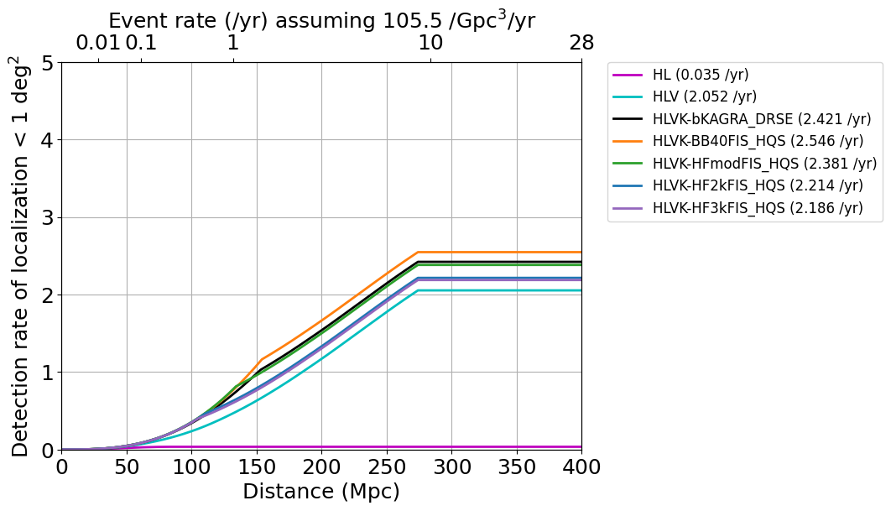
JGWC 2025年研究会 (JAXA, Sagamihara, May 9-10, 2025)
upgrade choices based on sky localization capability
Download online
Yuta Michimura
RESCEU, University of Tokyo
michimura@resceu.s.u-tokyo.ac.jp
A high-frequency upgrade of KAGRA is being considered to probe neutron star physics via binary neutron star (BNS) coalescences. Given the low BNS merger rate, focusing solely on post-merger signals may not be an effective strategy. Even if detected, limited signal-to-noise ratios would make extracting neutron star physics challenging. A key question is whether to prioritize maximizing the BNS range to boost detection rates or enhancing high-frequency sensitivity to improve sky localization and tidal deformability estimation. We estimate the sky localization capability of the LIGO-Virgo-KAGRA network, accounting for detector duty factors. For identical BNS detections, the high-frequency upgrade improves sky localization by ~20% over the broadband option. However, in terms of annual events localized within 1 deg², the broadband upgrade performs better. Adding KAGRA increases this number by about 20%.
KAGRA upgrade options in 2030s
KAGRA 10yr Task Force considers 15 upgrade options for 2030s
Here we consider 4 options out of them
- bKAGRA DRSE: original design sensitivity as a reference
- BB40: broadband upgrade
- HFmod: high frequency upgrade
- HF2k or HF3k: dips at 2 kHz or 3 kHz
All assume high-Q suspensions
as planned, 10 dB input frequency
independent squeezing
KAGRA upgrade options:
K. Komori, JGW-L2516564
LIGO
Virgo
O6?
O5 target:
25-130 Mpc
KAGRA
O4 target: 10 Mpc
A#: LIGO-T2300041
AdV+: LIGO-T2000012
Sky localization capability including duty factor
We usually assume a 100% single detector duty factor (left plots) but reducing it to, e.g., 80% (right plots) significantly alters the sky localization distribution across the sky.
HLVK covers 90+% of events
HLVK
HLV
HL
HLVK
HLV
HL
Best is
HFmod
Single detector detections cannot localize
Adding
KAGRA
Better localization from larger network
Some are completely missed due to limited duty factor
Large fraction is not well localized in HLV case due to limited duty factor
GW190425
Hard to EM follow up
(far + not well localized)
1 m class telescope
4 m class
HL
HL
Methods and
Acknowledgements
GW170817
8 m class
90% below this line
HLVK
HLV
median
HLVK
HLV
Sky localization estimated via Fisher analysis using the IMRPhenomD waveform for a GW170817-like binary at redshift z = 0.03 (135 Mpc), sampled over 1944 uniformly distributed combinations of source location and polarization angle [see YM+, PRD 102, 022008 (2018) for details].
This was repeated for all combinations of detectors, and the resulting sky localization distributions were combined according to the network duty factor to obtain the actual sky localization distribution.
Sky localization as a function of distance was plotted using ΔΩ ∝ (SNR)⁻² ∝ d², up to the BNS range (the sky-averaged distance at which a BNS signal can be detected with SNR = 8).
Event rate was estimated using O3b estimate of 105.5 /Gpc³/yr, multiplied by volume 4π/3*L³ [LVK, PRX 13, 011048 (2023)]
Treatment of beyond BNS range is of future work.
We would like to thank Masaomi Tanaka for his invaluable input on sky localization requirements from the perspective of optical and infrared follow-up observations.
Easy to EM follow up
Lucky 10% below this line
Most covered by HLVK
GRB211211A
HLVK
GRB230307A
Above KAGRA range,
HLV rate is used
HLV
Best is
BB40 due to BNS range
HLVK
KAGRA range
Virgo range (HL rate is used above this)
Detection rate can be estimated by integrating probability x event rate over distance
HLV
HL
HL
Comparison of upgrades
Low rate for HL due to low probability
of < 1 deg² (saturates at ~80 Mpc)
 | HL | HLV | bKAGRA | BB40 | HFmod | HF2k | HF3k
BNS range (1.4-1.4 M☉) | 670 Mpc | 273 Mpc | 152 Mpc | 153 Mpc | 133 Mpc | 109 Mpc | 104 Mpc
Median localization ^{[1]} | 10.6 deg² | 0.55 deg² | 0.37 deg² | 0.28 deg² | 0.23 deg² | 0.27 deg² | 0.30 deg²
< 10 deg² rate ^{[2]} | 1.1 /yr | 5.3 /yr | 5.5 /yr | 5.6 /yr | 5.5 /yr | 5.4 /yr | 5.4 /yr
< 1 deg² rate ^{[2]} | 0.04 /yr | 2.1 /yr | 2.4 /yr | 2.5 /yr | 2.4 /yr | 2.2 /yr | 2.1 /yr
Post-merger rate ^{[3]} | < 10⁻³ /yr |  |  |  | < 0.06 /yr | < 0.1 /yr | < 0.2 /yr
Tidal deformability improvement compared with HL case ^{[4]} |  |  |  | ~25% | ~55% | ~45% | ~30%
[1] For GW170817-like binary at 135 Mpc [2] Detection rate for 80% duty factor case [3] Detection rate with SNR>5. Depend on neutron star equation of state and BNS event rate. See H. Tagoshi & S. Morisaki, JGW-P2416311 for details. [4] Reduction of estimation error due to addition of KAGRA. See S. Morisaki, JGW-G2516593 for details. |  |  | Which KAGRA O6 plan do you like?

