Slide 1
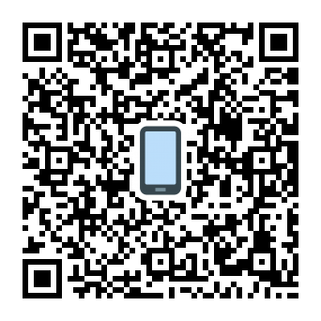
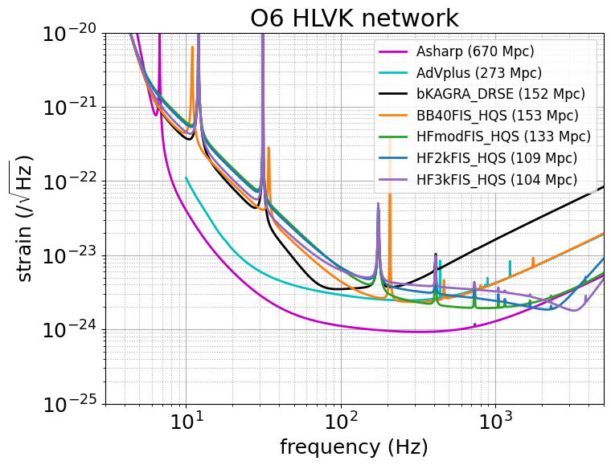
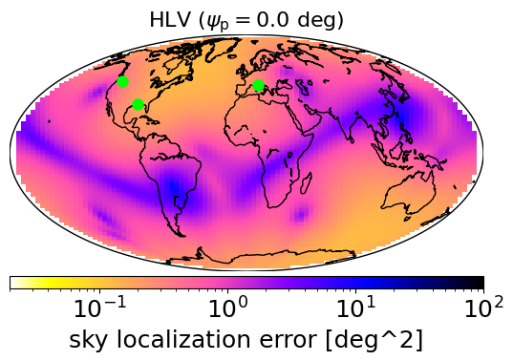
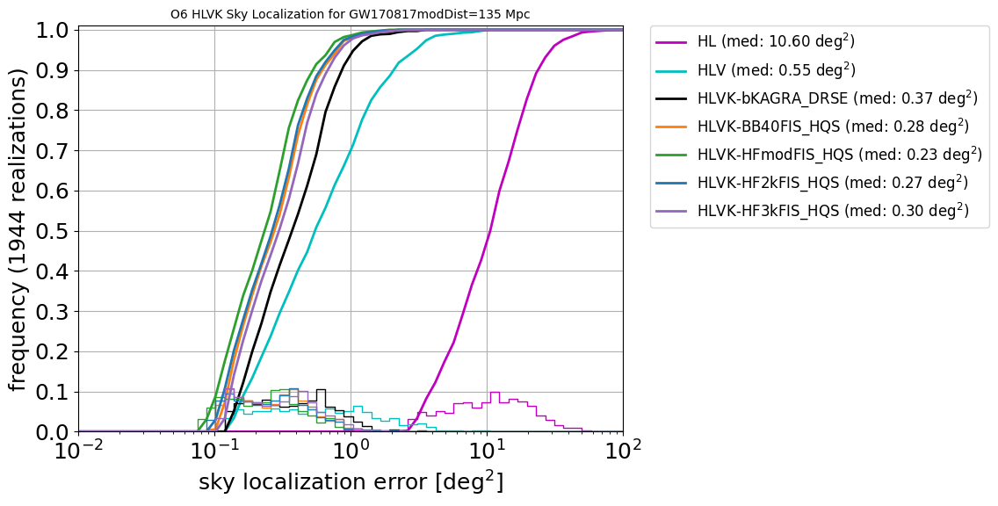
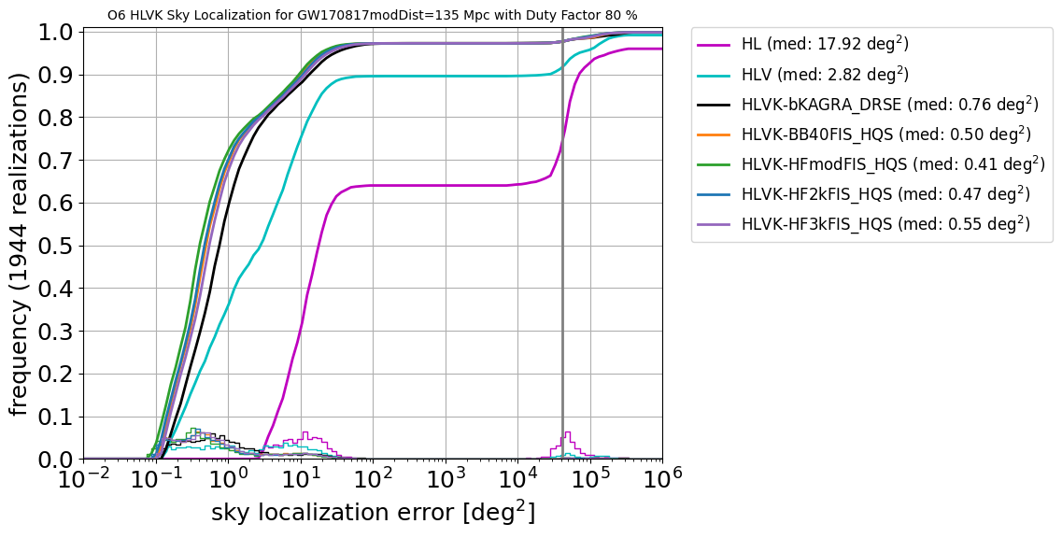
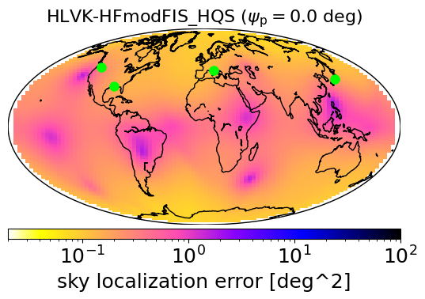
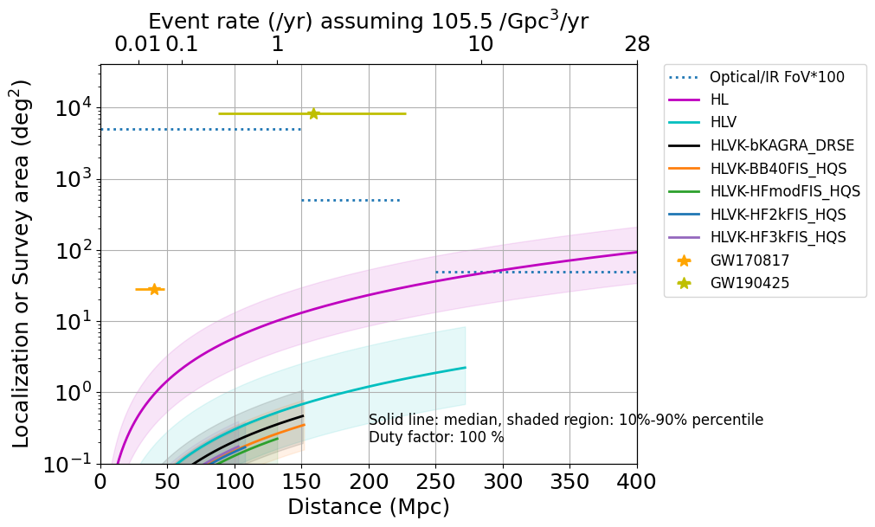
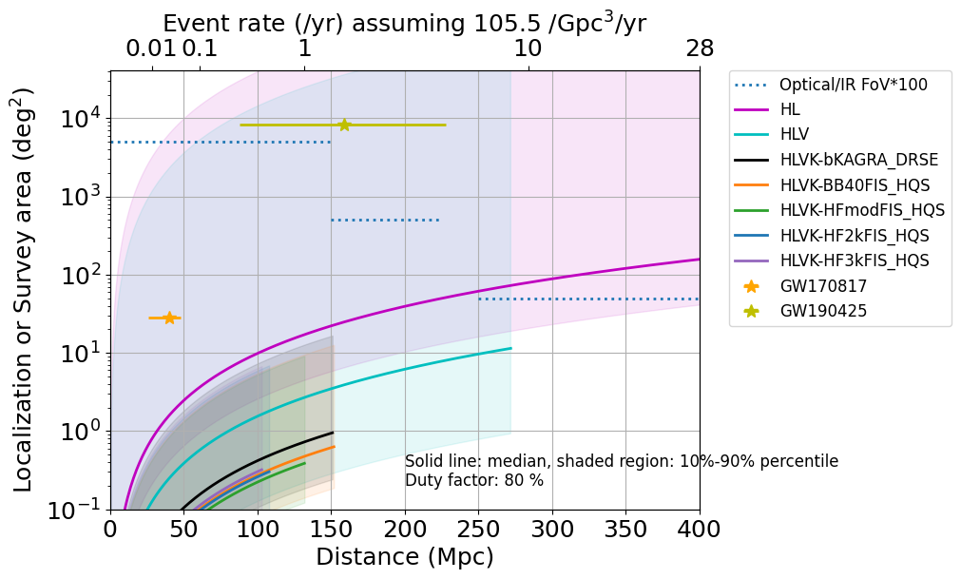
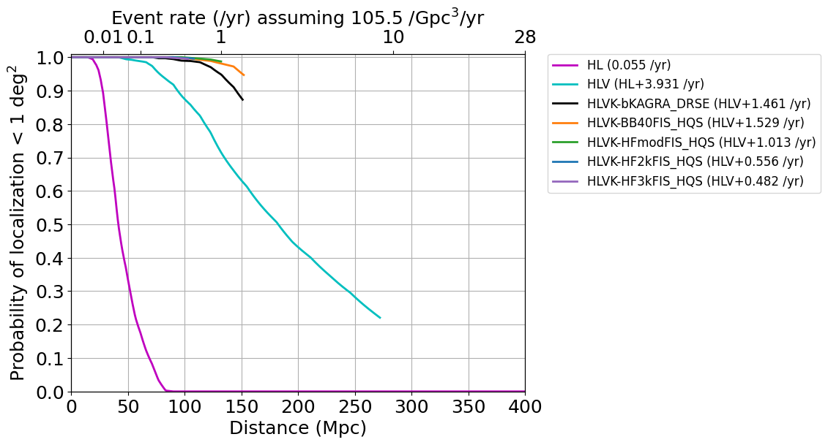
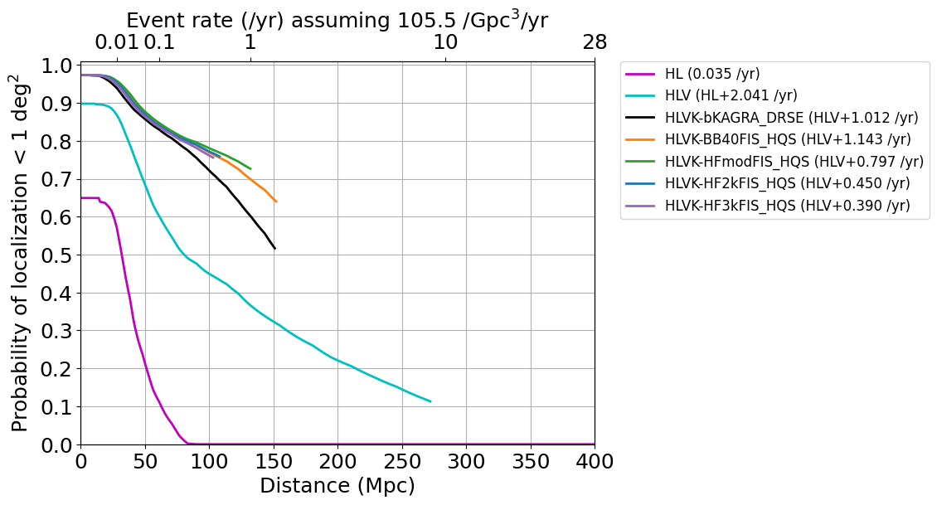
JGWC 2025年研究会 (JAXA, Sagamihara, May 9-10, 2025)
upgrade choices based on sky localization capability
Download online
Yuta Michimura
RESCEU, University of Tokyo
michimura@resceu.s.u-tokyo.ac.jp
A high-frequency upgrade of KAGRA is under consideration, aiming to target post-merger signals of binary neutron star (BNS) coalescences. However, given the low BNS merger rate, focusing solely on post-merger signal detection may not be an effective strategy. Even if a post-merger signal is detected, extracting neutron star physics would be challenging due to limited signal-to-noise ratio. An important question is whether to prioritize maximizing the BNS range to increase the detection rate, or to enhance high-frequency sensitivity to improve sky localization and tidal deformability. In this study, we estimate the sky localization capability of the LIGO-Virgo-KAGRA network, incorporating the detectors' duty factors. We find that, for the same BNS detections, the high-frequency upgrade yields approximately 20% better sky localization than the broadband option. However, in terms of the number of events per year localized to within 1 deg², the broadband upgrade performs better. Notably, with the addition of KAGRA to the network, this number increases by a factor of about 1.5.
KAGRA upgrade options in 2030s
KAGRA 10yr Task Force considers 15 upgrade options for 2030s
Here we consider 4 options out of them - bKAGRA DRSE: original design sensitivity as a reference
- BB40: broadband upgrade
- HFmod: high frequency upgrade - HF2k or HF3k: dips at 2 kHz or 3 kHz
All assume high-Q suspensions as planned, frequency independent squeezing (10 dB input)
A#: LIGO-T2300041
AdV+: LIGO-T2000012
KAGRA upgrade options:
K. Komori, JGW-L2516564
c.f. KAGRA O4 target (-2025): 10 Mpc
KAGRA O5 target (2028?~): 25-130 Mpc
Sky localization capability including duty factor
We usually assume a 100% single detector duty factor (left plots) but reducing it to, e.g., 80% (right plots) significantly alters the sky localization distribution across the sky.
HLVK covers 90+% of events
HLVK
HLV
HL
HLVK
HLV
HL
Best is
HFmod
Single detector detections cannot localize
Adding
KAGRA
Better localization from larger network
Some are completely missed due to limited duty factor
Large fraction is not well localized in HLV case due to limited duty factor
GW190425
Hard to EM follow up
(far + not well localized)
1 m class telescope
4 m class
HL
HL
Methods and
Acknowledgements
GW170817
8 m class
90% below this line
HLVK
HLV
median
HLVK
HLV
Sky localization estimated via Fisher analysis using the IMRPhenomD waveform for a GW170817-like binary at redshift z = 0.03 (135 Mpc), sampled over 1944 uniformly distributed combinations of source location and polarization angle [see YM+, PRD 102, 022008 (2018) for details].
This was repeated for all combinations of detectors, and the resulting sky localization distributions were combined according to the network duty factor to obtain the actual sky localization distribution.
Sky localization as a function of distance was plotted using ΔΩ ∝ (SNR)⁻² ∝ d², up to the BNS range (the sky-averaged distance at which a BNS signal can be detected with SNR = 8).
Event rate was estimated using O3b estimate of 105.5 /Gpc³/yr, multiplied by volume 4π/3*L³ [LVK, PRX 13, 011048 (2023)]
Treatment of beyond BNS range is of future work.
We would like to thank Masaomi Tanaka for his invaluable input on sky localization requirements from the perspective of optical and infrared follow-up observations.
Easy to EM follow up
Lucky 10% below this line
Most covered by HLVK
GRB211211A
GRB230307A
HLVK
HLVK
Best is
BB40 due to BNS range
HL
HLV
Probability of sky localization being < 1deg² as a function of distance plotted up to BNS range
Detection rate can be estimated by integrating this over distance up to BNS range
HL
HLV
Comparison of upgrades
Probability of 2+ detector event
 | HL | HLV | bKAGRA | BB40 | HFmod | HF2k | HF3k
BNS range | 670 Mpc | 273 Mpc | 152 Mpc | 153 Mpc | 133 Mpc | 109 Mpc | 104 Mpc
Median localization ^{[1]} | 10.6 deg² | 0.55 deg² | 0.37 deg² | 0.28 deg² | 0.23 deg² | 0.27 deg² | 0.30 deg²
< 10 deg² rate ^{[2]} | 1.1 /yr | 6.4 /yr | 7.8 /yr | 7.8 /yr | 7.4 /yr | 6.9 /yr | 6.9 /yr
< 1 deg² rate ^{[2]} | 0.04 /yr | 2.1 /yr | 3.1 /yr | 3.2 /yr | 2.9 /yr | 2.5 /yr | 2.5 /yr
Post-merger rate ^{[3]} | < 10⁻³ /yr |  |  |  | < 0.06 /yr | < 0.1 /yr | < 0.2 /yr
Tidal deformability improvement compared with HL case ^{[4]} |  |  |  | ~25% | ~55% | ~45% | ~30%
[1] At 135 Mpc, for 100% duty factor case [2] Detection rate for 80% duty factor case [3] Detection rate with SNR>5. Depend on neutron star equation of state and BNS event rate. See H. Tagoshi & S. Morisaki, JGW-P2416311 for details. [4] Reduction of estimation error due to addition of KAGRA. See S. Morisaki, JGW-G2516593 for details. |  |  | Which KAGRA O6 plan do you like?

