Slide 1



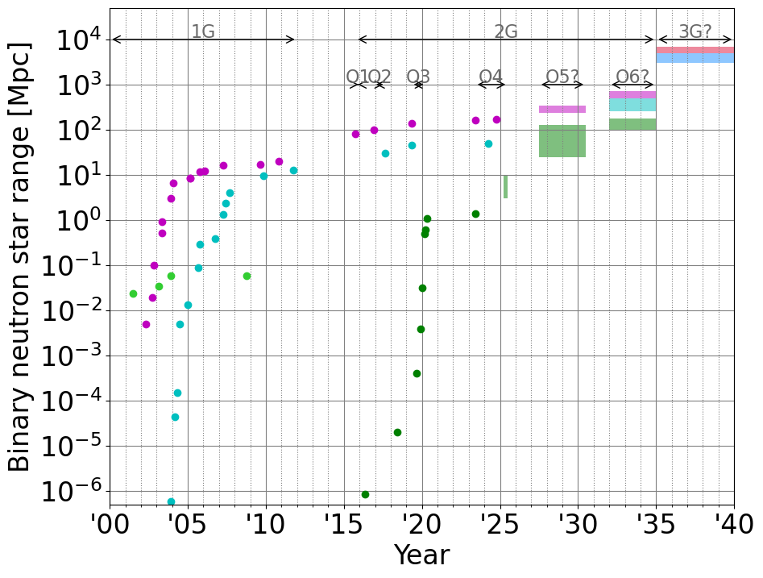
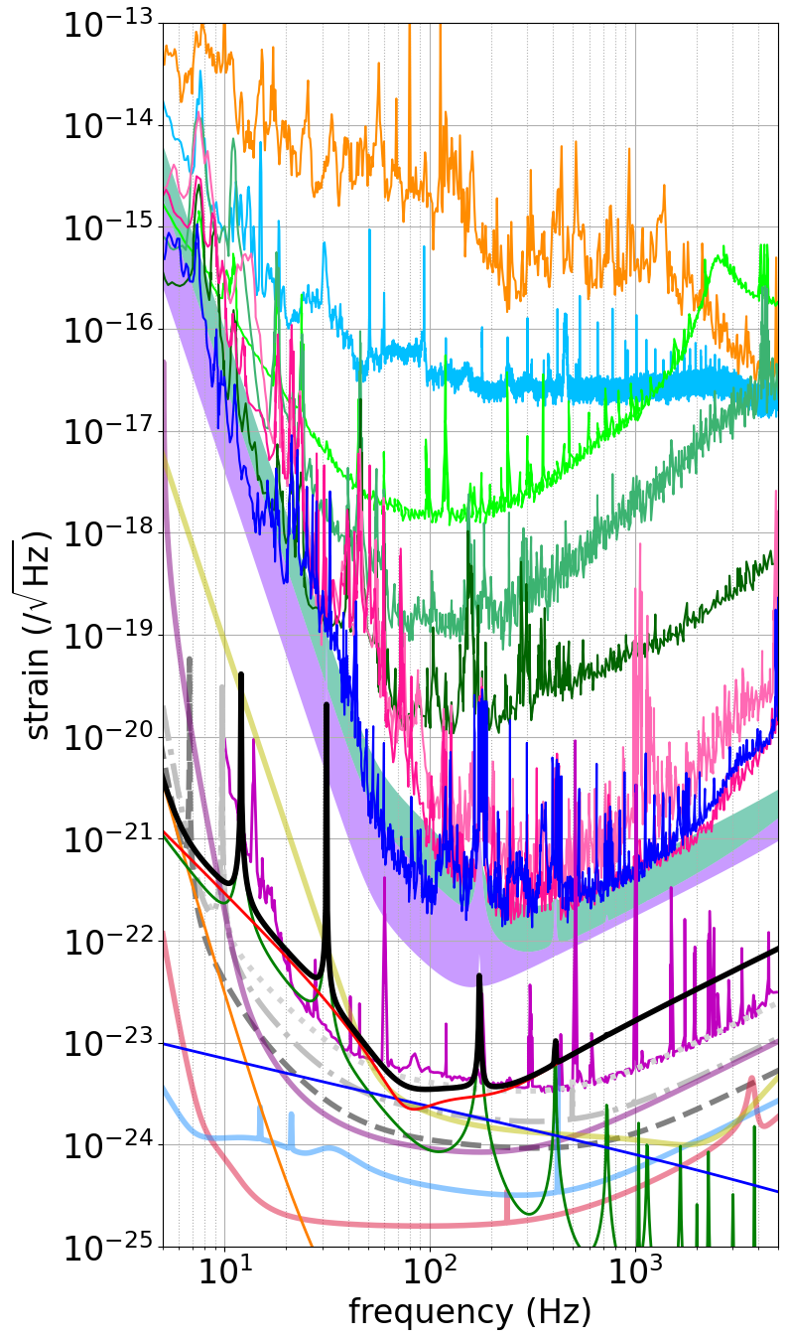
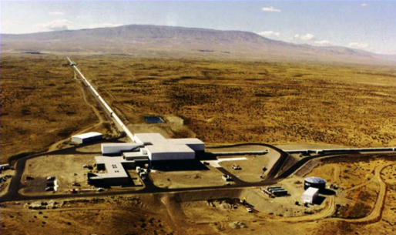
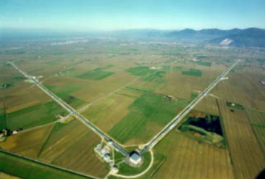
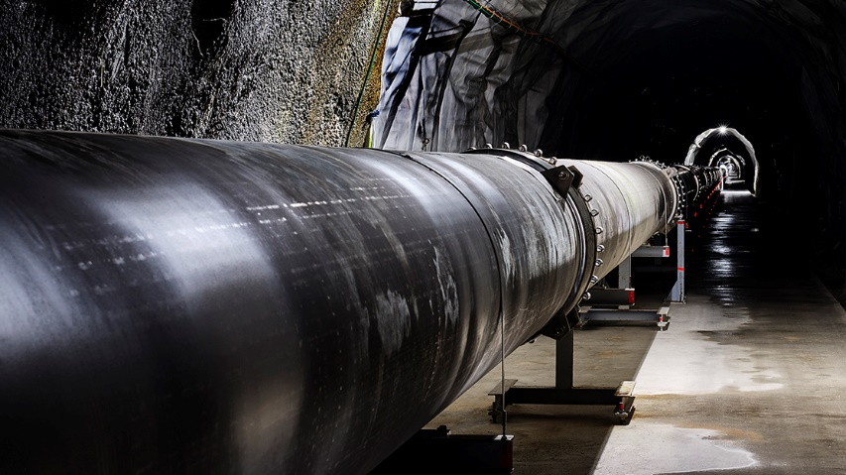
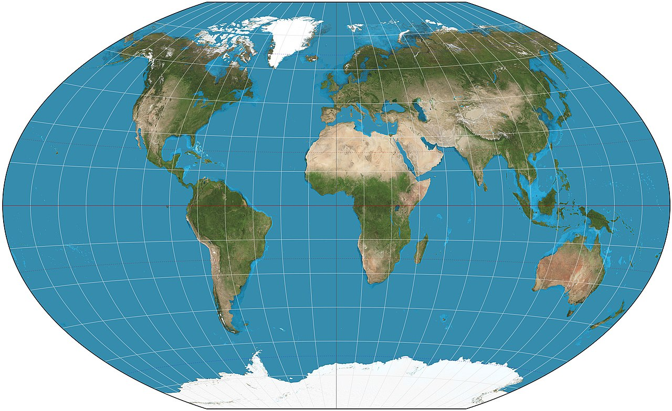
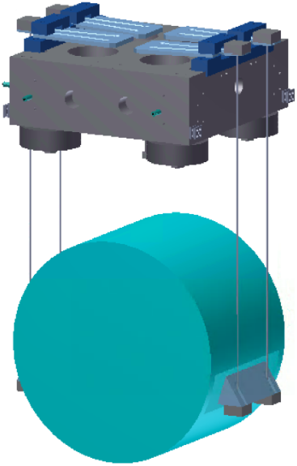
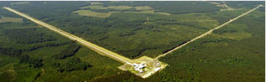
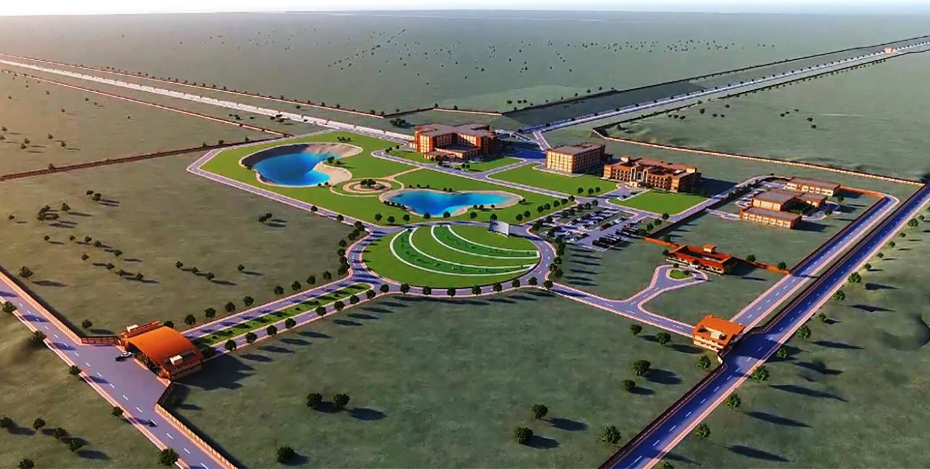
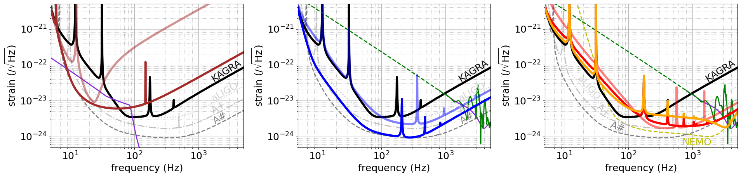
Theories of Astrophysical Big Bangs 2025 (RIKEN, Feb 17-19, 2025)
high-frequency upgrade for neutron star physics
Download online
Yuta Michimura
RESCEU, University of Tokyo
michimura@resceu.s.u-tokyo.ac.jp
For KAGRA 10yr Task Force,
KAGRA Future Strategy Committee
To make multi-messenger observations like GW170817 routine, LIGO and Virgo are planning broadband upgrades, and next-generation projects such as Einstein Telescope and Cosmic Explorer are underway. The world’s only cryogenic interferometer, KAGRA, requires a different upgrade strategy, as high-frequency sensitivity demands higher laser power, while low-frequency sensitivity requires thin fibers with limited heat extraction capability. After evaluating various upgrade scenarios, we find that high-frequency option is the most feasible as a first step towards a broadband upgrade. This upgrade would improve sky localization of binary neutron stars and enable post-merger signal detections.
A+
A#
Cosmic Explorer
Einstein Telescope
LIGO
Upgrade
April 2016
Virgo
KAGRA upgrade?
May 2018
TAMA
KAGRA
Aug 2019
Nov 2019
Dec 2019
Feb 2020
Mar 2020 (O3GK)
May 2023 (O4a)
Binary neutron star range
evolution of LVK
Sensitivity improvement
of KAGRA
Design and status of KAGRA
Seismic noise + gravity gradient
noise is low due to underground
LIGO Hanford
Virgo (3 km)
KAGRA
(3 km, cryogenic)
Suspension thermal noise
is high due to thick sapphire
fibers to extract heat
Target by June 2025
KAGRA design
aLIGO 2024 (O4)
Quantum shot noise
is high due to limited laser power
aLIGO design
A+ design (O5; 2027?)
A# design (O6; 2030?)
LIGO Voyager (cryo)
NEMO (Australia 4 km)
Einstein Telescope
(EU 3G 10 km LF+HF
xylophone; 2035~?)
Cosmic Explorer
(US 3G 40 km; 2035~?)
LIGO Livingston
(4 km)
Mirror thermal noise
is low due to cryogenic sapphire mirror (22 K)
ET-LF
LIGO-India
(4km; 2030?~)
ET-HF
Possible upgrade plans
Low frequency focus
Broadband plans
High frequency focus
LF2019
BNS1.5-1.5
at 100 Mpc
Post-merger signal
example
R. Harada+, PRD 110,
123005 (2024)
LF2024
BB2019
HF2019
BBH100-100
at 1Gpc
BB2024
HF2024
Baseline design
(LIGO O6
upgrade)
HF3k
 |  | KAGRA | A# | LF2019 | LF2024 | BB2019 | BB2024 | HF2019 | HF2024 | HF3k
 | 100M☉ - 100M☉ | 353 Mpc | 4927 Mpc | 2019 Mpc | 3787 Mpc | 306 Mpc | 2154 Mpc | 112 Mpc | 200 Mpc | 277 Mpc
 | 30M☉- - 30M☉ | 1095 Mpc | 6144 Mpc | 1088 Mpc | 2382 Mpc | 842 Mpc | 4229 Mpc | 270 Mpc | 407 Mpc | 552 Mpc
 | 1.4M☉ - 1.4M☉ | 153 Mpc | 670 Mpc | 85 Mpc | 196 Mpc | 178 Mpc | 537 Mpc | 155 Mpc | 133 Mpc | 104 Mpc
BNS sky localization ※ |  | 10.64 deg² (HL-only) → 1.40 deg² (with K) |  | 10.28 deg² | 2.65 deg² | 0.77 deg² | 0.42 deg² | 0.57 deg² | 0.61 deg² | 0.93 deg²
BNS post-merger signal detection rate (LF & BB plans are less than 10⁻³ events/year) Based on merger rate estimate from O3; SNR>5. See H. Tagoshi & S. Morisaki, JGW-P2416311 for details. |  |  |  |  |  |  |  | 10⁻⁵-10⁻³ /year | 10⁻³-0.06 /year | 10⁻³-0.2 /year
Technical challenges FC = filter cavity SQZ = squeezing SRM = signal recycling mirror |  | * Low loss suspension * Sapphire birefringence * 0.35 MW arm power | * 40 kg → 100 kg test mass * 300 m FC, 10 dB SQZ * 1.5 MW arm power * 1/4 coating thermal | * Heavier & longer suspensions + for 2024 ver... * Reducing vertical resonant frequency of blade springs * 23 kg → 40 kg test mass * 300 m FC w/ 30 ppm loss * 1/2 absorption * Various technical noises at low frequencies |  | * 30 m FC with 30 ppm loss + for 2024 ver... * Reducing vertical resonant frequency of blade springs * 23 kg → 100 kg test mass * 30 m → 85 m FC, 9 dB SQZ * 1.5 MW arm power * 1/4 coating thermal * 1/4 absorption |  | * Shorter and thicker sapphire fibers * No FC, 6 dB SQZ * 1.7 MW arm power * 90.7% SRM | * 96% SRM | * 99.5% SRM
References: For plans 2019 (~5-year plans), see YM+, PRD 102, 022008 (2020) For other plans (~10-year plans), see JGW-T2416182 (public document) For various science cases, see KAGRA, PTEP 2021, 05A103 (2021) |  |  |  | Which KAGRA upgrade plan do you like?
Binary Black Holes / Binary Neutron Stars
BBH / BNS
ranges (SNR>8)
* No FC, 10 dB SQZ
* 0.75 MW arm power
* No changes in the suspensions required. Can go to other configurations just by changing the SRM.
※ Fisher analysis using IMRPhenomD waveform for GW170817-like binary at z=0.03 (127 Mpc) with two A#s and KAGRA.
Median of 108 uniformly distributed sets of the source location and the polarization angle is shown.

