Slide 1

Release of
KAGRA Instrument Science
White Paper 2024 and
Proposal for Amending
Authorship Policy Regarding
Long-Term Experimental Activities
JGW-G2416309
34th KAGRA Face-to-Face Meeting Dec 2024
December 18, 2024
Yuta Michimura
RESCEU, UTokyo
michimura@resceu.s.u-tokyo.ac.jp
for KAGRA FSC

Slide 2
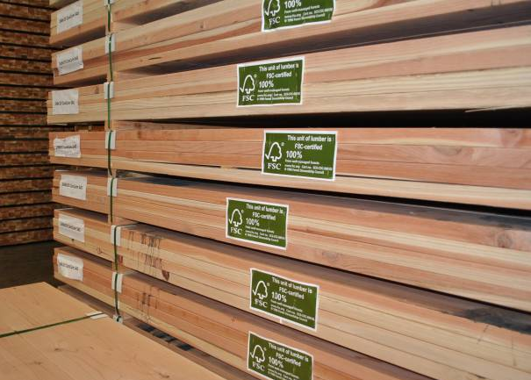
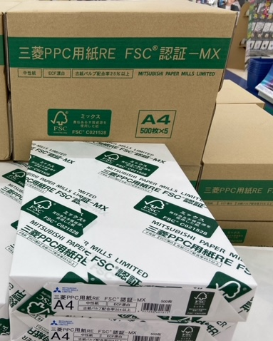
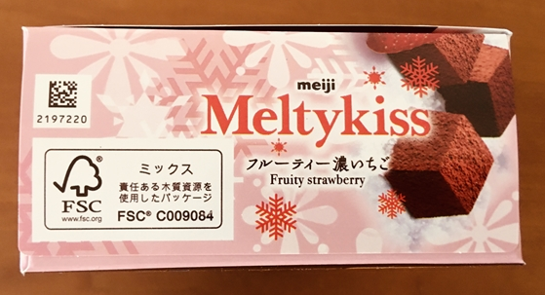
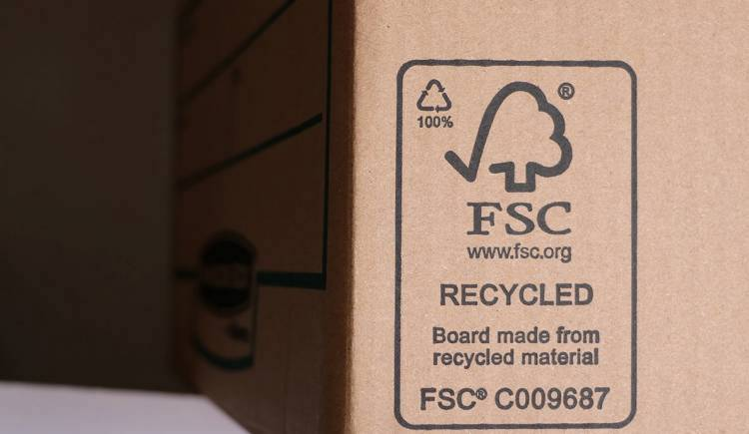
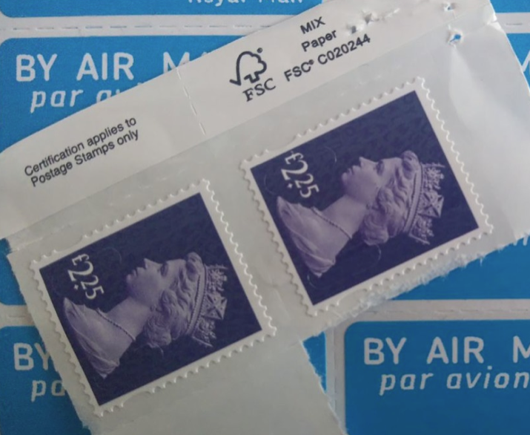
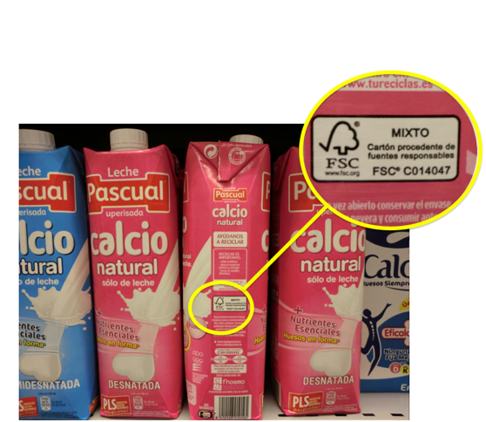
FSC Activities
https://fsc.org/
https://shitte-erabo.net/
fscproducts/fscmark/

Slide 3
Instrument Science White Paper 2024
Released on December 3, 2024
Publicly available at JGW-T2416182
Comments welcome!
Contributors:
paperless!
Yohei Nishino
Munetake Otsuka
Atsushi Nishizawa
Shalika Singh
Kentaro Somiya
Ryosuke Sugimoto
Masahide Tamaki
Satoshi Tanioka
Haoyu Wang
Kazuhiro Yamamoto
Takaaki Yokozawa
Tomotada Akutsu
Masaki Ando
Rishabh Bajpai
Marc Eisenmann
Kentaro Komori
Ray-Kuang Lee
Yuta Michimura
Kohei Mitsuhashi
Jyotirmaya Mohanta
Michael Page

Slide 4

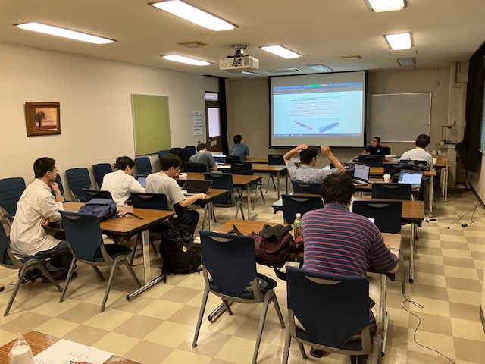
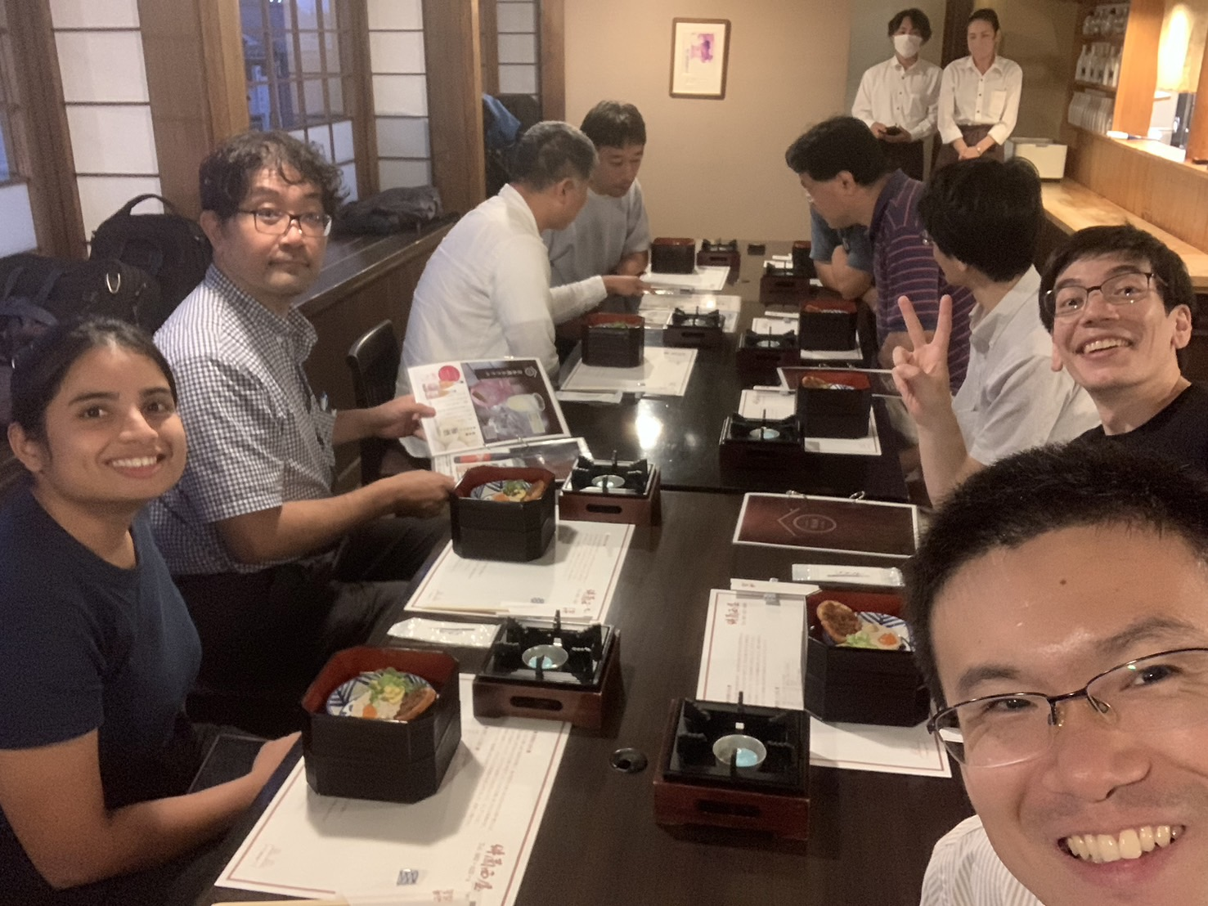
WP Writing Workshop
Oct 2-3, 2024 @ Hiroshima University
Thanks to Nishizawa-san and ASPIRE-GW

Slide 5
Instrument Science White Paper 2024
Executive Summary
Introduction
- History from FPC white paper 2019
- Focus on post-O5 and beyond
Survey of Current Technologies
- Over 60 technologies
- Feasibility score: 0-5
Possible Upgrade Plans
- Summary of outstanding issues
- Example upgrade plans (LF, HF, BB)

Slide 6
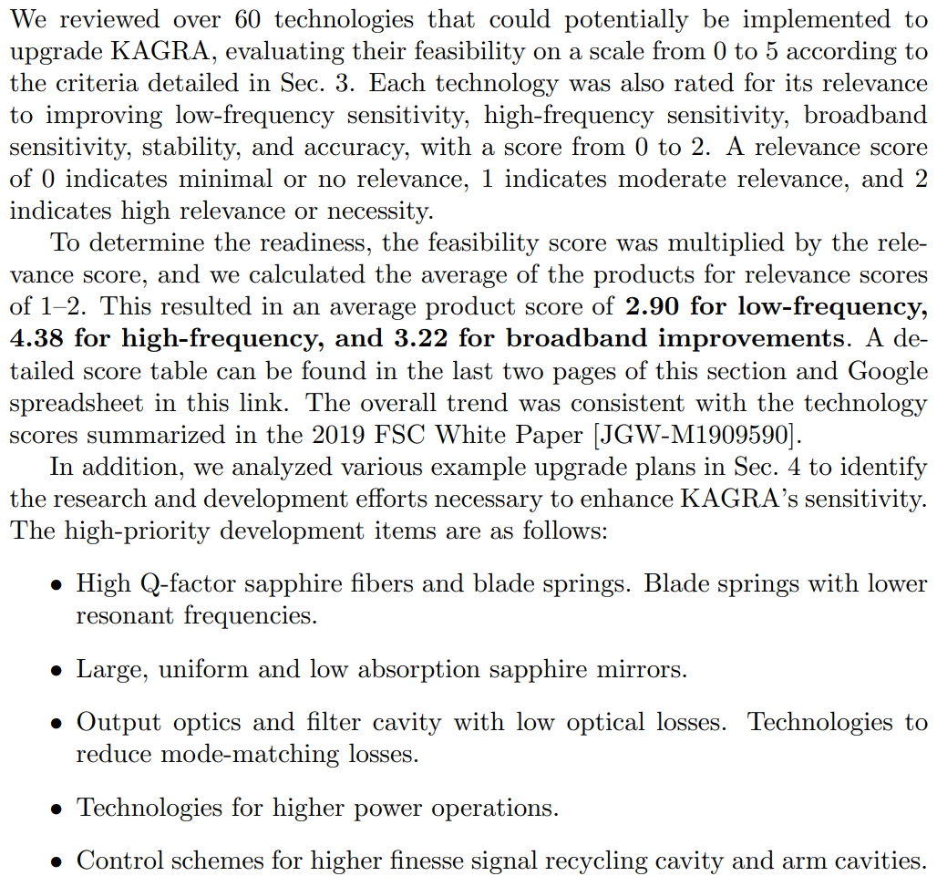
Executive Summary

Slide 7
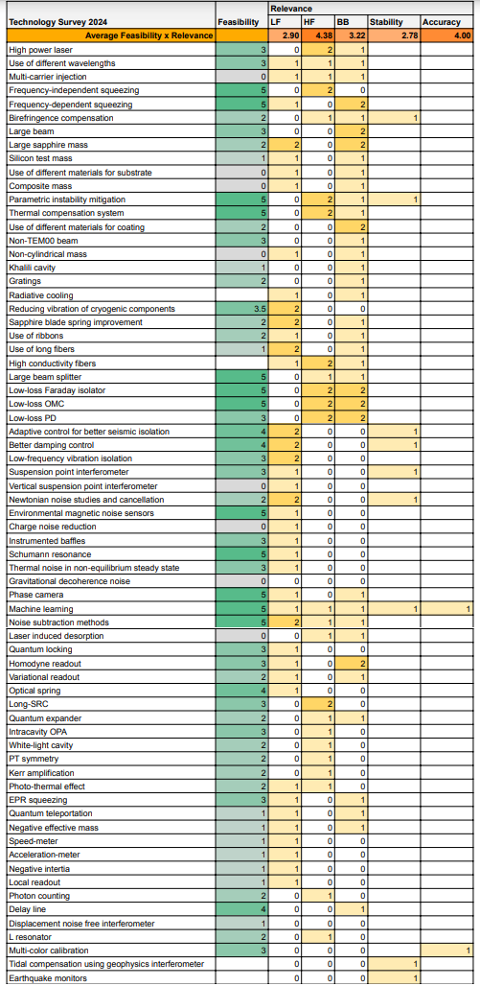
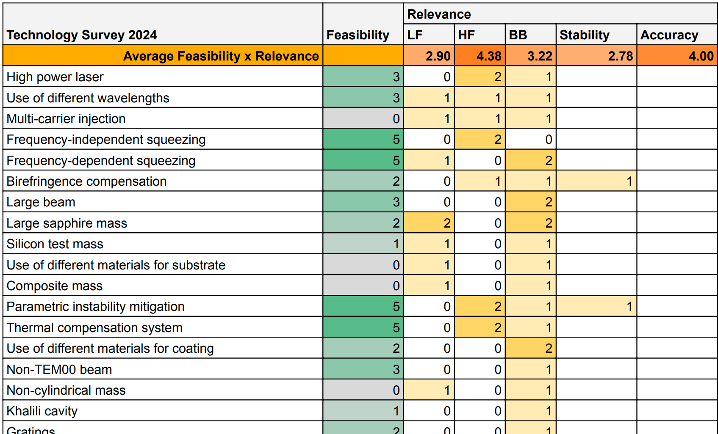
Technology Score
Relevance score: 0-2 for
LF, HF, BB, stability, accuracy
improvements
Relevance x Feasibility
Averaged over technologies

Slide 8
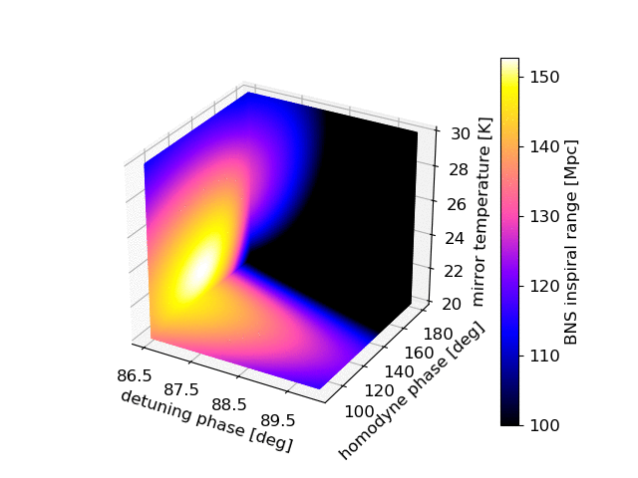
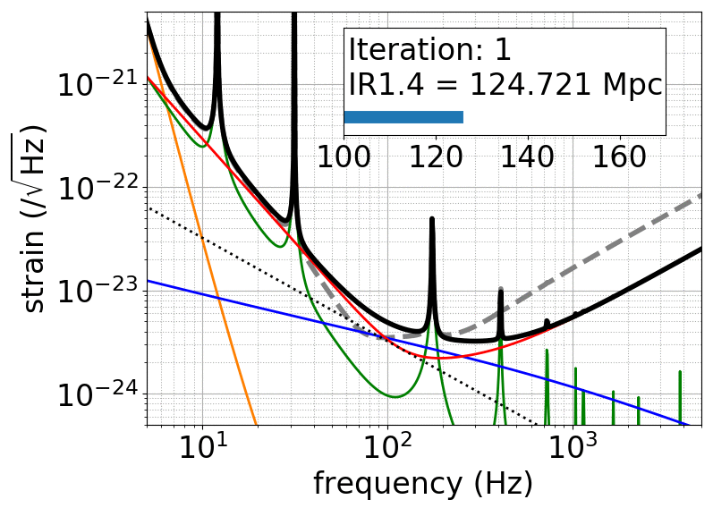
Upgrade Plans by Swarm Intelligence
Interferometer parameters are tuned with particle swarm optimization to
- LF plans
maximize 100-100 range
- HF plans
minimize BNS sky localization error
or
deep dip above kHz
- BB plans
maximize 1.4-1.4 range
YM+, PRD 97, 122003 (2018)

Slide 9
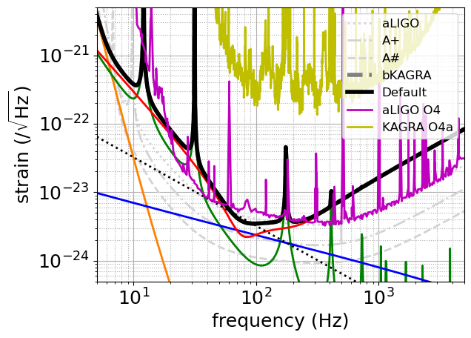
Default bKAGRA Design Sensitivity
Default bKAGRA: Detuned RSE
NOTE: not all the requirements to achieve these fundamental noises are still not yet achieved
e.g.
- suspension loss
10⁻⁴ to 10⁻⁵
instead of 2x10⁻⁷
- substrate loss 10⁻⁶
instead of 10⁻⁸
- blade spring loss
4x10⁻⁵
instead of 7x10⁻⁷
- optical losses still
higher by ~ x2

Slide 10
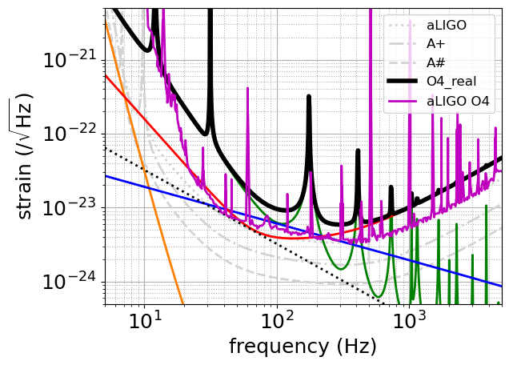
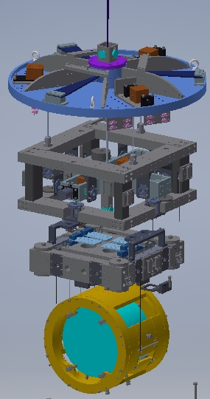
With Current Mechanical Losses
If we cannot improve the mechanical losses from the current measured values, low frequency sensitivity limit is worse by ~ x5 compared with
current aLIGO

Slide 11
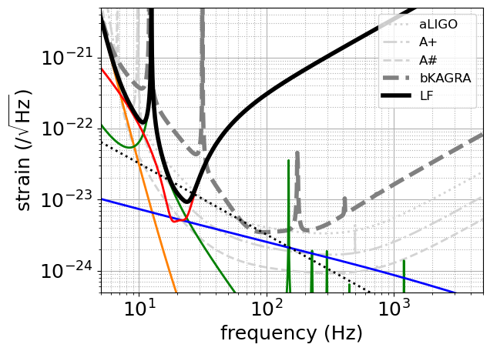
Possible Upgrade Plans
LF proposed by FPC in 2019
x4 heavier IM mass (82 kg) + Thinner and longer CuBe wires and sapphire fibers +
3 mW extra heat
(instead of 50 mW)
~ A+ at LF

Slide 12
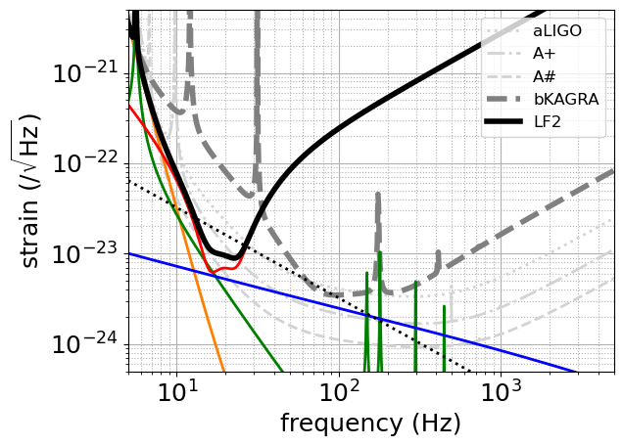
Possible Upgrade Plans
LF2
LF2019 +
14.5 Hz to 5 Hz sapphire blade springs

Slide 13
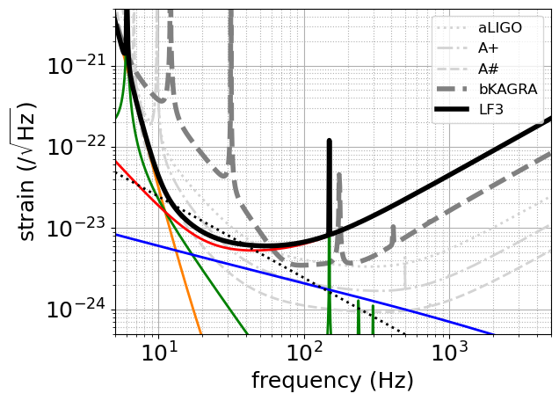
Possible Upgrade Plans
LF3
LF2 +
300-m long, 30 ppm loss filter cavity +
40 kg TM +
x1/2 absorption
~A# at LF

Slide 14
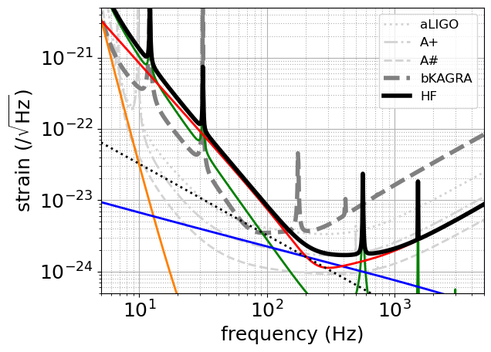
Possible Upgrade Plans
HF proposed by FPC in 2019
Shorter and thicker sapphire fibers +
3.4 MW/2 in each arm + 6 dB detected squeezing +
90.7% SRM
Beyond A+
at HF

Slide 15
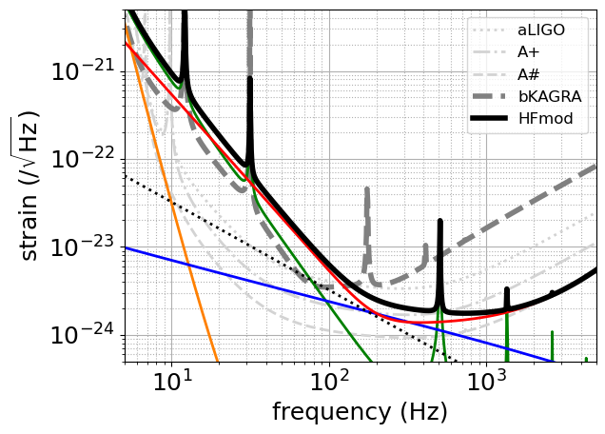
Possible Upgrade Plans
HFmod (similar but different from HFmod by 10 yr TF)
Shorter and thicker sapphire fibers +
3.1 MW/2 in each arm + 7 dB detected squeezing
(lower loss) +
95.6 % SRM
~A# at HF

Slide 16
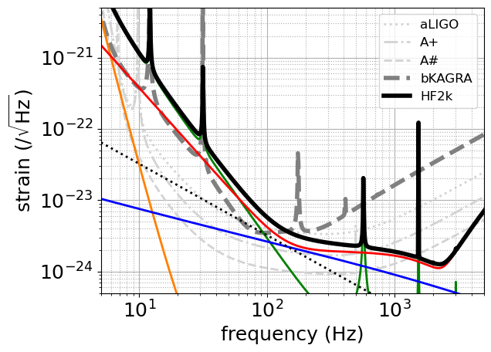
Possible Upgrade Plans
HF2k (similar but different from HF2k by 10 yr TF)
Short and thicker sapphire fibers +
3.5 MW in each arm + 0.2% ITM + 7 dB detected squeezing
(lower loss) +
99.5% SRM
Beyond A#
at ~2 kHz

Slide 17
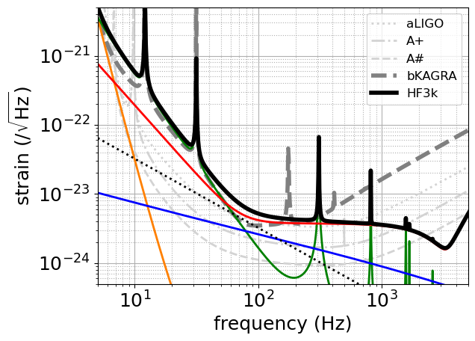
Possible Upgrade Plans
HF3k (similar but different from HF3k by 10 yr TF)
Short and thicker sapphire fibers +
3.5 MW/2 in each arm + 7 dB detected squeezing
(lower loss) +
99.5% SRM
Beyond A#
at ~3 kHz

Slide 18
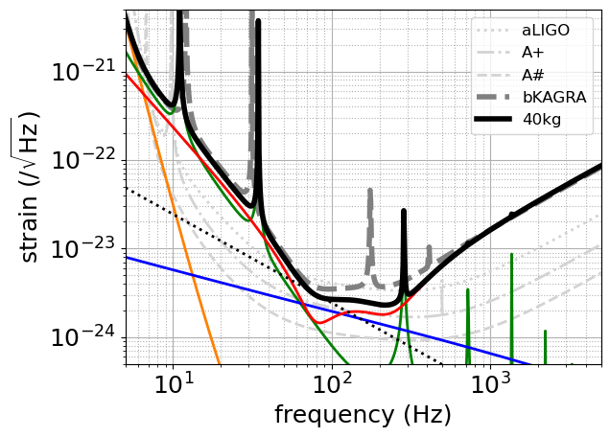
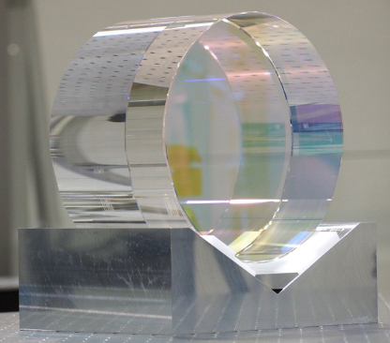
Possible Upgrade Plans
40kg proposed by FPC in 2019
40 kg TM (largest mass that can be put into current cryostat without changing shields etc. design)

Slide 19
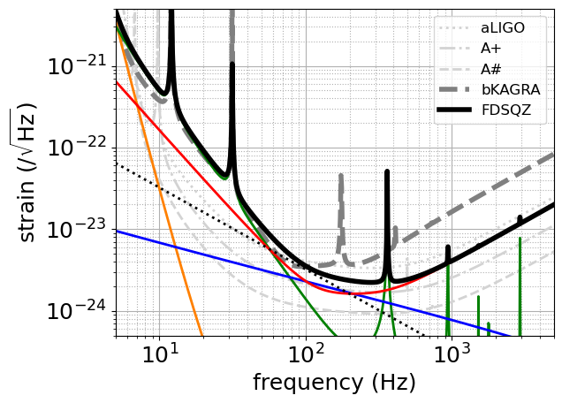
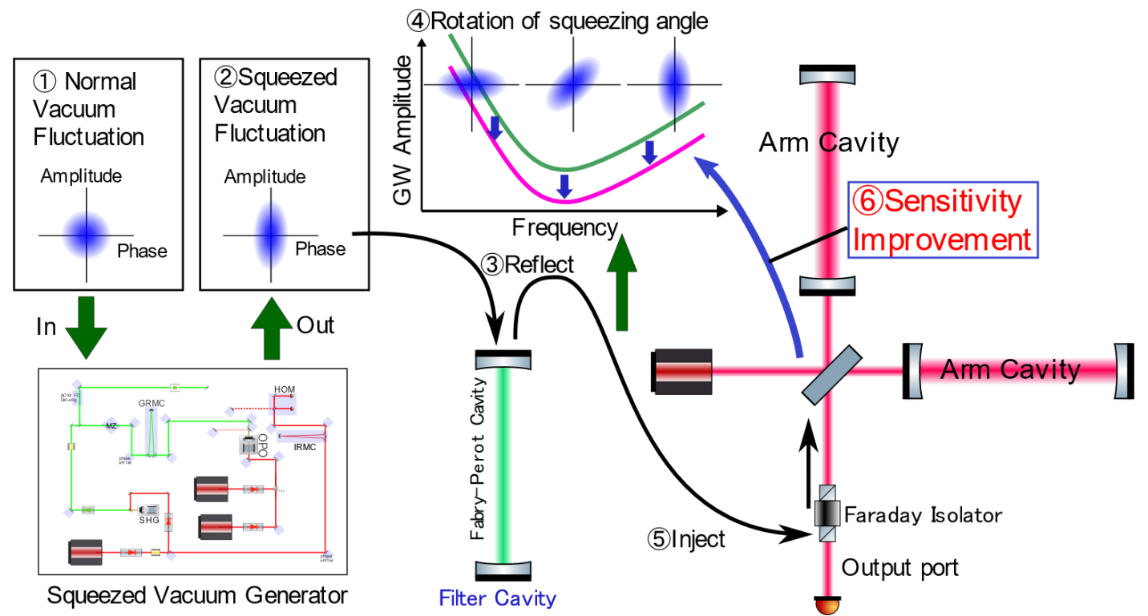
Possible Upgrade Plans
FDSQZ proposed by FPC in 2019
Frequency dependent squeezing with 30-m filter cavity

Slide 20
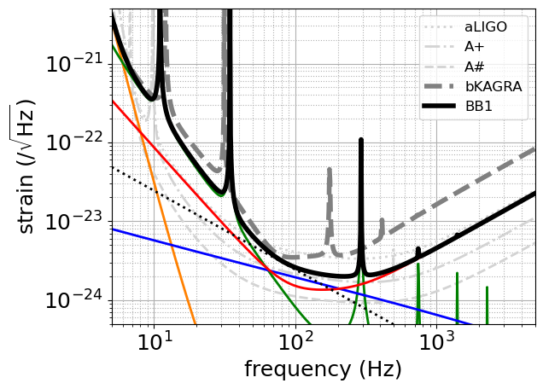
Possible Upgrade Plans
BB1
40 kg TM + 85-m filter cavity (studied by KFC project) giving 5 dB detected squeezing

Slide 21
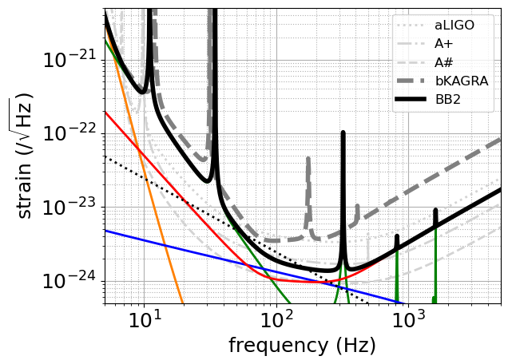
Possible Upgrade Plans
BB2
BB1 +
9.1 dB detected squeezing (lower loss)

Slide 22
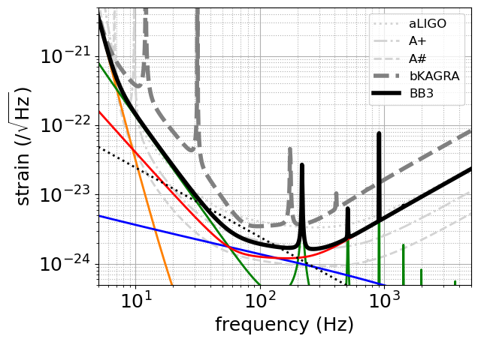
Possible Upgrade Plans
BB3
BB2 +
LF2019 improvements + 5 Hz blade springs
~A+ at mid
freq.

Slide 23
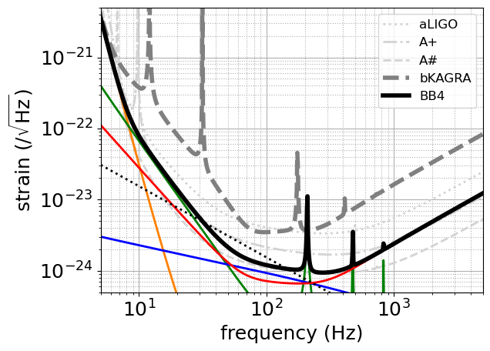
Possible Upgrade Plans
BB4
BB3 +
100 kg TM + x1/4 coating thermal noise +
x1/4 absorption +
2.9 MW/2 in
each arm
~A# at mid
freq.

Slide 24
Lessons Learned
Improvements in sapphire fibers and blade springs are crucial for LF improvements
Improvements in sapphire mirrors and coatings are crucial for mid. frequencies
Developments in lower loss optics, high power operations, and higher finesse arm cavities and SRC are crucial for HF improvements
To compete with A#, HF would be most feasible
Even with less sensitive BB plans, KAGRA’s contributions to the network observation are important. Needs further study.

Slide 25

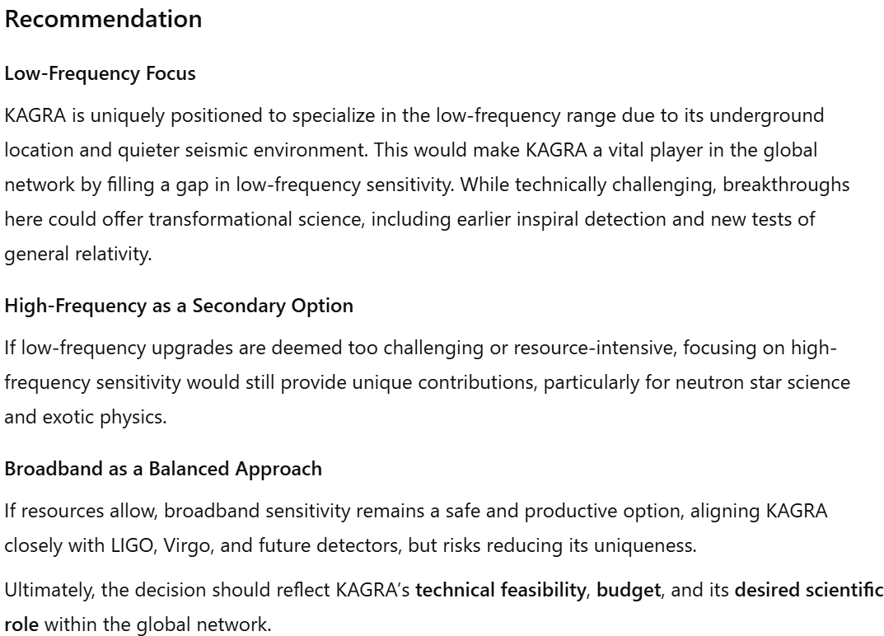

Slide 26
Proposal to allow for long term experimental activities for
KAGRA authorship

Slide 27
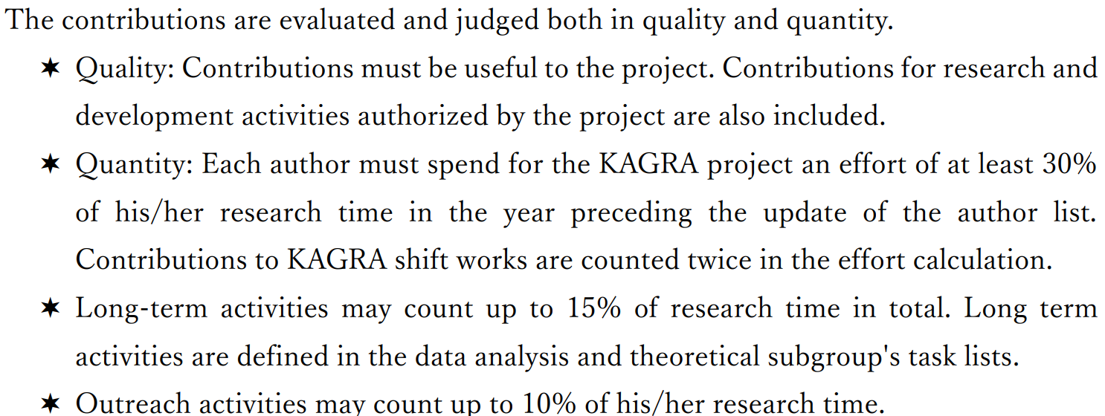
Current Authorship Policy
Long-term activities may count up to 15% of research time in total. Long term activities are defined in the data analysis and theoretical subgroup's task lists.
Why not include experimental R&Ds?
JGW-M1503490-v7

Slide 28
Amendment Proposal
Long-term activities may count up to 15% of research time in total. Long term activities are defined in the data analysis and theoretical subgroup's task lists.
Proposed amendment
Long-term activities may count up to 15% of research time in total. Long term activities are defined in the data analysis, theoretical subgroup, and instrumental science task lists.

Slide 29
Summary Table for Authorship
Activity |  | Management | White Paper | Time frame | Author-ship
Data analysis / Theory |  | KSC-DAC/ Theory Group | LVK Observational Science WP | Short Term | <= 100%
 |  |  |  | Long Term | <= 15% in total
 | Project task | EO-SEO/ Operations | LVK Operations WP | Short Term | <= 100%
 | Project R&D | KSC-FSC-PRDC | KAGRA Instrument Science WP | Short Term | <= 100%
 | Advanced R&D | KSC-FSC |  | Long Term | <= 0% → <= 15%
EPO |  | KSC-EPO | LVK Communications and Education WP | - | <= 10%
Experiment
Note that current KAGRA Instrument Science WP does not include tasks under SEO. Instrument Science WPs for LIGO, Virgo, KAGRA are independent right now.

Slide 30
Summary
KAGRA Instrument Science White Paper 2024 is released
Any comments welcomed
Welcome to join FSC or FWG
FWG 4th open meeting on December 19 @ Ookayama

