Slide 1
Release of KAGRA Instrument Science White Paper 2024 and Proposal for Amending Authorship Policy Regarding Long-Term Experimental Activities
JGW-G2416309 34th KAGRA Face-to-Face Meeting Dec 2024
December 18, 2024
Yuta Michimura
RESCEU, UTokyo
michimura@resceu.s.u-tokyo.ac.jp
for KAGRA FSC

Slide 2
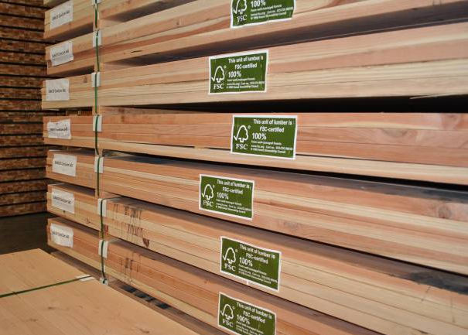
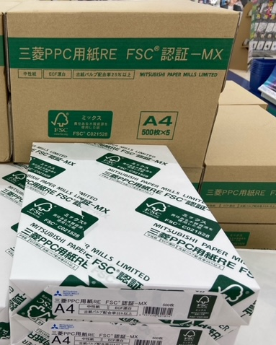
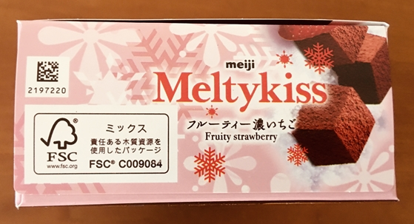
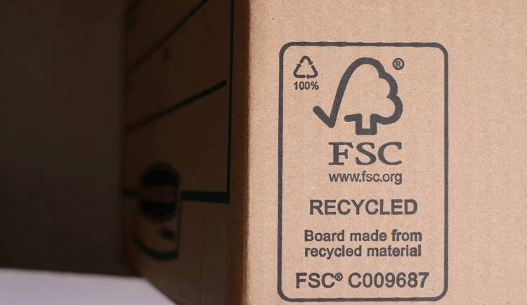
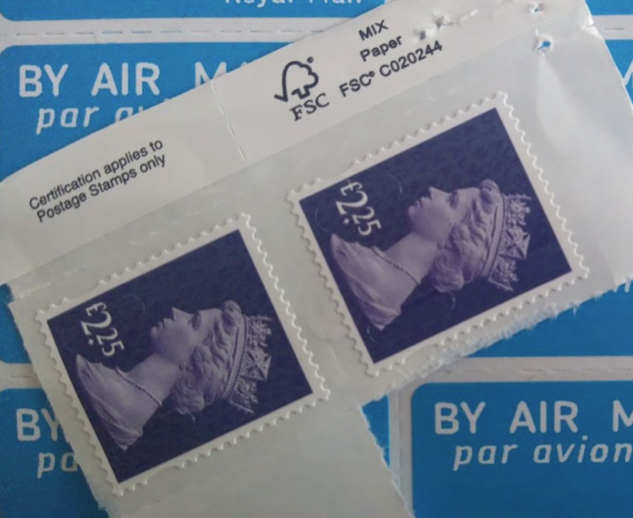
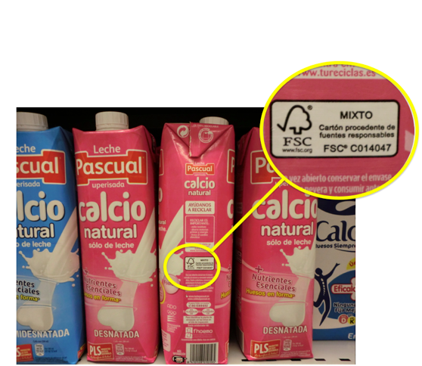
FSC Activities
https://fsc.org/
https://shitte-erabo.net/ fscproducts/fscmark/

Slide 3
Instrument Science White Paper 2024
Released on December 3, 2024
Publicly available at JGW-T2416182
Comments welcome!
Contributors:
paperless!
Yohei Nishino
Munetake Otsuka
Atsushi Nishizawa
Shalika Singh
Kentaro Somiya
Ryosuke Sugimoto
Masahide Tamaki
Satoshi Tanioka
Haoyu Wang
Kazuhiro Yamamoto
Takaaki Yokozawa
Tomotada Akutsu
Masaki Ando
Rishabh Bajpai
Marc Eisenmann
Kentaro Komori
Ray-Kuang Lee
Yuta Michimura
Kohei Mitsuhashi
Jyotirmaya Mohanta
Michael Page

Slide 4
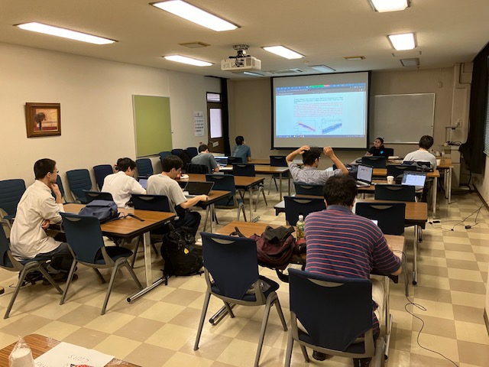
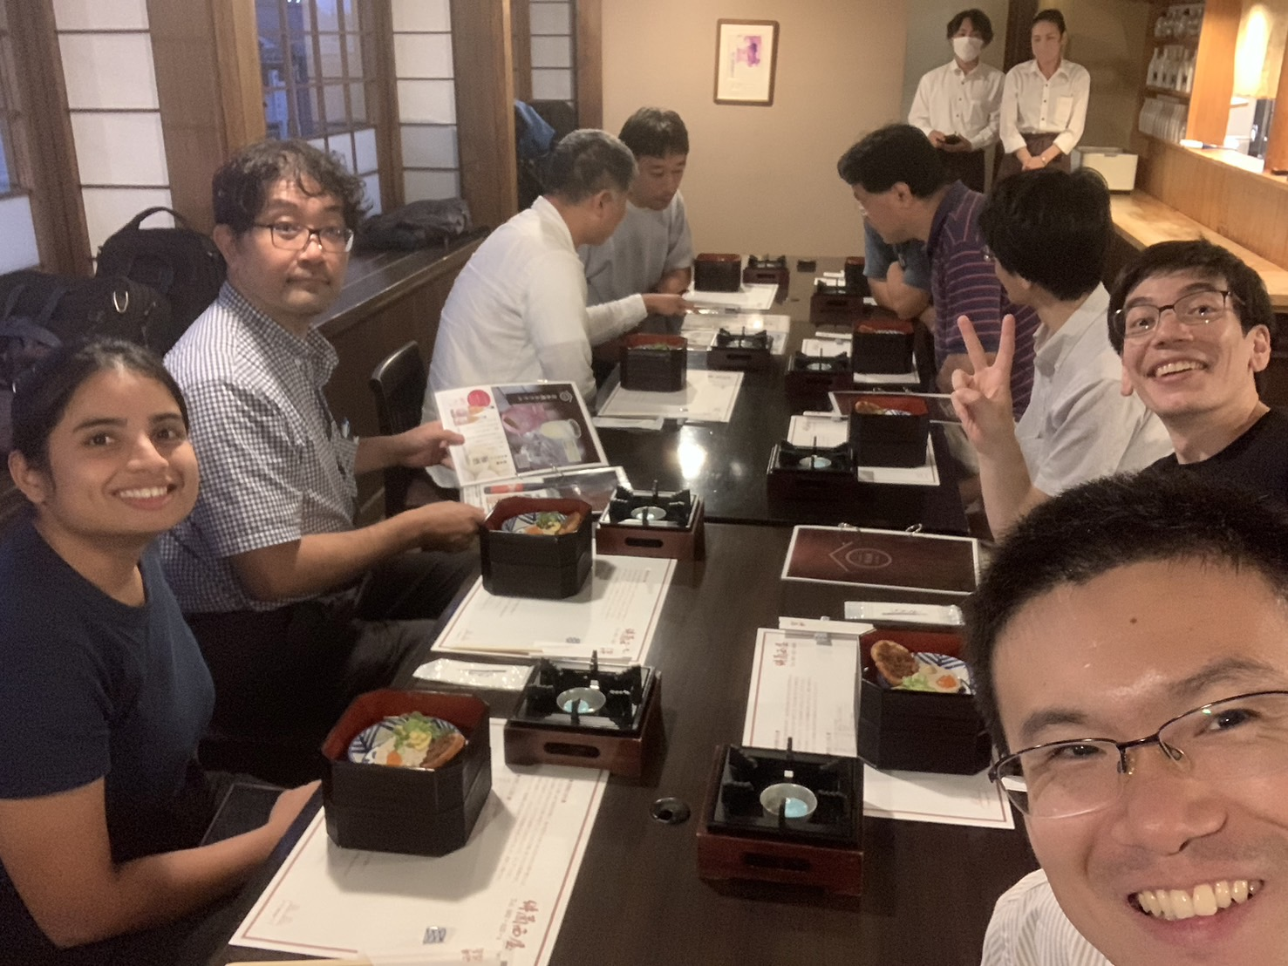
WP Writing Workshop
Oct 2-3, 2024 @ Hiroshima University
Thanks to Nishizawa-san and ASPIRE-GW

Slide 5
Instrument Science White Paper 2024
Executive Summary
Introduction - History from FPC white paper 2019 - Focus on O5 and beyond
Survey of Current Technologies - Over 60 technologies - Feasibility score: 0-5
Possible Upgrade Plans - Summary of outstanding issues - Example upgrade plans (LF, HF, BB)

Slide 6
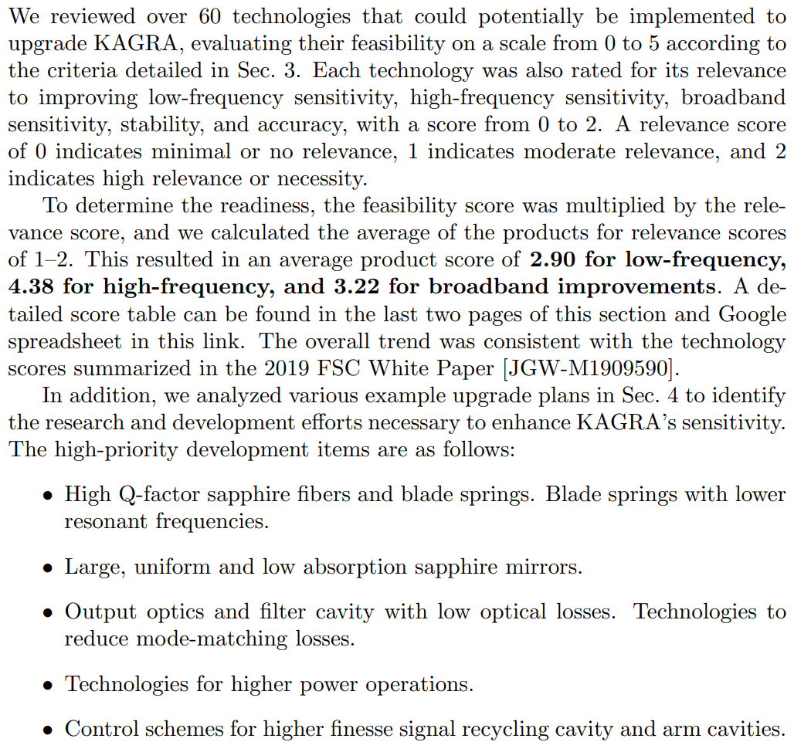
Executive Summary

Slide 7
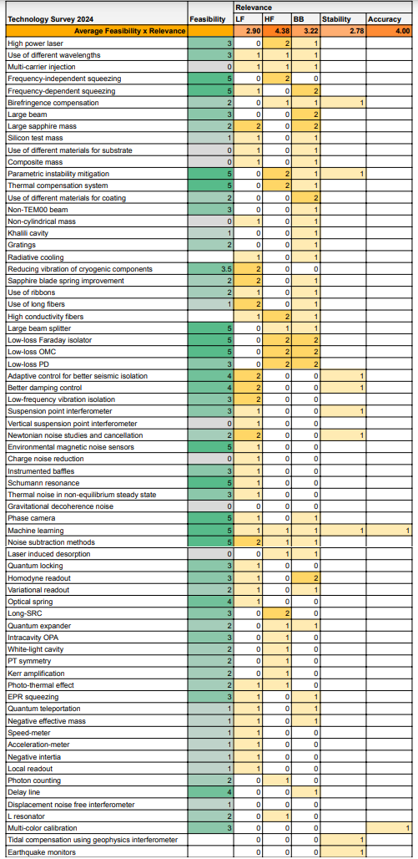
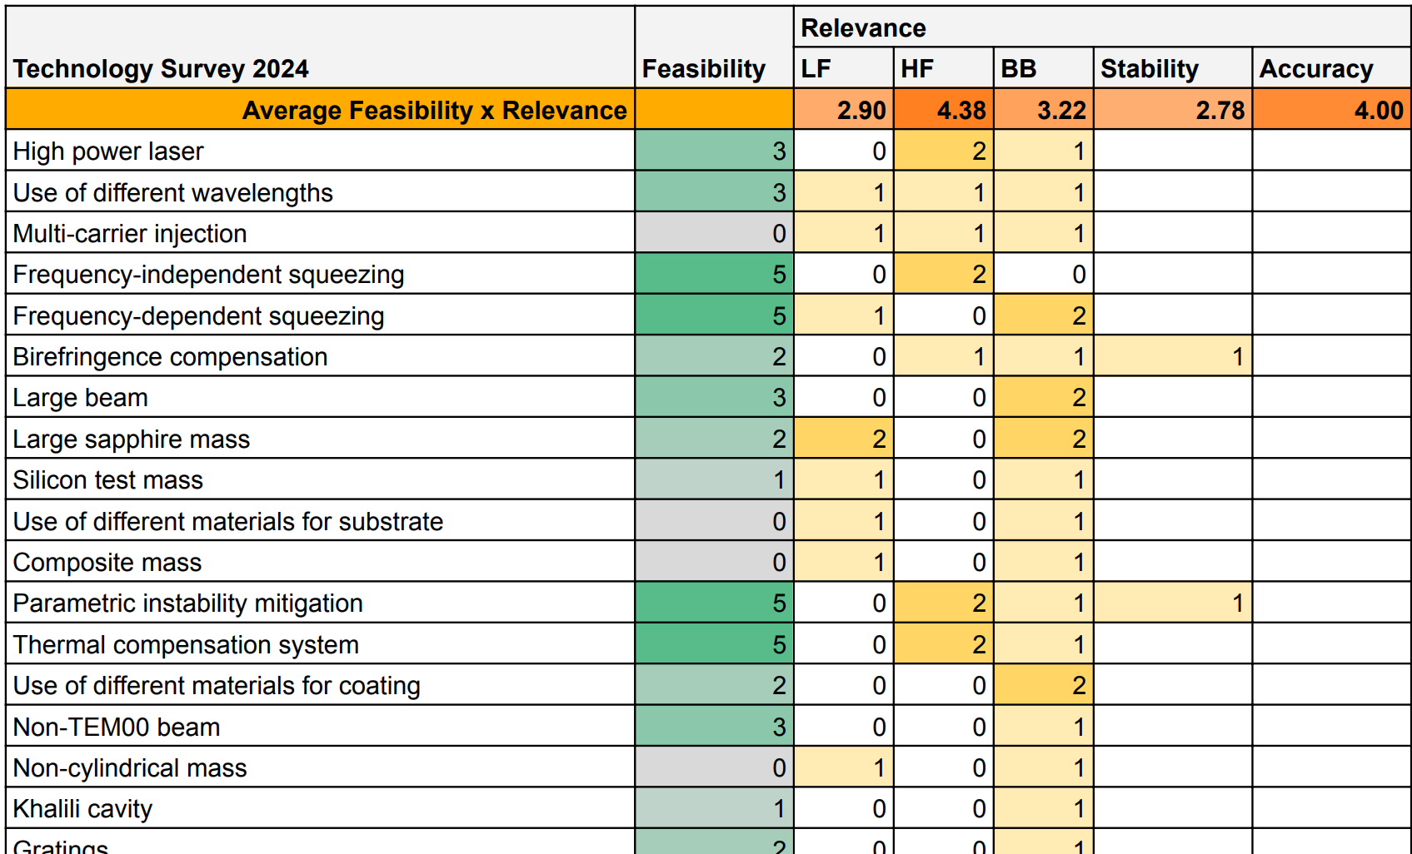
Technology Score
Relevance score: 0-2 for LF, HF, BB, stability, accuracy improvements
Relevance x Feasibility
Averaged over technologies

Slide 8
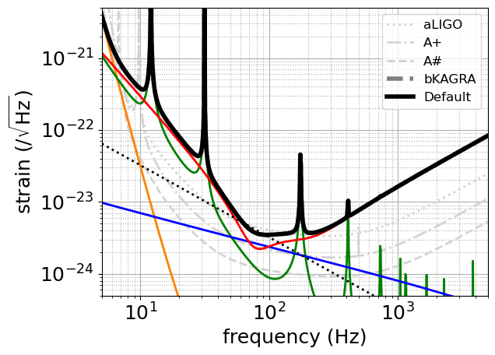
Possible Upgrade Plans
Default bKAGRA: Detuned RSE

Slide 9
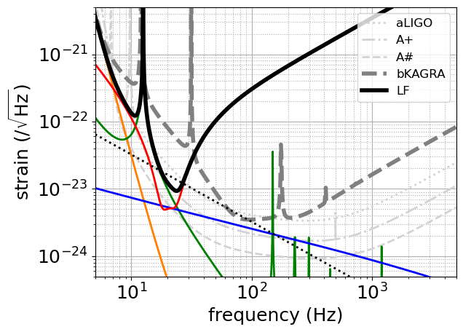
Possible Upgrade Plans
LF proposed by FPC in 2019
x4 heavier IM mass (82 kg) + Thinner and longer CuBe wires and sapphire fibers + 3 mW extra heat (instead of 50 mW)
~ A+ at LF

Slide 10
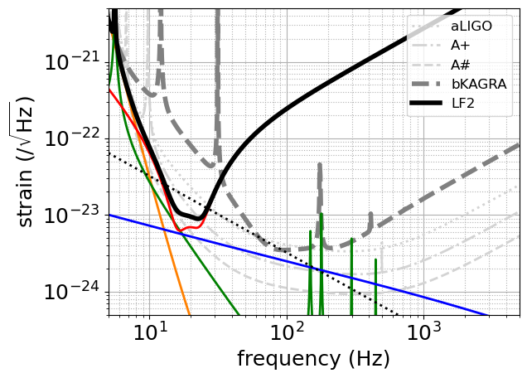
Possible Upgrade Plans
LF2
LF2019 + 14.5 Hz to 5 Hz sapphire blade springs

Slide 11
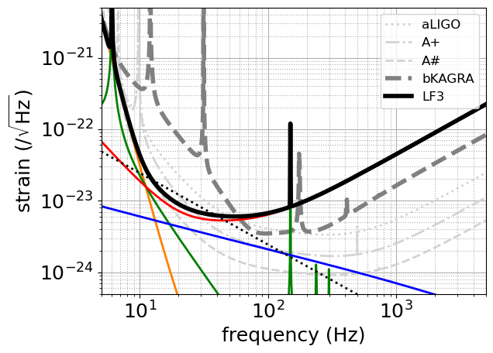
Possible Upgrade Plans
LF3
LF2 + 300-m long, 30 ppm loss filter cavity + 40 kg TM + x1/2 absorption
~A# at LF

Slide 12
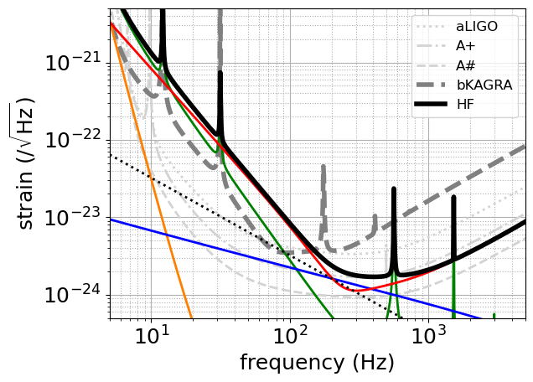
Possible Upgrade Plans
HF proposed by FPC in 2019
Shorter and thicker sapphire fibers + 3.4 MW/2 in each arm + 6 dB detected squeezing + 90.7% SRM
Beyond A+ at HF

Slide 13
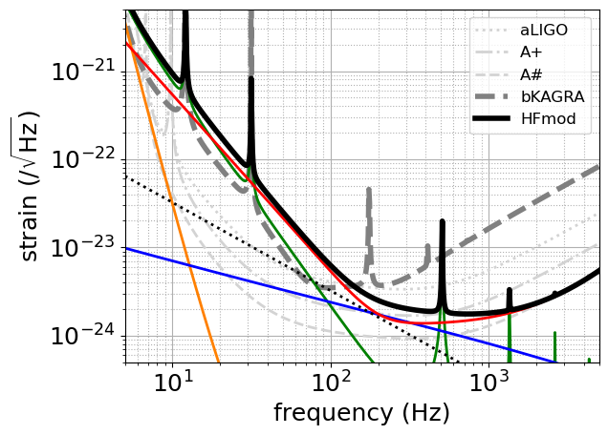
Possible Upgrade Plans
HFmod (similar but different from HFmod by 10 yr TF)
Shorter and thicker sapphire fibers + 3.1 MW/2 in each arm + 7 dB detected squeezing (lower loss) + 95.6 % SRM
~A# at HF

Slide 14
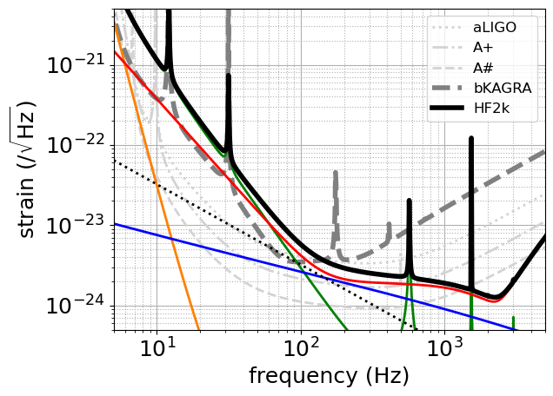
Possible Upgrade Plans
HF2k (similar but different from HF2k by 10 yr TF)
Short and thicker sapphire fibers + 3.5 MW in each arm + 0.2% ITM + 7 dB detected squeezing (lower loss) + 99.5% SRM
Beyond A# at ~2 kHz

Slide 15
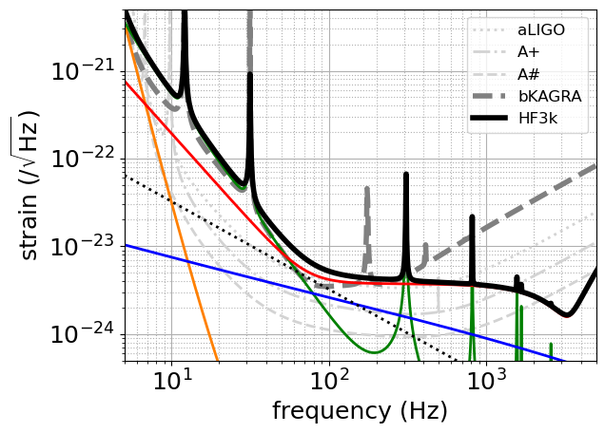
Possible Upgrade Plans
HF3k (similar but different from HF3k by 10 yr TF)
Short and thicker sapphire fibers + 3.5 MW/2 in each arm + 7 dB detected squeezing (lower loss) + 99.5% SRM
Beyond A# at ~3 kHz

Slide 16
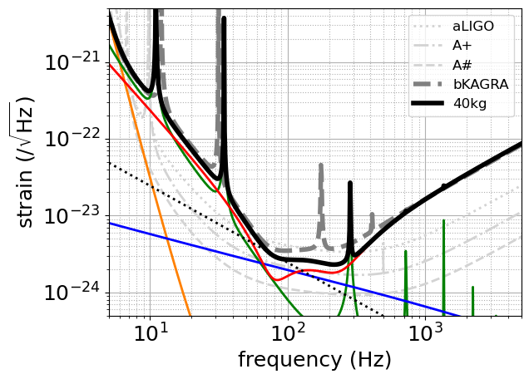
Possible Upgrade Plans
40kg proposed by FPC in 2019
40 kg TM

Slide 17
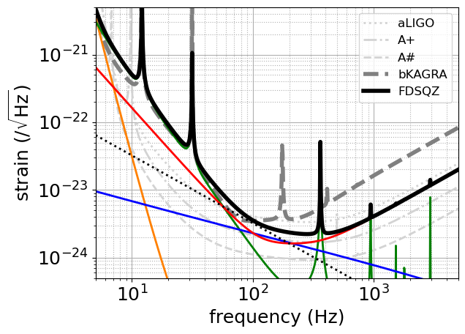
Possible Upgrade Plans
FDSQZ proposed by FPC in 2019
Frequency dependent squeezing with 30-m filter cavity

Slide 18
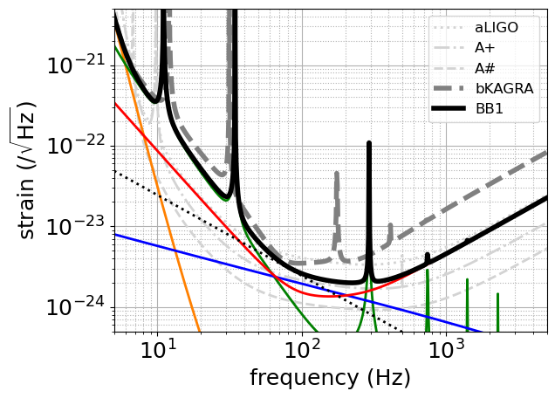
Possible Upgrade Plans
BB1
40 kg TM + 85-m filter cavity (studied by KFC project) giving 5 dB detected squeezing

Slide 19
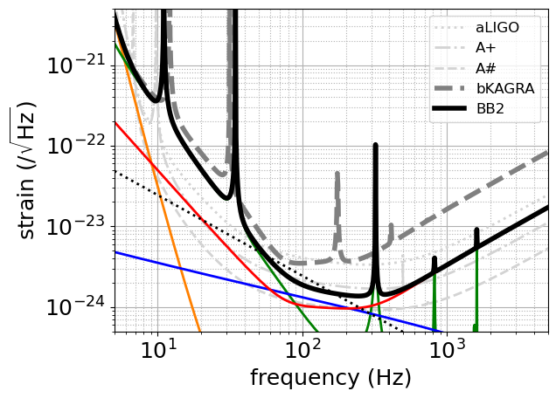
Possible Upgrade Plans
BB2
BB1 + 9.1 dB detected squeezing (lower loss)

Slide 20
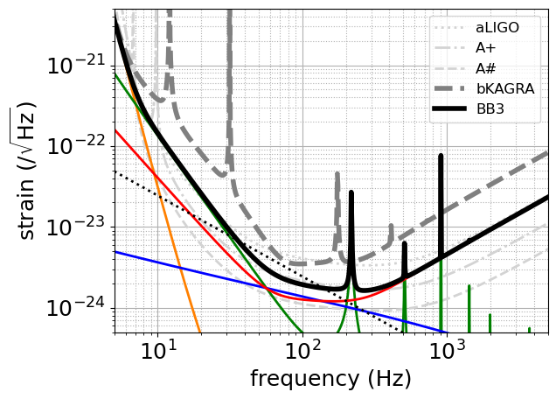
Possible Upgrade Plans
BB3
BB2 + LF2019 improvements + 5 Hz blade springs
~A+ at mid freq.

Slide 21
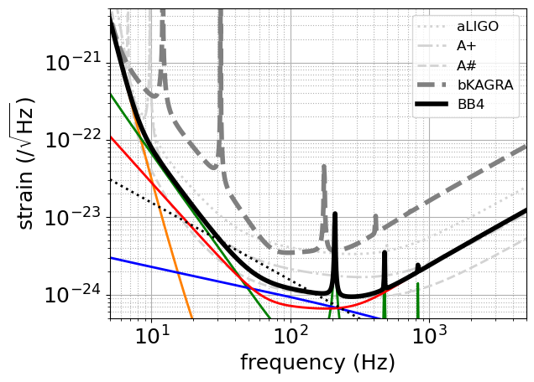
Possible Upgrade Plans
BB4
BB3 + 100 kg TM + x1/4 coating thermal noise + x1/4 absorption + 2.9 MW/2 in each arm
~A# at mid freq.

Slide 22
Lessons Learned
Improvements in sapphire fibers and blade springs are crucial for LF improvements
Improvements in sapphire mirrors and coatings are crucial for mid. frequencies
Developments in lower loss optics, high power operations, and higher finesse arm cavities and SRC are crucial for HF improvements
To compete with A#, HF would be most feasible
Even with less sensitive BB plans, KAGRA’s contributions to the network observation are important. Needs further study.

Slide 23
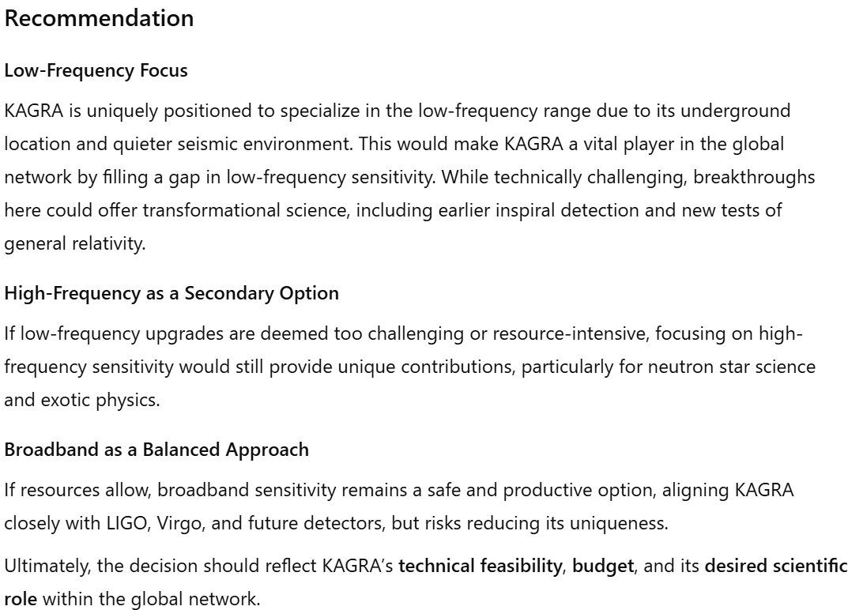

Slide 24
Proposal to allow for long term experimental activities for KAGRA authorship

Slide 25
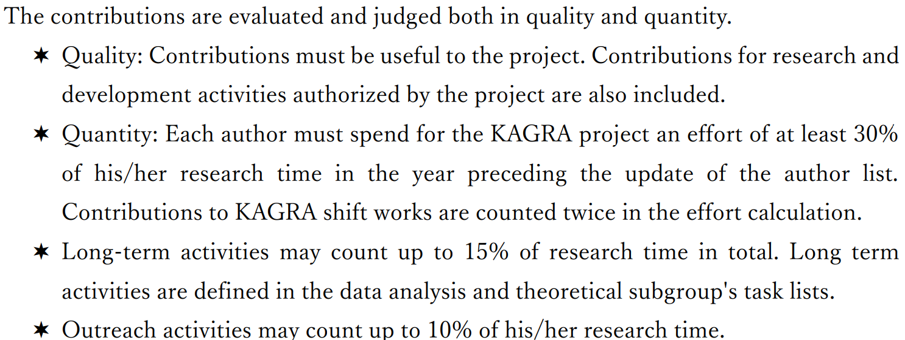
Current Authorship Policy
Long-term activities may count up to 15% of research time in total. Long term activities are defined in the data analysis and theoretical subgroup's task lists.
Why not include experimental R&Ds?
JGW-M1503490-v7

Slide 26
Amendment Proposal
Long-term activities may count up to 15% of research time in total. Long term activities are defined in the data analysis and theoretical subgroup's task lists.
Proposed amendment
Long-term activities may count up to 15% of research time in total. Long term activities are defined in the data analysis, theoretical subgroup, and instrumental science task lists.

Slide 27
Summary Table for Authorship
Activity |  | Management | White Paper | Time frame | Author-ship
Data analysis / Theory |  | KSC-DAC/ Theory Group | LVK Observational Science WP | Short Term | <100%
 |  |  |  | Long Term | <15% in total
 | Project task | EO-SEO/ Operations | LVK Operations WP | Short Term | <100%
 | Project R&D | KSC-FSC-PRDC | KAGRA Instrument Science WP | Short Term | <100%
 | Advanced R&D | KSC-FSC |  | Long Term | <0% → <15%
EPO |  | KSC-EPO | LVK Communications and Education WP | - | < 15% in total
Experiment
Note that current KAGRA Instrument Science WP does not include tasks under SEO. Instrument Science WPs for LIGO, Virgo, KAGRA are independent right now.

Slide 28
Summary
KAGRA Instrument Science White Paper 2024 is released
Any comments welcomed
Welcome to join FSC or FWG

