Slide 1


Basics of Laser Interferometer Sensing and Control
JGW-G2416005
KAGRA Student Workshop 2024 @ Mozumi
August 27, 2024
Yuta Michimura
RESCEU, University of Tokyo
michimura@resceu.s.u-tokyo.ac.jp

Slide 2

Topics
Michelson interferometer
Linear system
Power spectrum
Transfer function
Feedback system
Quantum noise

Slide 3
Further Reading
Eric D. Black, Ryan N. Gutenkunst, An introduction to signal extraction in interferometric gravitational wave detectors, Am. J. Phys. 71, 365 (2003)
Peter R. Saulson, Fundamentals of Interferometric Gravitational Wave Detectors (World Scientific, 1994)
中村卓, 三尾典克, 大橋正健 編著『重力波をとらえる』(京都大学学術出版会, 1998)
日野幹雄『スペクトル解析』(朝倉書店, 2010)
片山徹『フィードバック制御の基礎』(朝倉書店, 2002)
東京大学 物理学実験II ブラウン運動 テキスト

Slide 4
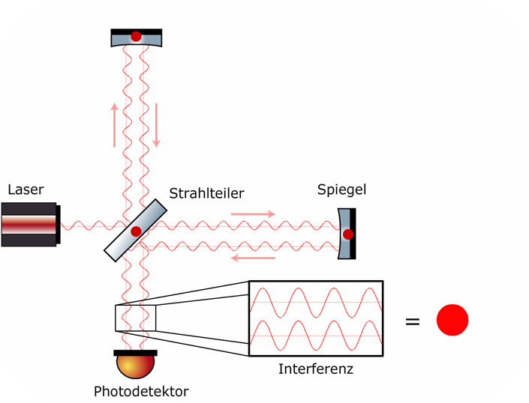
Michelson Interferometer
Measures differential arm length change
Beam
splitter
Laser source
Movable mirror
Interference
Photodiode

Slide 5
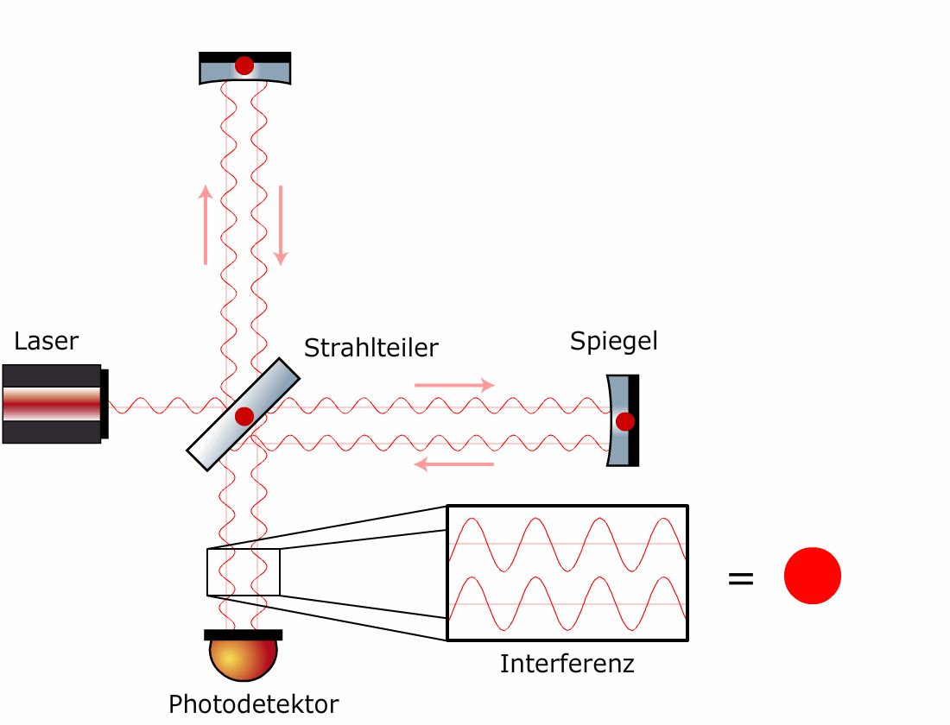
Michelson Interferometer
Measures differential arm length change
Gravitational waves
Beam
splitter
Laser source
Movable mirror
Fringe change
Interference
Photodiode

Slide 6
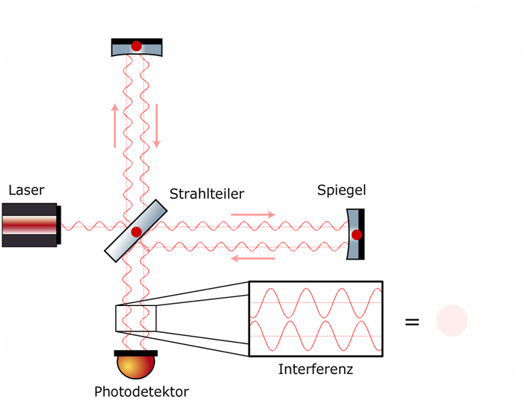
Interferometer Control
Control mirror positions to “lock” the fringe
Gravitational waves
GW signal
Beam
splitter
Laser source
Movable mirror
Feedback control
Fringe
stop
Interference

Slide 7
Linear System
Control makes the system linear
Actuator
(Mirror)
Gravitational waves
GW signal
Sensor
(Interferometer)
Feedback control

Slide 8
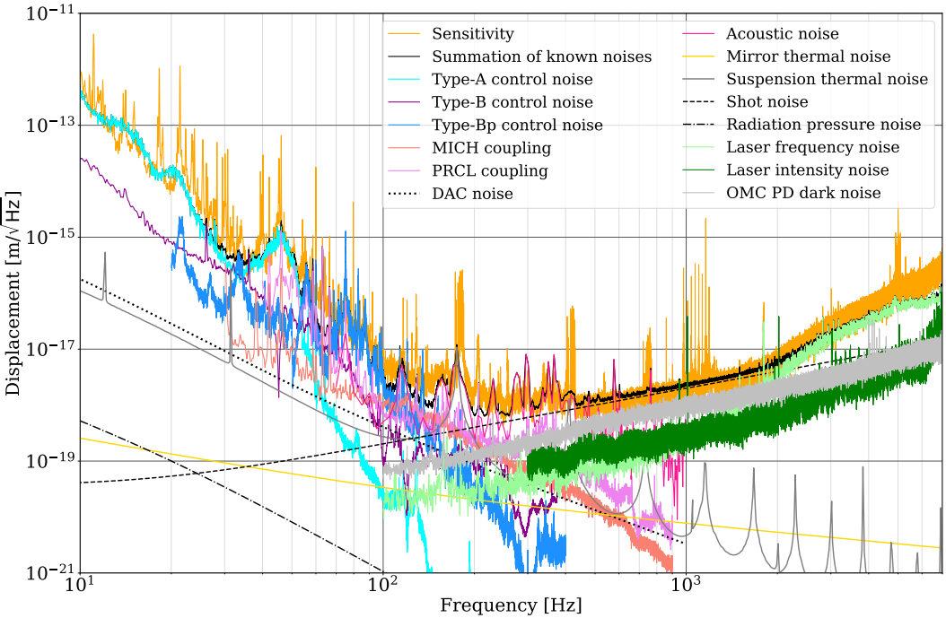
Noises and Sensitivity
Noises in the loop limits the sensitivity
Actuator
(Mirror)
Electronics
noise
Gravitational waves
GW signal
Seismic
motion
Thermal
vibrations
Sensor
(Interferometer)
Feedback control
Shot
noise
Electronics
noise

Slide 9
Things You Will Learn (over the years)
Spectrum Analysis
Mechanics
Actuator
(Mirror)
Electronics
noise
Gravitational waves
GW signal
Seismic
motion
Thermal
vibrations
Interferometry
Sensor
(Interferometer)
Feedback control
Shot
noise
Control Theory
Electronics
noise
Electronics

Slide 10
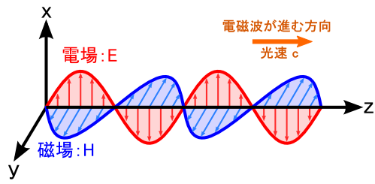
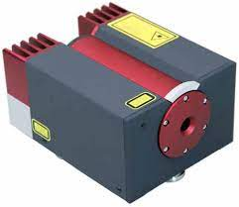
Laser Beam
Electro-magnetic waves
Electric field can be written as
Speed of light: c
Electric field: E
Magnetic field
wavelength
phase
angular
frequency
of laser
phase at distance L
amplitude

Slide 11
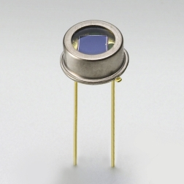
Photodiodes
Photodiodes (PDs)
Convert photons into electrons
Detects light power (square of amplitude)
We can only detect power
change
Phase change cannot be
detected directly

Slide 12
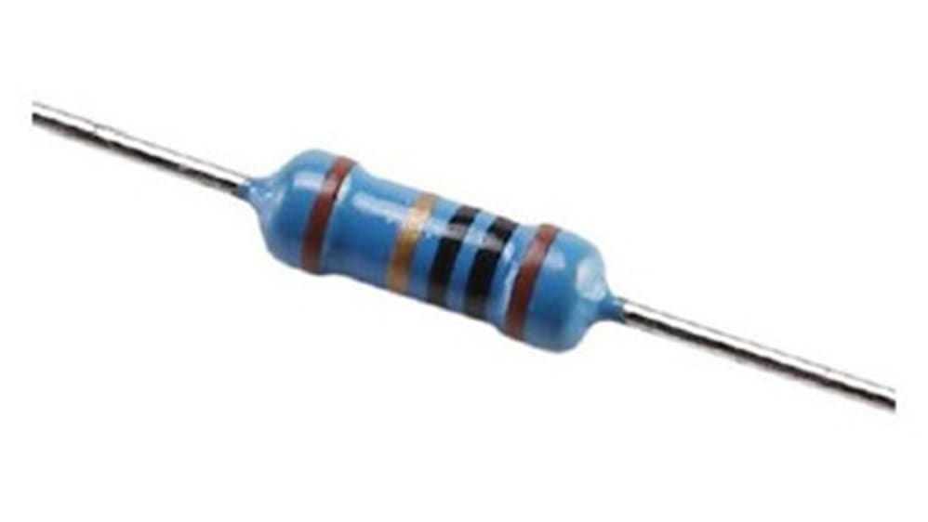
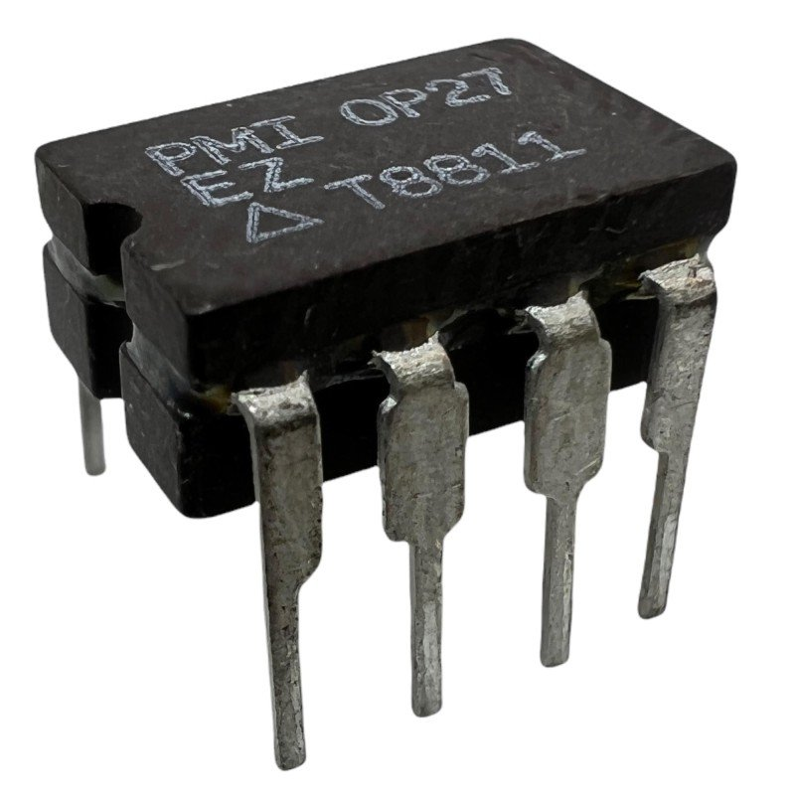
Transimpedance Amplifier
Power change signal will be converted into voltage change signal
Photon energy
[W]
=[J/s]
Transimpedance gain
(Resistance)
[Ω]
Photons
[1/s]
Quantum efficiency
[V]
Photoelectric effect
Electrons
Current
Op amp
[A]=[C/s]

Slide 13
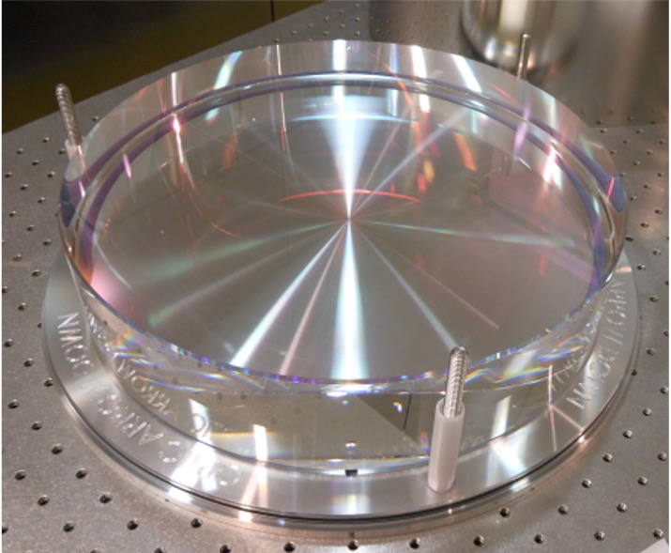
Beam Splitter
Split beam in two
Half in power, 1/√2 in amplitude
Sign flip in back reflection

Slide 14
Output of Michelson Interferometer
What is the power detected at the photodiode?
phase at distance L
Laser
Beam
splitter
Photodiode

Slide 15
Output of Michelson Interferometer
What is the power detected at the photodiode?
From Y-am
From X-arm
Input power
Differential arm length

Slide 16
Output of Michelson Interferometer
Power changes with differential arm length change
(interference)
Laser
Bright fringe in every half wavelength change in differential arm length

Slide 17
Output of Michelson Interferometer
Ratio between power change and length change
Laser
Differential arm length change can be detected from “linear” power change at the photodiode

Slide 18
Linear System
System that has linear input and output relations
Linear System
Input
Output
Homogeneity
Additivity

Slide 19
Fourier Transform
Handy to think in frequency domain
Linear System
Input
Output

Slide 20
Power Spectrum Density
Handy to think in frequency domain
Linear System
Input
Output
[m]
[W]
[m²/Hz]
Power
Spectrum Density
[W²/Hz]
[m/√Hz]
Amplitude
Spectrum Density
[W/√Hz]
Fourier transform of

Slide 21
Power Spectrum Density

Slide 22
Transfer Function
Ratio of input and output
Linear System
Input
Output
[m]
[W]
[m²/Hz]
Power
Spectrum Density
[W²/Hz]
[m/√Hz]
Amplitude
Spectrum Density
[W/√Hz]

Slide 23
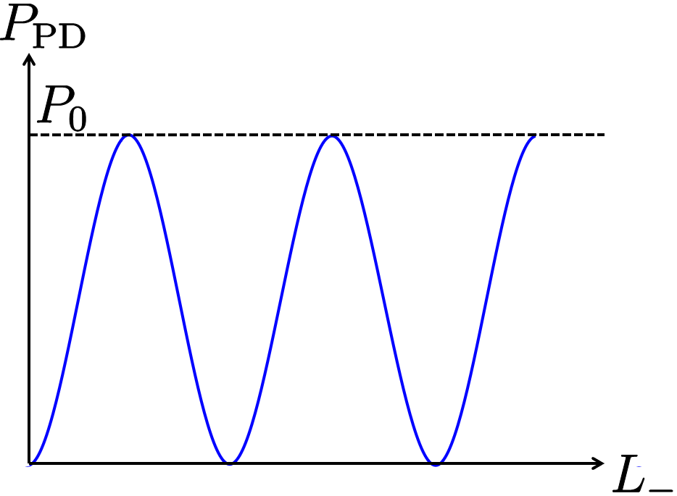
Transfer Function of Interferometer
Constant if fringe is fixed

Slide 24
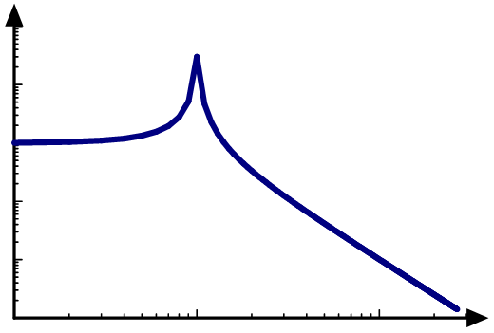
Transfer Function of Actuator
Equation of motion of a suspended mirror
Transfer function from force to displacement
Q-value
Resonant frequency

Slide 25
Feedback Control Loop
Now we can analyze the loop in frequency domain
Actuator
(Mirror)
GW signal
Gravitational waves
Sensor
(Interferometer)
Feedback control
We will design this filter later

Slide 26
Feedback Control Loop
Open loop transfer function G(ω) is important
GW signal can be estimated from Y(ω) (feedback signal) if G(ω) >>1

Slide 27
Feedback Control Loop
Open loop transfer function G(ω) is important
Loop can “oscillate” if G(ω)=-1
→ Nyquist stability criterion
Control filter is designed to meet this criterion

Slide 28
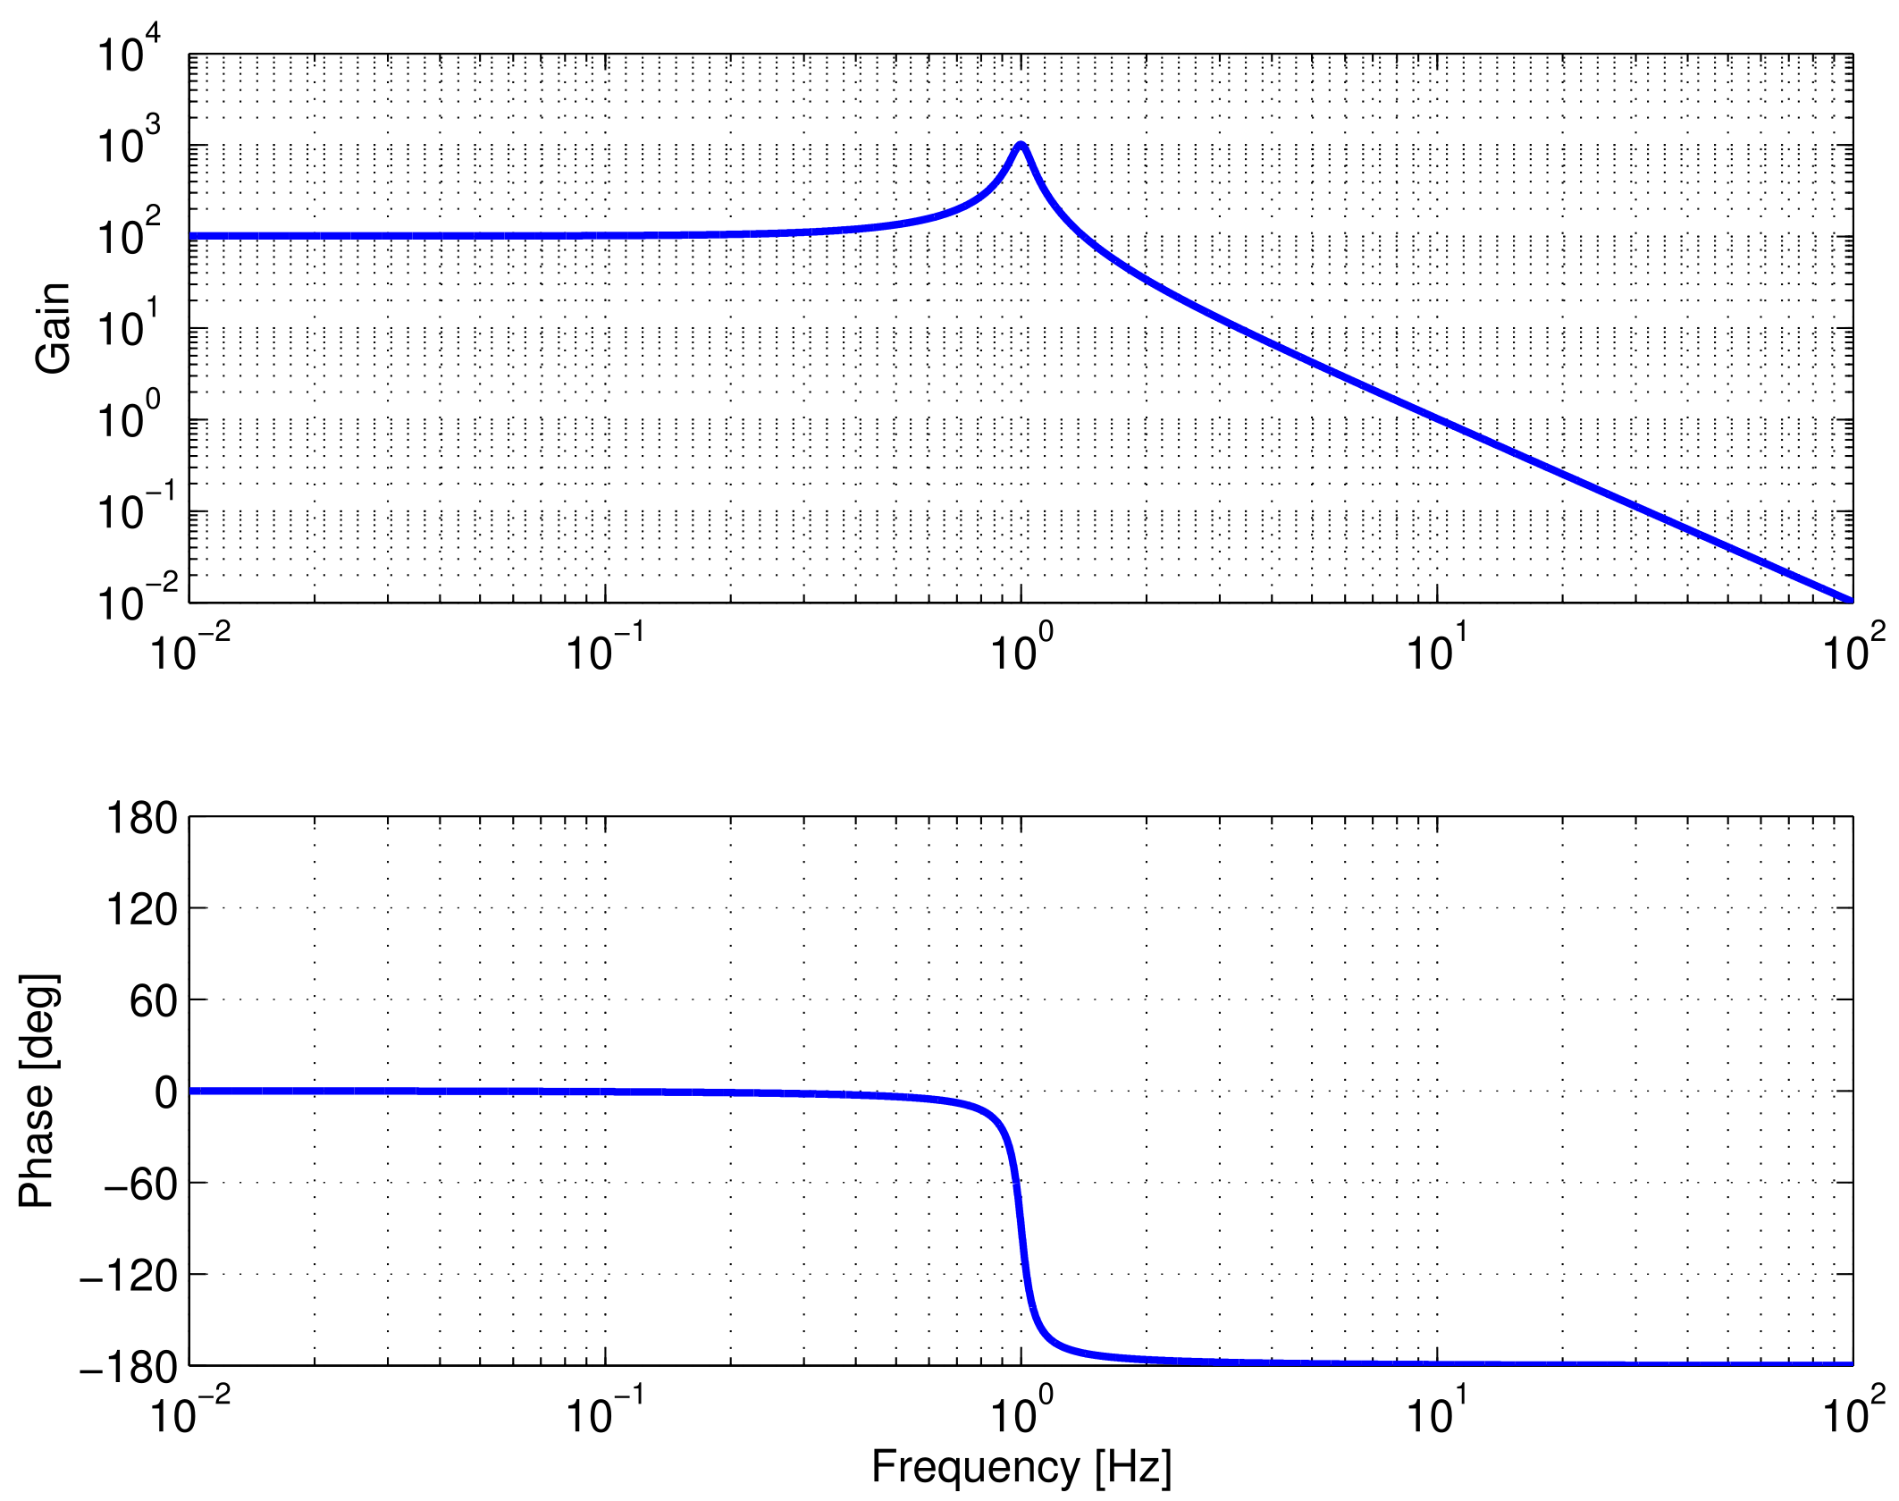
Unstable Loop
G(ω)=-1 at unity gain frequency
Actuator
(Mirror)
-1
GW signal
GWs
Sensor
(Interferometer)
If frequency independent

Slide 29
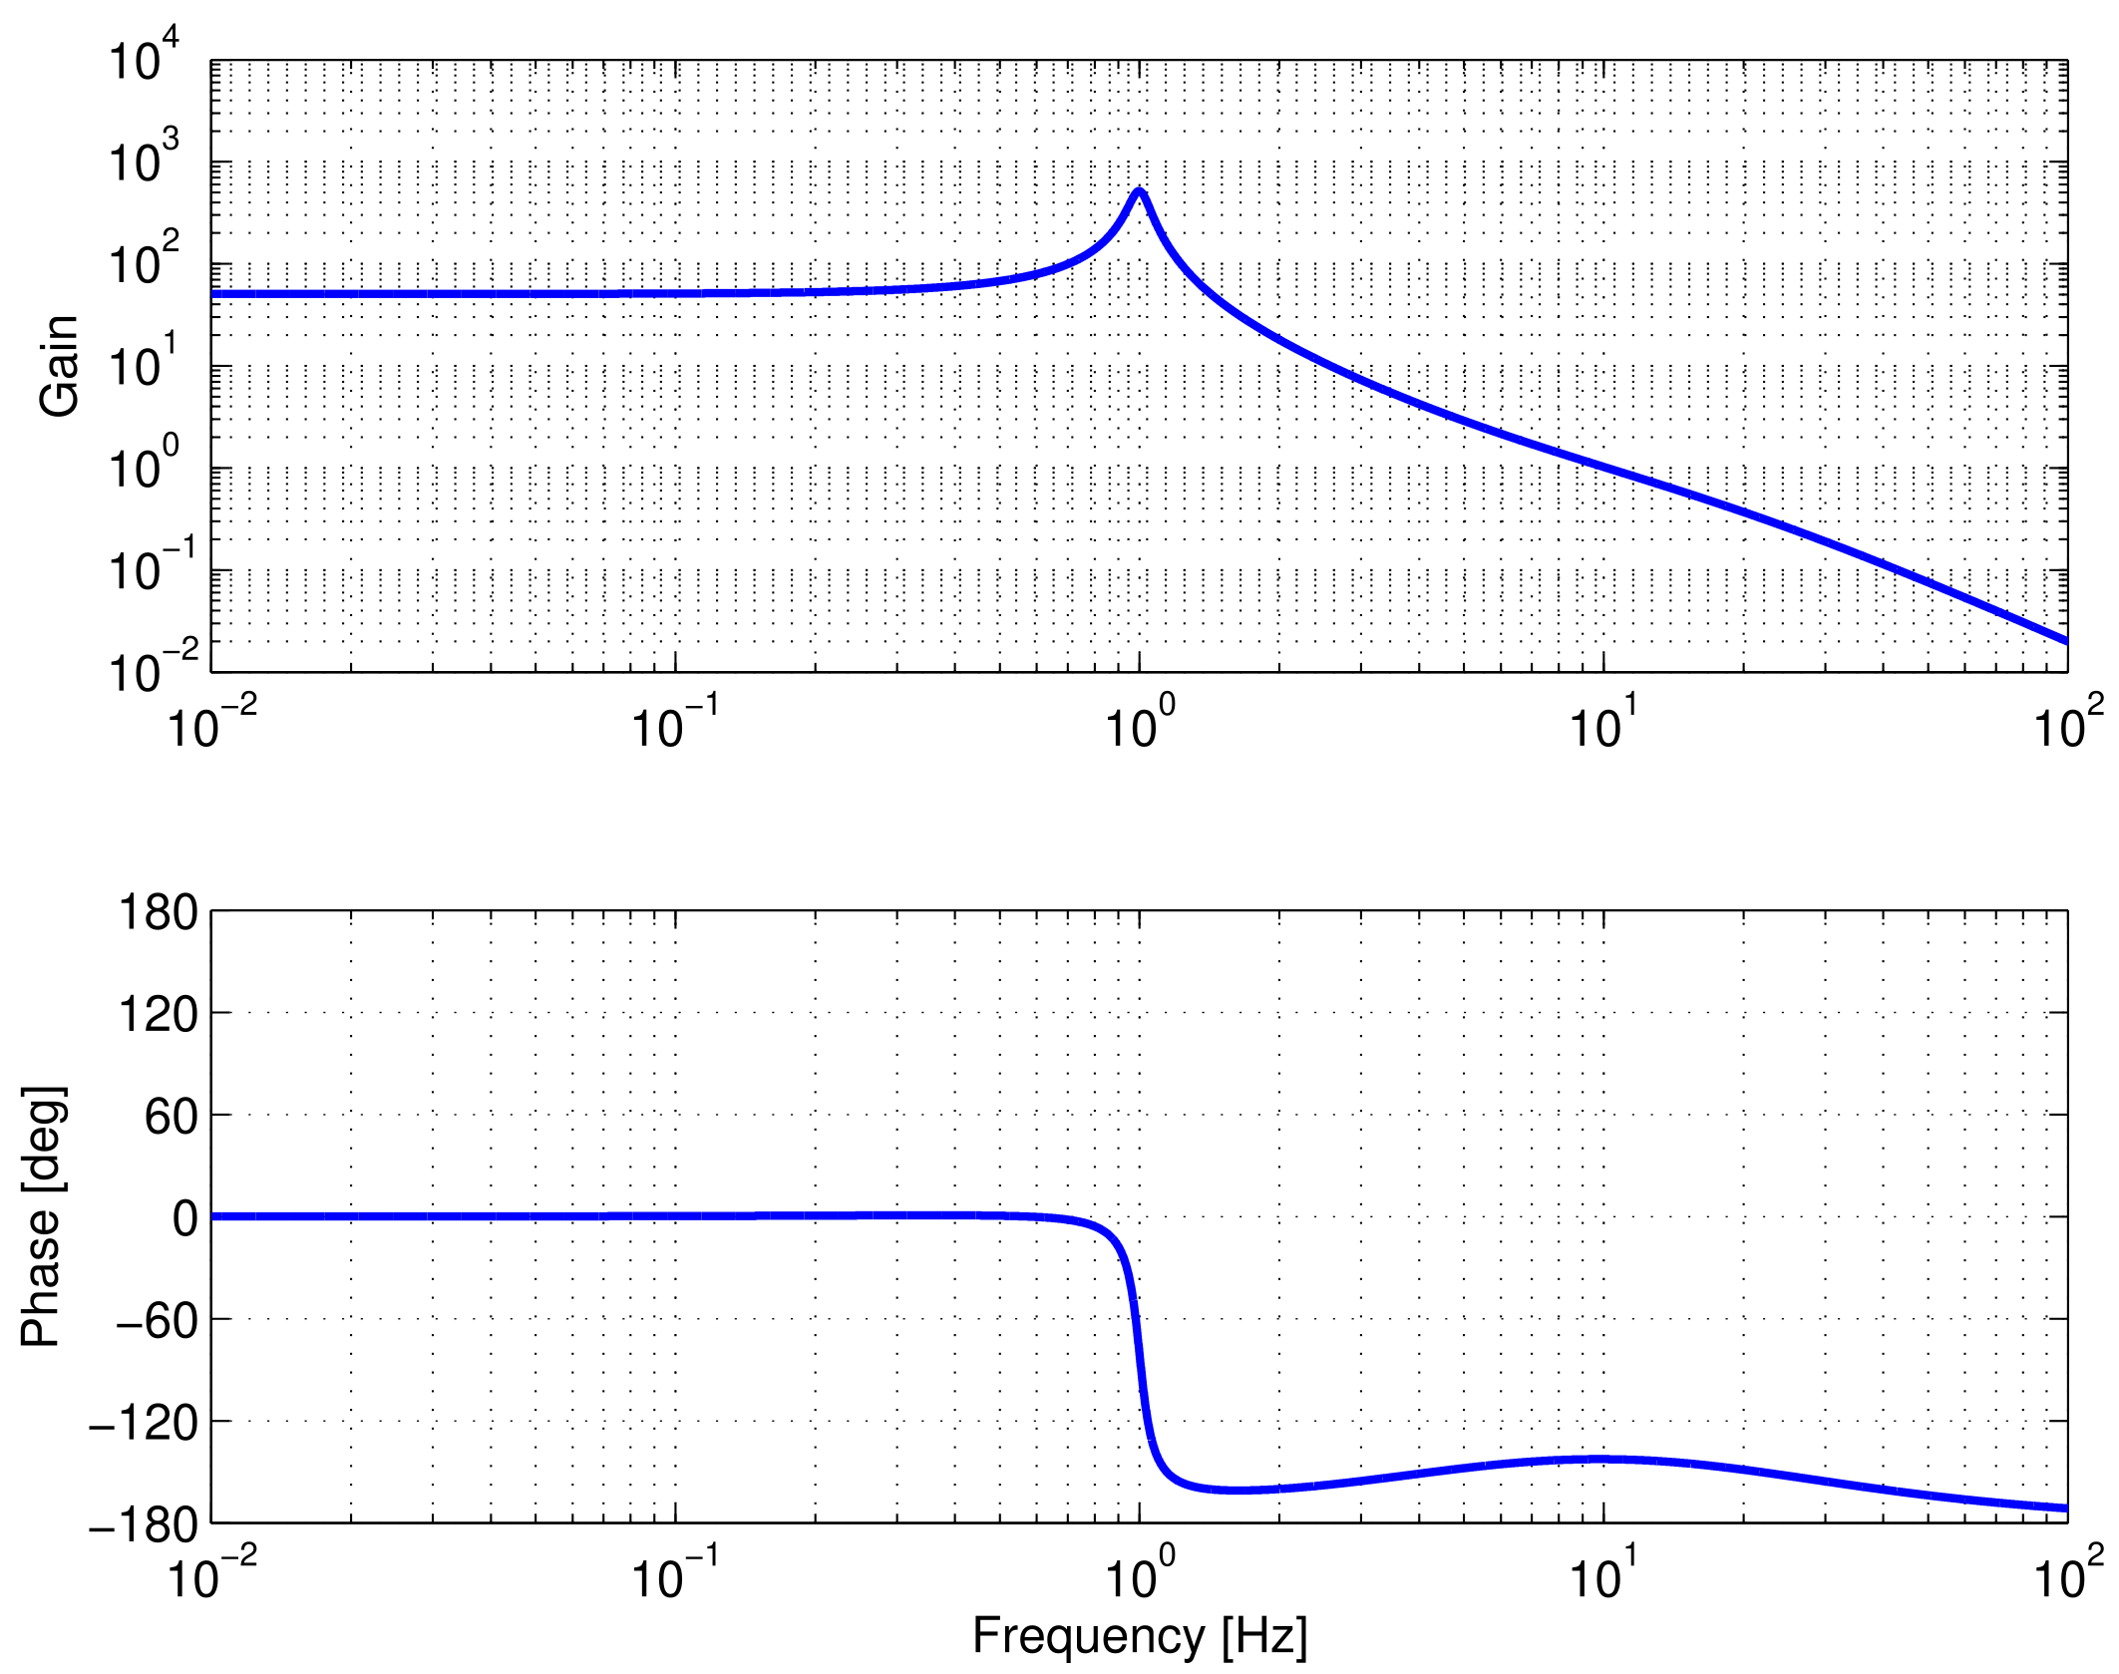
Stable Loop
Phase margin at unity gain frequency
Actuator
(Mirror)
not -1
GW signal
GWs
Sensor
(Interferometer)
Phase margin
Lead-lag filter

Slide 30
Force Noise and Sensing Noise
Loop calculation gives noise contributions
Actuator
(Mirror)
Force
noise
GW signal
GWs
Sensing noise contribution
Sensor
(Interferometer)
Force noise
contribution
Sensing
noise
Estimated GW signal

Slide 31
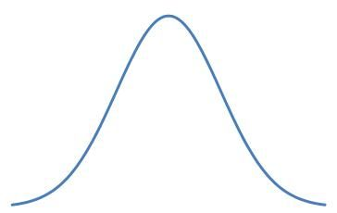
Shot Noise
Number of photons to photodiodes fluctuates
Quantum fluctuation of power
Photodiode
Photon energy
Number of photons
Shot noise
spectrum
Quantum efficiency

Slide 32
Shot Noise Limit of Michelson
Power change
Shot noise
Shot noise limited sensitivity
Better shot noise with higher input power
Best at dark fringe (where P_{PD}=0)

Slide 33
Radiation Pressure Noise
Number of photons to mirror fluctuates
Power fluctuation
Mirror displacement
Mirror
Assumed Michelson with input power P₀
Force to displacement
(Actuator TF)
Force on mirror
free-falling mirror
(above resonant frequency)

Slide 34

Standard Quantum Limit
Shot noise is lower with higher power
Radiation pressure noise is lower
with lower power
Standard Quantum Limit (SQL) for Michelson
Trade-off
√2 for two arms
m is mirror mass
(m/2 is reduced mass)
Assuming BS with infinite mass
from Uncertainty principle

Slide 35
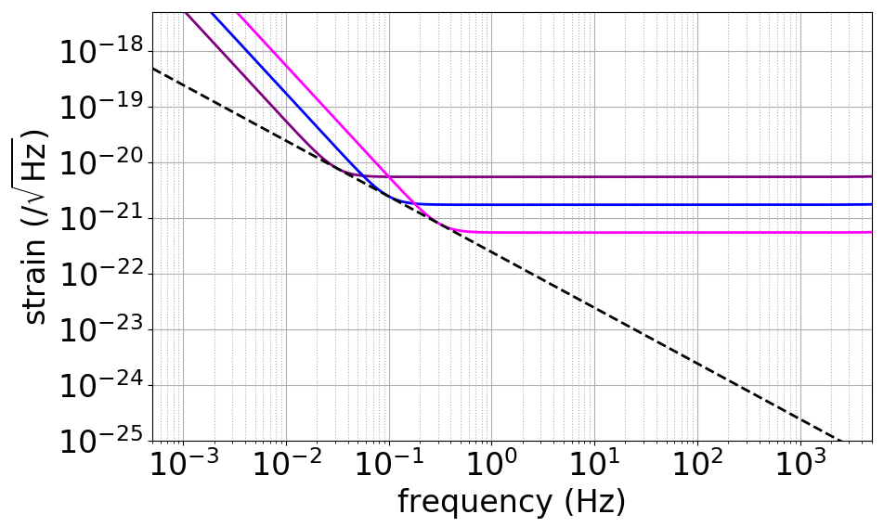
Input Power and Sensitivity
SQL cannot be beaten by changing power
Radiation pressure
Michelson
(10 W)
Shot
Michelson
(100 W)
Michelson
(1000 W)
SQL Michelson
(3 km, 20 kg)

Slide 36
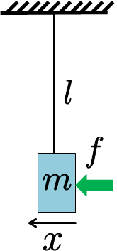
Summary
Mechanics
Spectrum Analysis
Actuator
(Mirror)
Electronics
noise
Gravitational waves
GW signal
Seismic
motion
Thermal
vibrations
Interferometry
Sensor
(Interferometer)
Feedback control
Shot
noise
Control Theory
Electronics
noise
Electronics

