Slide 1
Future Strategy for KAGRA
JGW-G2415980 33rd KAGRA Face-to-Face Meeting Aug 2024
August 23, 2024
Yuta Michimura
RESCEU, UTokyo
michimura@resceu.s.u-tokyo.ac.jp
(Moved from Caltech in April 2024)

Slide 2
Future Strategy Committee
FSC's goal is (i) to make a suggestion of a concrete plan for KAGRA+ and beyond, and (ii) to recommend technologies that are to be implemented to KAGRA https://gwwiki.icrr.u-tokyo.ac.jp/JGWwiki/KAGRA/KSC/FSC
Chairs changed in May 2024 Masaki Ando (Chair) Yuta Michimura (Chair) Sadakazu Haino (co-chair) Sadakazu Haino (co-chair) Somiya Kentaro (co-chair) Somiya Kentaro (co-chair) Atsushi Nishizawa (co-chair)
White paper writing team (chaired by S. Haino) is dissolved, but now whole FSC will take care
Project R&D Committee (PRDC; chaired by K. Somiya) is still managed by FSC

Slide 3
Welcome to join FSC
We welcome anyone interested to join FSC Just email me at michimura@resceu.s.u-tokyo.ac.jp
Current members: Masaki Ando Rishabh Bajpai Hong-Bo Jin Ray-Kuang Lee Matteo Leonardi Ettore Majorana Quynh Lan Nguyen
Micheal Page Surojit Saha Shalika Singh Lijing Shao Haoyu Wang Kazuhiro Yamamoto Takaaki Yokozawa

Slide 4
Instrument Science White Paper
2019 version (JGW-M1909590) was summarized as following papers, but we failed to update since Y. Michimura+, PRD 102, 022008 (2020) (instrument part) KAGRA Collab., PTEP 2021, 05A103 (2021) (science part)
2024 is a year to turn over a new leaf
Overleaf link: https://www.overleaf.com/6619811679 sbdjbqnrpxdm#bb456b
We will focus on instrument, and plan to update yearly by Dec F2F
Science part is updated yearly as LVK Observational Science White Paper

Slide 5
White Paper Structure
Executive Summary (to be written by Dec 2024) - Summary of feasibility and relevance for each tech. - Summary of good upgrade candidates
Introduction (written) - Background and the scope
Survey of Current Technologies (to be written by Oct 2024) - Review of any technologies which could be applied to improve KAGRA sensitivity, stability, and accuracy - Authors are (tentatively) assigned to most of items - Any ideas on new technologies missing and volunteers to write are highly welcomed
Possible Upgrade Plans (to be written by Dec 2024) - Example upgrade plans that can be achieved by combining these technologies

Slide 6
List of Technologies for Survey
Light sources
High power laser
Use of different wavelengths
Multi-carrier injection
Frequency-independent squeezing
Frequency-dependent squeezing
Test masses and coatings
Birefringence reduction
Large beam
Large sapphire mass
Use of different materials for test mass
120K Silicon
Composite mass
Parametric instability mitigation
Thermal compensation system
Use of different materials for coatings
Non-TEM00 beam
Non-cylindrical mass
Khalili cavity
Gratings
Cryogenic suspensions
Sapphire blade spring improvement
Use of ribbons
Use of long fibers
High conductivity fibers
Other optics
Large beamsplitter
Low-loss Faraday isolator
Low-loss OMC
Low-loss PD
Calibration
Multi-color calibration
Low frequency noise reduction systems
Seismic noise reduction
Suspension point interferometer
Newtonian noise cancellation
Environmental magnetic noise sensors
Charge noise reduction
Instrumental baffles
Advanced classical control systems
Phase camera
Machine learning
Laser induced desorption
Quantum locking
Quantum control systems
Homodyne readout
Variational readout
Optical spring
Long-SRC
Quantum expander
Intracavity OPA
White-light cavity
PT symmetry
Kerr amplification
EPR squeezing
Quantum teleportation
Negative inertia
Alternative topologies
Speed-meter
Acceleration-meter
Detuned speed-meter
Delay line
Local readout
Single-photon detector
Displacement noise free interferometer
L resonator

Slide 7
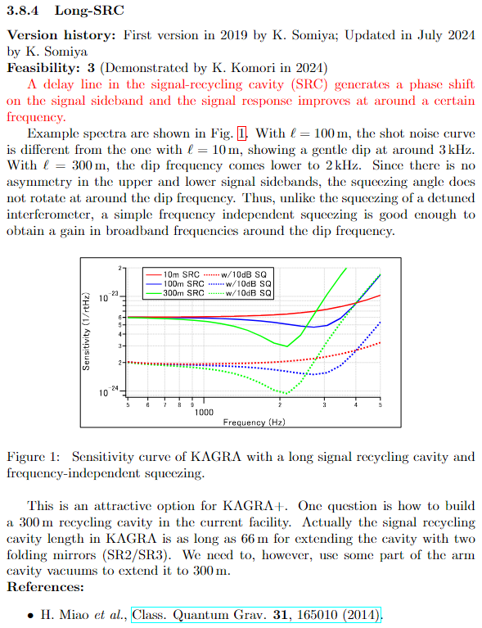
Example of Survey Text
Name of the technology
Version history to keep track of when/who updated the text
Feasibility score and short justification 0: Idea phase
1: Theoretically well studied
2: Demonstration experiment on going
3: Demonstrated with a table-top experiment
4: Demonstrated with a prototype experiment (e.g. TAMA)
5: Demonstrated with one of LVK detectors
Copy text from previous version (2019) and updated part will be in red.
Summarize in 3-4 paragraphs.
Plot if you have (usually not necessary)
References

Slide 8
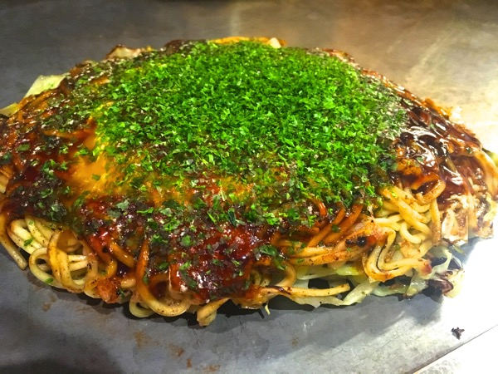
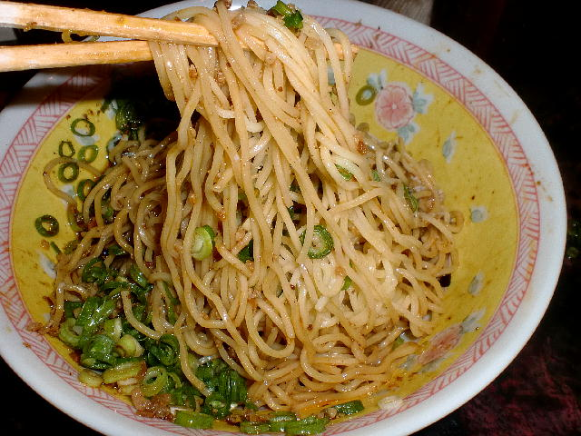
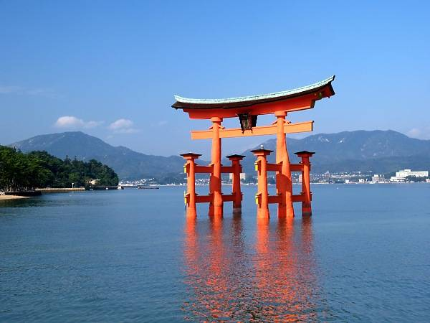
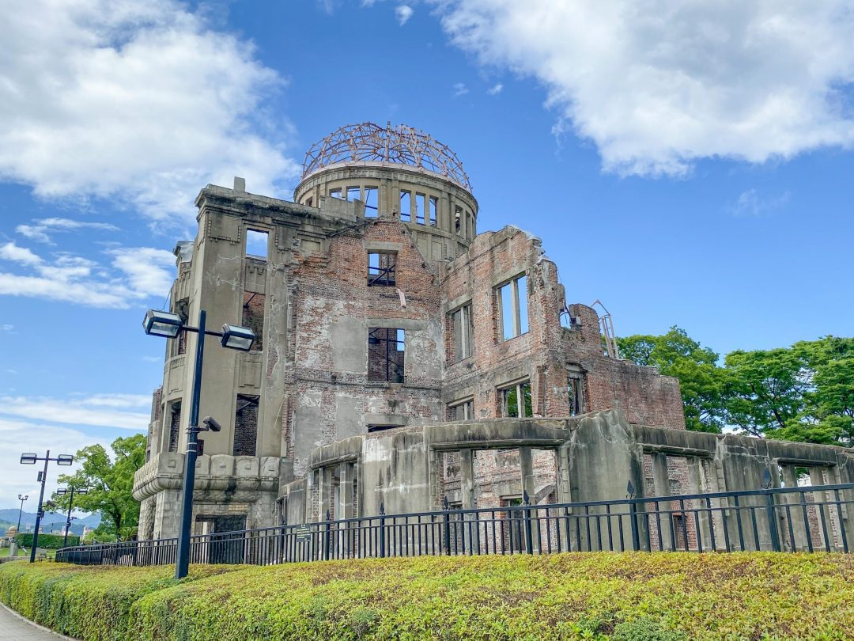
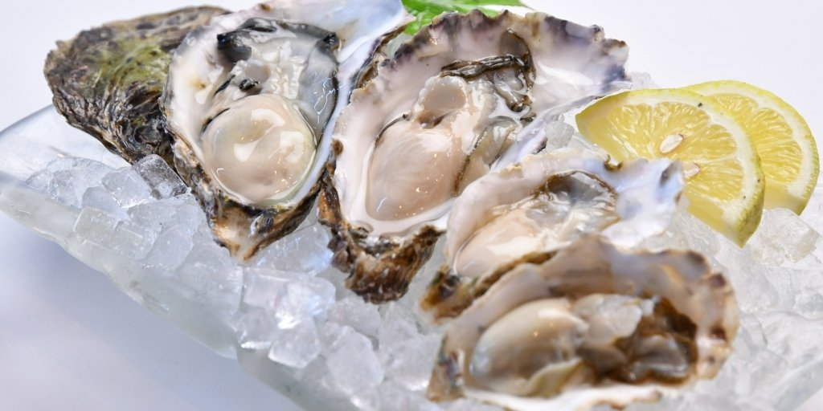
White Paper Writing Workshop
Dates: October 2-3, 2024 Venue: Hiroshima University https://gwwiki.icrr.u-tokyo.ac.jp/JGWwiki/KAGRA/KSC/FSC/WWW2024
Authors of white paper are invited

Slide 9
FWG 4th Open Meeting
Future Working Group (FWG) is open to anyone interested in new ideas https://gwwiki.icrr.u-tokyo.ac.jp/JGWwiki/KAGRA/KSC/FSC/FWG
You can be a member just by sending an email to kagra-fwg-ctl@icrr.u-tokyo.ac.jp with "subscribe (YOUR NAME)" in the main body
Planning to have a FWG 4th Open Meeting in Dec 2024, as a satellite meeting of F2F

Slide 10
Schedule
Sep 30, 2024: Deadline for tech. survey writing
Oct 2-3, 2024: White paper Writing Workshop
Dec 16-18, 2024: KAGRA F2F - FWG 4th Open Meeting - Release of White Paper 2024
Feb-Apr 2025: Call for Project R&D - White Paper will be used to evaluate
Apr-June 2025: Application for KAKENHI grants - Hopefully the White Paper will be useful for applying to Tokusui, Kiban S etc., with more common agreement among collaborators
Dec 2025: Release of White Paper 2025 …

Slide 11
Summary
KAGRA Instrument Science White Paper 2024 is being written
Any comments and volunteers are welcomed
Welcome to join FSC or FWG

Slide 12
Additional Slides

Slide 13
Instrument Science White Paper Session
Date: Aug 22 15:00-17:30
Venue: 73C (3rd floor of this TCU Building 7)

Slide 14
Scope of FSC
White paper writing
Organizing Project R&D and Advanced R&D
Coordination of Future Working Group Open Meetings
Responsible for future discussions within KAGRA
Responsible for future discussions in JGWC, CRC meetings etc.
Responsible for discussions of 2.5-3Gs in LVK meetings, IGWN etc.

Slide 15
Feedback
Update
Science/Instrument focus

Slide 16
New ideas
Stimulating new ideas
Commit to the Project
Implementation
Advanced R&D
White Paper
Project R&D
FWG Open Meeting

