Slide 1



First results from ultralight vector dark matter search with KAGRA
PASCOS 2024 @ Quy Nhon, Vietnam
July 9, 2024
Yuta Michimura
RESCEU, University of Tokyo
michimura@resceu.s.u-tokyo.ac.jp
on behalf of the LIGO-Virgo-KAGRA Collaboration
Based on arXiv:2403.03004

Slide 2
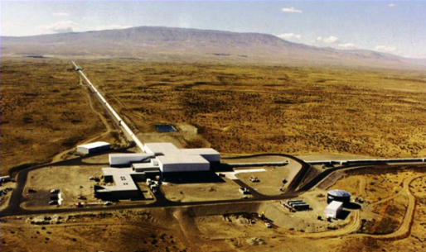
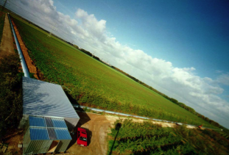
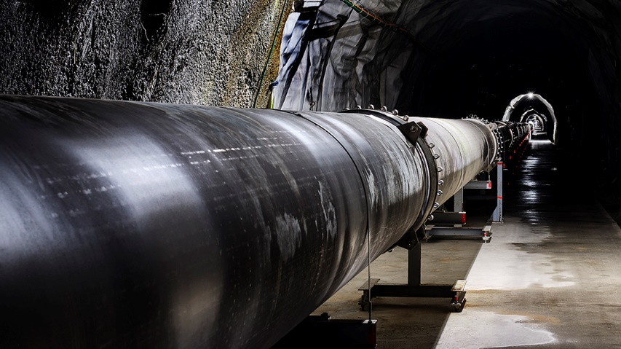

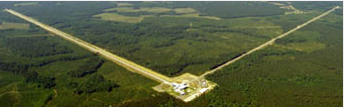
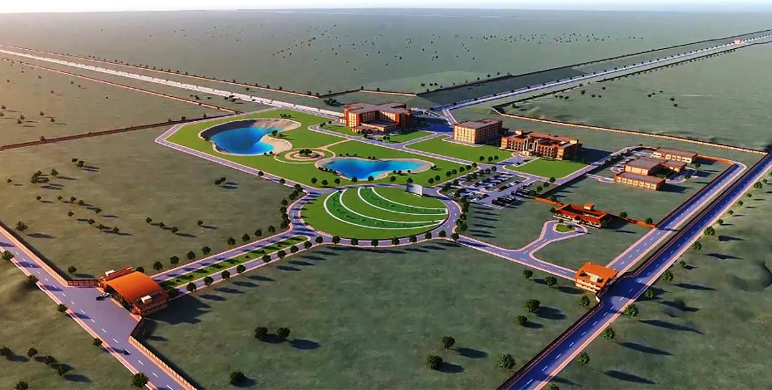
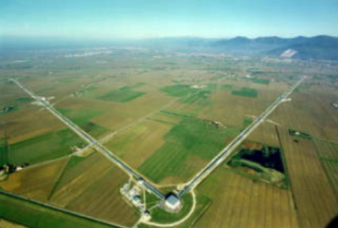
Global Network of GW Detectors
GEO600
LIGO Hanford
KAGRA
LIGO Livingston
LIGO-India
Virgo

Slide 3
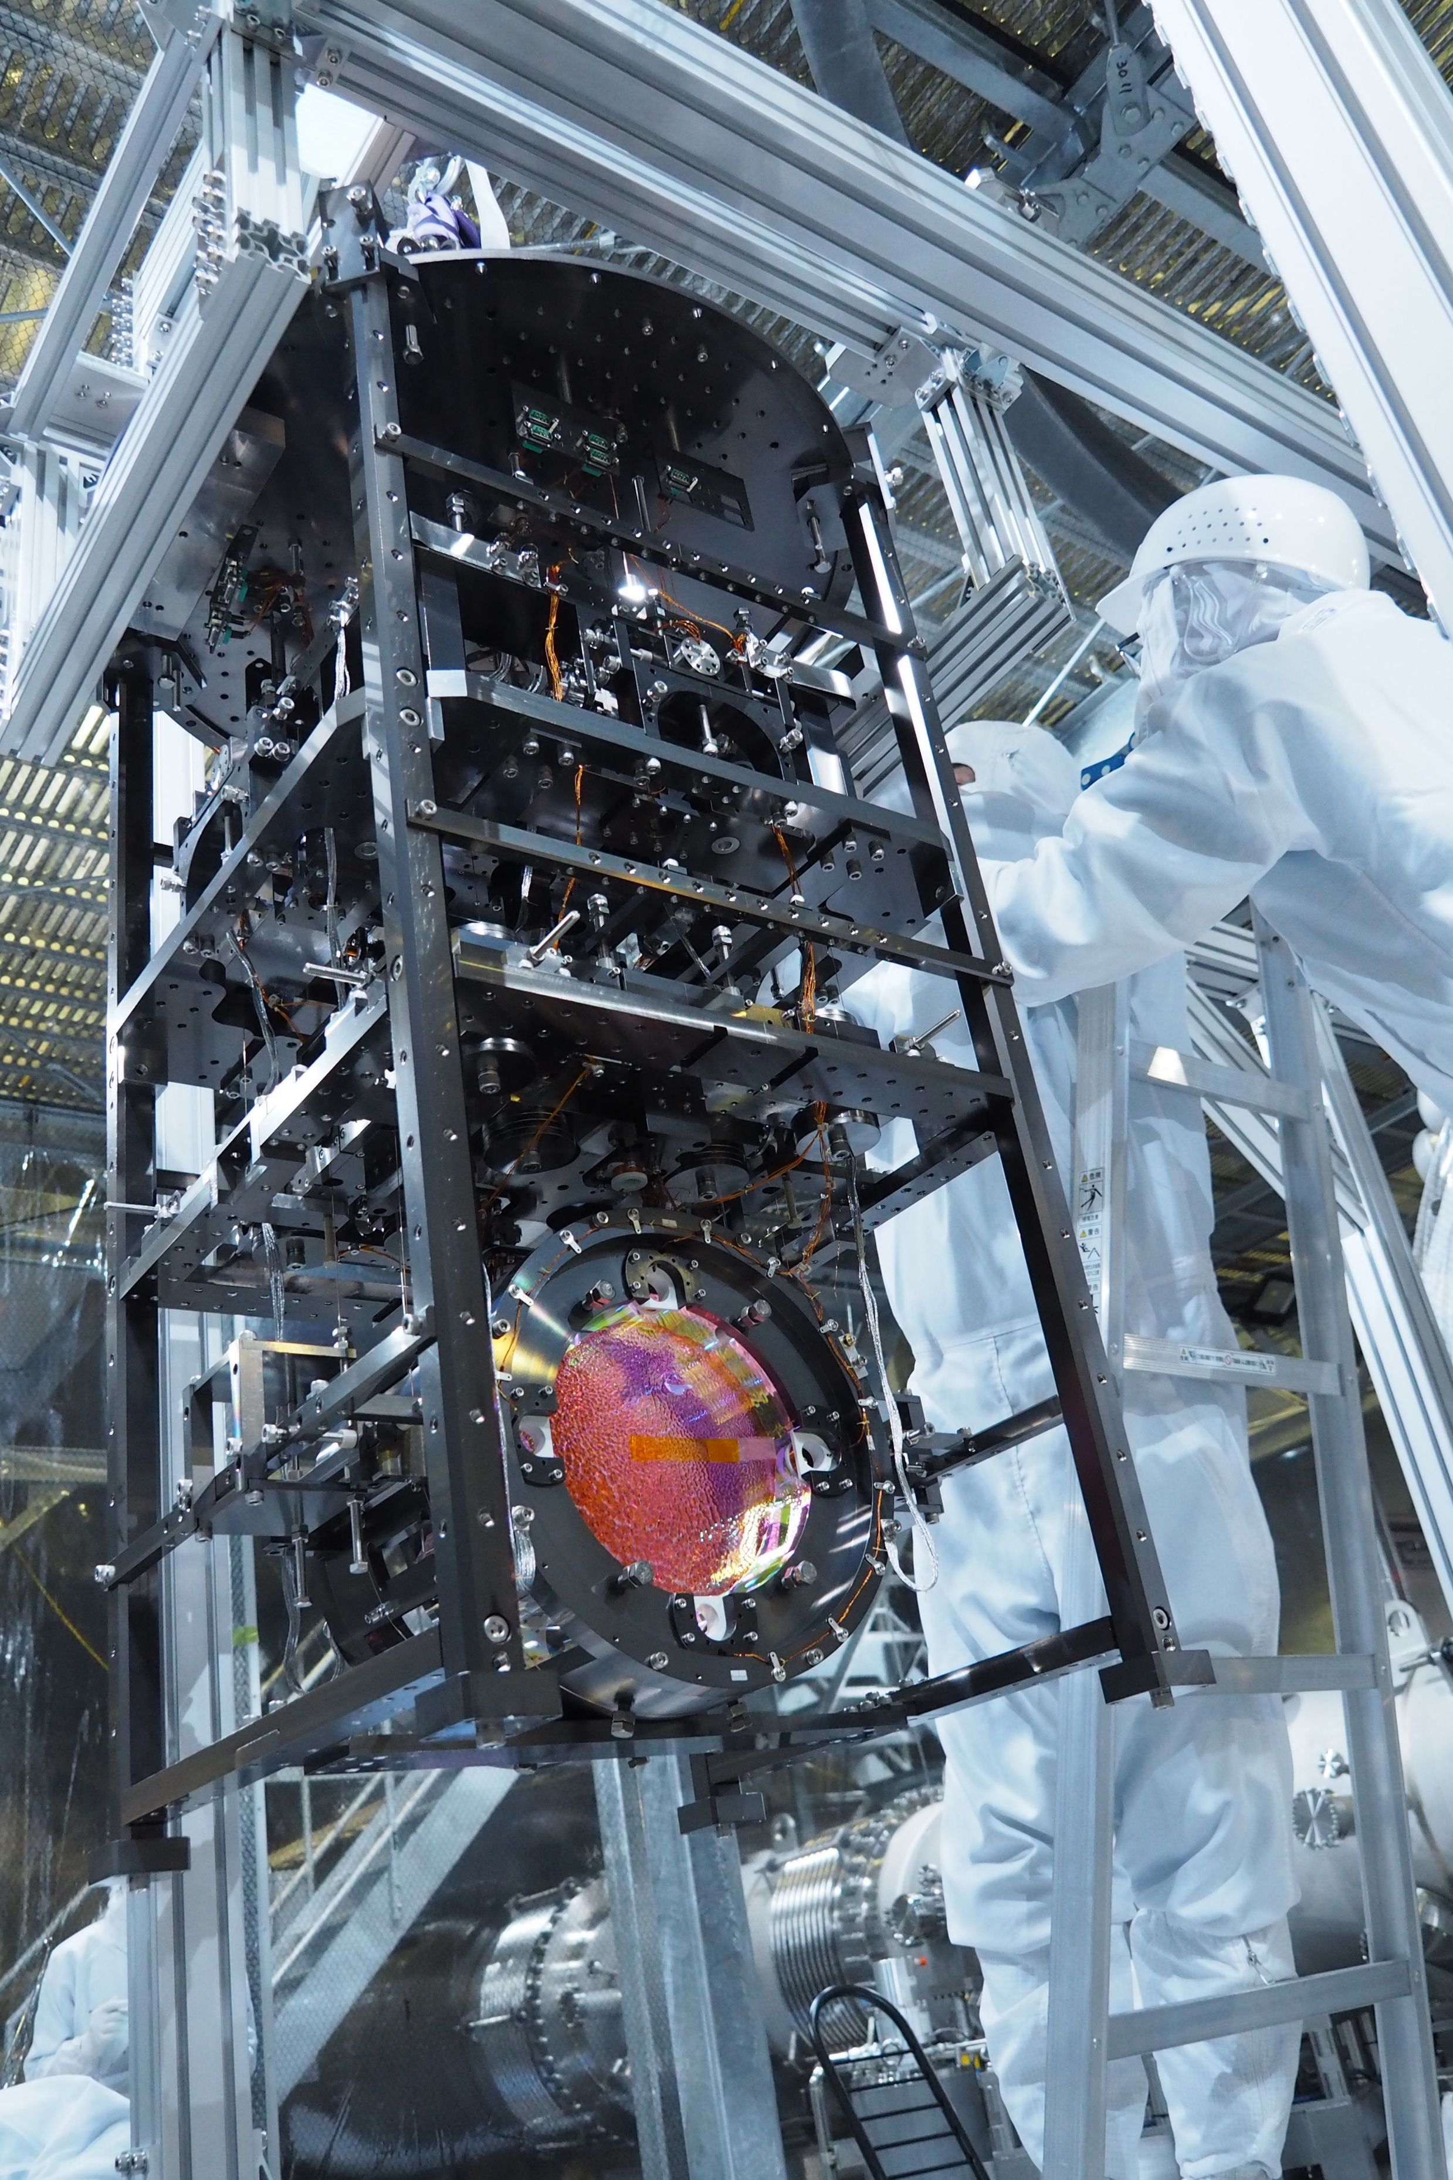
KAGRA Project
Project started in 2010
Construction completed
and signed MoA with
LIGO/Virgo in 2019
400+ collaborators
13 countries
First (and so far, only)
underground and
cryogenic detector

Slide 4
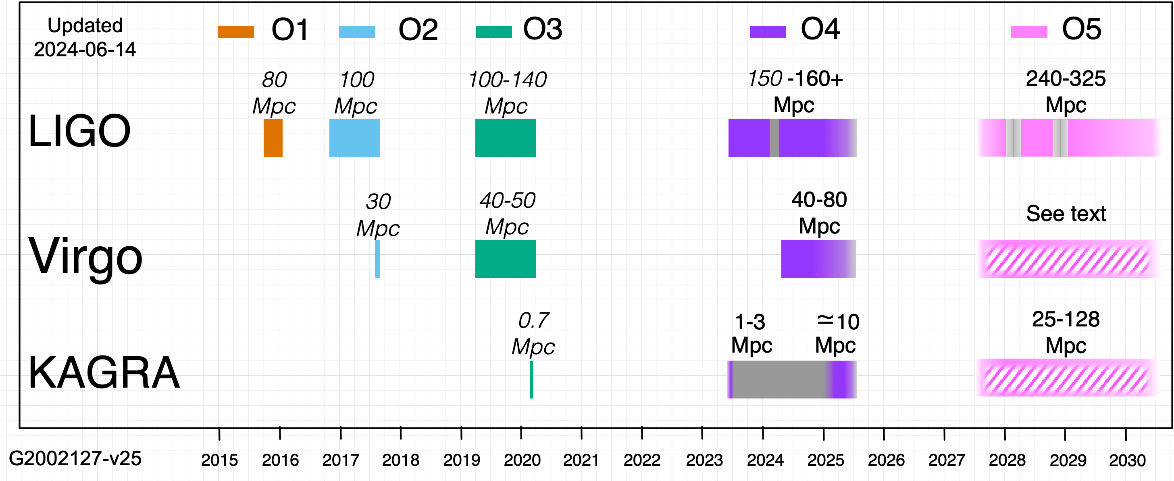
LIGO-Virgo-KAGRA Observing Plan
Coordinated runs to detect GW signals by multiple detectors
First binary
black holes
First binary
neutron stars
https://observing.docs.ligo.org/plan/
First neutron star-
black hole binary
Planning to restart
by June 2025
O4 started on May 24, 2023

Slide 5
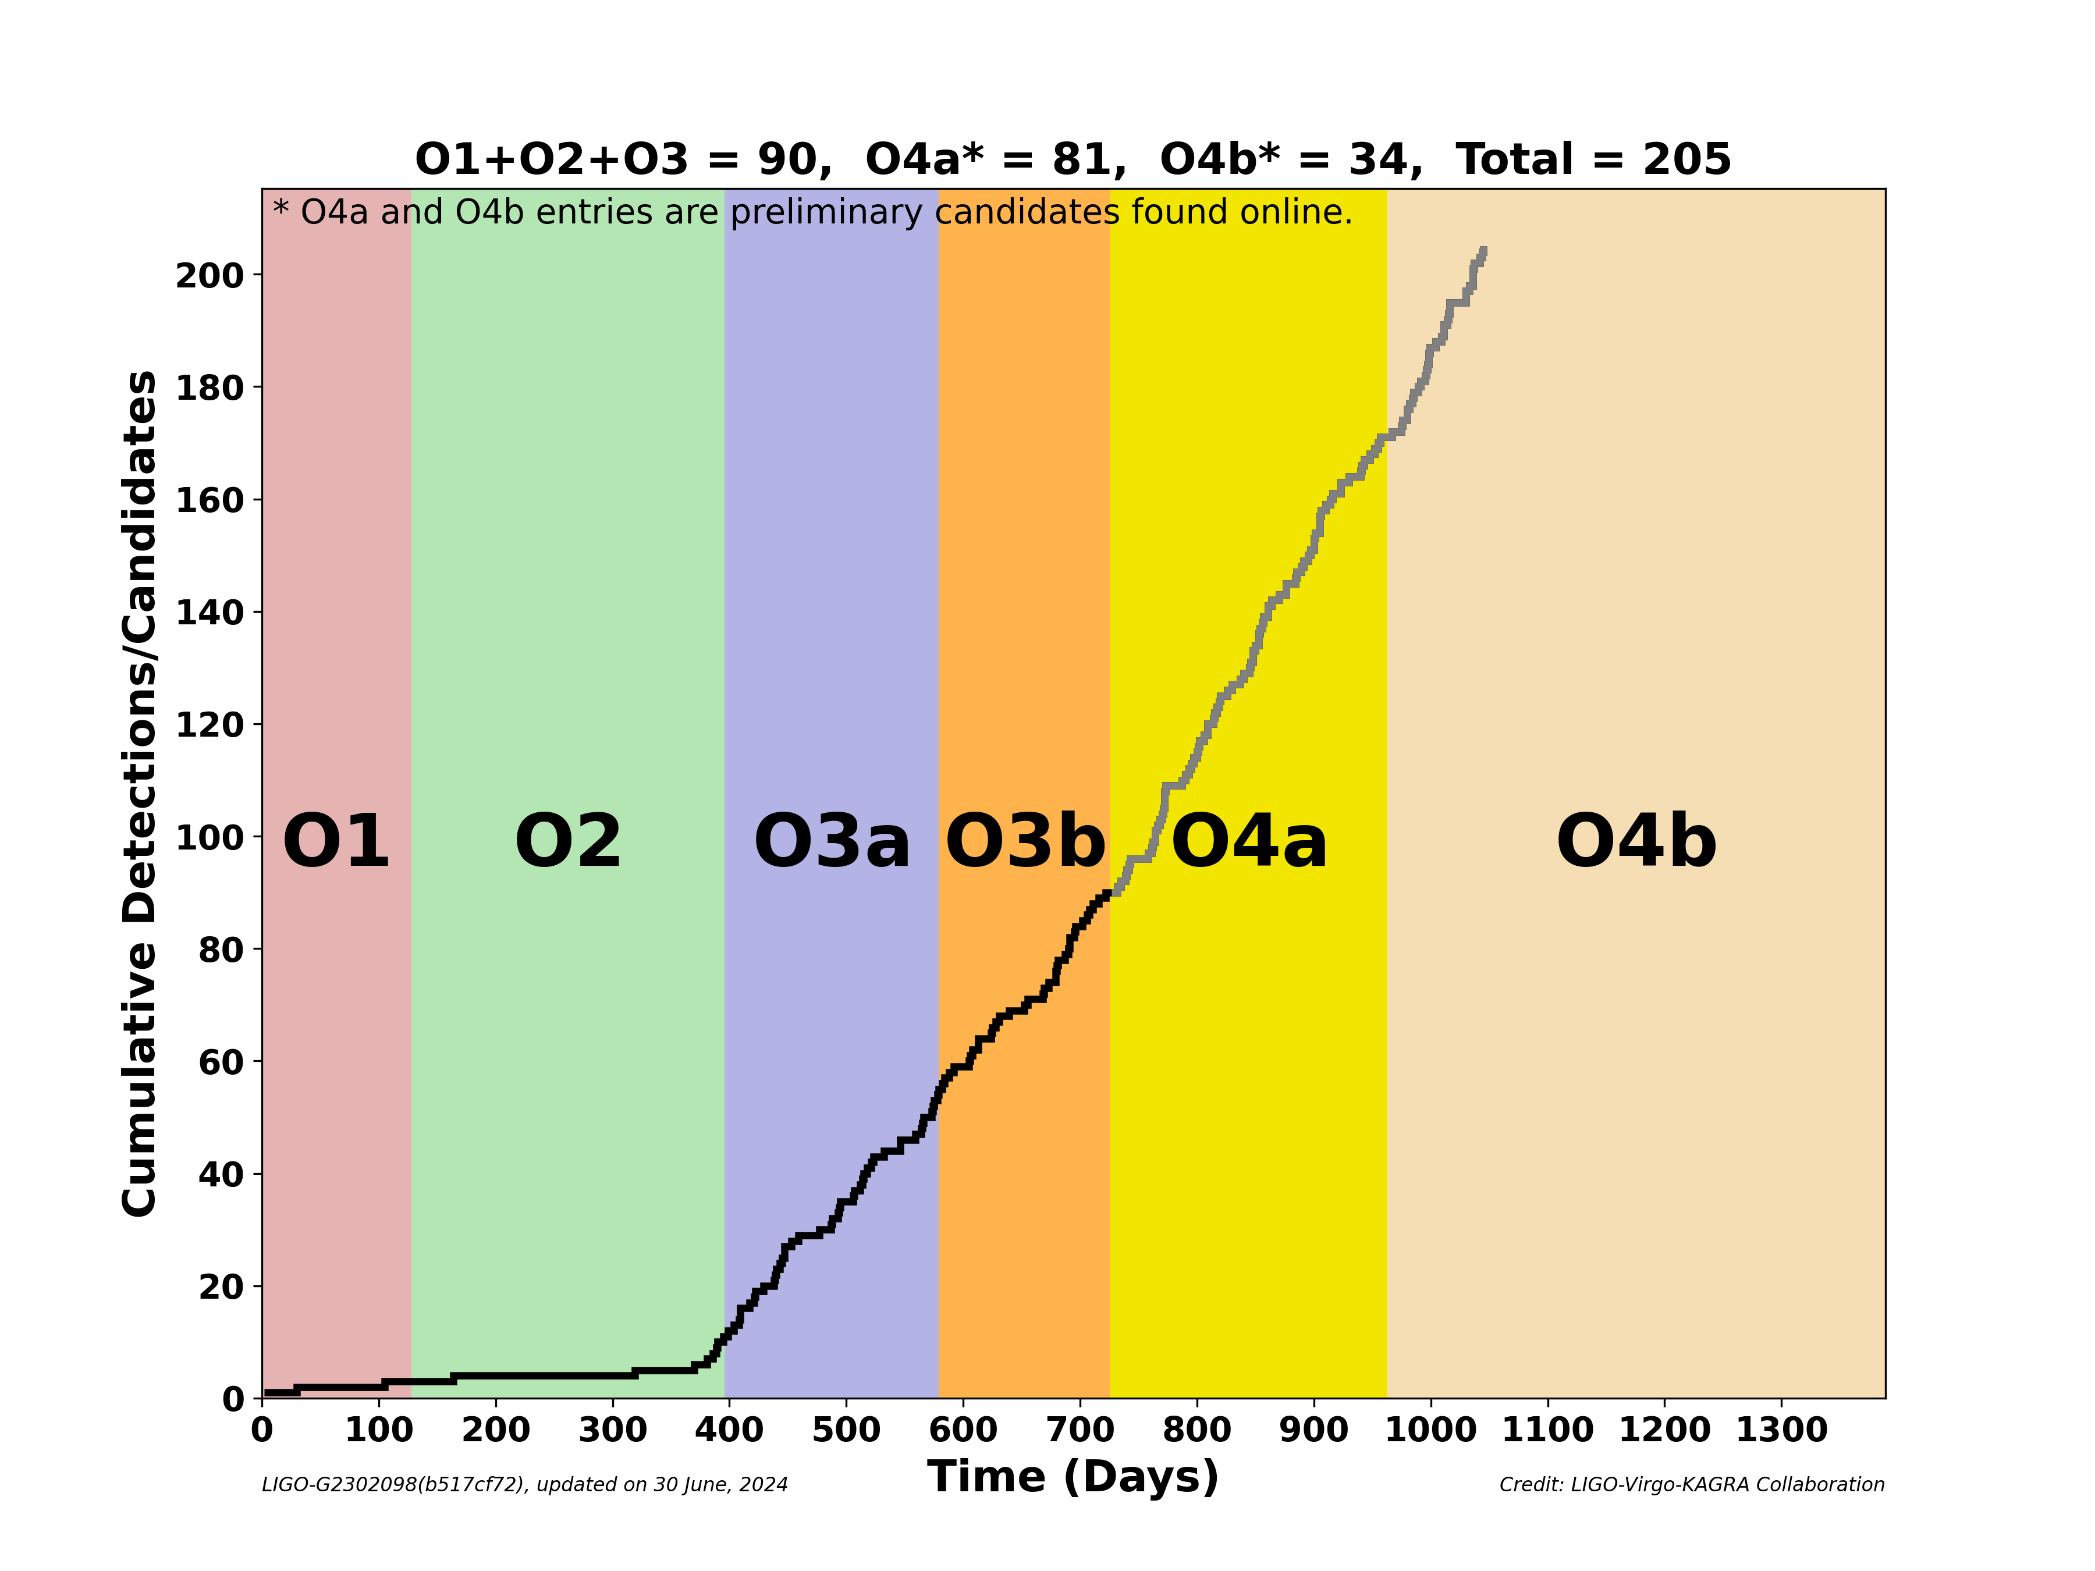
LIGO-Virgo-KAGRA O4 Run Status
More than 100 events reported from LIGO-Virgo
Will continue until June 9, 2025
KAGRA plans to
join by the end
of O4
Currently
recovering from
7.6 magnitude
earthquake on
January 1, 2024
(hardware work
completed)
LIGO-G2302098

Slide 6
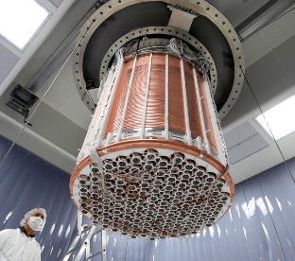
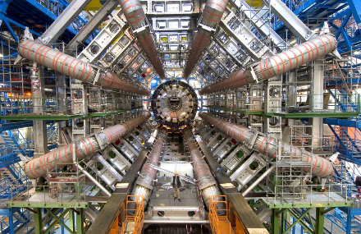
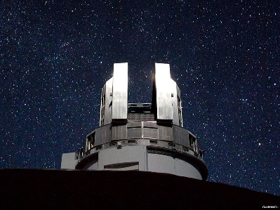
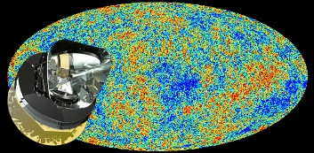
Various Dark Matter Models
~90 orders of magnitude in mass
Searches focused on WIMPs, but not detected yet
Motivates new searches for other candidates
Dark Matter Mass (GeV)
10⁻³⁰
10⁻²⁰
10⁻¹⁰
10⁰
10¹⁰
10²⁰
10³⁰
10⁴⁰
10⁵⁰
10⁶⁰
Ultralight DM
Light DM
Heavy
DM
Composite DM &
Primordial BHs etc.
Excluded from gravitational microlensing and CMB observations
DM de Broglie wavelength exceeds DM halo size of the smallest dwarf galaxies
(~ kpc)
WIMP
Q-ball
QCD axion
Higgs boson
(125 GeV)
Planck mass
(1.2e19 GeV)
Solar mass
(1.1e57 GeV)
2.4 Hz ~ 2.4 kHz
(1e-14 ~ 1e-11 eV)
Laser
Interferometry
Cosmic microwave background
Underground experiments
(XENON etc.)
LHC
Subaru telescope
etc.

Slide 7
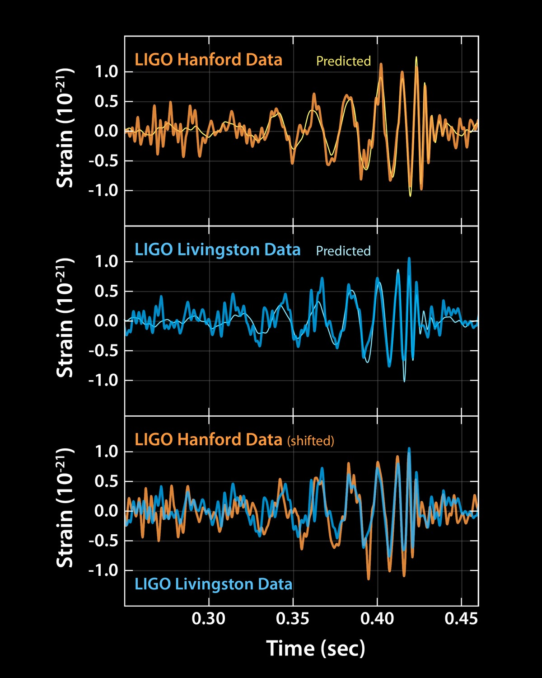
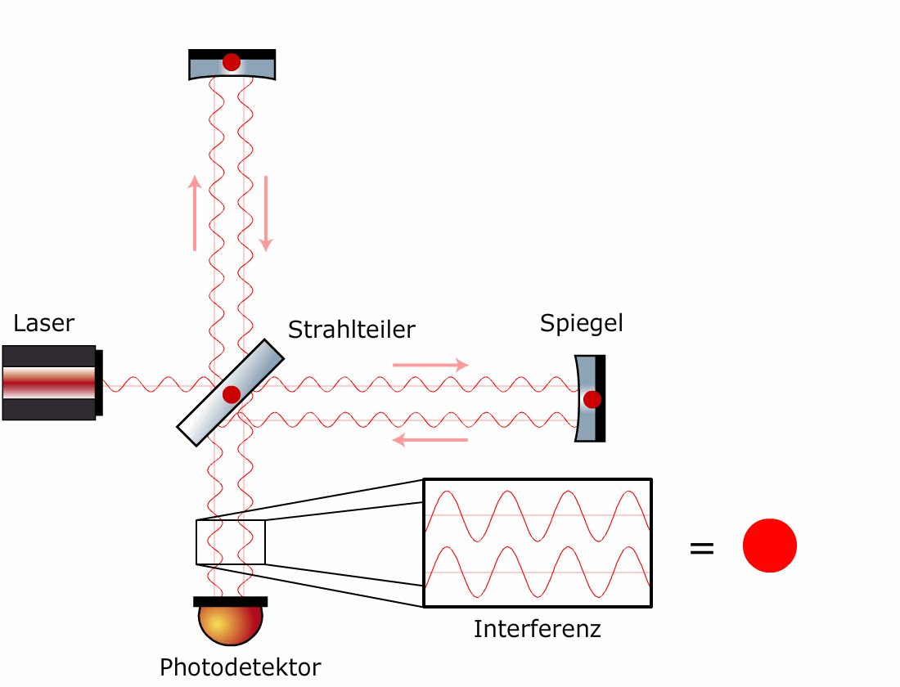
Ultralight DM with Interferometers
Bosonic ultralight field (<~1 eV) are well-motivated from cosmology
Behaves as
classical waves
Laser interferometers are sensitive to such oscillating changes
Caltech/MIT/LIGO Lab.

Slide 8
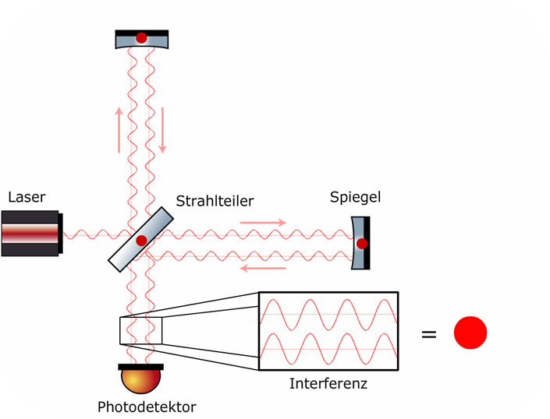
Laser Interferometry
measures differential arm length change
Michelson
interferometer
Beam
splitter
Laser source
Movable mirror
Interference
Photodiode

Slide 9
Laser Interferometry
measures differential arm length change
Michelson
interferometer
Gravitational waves
Beam
splitter
Laser source
Movable mirror
Fringe change
Interference
Photodiode

Slide 10
Laser Interferometry
measures differential arm length change
Tiny forces
from vector DM
Mirror thickness changes from scalar DM
Metric changes from spin-2 DM
S. M. Vermeulen+,
Nature 600, 424 (2021)
Beam
splitter
Y. Manita+,
PRD 107, 104007 (2023)
Laser source
Movable mirror
Speed of light changes from axion DM
Fringe change
Interference
K. Nagano, T. Fujita, YM, I. Obata,
PRL 123, 111301 (2019)
Photodiode

Slide 11
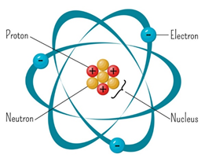
Vector Boson
Possible new physics beyond the standard model:
New gauge symmetry and vector boson
New vector boson can be dark matter
B-L (baryon minus lepton number)
- Conserved in the standard model
- Can be gauged without additional ingredients
- Equals to the number of neutrons
- Roughly 0.5 per neutron mass,
but slightly different between materials
Fused silica: 0.501
Sapphire: 0.510
Vector boson DM
gives oscillating force
vector field

Slide 12
Oscillating Force from Vector Field
Acceleration of mirrors
Vector boson mass and
coupling can be measured
by measuring the oscillating
mirror displacement
Almost no signal for symmetric
cavity if cavity length is short
(phase difference is 10⁻⁵ rad @ 100 Hz for km cavity)
How about using interferometric GW detectors?
charge
vector boson mass
polarization
coupling
(normalized by e)
mirror mass
different phase at different position
DM density
Force
Force
A. Pierce+, PRL 121, 061102 (2018)

Slide 13
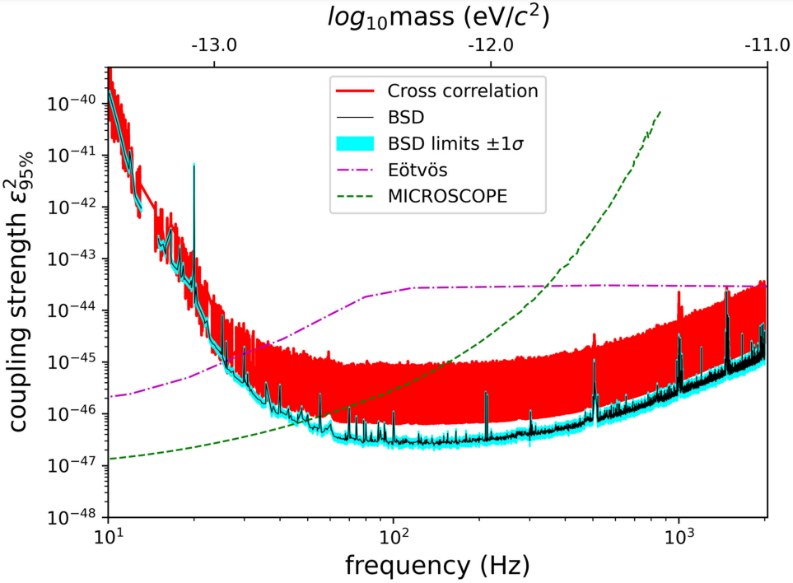
Previous Searches with LIGO/Virgo
Vector boson dark matter search with LIGO O1 data and LIGO/Virgo O3 data have been done
Better constraint than equivalence principle tests
Even better
constraint could
be obtained from
KAGRA
H-K Guo+, Communications Physics 2, 155 (2019)
LIGO-Virgo-KAGRA Collaboration, PRD 105, 063030 (2022)

Slide 14
Search with GW Detectors
GW Detectors are
sensitive to differential
arm length (DARM)
change
Most of the signal
is cancelled out
(LIGO/Virgo case)
Vector field
Force
Force
Laser
DARM
photodiode

Slide 15

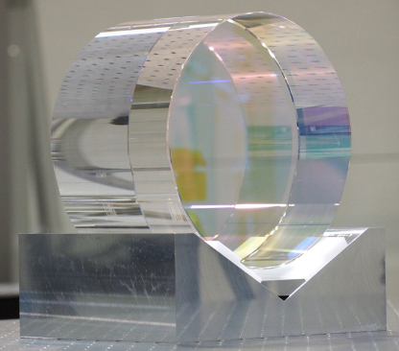
Search with KAGRA
KAGRA uses cryogenic
sapphire mirrors for
arm cavities, and
fused silica mirrors
for others
KAGRA can do better
than LIGO/Virgo which
uses fused silica for all
the mirrors
Vector field
Force
Force
Laser
B-L charge
Fused silica: 0.501
Sapphire: 0.510
DARM
photodiode

Slide 16
Search with KAGRA
By measuring the
lengths of auxiliary part
of the interferometer,
force difference
between sapphire
and fused silica can be
measured
Vector field
Force
Force
Laser
Auxiliary lengths
DARM
photodiode

Slide 17
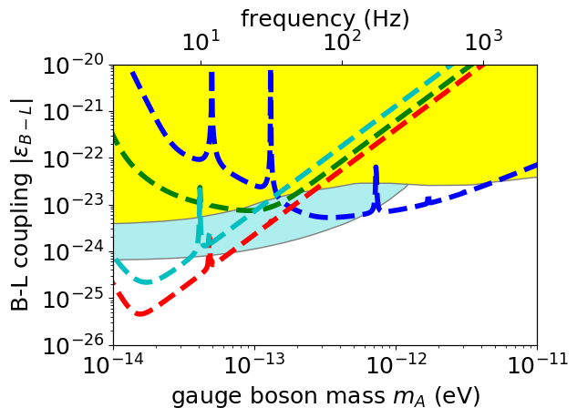
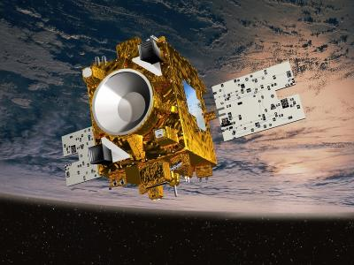
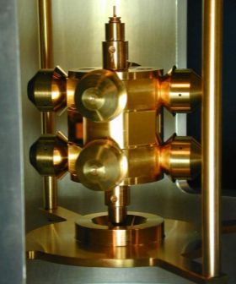
KAGRA Vector Boson Sensitivity
Auxiliary length channels have better design sensitivity than DARM (GW channel) at low mass range
Sensitivity better than equivalence principle tests
YM, T. Fujita, S. Morisaki, H. Nakatsuka, I. Obata,
PRD 102, 102001 (2020)
S. Morisaki, T. Fujita, YM, H. Nakatsuka, I. Obata,
PRD 103, L051702 (2021)
PRCL
Eöt-Wash
torsion pendulum
DARM
(GW channel)
SRCL
Auxiliary lengths
MICROSCOPE
mission
MICH

Slide 18
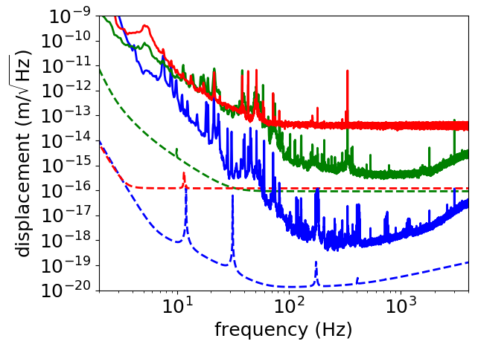
KAGRA 2020 Data Analysis
KAGRA performed joint observing run in April 2020 with GEO600 (O3GK)
Displacement sensitivity still not good
~ 6 orders of magnitude to go at 10 Hz
Auxiliary data
not even
considered as
useful science
data
Data analysis
done using
a new pipeline
Measured
MICH
PRCL
Designed
DARM
H. Nakatsuka+,
PRD 108, 092010 (2023)

Slide 19
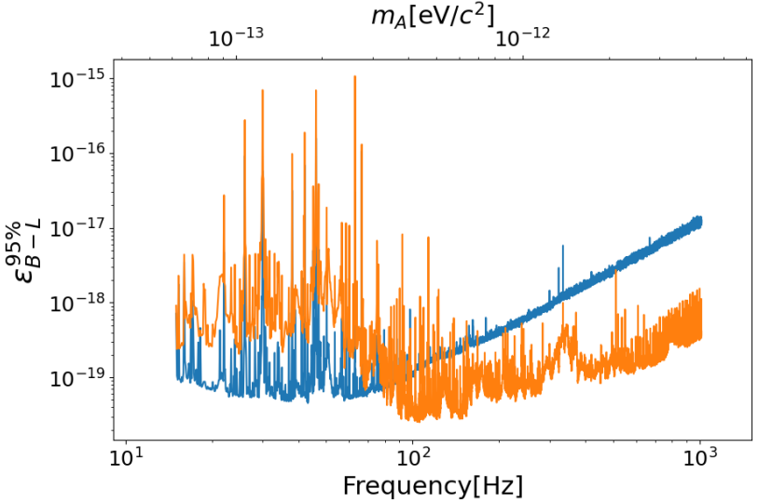

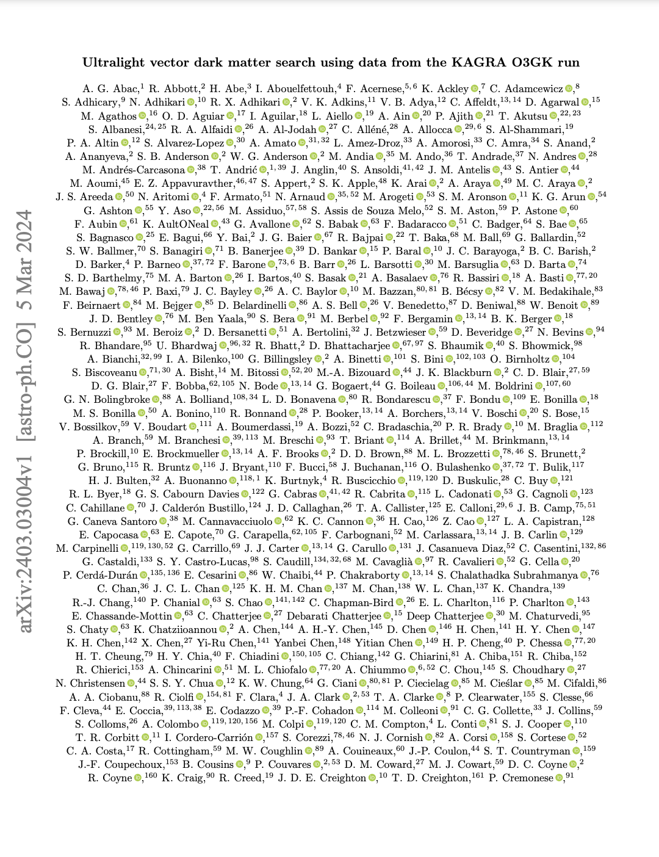
KAGRA Data Analysis Results
Still ~5 orders of
magnitude worse than
equivalence principle
tests
Demonstrated the
feasibility of using
auxiliary channels
for astrophysics
New data will be
available from O4b
and beyond
LIGO-Virgo-KAGRA, arXiv:2403.03004
(Paper written by J. Kume with 1800+ authors!)

Slide 20
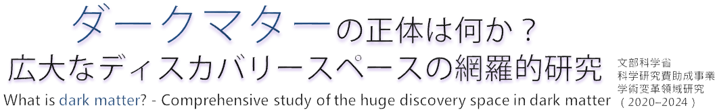

Summary
Laser interferometers open up new possibilities for dark matter search
First ultralight vector dark matter search using KAGRA 2020 data was performed
- Sapphire mirrors allowed a new search
- LIGO-Virgo-KAGRA collab., arXiv:2403.03004
(to be appeared in PRD)
New data will be available by June 2025
Also… first ultralight axion dark matter data will be available by June 2025 (ask me later!)

Slide 21
Additional Slides

Slide 22
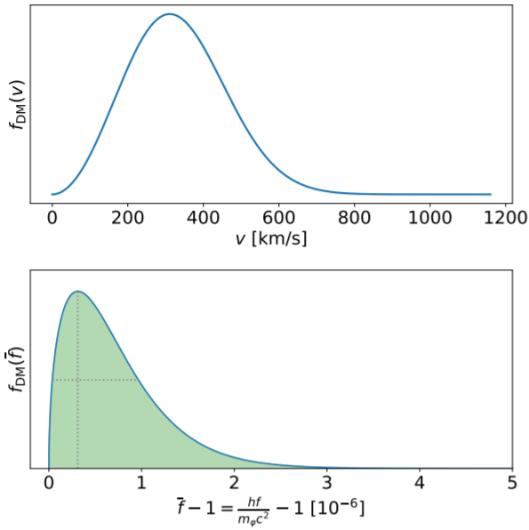
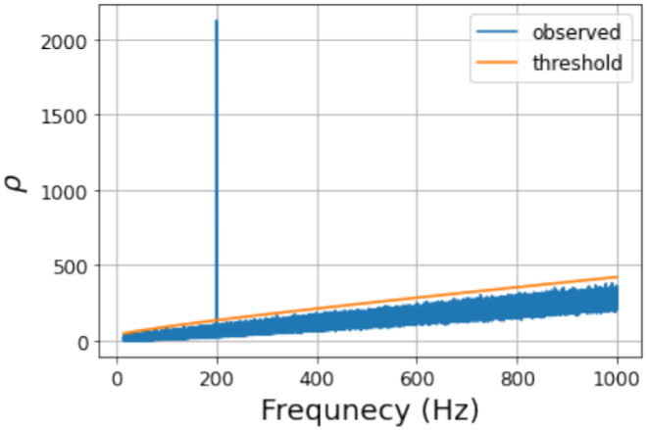
Data Analysis Pipeline
E. Savalle+,
PRL 126, 051301 (2021)
Nearly monochromatic signal
Stack the spectra in this
frequency region to calculate SNR
Detection threshold
determined assuming
follows distribution
(=assuming Gaussian noise)
From , calculate 95% upper limit on coupling constant
Applied the pipeline to mock data for verification
Data
PSD
Injected signal
detected
Obs. time
SNR threshold

Slide 23
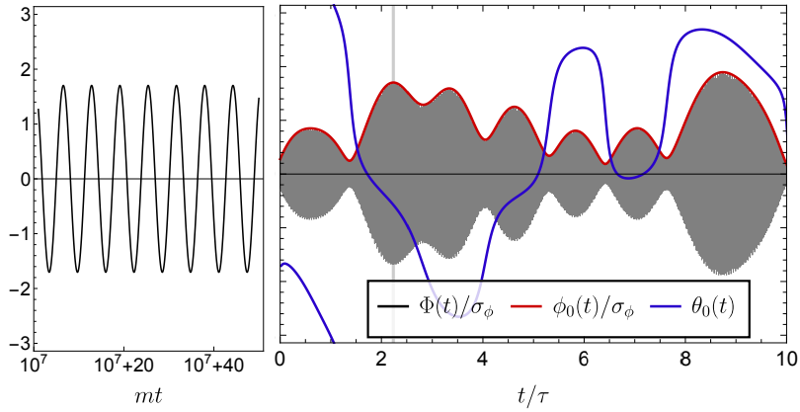
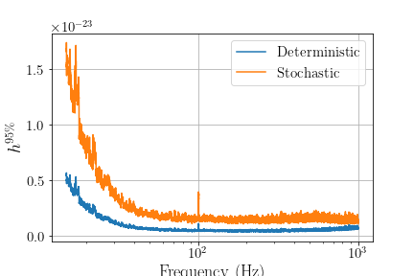
Stochastic Nature of DM Signal
DM signal is from superposition of
many waves with various
momentum, phase and polarization
The amplitude fluctuates at
the time scale of
At low frequencies,
DM signal could be
too small by chance and
elude detection
Method to calculate
upper limit taking into
account this stochasticity
developed
H. Nakatsuka+,
PRD 108, 092010 (2023)
Stochastic upper limit
(from mock data)
Deterministic upper limit

Slide 24

Coherence Time
SNR grows with √Tobs if integration time is shorter than coherence time
SNR grows with (Tobs)^{1/4} if integration time is longer
axion wind
de Broglie wavelength (coherent within this region)

Slide 25
Freq-Mass-Coherence Time
Frequency | Mass | Coherent Time | Coherent Length
0.1 Hz | 4.1e-16 eV | 0.32 year | 3e12 m
1 Hz | 4.1e-15 eV | 1e6 sec 12 days | 3e11 m
10 Hz | 4.1e-14 eV | 1.2 days | 3e10 m
100 Hz | 4.1e-13 eV | 2.8 hours | 3e9 m
1000 Hz | 4.1e-12 eV | 17 minutes | 3e8 m
10000 Hz | 4.1e-11 eV | 1.7 minutes | 3e7 m

Slide 26
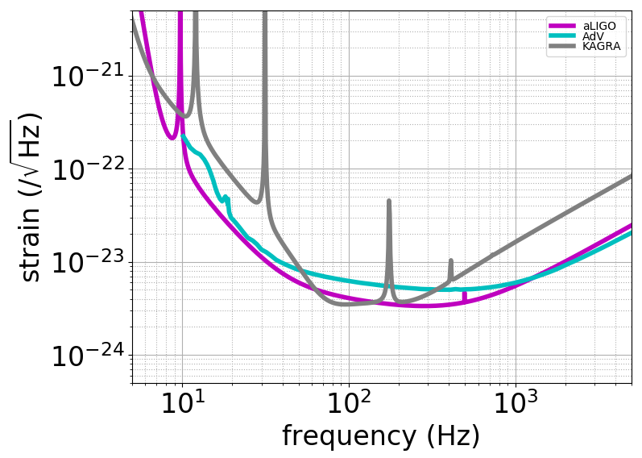
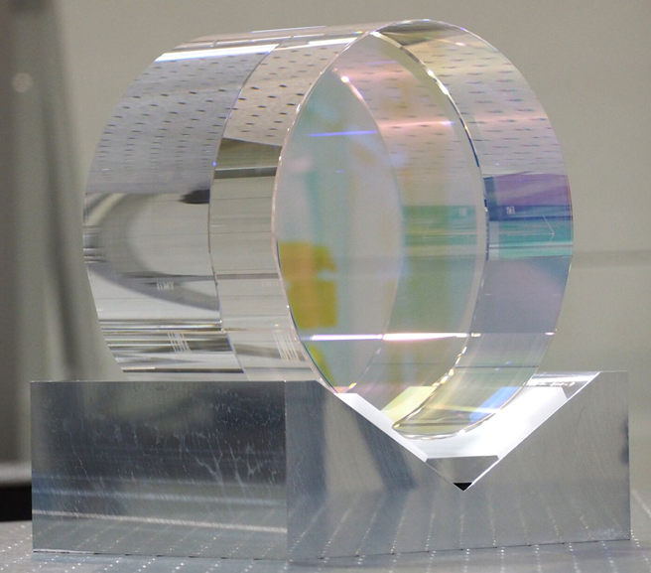
KAGRA Design Sensitivity
Not good at low freq. because of thick and short fiber (35 cm, φ1.6 mm) to extract heat, and lower mass
23 kg was
the largest available sapphire mirror
KAGRA
23 kg
3 km
AdV
42 kg
3 km
aLIGO
40 kg
4 km

Slide 27
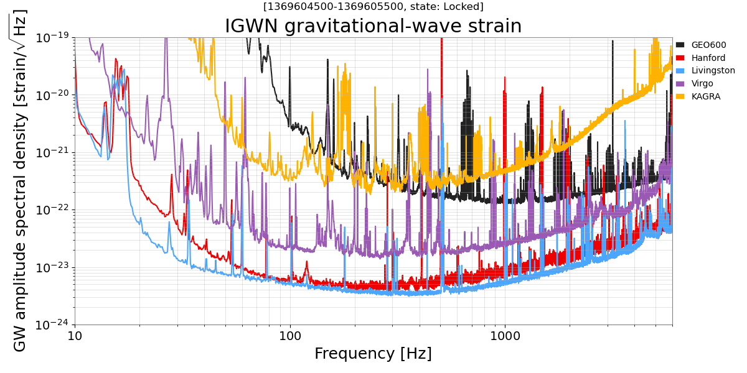
(Roughly) Current Sensitivity
Smaller the better in y-axis
Virgo
KAGRA
GEO600
LIGO Livingston
LIGO Hanford
NOTE: Not the latest. Taken when 5 detectors are locked simultaneously on June 1, 2023

Slide 28
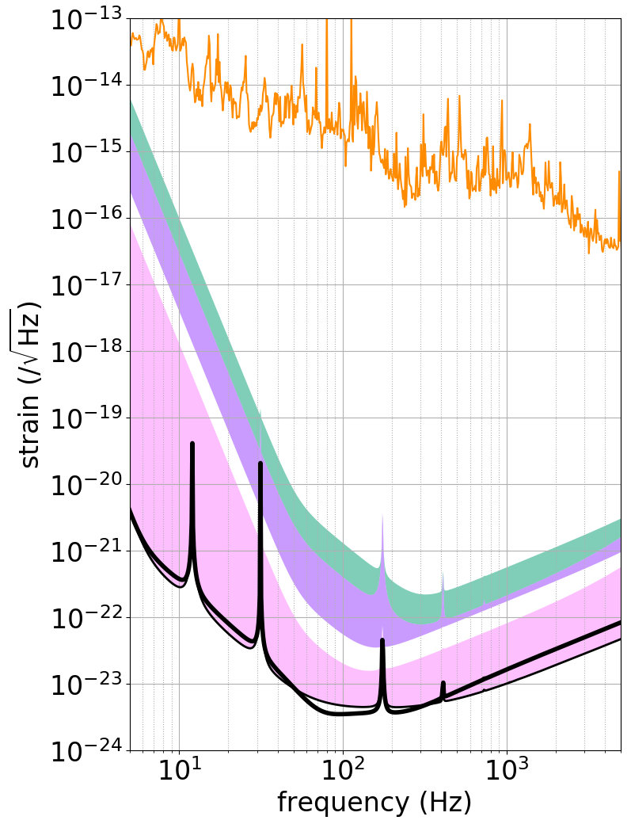
KAGRA
Sensitivity
iKAGRA (2016)
- First test run
- 1+2 weeks
- Room temperature
- Michelson interferometer
PTEP 2018, 013F01 (2018)
Design

Slide 29
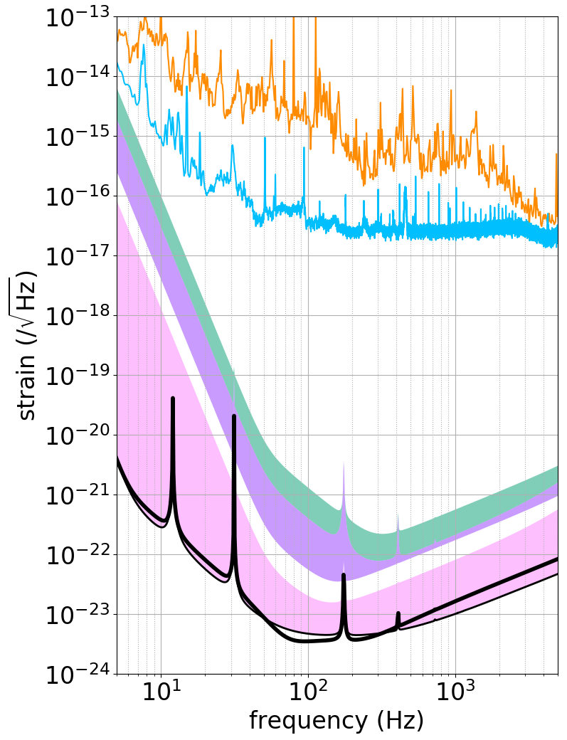
KAGRA
Sensitivity
bKAGRA Phase 1 (2018)
- First test run with < 20 K
test mass
- 10 days
- Michelson interferometer
CQG 36, 165008 (2019)
Design

Slide 30
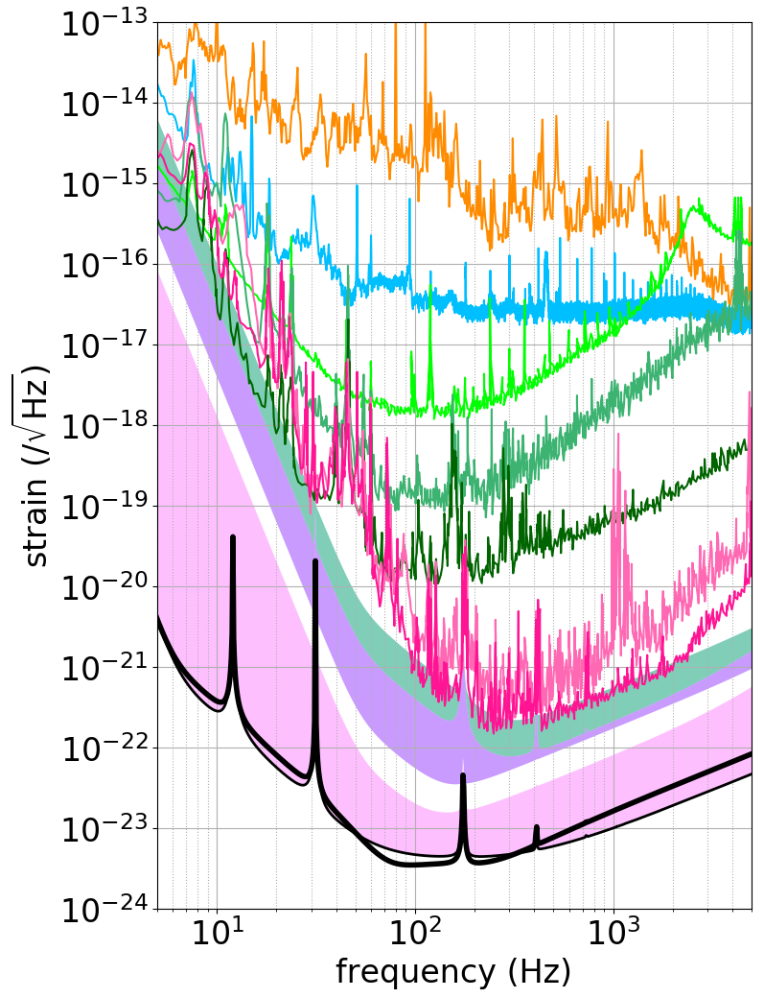
KAGRA
Sensitivity
First FPMI lock (Aug 2019)
O3GK (2020)
- First observing run with GEO600
- Feb-Apr 2020
- ~250 K
- Power-recycled
Fabry-Perot Michelson interferometer
Design
PTEP 2021, 05A101 (2021)

Slide 31
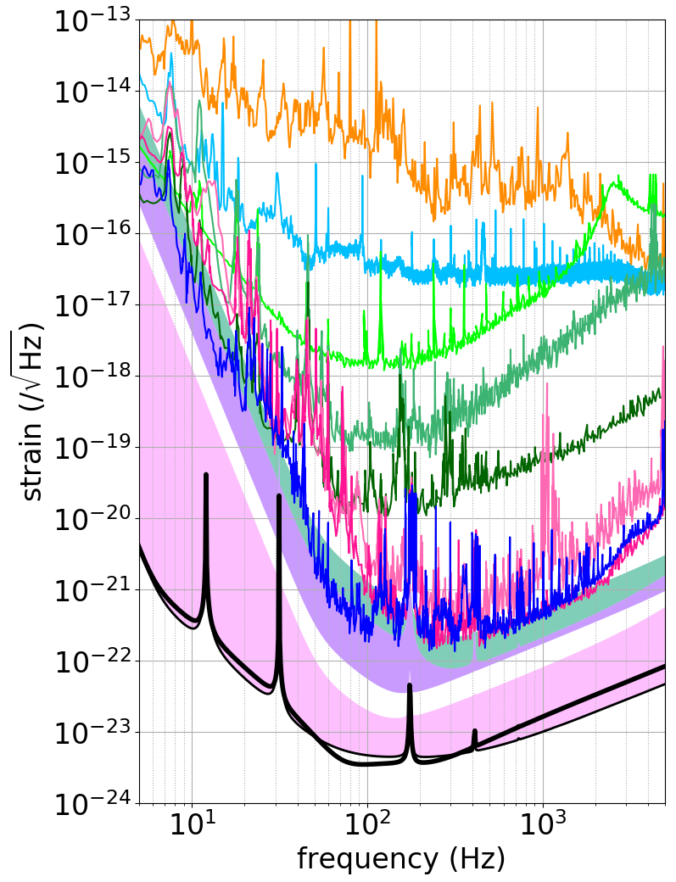
KAGRA
Sensitivity
O4a target (1-3 Mpc)
O4b target (3-10 Mpc)
O4a (May 2023)
- Started with LIGO
- May-Jun 2020
- ~250 K
- Power-recycled
Fabry-Perot Michelson interferometer
Design

