Slide 1


Noise from birefringence fluctuations in laser interferometric gravitational wave detectors
JGW-G2315436
KAGRA Future Working Group 3rd open meeting (Online)
December 7, 2023
birefringence
Yuta Michimura
LIGO Lab, Caltech
yuta@caltech.edu
RESCEU, UTokyo
michimura@phys.s.u-tokyo.ac.jp

Slide 2
Overview
Fluctuations in mirror birefringence will be phase noises for GW detectors
This can be avoided by aligning input polarization axis and mirror crystal axes
Requirements at 100 Hz will be
- Δφ<~10⁻⁸ rad/√Hz (or Δn<~10⁻¹⁴/√Hz) for substrate
- Δφ<~10⁻¹⁰ rad/√Hz for coating
Measurements and simulation work are necessary for further study
Y. Michimura, H. Wang, F. Salces-Carcoba, C. Wipf, A. Brooks, K. Arai, R. X. Adhikari,
arXiv:2308.00150 (to appear in PRD)

Slide 3
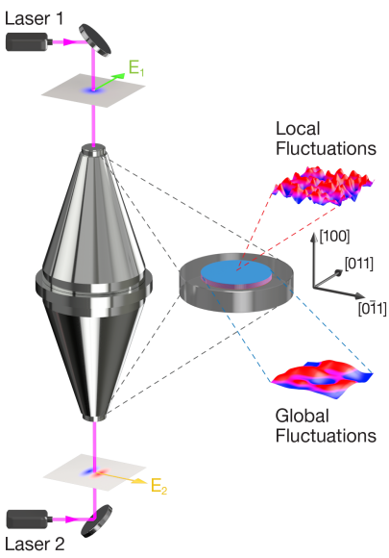
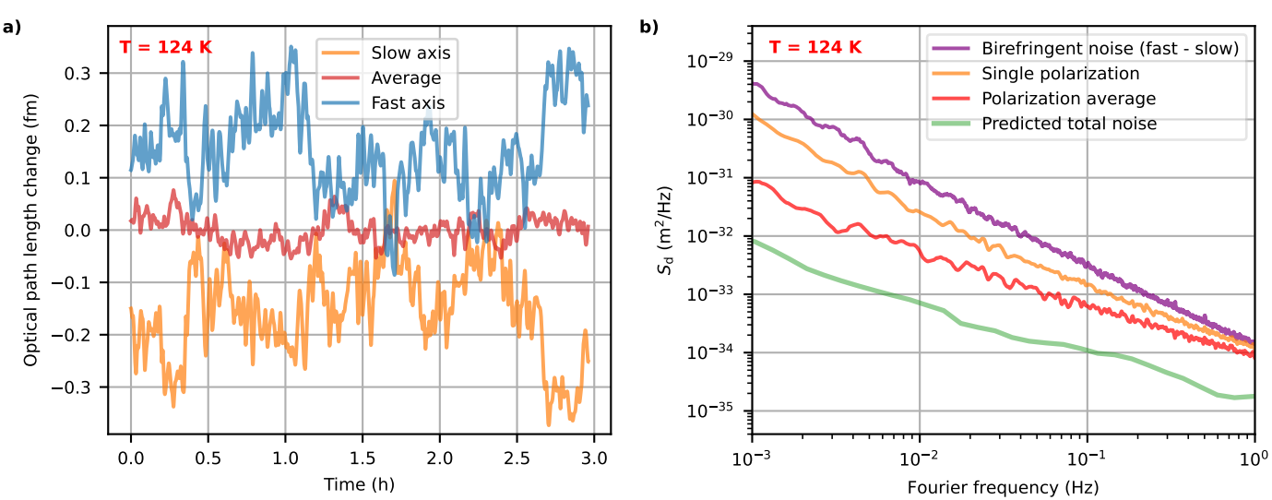
Birefringence Noise
Crystalline materials (Silicon, Sapphire, AlGaAs etc.) are promising, but has birefringence
Static birefringence is (probably) small enough
e.g., CQG 33, 015012 (2015), APL 122, 064101 (2023)
JILA found “birefringent noise” in AlGaAs
PRX 13, 041002 (2023)
What is the requirement for mirror birefringence fluctuations for GW detectors?

Slide 4
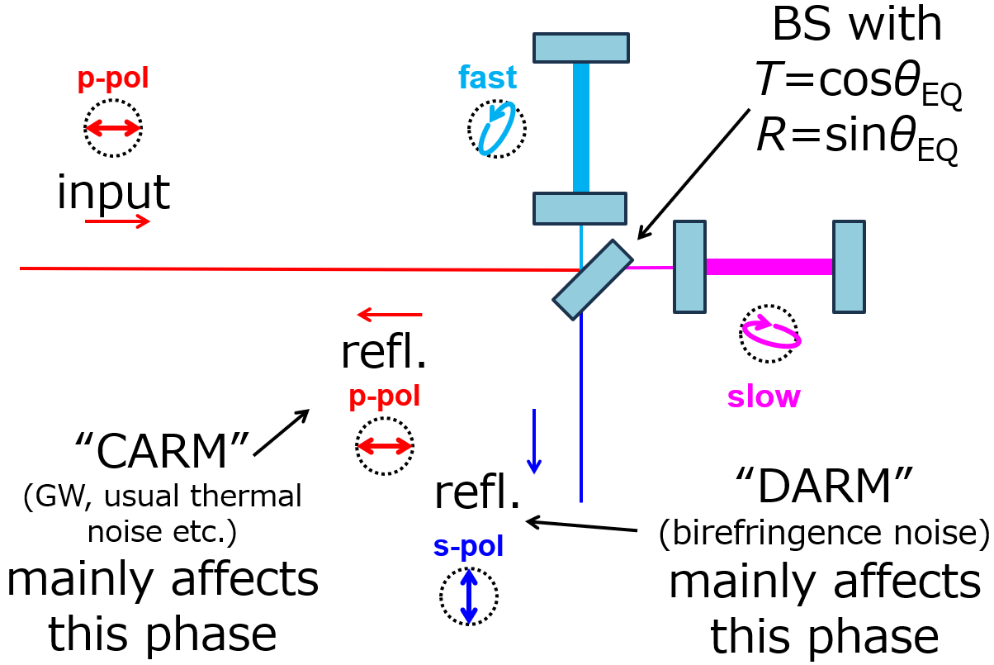
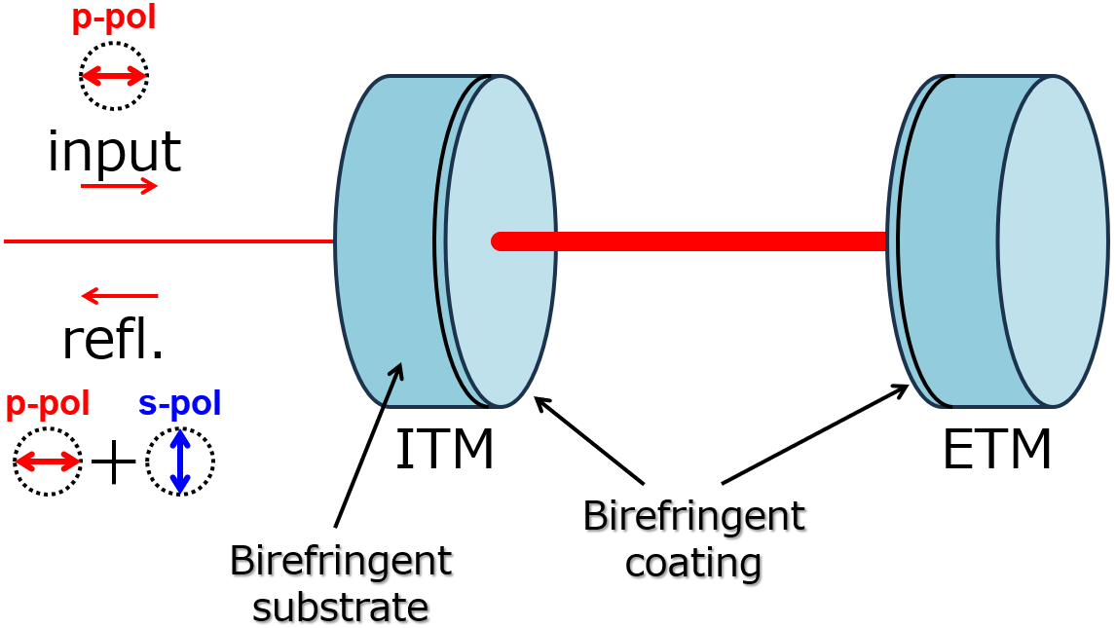
Birefringent FP Cavity ≒ FPMI
Fabry-Pérot cavity with birefringent mirror can be understood as unbalanced Fabry-Pérot Michelson
Birefringent FP Cavity
Unbalanced FPMI
≒

Slide 5
Birefringent FP Cavity
Consider a FP cavity with mirrors that have substrate and coating birefringence
p-pol
input
refl.
p-pol
s-pol
ITM
ETM
Birefringent coating
Birefringent substrate

Slide 6
Birefringent FP Cavity
This is equivalent to FP cavity with waveplates
p-pol
fast
slow
input
refl.
p-pol
s-pol
ITM
ETM
Birefringent coating as WP
Birefringent substrate as WP
Effects are enhanced by cavity

Slide 7
Birefringent FP Cavity
FP cavity can be reduced to single “equivalent waveplate”
Two polarization eigenmodes have different resonant frequencies
Angle between axes θ_{EQ}
p-pol
fast
input
refl.
slow
p-pol
s-pol
Birefringent FP as equivalent WP

Slide 8
Birefringent FP Cavity
“Equivalent waveplate” splits input polarization into two eigenmodes
slow
p-pol
p-pol
input
cosθ_{EQ}
-sinθ_{EQ}
Different phase shift
due to birefringence
refl.
sinθ_{EQ}
cosθ_{EQ}
s-pol
“Unbalanced BS”
for axes rotation
to cavity axes
“Unbalanced BS”
for rotating back to p/s axes
fast

Slide 9
Birefringent FP Cavity
So, birefringent FP cavity is equivalent to FPMI with unbalanced BS
BS with
T=cosθ_{EQ}
R=sinθ_{EQ}
fast
p-pol
input
refl.
p-pol
slow
“CARM”
(GW, usual thermal noise etc.)
mainly affects this phase
refl.
“DARM”
(birefringence noise)
mainly affects this phase
s-pol

Slide 10
Avoiding Birefringence Noise
“CARM” (GW, usual thermal noise etc.) and “DARM” (birefringence noise) are mixed due to unbalanced BS, and therefore birefringence noise couples to GW signal
How to avoid?
- Align polarization
axis and mirror axes
(make θ_{EQ}=0)
- Make coating brief.
large (make only one
of the eigenmodes resonant;
would not work for substrate brief.)
fast
p-pol
T=cosθ_{EQ}
R=sinθ_{EQ}
input
refl.
p-pol
refl.
slow
s-pol

Slide 11
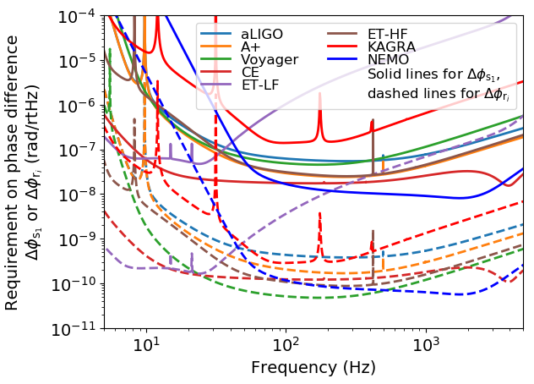
Requirements for Birefringence
Displacement noise coupling
Factor only for substrate birefringence
Angle between polarization axis and cavity axes
Phase difference between axes
Requirements on Δφ
assuming θ~1 deg
For substrate
Δφ<~10⁻⁸ rad/√Hz
(or Δn<~10⁻¹⁴/√Hz)
For coating
Δφ<~10⁻¹⁰ rad/√Hz

Slide 12
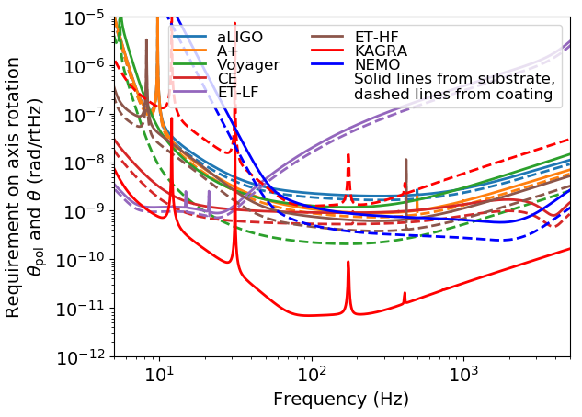
Requirements for Axis Rotation
Displacement noise coupling
Factor only for substrate birefringence
Phase difference between axes
Angle between polarization axis and cavity axes
Requirements on θ
assuming Δn~10⁻⁷ or 10⁻⁴ for substrate, Δφ~1 mrad for coating
For substrate/coating
θ<~10⁻¹⁰ rad/√Hz
Strict requirement for KAGRA if Δn~10⁻⁴ (sapphire)
For others, assumed
Δn~10⁻⁷ (e.g. silicon)

Slide 13
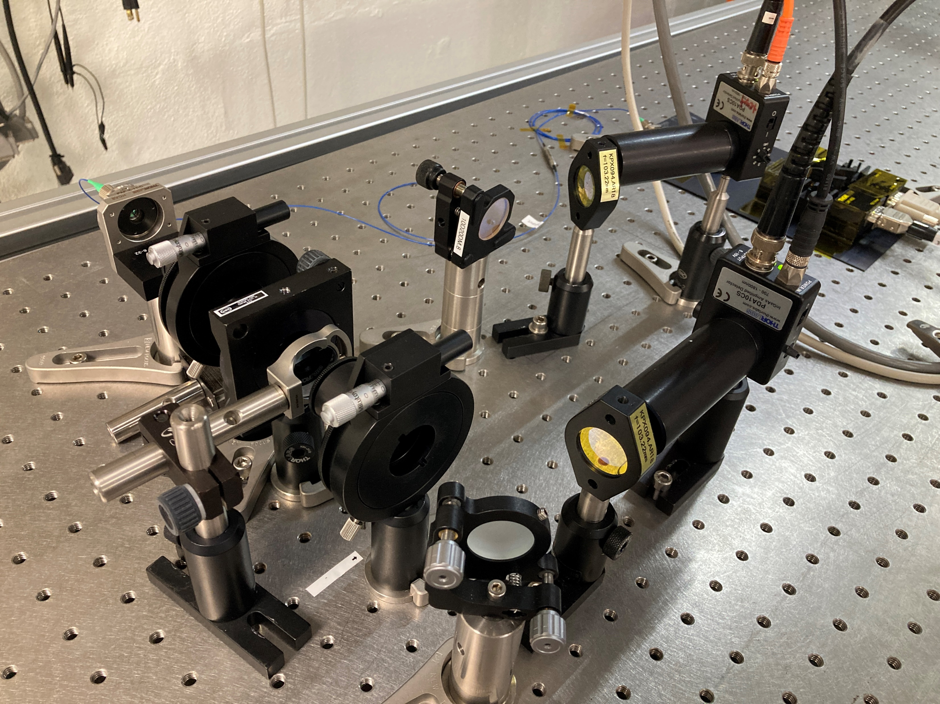
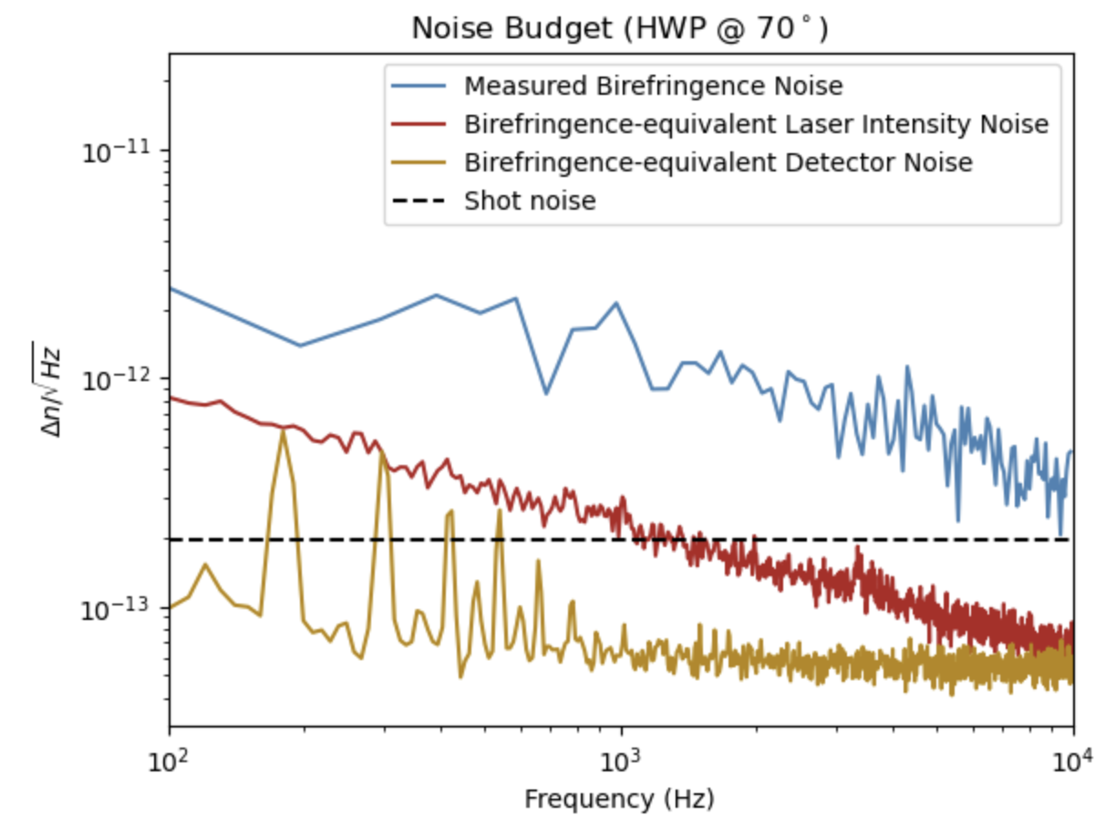
Measurement at Caltech
Silicon birefringence measurements started
Sensitivity to Δn of 2x10⁻¹² /rtHz @ 100 Hz achieved with Silicon @ 1550 nm, room temp.
- Measurement at different input polarization suggest this is limited by noise not from silicon
Si (φ1 inch, t 5 mm)
Measured
Gran-Laser Prism
Measurement and plot by Kushal Jain

Slide 14
Summary and Outlook
Fluctuations in mirror birefringence will be phase noises for GW detectors
Measurements of birefringence fluctuations in Silicon, Sapphire, AlGaAs etc. are necessary to see if they meet the requirement
Further simulation studies necessary for
- Investigating PRC/SRC effects
(unbalanced BS, ITM birefringence)
- Noise from inhomogeneous birefringence x beam spot motion
- Investigating effects for squeezing
- Classical radiation pressure noise from orthogonal pol.
YM+, arXiv:2308.00150

