Slide 1
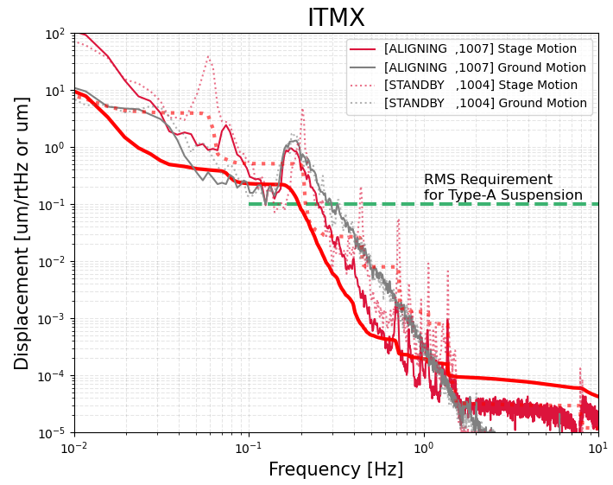
Plan1-1. Inertial damping with L-4C sensor
Though the control with L-4C sensor can damp the resonant peaks due to the IP and the filter chain well, the reduction of microseismic peak is not enough. Design of the filter with gain boost is necessary around this peak.
The spectrum of the out-of-loop L4-C sensor on the IP and the seismometer on the ground. The solid line shows the ALIGNED state with damping and the dotted line shows the STANDBY state without damping. The integrated RMS from 0.1Hz is ~0.2um (bold line).

Slide 2
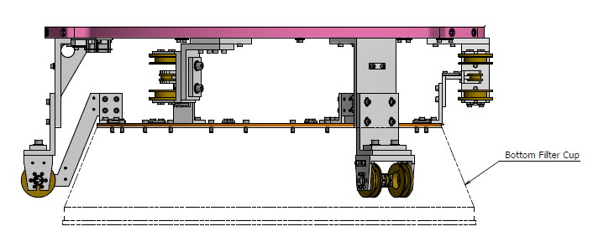
Improvement of LVDT driver for BF damper
The BF dampers use common coils in the LVDT and the actuator. The actuator signals coupled to the LVDT signals in O3. The LVDT drivers were replaced to the modified ones. The BF damper may suppress the lowest mode of filter chain at 0.15Hz.

Slide 3
Improvement of LVDT drivers for BF damper
H1
H2
H3
V1
V2
V3
Measured transfer functions from an actuator to the LVDT readout of the same channel. There is a dramatic improvement in eliminating the spurious coupling at high frequencies.
https://klog.icrr.u-tokyo.ac.jp/osl/?r=16534

Slide 4
Plan1-2. Improvement of inertial sensors for IP control
The servo type accelerometers (IX, IY) and the commercial geophones (EX, EY) are used as inertial sensors in Type-A towers.
The sensitivity of present inertial sensors are not good enough to control the IPs around 0.1Hz.
We replace the inertial sensors to better accelerometers.
  Replace the present position sensors.
  Tune the folded pendulums to 0.2Hz.

Slide 5
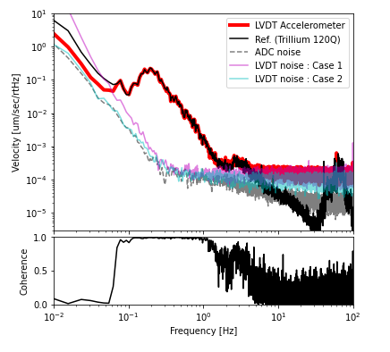
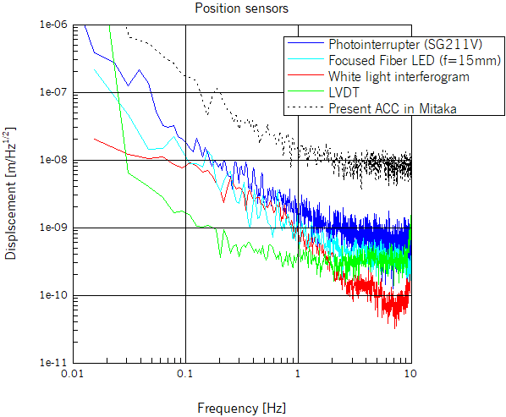
Prototype test at the KAGRA site
Some kinds of position sensors (photointerrupter, fiber LED, white light interferogram, and LVDT) have been evaluated. The LVDT had the best sensitivity around 0.1Hz.
Prototype accelerometer with the LVDT was tested at the KAGRA site.
One order improvement at 0.1Hz is expected.
(Geophone)
Sensitivities of some kinds of sensors
Measured spectra at the KAGRA site

Slide 6
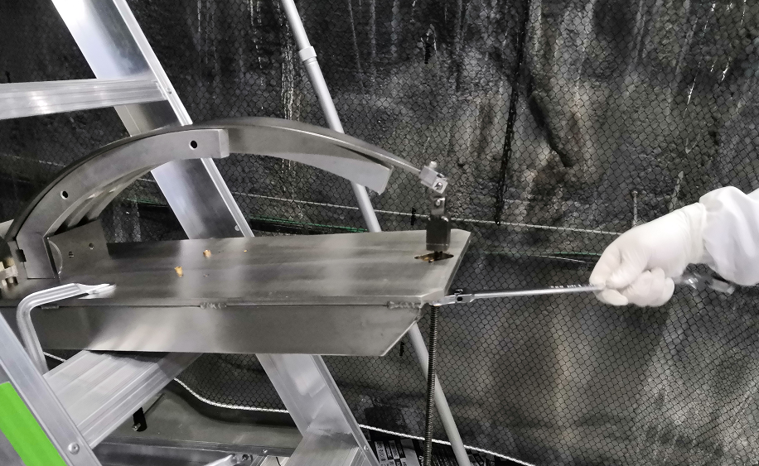
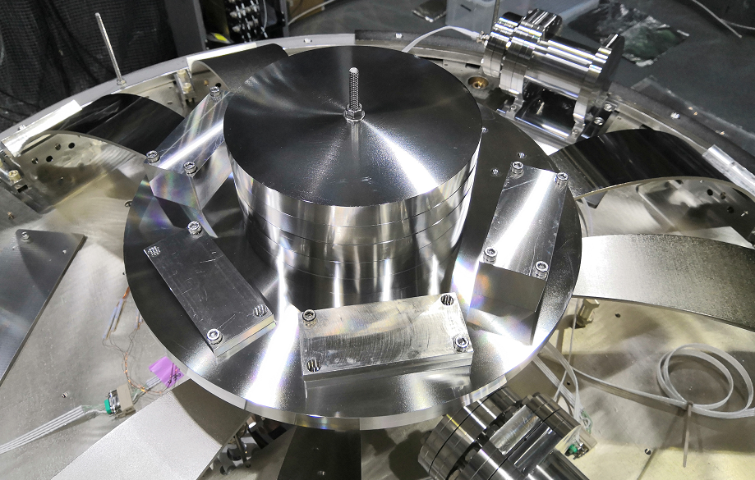
Plan3-1: Replacement of GAS blades for F0 in IX/IY
The F0 had overloaded by 4-10kg. The F0 keystones were fixed in O3. Three (of six) blades (for 297kg load) were replaced to strong blades (for 347kg load). The F0 can work as a vertical filter and the height of keystone became adjustable.
Plan3-2. Extension of adjustable range for F0 in IX/IY
The F0 was tuned to 0.2Hz (as single pendulum). The adjustable range was extended to more than +/- 3.5mm.

