Slide 1
Height adjustment of Type-A suspension
2021/3/30 Y. Aso
2021/8/10 R. Takahashi
For an interferometer to work properly, its mirrors need to be kept at a specified height.
The height of the mirror of a Type-A suspension system changes due to mainly three reasons.
  Shrinkage of the cryo-payload by cooling
  Change of buoyancy by vacuum evacuation
  Temperature change of the tower part
③ should be addressed by stabilizing the temperature of the chambers.
① and ② are inevitable and the adjustment mechanisms of the Type-A tower should be able to handle them.
This document shows a procedure to properly compensate for the height change caused by ① and ② .

Slide 2
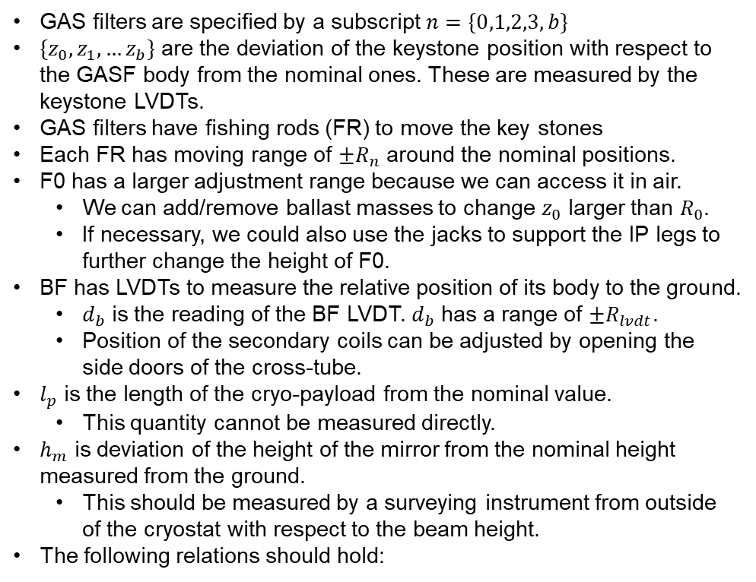











Definitions of variables and constants
GAS filters are specified by a subscript $n=\{0,1,2,3, b\}$
$\{z_{0}, z_{1}, …z_{b}\}$ are the deviation of the keystone position with respect to the GASF body from the nominal ones. These are measured by the keystone LVDTs.
GAS filters have fishing rods (FR) to move the key stones
Each FR has moving range of ${±R}_{n}$ around the nominal positions.
F0 has a larger adjustment range because we can access it in air.
  We can add/remove ballast masses to change $z_{0}$ larger than $R_{0}$.
  If necessary, we could also use the jacks to support the IP legs to further change the height of F0.
BF has LVDTs to measure the relative position of its body to the ground.
  $d_{b}$ is the reading of the BF LVDT. $d_{b}$ has a range of ${±R}_{lvdt}$.
  Position of the secondary coils can be adjusted by opening the side doors of the cross-tube.
$l_{p}$ is the length of the cryo-payload from the nominal value.
  This quantity cannot be measured directly.
$h_{m}$ is deviation of the height of the mirror from the nominal height measured from the ground.
  This should be measured by a surveying instrument from outside of the cryostat with respect to the beam height.
The following relations should hold:
F0
+
$$z_{0}$$
Jack
F1
$$z_{1}$$
-
F2
$$z_{2}$$
F3
$$z_{3}$$
$$d_{b}$$
BF
$$z_{b}$$
$$d_{s}$$
Cryo-Payload
$$l_{p}$$
Mirror
$$h_{m}$$
$h_{m}=z_{0}+z_{1}+z_{2}+z_{3}+z_{b}+l_{p}$
$$d_{b}=z_{0}+z_{1}+z_{2}+z_{3}−d_{s}$$

Slide 3
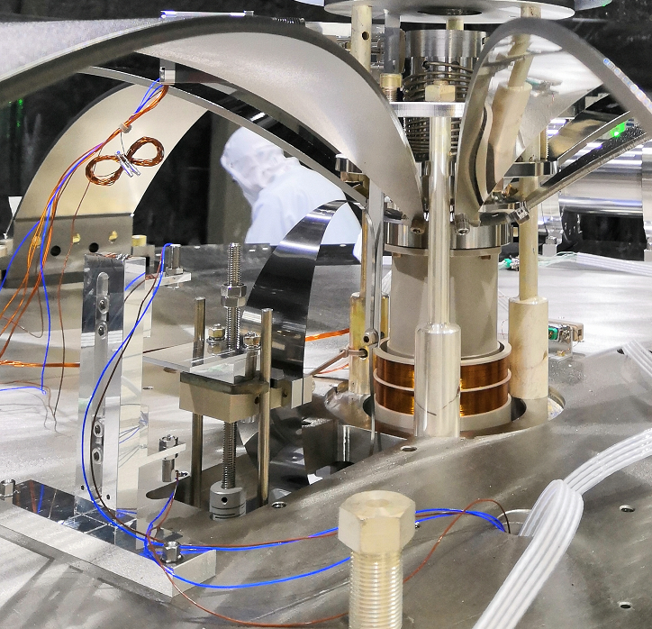
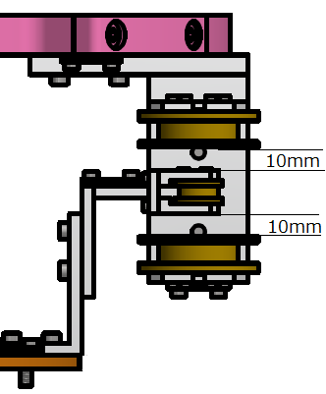
Condition
Predicted shrinkage length by cooling is 10mm.
Buoyancy effect by evacuation is -0.5mm.
Though the jack can change the height of F0 baseplate, it is very difficult to keep the tilt of IP during the adjustment.
Range of BF LVDTs (R_{lvdt}) is +/- 10mm. The height setting of secondary coils must fit the adjustable range of filter height.
In order to prevent for the FR to stuck and for the keystone to touch the mechanical limit, margin of 0.2mm is necessary for each filter.
Fishing rod (FR)
FR for F0
BF LVDT vertical

Slide 4
Adjustable range of GAS filters
[mm]

Slide 5
Case 1
The beam height error is almost zero.
[Room Temp.]
  Setpoint of GAS filters: +7.7mm
  Adjustable range of ITMX: -15.4mm, +0mm.
[Cryogenic Temp.]
  Setpoint of GAS filters: -2.3mm
  Adjustable range of ITMX: -5.4mm, +10.0mm.
Case 2
The beam height error and the shrinkage length error are comparable.
[Room Temp.]
  Setpoint of GAS filters: +5.0mm
  Adjustable range of ITMX: -12.7mm, +2.7mm.
[Cryogenic Temp.]
  Setpoint of GAS filters: -5.0mm
  Adjustable range of ITMX: -2.7mm, +12.7mm.

