Slide 1
Cooling Process to avoid frosting on the surface of the KAGRA Test Mass and ….
Nobuhiro KIMURA
Institute for Cosmic Ray Research
The University of Tokyo
On behalf of the KAGRA cryogenic group
External Review for KAGRA Cooling Process to avoid Frosting 20/July/2021

Slide 2
Contents
Objective of the external review
Defrosting experiment using KAGRA cryostat
Proposal of the KAGRA cooling scenario for O4
Enhancement plan to avoid frosting

Slide 3
Objective of this external review is
“In order to avoid frosting on the surface of the test mass, this review confirms whether there are any remaining issues with the proposed cooling scenario for the test mass.”

Slide 4
Defrosting experiment using KAGRA cryostat
Outline
Purpose of the defrosting experiment
Example of frosted view ports
Cooling scenario examined to avoid frosting
Result of cooling characteristics of the cryostat
Residual gas measurement during the cooling
Performance defrost heaters
Summary of experiment

Slide 5
Purpose of the defrosting experiment
1. Determine the cooling process for Test Mass avoid frosting
Including confirmation of the occurrence of frosting on the test mass or view ports under the condition of leak rate <10^-10Pam^-3/s).
(Leakage of KAGRA specification is not >10^-10Pam^-3/s).)
2. Measurement of partial pressure of residual gas during cooling
Identification of frosting components.
It was assumed that frost was formed by frosting of O₂, N₂ and H₂O.
3.Defrosting experiment by defrost heaters
Feasibility study of defrosting heaters.
(If no frost adheres during experiment, check the temperature profile by defrost heater.)

Slide 6
Example of frosted view ports
Frosting on the surface of the test mass and there is a serious problem at the KAGRA.
In order to find a way to cool the test mass down to ~20 K while preventing frosting, KAGRA cryogenic subgroup have conducted the cooling experiment using the KAGRA cryostat.
Frosting
TM oplev light source side
TM oplev QPD side
Photos show examples of the frosting on the surface of view ports with vacuum leak at TM temperature of ~25K. (@EXC 2020/08)
It was assumed that frost was formed by frosting of O₂, N₂ or H₂O.

Slide 7
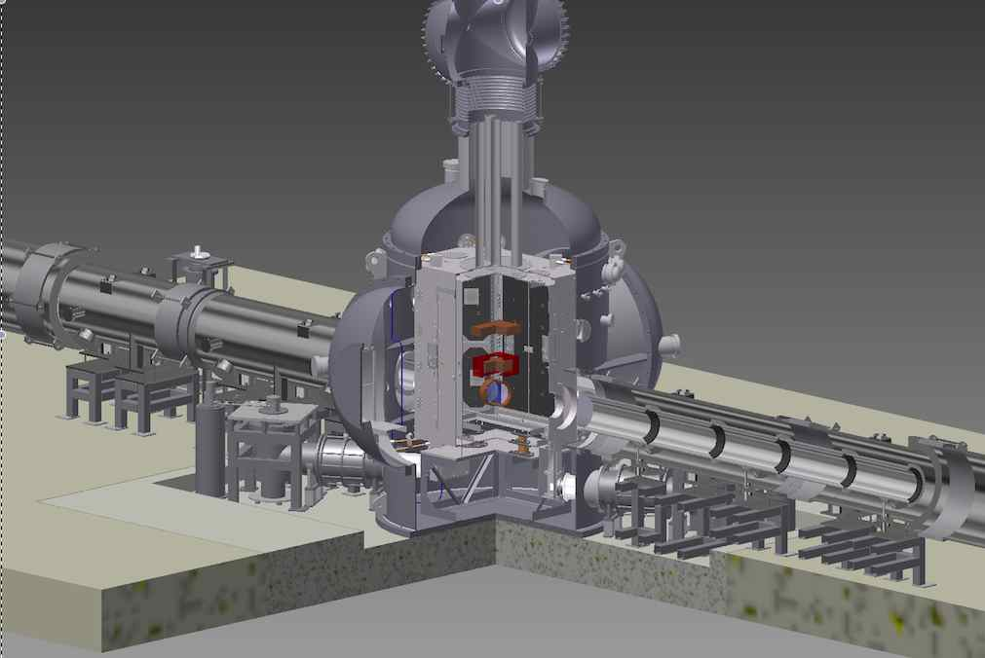
KAGRA cryogenic system
Inner radiation shield
Outer radiation shield
Duct Shield
Test mass
View ports
Duct Shield
Cryo-cooler units
Structural view of KAGRA Cryostat with shield ducts
Notes:
KAGRA cryostat consist of one main cryostat and two cryo-duct shields.
The main cryostat has a inner and a outer radiation shield.
Cryo-payload with Test Mass is in the inner radiation shield.
View ports for Opleve are attached inner and outer radiation shield.

Slide 8
Cryo-cooler layout
Inner radiation shield
Pulse Tube type Cryo-cooler (PTC) with Vibration reduction
Outer radiation shield
Baffles
two units
Cooling
Cryo-Payload
Main Beam
Cryo-payload
cooling
400kW
300K
Radiation
two units
Duct Shield
Cryostat
Inner shield
cooling
2 units for cooling cryo-payload
2 units for cooling inner shield
4 units for cooling outer shield
Four cryocooler units per one cryostat

Slide 9
Temperature distribution and internal pressure of the KAGRA cryostat after cooling
Inner radiation shield
= ~15 K
Outer radiation shield
=~100 K
Test mass
= 23 K
Duct Shield
= 90 ~ 125 K
Duct Shield
= 90 ~ 125 K
Internal pressure = 5.8 x 10^-6 Pa

Slide 10
Cooling scenario examined to avoid frosting
Fundamental features of the cooling method:
Avoiding frost on the test mass by stepwise adsorption of residual gas components on the radiation shield surface
Final
Step
Step 1
Step 2
Step 3
Goal
21 days
11 days
24 days
10 days
Vacuum pumping
Internal pressure
< 10^-4 Pa
No leakage
> 10^-10 Pam^3/s
Cooling down
duct shields
Radiation Temp.
90 K ~ 150 K
Trap H₂O
Cooling down
internal shields
Radiation Temp.
20 K ~ 30K
Trap O₂ and N₂
Cooling down
Test
Mass
T_{TM}=~20 K
It takes 76 days in total to cool down Test Mass

Slide 11
Cooling scenario examined to avoid frosting
Fundamental features of the proposed cooling method:
Avoiding frost on the test mass by stepwise adsorption of residual gas components on the radiation shield surface
Step 1: Start vacuum pumping.
Wait inner pressure shall be lower than ~10^-4 Pa.
It will take 21 days including 3 days of vacuum leak test .
Leak test should be satisfied KAGRA specification which are no leakage > 1x10^-10 Pam^3/sec.

Slide 12
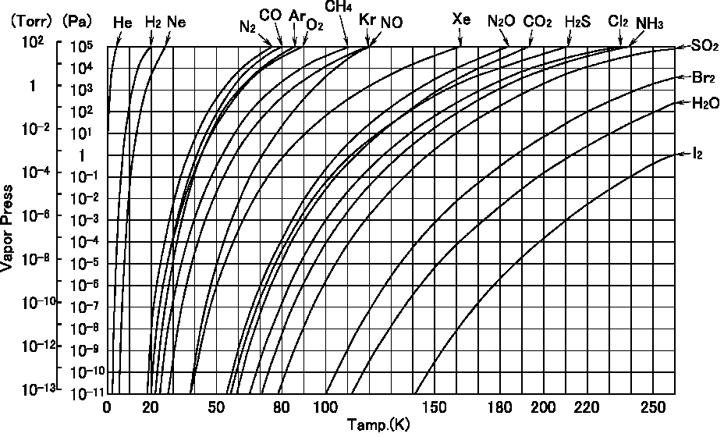
Evacuated by vacuum pumps
> 1x10⁻⁴ Pa
Step 1: Evacuation by vacuum pumps

Slide 13
Step 2: Turn on duct shield cryocoolers to trap H₂O on the surface of duct shield.
Wait surface temperature of duct shield should be lower than 130 K. It will take 11 days.
Step 3: Turn on two cryocooler for radiation shields to trap N2 on the surface of inner shield.
The mirror is cooled by radiation from the inner shield.
Wait surface temperature of inner shield should be lower than 20 K.
It will take 24 days after turning on the coolers.

Slide 14
> 1x10⁻⁶ Pa
T_{outer} > 130 K
Step 2:Trap H₂O by duct & outer shields

Slide 15
Step 2: Turn on duct shield cryocoolers to trap H₂O on the surface of duct shield.
Wait surface temperature of duct shield should be lower than 130 K. It will take 11 days.
Step 3: Turn on two cryocooler for radiation shields to trap N2 on the surface of inner shield.
The mirror is cooled by radiation from the inner shield.
Wait surface temperature of inner shield should be lower than 20 K.
It will take 24 days after turning on the coolers.

Slide 16
< 1x10⁻⁶ Pa
20 < T_{inner}
Step 3: Trap O₂ & N₂ by inner shield

Slide 17
Final Step:
Turn on two cryo-coolers for payload.
It will take 10 days after switched on the coolers to reach steady state condition of mirror temperature.

Slide 18
Defrosting experiment using KAGRA cryostat
Outline
Purpose of the defrosting experiment
Example of frosted view ports
Cooling scenario examined to avoid frosting
Result of cooling characteristics of the cryostat
Performance defrost heaters
Residual gas measurement during the cooling
Summary of experiment

Slide 19
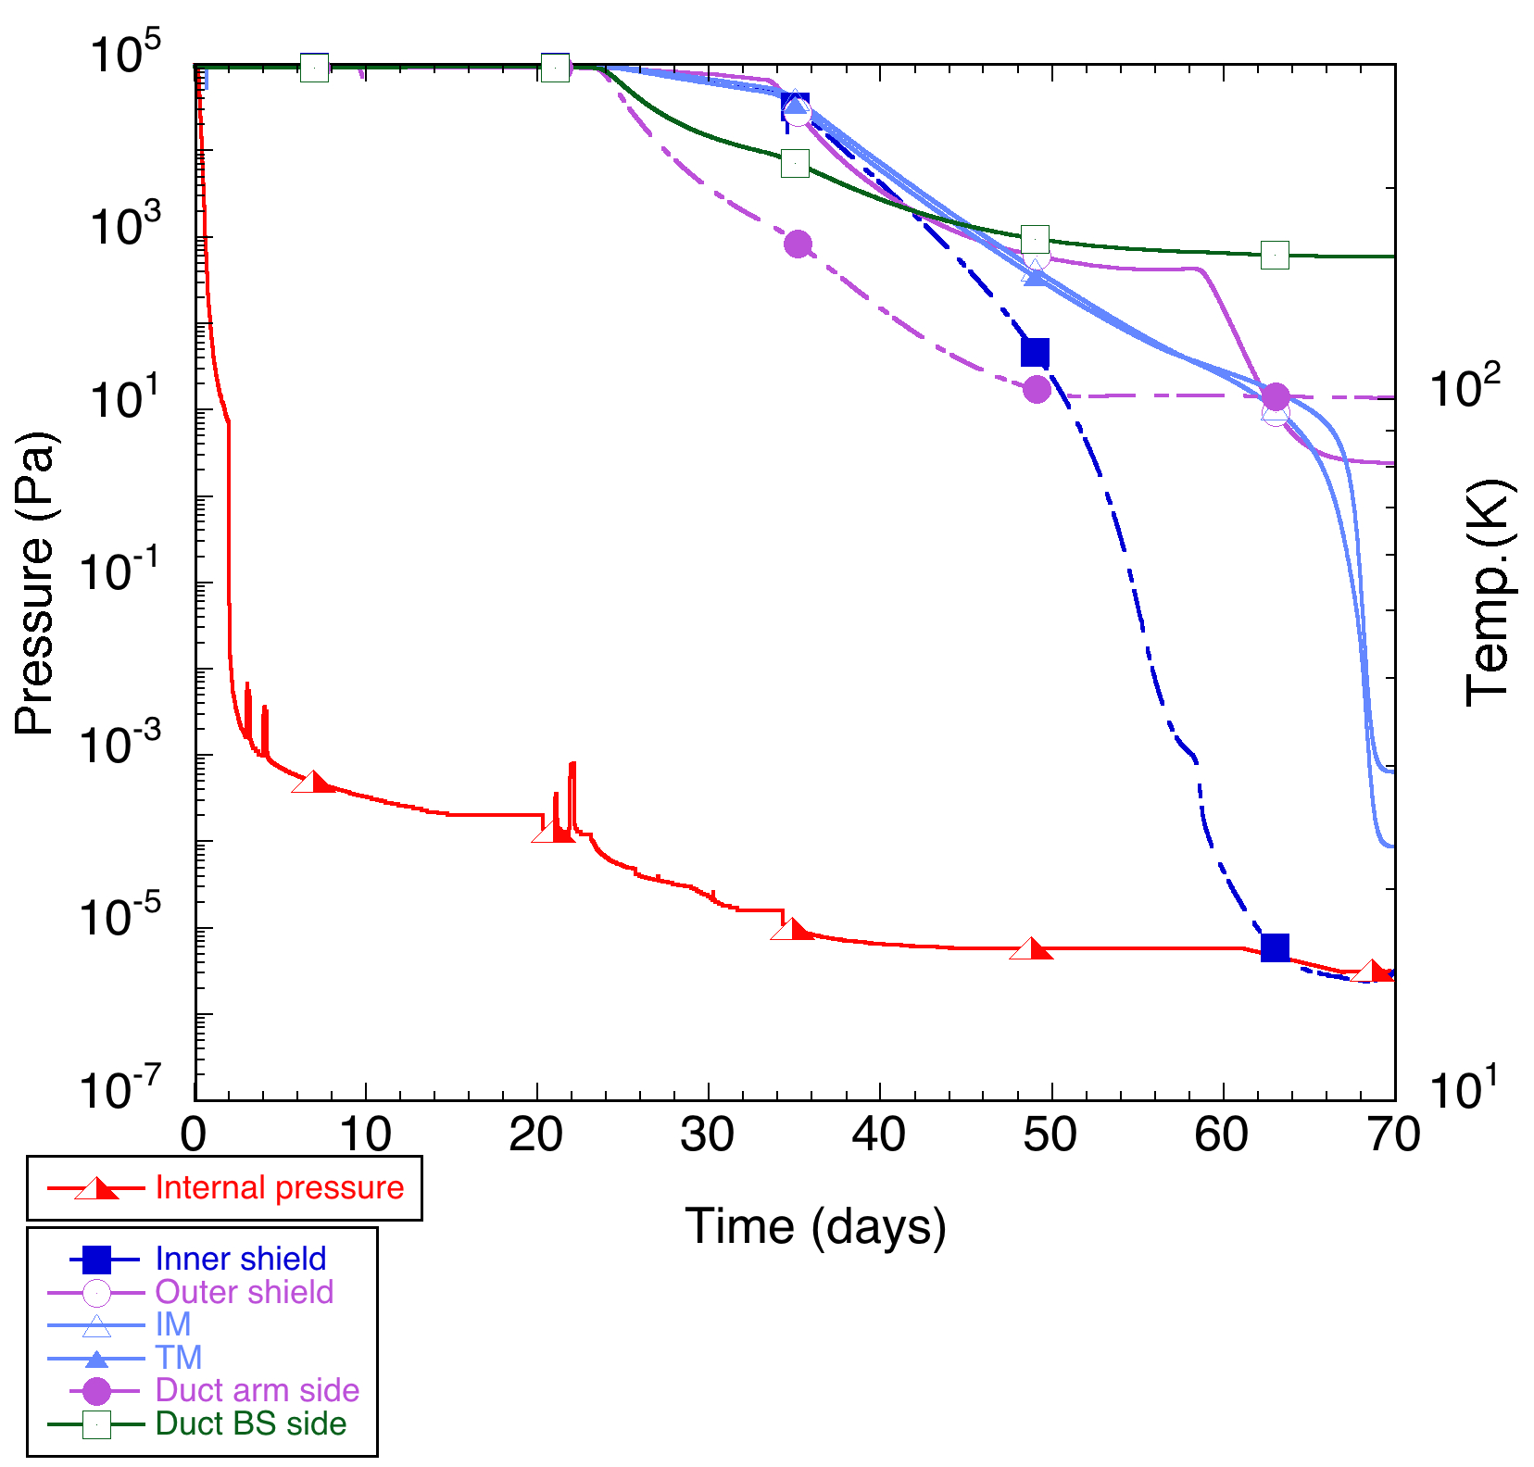
One root pump “ON”
Two cryostat shield cooler “ON”, T_{duct}=150~200 K, T_{TM} ~ 230 K
Two payload cooler “ON”, T_{inner} < 30 K,
T_{TM} > 150 K
> 140 K
\
Two turbo molecule pumps “ON”,
when P < 10 Pa
Two duct shield cooler “ON”,
when P ~10^-4 Pa
> 30 K
P_{cryo}= ~5.8 x 10^-6 Pa
Temperature dependence of internal pressure

Slide 20
Defrosting experiment using KAGRA cryostat
Outline
Purpose of the defrosting experiment
Example of frosted view ports
Cooling scenario examined to avoid frosting
Result of cooling characteristics of the cryostat
Residual gas measurement during the cooling
Performance defrost heaters
Summary of experiment

Slide 21
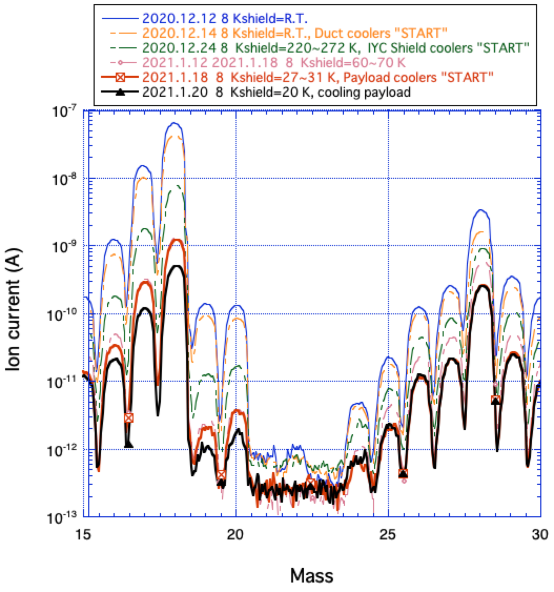
H₂O
Trap by duct shield
~130 K
N₂
Trap by inner shield
~20 K
Temperature dependence of H₂O and N₂

Slide 22
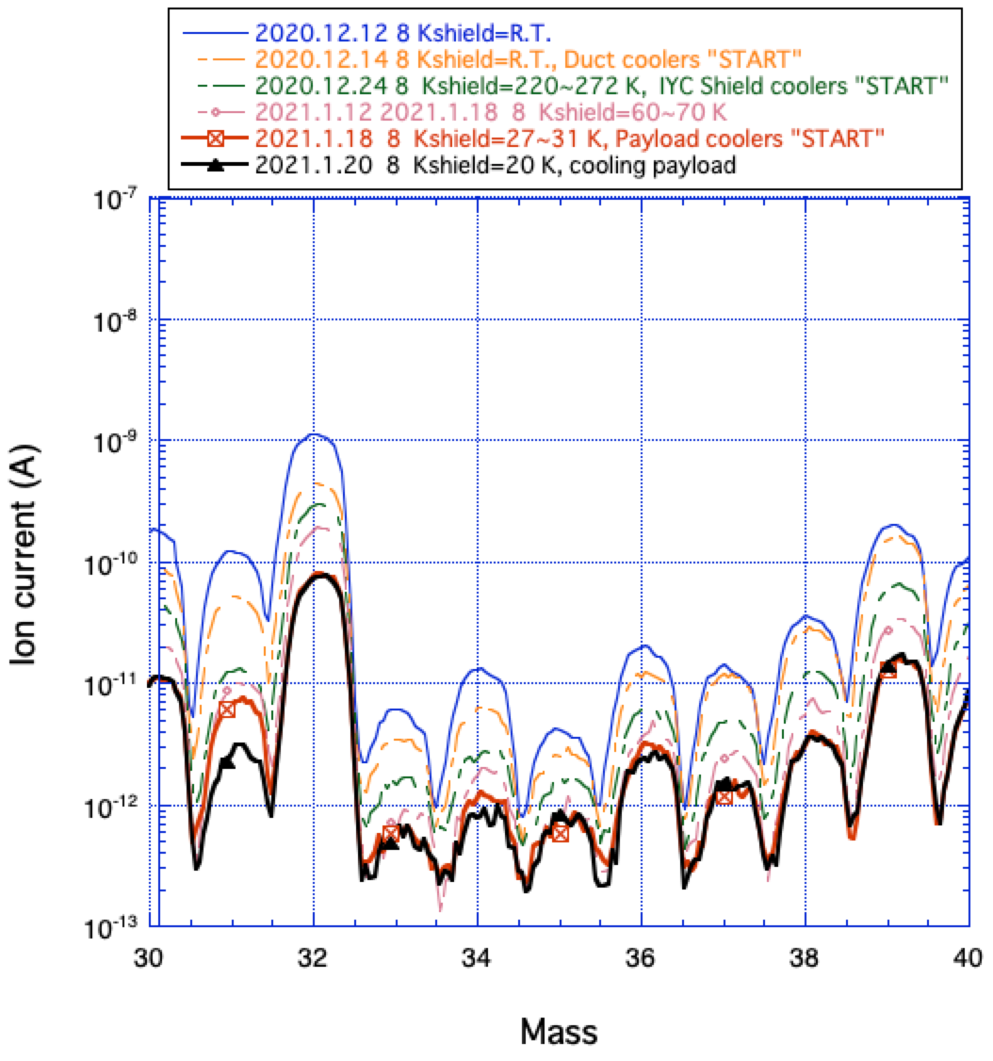
O₂
Temperature dependence of Q-mass

Slide 23
Defrosting experiment using KAGRA cryostat
Outline
Purpose of the defrosting experiment
Example of frosted view ports
Cooling scenario examined to avoid frosting
Result of cooling characteristics of the cryostat
Residual gas measurement during the cooling
Performance defrost heaters
Summary of experiment

Slide 24
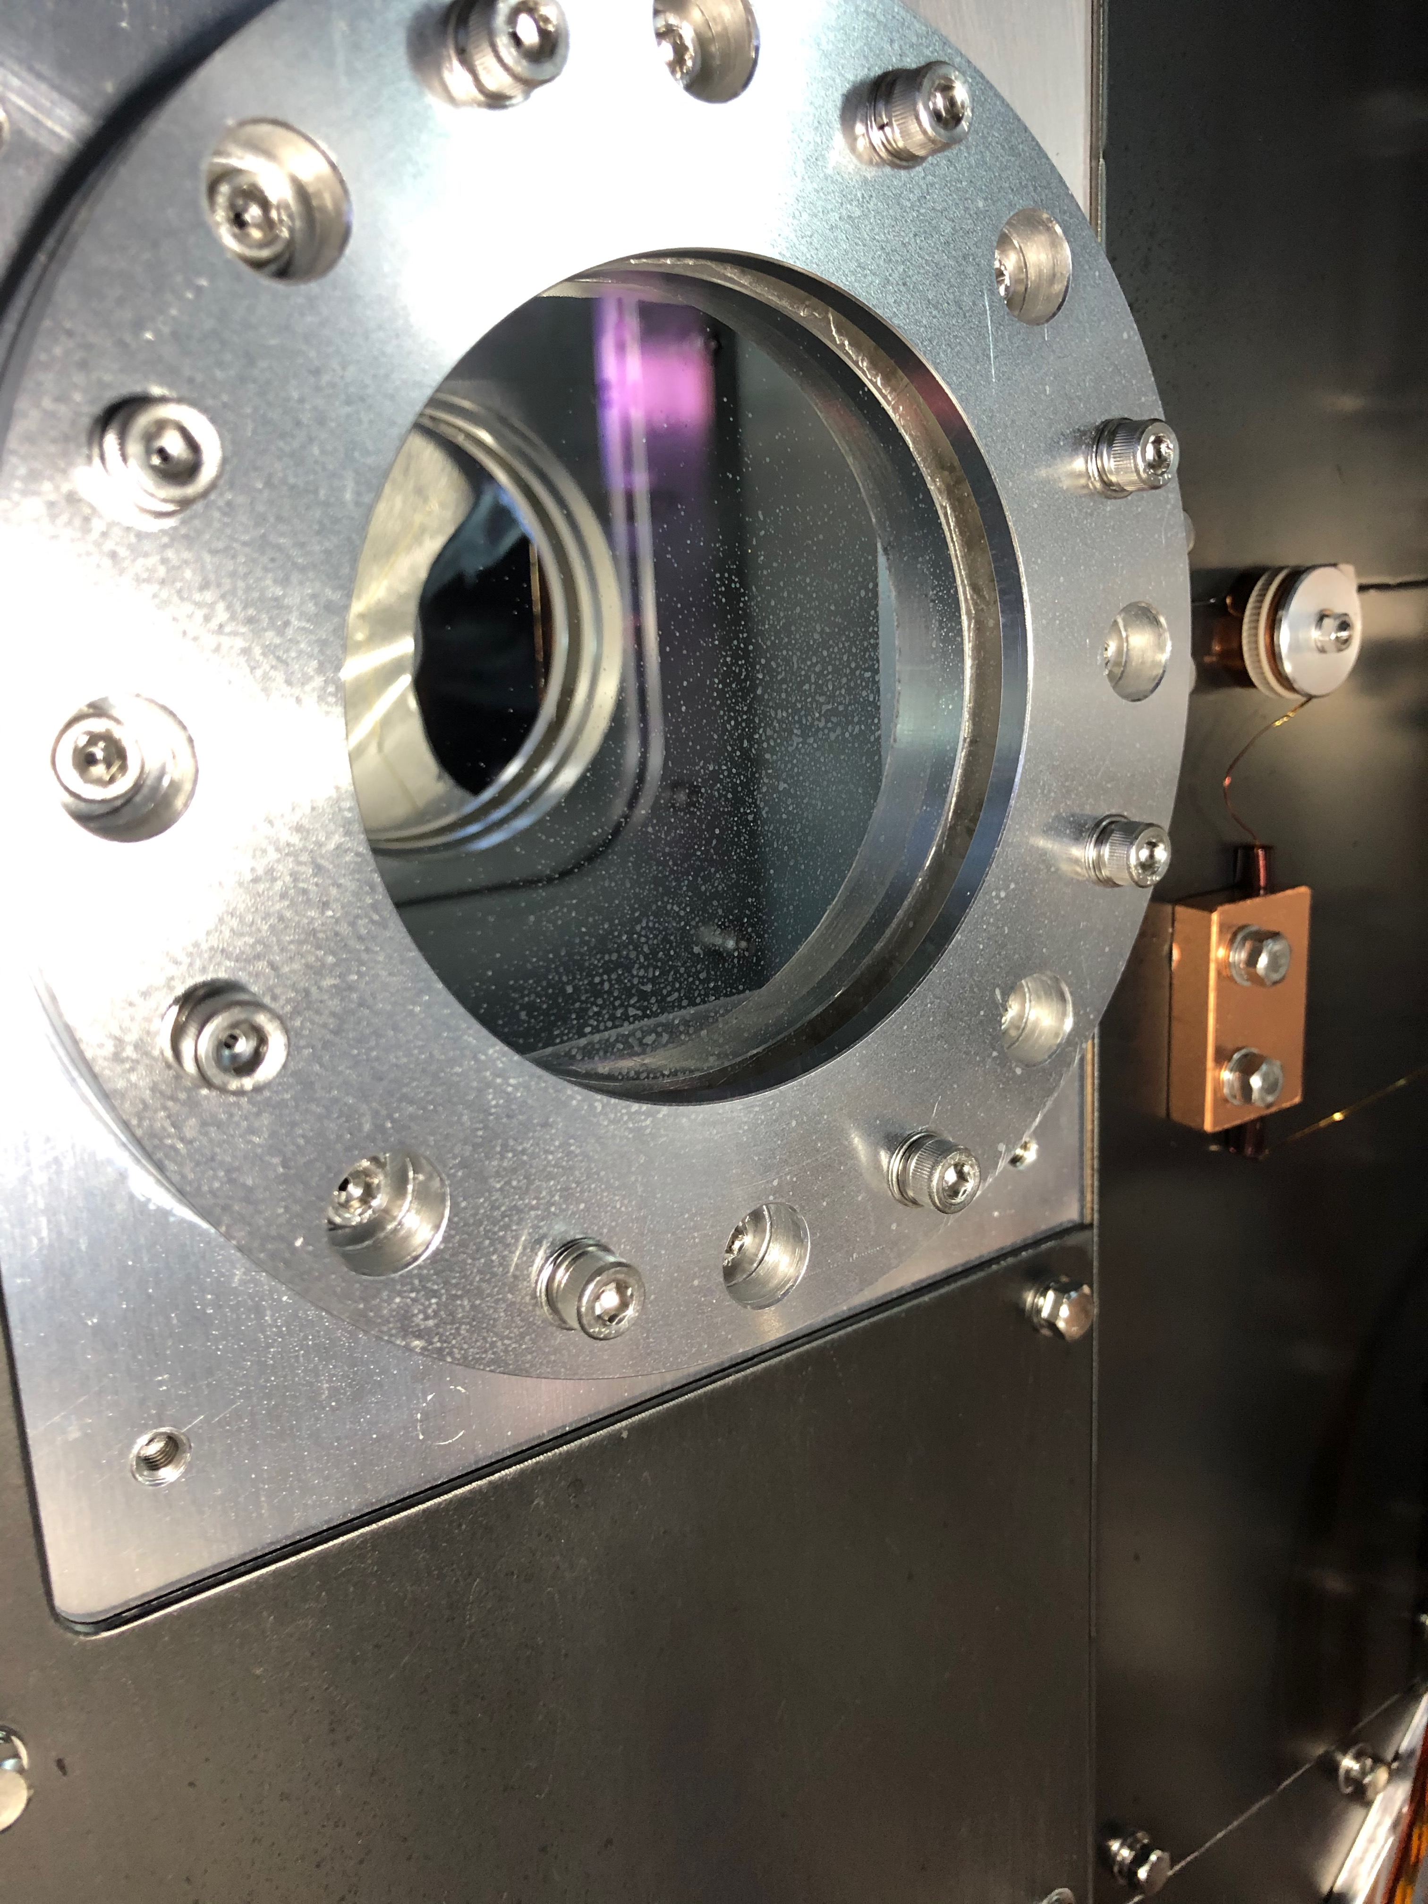
Defrost heater layout
Two calibration heaters were equipped with
the top of inner radiation shield.
A small heater was attached on IM for defrosting mirror surface.
One defrost heater was attached on view port.
Three kinds of heaters for defrosting were installed in this experiment.
Image of defrost heater

Slide 25
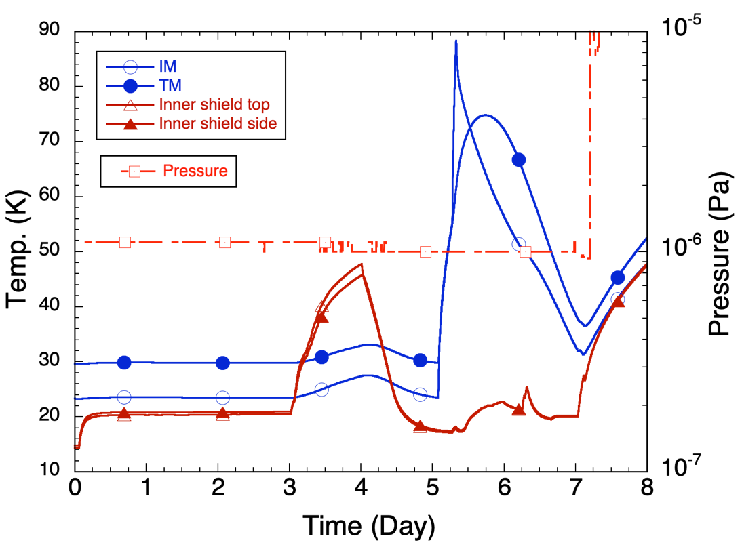
T_{TM}=~75 K
T_{inner shield}=~45 K
Inner Top cal heater “OFF”
IM heater “ON”, Q_{IM}=2.5 W
~two days
~two days
Defrost heater
“ON”
Q_{dh}=~5 W
Inner top cal heater “ON”, Q_{Th}=~31 W
Characteristics of heat input response

Slide 26
Summary of experiment -1/2-
Frosting on the surface of view ports were not appeared during the experiment!
It can be assumed frosting on the surface of Test Mass was not appeared visually.
Following items were confirmed with the experiment;
Proposed cooling scenario can avoid frosting for O4.
Calibration heaters worked well as defrost heaters for view ports on the inner shield. To defrost the view ports on inner shield, it will take 1 days to warm up to ~50 K (above O₂ vapor temperature of 48 K at 1x10^-5 Pa) , and 1 days to re-cool down to ~20 K.
Heater attached on the IM worked well as defrost heater for mirror.
To defrost the mirror, it will take 1 days to warm up to ~70 K,
(above N₂ vapor temperature of 53 K at 1x10^-3 Pa) , and 1 days to re-cool down to ~20 K.
Partial pressure measurement of residual gas at each temperature was performed, and confirmed frosting components.

Slide 27
Summary of experiment -2/2-
Lessons learned
Best effort for minimizing vacuum leak
Mitigation of frosting
Four steps cooling method.
Defrosting by heaters, when frost is occurred.
Confirmation no leakage > 10^-10 Pam^3/sec.
Check continuous measurement of residual gas components in the all of vacuum chambers.

Slide 28
Proposal of the KAGRA cooling scenario for O4
KAGRA test masses will be cooled down with the same cooling method as same as the defrosting experiments.
It will take two and half months to reach ~20 K.
Use the defrost heater to defrosting, when it appear on the surface of the test mass or view port.
It needs two days to defrost.
Reinforce of leak testing to satisfy KAGRA's required specifications < 1x10^-10 Pam^3/s for all of vacuum chambers

Slide 29
Enhancement plan to avoid frosting
Enhance pumping capacity by increasing the number of vacuum pumps.
Especially around the cryostat, to reduce the achieved pressure as much as possible.
Add process gas monitor, to realize continuous measurement of residual gas components in the vacuum chambers including PR, SR, BS and so on.

Slide 30
Plan for increasing the number of vacuum pumps to enhance pumping capacity by
茂住側
[26]
EYT
[36]
[30]
EYV
EYC
MC : Mode Cleaner
BS : Beam Splitter
IXA, EXA, IYA, EYA : Auxiliary optical baffle
EXT, EYT : Transmitting telescope
IXC, EXC, IYC, EYC : Cryogenic Mirror
IXV, EXV, IYV, EYV : Vibration Isolation (2nd story)
GV: Gate valve
[35]
[38]
EYA
[34]
GVetmy
[21-25]
[43]
[42]
[31]
[40]
GVitmy
IYA
[29]
[44]
[45]
[37]
MCE
[8]
[28]
IYV
IYC
[6]
IXV
EXV
[1]
GVbsy
[41]
[16-20]
[32]
[33]
[9]
[13]
[11]
GVbsx
MCF
IFI
IMM
PRM
PR3
PR2
BS
IXC
IXA
EXA
EXC
EXT
GVmc
[12]
GVitmx
GVetmx
SR2
[3]
[5]
[7]
[10]
[2]
[27]
SR3
3000 m
[39]
[14]
佐古西側
TMP
IP
SRM
solid mark = already installed
blank mark = additively to be installed
[15]
14 of ion pumps
OMMT
跡津側
8 of turbo-molecular pumps
OMC

Slide 31
Appendix

Slide 32
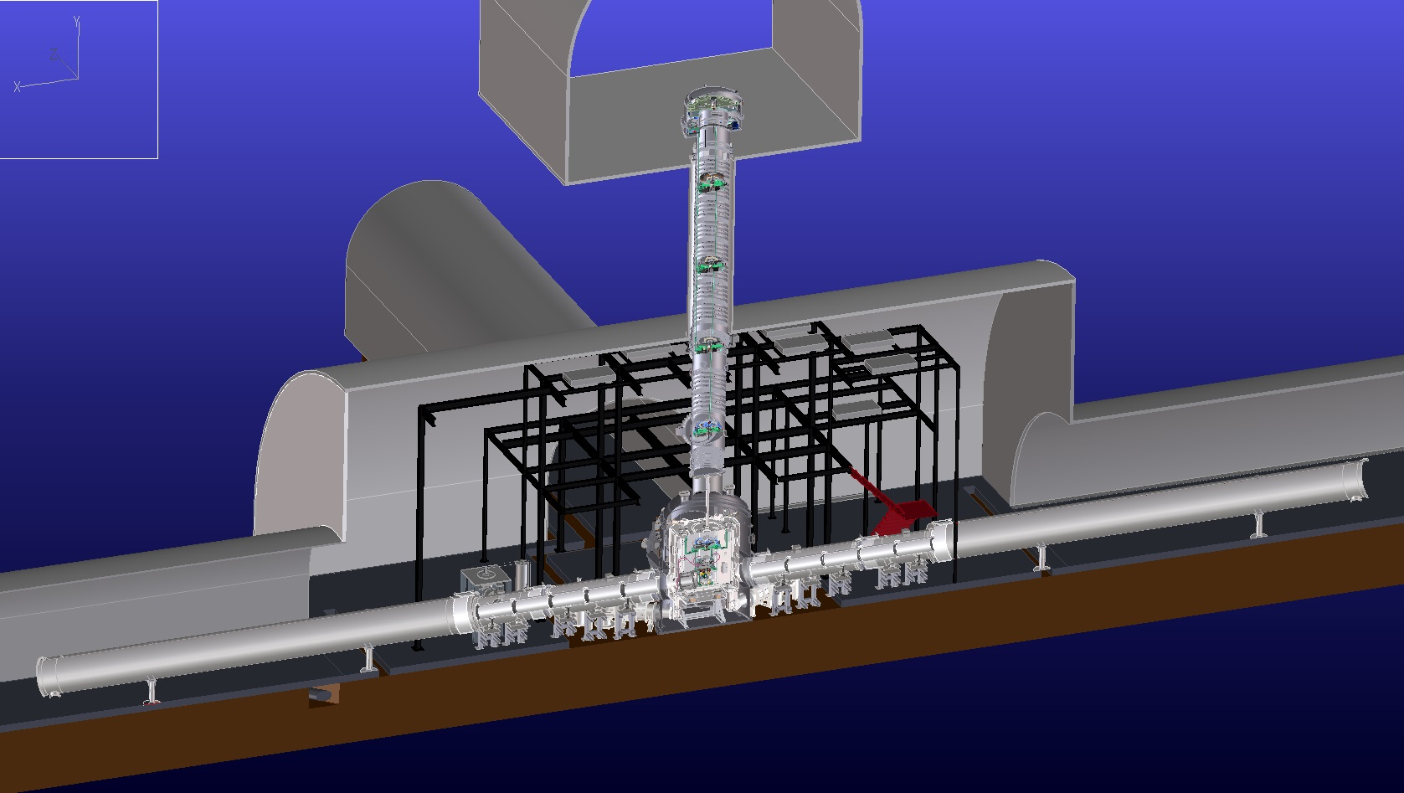
Overview of KAGRA Cryogenics system
Main mirror parts
Vibration isolation system
at room temperature
Cryo shield ducts
in order to terminate
300 K radiation
14m
Beam duct
Cryostat with four cryocoolers

Slide 33
Structure of KAGRA Cryostat
Stainless steel t=20mm
Diameter 2.4 m
Height ~4.3 m
M ~ 12 ton
Cold Mass:
8K shield ~455 kg
80 K shield ~590 kg
Seismic Attenuation System (SAS)
Cryogenic Payload
4.3 m
Sapphire Mirror
(α-alumina crystal)
View Ports
Radiation Shields
Duct Shield
Main Laser Beam
Cryocoolers
Pulse tube, 60Hz
0.9 W at 4K (2nd)
36 W at 50K (1st)
Four Cryocooler Units
φ2.6m
S. Koike

Slide 34
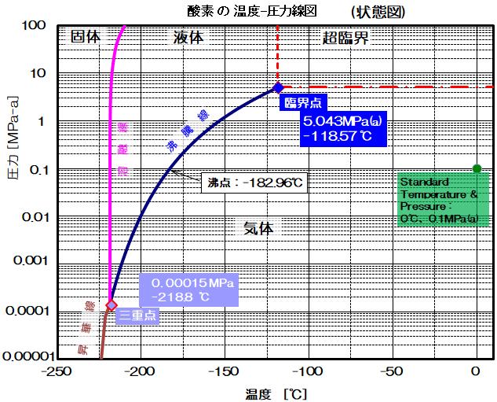
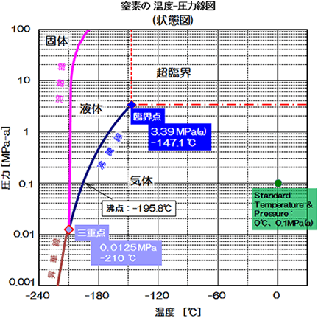
1x10-3 Pa → ~-220 ℃（~53 K）
Solid
Solid
Liquid
super critical
O₂
super critical
N₂
Liquid
Pressure (MPa absolute)
Boiling point:-182.96 C
Pressure (MPa absolute)
Gas
Gas
Gas
Boiling point:-147.1 C
Temperature (℃)
Temperature (℃)
1x10⁻⁵ Pa → ~-225 ℃（~48 K）
State diagrams of O2 and N2

Slide 35
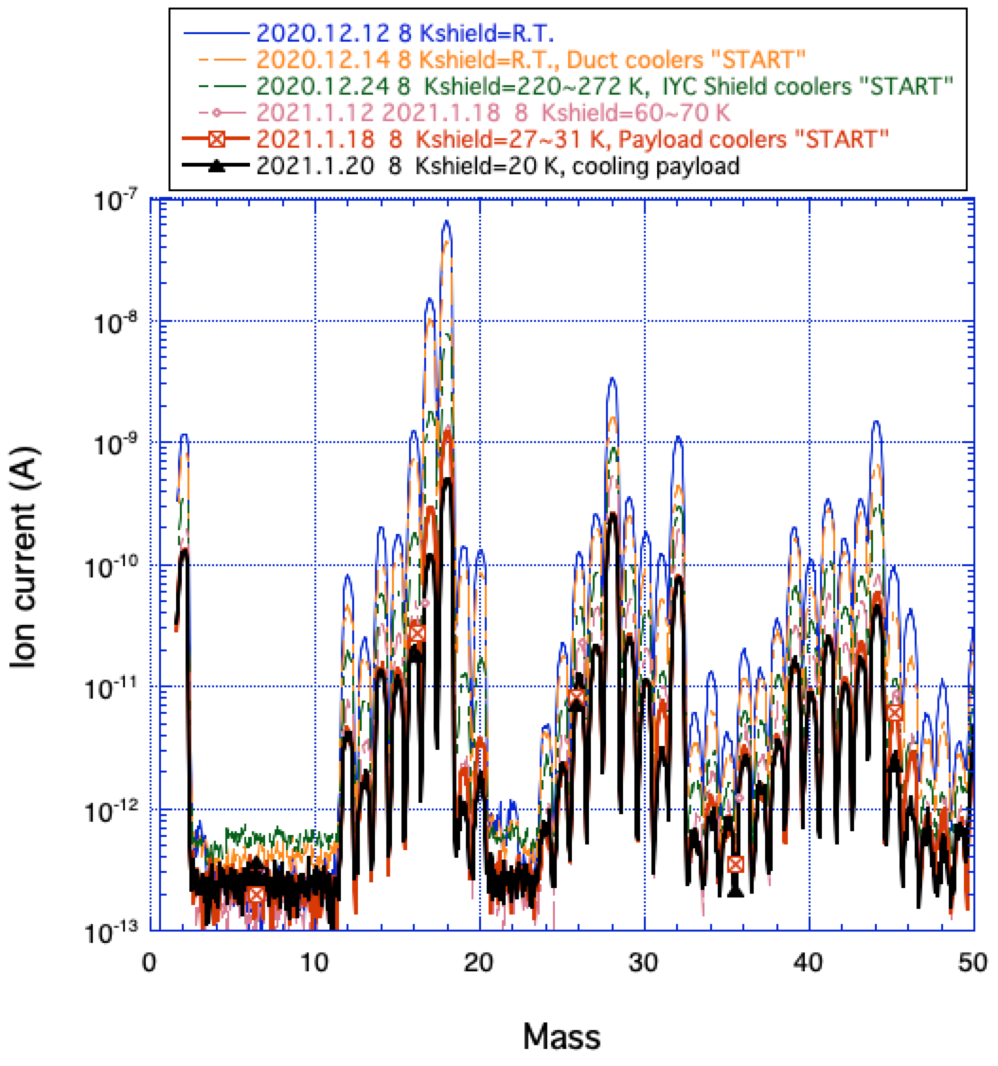
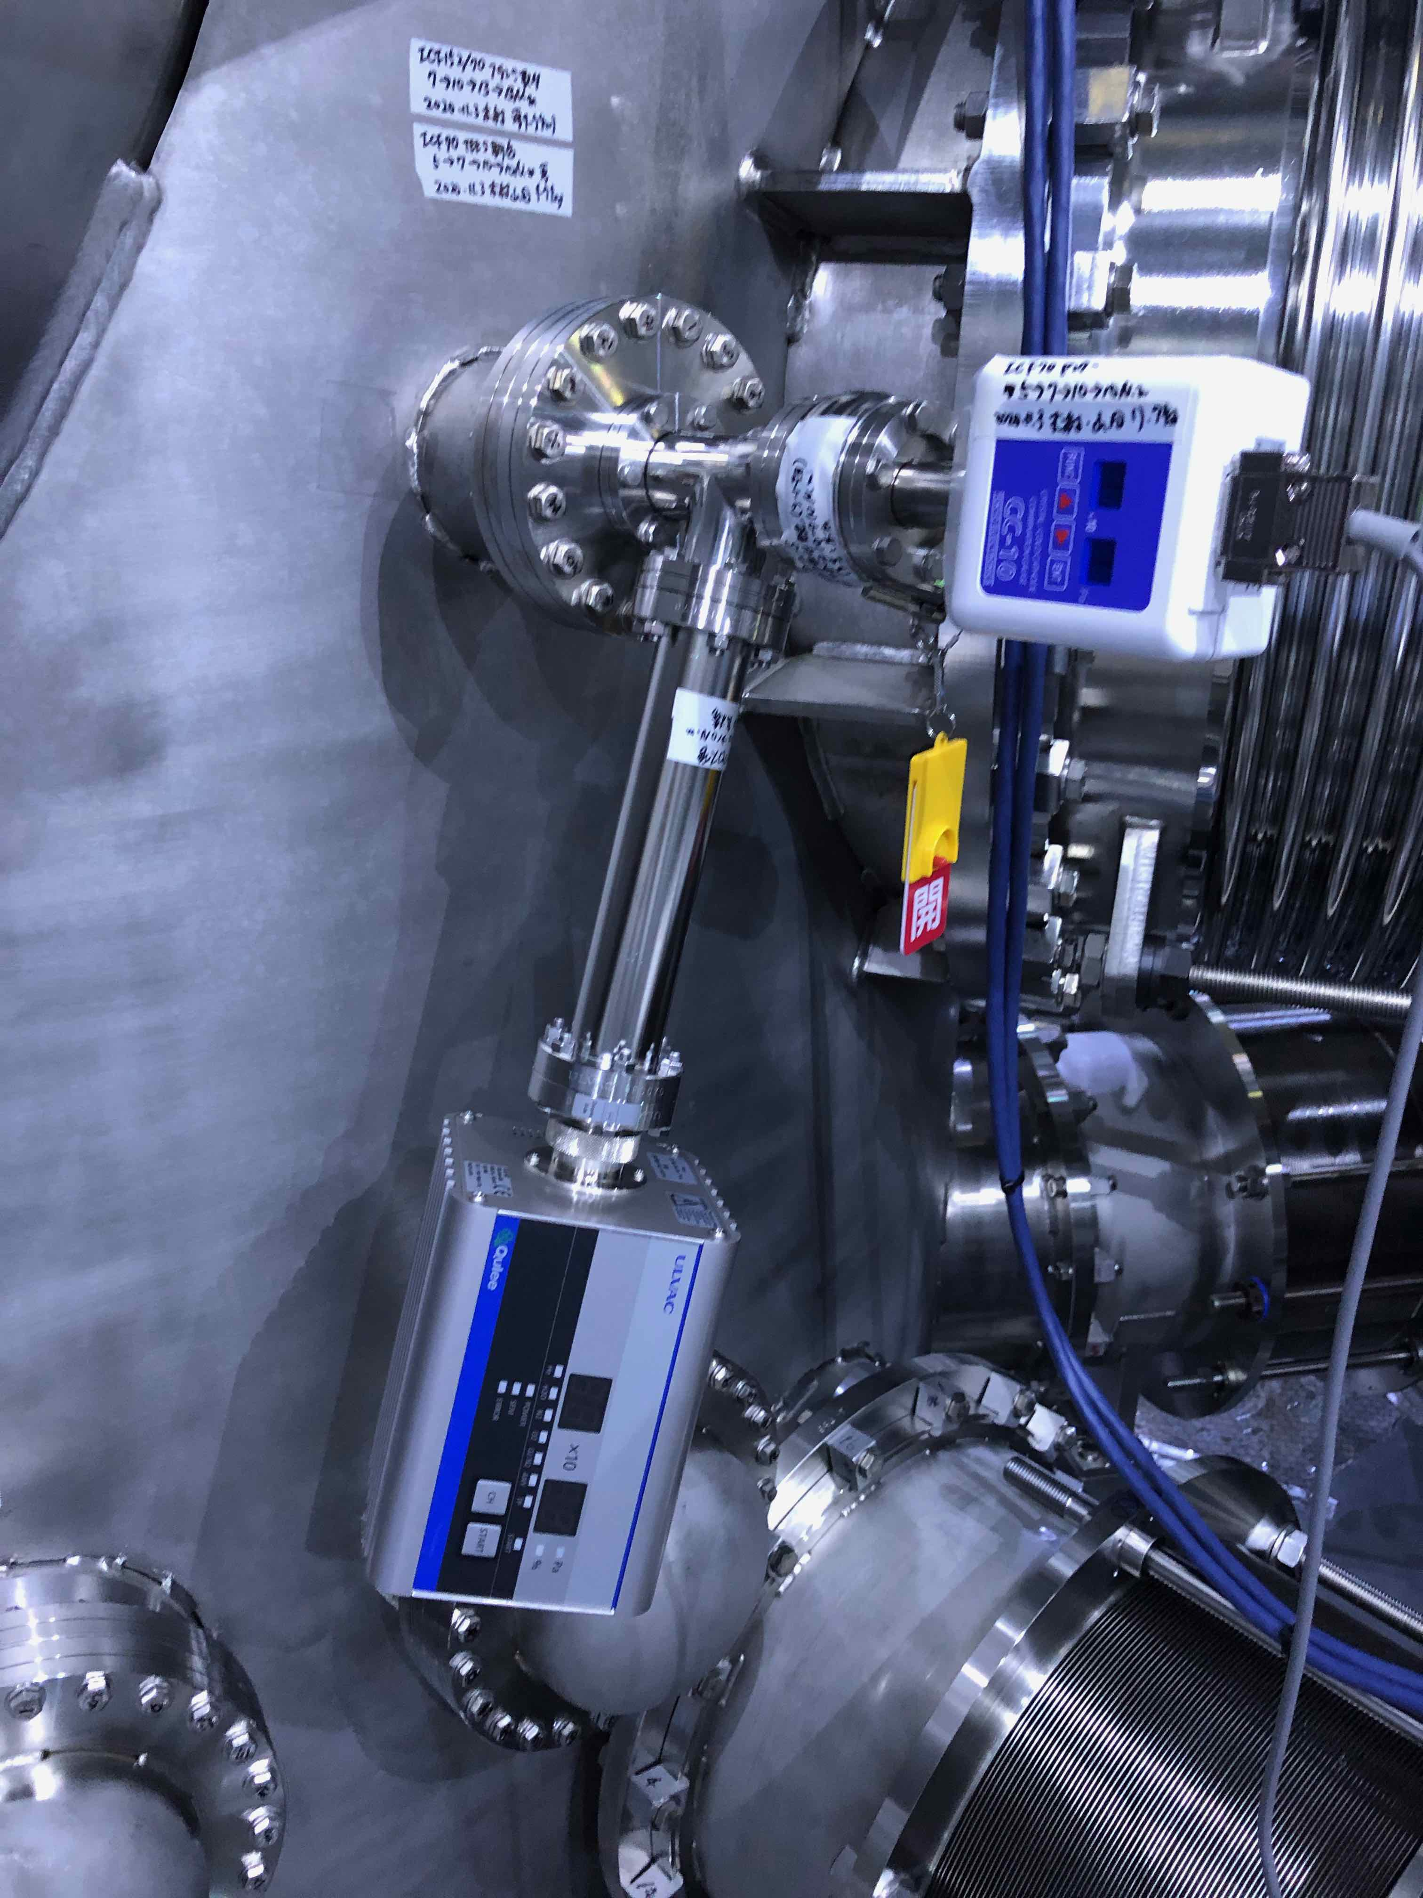
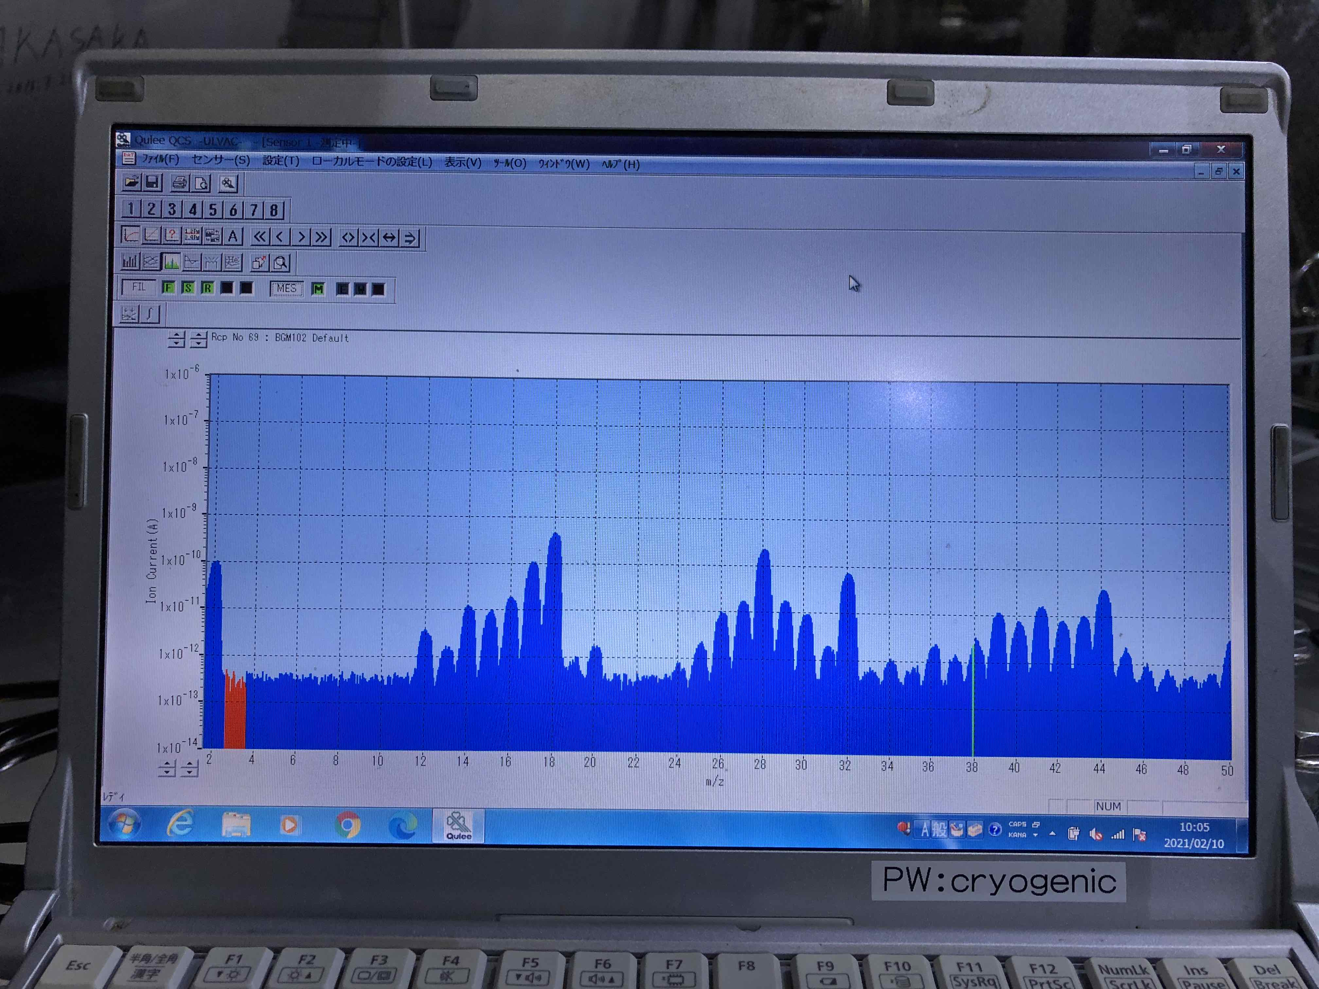
Temperature dependence of Q-mass

