Slide 1
The cooling scenario for O4 without frosting on the surface of the KAGRA Test Mass and ….
Nobuhiro KIMURA
Institute for Cosmic Ray Research
The University of Tokyo
On behalf of the cryogenic subgroup of KAGRA
2021 Gravitational Wave Advanced Detector Workshop 20/May/2021

Slide 2
Outline
Introduction
An example of frosting on the surface of view ports
Cryogenic system for KAGRA
Issues in de-frosting experiment using KAGRA cryostat
Results of de-frosting experiment using KAGRA cryostat
Test mass cooling by the scenario for O4
Residual gas measurement during the Test Mass cooling
Performance defrost heaters
Summaries

Slide 3
An example of frosting on the surface of view port
Frosting on the surface of the test mass and the viewports of
the radiation shields is a serious problem at the KAGRA.
In order to find a way to cool the test mass down to ~20 K while preventing frosting, KAGRA cryogenic subgroup have conducted the cooling experiment using the KAGRA cryostat.
Frosting
TM oplev light source side
TM oplev QPD side
Photos show examples of the frosting on the surface of view ports with vacuum leak at TM temperature of ~25K. (@EXC 2020/08)
It was assumed that frog on the surface was formed by frosting of O₂, N₂ and H₂O.
Notes:
Frost on the surface of the test mass and the viewports of
the radiation shield is a serious problem at the KAGRA.
In order to find a way to cool the test mass down to ~20 K while preventing frosting, KAGRA cryogenic subgroup have conducted the cooling experiment using the KAGRA cryostat.
In this experiment, we succeeded in preventing frosting on the surface of test mass and the viewports.
The results of the cryostat cooling experiments are reported in this talk.

Slide 4
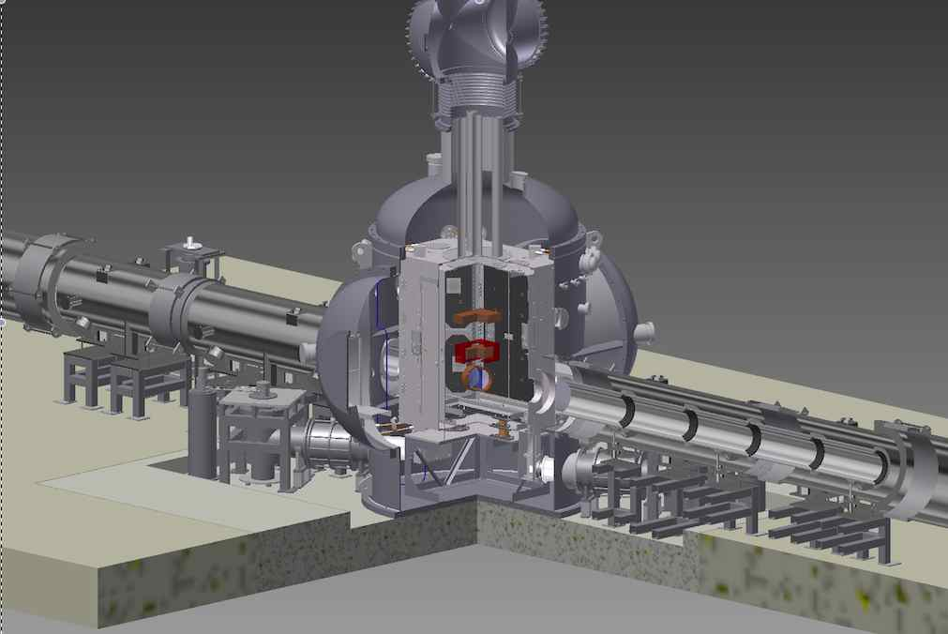
Structural view of KAGRA Cryostat with shield ducts
Inner radiation shield
Outer radiation shield
Shield duct
Test mass
View ports
Shield duct
Cryo-cooler units

Slide 5
Cryo-cooler layout
Pulse Tube type Cryo-cooler (PTC) with Vibration reduction
Inner radiation shield
Outer radiation shield
Baffles
two units
Cooling
Cryo-Payload
Main Beam
Cryo-payload
cooling
400kW
300K
Radiation
two units
Shield ducts
Cryostat
Inner shield
cooling
2 units for cool cryo-payload
2 units cool for the inner shield
4 units cool for the outer shield
Four 4K cryocooler units per one cryostat

Slide 6
Issues in de-frosting experiment using KAGRA cryostat
1. Determine the cooling scheme for Test Mass without frosting
Including confirmation of the occurrence of frosting on the view ports under the condition of leak rate <10^-10Pam^-3/s)
2. Defrosting experiment by defrost heaters
Confirmation of defrost heater performances
(If no frost adheres, check the temperature profile of defrost heating.)
3. Measurement of partial pressure of residual gas to confirm frosting components
Notes:
IYC冷却実験での実証課題
1．冷却スキームの確定
（リーク <10^-9Pam^-3/sで条件で可視化窓の霜付きの発生するかの確認を含む）
真空引き:2 weeks、ダクトシールド冷却： 2 weeks、輻射シールド冷却： 4 weeks、
test mass冷却： 4 weeksぐらい
2．除霜ヒータの性能確認
（霜が付着しなかった場合はヒータ加熱による除霜ヒータ表面の温度プロファイルの確認）
3．テストマスの冷却時間の確定（熱伝導帯固定部の増し締め）山田君
4．テストマスの除霜実験？
（テストマス表面の霜付きをどのようにして測定するか未定）
ヒーターをＩＭに付ける。
5．残留ガスの分圧測定（窒素、水分）霜付きの成分を確認 Q-massをIXCから移設

Slide 7
Proposed Test mass cooling scenario for O4 - Issure: How maintain mirror temperature lower than 100 K without frosting on the surface of the mirror -
Cooling steps at this experiment;
Step 1:
Start vacuum pumps and wait inner pressure shall be lower than ~10^-4 Pa.
It will take 21 days including vacuum leak test for 3 days.
Step 2:
To trap H₂O residual gas on the surface of duct shield, Start duct shield cryocoolers and wait surface temperature of duct shield shall be lower than lower than ~150 K.
It will take 11 days.
Step 3:
To trap nitrogen gas on the surface of inner shield, start two shield cryocooler units. The mirror is cooled by only radiation to the inner shield.
Wait surface temperature of inner shield shall be lower than lower than ~20 K.
It will take 24 days after switched on the coolers.
Step 4:
Switched on payload cryo-coolers.
It will take 10 days after switched on the coolers to reach steady state condition of mirror temperature.

Slide 8
Temperature distribution and pressure in the KAGRA Cryostat after cooling
Inner radiation shield
= ~15 K
Outer radiation shield
=~100 K
Test mass
= 23 K
Shield duct
= ~125 K
Shield duct
=~ 125 K
Internal pressure = 5.8 x 10^-6 Pa

Slide 9
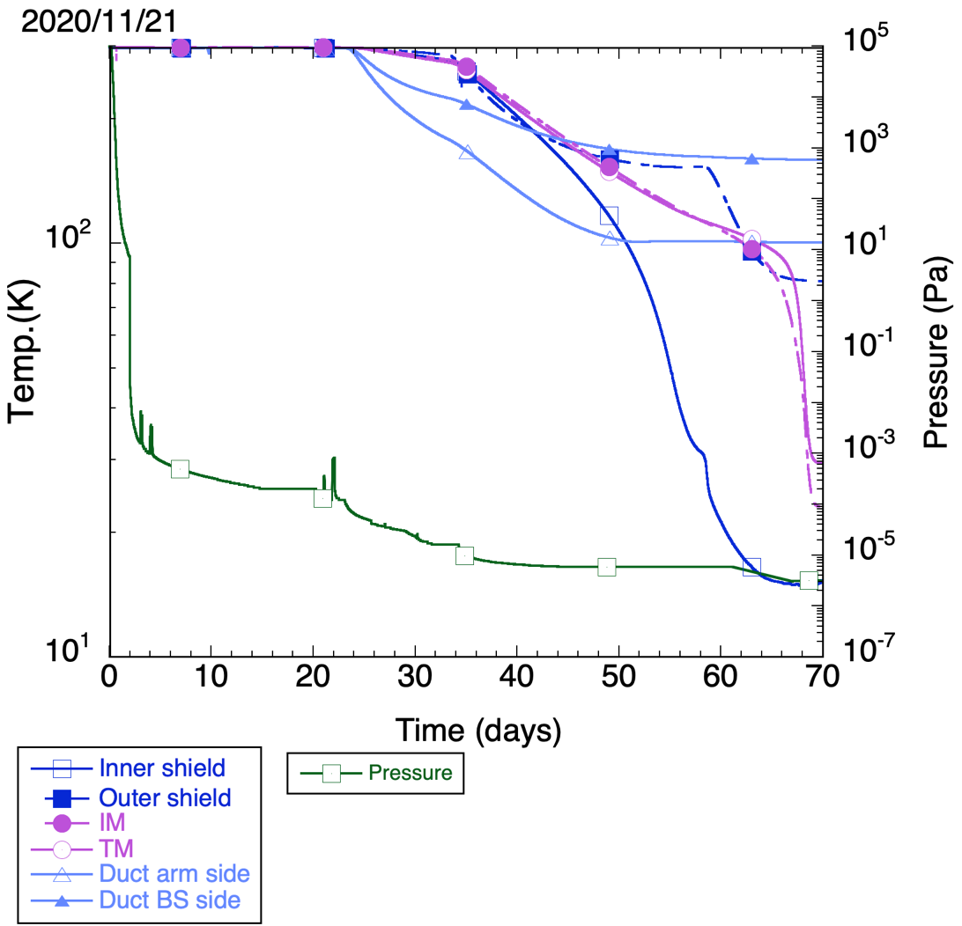
Two cryostat shield cooler “ON”, T_{duct}=150~200 K, T_{TM} ~ 230 K
One root pump “ON”
Two payload cooler “ON”, T_{inner} < 30 K,
T_{TM} > 150 K
> 140 K
\
Two turbo molecule pumps “ON”
> 30 K
Two duct shield cooler “ON”
P_{cryo}=
5.8 x 10^-6 Pa
Temperature dependence of internal pressure

Slide 10
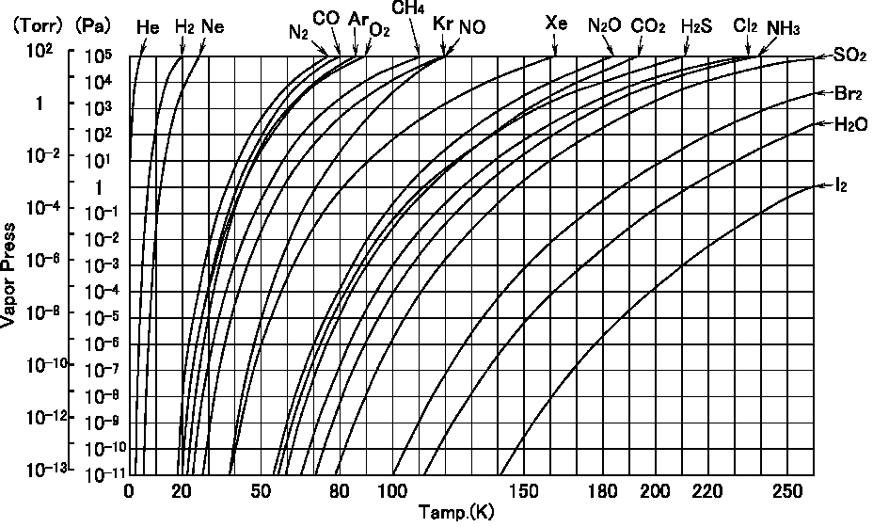
> 1x10⁻⁶ Pa
15 < T_{inner} < 30 K
T_{outer} > 130 K
Trap O₂ & N₂ by inner shield
Trap H₂O by duct & outer shields

Slide 11
Defrost heater layout
Two calibration heaters were equipped with
the top of inner radiation shield.
A small heater was attached on IM for defrost of mirror surface.
A defrost heater was attached on view port.
Three kinds of heaters for defrosting were installed in KAGRA cryostat.
Image of defrost heater

Slide 12
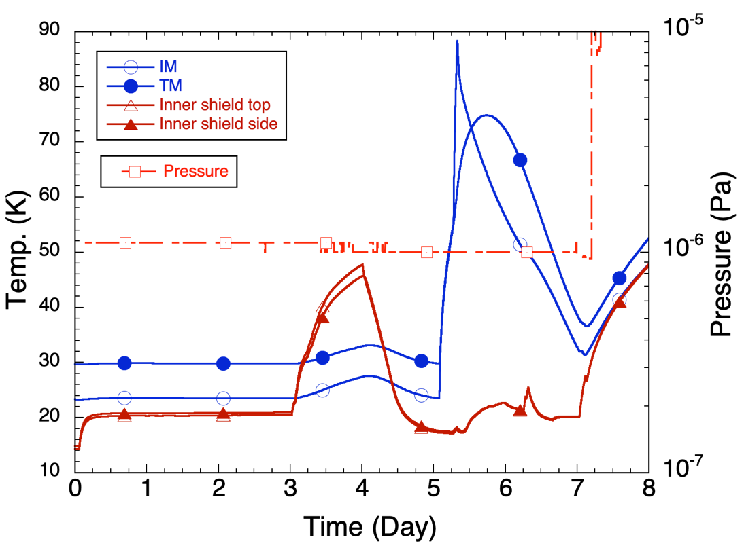
T_{TM}=~75 K
T_{inner shield}=~45 K
Inner Top cal heater “OFF”
IM heater “ON”, Q_{IM}=2.5 W
~two days
~two days
Defrost heater
“ON”
Q_{dh}=~5 W
Inner top cal heater “ON”, Q_{Th}=~31 W
Characteristics of heat input response

Slide 13
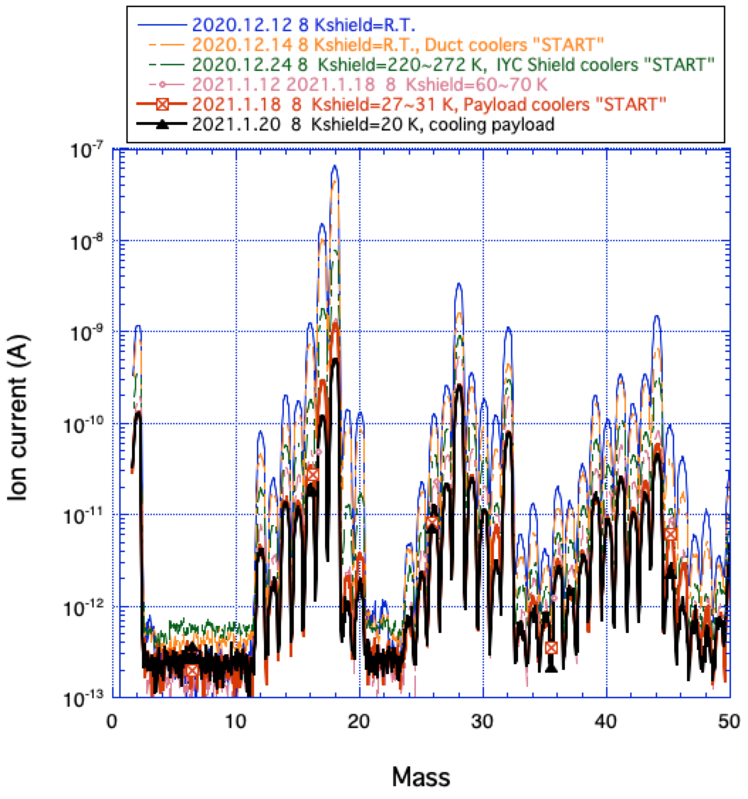
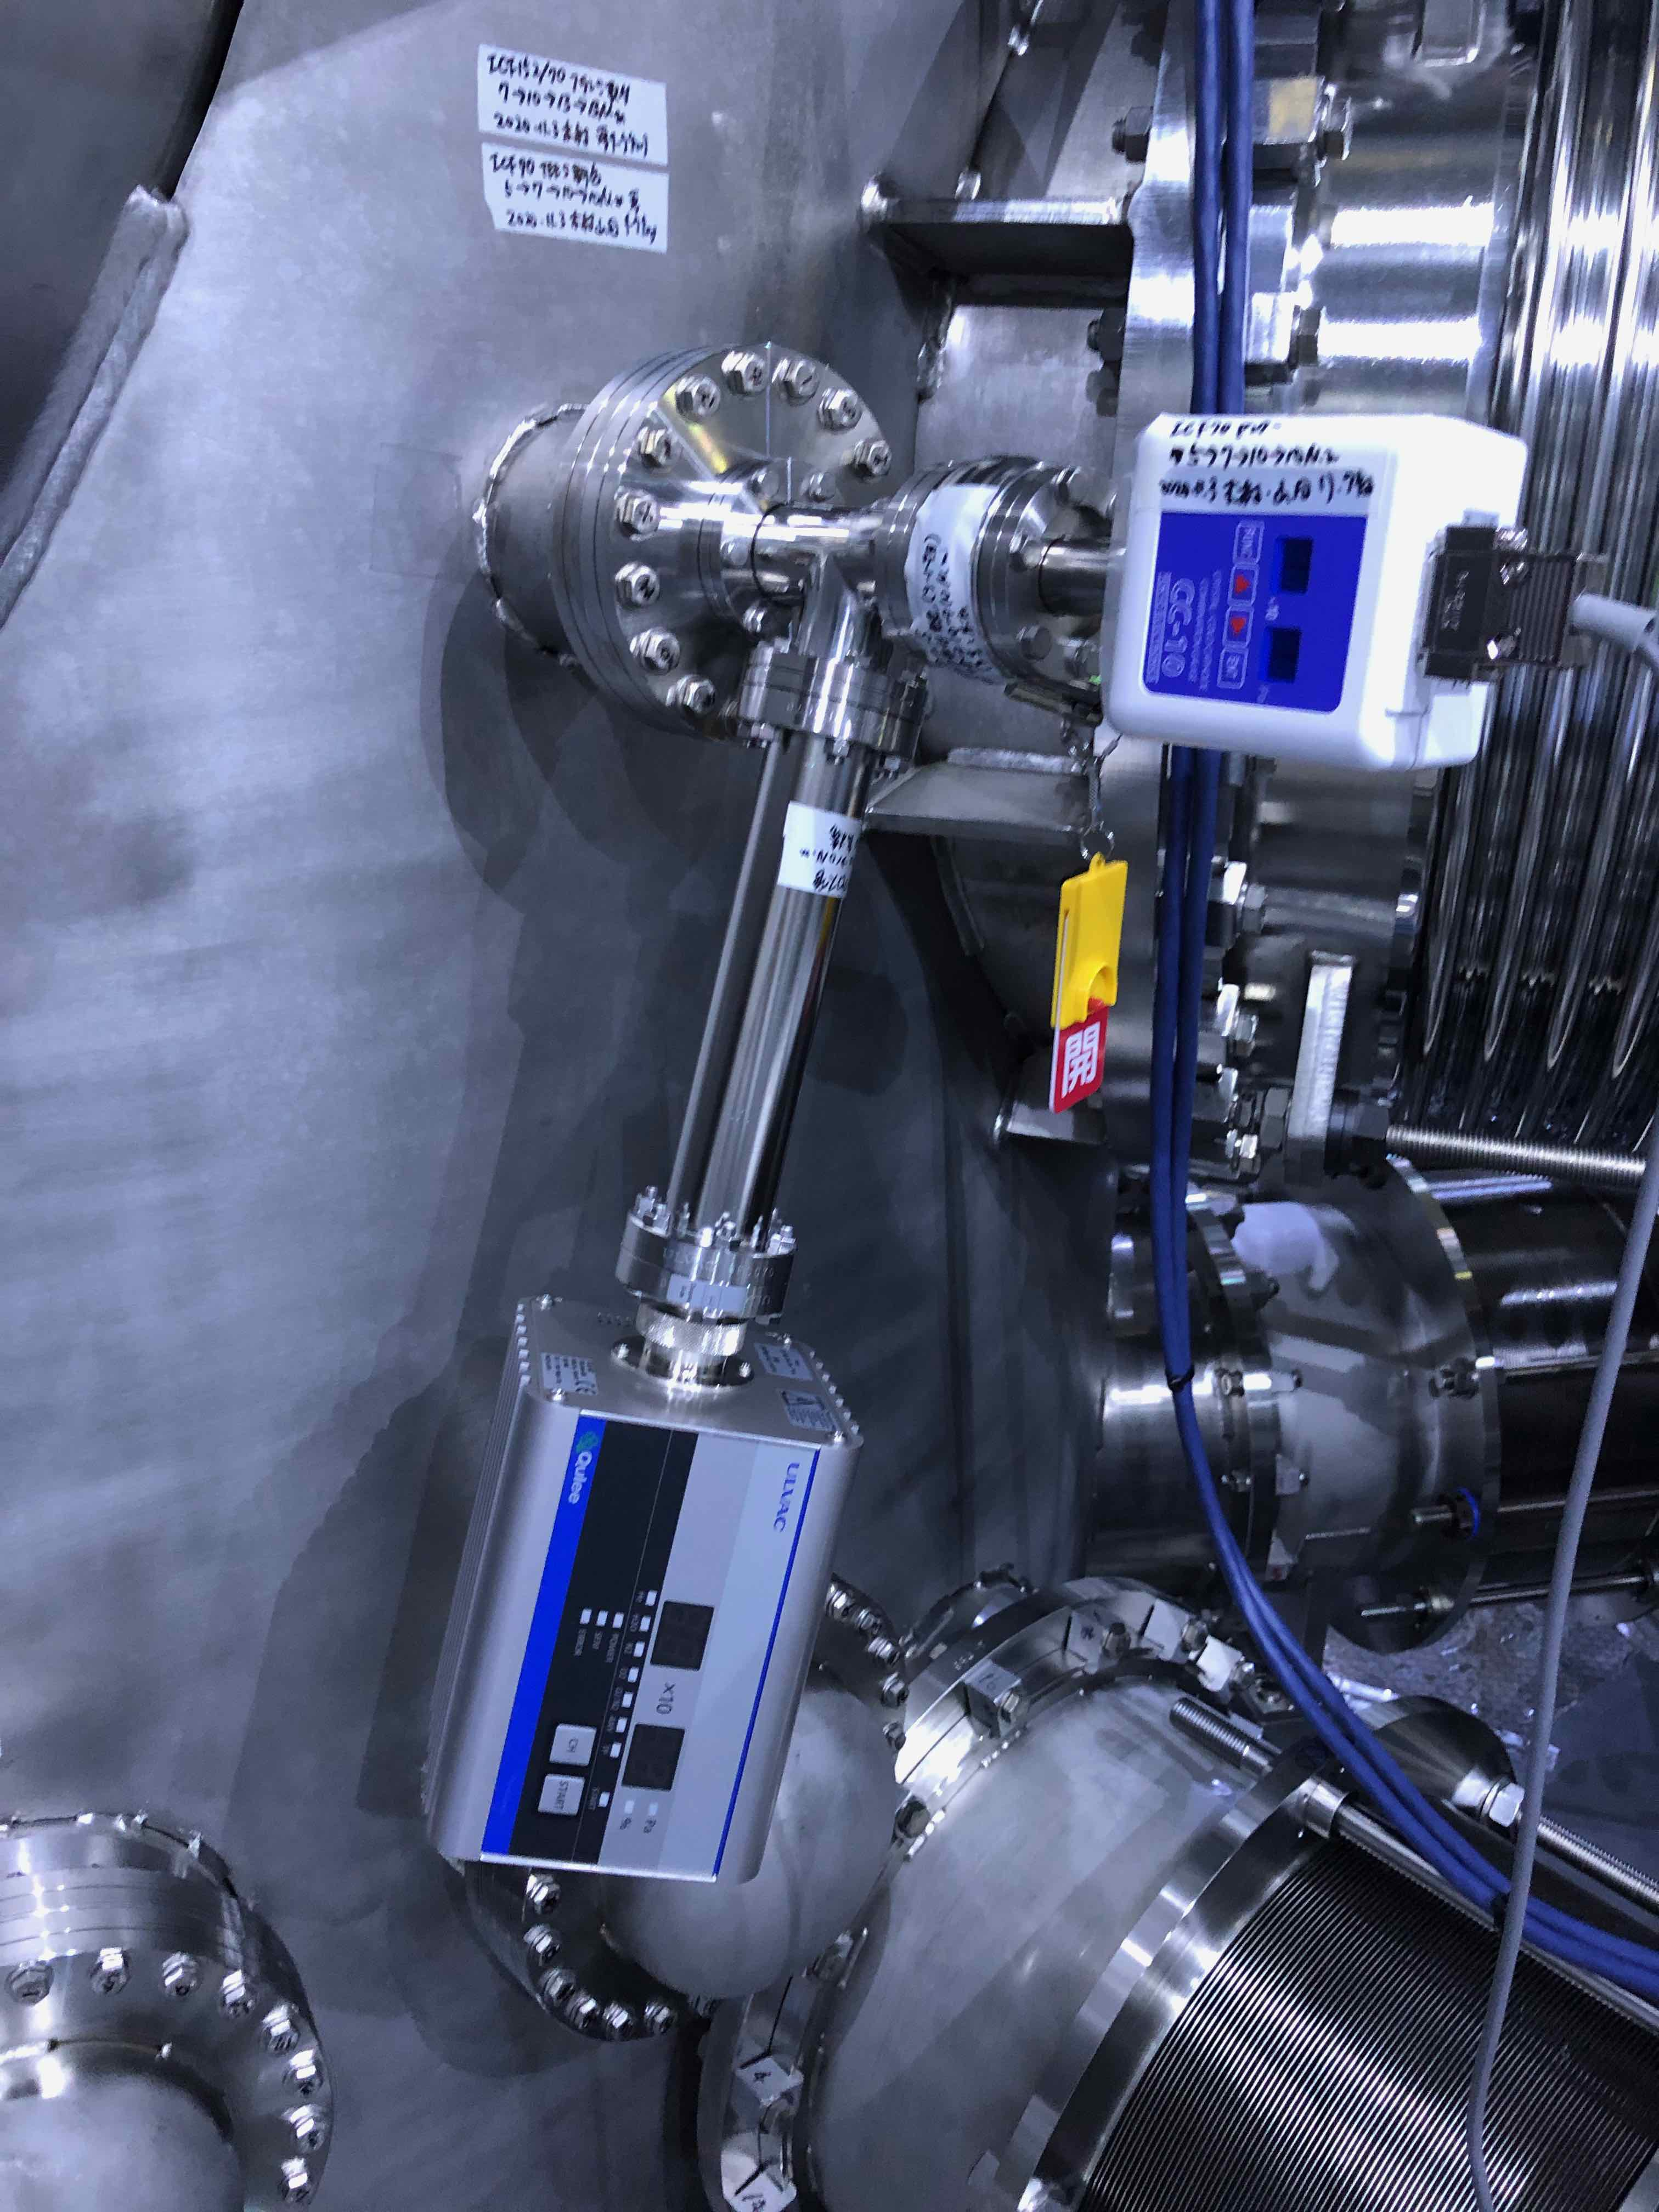
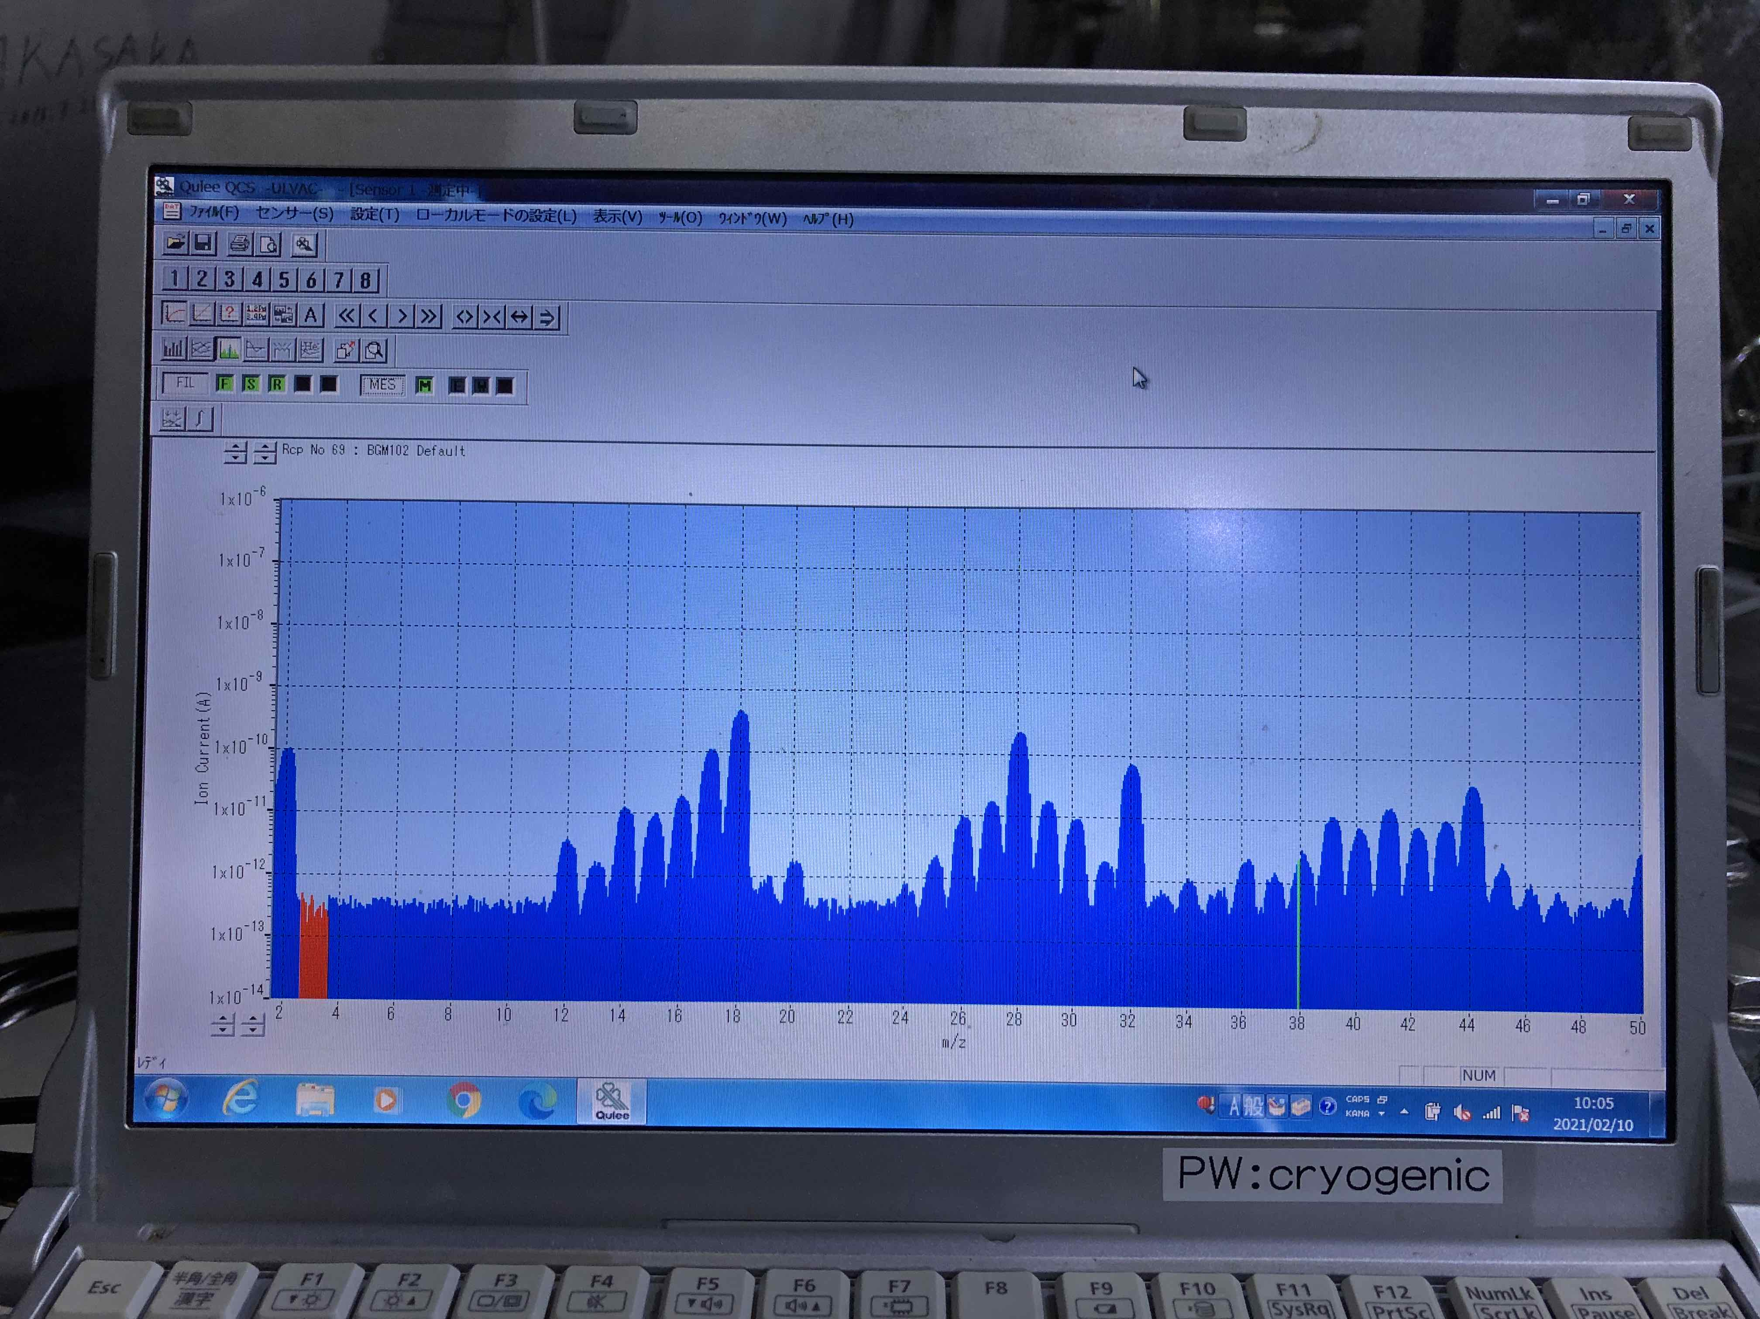
Temperature dependence of Q-mass

Slide 14
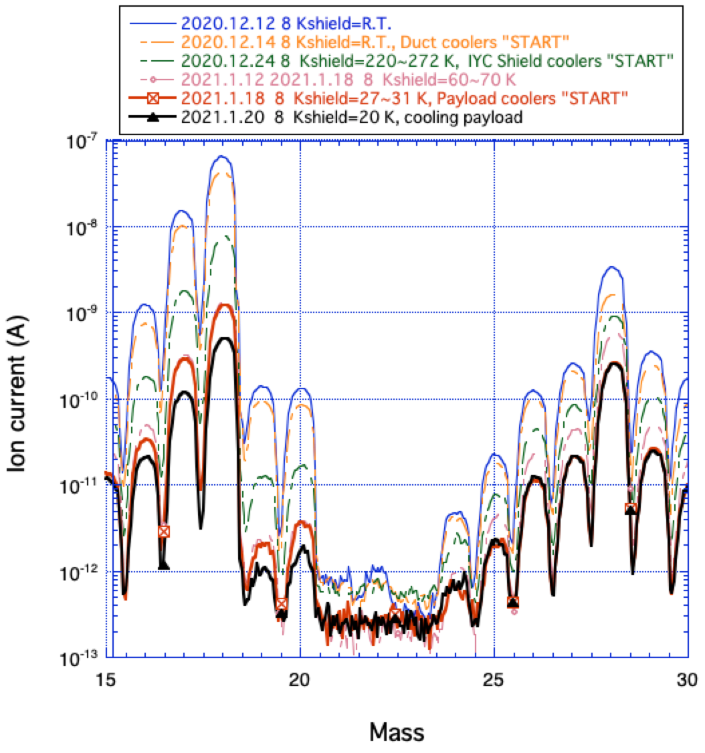
H₂O
N₂
Temperature dependence of Q-mass

Slide 15
Summaries
Frost on the surface of view ports were not appeared during this experiment!
Following items were confirmed in this experiment;
Frost on the view ports are not appeared by proposed cooling scenario.
Calibration heaters on the surface of inner radiation shield well worked as defrost heater for view ports on the surface of inner radiation shield up to ~50 K. It will take 2 days for defrosting for surface of the view ports.
Heater on the IM well worked as defrost heater for mirror on the up to ~70 K. It will take 2 days for defrosting for surface of mirror.
Partial pressure measurement of residual gas at each temperature was performed.

Slide 16
Appendix

Slide 17
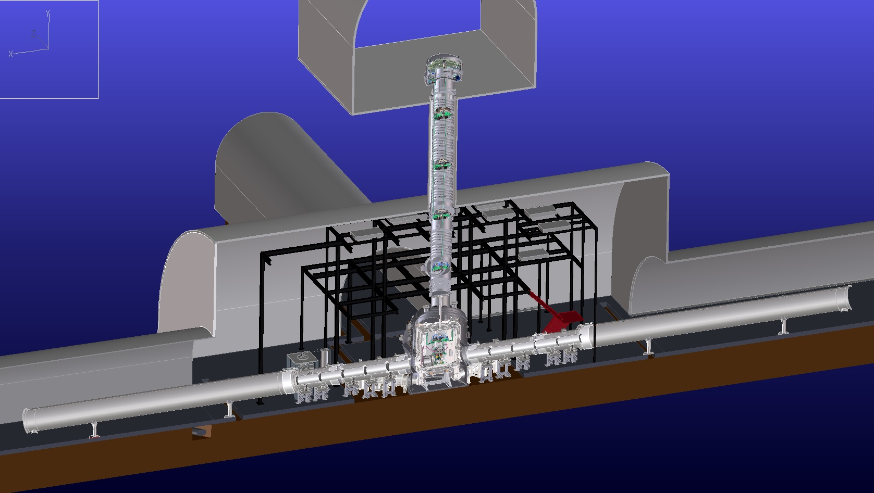
Overview of KAGRA Cryogenics system
Main mirror parts
Vibration isolation system
at room temperature
Cryo shield ducts
in order to terminate
300 K radiation
14m
Beam duct
Cryostat with four cryocoolers

Slide 18
Structure of KAGRA Cryostat
Stainless steel t=20mm
Diameter 2.4 m
Height ~4.3 m
M ~ 12 ton
Cold Mass:
8K shield ~455 kg
80 K shield ~590 kg
Seismic Attenuation System (SAS)
Cryogenic Payload
4.3 m
Sapphire Mirror
(α-alumina crystal)
View Ports
Radiation Shields
Duct Shield
Main Laser Beam
Cryocoolers
Pulse tube, 60Hz
0.9 W at 4K (2nd)
36 W at 50K (1st)
Four Cryocooler Units
φ2.6m
S. Koike

Slide 19
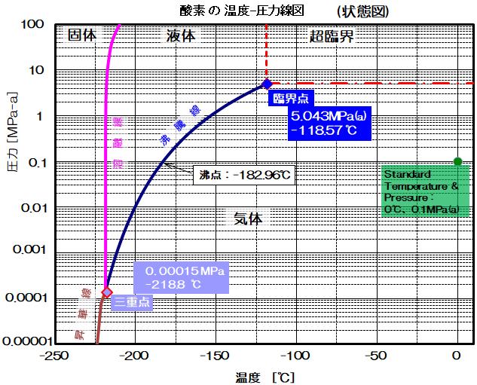
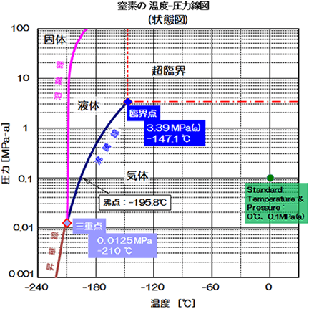
1x10-3 Pa → ~-220 ℃（~53 K）
Solid
Solid
Liquid
super critical
O₂
super critical
N₂
Liquid
Pressure (MPa absolute)
Boiling point:-182.96 C
Pressure (MPa absolute)
Gas
Gas
Gas
Boiling point:-147.1 C
Temperature (℃)
Temperature (℃)
1x10⁻⁵ Pa → ~-225 ℃（~48 K）
State diagrams of O2 and N2

Slide 20
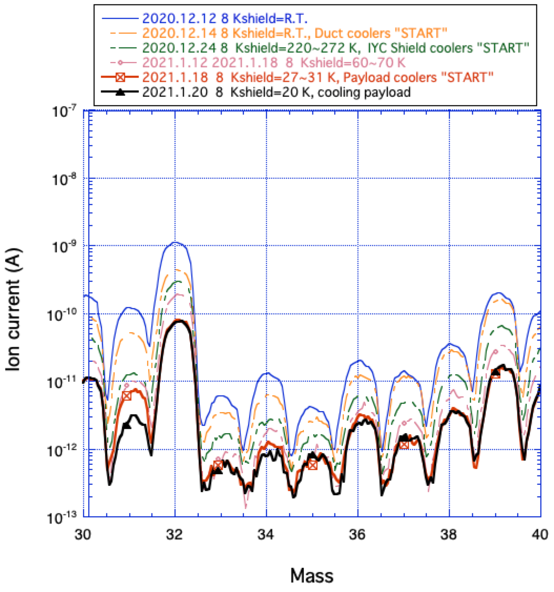
O₂
Temperature dependence of Q-mass

