Slide 1
Short Introduction to
学術変革 ダークマター
(Transformative Research Area "Dark Matter")
JGW-G2112904
KAGRA Telecon (Online)
May 12, 2021
Yuta Michimura
Department of Physics, University of Tokyo

Slide 2

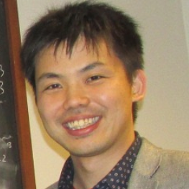
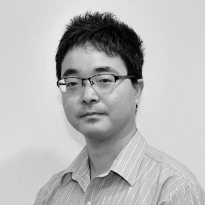
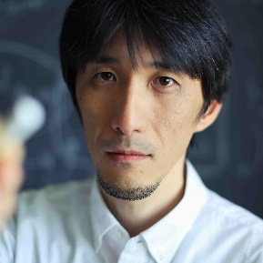

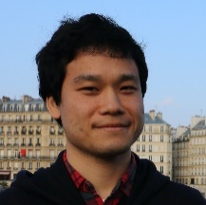
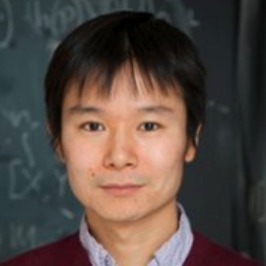
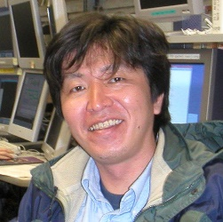

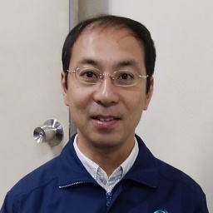
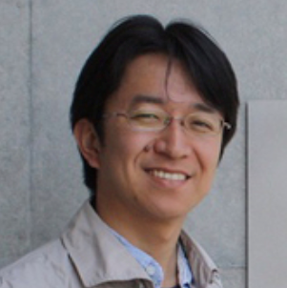

学術変革 ダークマター
From November 2020 to March 2025
https://member.ipmu.jp/DarkMatter/
Dark matter mass [GeV/c²]
10^{–40}
10^{–30}
10^{–20}
10^{–10}
10⁰
10¹⁰
10²⁰
10³⁰
10⁴⁰
10⁵⁰
10⁶⁰
10⁷⁰
Excluded
Ultralight field
Light particle
Heavy particle
Macroscopic
Excluded
WIMP
Particle
X-ray
X-ray
CMB
Neutrino experiments
X-ray
CMB
Laser interferometers
Gravitational lensing
e⁺e–
Cosmic rays
Subaru imaging / spectroscopy
Subaru spectroscopy

Slide 3
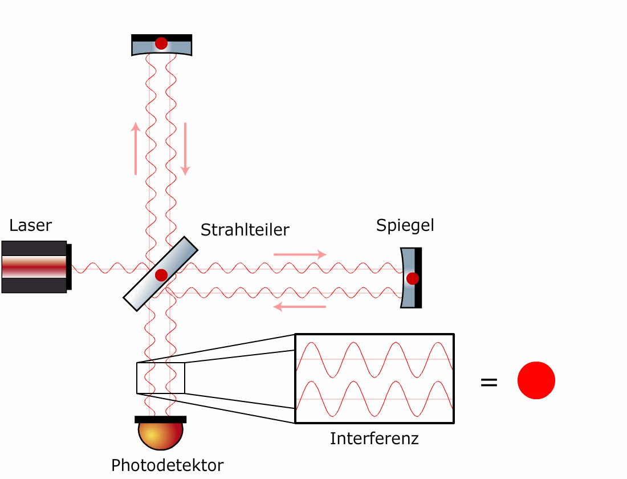
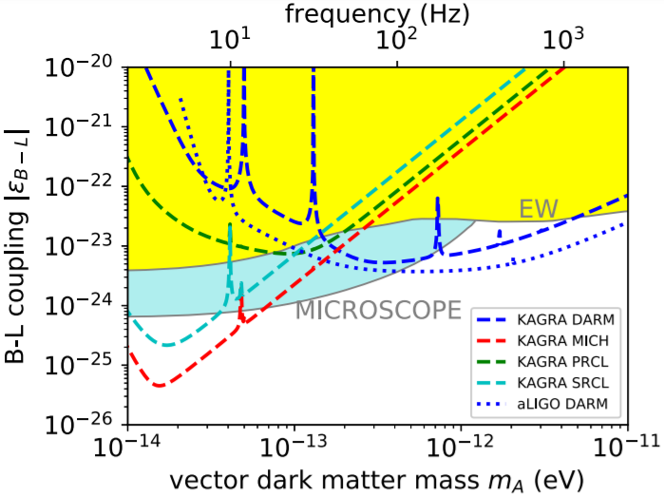
Ultralight Dark Matter
Ultralight DM (<~1 eV) behaves as classical wave fields
Laser interferometers are sensitive to tiny length changes from such oscillations

Slide 4
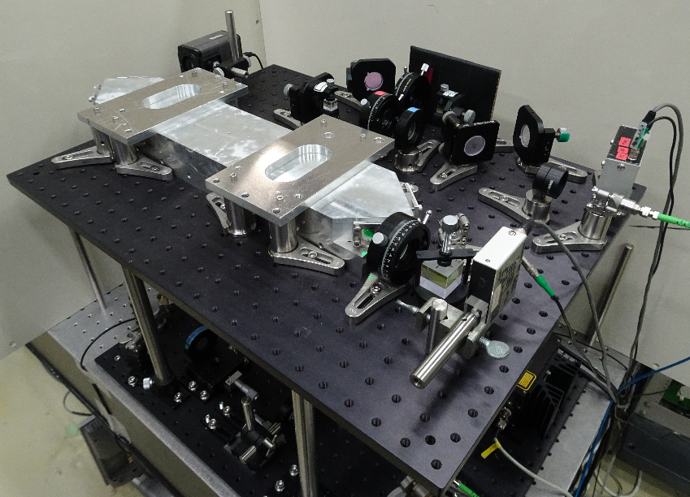
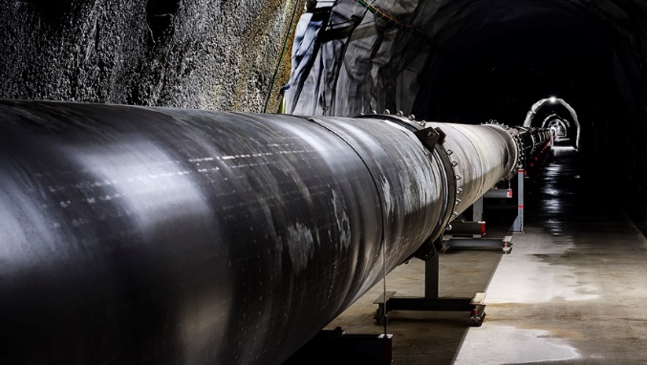

Our Strategy
Use both table-top optical cavities and large-scale laser interferometric gravitational wave detectors
Ultralight DM
Broad band
Axion like particles
PRL 121, 161301 (2018)
Table-top
optical cavity
Narrow band
PRL 123, 111301 (2019)
+
Polarization measurement
Gauge bosons
PRD 102, 102001 (2020)
PRD 103, L051702 (2021)

Slide 5
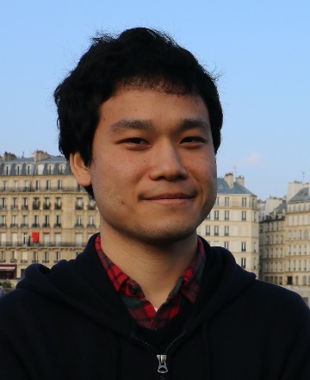




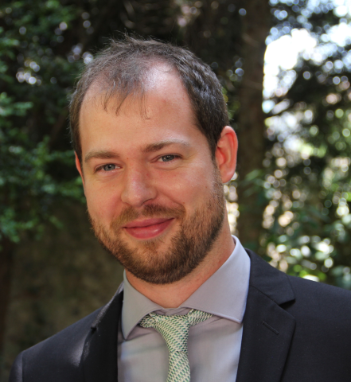



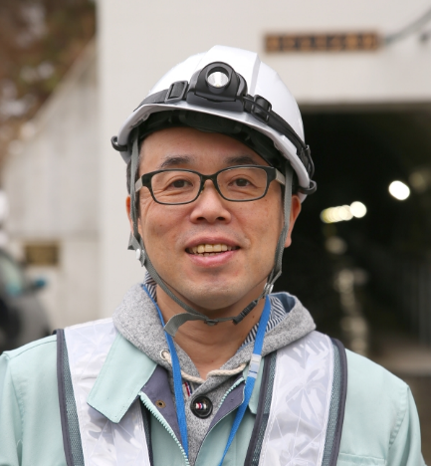

Our Team
※Non-LVK member
PI: Yuta Michimura
(道村唯太, UTokyo)
Experiment
Co-I: Tomohiro Fujita
(藤田智弘, ICRR)
Theory
& Data analysis
Yuka Oshima
Hiroki Fujimoto
Koji Nagano
Ippei Obata
Hiromasa Nakatsuka
Soichiro Morisaki
Jun’ya Kume
Atsushi Nishizawa
... and more to come!
Co-I: Matteo Leonardi
(マテオ・レオナルディ, NAOJ)
Optical characterization
Co-I: Shinji Miyoki
(三代木伸二, ICRR)
KAGRA

Slide 6
The Budget
1.49M JPY (~1.37M USD) in total
- from November 2020 to March 2025
Roughly half is planned be used for KAGRA
- Already spent some to buy optics etc. for KAGRA
- Improving the sensitivity to GW
will improve the sensitivity to DM
1 Project Researcher will join us from July 2021
- Will work on birefringence studies and other interferometer simulations for KAGRA
By the way, we are also looking for another Project Researcher working on the data analysis

Slide 7
Past Presentations/Publications
On axion search by Koji Nagano at F2F April 2019
(Poster Award)
On DM searches by Tomohiro Fujita and Yuta Michimura at KIW7 Dec 2020
Y. Michimura+, Phys. Rev. D 102, 102001 (2020)
- Submitted through CPC
S. Morisaki+. Phys. Rev. D 103, L051702 (2021)
- Presented at LVK Dark Matter call on Oct. 28, 2020

Slide 8
Expected LVK Publications
Gauge boson dark matter search using O3GK KAGRA data
- On-going
- New approach to use MICH/PRCL data
(Unique to KAGRA since we use sapphire)
Axion dark matter search using O4 KAGRA data
- Using polarization optics
Updated gauge boson dark matter search using O4 KAGRA data
- Hopefully do better than LIGO DARM
Also, some short author papers discussing the data analysis pipelines and experimental proposals

