Slide 1
Future Plans of Ground Based GW projects
地上の将来計画
S.Haino
KAGRA collaboration
CRC town meeting (Dec./21, 2019)

Slide 2
Typical GW strain amplitude
..
r_{g}
R
2G
c⁴R
Schwarzschild radius
h ~ I ~ =
e.g. Solar mass (r_{g}~3km) NS-NS binary merging
at ~speed of light located at 100 Mpc away
h ~ = 10⁻²¹
GW signal is very tiny but propagate as 1/R (not 1/R²)
Distance to the source
3 km
100 Mpc

Slide 3
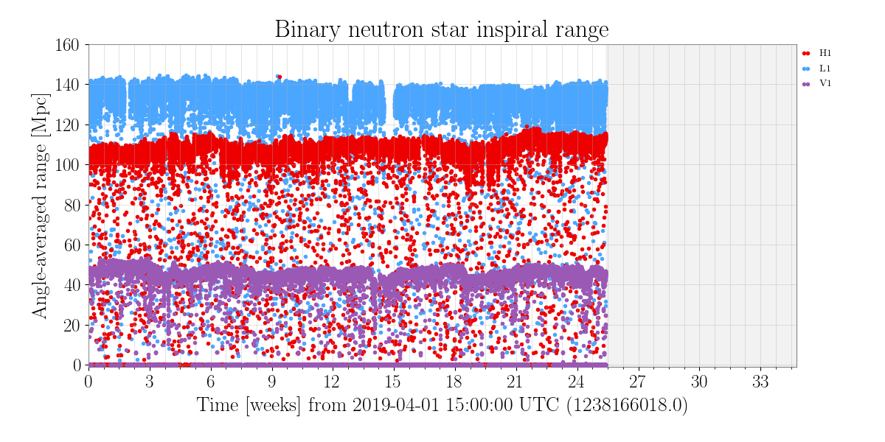
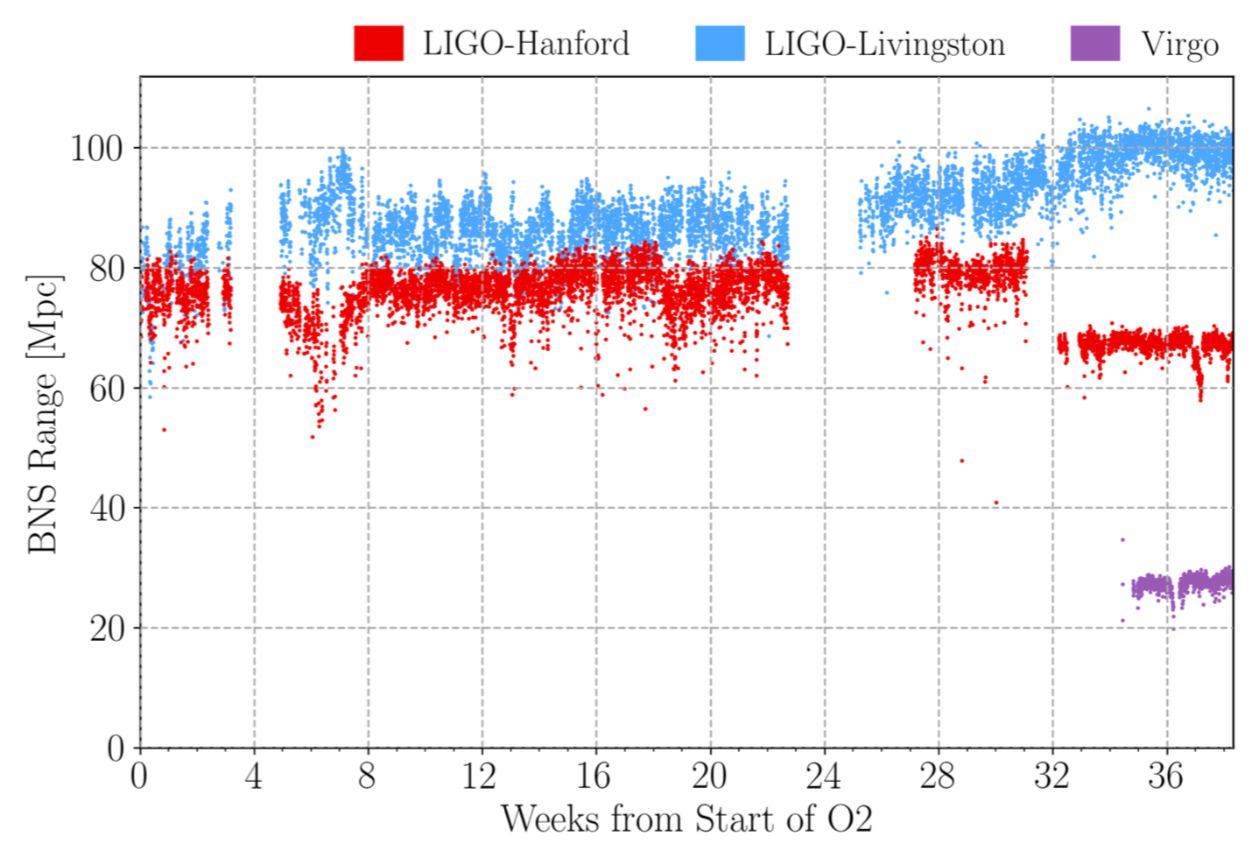
Sensitivity and events
O3 ~130 Mpc
O2 80~100 Mpc

Slide 4
Future Prospects (ground based)
Near term (5~10 years) - 2G (2nd Generation)
- (Almost) funded in U.S. and Europe
- O4 in 2022~
- O5 in 2025~
Far term (10~ years) - 3G (3rd Generation)
- New facility and big funding needed
- Cosmic Explorer (US)
- Einstein Telescope (ET)
- Japan ? Discussion in this session
- …

Slide 5
Quick review in GW science
Based on SH’s personal view with help of A.Nishizawa
Topic/Source | Ground (2G) | Ground (3G) | Space | Comment
BNS, NSBH | ○ | ◎ | ○ | Science: Test of GR, NS EoS, Multi messenger, sGRB, Standard siren, …
Stellar-mass BBH | ◎ | ◎ | ○ | Science: Test of GR, Formation scenario, … Space: inspiral phase
Intermediate BBH | △ | ◎ | ◎ | Science: Formation scenario, Test of GR, …
Pulsar CW | △(?) | ○(?) | △(?) | Depends on models Science: NS EOS and internal structure
Massive BBH | ✕ | ✕ | ◎ | Science: Formation scenario, Test of GR, …
EMRI Harmonics | ✕ | △ | ◎ | Science: Formation scenario, Test of GR, …
WD, GB | ✕ | ✕ | ◎ | Science: SN astrophysics, Standard siren
Supernovae | ? | ○(?) | △(?) | Depends on model and luck Science: explosion mechanism
Primordial GW | ? | ? | ◎(?) | Depends on models Science: Direct test of inflation
Cosmology | ○ | ◎ | ◎ | Source: BNS/NSBH, BBH, WD, Primordial
Test of GR | ◎ | ◎ | ◎ | Source: BNS/NSBH, BBH, EMRI
BNS: Binary Neutron Star, NSBH: Neutron Star-Black Hole, BBH: Binary Black Hole,
CW: Continuous Wave, EMRI: Extreme mass ratio inspiral, WD: White Dwarf, GB: Galactic Binary

Slide 6
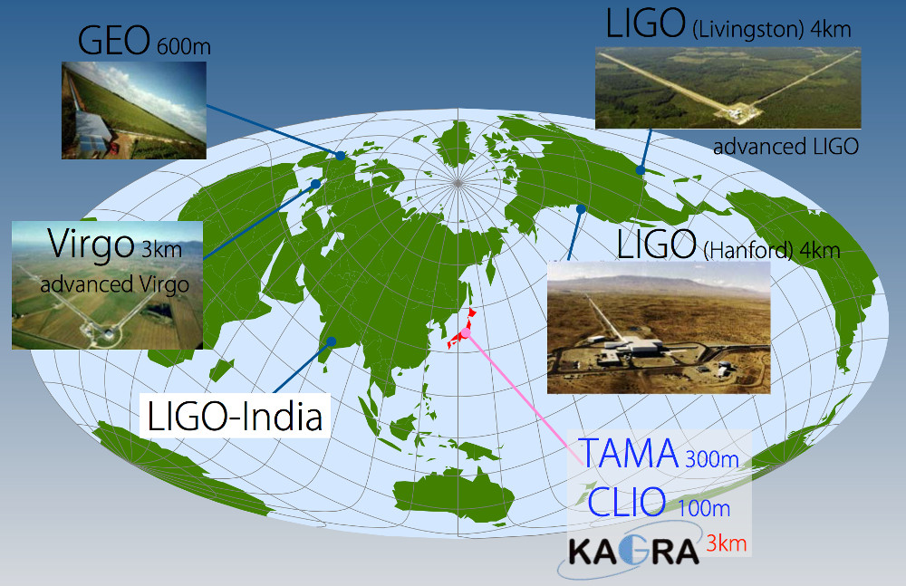
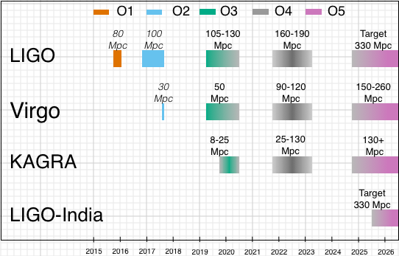
LIGO/Virgo O4, O5 projection
[LIGO-P1200087][arXiv:1304.0670]

Slide 7
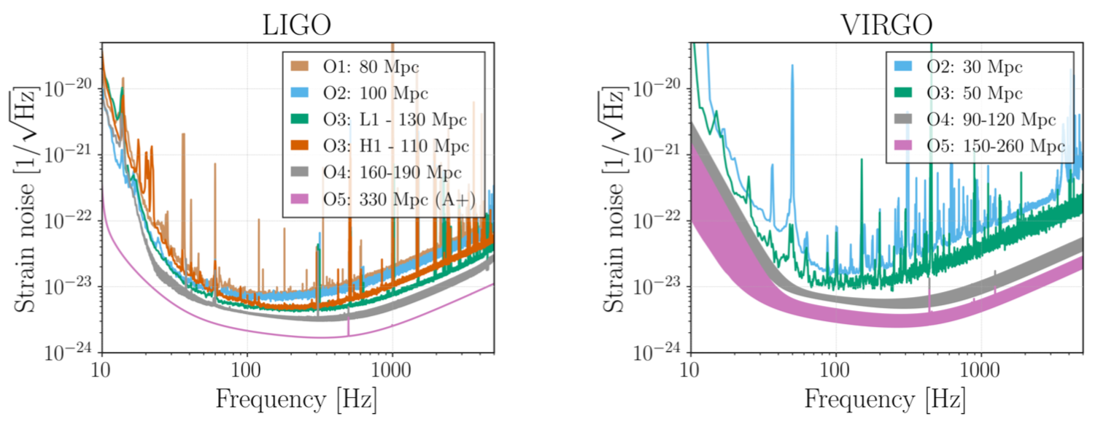
LIGO/Virgo O4, O5 projection
Updated on July/11/2019 at LIGO-P1200087
also at arXiv:1304.0670
LIGO O4: 160 – 190 Mpc O5: 330 Mpc
Virgo O4: 90 – 120 Mpc O5: 150-260 Mpc

Slide 8
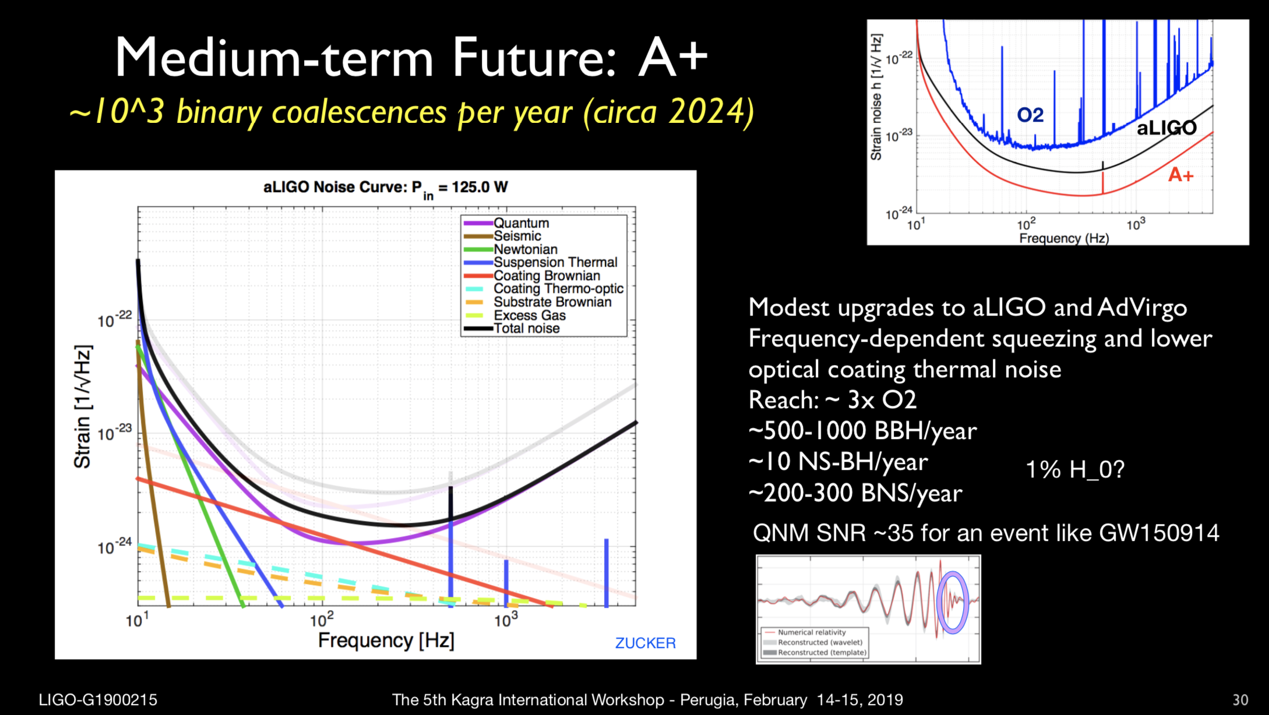
O5: A+
(Advanced LIGO+ in U.S.)
L. Cadonati 5th KIW 2019

Slide 9
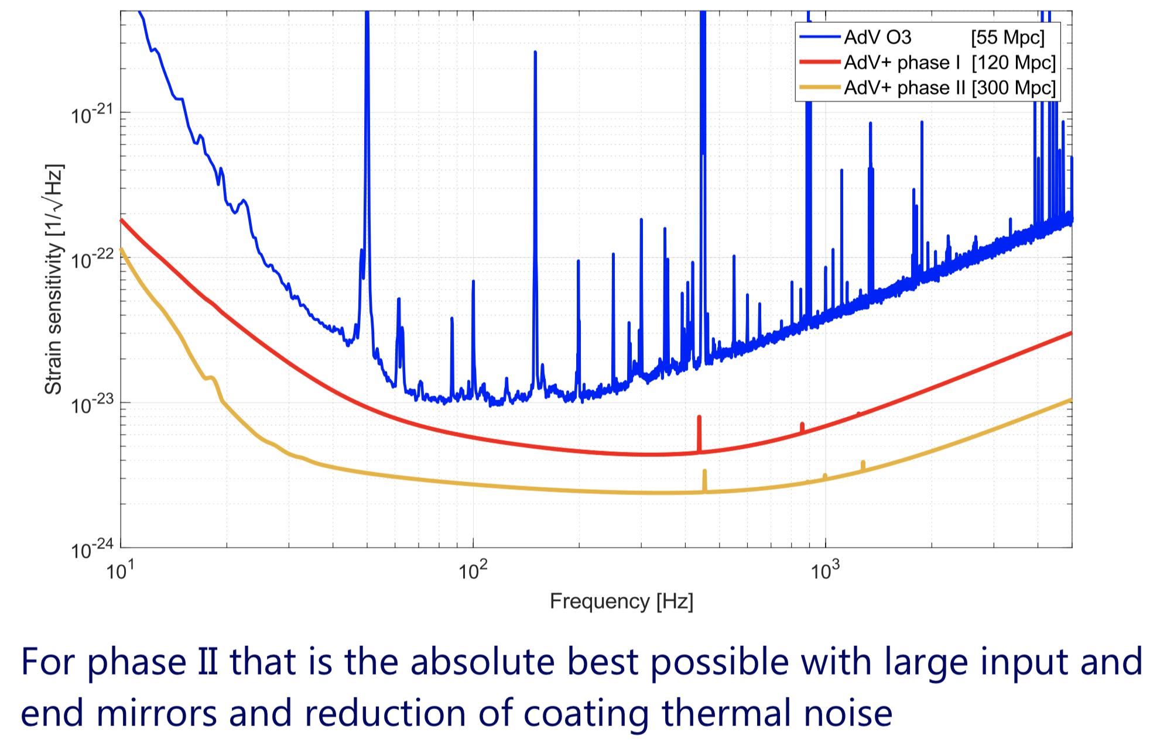
O5: AdV+
(Advanced Virgo+ in Italy)
J. Degallaix GWADW 2019

Slide 10
3G: Each region’s prospects
Projects being discussed for many years
U.S – CE1 (2030~) /CE2 (2040~)
Europe – ET (2030~)
Projects being proposed recently
Australia – oz-HF (?)
China – ZAIGA (?)

Slide 11
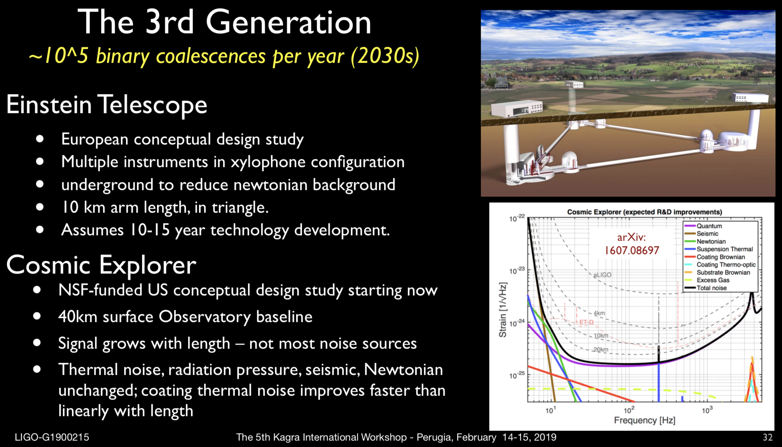
L. Cadonati 5th KAGRA International Workshop 2019

Slide 12
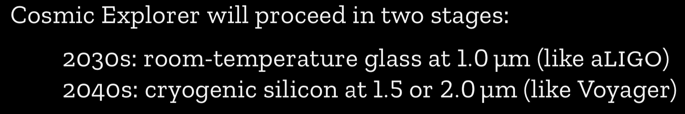
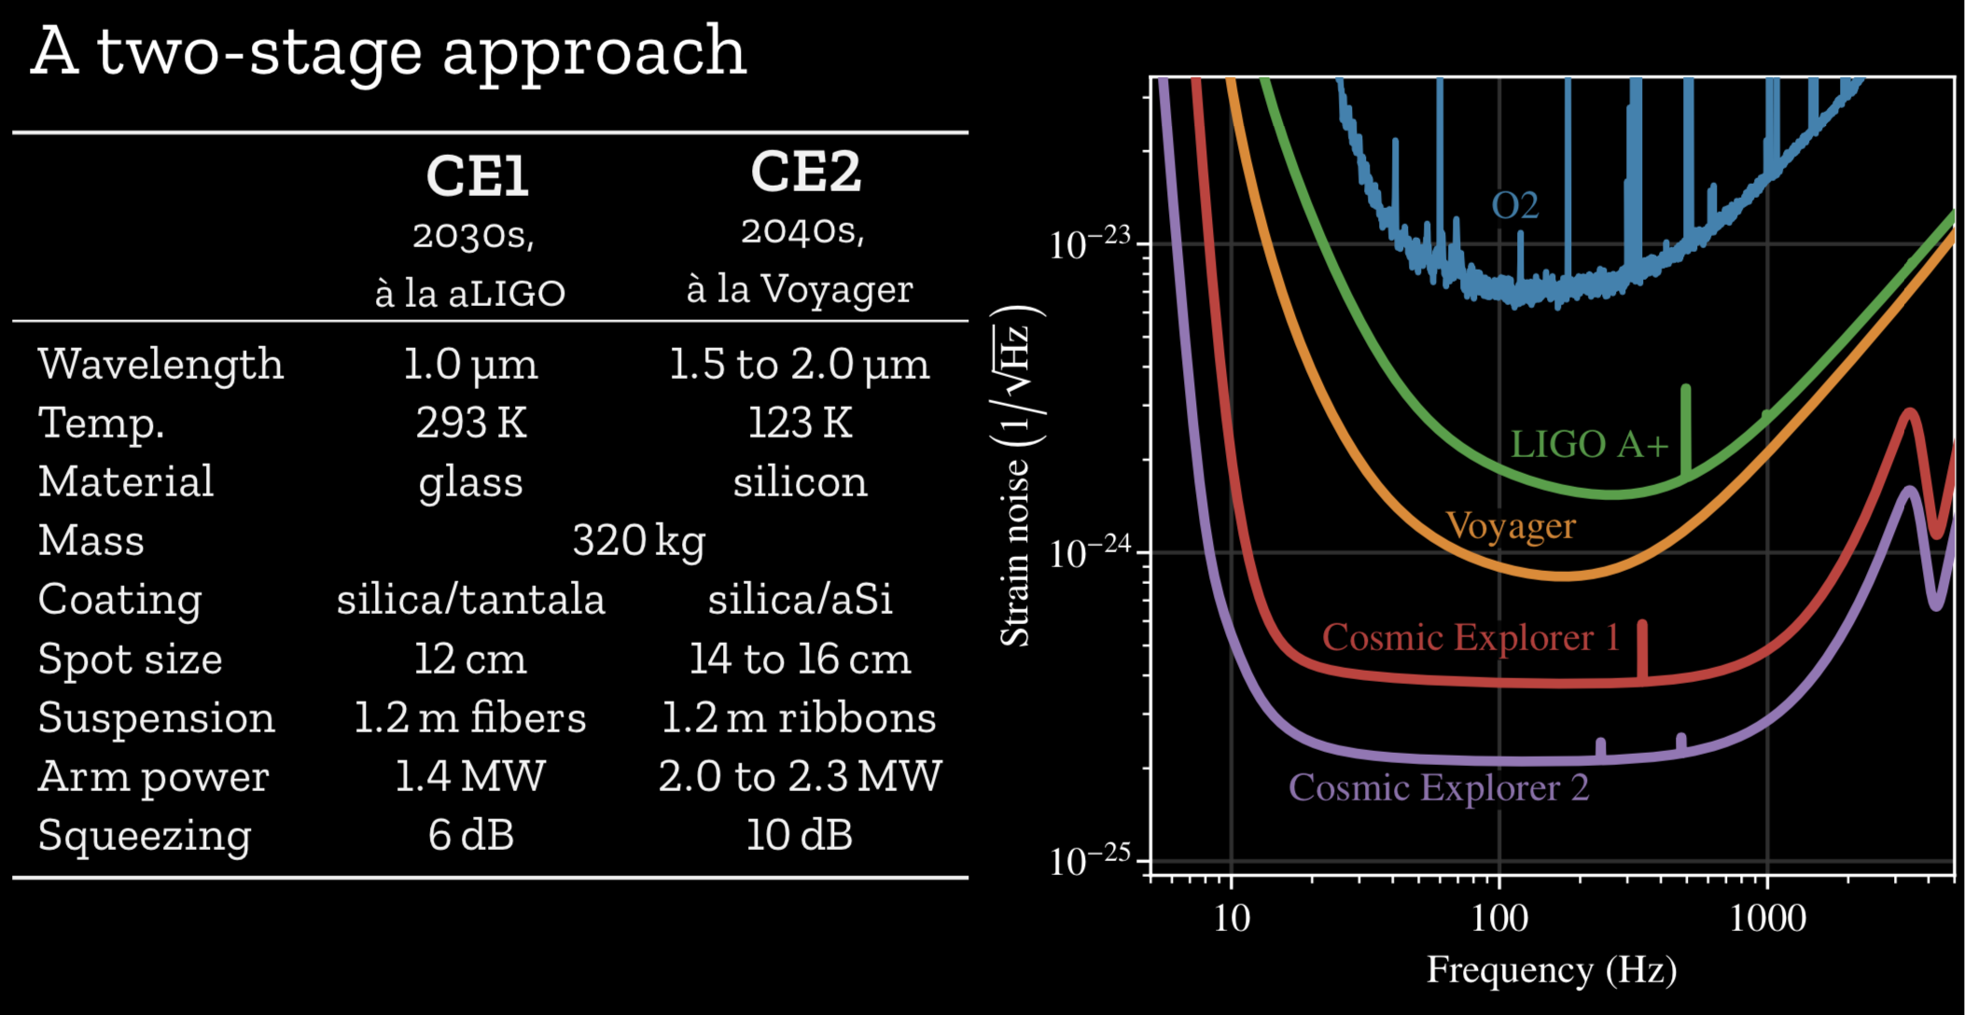
Cosmic Explorer (U.S.)
E. Hall DAWN-V (2019)

Slide 13
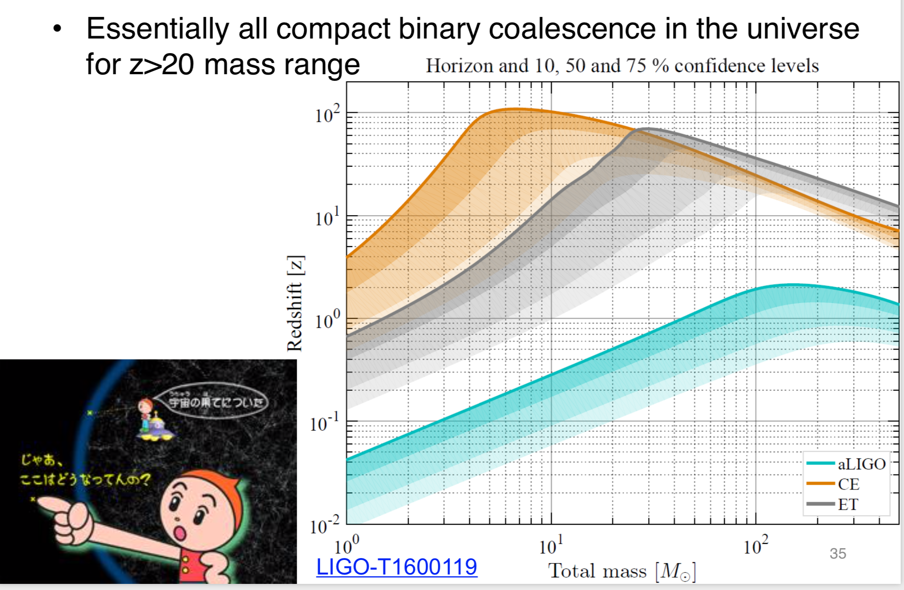
Y. Michimura Lab seminor (2017)

Slide 14
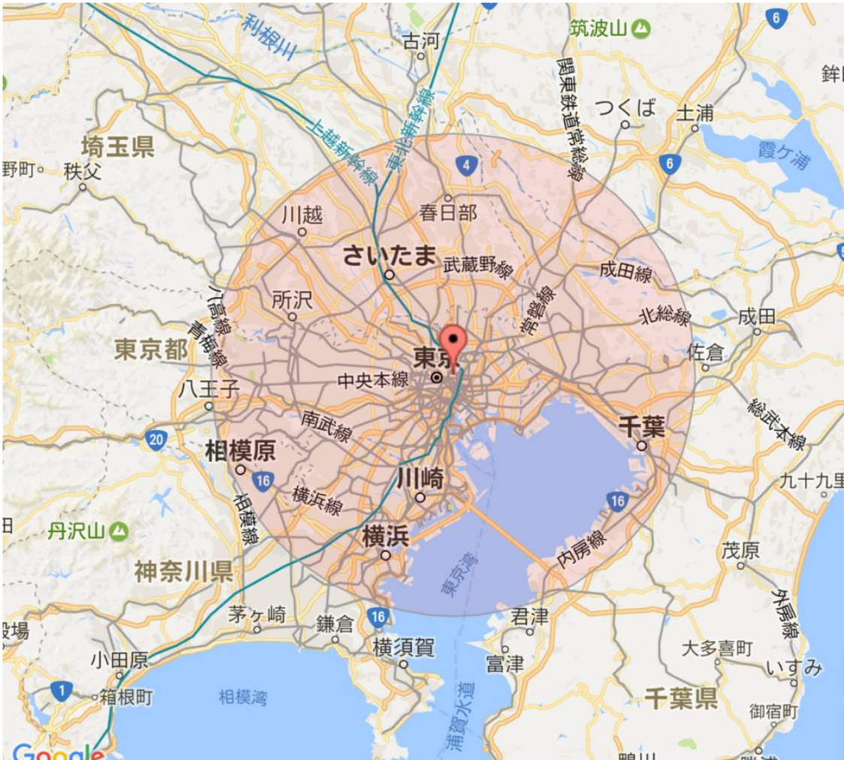
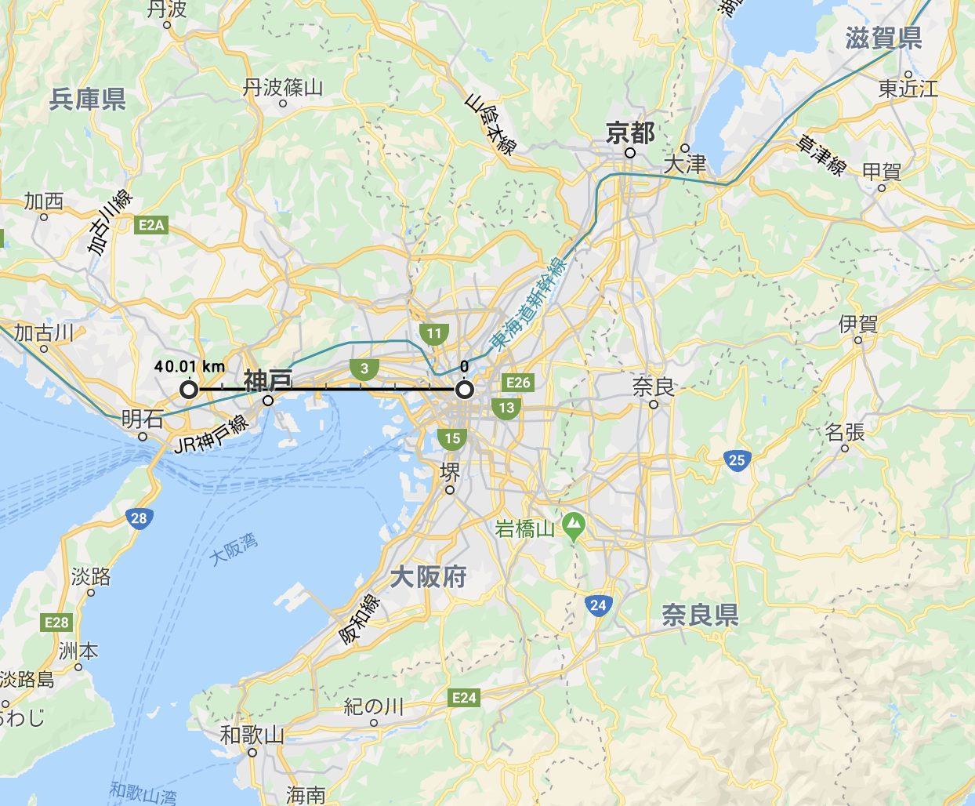
40 km scale

Slide 15
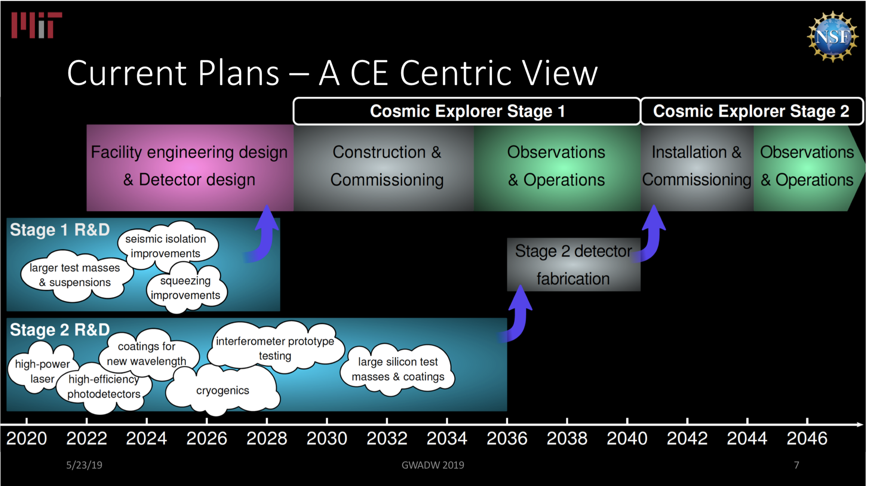
Cosmic Explorer (U.S.)
M. Evans GWADW 2019

Slide 16
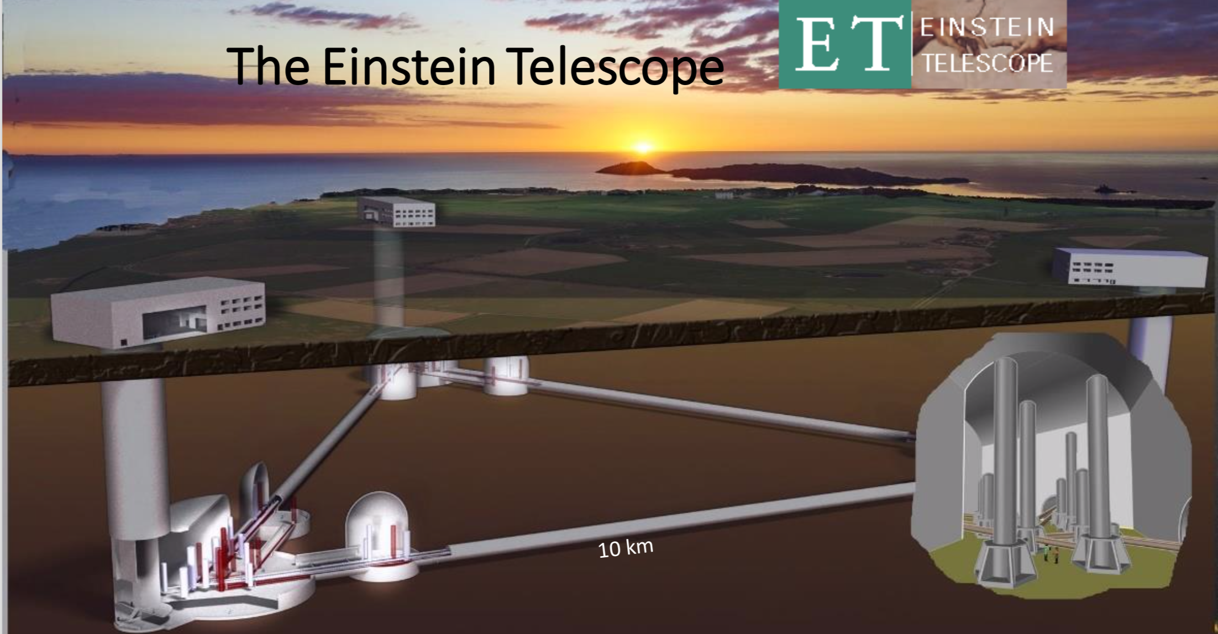
M. Punturo KIW5 2019

Slide 17
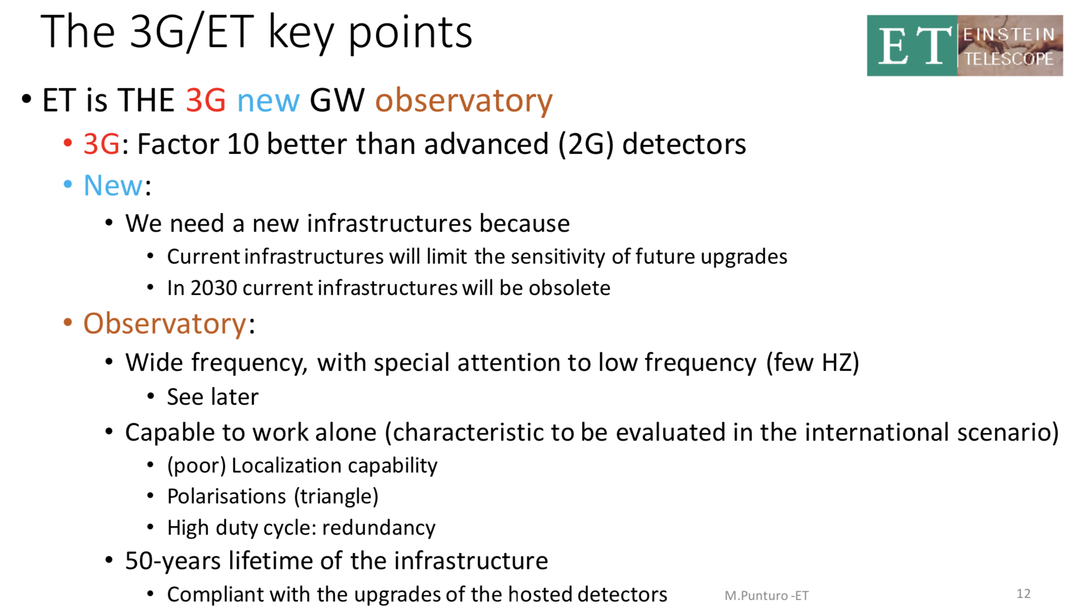
M. Punturo KIW5 2019

Slide 18
Operation planned from 2032
M. Punturo KIW5 2019

Slide 19
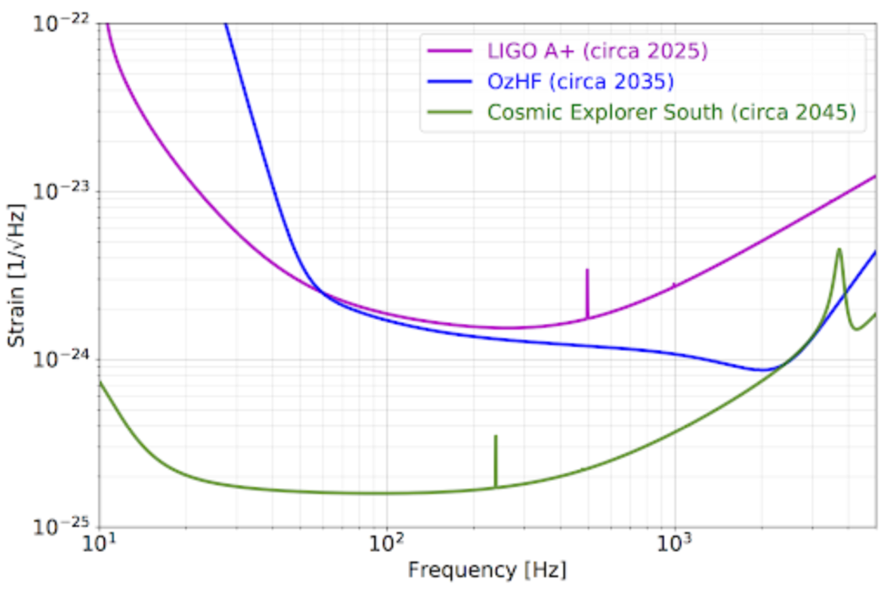
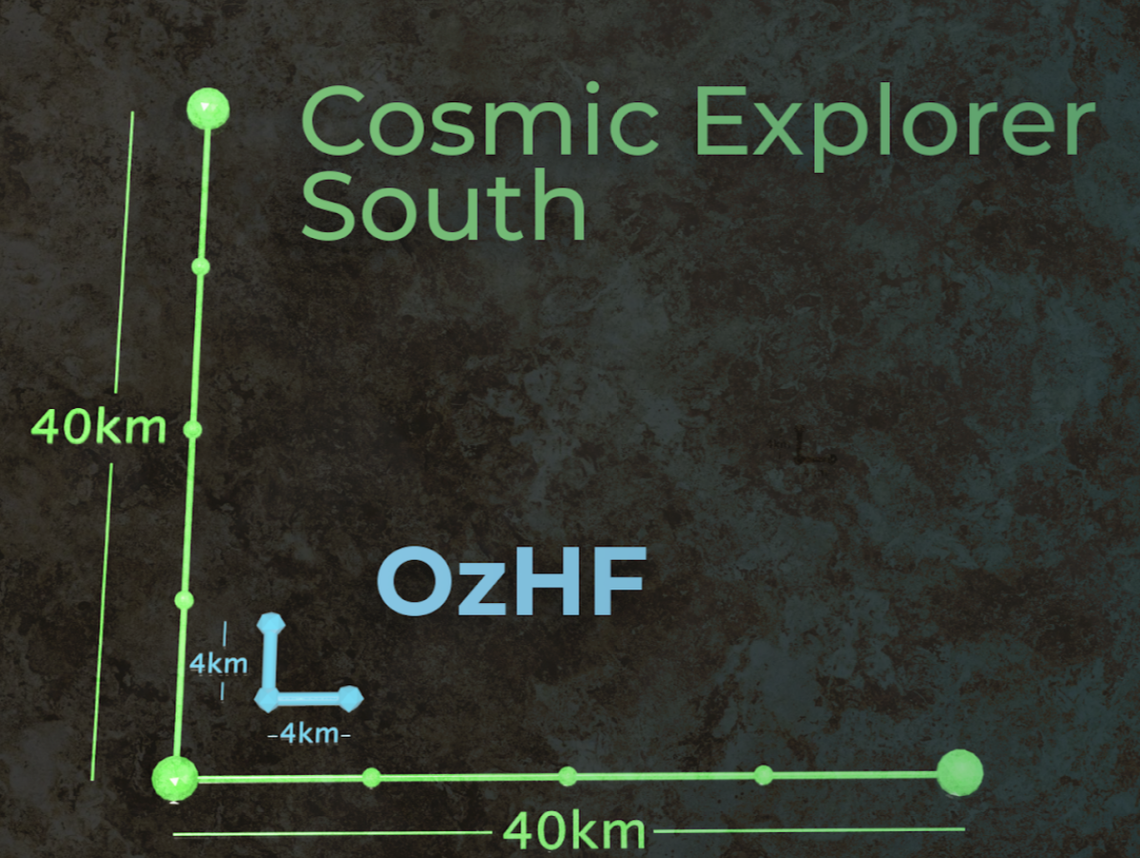
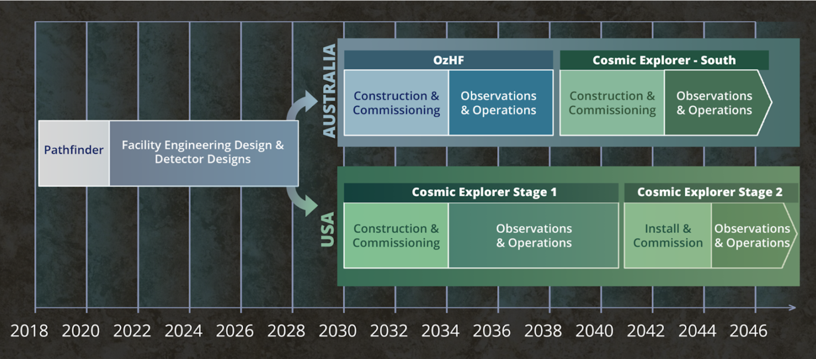
oz-HF (Australia)
arXiv:1912.06305 (2019/12/16)

Slide 20
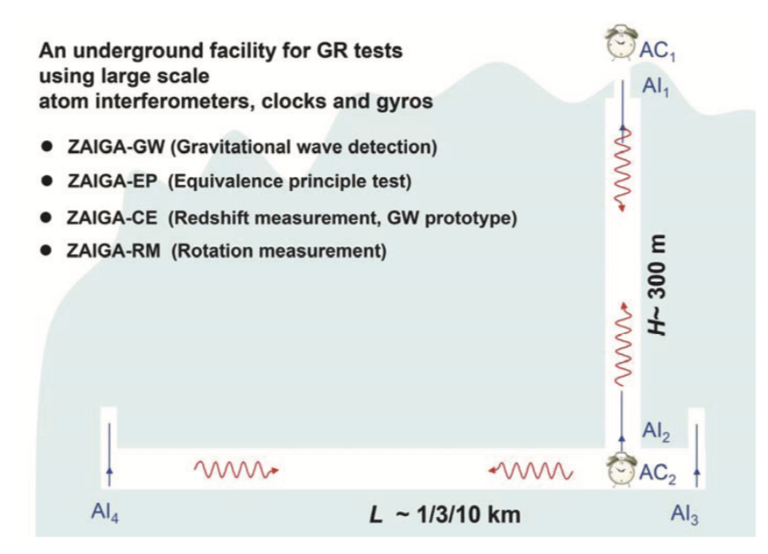
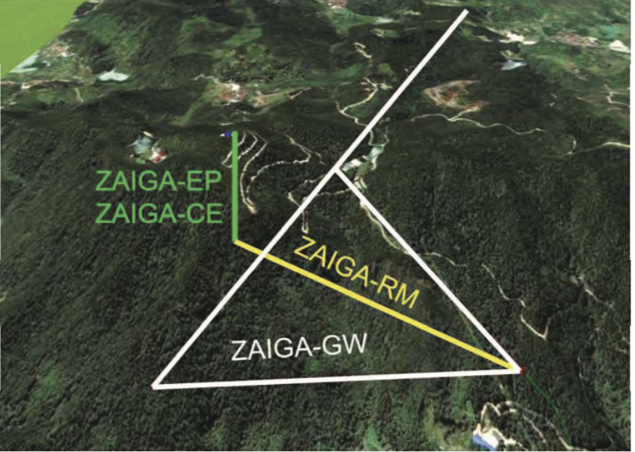
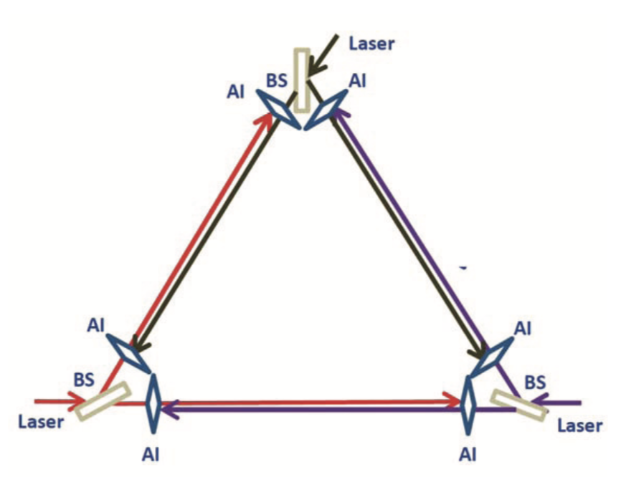
ZAIGA-GW (China)
arXiv:1903.09288
Atomic Interferometer
300m vertical Tunnel funded
and will be completed in 2020
Operation by 2025 (if fully funded)

Slide 21

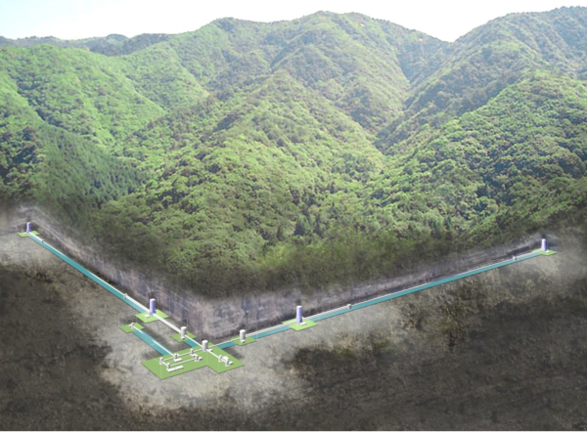
Then, KAGRA (Japan)

Slide 22
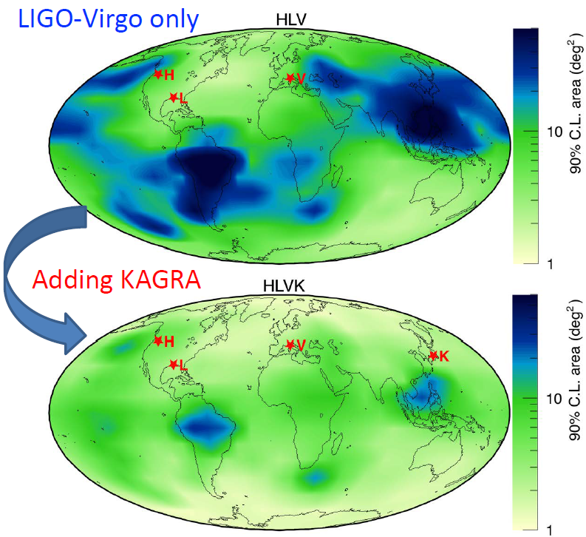
Contributions expected by KAGRA
Detector network duty factor (N>=3)
HLV 34% (3/3) → HLVK 65% (3/4) (assuming 70% each)
Sky localization improvement
Typically factor of 3
- EM counterpart
- Hubble constant
GW polarization measurements
- Test of General Relativity
including polarization modes
JGW-G1808212
(KAGRA design sensitivity)
H. Takeda+, PRD 98, 022008 (2018)

Slide 23
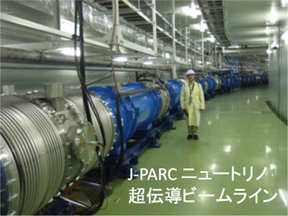
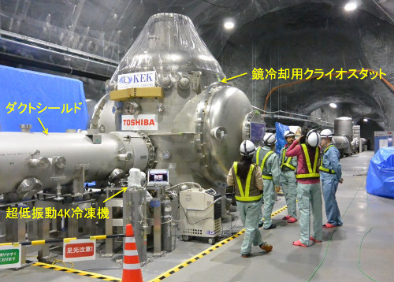
Application of Accelerator technologies to KAGRA
KEK cryogenic center is leading the development of KAGRA cryogenic system
KAGRA cryostat
J-PARC neutrino
super-conducting beam line

Slide 24
Specific issues for cryogenic
Not trivial to do both
- high power (400 kW on mirror)
- low temperature (20 K)
heat
extraction
Laser from BS
Laser in
arm cavity
thinner and longer fibers preferred
for suspension thermal noise reduction
heat absorption
(bulk, surface)
ITM
Dilemma
thicker and shorter preferred for efficient heat extraction

Slide 25
KAGRA Future Planning
KAGRA has been focusing to finish the installation of current configuration ; discussion on the future upgrade was not so active until 2018
Finally, KAGRA installation was almost completed and Future Planning Committee (FPC) has been established in Dec./2018 and started discussions on the future upgrade

Slide 26
KAGRA now and future
Even though installation of components is done,
we still have many issues [T. Tomaru’s talk]
Birefringence of sapphire bulk is one of the serious issue which prevents us from achieving the design sensitivity even in O4 (2022~)

Slide 27
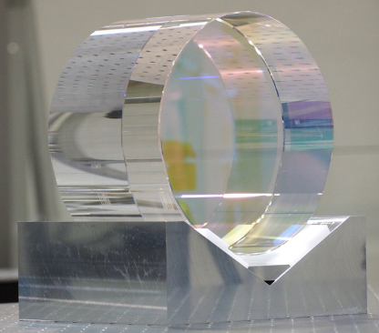
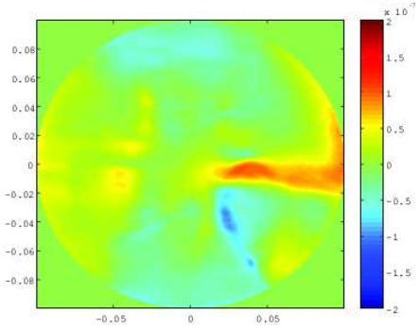
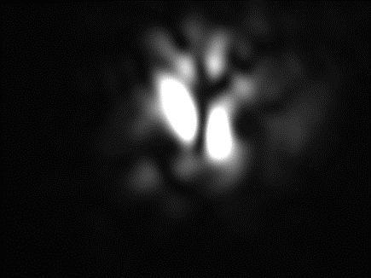
Sapphire birefringence issue
K. Somiya, et. al
PRD 100, 082005 (2019)
a few % p-pol in reflection
s-pol
Laser
Power and signal recycling cavities contaminated by p-pol
p-pol beam shape from ITM reflection

Slide 28
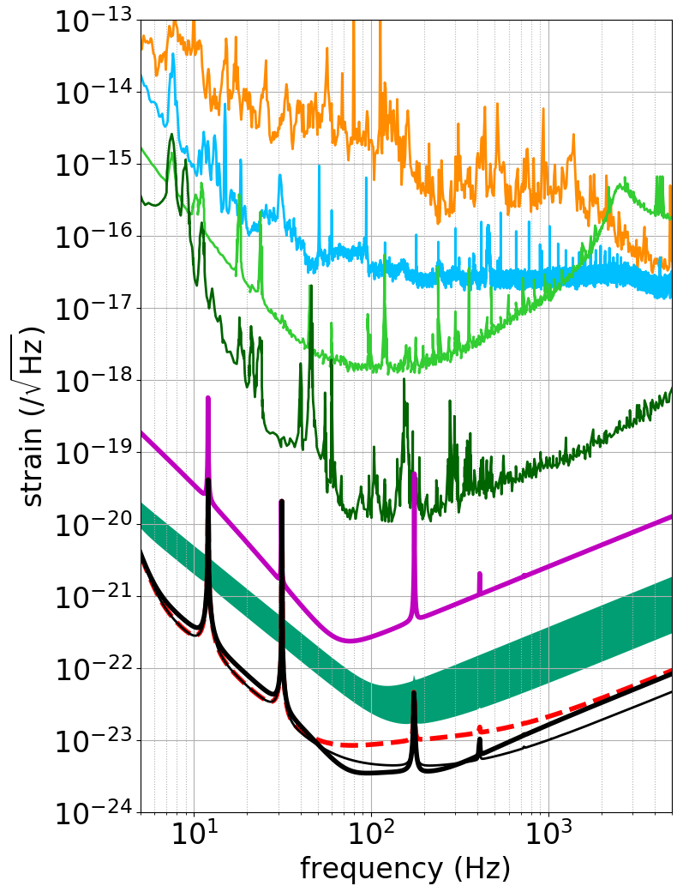
KAGRA near future prospects
Towards O4 (2022~)
Manage with the current (birefringent) sapphire
Most of the time for commissioning/noise hunting
Expected sensitivity up to 80 Mpc
Y. Michimura
JGW-G1911123
O4 limit (~80 Mpc)

Slide 29
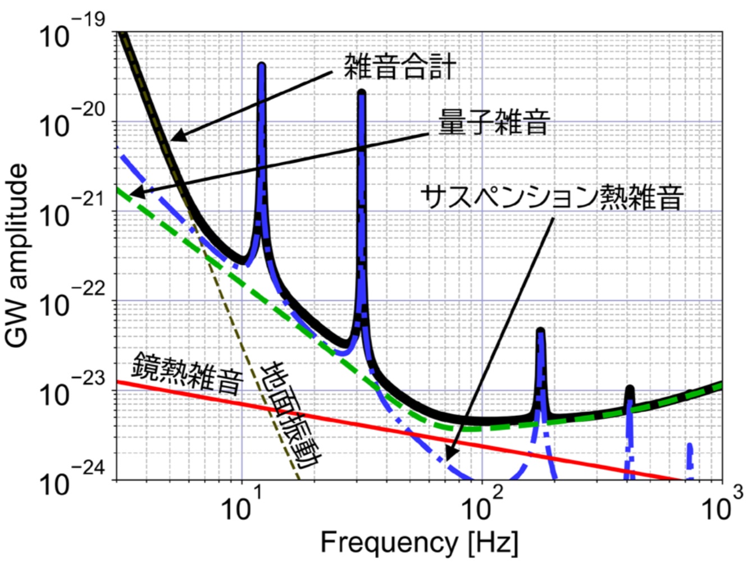
KAGRA near future upgrade
Highest priority task is to develop high spec. sapphire mirrors with negligible birefringence
Then, KAGRA design sensitivity is mostly limited by
quantum noise
Frequency dependent
squeezing technique
is expected to reduce
quantum noise
in wide frequency range
JGW-T1910879

Slide 30
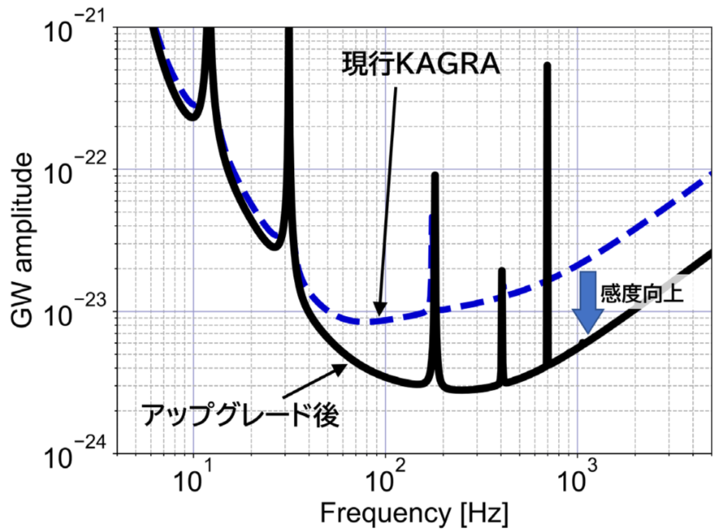
KAGRA near future upgrade
Highest priority task is to develop high spec. sapphire mirrors with negligible birefringence
Then, KAGRA design sensitivity is mostly limited by
quantum noise
Frequency dependent
squeezing technique
is expected to reduce
quantum noise
in wide frequency range
JGW-T1910879

Slide 31

High spec. sapphire mirror
We have been collaborating with crystal makers in Japan and a research institute in Lyon, France (iLM).
Recently iLM got a new funding focused on the development of high quality and bigger sapphire substrate
Gravitational Astronomy
Sapphire Optics (OSAG)
Collaboration

Slide 32
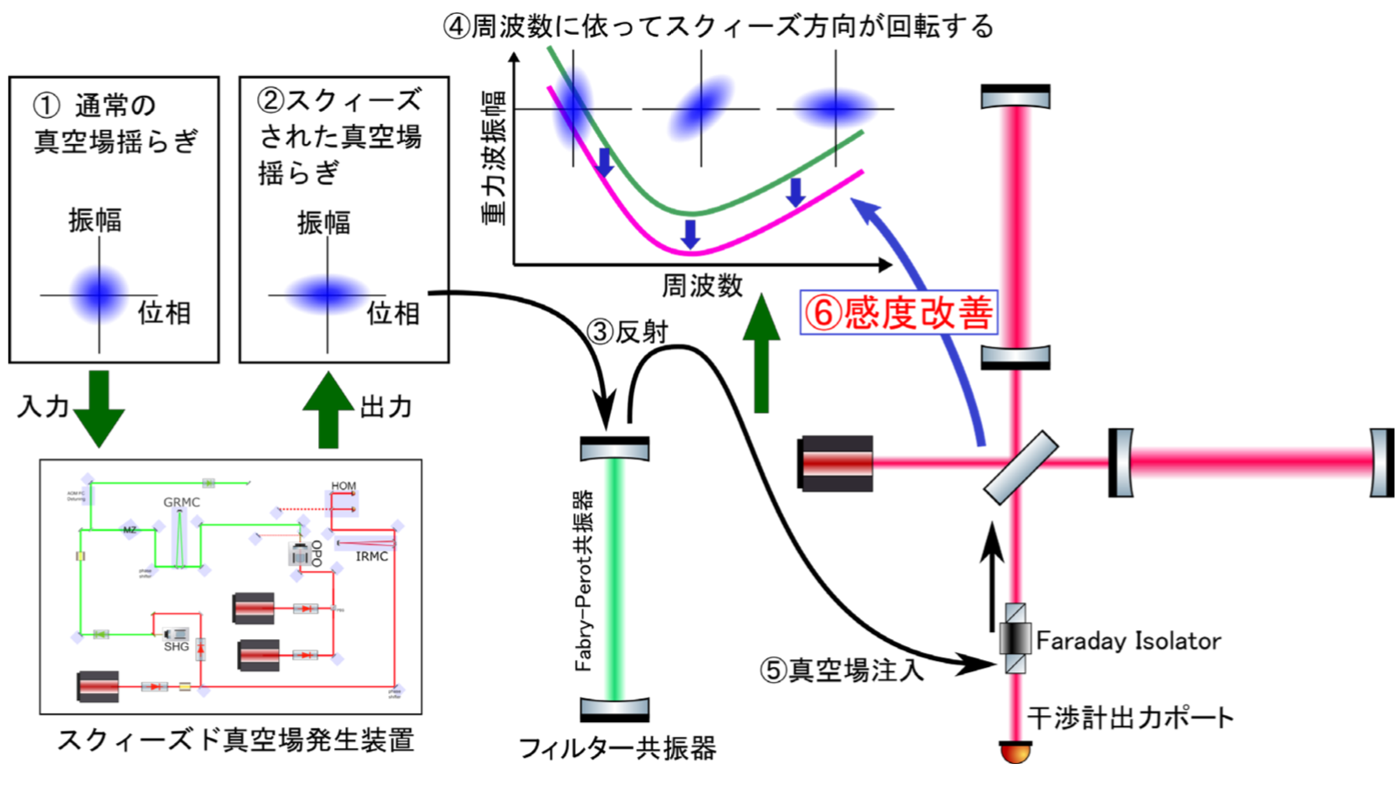
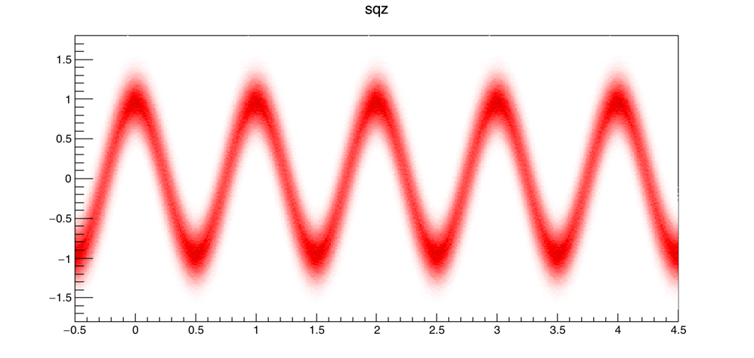
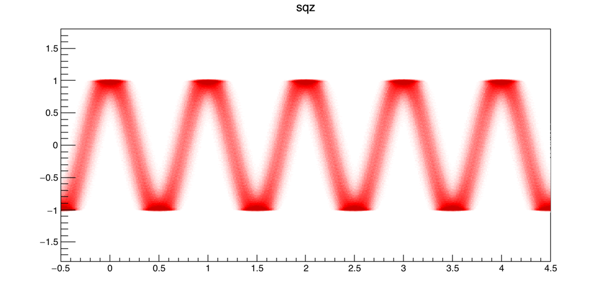
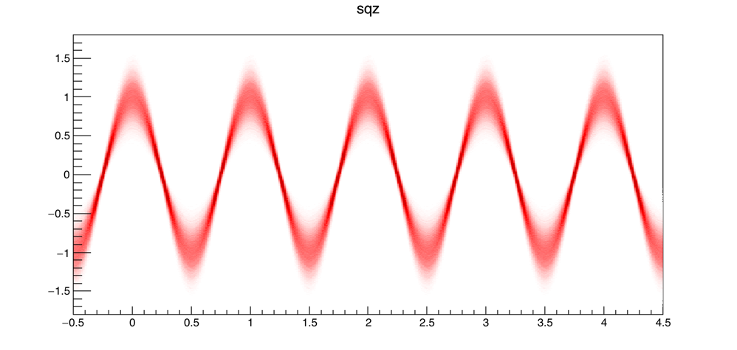
Freq. dependent squeezing
Active developments in NAOJ and
oversea KAGRA institutes (e.g. Taiwan, Korea)

Slide 33
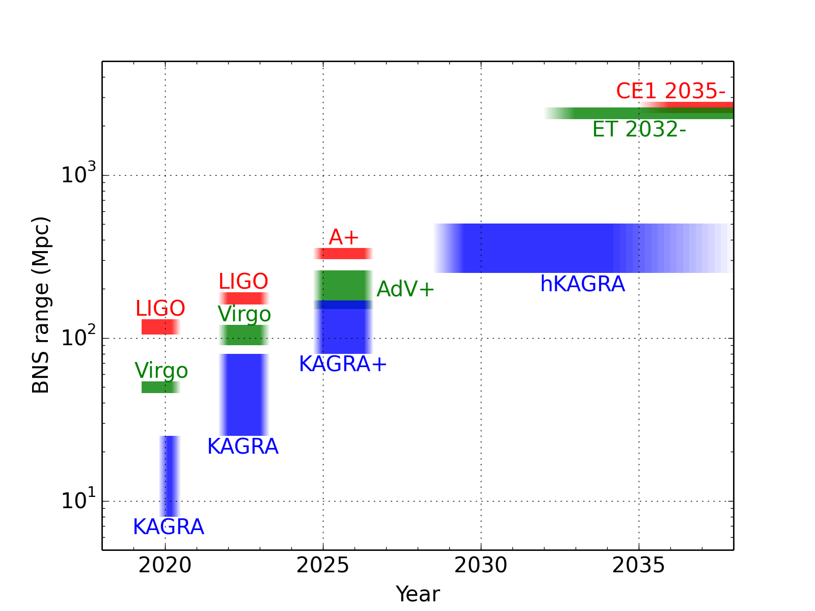
KAGRA near future projection
arXiv:1304.0670
O5
O4
O3
80-170 Mpc
25-80 Mpc
8-25 Mpc
To be downscaled to ~1Mpc

Slide 34
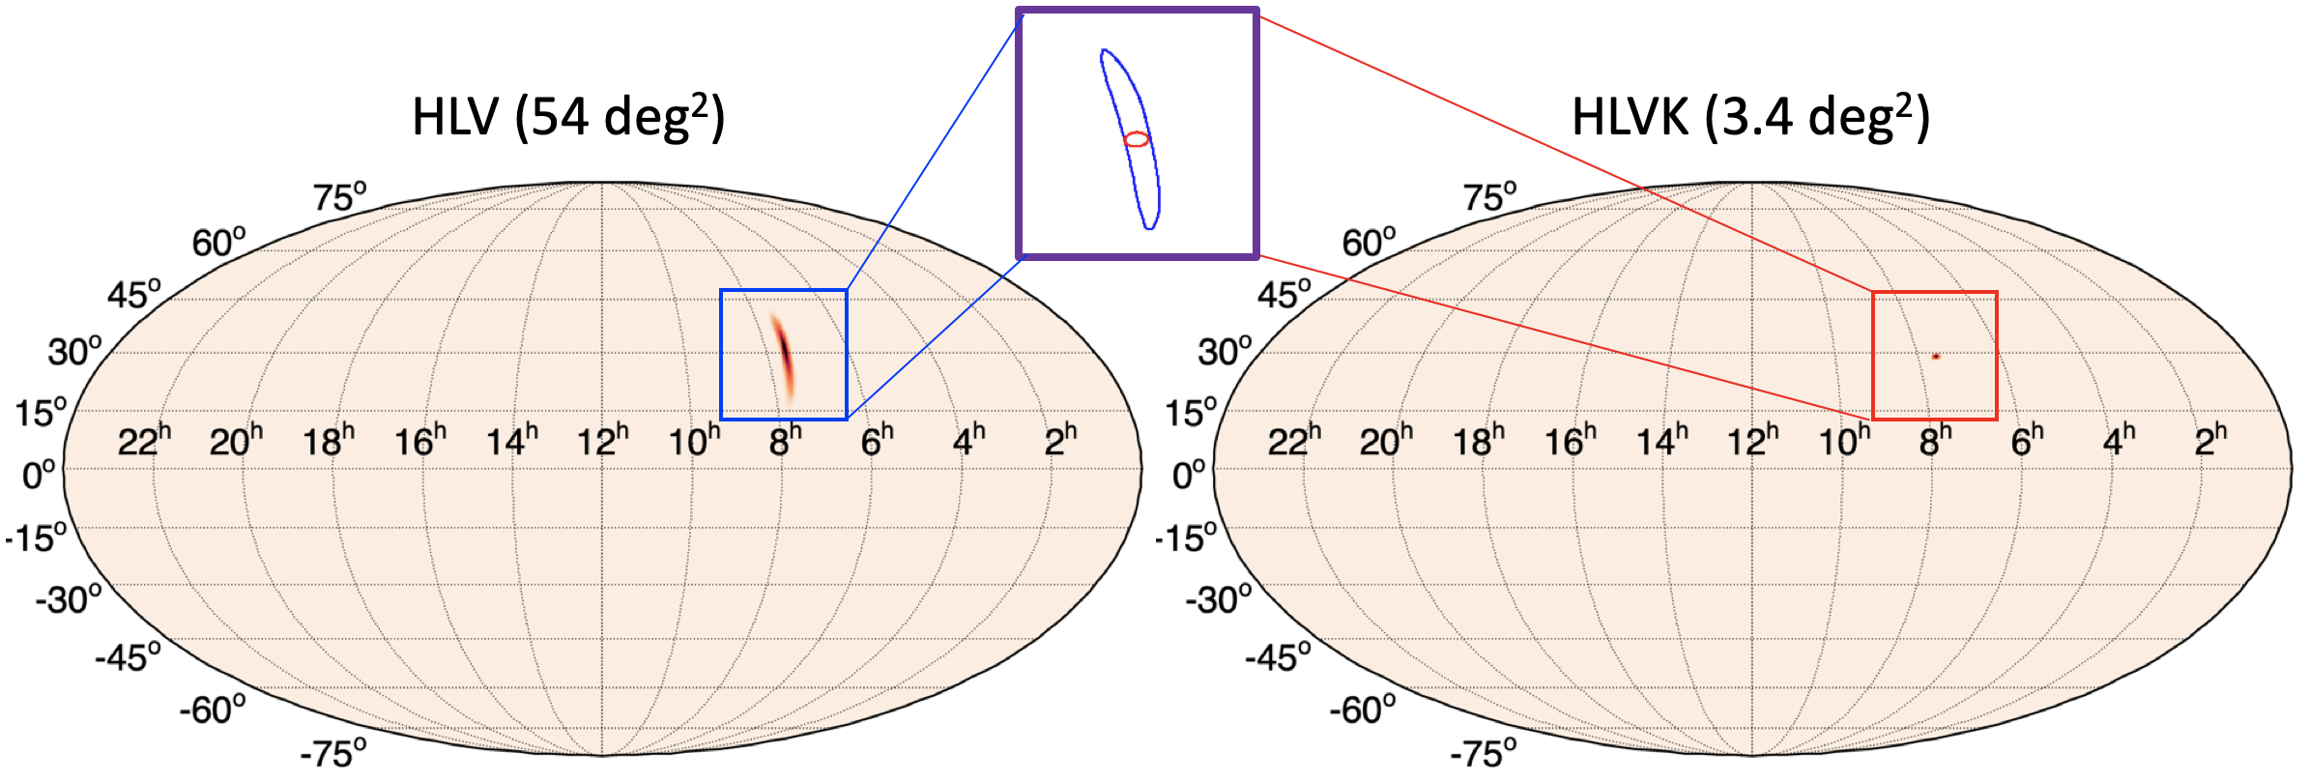
KAGRA’s contribution in O4~O5
Sky localization of BNS to be significantly improved
An example of BNS event for which KAGRA can improve
the sky localization accuracy

Slide 35
KAGRA far future upgrade idea
Even though KAGRA is facing a difficult time,
once we find the solution of current issues,
it is not a dream to consider the far future
with ultimate potential of cryogenic sapphire

Slide 36
Ultimate goal of KAGRA
Assuming 200kg, 10ppm/cm sapphire, 500 W laser and 10dB FD squeezing are available (in 10 years)
Estimated sensitivity as ~500 Mpc [JGW-G1910533]
It will be the most sensitive detector with the conventional (1064nm and existing facility) technology
We need a name; ultimate KAGRA (uKAGRA) ?

Slide 37
Ultimate goal of KAGRA
Assuming 200kg, 10ppm/cm sapphire, 500 W laser and 10dB FD squeezing are available (in 10 years)
Estimated sensitivity as ~500 Mpc [JGW-G1910533]
It will be the most sensitive detector with the conventional (1064nm and existing facility) technology
We need a name; ultimate KAGRA (uKAGRA) ?

Slide 38
Technological challenges
Big sapphire mirror with low absorption
- Collaboration with iLM
- Proposal accepted for 200kg sapphire facility
High power laser
- 500W is not a dream in 5~10 years
Suspension and heat extraction
High power tolerance of room temp. optics
…

Slide 39
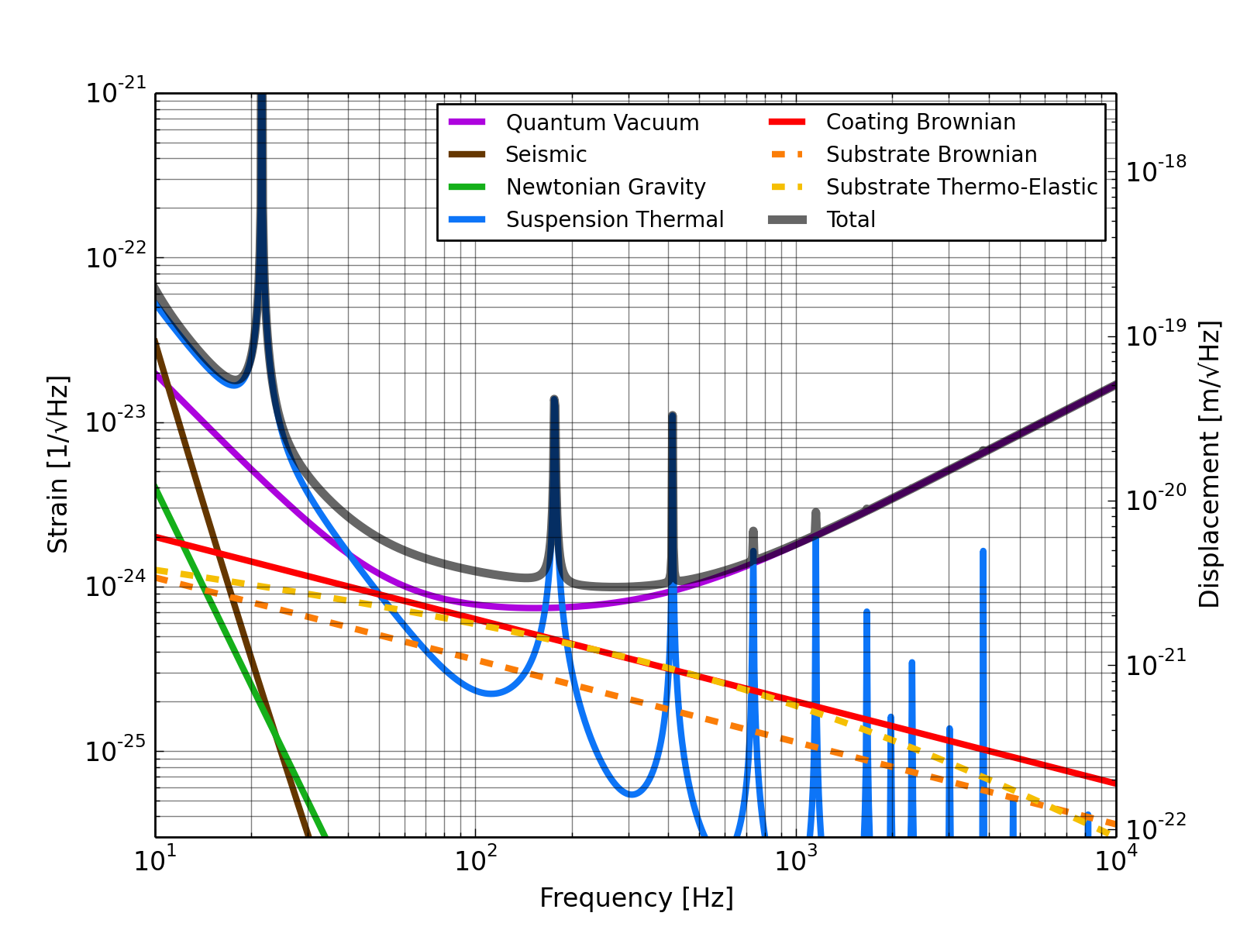
uKAGRA example sensitivity curve
BNS range: 505 Mpc

Slide 40
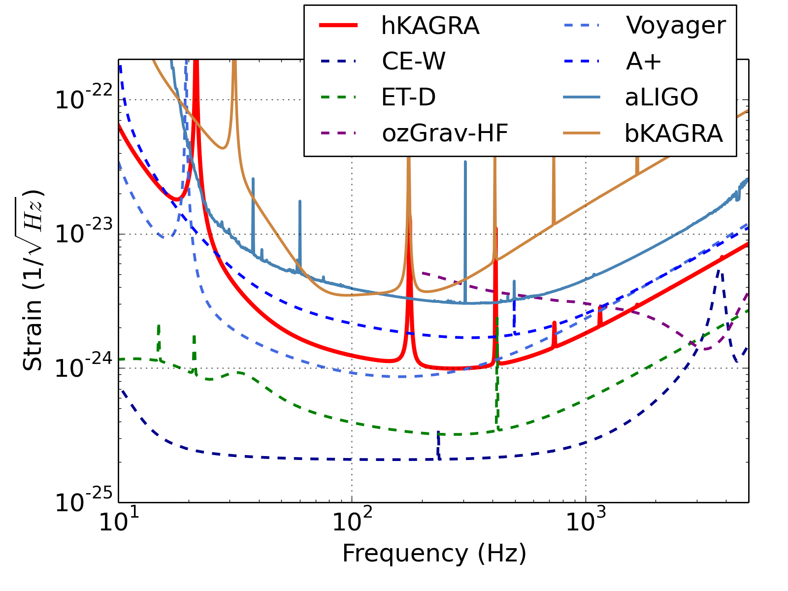
Comparison with other detectors
u

Slide 41
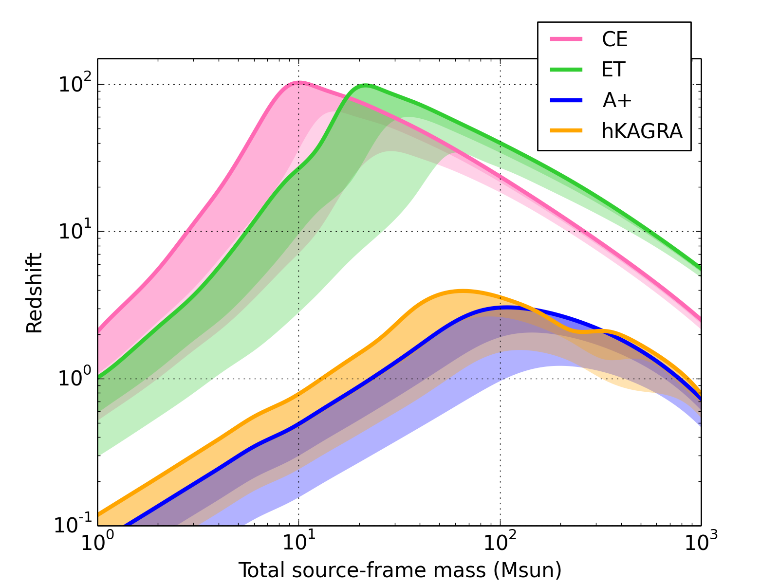
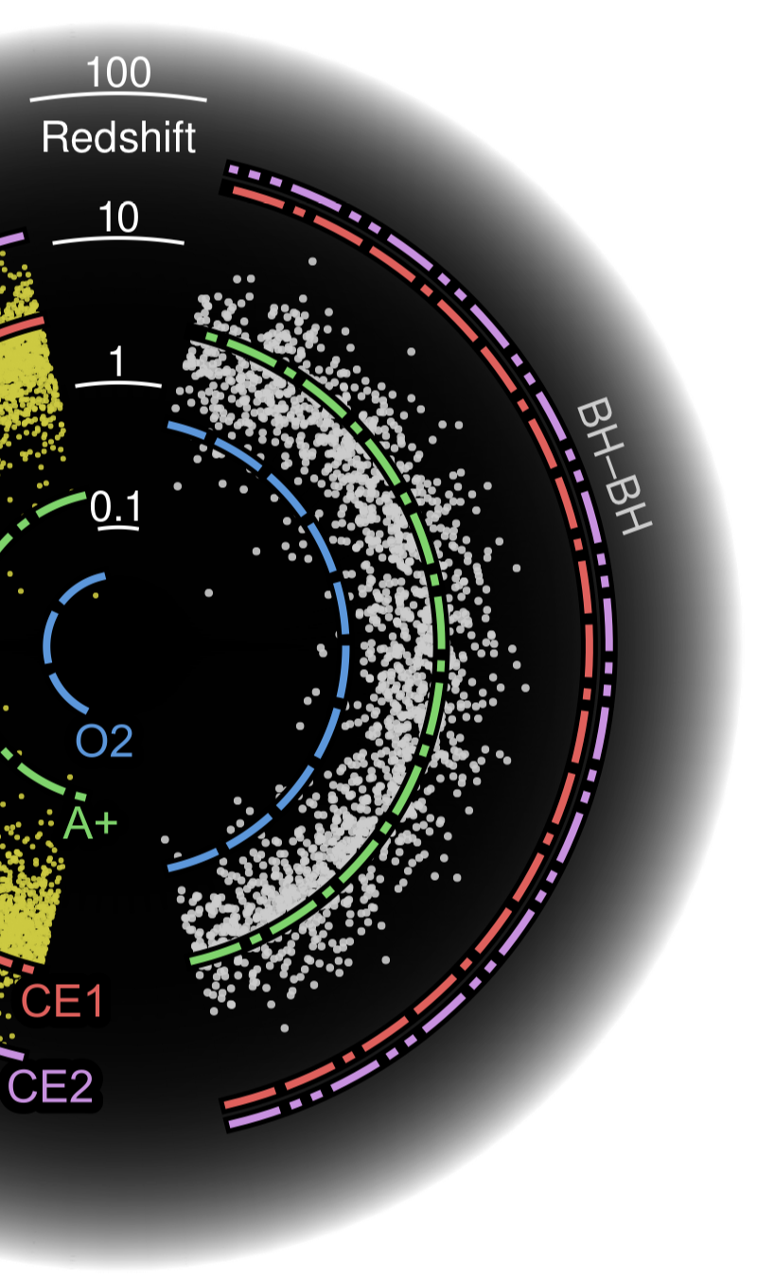
Redshift reach VS total mass
uKAGRA would be able to
reach most of the BBH sources
Horizon
10% detected
50% detected
u
uKAGRA z~3.9
A+ z~2.5
30-30 Msun

Slide 42
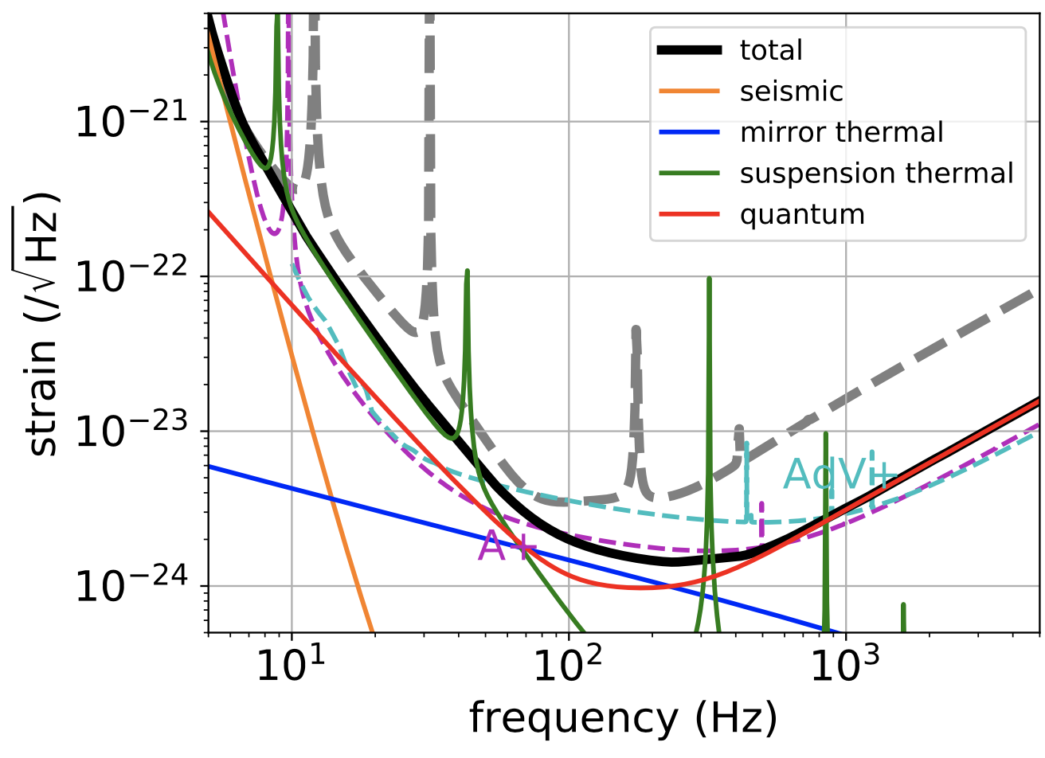
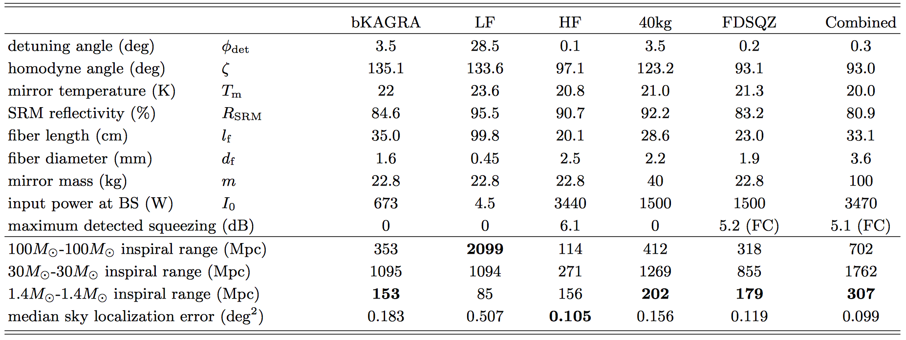
In case of 100kg/350W
JGW-T1809537

Slide 43
KAGRA future projection
3G
uKAGRA can fill
the “science gap”
between O5 and 3G
O5
O4
O3
(?)
300-500 Mpc
u
80-170 Mpc
25-80 Mpc
8-25 Mpc

Slide 44
Prospects of GW science
Continuous sensitivity improvements offer us increasing events (3rd power) and science cases
- Neutron Star Equation of State (EoS)
- Test of General Relativity at extreme conditions
New generation of Multi-messenger science
- Short GRB
- Precision and independent determination of
cosmological constants
Possible detection of new sources
- Supernovae (with EM, GW and neutrino)
- Massive BBH, …

Slide 45
Advantage of KAGRA in 3G era
Existing facility
- KAGRA observatory should work for >15 years
- New and huge facilities needed for 3G (CE, ET)
→ difficulty and unknown about the fundings
Long experience of cryogenic sapphire
- New technology (e.g. cryogenic silicon mirror)
is very challenging and uncertain for 3G (CE, ET)
→ they don’t even know what are the issues

Slide 46
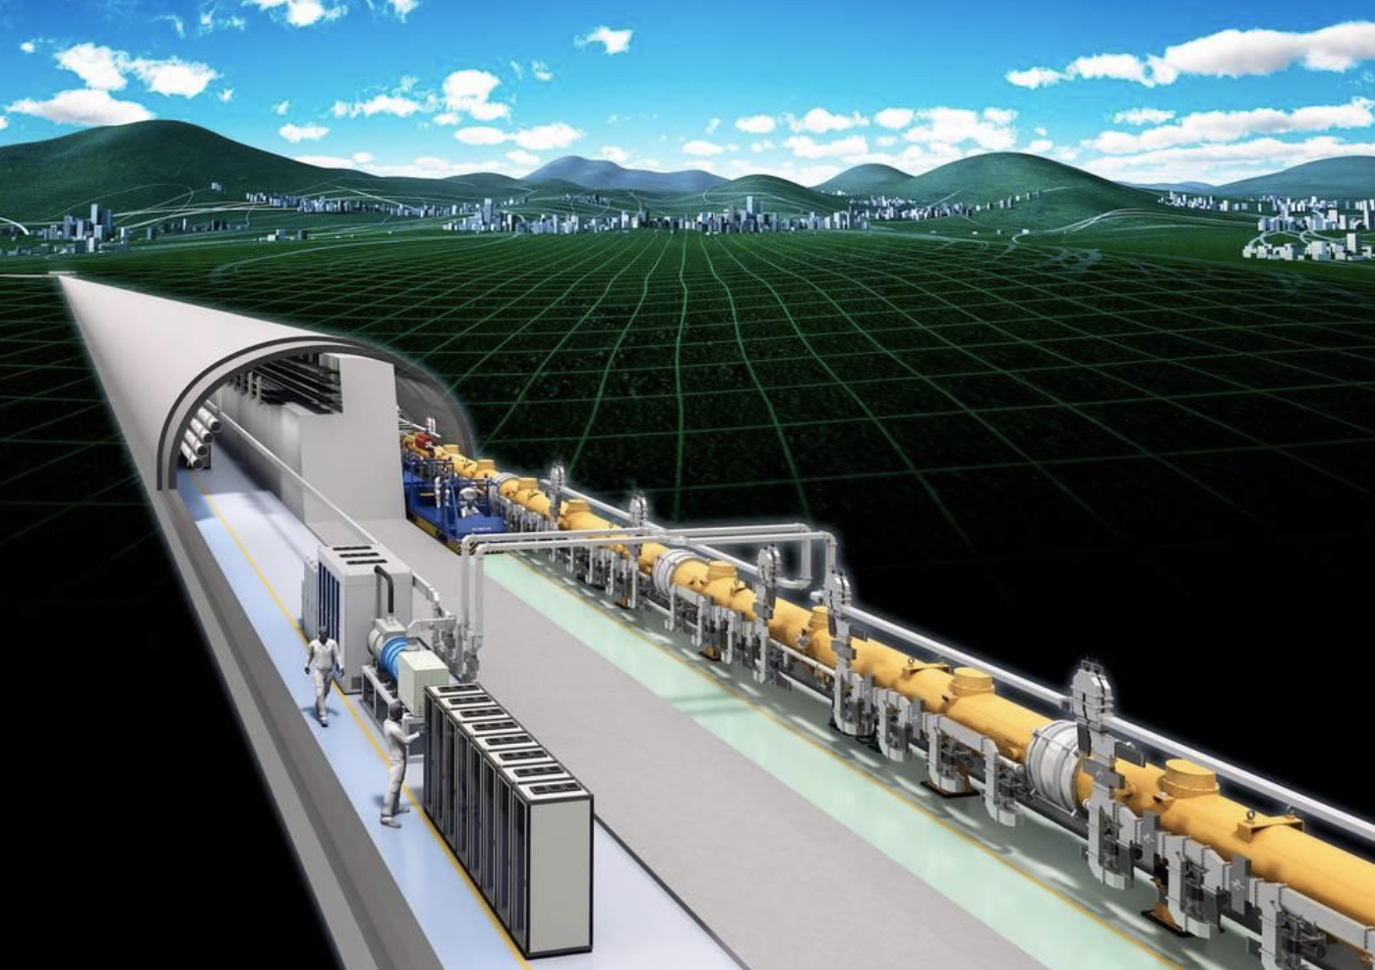


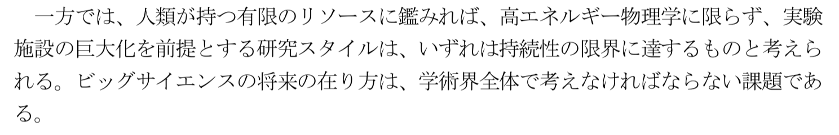
Concerns on a big facility - ILC
Science Council of Japan, Dec./ 2018
(中略)

Slide 47
KAGRA future projection
3G
uKAGRA can fill
the “science gap”
between O5 and 3G
O5
O4
O3
(?)
300-500 Mpc
u
80-170 Mpc
25-80 Mpc
8-25 Mpc

Slide 48
Summary
Even though it is a difficult time for KAGRA,
the future is still bright
- At least we know what are the issues
- KAGRA can maximize the advantage of existing
underground facility
KAGRA should catch up to LV in ~5 years (~80 Mpc),
reach the same sensitivity in ~10 years (~160 Mpc)
and aim at the ultimate configuration (~500 Mpc)

Slide 49
Parameters assumed (dimensions)
As an example; further optimization may be needed
Parameter name | bKAGRA | uKAGRA
Mirror size (and mass) | 𝜙22cm ×15 cm (22.8 kg) | 𝜙45cm ×31.5 cm (200 kg)
Sapphire suspension | 𝜙1.6mm ×35cm | 𝜙2.7mm ×50cm
Wire safety factor | 12.58 | 5.0
Intermediate mass | 20.5 kg | 180 kg
Beam size | 3.5 cm | 7.0 cm
Clear aperture (4𝜎) | 14 cm | 28 cm
Coating improvement | None | x2
Squeezer | None | Freq. dependent (10 dB)
Filter cavity | None | 300 m

Slide 50
Parameters assumed (power-related)
As an example; further optimization may be needed
Parameter name | bKAGRA | uKAGRA
Laser power (before PRM) | 70.1 W | 500 W
Power at BS | 674 W | 4.8 kW
Arm power | 0.32 MW | 2.3 MW
Mirror temperature | 22 K | 18.4 K
Heat to be extracted (ITM) | 0.72 W | 2.76 W
Heat absorption | 50 ppm/cm | 10 ppm/cm
Thermal conductivity coefficient (𝛼₀)^{*1} | 7.98 W/K/m | 16 W/K/m
Thermal conductivity (𝜅)^{*1} | 7.2 kW/K/m | 19.8 kW/K/m
^{*1} 𝜅 = 𝛼₀ d/d₀ T^{𝛽}, where d₀ is diameter of bKAGRA suspension (1.6mm)

