Slide 1
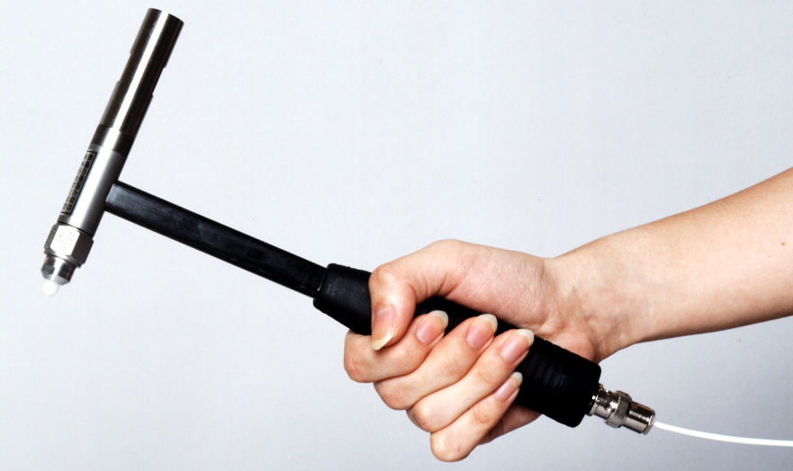
How to use an impulse hammer
Taiki Tanaka
[1]

Slide 2
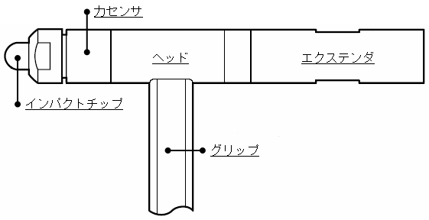
Adjusting the impulse force
Adjust the impulse force of the impulse hammer by changing the extender and tip
In general, the tip affects the frequency structure of the impulse, and the extender affects the energy level of the impulse
The frequency structure and energy level are interrelated, so if the hammer structure is different, both will be affected
The speed of the impulse also affects both
Accelerometer
Head
Extender
Impact tip
[1]
Grip

Slide 3
Adjusting the impulse force
It is necessary to adjust both energy and frequency structure according to the purpose of measurement
For large structures with low rigidity, generally use a soft tip and an extender to vibrate sufficiently in low-frequency range
The following methods can be used to adjust the impulse energy
Human adjustment (not recommended)
Change the size of the hammer
Change extender
[2]

Slide 4
Adjusting the impulse force
As the mass of the hammer increases, the impulse energy also increases, but it is easier to impulse twice (double hammering), so care must be taken
The frequency structure can be adjusted by selecting the tip of the impulse hammer
However, even with the same chip, care must be taken because the frequency structure changes depending on the characteristics of the impulsed object

Slide 5
Adjusting the impulse force
When adjusting the impulse energy by hand
If changing the magnitude of the impulse force by hand, it is difficult to maintain reproducibility even by an expert, so avoid it as much as possible
Just change the collision speed, not the force of the hammering

Slide 6
How to use a impulse hammer
At impulse
Support a hammer softly and lightly
It is important to use the mass of a hammer to impulse rather than hammering with human power
Make hammering uniform as possible, and adjust the force by changing the hammer state
The hand only gives the hammer the first speed
If force is applied by hand, the impulse is unstable and the same impulse cannot be achieved

Slide 7
How to use a impulse hammer
Impulse point and direction
Since the impulse surface of the tip has an area, make sure that the center of the tip matches the impulse point
The impulse point must be decided in advance (impulse point marking)
The impulse direction must match the direction of the accelerometer in a hammer
A hammer should not tilt more than 10 degrees from the normal direction of the object surface
Especially when the extender is attached, take care that it does not rotate with the impulse system including the hand

Slide 8
How to use a impulse hammer
The moment of impulse
a hammer is free at the moment of impulse
Do not restrain by hand
Quickly pull the impulse hammer as soon as it impulse the object
Concentrate consciousness on pulling rather than hammering

Slide 9
Reference
[1] ー振動実験及び振動解析を活用した機械設計技術― (Japanese)
第2章(p.95, 96, 118)
[2] Model 086C03, Installation and Operating Manual

