Slide 1
OMC Layout Modification Plan v2
2019/8/18
Yoichi Aso

Slide 2
There are several problems with the current component layout of the OMC
OMC cavity axis does not go through the center of the mirrors
The beam spot size on the DC PDs is too large
The aperture size is about the same as the 2.7sigma diameter of the beam
Ghost beams need to be dumped.
In order to cope with the above issues, I propose to modify the layout of the OMC as shown in the following pages.

Slide 3
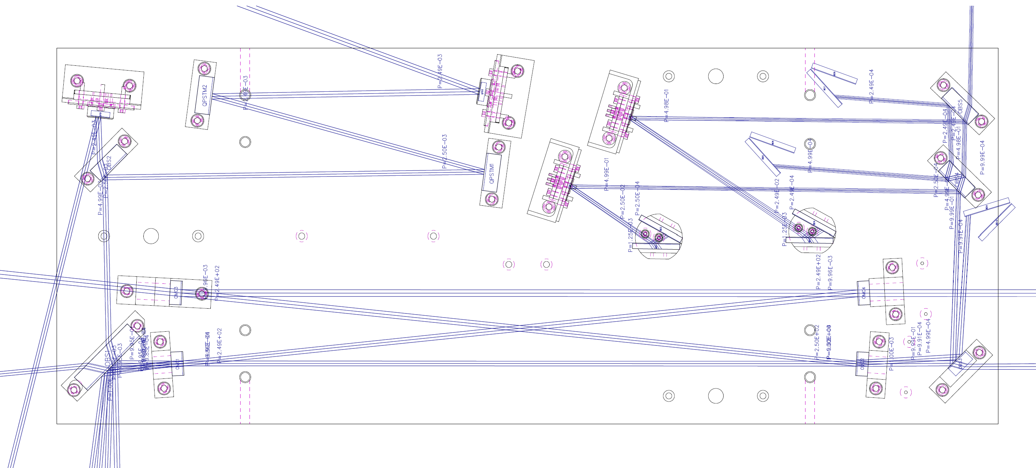
Modified OMC layout with stray beam tracing
Input power is normalized to 1
Stray beams with 1/10000 of the input power are shown

Slide 4
Modification point 1: Slightly tweak the OMC mirror orientations within the play
of the screw holes

Slide 5
Modification point 2: Replace the OBS3 with a curved mirror
ROC = 500mm
A new mirror mount will be designed for this mirror

Slide 6
Explanation of the modification point 2
A curved OBS3 will make the beam spot size smaller at the DC PDs.
3 sigma diameter will be about 1.9mm
The 45deg. AOI induces strong astigmatism. Still, with ROC=500mm, the beam becomes circular on the PDs.
Asking Layertec about the possibility of using a stock mirror for 0 deg. AOI with p-pol 45deg AOI.

Slide 7
Modification point 3: Tweak the orientations of those mirrors
These adjustments are necessary to hit the center of the DCPDs
as well as avoiding AR reflected beams hitting the barrel of OBS4

Slide 8
Modification point 4: Additional beam dumps
The mount for this BD should be
unified with the one for OBS4
Special mounts for those BDs are necessary to fix them with the existing screw holes

Slide 9
Modification point 5: Tweaked the orientation and position of
the components in the QPD path
This stray beam should clear the OBS2:
rotated the QPD1

Slide 10
If the lead-time for the curved OBS3 is too long, we can fall back to the flat OBS3
In this case, the beam spot size on the DCPD becomes larger
(3 sigma diameter is 3.7mm)
Small adjustments to the OBS4 and the BD positions are necessary

Slide 11
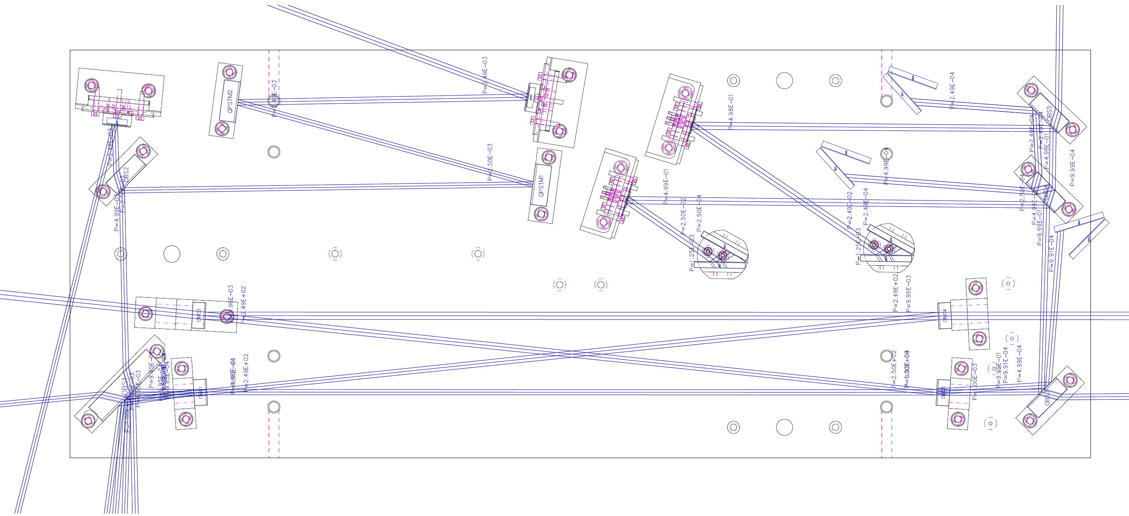
OMC layout with a flat OBS3
Beam size is larger
Need to shift the OBS4 position to avoid the AR reflected
beam from hitting the barrel of the mirror
Shift the BD plate

Slide 12
Damping the 700Hz resonance
Effectively damping a stiff mode requires a stiff lossy material
Assume a spring-mass system shown on the right
$k_{1}$ represents a stiff resonant mode
We attach a lossy spring $k_{2}$ in parallel
The overall spring constant is
$k=k_{1}+k_{2}\left(1+iφ\right)=(k_{1}+k_{2})(1+i\frac{k_{2}}{k_{1}+k_{2}}φ)$
Therefore, the effective loss angle will be smaller than the original loss angle of the lossy material by a factor of $\frac{k_{2}}{k_{1}+k_{2}}$.
This means, the stiffness of the lossy material ($k_{2}$) needs to be comparable to $k_{1}$ to effectively damp the stiff resonant mode.
Soft materials such as rubber may not be effective in our application.
Damping metal M2052 is a potential candidate for killing the 700Hz resonance.
$$k_{1}$$
$$k_{2}$$

Slide 13
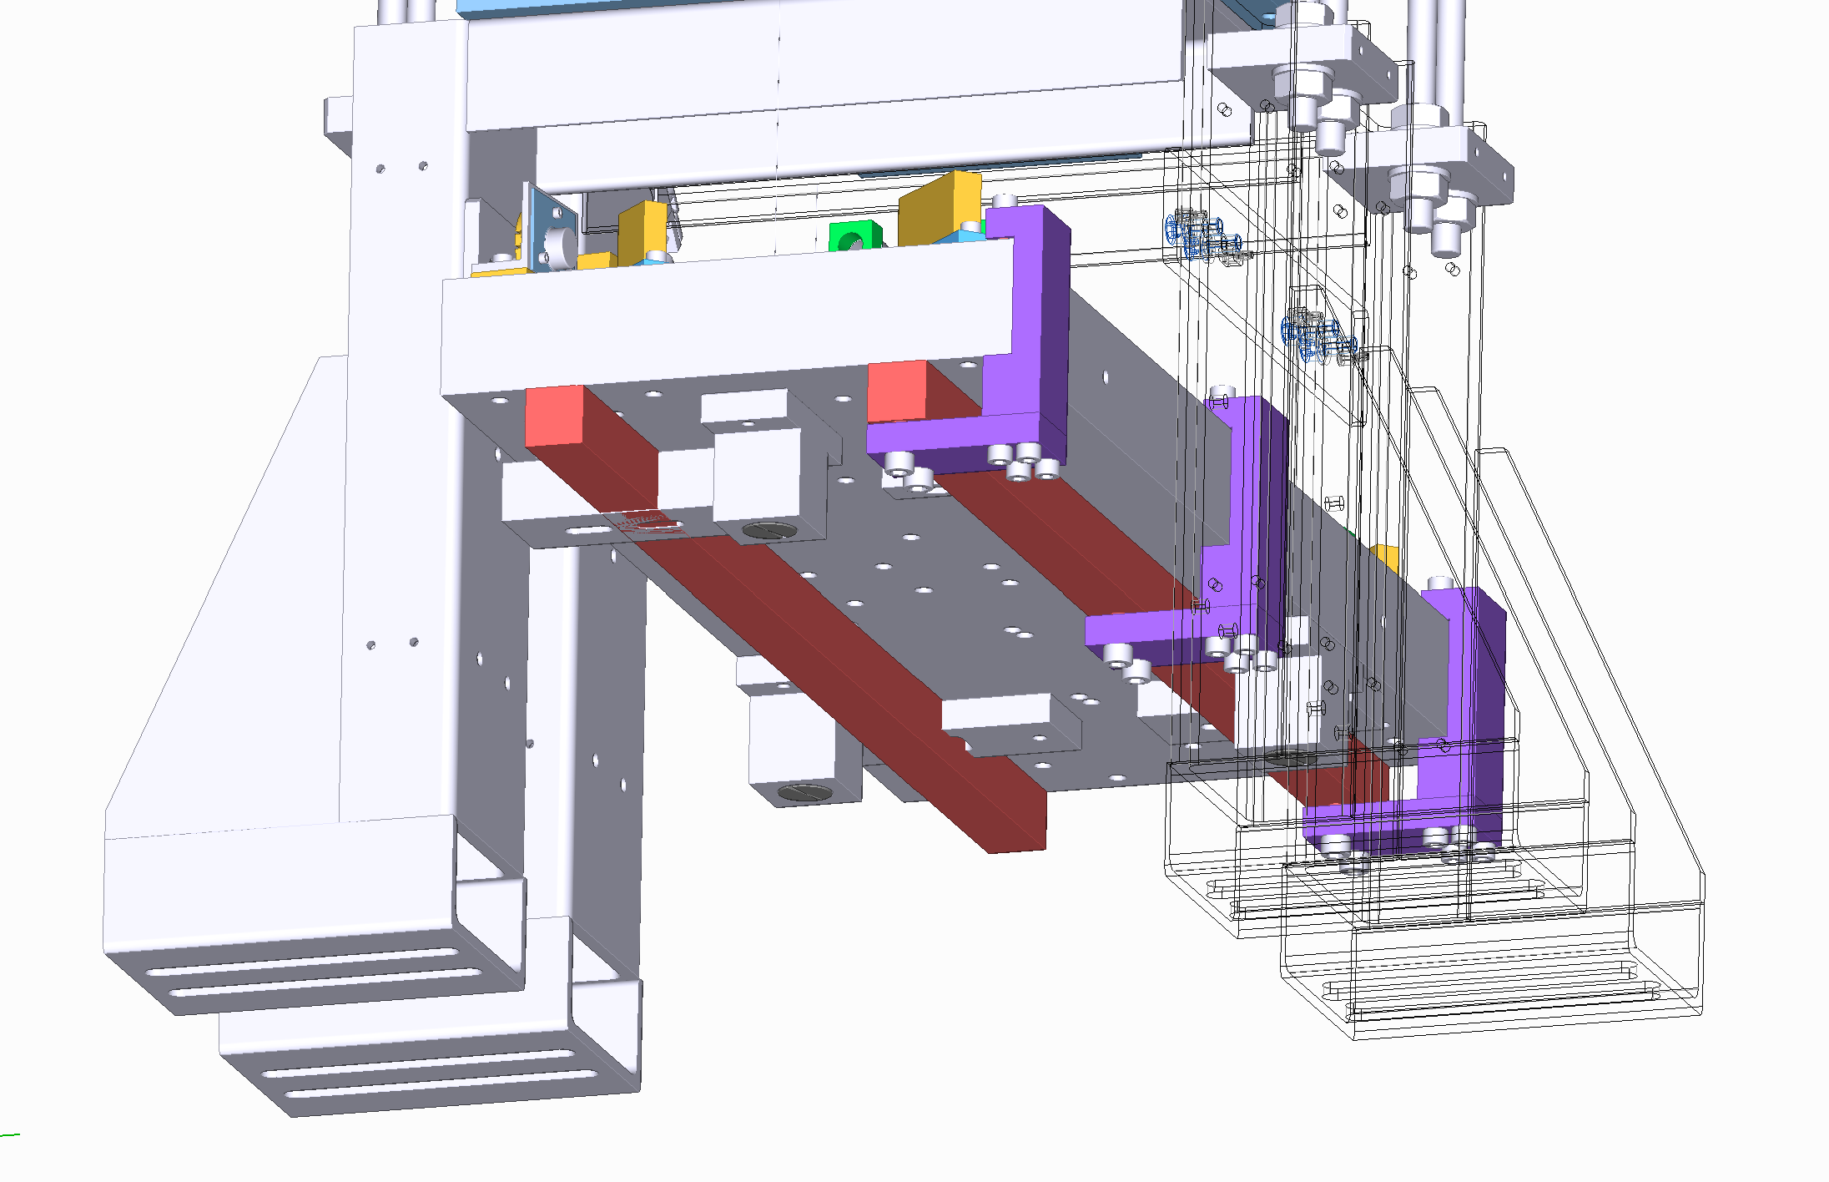
A possible configuration of attaching M2052 rods on the bottom of the OMC
breadboard.
Red rods are M2052
We use existing screw holes and
clamps (purple components) to attach
the M2052 rods.
This is just an idea.
Details need to be worked out.
Takahashi-san will perform a test in Mitaka.
Aso ordered an M2052 rod for this test.

