Slide 1
OMC Layout Modification Plan
2019/8/7
Yoichi Aso

Slide 2
There are several problems with the current component layout of the OMC
OMC cavity axis does not go through the center of the mirrors
The beam spot size on the DC PDs is too large
The aperture size is about the same as the 2.7sigma diameter of the beam
Ghost beams need to be dumped.
In order to cope with the above issues, I propose to modify the layout of the OMC as shown in the following pages.

Slide 3
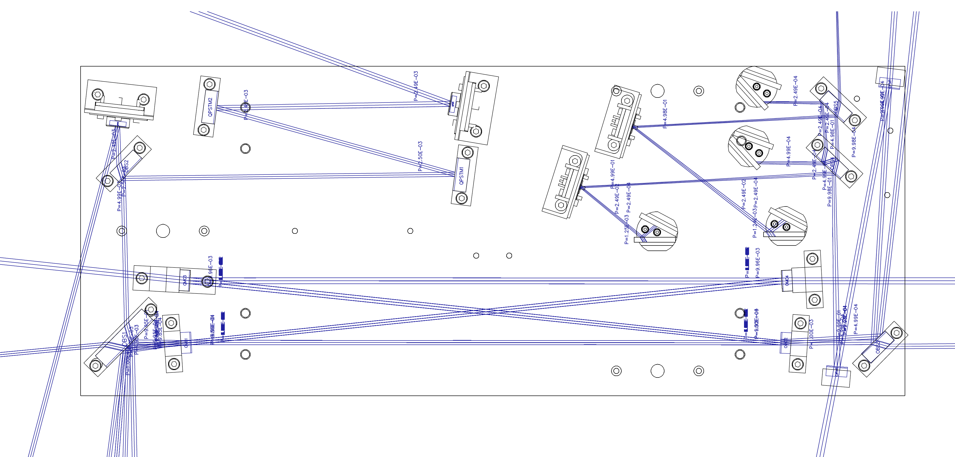
Modified OMC layout with stray beam tracing
Input power is normalized to 1
Stray beams with 1/10000 of the input power are shown

Slide 4
Modification point 1: Slightly tweak the OMC mirror orientations

Slide 5
Modification point 2: Add folding mirrors in the output path
This mirror is curved (ROC=400mm or 500mm)
Special mirror mounts will be designed for those mirrors

Slide 6
Explanation of the modification point 2
Adding a curved mirror will make the beam spot size smaller at the DC PDs.
3 sigma diameter will be less than 1mm
There is a possibility to make OBS3 curved. However, in this case, strong astigmatism is induced, due to the 45deg. AOI. This limits the achievable beam spot size to over 1.8mm (3sigma dia.)
Moreover, buying a curved mirror with 99.95% reflectivity for P-pol 45deg AOI may take some time (asking Layertec now).
Normal incident high reflectivity mirror with R=500mm is available in stock from Layertec.
The folded layout does not induce strong astigmatism. Therefore, the achievable beam size is smaller.

Slide 7
Modification point 3: Moving the DC PDs forward for easier access when
replacing the diode

Slide 8
Modification point 4: Additional beam dumps

Slide 9
Modification point 5: Tweaked the orientation and position of
the components in the QPD path
This stray beam should clear the OBS2:
rotated the QPD1

Slide 10
Since we want to modify many things,
it is probably better to make a new breadboard with proper screw holes
In order to damp the 700Hz resonance, I propose to attach lossy material
to the breadboard, such as M2052.
Adding screw holes for the damping material is possible if we make a new BB.
We can also add screw holes for the mirror positioning jigs.

