Slide 1
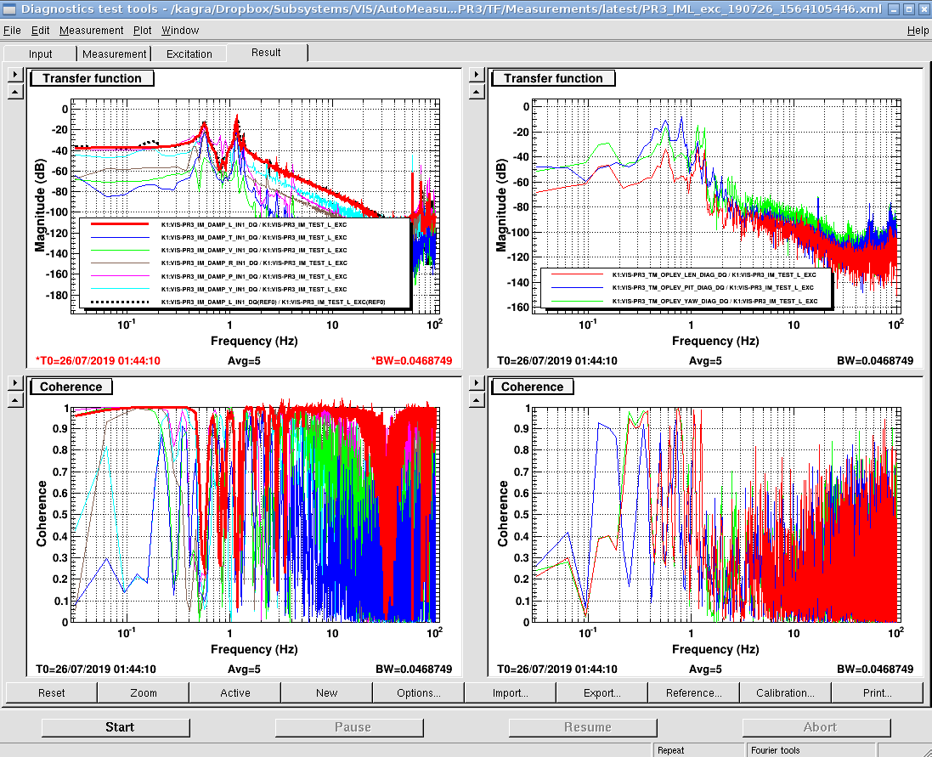
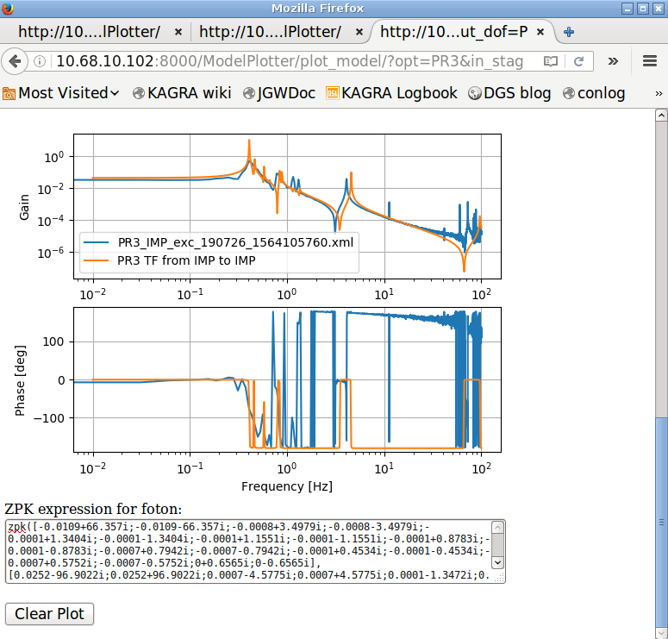
VIS tools for commissioning
Time to work on Commissioning!
Use the VIS tools to speed up the commissioning!
Any suggestions, requests, questions are also welcome ☺
1. Auto measurement system
2. VIS Plotter

