Slide 1
Vibration isolation for the KAGRA beam splitter and signal recycling optics
FabiÁn Pena arellano on behalf of the kagra collaboration
ICRR, The university of tokyo

Slide 2
Outline
About KAGRA: cryogenic payload, underground location and types of suspensions.
Description of the Type B suspension: mechanics.
Type B suspension model prediction: control loop noise within the interferometer observation band.
Future work
Conclusions

Slide 3
Acknowledgment
Core Type B team: Mark Barton (leader), Fabian Peña Arellano, Naoatsu Hirata.
Other VIS members: Ryutaro Takahashi (VIS leader), Yoshinori Fujii, Yoichi Aso (manager), Koki Okutomi, Ayaka Shoda, Naoisha Sato, Hideharu Ishisaki, Lucia Trozzo.
Previous members: Enzo Tapia San Martin, Takanori Sekiguchi, Naoko Ohishi, Daisuke Tatsumi, Riccardo De Salvo.
Others: Raffaele Flaminio, Akutsu, Tomotada Akutsu, Simon Zeidler.
Students: Yuhang Zhao, Kazuya Yokogawa, Yuya Kuwahara, Yingtang Liu, Toshiya Yoshioka, Perry Forsyth, Panwei Huang, Rikako Hatoya, Terrence Tsang, Ryohei Kozu.

Slide 4
References
Akiyama et al. “Vibration isolation system with a compact damping system for power recycling mirrors of KAGRA.” Classical and Quantum Gravity, 12 April 2019, 36 095015.
Fabián Peña Arellano et al. “Characterization of the room temperature payload prototype for the cryogenic interferometric gravitational wave detector KAGRA.” Review of Scientific Instruments, 87, 034501 (2016).
T. Sekiguchi, “A study of low frequency vibration isolation system for large scale gravitational wave detectors,” PhD thesis, University of Tokyo, 2016.
K. Okutomi, “Development of a 13.5-meter-tall Vibration Isolation System for the Main Mirrors in KAGRA, ” PhD thesis, The Graduate University of Advances Studies, 2019.
Mark Beker, “Low frequency sensitivity of next generation gravitational wave detectors,” PhD thesis, Nikhef, 2013.
Matheus Blom, “Seismic attenuation for Advanced Virgo: vibration isolation for the external injection bench,” PhD thesis, Nikhef, 2015.
Alexander Wanner, “Seismic Attenuation System (AEI-SAS) for the AEI 10 m Prototype,” PhD thesis, Leibniz Universität Hannover, 2013.

Slide 5
Introduction
What KAGRA is

Slide 6
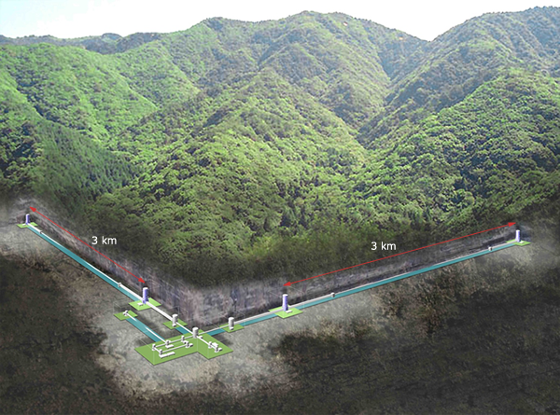
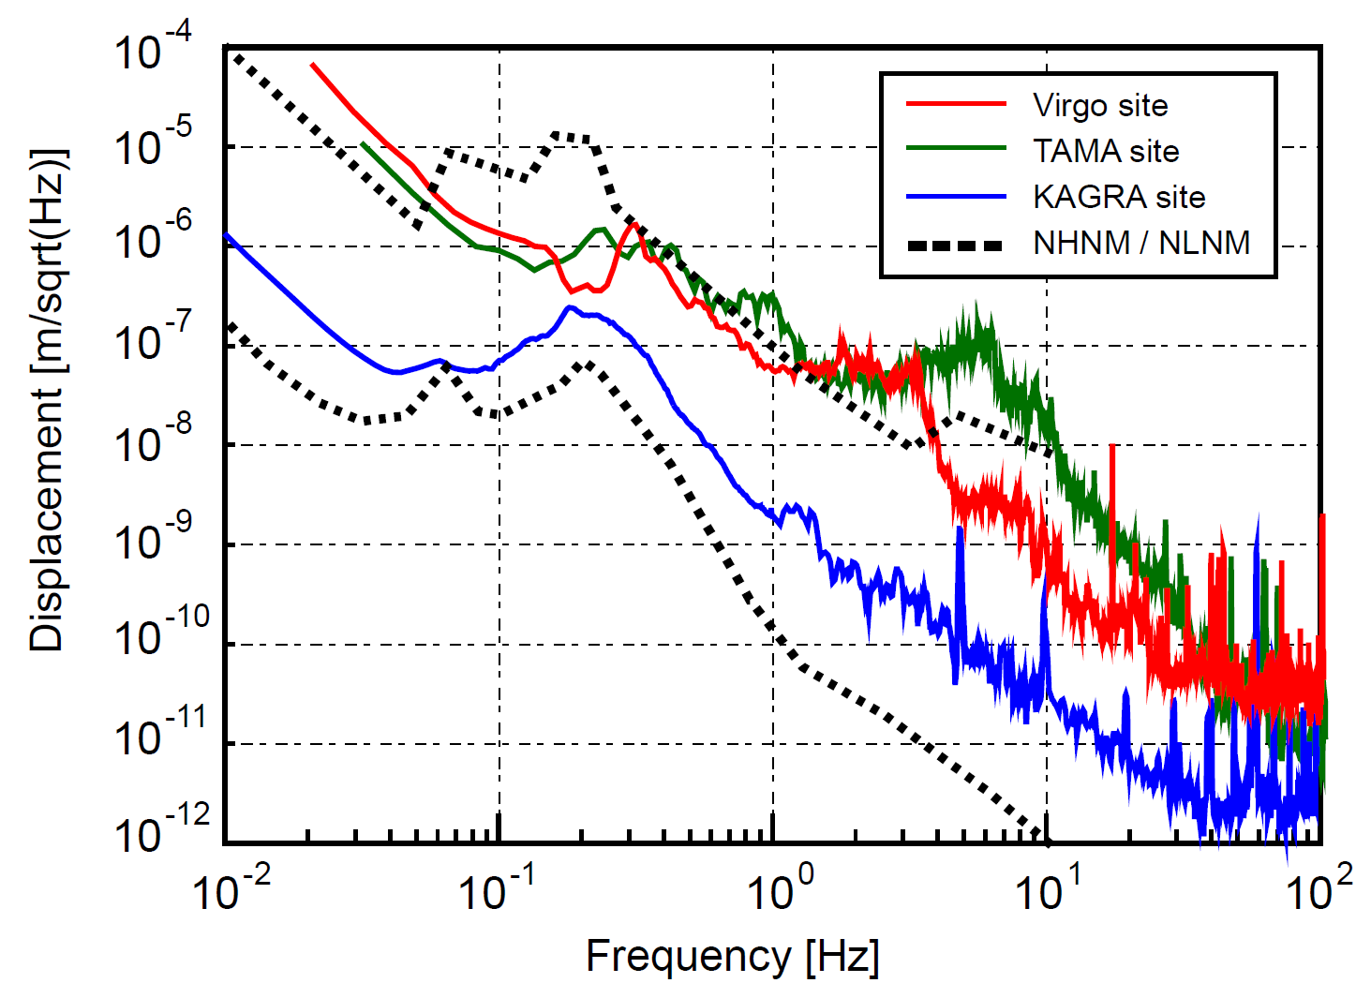
KAGRA is an underground detector
Depending in the frequency between 10 and 100 times reduction between TAMA and KAGRA sites
Plot by Takanori Sekiguchi

Slide 7
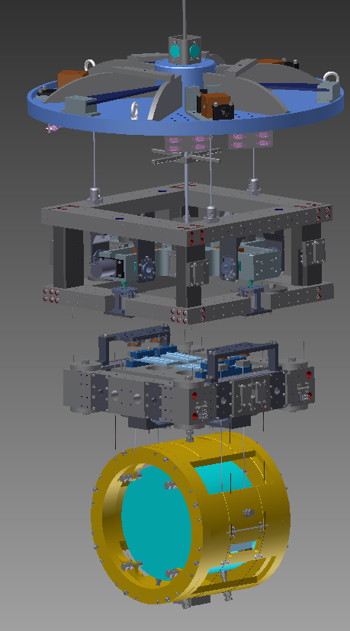
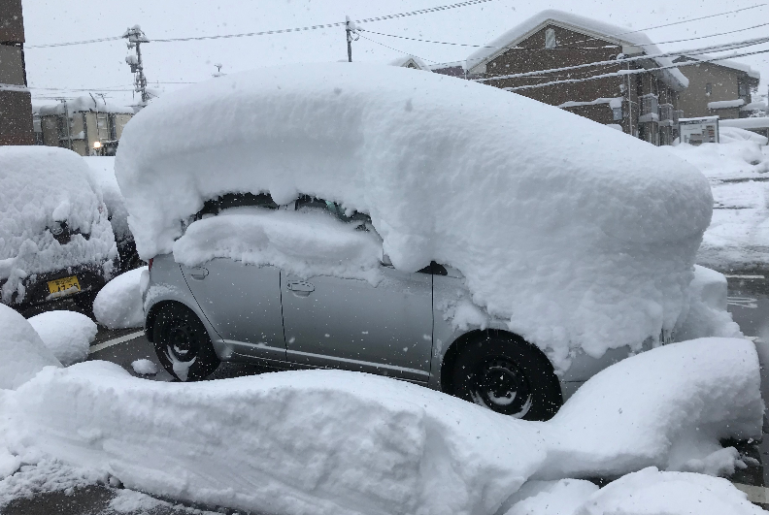
KAGRA is a cryogenic detector (1)
Side view
Sapphire mirrors
Cooled down to 20 K
Mass of 200 kg
Photo by Tomotada Akutsu
Don’t expect a tropical place like Natal!
Drawing by A. Hawigara

Slide 8
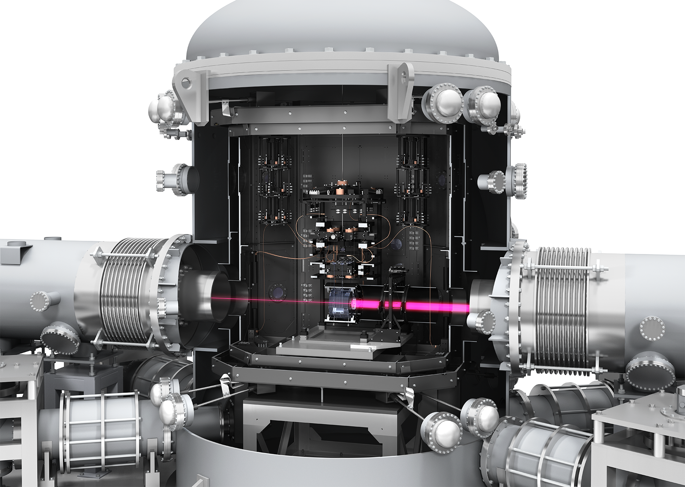
KAGRA is a cryogenic detector (2)
Side view
Sapphire mirrors
Cooled down to 20 K
Mass of 200 kg
© KAGRA collaboration/ Ray Hory

Slide 9
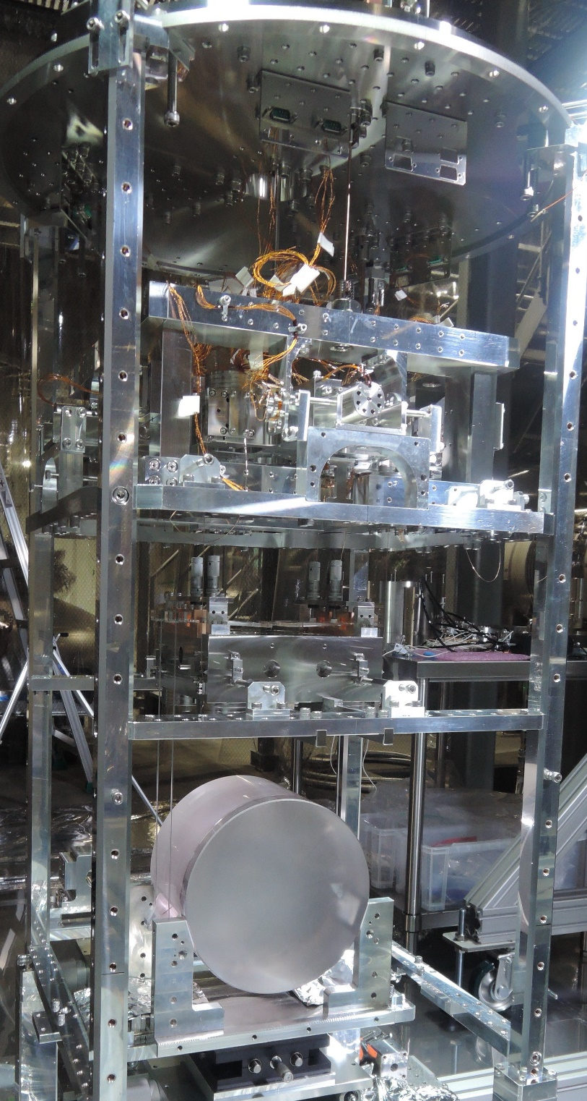
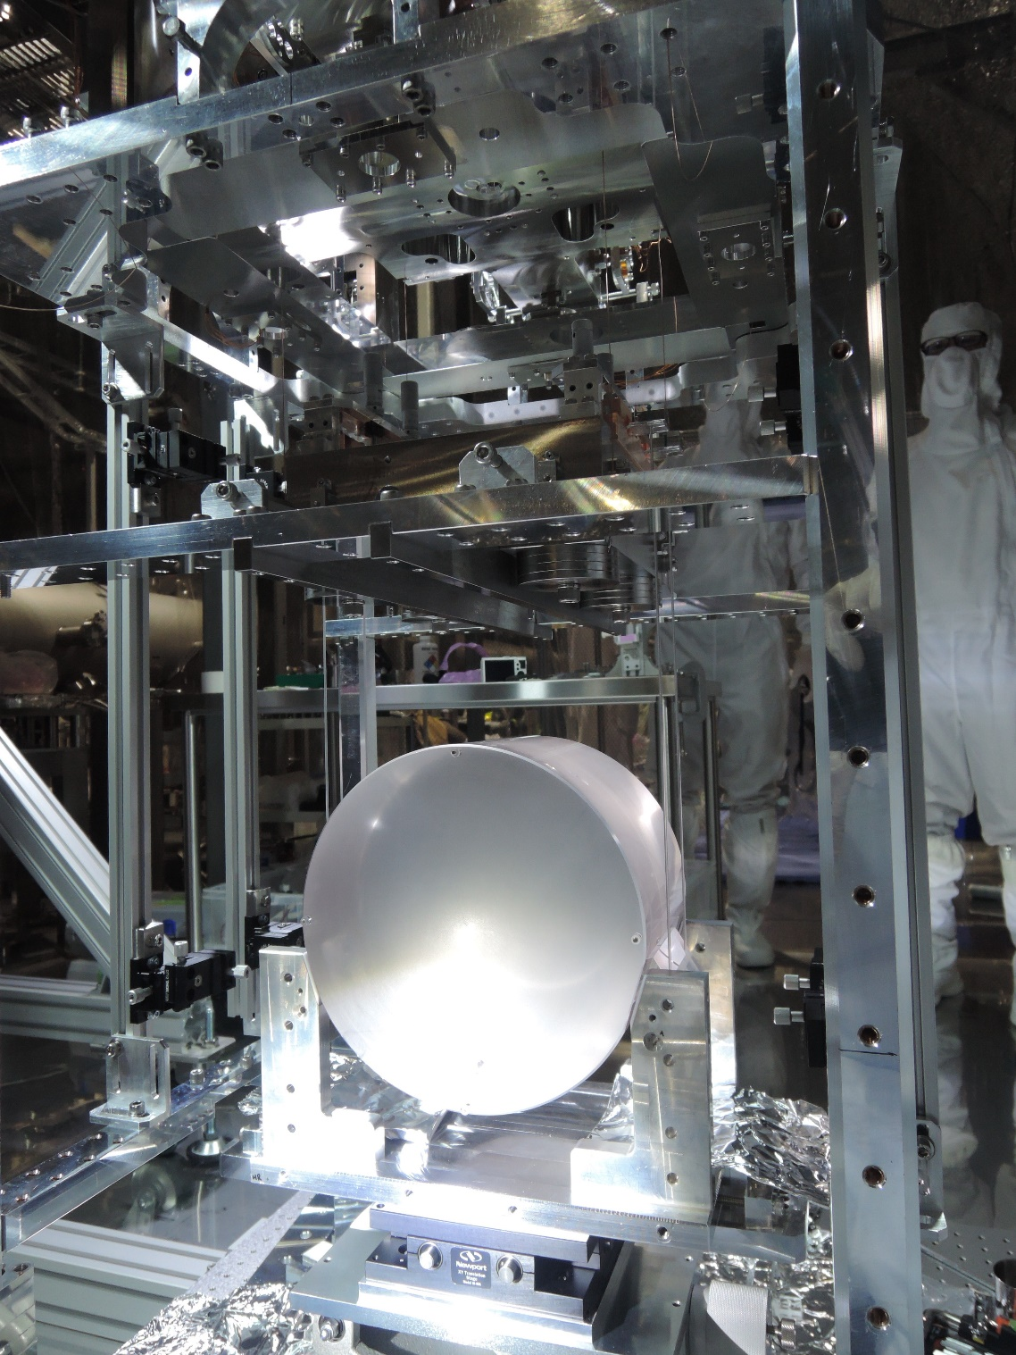
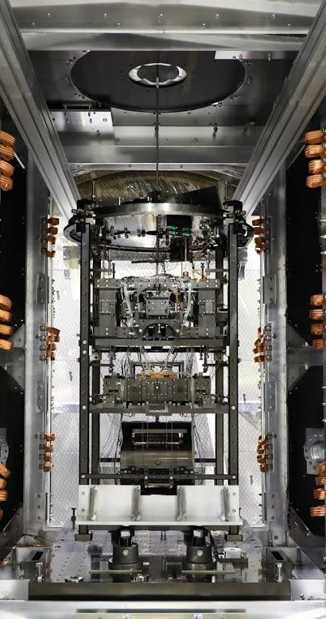
KAGRA is a cryogenic detector (3)
Side view
Photos: Rahul Kumar and Higiwara.

Slide 10
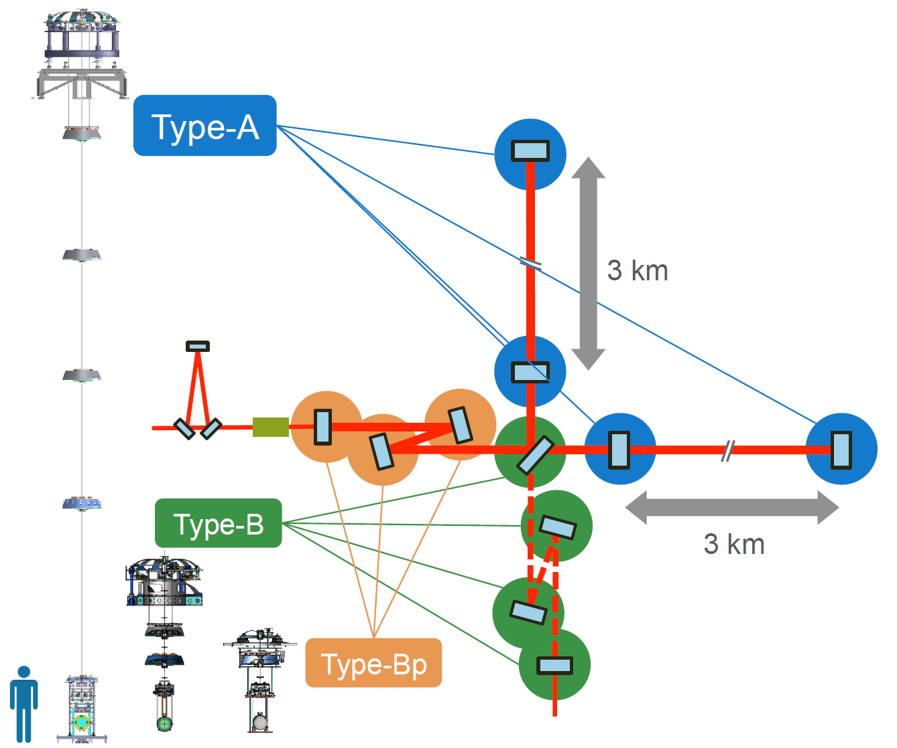
Suspensions for the main interferometer mirrors (1)
4  Type A for the Test Masses sensitive to GW.
4  Type B for the beam splitter and signal recycling mirrors.
3  Type Bp for the power recycling mirrors.
Drawing by Koki Okutomi

Slide 11
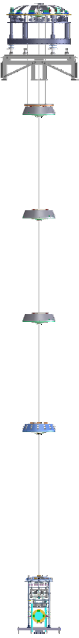
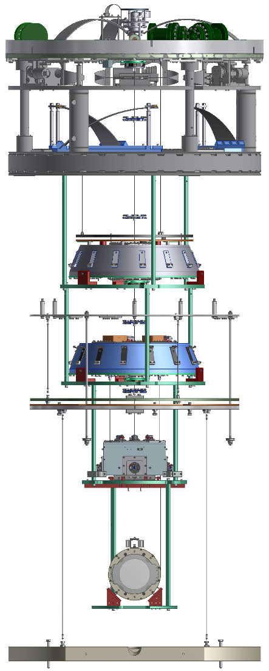
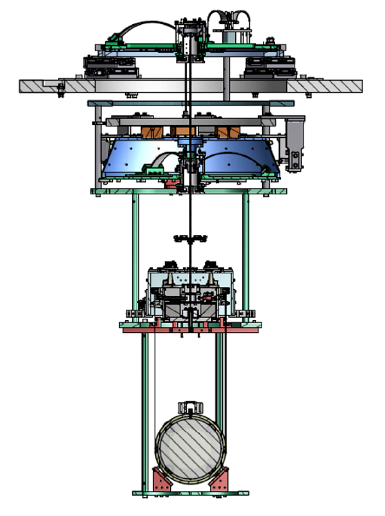
Suspensions for the main interferometer mirrors (2)
Type Bp
Type B
Type A
Power recycling mirrors
Beam splitter and signal recycling mirrors
Test masses
Room temperature
payload
Cryogenic payload

Slide 12
Aim of requirements
At high frequencies above and at 10 Hz: to achieve the interferometer target sensitivity.
  Beam splitter: 3.39 × 10⁻¹⁸ m/√Hz at 10 Hz.
  Signal recycling mirror: 2.54 × 10⁻¹⁸ m/√Hz at 10 Hz.
At low frequencies:
  Lock acquisition: v = 0.5 μm/s (integrated RMS).
  Interferometer stable operation: pitch and yaw 1 µm RMS displacement.
  Quick recovery after losing the interferometer lock (e.g. due to an earthquake): time constant upon damping of less than 60 seconds.
  Enzo Tapia will talk about the performance at low frequencies.

Slide 13
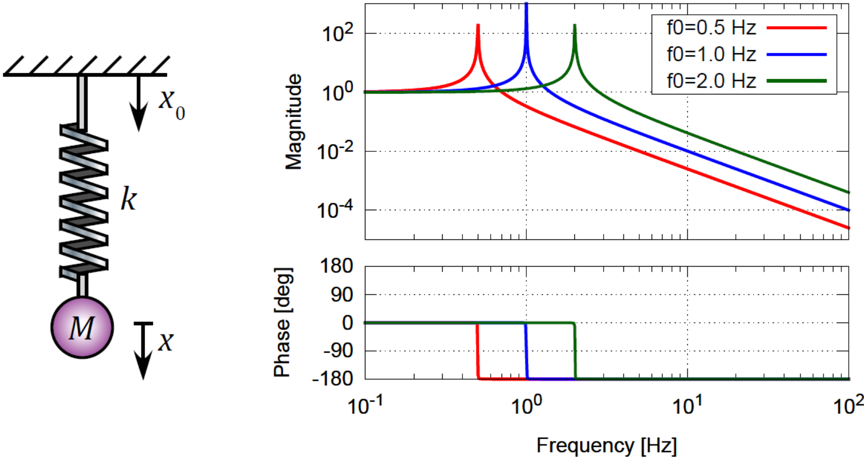
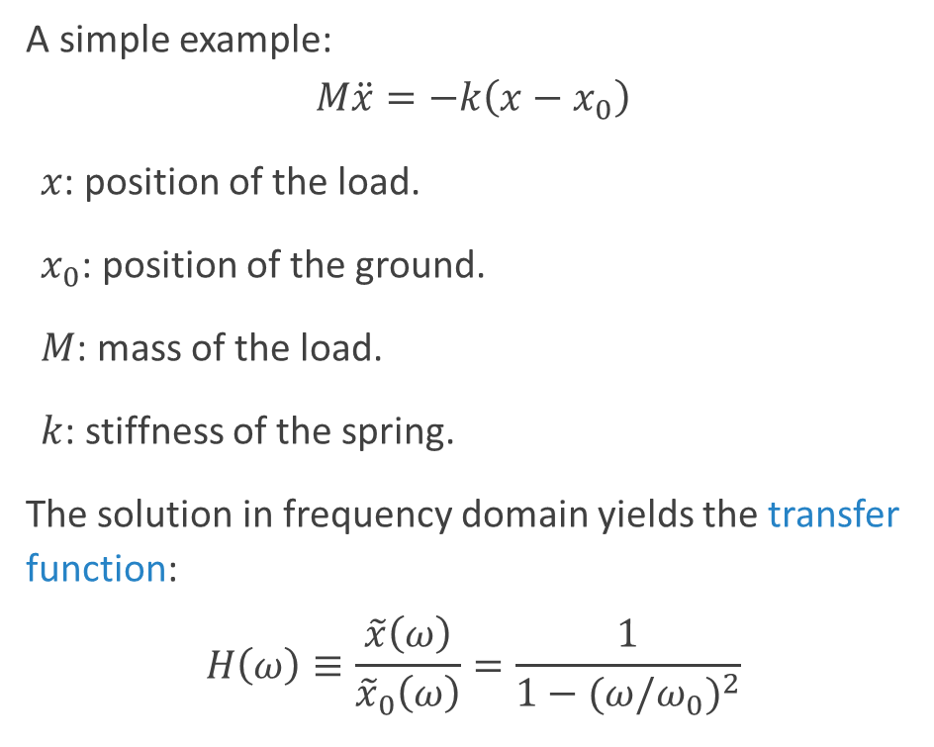

Passive vibration isolation
A simple example:
$$M\ddot{x}=−k\left(x−x_{0}\right)$$
$x$: position of the load.
$x_{0}$: position of the ground.
$M$: mass of the load.
$k$: stiffness of the spring.
The solution in frequency domain yields the transfer function:
$$H\left(ω\right)≡\frac{\tilde{x}\left(ω\right)}{{\tilde{x}}_{0}\left(ω\right)}=\frac{1}{1−{(ω/ω_{0})}^{2}}$$
$$ω_{0}=\sqrt{\frac{k}{M}}$$
Above the resonant frequency the vibrations are filtered.
Challenge: support a heavy load (100s of kg) with a very soft system (low resonant frequency).
T. Sekiguchi, “A study of low frequency vibration isolation system for large scale gravitational wave detectors,” Ph.D. thesis, University of Tokyo, 2016.

Slide 14
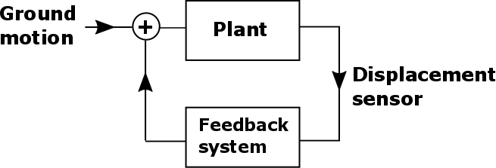
Active vibration isolation
The system still has resonant movement that has to be damped
We need to damp resonant motion to keep stability of the optical system.
+
Geophones for velocity.
Shadow sensors for displacement.
Inductive sensors for displacement.
-
Actuator
T. Sekiguchi, “A study of low frequency vibration isolation system for large scale gravitational wave detectors,” Ph.D. thesis, University of Tokyo, 2016.

Slide 15
Transfer functions
Other type of transfer functions are measured with the control loop open.
We move the system according to a prescription and sense its response.
We use them for
Assessing the health of the system
  Otherwise freely hanging components are touching each other.
  Misconnected or disconnected cables
  Errors in the software
Designing controls filters offline.
+
-
Actuator

Slide 16
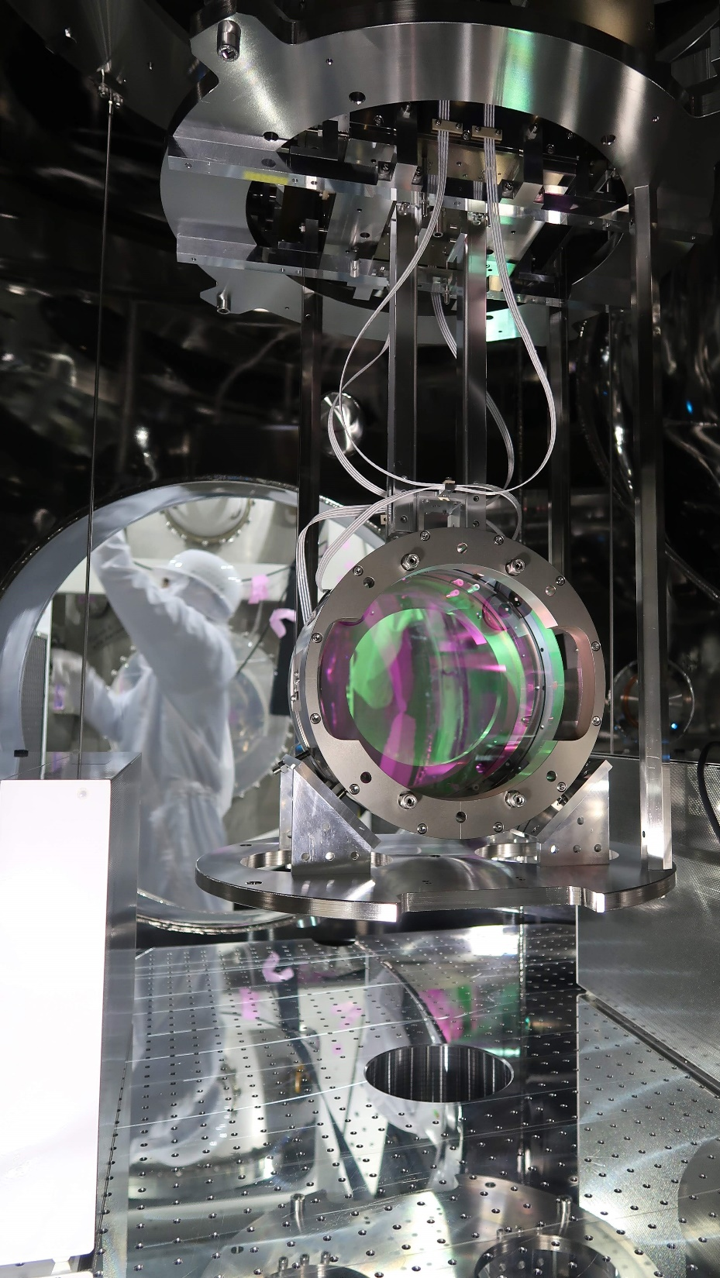
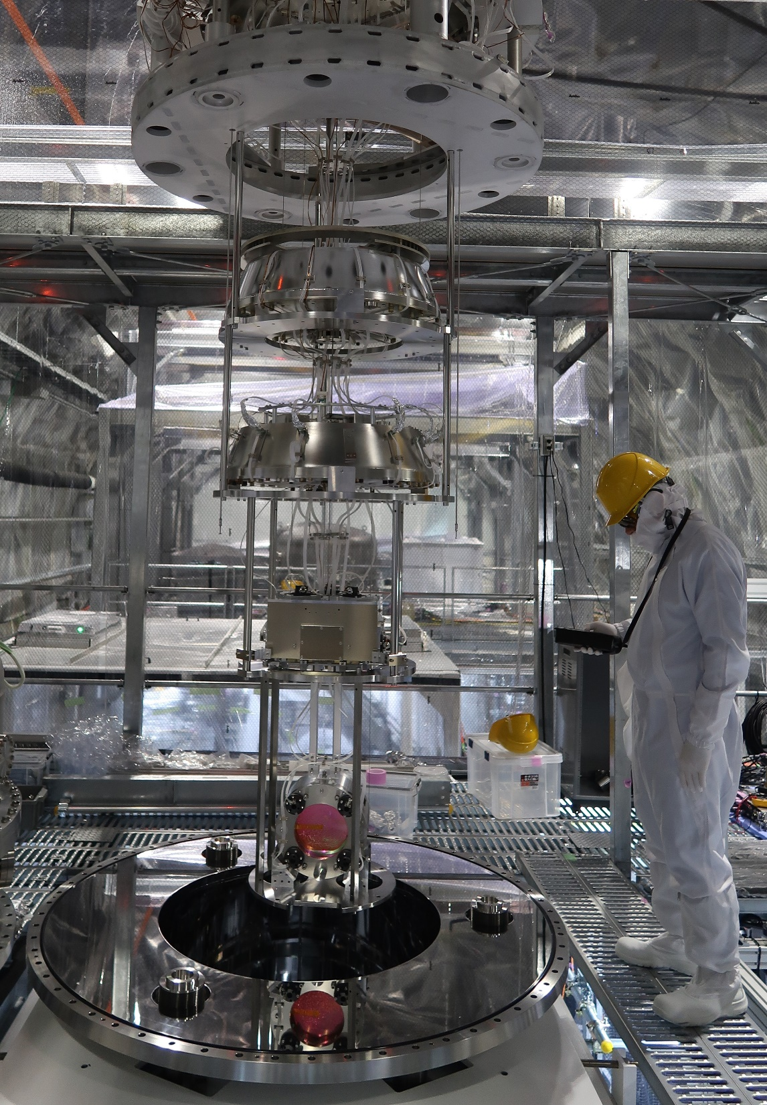
Description of the Type B suspension
Room temperature
Beam splitter
Three signal recycling mirrors

Slide 17
Overview of the suspension
Top GAS filter
Inverted pendulum
Quadruple pendulum.
A pre-isolator:
  Inverted pendulum horizontal isolation.
  GAS filter for vertical isolation.
A chain with 3 × GAS filters for vertical isolation.
Magnetic damper.
Payload:
  Marionette and its recoil body.
  Optic and its recoil body.
Sensors and actuators.
Optical lever.
Suspended optical table.
Standard GAS filter
Surface supported by ground
Bottom GAS filter
Intermediate mass assembly
Payload
Optic assembly
SR suspension

Slide 18
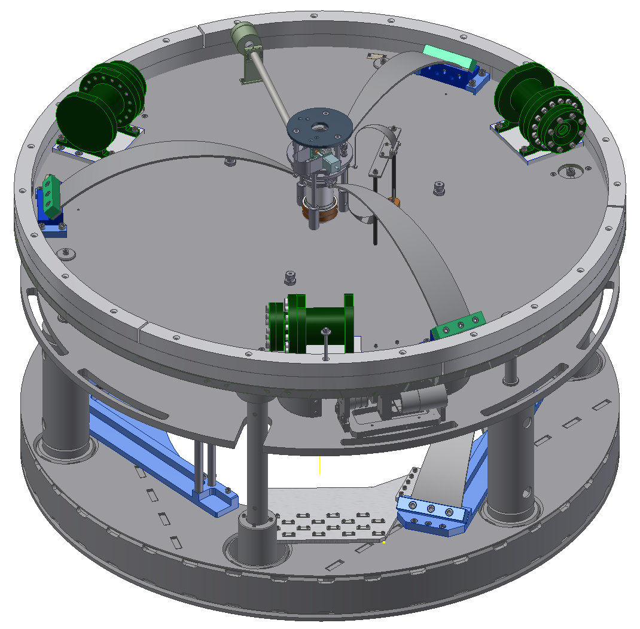
Basic elements of the pre-isolator
Inverted pendulum for horizontal isolation
3 × IP legs
3 × Geophones for inertial damping.
3 × LVDTs for position measurement.
3 × Coil-magnet actuators.
3 × Horizontal mechanical actuators.
Geometric anti-spring filter for vertical isolation
Three maraging steel blades.
1 × LVDT for position measurement.
1 × Coil-magnet actuator.
1 × Vertical mechanical actuator (fishing rod).
1 × Yaw mechanical actuator.
SR pre-isolator

Slide 19
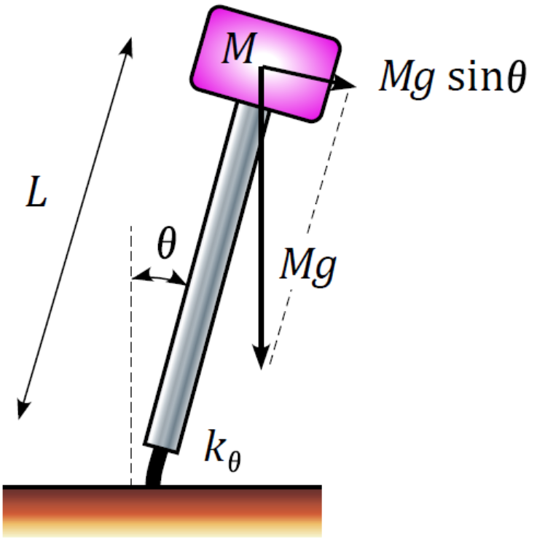
Inverted pendulum: horizontal isolation
  It filters horizontal vibrations.
  A stiff flexure provides a restoring force for the heavy load.
  When the IP is out of equilibrium the weight of the load produces the anti-spring effect making the system softer.
The weight pulls the load away from equilibrium
Flexure
T. Sekiguchi, “A study of low frequency vibration isolation system for large scale gravitational wave detectors,” Ph.D. thesis, University of Tokyo, 2016.

Slide 20
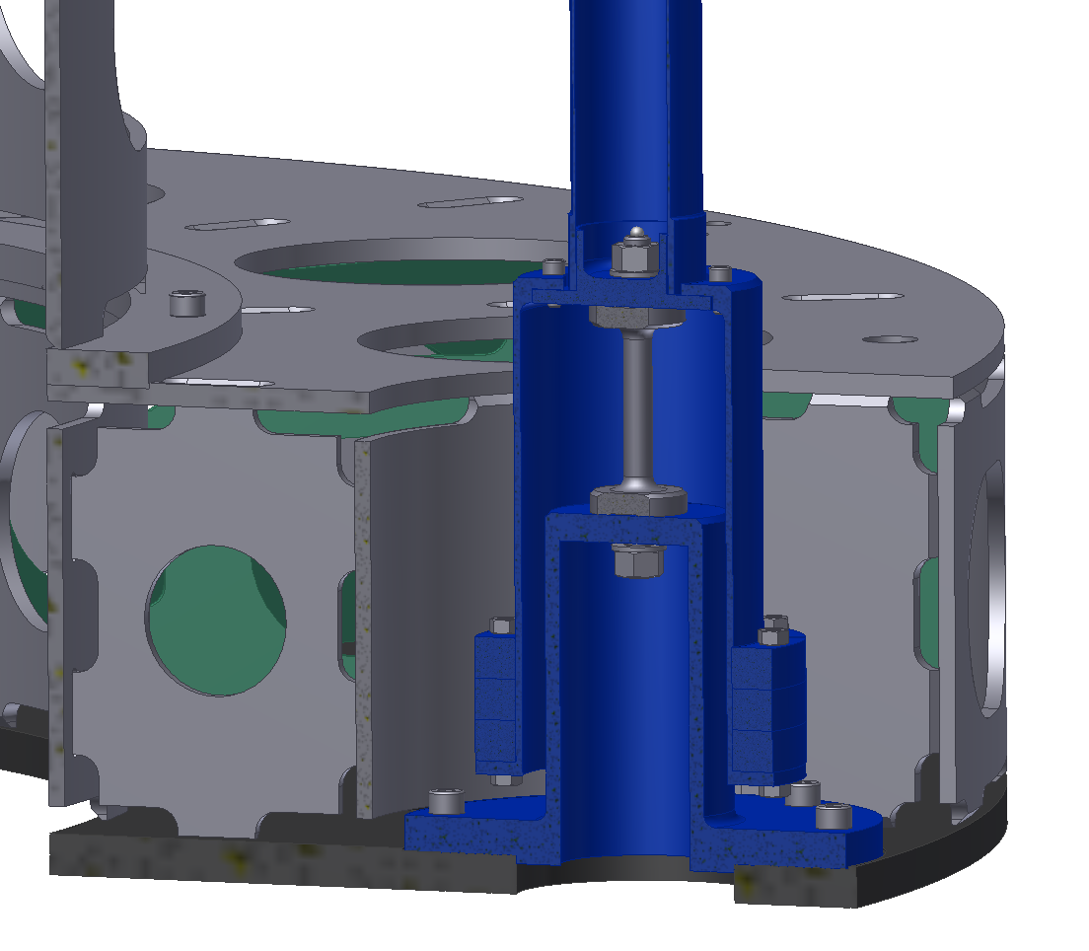
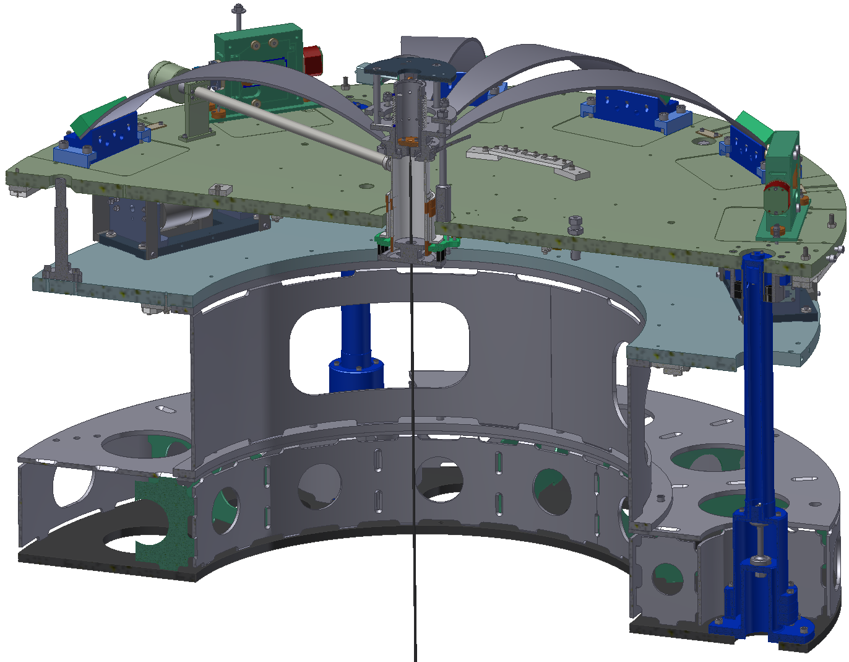
Inverted pendulum components (1)
IP table
IP flexure
IP leg
Suspension rod
BS pre-isolator
248 kgf
Base supported by the ground
The flexure is ~∅10.6 mm

Slide 21
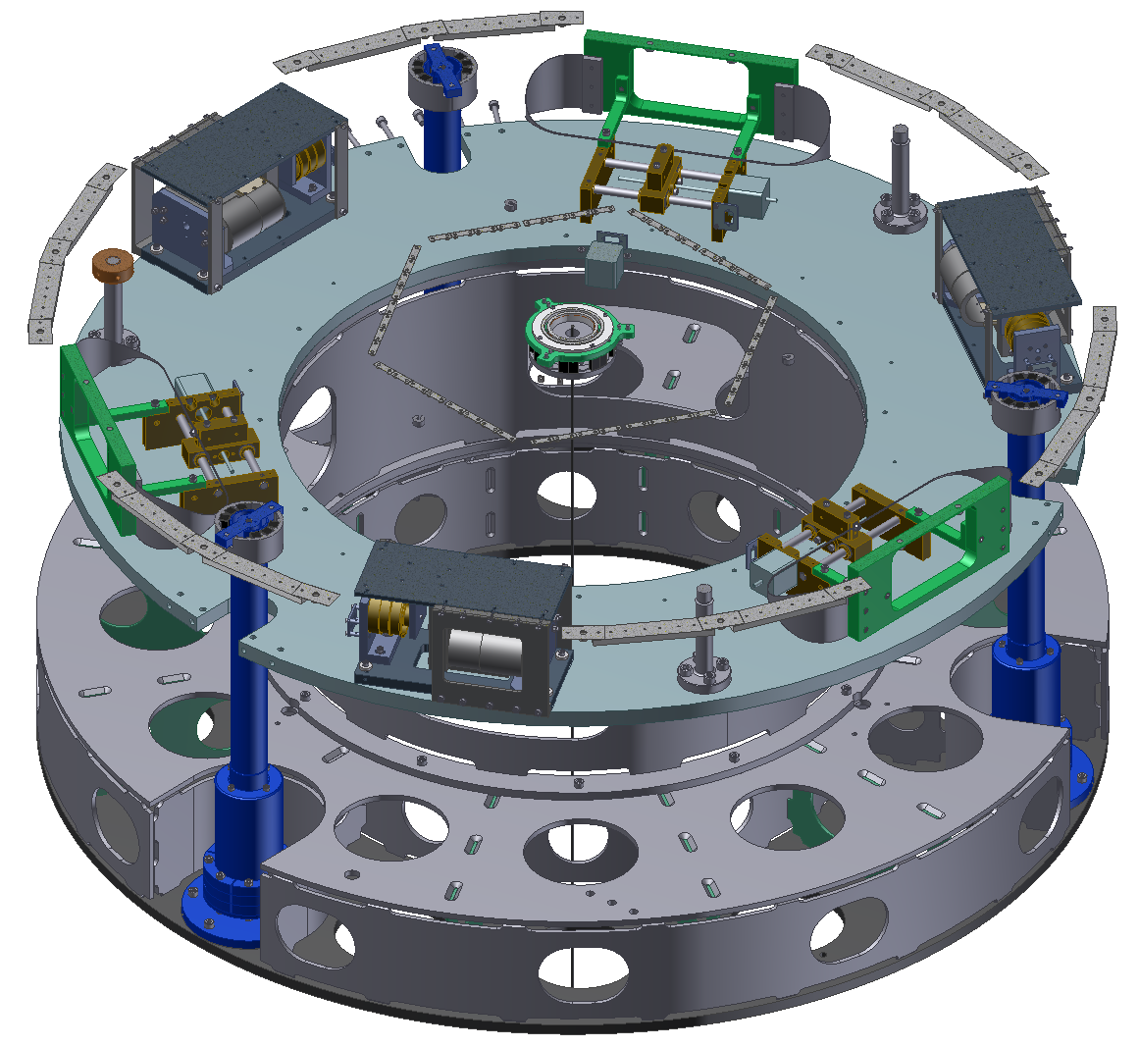
Inverted pendulum components (2)
Geophone
LVDT
Fishing Rod
Geophone
LVDT
Fishing Rod
Geophone
Fishing Rod
SR inverted pendulum
LVDT
BS inverted pendulum

Slide 22
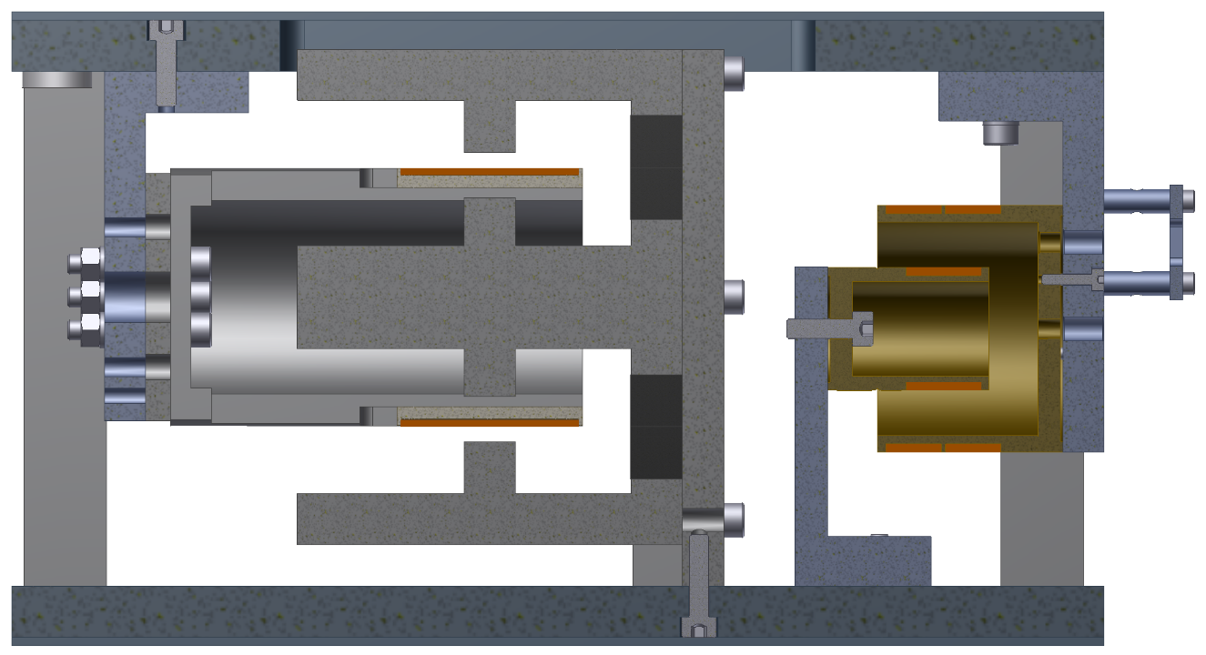
LVDTs and coil-magnet actuators at the IP
Attached to IP table
Secondary coil
Actuation coil
Magnets
(Linear Variable Displacement Transducer
or any of the other 3 different names)
Yoke
Primary coil
Attached to ground

Slide 23
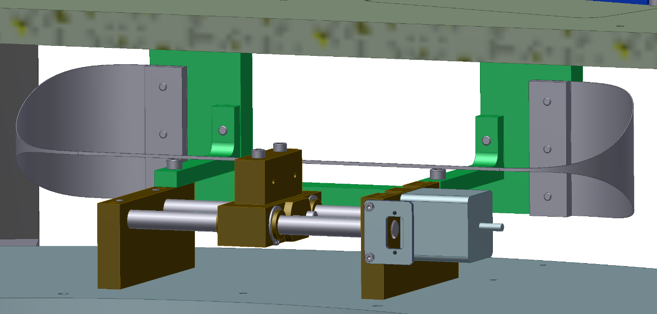
Horizontal fishing rods at the IP
Blade attachment point to carriage
IP table
We can adjust the IP position within several 10s of µm and µrad of the desired position.
Then we use the coil magnet actuators.
Blade
Blade
Movable carriage
Stepper motor
Ground

Slide 24
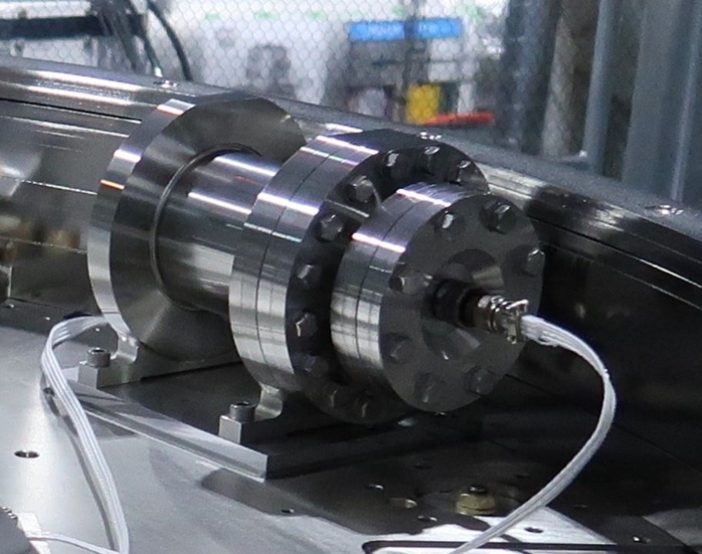
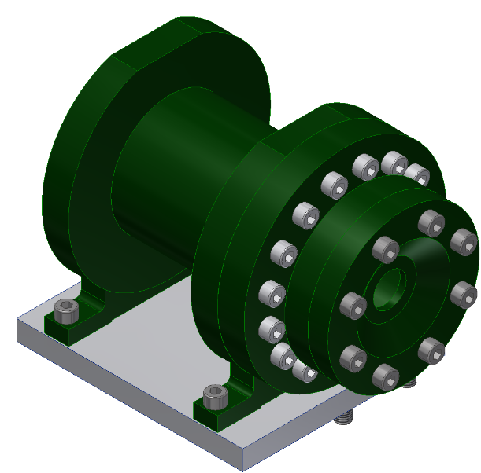
Geophones
They provide an output proportional to velocity.
The aim of using the geophones is to damp the micro-seismic peak at around 200 mHz.
The geophones and the LVDTs are combined into a single sensor using a blending filter:
  LVDT for position control at low frequencies (aiming at lower than 90 mHz.)
  Geophones for the micro-seismic peak at 0.2 Hz.
They are inside a hermetically sealed pod in air.

Slide 25
Geophone sensitivity
The noise is measured in sets of three geophones by estimating the correlated and uncorrelated components of their signals.
Correlated component: ground vibrations at the measurement site.
Uncorrelated components: the noise of each geophone.
Sensitivity @ micro-seismic peak
Sleeman et al. Three channel correlation analysis: a new technique to measure instrumental noise in digitalizer and seismometers. Bulletin of the Seismological Society of America, vol. 96, issue 1, pp. 258-271
Measured by Yoshinori Fujii

Slide 26
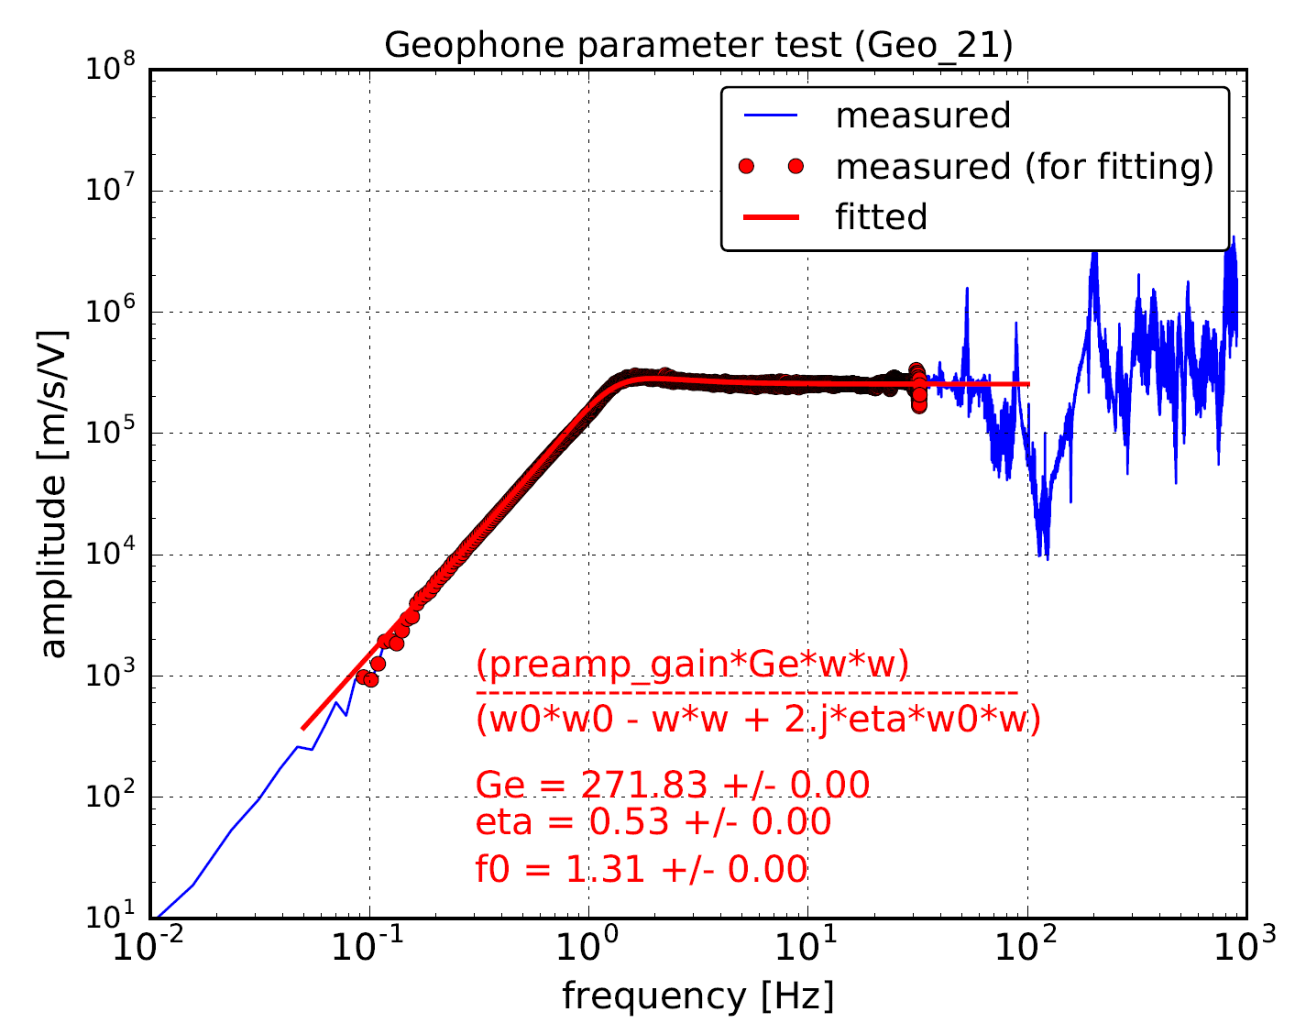
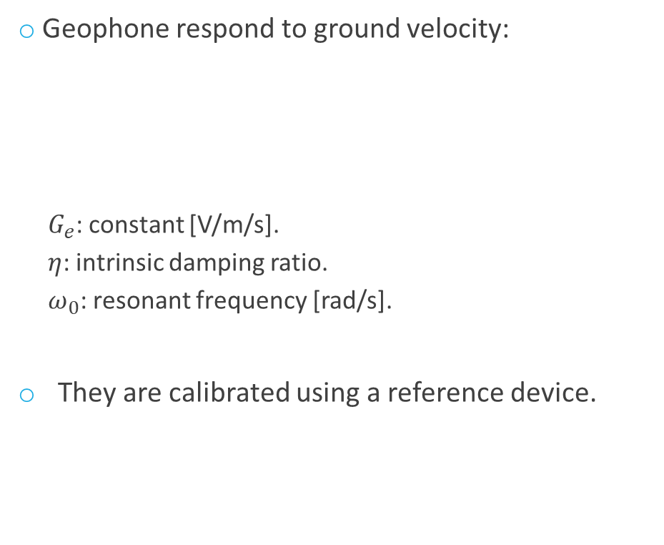
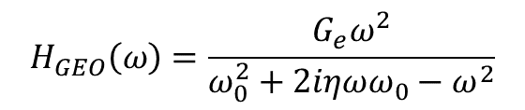
Geophones calibration
Geophone respond to ground velocity:
  $G_{e}$: constant [V/m/s].
  $η$: intrinsic damping ratio.
  $ω_{0}$: resonant frequency [rad/s].
They are calibrated using a reference device.
Measurement
$$H_{GEO}\left(ω\right)=\frac{G_{e}ω^{2}}{ω_{0}^{2}+2iηωω_{0}−ω^{2}}$$
Coherent data
Coherence between sensors
No coherence between the sensors
Measured by Yoshinori Fujii

Slide 27
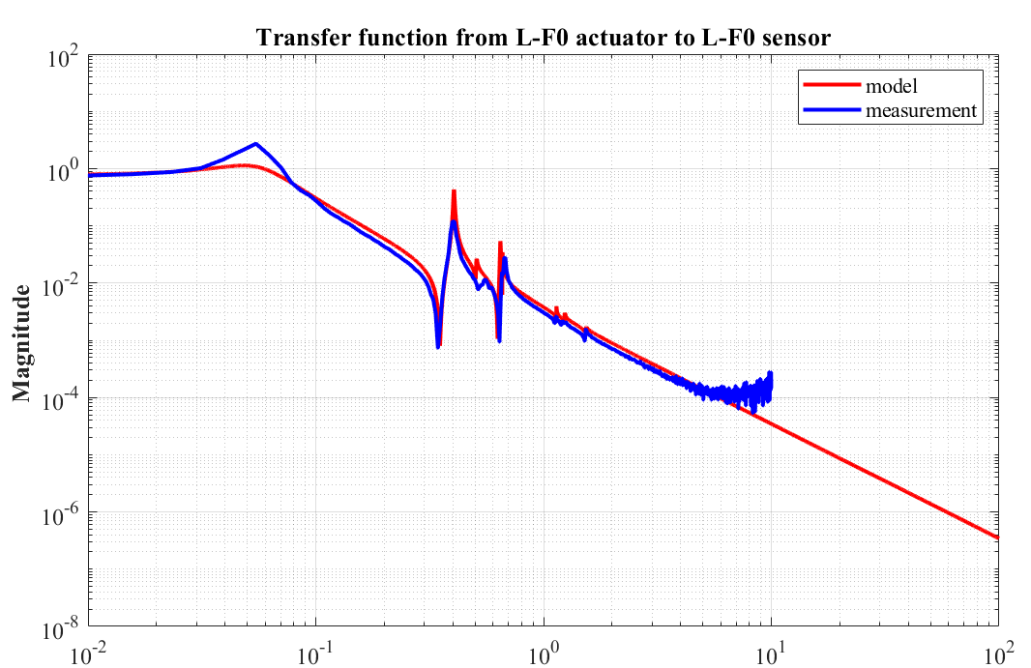
Inverted pendulum properties
Resonant frequencies for the SR2 IP:
Longitudinal: ~55 mHz.
Transverse: ~55 mHz.
Yaw: ~300 mHz.
~55 mHz
Electromagnetic coupling from the actuator
Structural damping is not considered properly in this model

Slide 28
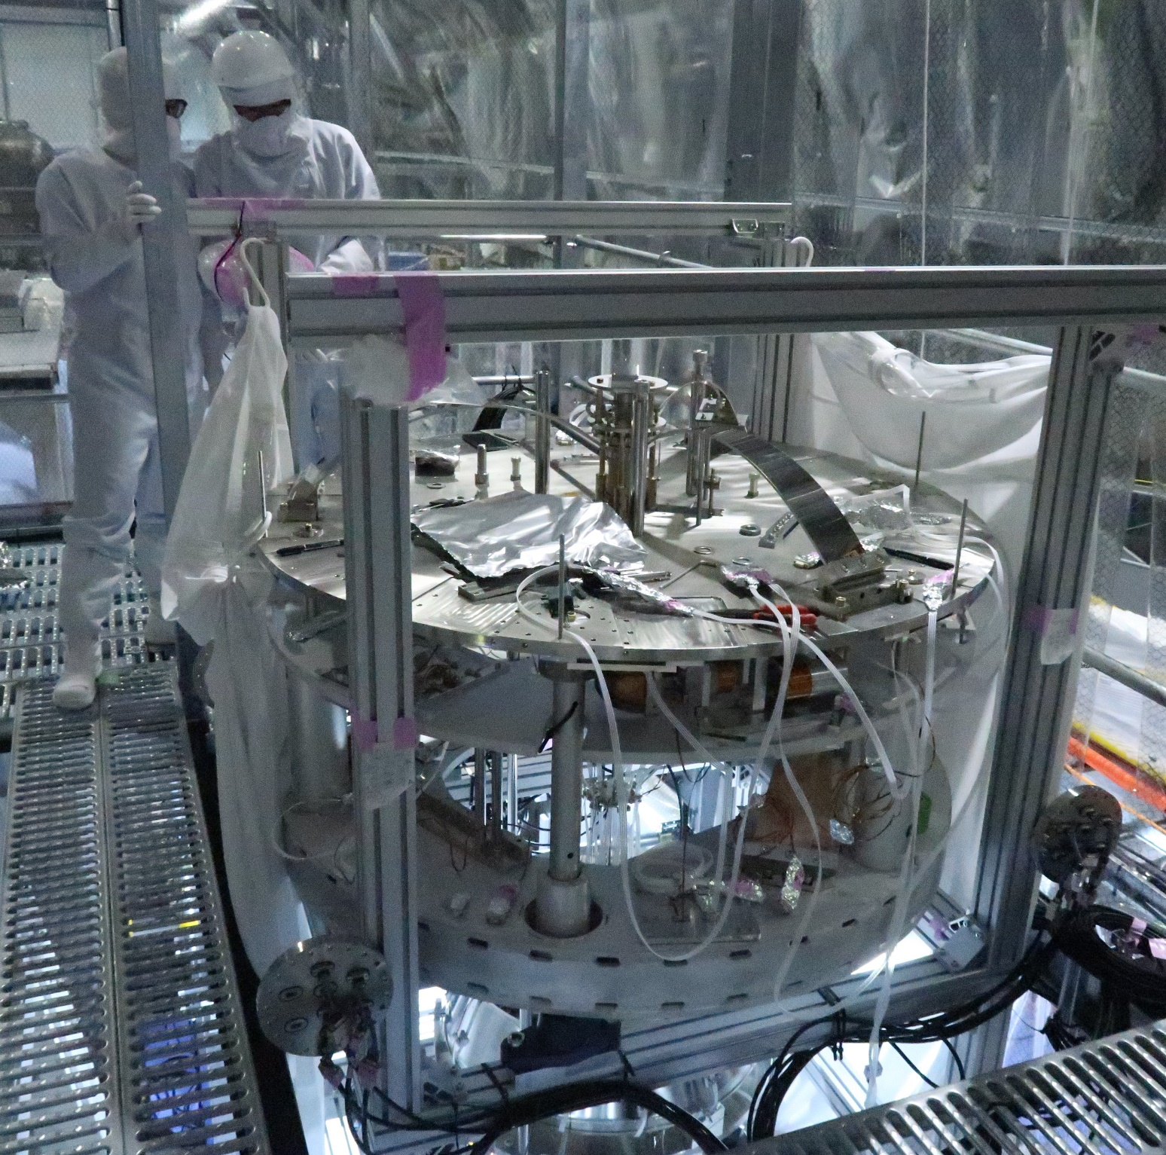
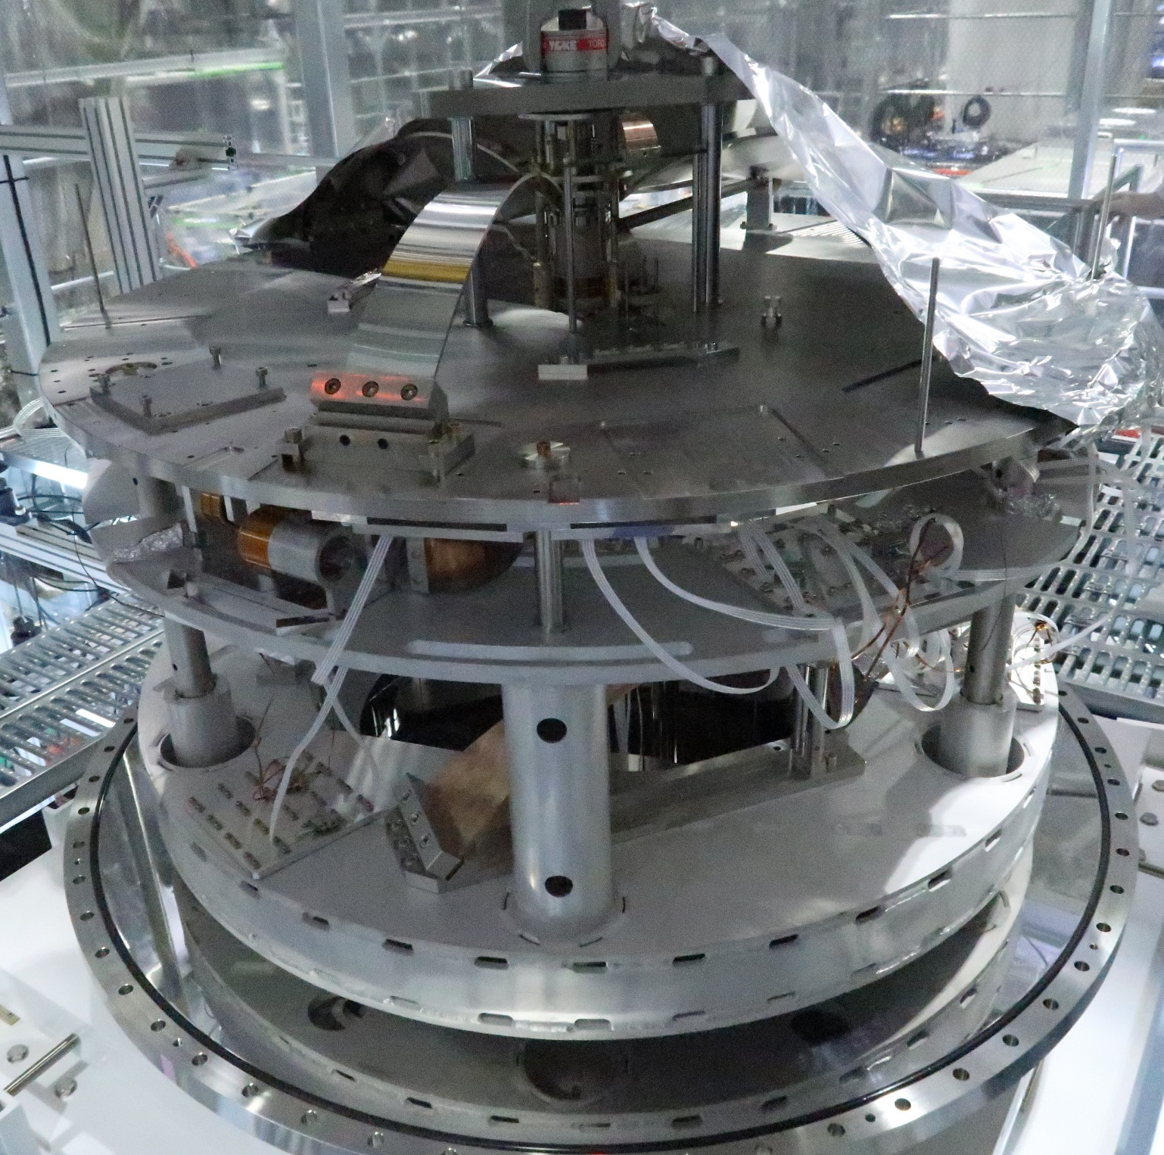

Slide 29
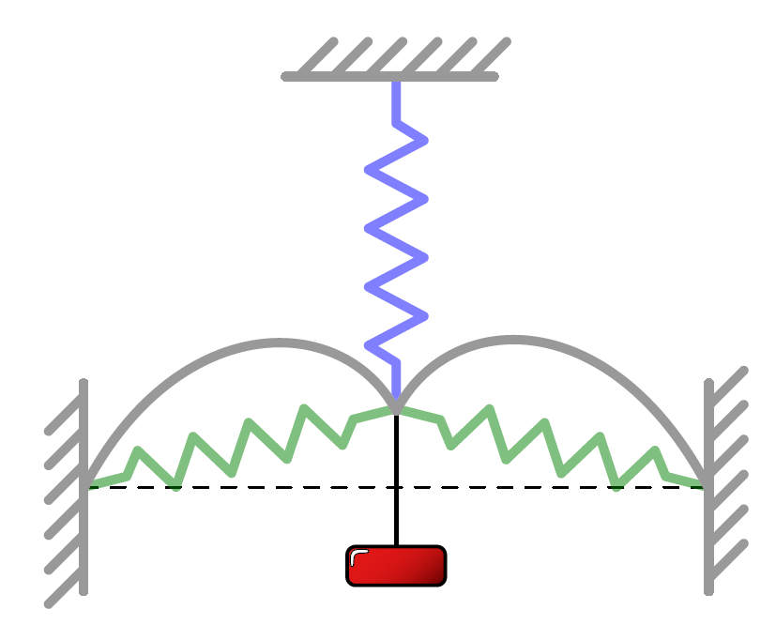


Geometric anti-spring
It filters vertical vibrations.
The extension spring is very stiff so it can support a heavy load.
The compression springs push the load away from the equilibrium position as the load moves: the system becomes softer.
Extension spring 1
$$F_{2}$$
$$F_{1}$$
Compression springs 2
Mg
Original drawing by Alexander Wanner

Slide 30
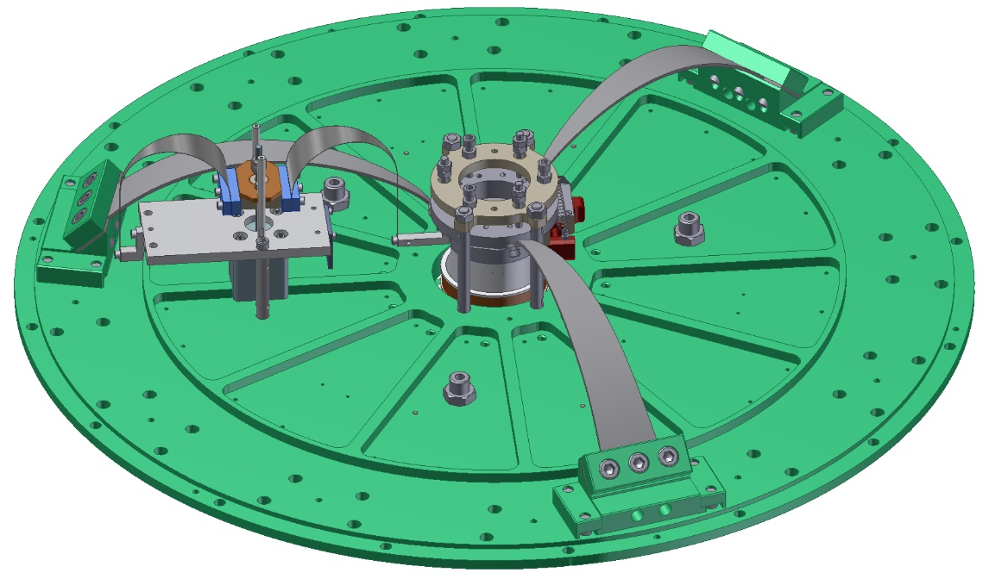
GAS filters in the Type B suspension
Similarities and differences:
All of them have fishing rod actuators. ①
All of them have LVDT displacement sensors. ②
All of them have coil-magnet actuators. ③
Yaw adjustment motor: Top Filter and Bottom filter. ④
Magnetic damper ring: only Standard Filter.
The Intermediate Recoil Mass (IRM) hangs directly from the Bottom Filter base plate. (It will be shown later.)
The Bottom Filter has tilt mechanism to finely adjust the position of the IRM. (Not shown.)
④ Yaw adjustment motor. Only TF and BF.
① Fishing rod
3 × Blades
② LVDT sensor
③ Coil magnet actuator (underneath, not seen)

Slide 31
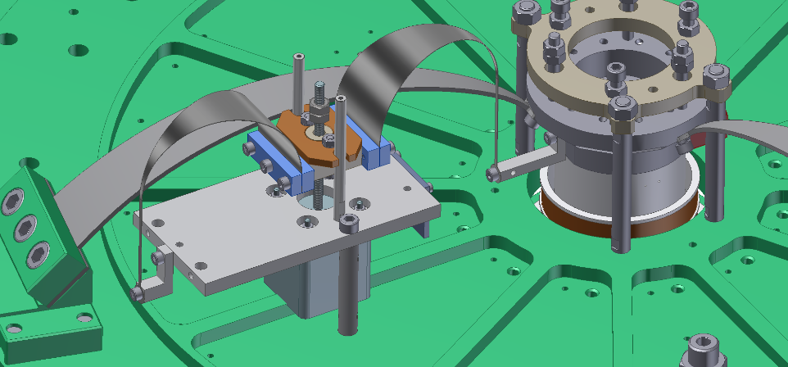
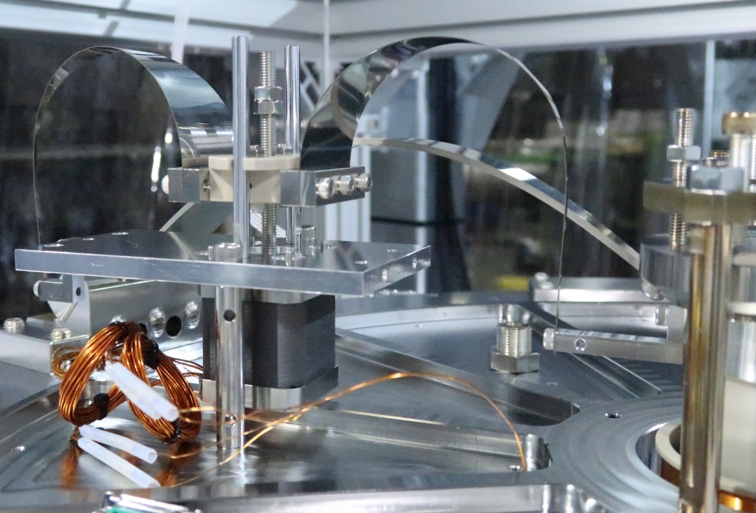
Fishing rods
Its aim to finely adjust the position of the load:
  We need to set the optic at the correct height.
  The keystone has to be at the right height.
We usually have to move it by tens of microns at the time and then use the coil magnet actuator to take it to the desired position.
This is not used in the control loop.

Slide 32
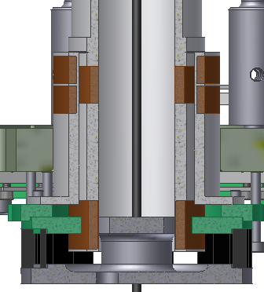
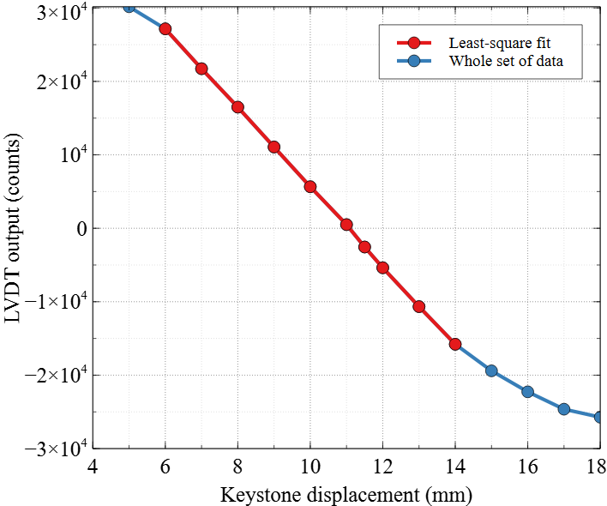
LVDT calibration
Primary coil
Secondary coil
GAS filter base
Actuation coil
Magnets
Yoke
Example: F0 LVDT in SRM
Calibration factor example: -0.185 μm/count.
Linear range: 8 mm.

Slide 33
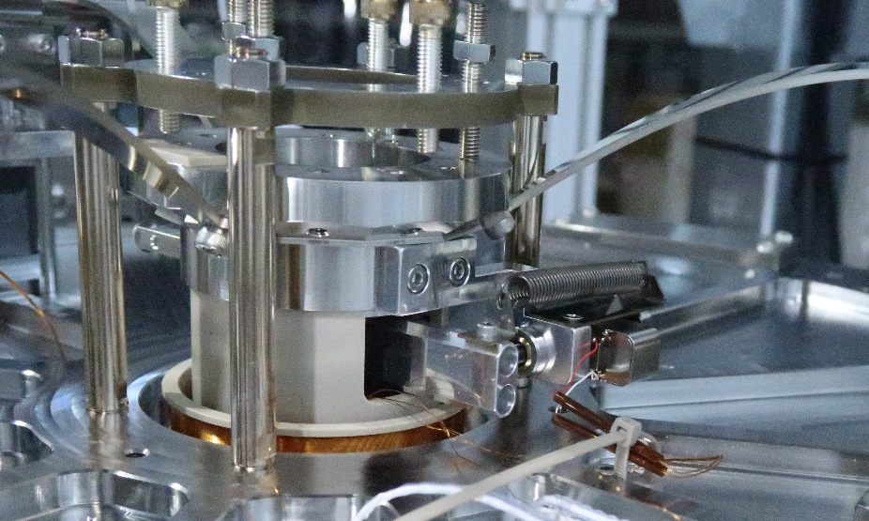
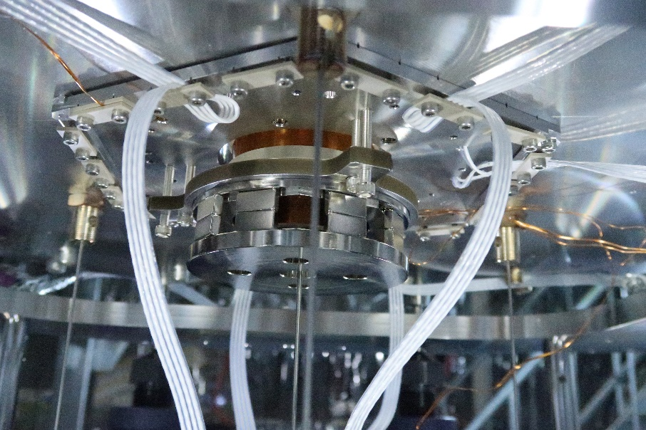
LVDT and coil-magnet actuators
Keystone
Blade
Actuation coil
LVDT secondary coil
Yoke
Suspension rod at the centre of coils

Slide 34
LVDT sensitivity
It was measured by locking the LVDT.
At 1 Hz: 0.04 μm/√Hz.
At 10 Hz: 0.02 μm/√Hz.
Integrated RMS: typical values from 0.1 to 0.5 μm.
SR2 F0 LVDT

Slide 35
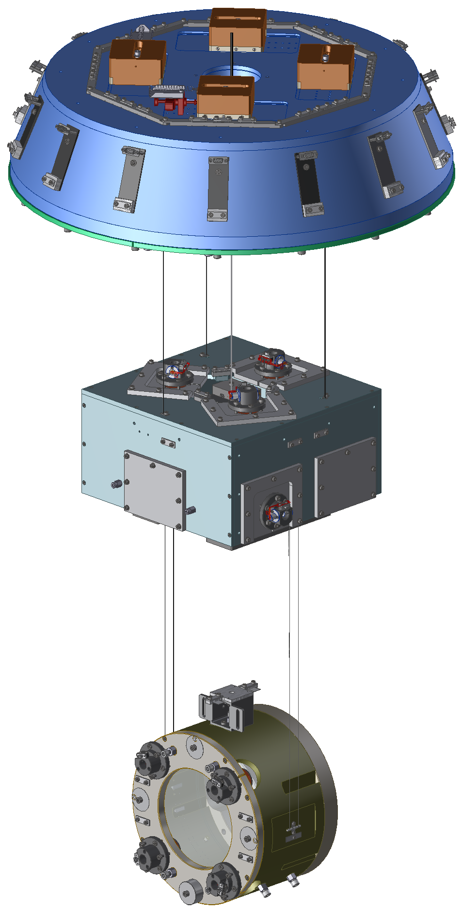
The payload (1)
Optic:
  it has magnets for applying forces with coils.
  It has primary and secondary wire breakers.
Recoil Mass: it holds coil for applying forces onto the optic.
Intermediate Mass (IM)
  It holds the optic and the Recoil Mass with wires.
  It serves as a marionette for roll and pitch.
  Yaw is adjusted with either the Bottom Filter or Top Filter.
  It has OSEMS to actively damp the resonant modes of the payload itself.
Intermediate Recoil Mass:
  Holds the OSEMs.
  Hangs from the BF with three suspension rods.
Oplev on the ground for measuring pitch, yaw and longitudinal.
The payload hangs from the BF
Payload

Slide 36
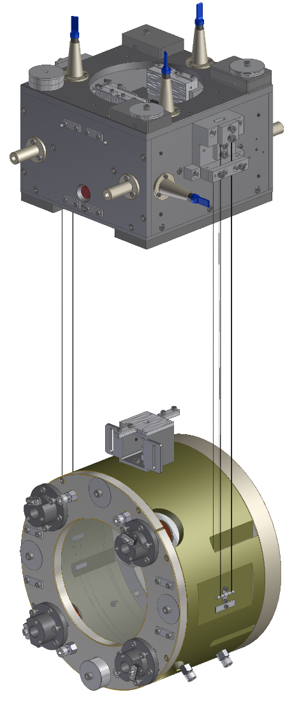
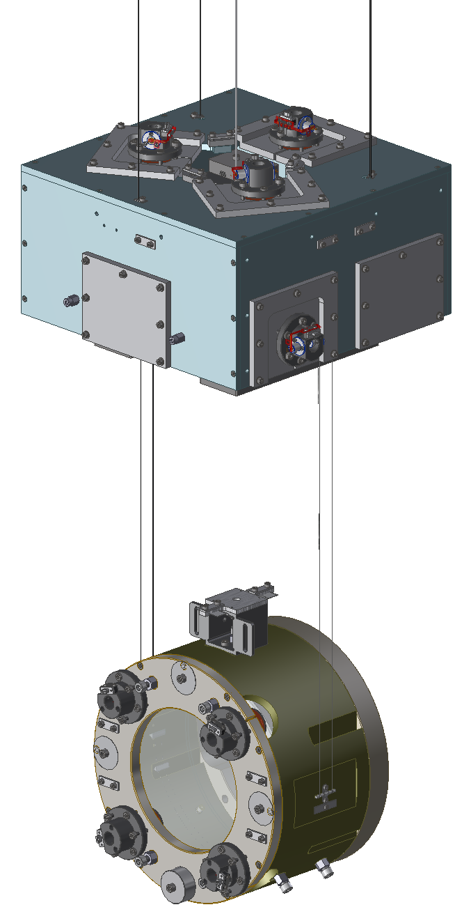
The payload (2)
Central rod for the IM
3 × Rods for the IRM
IRM: 3 × 2 mm maraging rod.
IM: 1 × 2 mm maraging rod (neck).
Optic: 2 × loops of piano wire 200 µm thick.
RM: 2 × loops of tungsten wire 650 µm tick.
IRM: aluminium, 8.9 kg.
IM: aluminium and stainless, 26.2 kg.
Optic: fused silica, 10.2 kg.
RM: titanium, 12.0 kg.

Slide 37
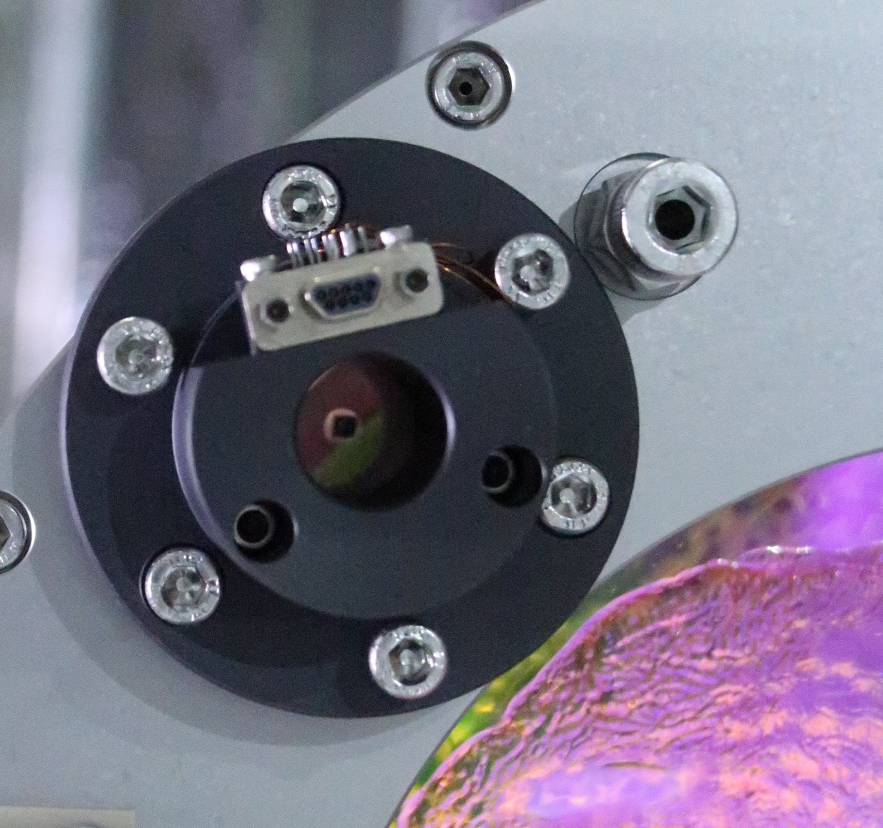
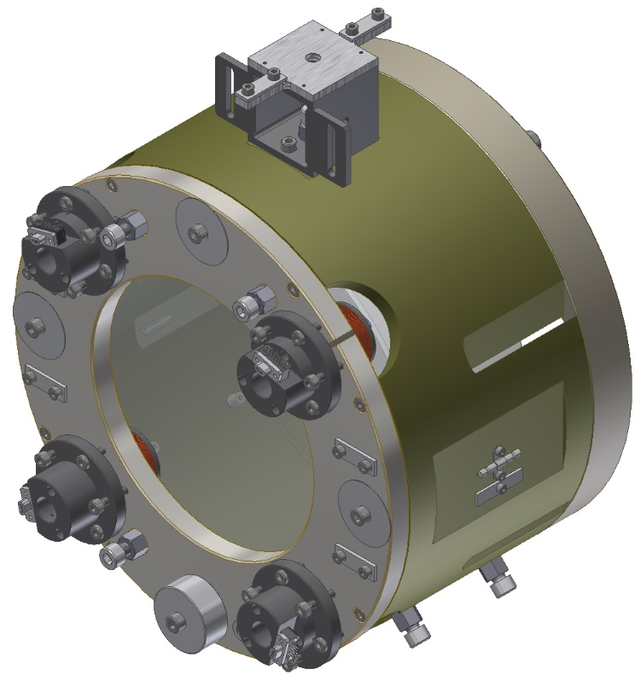
The Optic and the Recoil Mass (1)
Small
magnet
Optic with First Contact
The centres of mass of the optic and RM coincide, nominally.

Slide 38
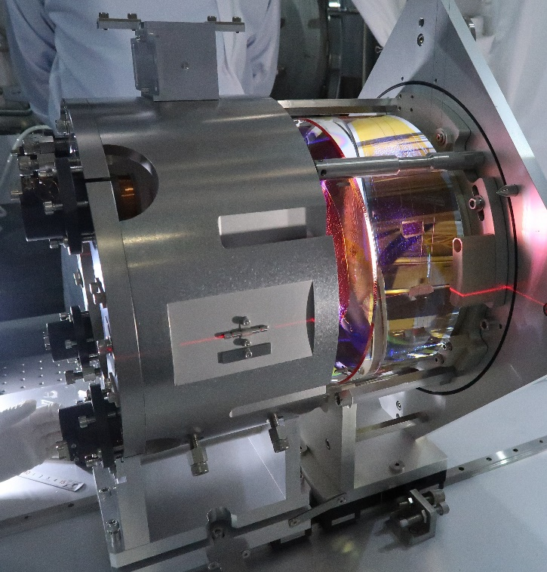
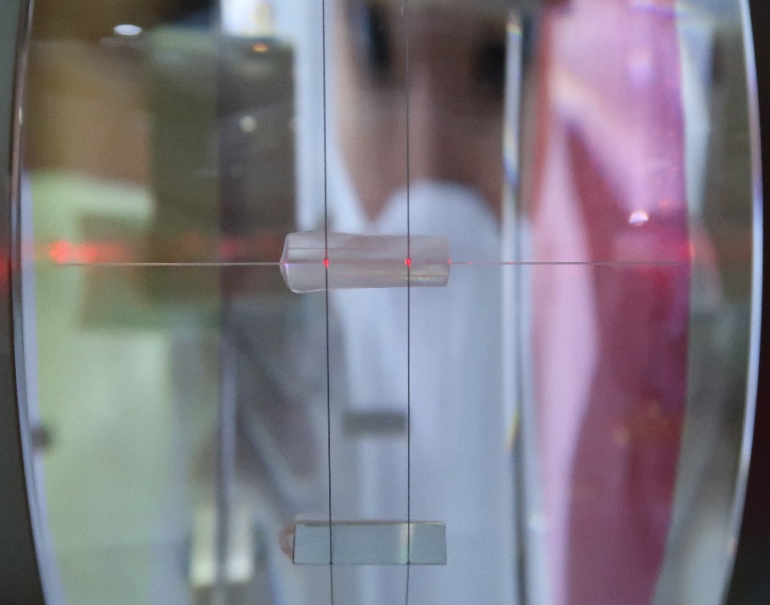
The Optic and the Recoil Mass (2)

Slide 39
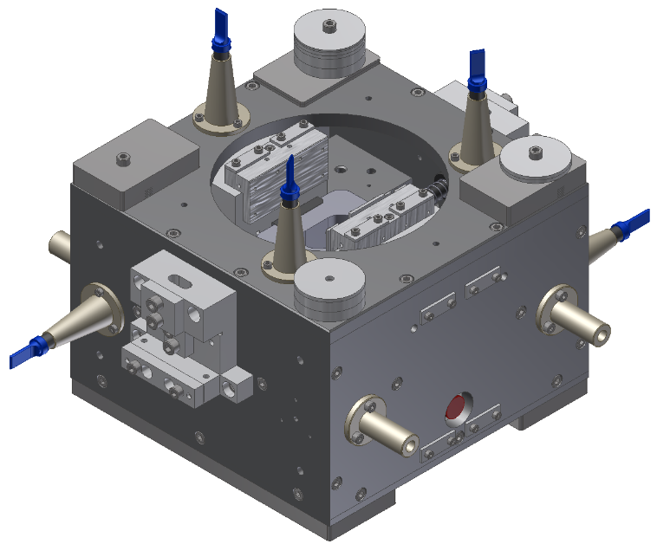
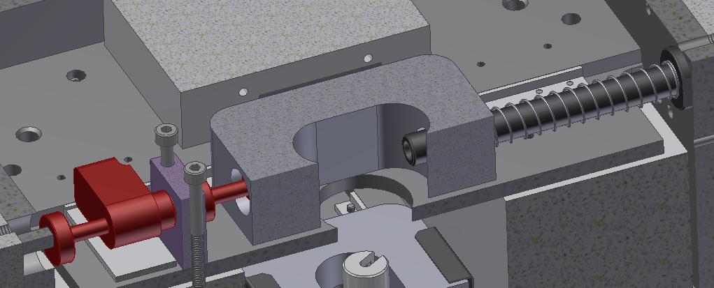

The Intermediate Mass marionette (1)
Pico-motor actuator
Movable mass
Spring
We can tilt the marionette in roll and pitch by changing the position of its centre of mass with sliding masses within.
We tend to adjust within a few μrad from desired position and then use coil magnet actuation.

Slide 40


The Intermediate Mass marionette (2)

Slide 41


Intermediate Recoil Mass
The RM is a box opened a the bottom.
It holds the OSEMs.
It hangs from the BF

Slide 42

Intermediate Recoil Mass
The RM is a box opened a the bottom.
It holds the OSEMs.
It hangs from the BF

Slide 43


OSEM: Optical Sensor and Electromagnetic Actuator
LED
Coil
Magnet
Lens
The flag creates a shadow
IM
The position sensor is a shadow sensor.
It has a coil magnet-actuator.
Mounted on IRM.
6 × OSEMs for 6 DoF: L, T, V, R, P and Y.
Photodiode
IRM
When the IM moves the flag changes the amount of light reaching the photodiode.

Slide 44

OSEM calibration and sensitivity
Calibration factor: 2.89 mV/µm
Linear range: 0.9 mm
Measured by Panwei

Slide 45

A quick graphical tour to assembly
Just a few pictures

Slide 46








Slide 47





Slide 48


Some measurements, simulation and status.
How does the system behave at low frequencies? Enzo has an answer!
What does the suspension model predict within the interferometer observation band above 10 Hz?
SRM with interference pattern
SR2 with SR3 far away along the pipe

Slide 49
Tools for simulation
SUMCOM: free hanging suspension
Mathematica.
Transfer function and list of resonant modes.
It’s capable of taking into account structural damping using complex numbers.
Control system simulation has not being implemented.
It provides a graphical representation of the resonant modes.
Control system simulation
Matlab/Simulink.
Transfer function and list of resonant modes.
Only viscous damping is available.
It’s used to assess the sensor noise fed back into the system.
Control filter design above 10 Hz.
Software written by Takanori Sekiguchi

Slide 50
Noise in sensors and the control loop
+
-
With noise
Enzo will talk
about this filters

Slide 51
Current status: residual motion within the observation band
We have calculated the motion of the optic to be too large within the observation frequency band.
The GAS LVDT noise fed back by the control loop is too high. Control filters still have to be rolled-off above resonant frequencies and below 10 Hz.
Inertial damping not implemented yet.
The calculation assumes 1% coupling from the vertical to the horizontal degree of freedom.
The OSEMs are expected to be off during observation. Angular control will be transferred to the main interferometer which uses wavefront sensors.
34: F1, L, T, R, P
36: IM, IRM, OPT, V
Requirement

Slide 52
Immediate future work
We will attempt to take advantage of the common mode rejection there may be among suspensions.
Characterization within the interferometer observation band.

Slide 53

Common mode rejection (1)
In general, the suspensions move in dissimilar ways.
In principle, in order to keep the mirrors as still as possible with respect to each other, perturbations have to be damped locally at each suspension.

Slide 54

Common mode rejection (2)
Nevertheless, we found evidence that in the central room the suspensions move together to a certain extent.
We would like to explore how to use this common mode movement in order to design a suitable control strategy.

Slide 55


Common mode rejection evidence
Common and differential seismic motion was measured in the Input Mode Cleaner area:
Below 20 Hz down to almost 0.150 Hz the common mode is larger than the differential mode.
A very simple preliminary model of the a plane wave traveling along the length of the IMC tunnel does not agree with the measurement.
More work is necessary.
MCe
To main
interferometer
20 m
Incoming laser
MCi
Measurement and calculation by Kousei Miyo

Slide 56

Dual recycling Michelson Interferometer
We’ll use the DRMI as a displacement sensor for characterization.
Measure residual motion.
Decide whether to use inertial damping or common-mode rejection.
We’ll use the back reflections of the input Test Masses.
The PR cavity will be used for laser frequency stabilization.
We aim to shake the IP and measure geophone output and interferometer output.

Slide 57
Summary
We have built four Type B suspensions for the beam splitter and signal recycling mirrors.
  Passive vibration isolation: IP and three GAS filters.
  Active vibration isolation: LVDTs, OSEMS and coil-magnet actuators.
  Payload comprises a marionette, the optic and their recoil masses.
More work is required to meet the requirement of at 10 Hz, namely, to roll-off the GAS control filters.
We aim to characterize the system by shaking the IP table and measuring transfer function from geophones to interferometer output.
We want to explore ways of using common mode rejection in order to design a suitable control strategy.

Slide 58








KAGRA is an international collaboration
This version of the Type B team has members from:
Australia
Mexico
Japan
Chile
Hong Kong
China

Slide 59


Temperature and GAS filters

Slide 60

Centre of percussion effect
Drawing by Alexander Wanner

Slide 61
Common mode rejection evidence
The seismic noise common and differential modes were measured between the X end and the central room using seismometers:
Below 0.4 Hz down to about 0.06 Hz the common mode is larger than the differential mode.
A very simple preliminary model of the a plane p-wave traveling along the length of the X arm agrees with the measurement.
More work is necessary.
Measurement and calculation by Kouseki Miyo

Slide 62


Inverted pendulum and top filter (1)
GAS blade springs
LVDT and coil-magnet
Actuator.
Inverted
pendulum
flexure

Slide 63


