Slide 1
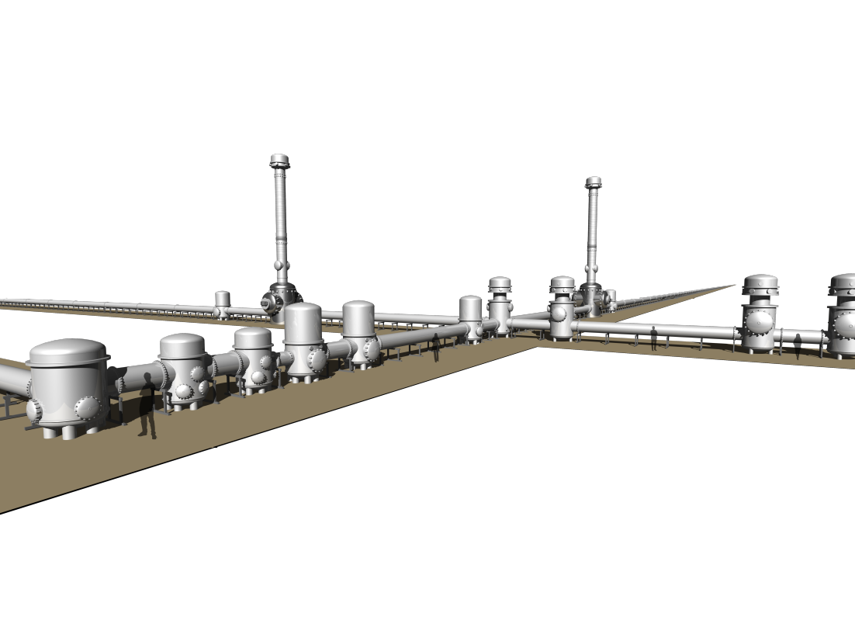
KAGRA Upgrade Plan
2019/5/9@LIGO PAC
National Astronomical Observatory of Japan
Yoichi Aso
On Behalf of The KAGRA Collaboration

Slide 2
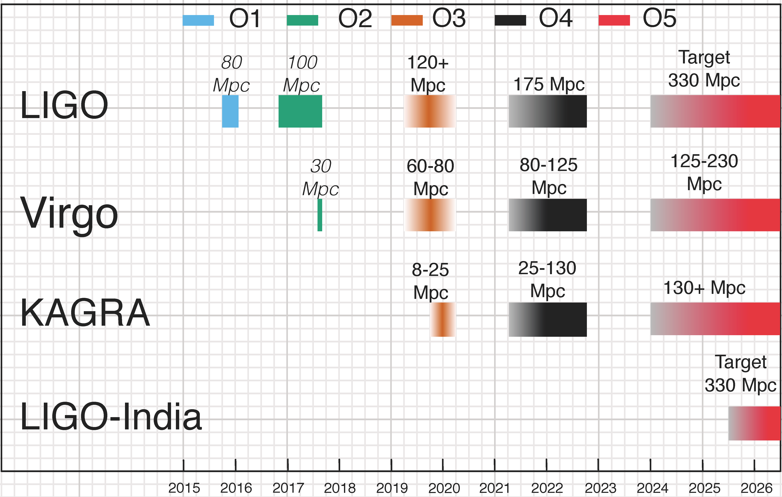
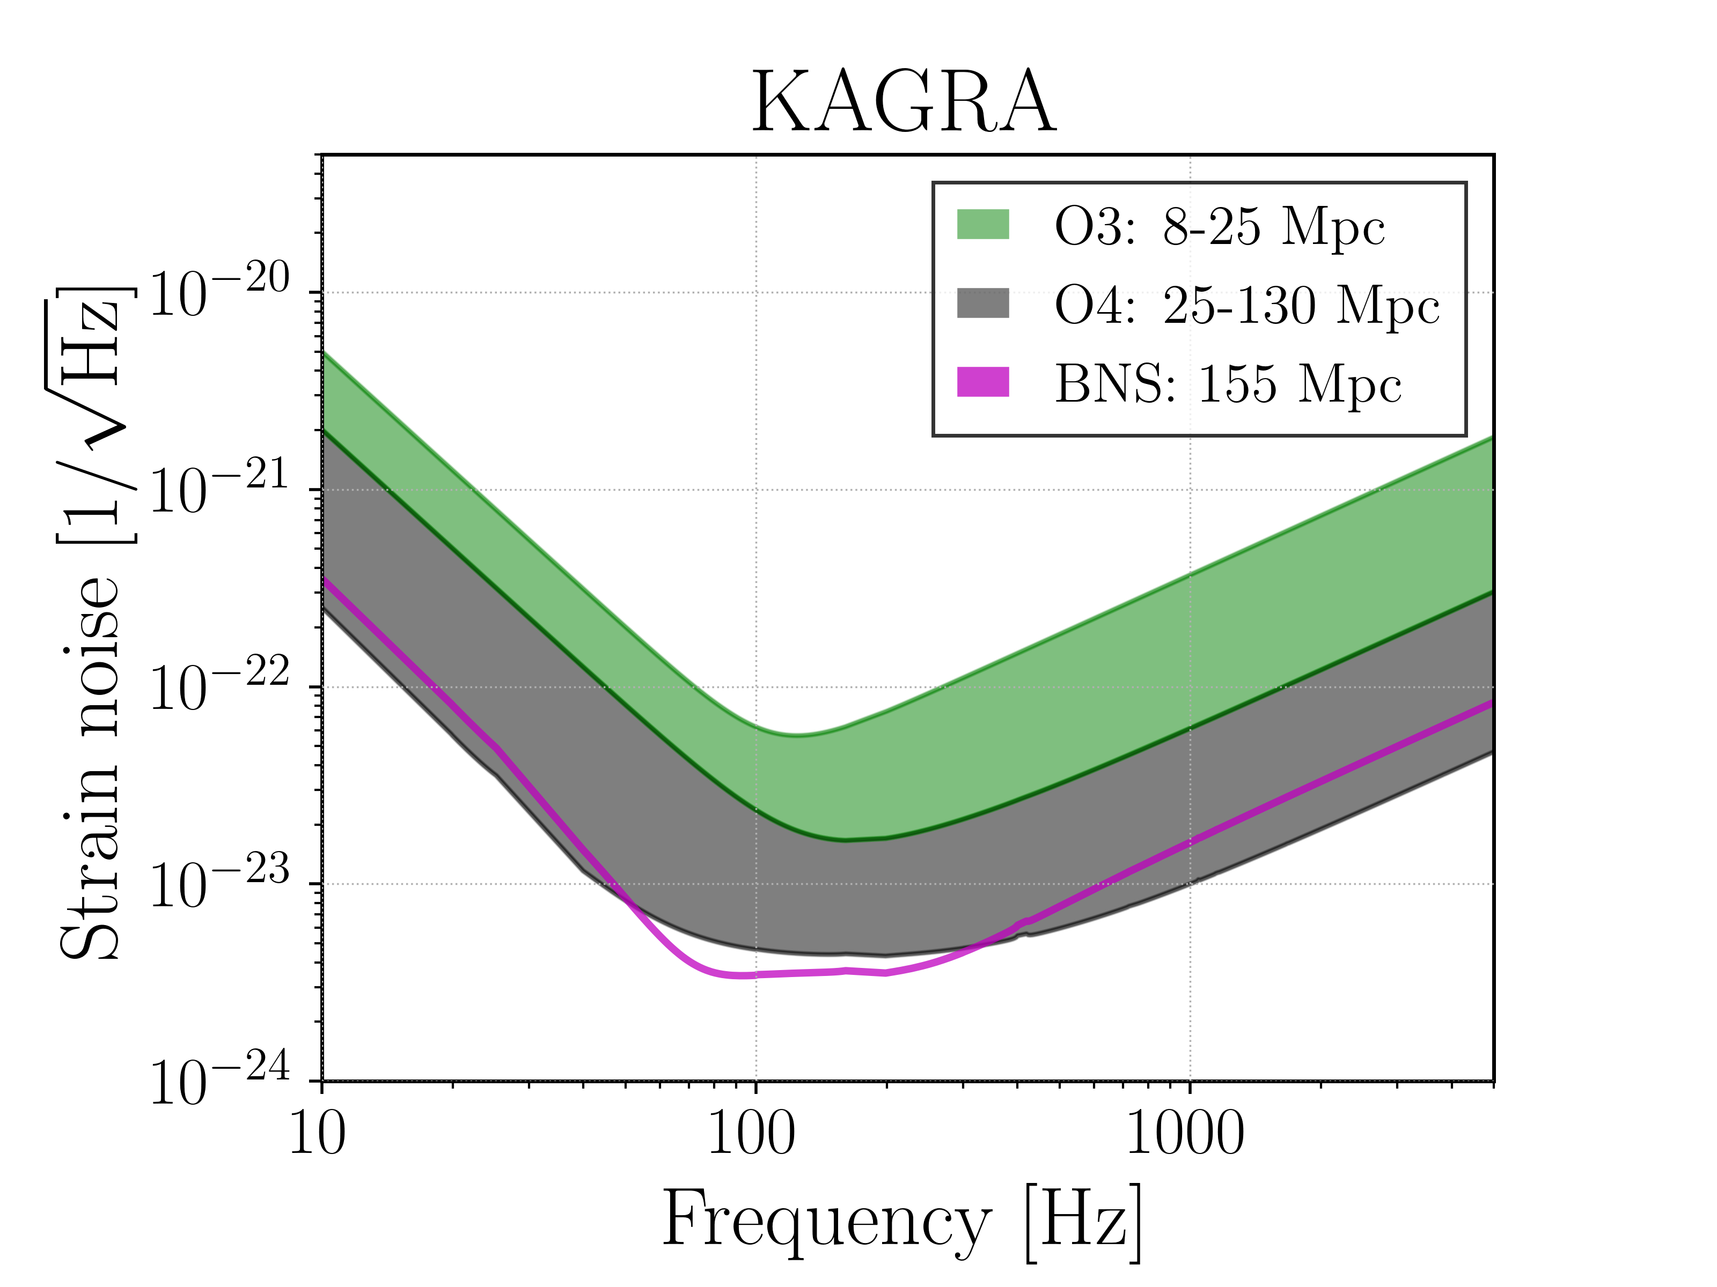

Slide 3
Upgrade !?

Slide 4
Historical Background
No official platform to discuss KAGRA upgrade until recently
PI wanted people to focus on the realization of the baseline KAGRA
Limited resource
Need to fulfill the commitments to the funding agency
Unofficial activities for upgrade still existed

Slide 5
Unofficial technical studies of KAGRA upgrade
Proposal for the discussion: 2017 March F2F meeting
JGW-G1706398
Discussions at KAGRA International Workshops
Presentations at Japan Physics Society meetings
Satellite meeting: 2017 Dec. 4th @TITECH
http://gwwiki.icrr.u-tokyo.ac.jp/JGWwiki/LCGT/Meeting/f2f/2017Dec/Sateite
KAGRA upgrade document tree
JGW-E1809314

Slide 6
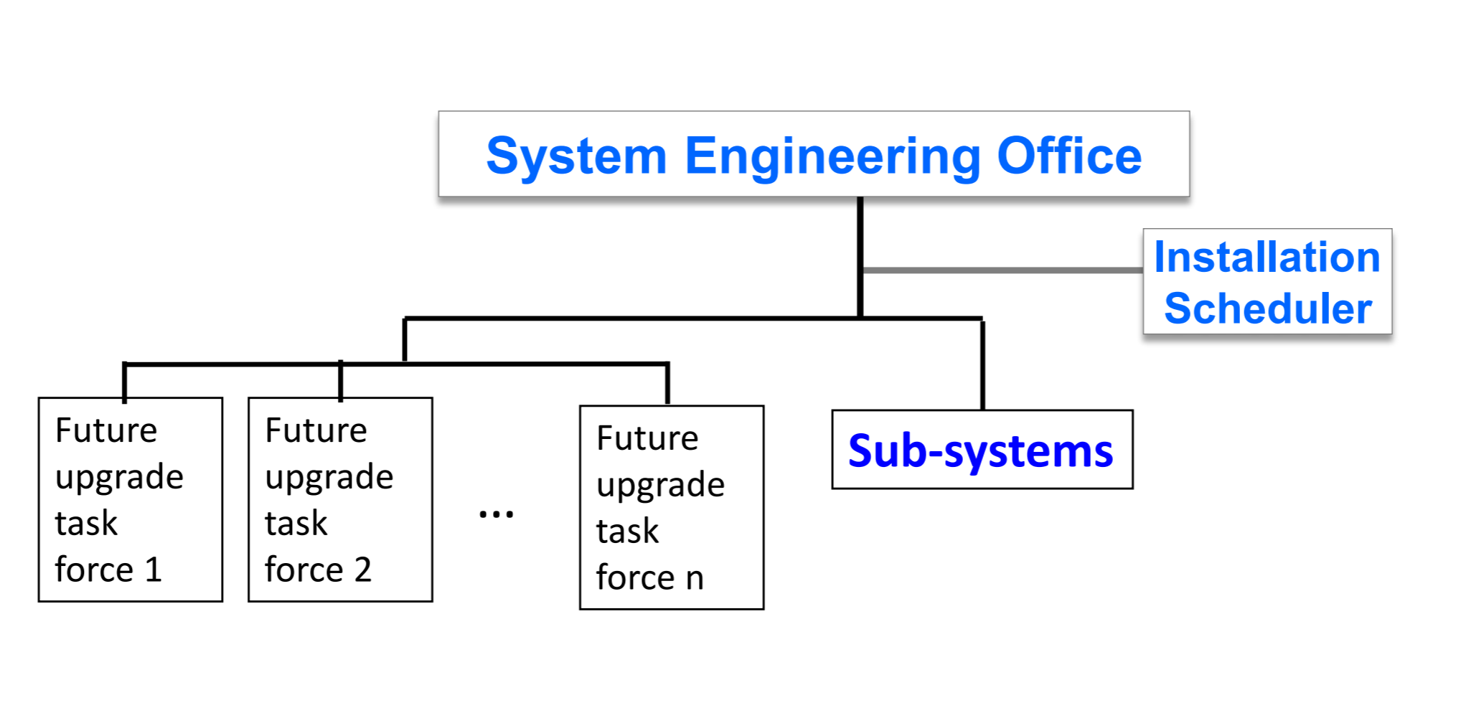
Kajita-san’s presentation@F2F in August 2018
JGW-G1808915
Officially presented PI’s vision on the future upgrade scheme of KAGRA
Recognized the need for starting the discussion of upgrade
Funding scheme:
Each group proposing an upgrade item should obtain grant by themselves

Slide 7
Discussion from another viewpoint: Authorship
KAGRA wants to join O3: Authorship becomes a serious matter
What are counted as contributions to warrant authorship ?
KAGRA authorship policy JGW-M1503490
“Contributions for research and development activities authorized by the project are also included”
Problem: No procedure to authorize an R&D by the project existed
We need to establish a process to recognize important R&Ds for KAGRA upgrade
To assess the importance of an R&D, we need a reference frame
A white paper on KAGRA upgrade plan
This issue was raised at the F2F in May 2018

Slide 8
Technical Study Group
KAGRA Management
(PI)
Future Upgrade
Discussion from authorship

Slide 9
Technical Study Group
KAGRA Management
(PI)
Future Upgrade
Needed to develop a unified framework
Discussion from authorship

Slide 10
Proposal to set up two committees under KSC
Future Planning Committee (FPC)
Manage the discussion of KAGRA future upgrade plan
Produce a white paper for future upgrade
Project R&D Committee (PRDC)
KAGRA Project R&D is an official R&D of KAGRA to be counted towards authorship
PRDC manages the selection of the Project R&Ds
Judgement is made based on the white paper by the FPC
Approved at the F2F meeting in Dec. 2019
FPC released the first draft of the white paper recently: JGW-M1909590

Slide 11
Funding Scheme
Basic direction given by the PI
Each group responsible for an upgrade item should obtain funding for the upgrade work
Especially, contributions from outside Japan is important
One example
Backup laser (60W) for O3 and 140W laser for O4
Academia Sinica (Taiwan) will procure commercial amplifiers (neoVAN-4S-HP) JGW-G1910052
The funding comes from Taiwan
Aso’s personal opinion
KAGRA project as a whole should still seek for a large funding from MEXT
In fact, we are applying for another Tokusui (~5MUSD)

Slide 12
Organization, Management
Basic idea given by Kajita-san
A task force for each upgrade item
SEO manages the overall upgrade
Aso’s personal opinion
A vast improvement in the project management is necessary for the upgrade
Implementing standard engineering management practices is important
Need to hire dedicated engineers for this
Need to find a practical compromise
Available resources
KAGRA people’s mindset for the project

Slide 13
Overview of the upgrade white paper
JGW-M1909590
List up scientific targets
List up potential technologies to be adopted for upgrade
Score the significance and feasibility of each technology
List up 4 candidates for upgrade
Low frequency optimization (LF)
Heavier mirror (40kg)
Frequency dependent squeezing (FDsq)
High frequency optimization (HF)
Recommendations
HF & FDsq for 5 year upgrade (after O4)
Continue R&D on LF and 40kg for longer term upgrade

Slide 14
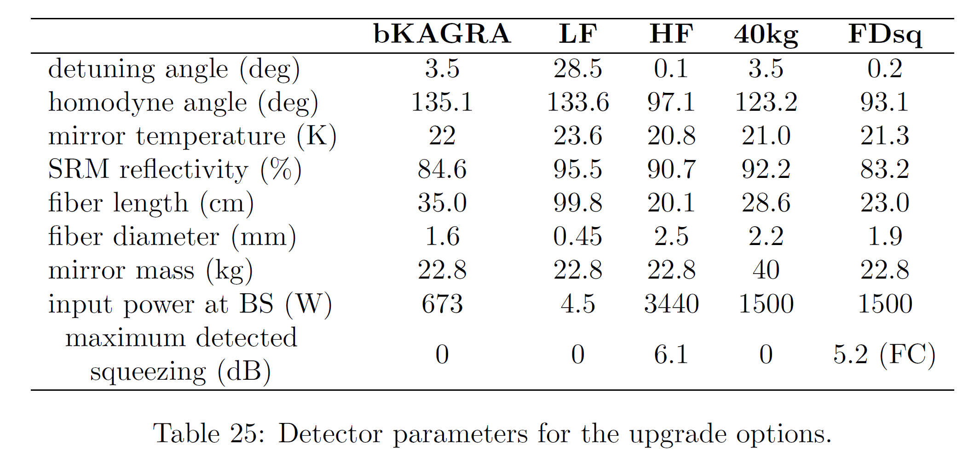
Parameters for candidate upgrade options

Slide 15
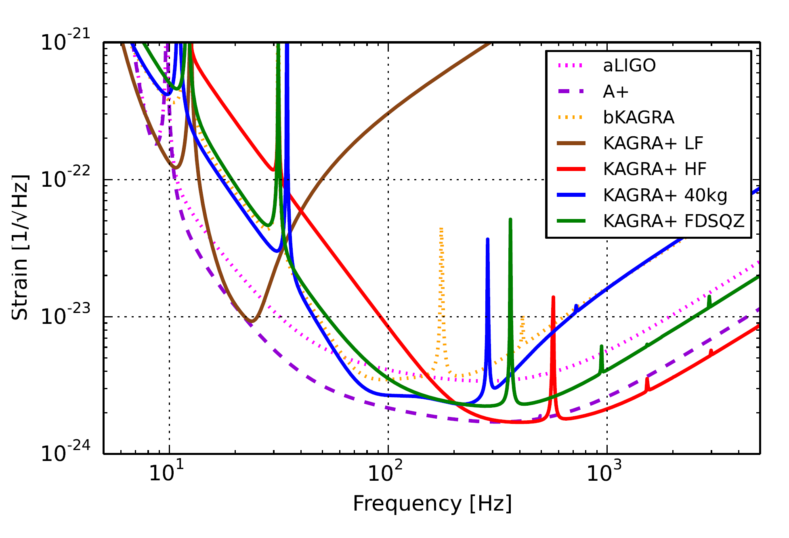
Comparison of noise curves

Slide 16
Peculiar issues with KAGRA upgrade
Trade-off between high power and low suspension thermal noise
High power => Large heat in the mirror => Thicker sapphire fiber => Larger suspension thermal noise
Broad band improvement is more difficult than aLIGO / aVirgo
We need to choose between high frequency and low frequency
Larger Heat
= High Susp. TN
High Power
= Lower Shot Noise

Slide 17
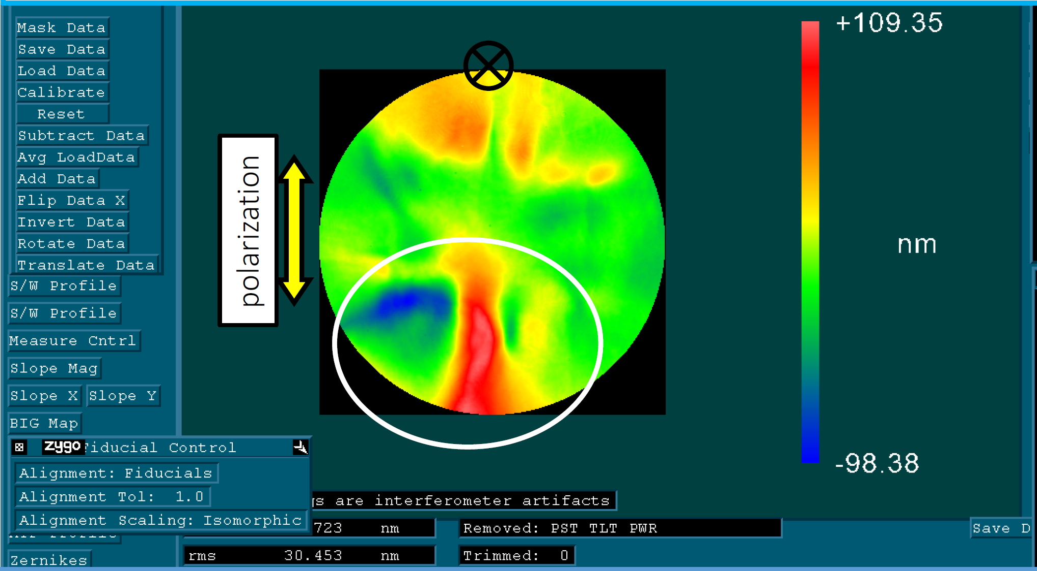
ITM inhomogeneity risk
ITM effective thickness
Large inhomogeneity in ITM transmission phase
Caused by the use of wrong polarization during correction polish (IBF)
Expected increase of shot noise
WFS signal may be distorted
Other adverse effects may exit
Need a strategy to make new mirrors
Simulated AS port beam shape
No inhomogeneity
With inhomogeneity

Slide 19
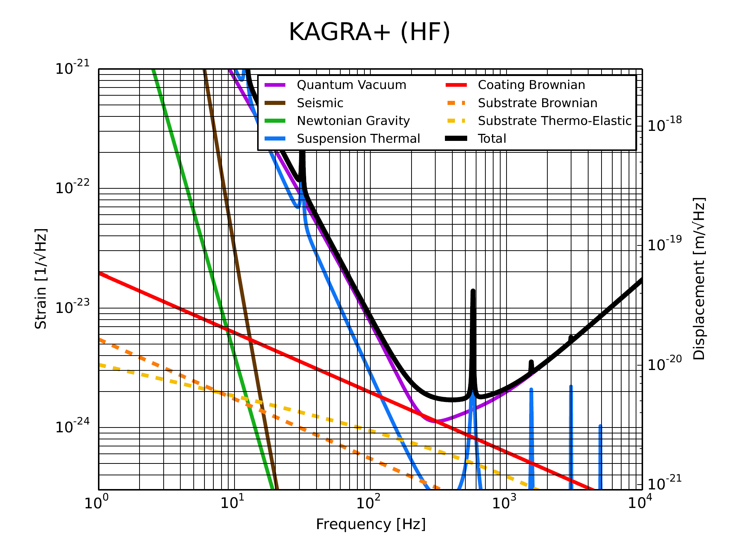

Slide 20
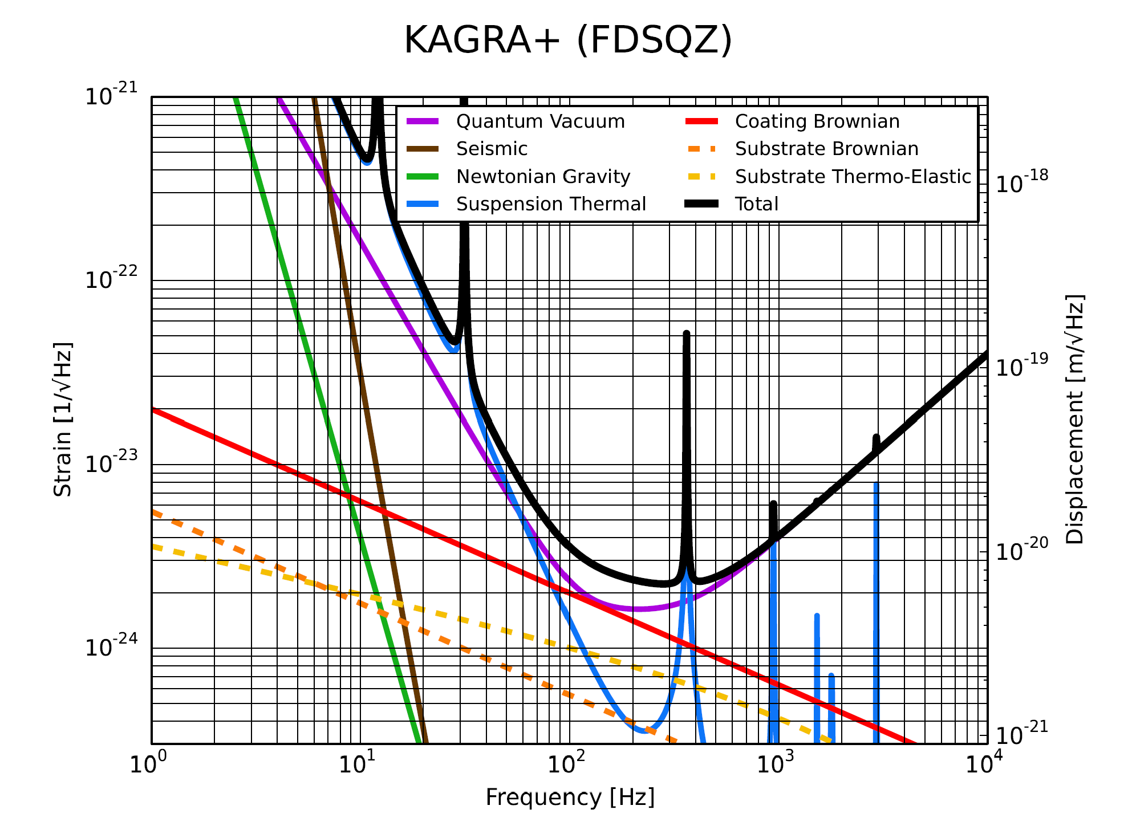

Slide 21
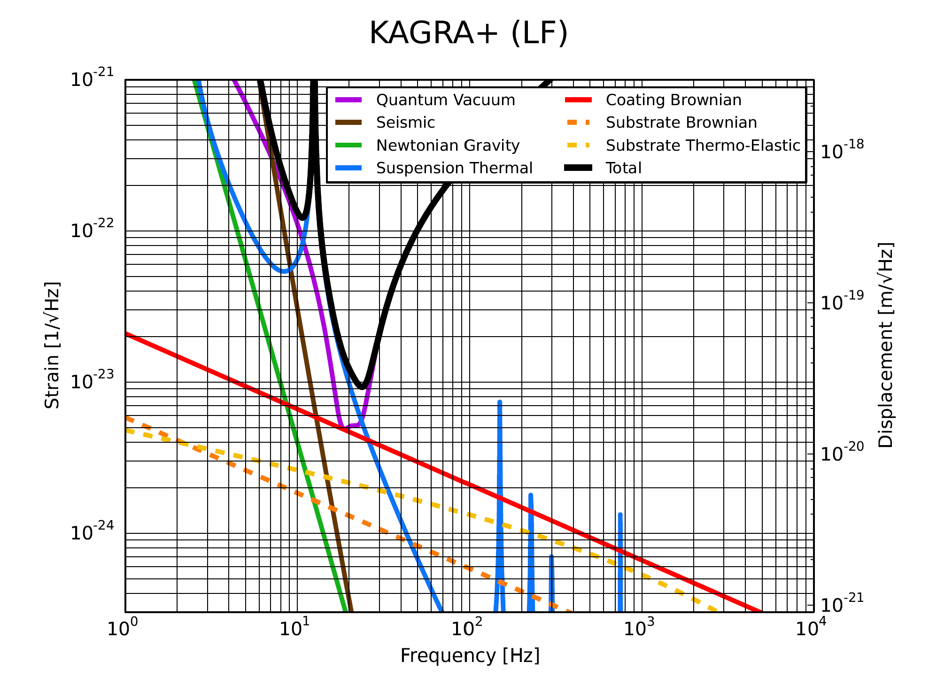

Slide 22
