Slide 1
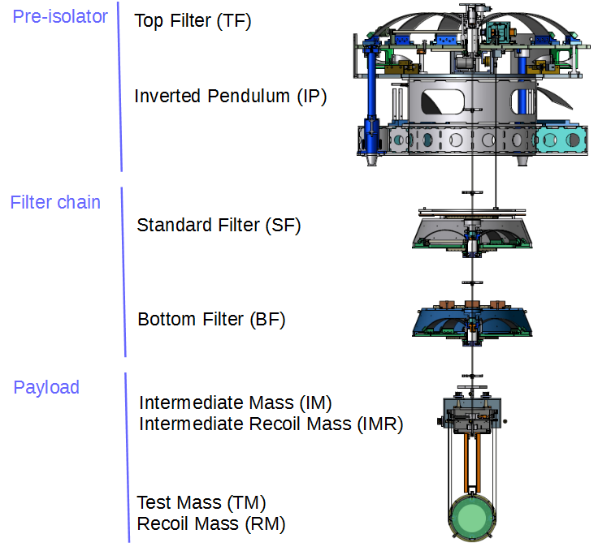
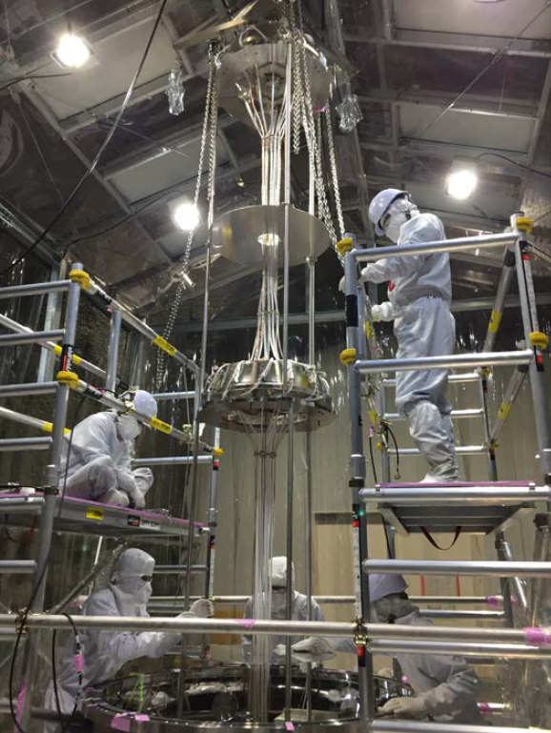
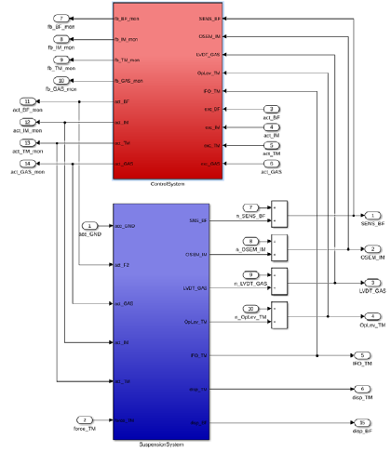
Orientation of Vibration Isolation System
SEO: Y. Aso Chief: R. Takahashi
Team leader: R. Takahashi (Type-A), M. Barton (Type-B), A. Shoda (Type-Bp), N. Ohishi (Type-C)
Schematic view of VIS
Installation work
Optimization of control
The 22nd Face to Face Meeting, ICRR, 19-21 April, 2019

