Slide 1
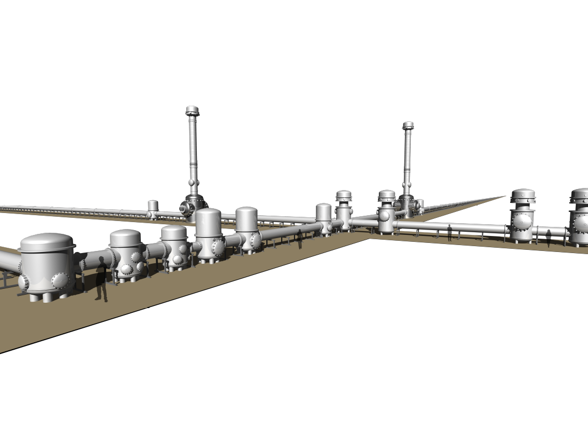
Summary of the recent VIS troubles
2019/4/1
National Astronomical Observatory of Japan
Yoichi Aso

Slide 2
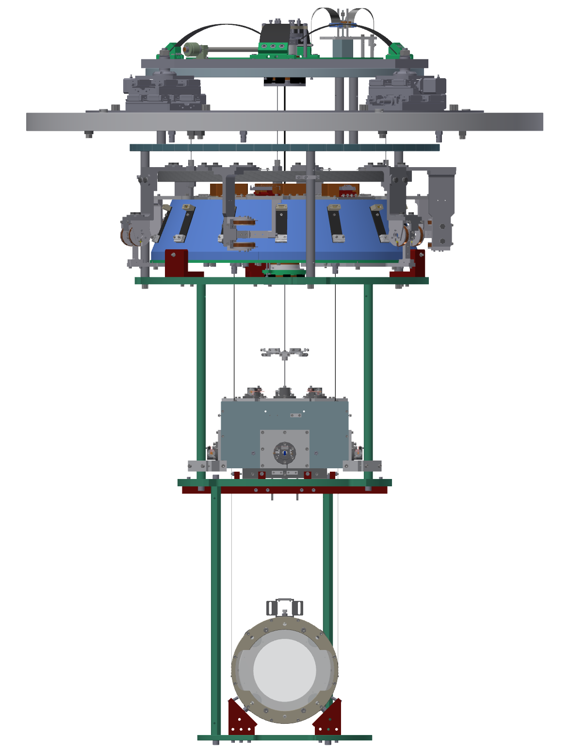
Preparation: Anatomy of the VIS
Type-Bp
Type-B

Slide 3
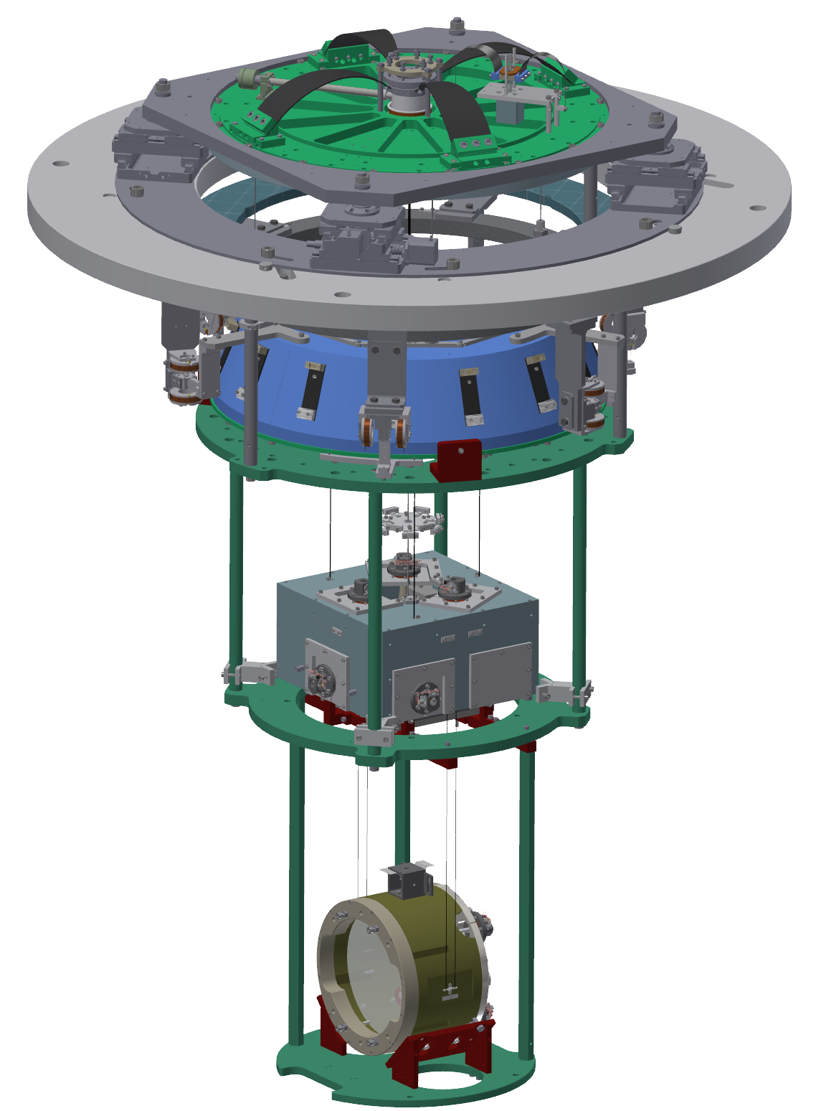
Type-Bp
Standard Filter
BF damper
Traverser
Bottom Filter
Intermediate Mass (IM)
Mirror
Recoil Mass

Slide 4
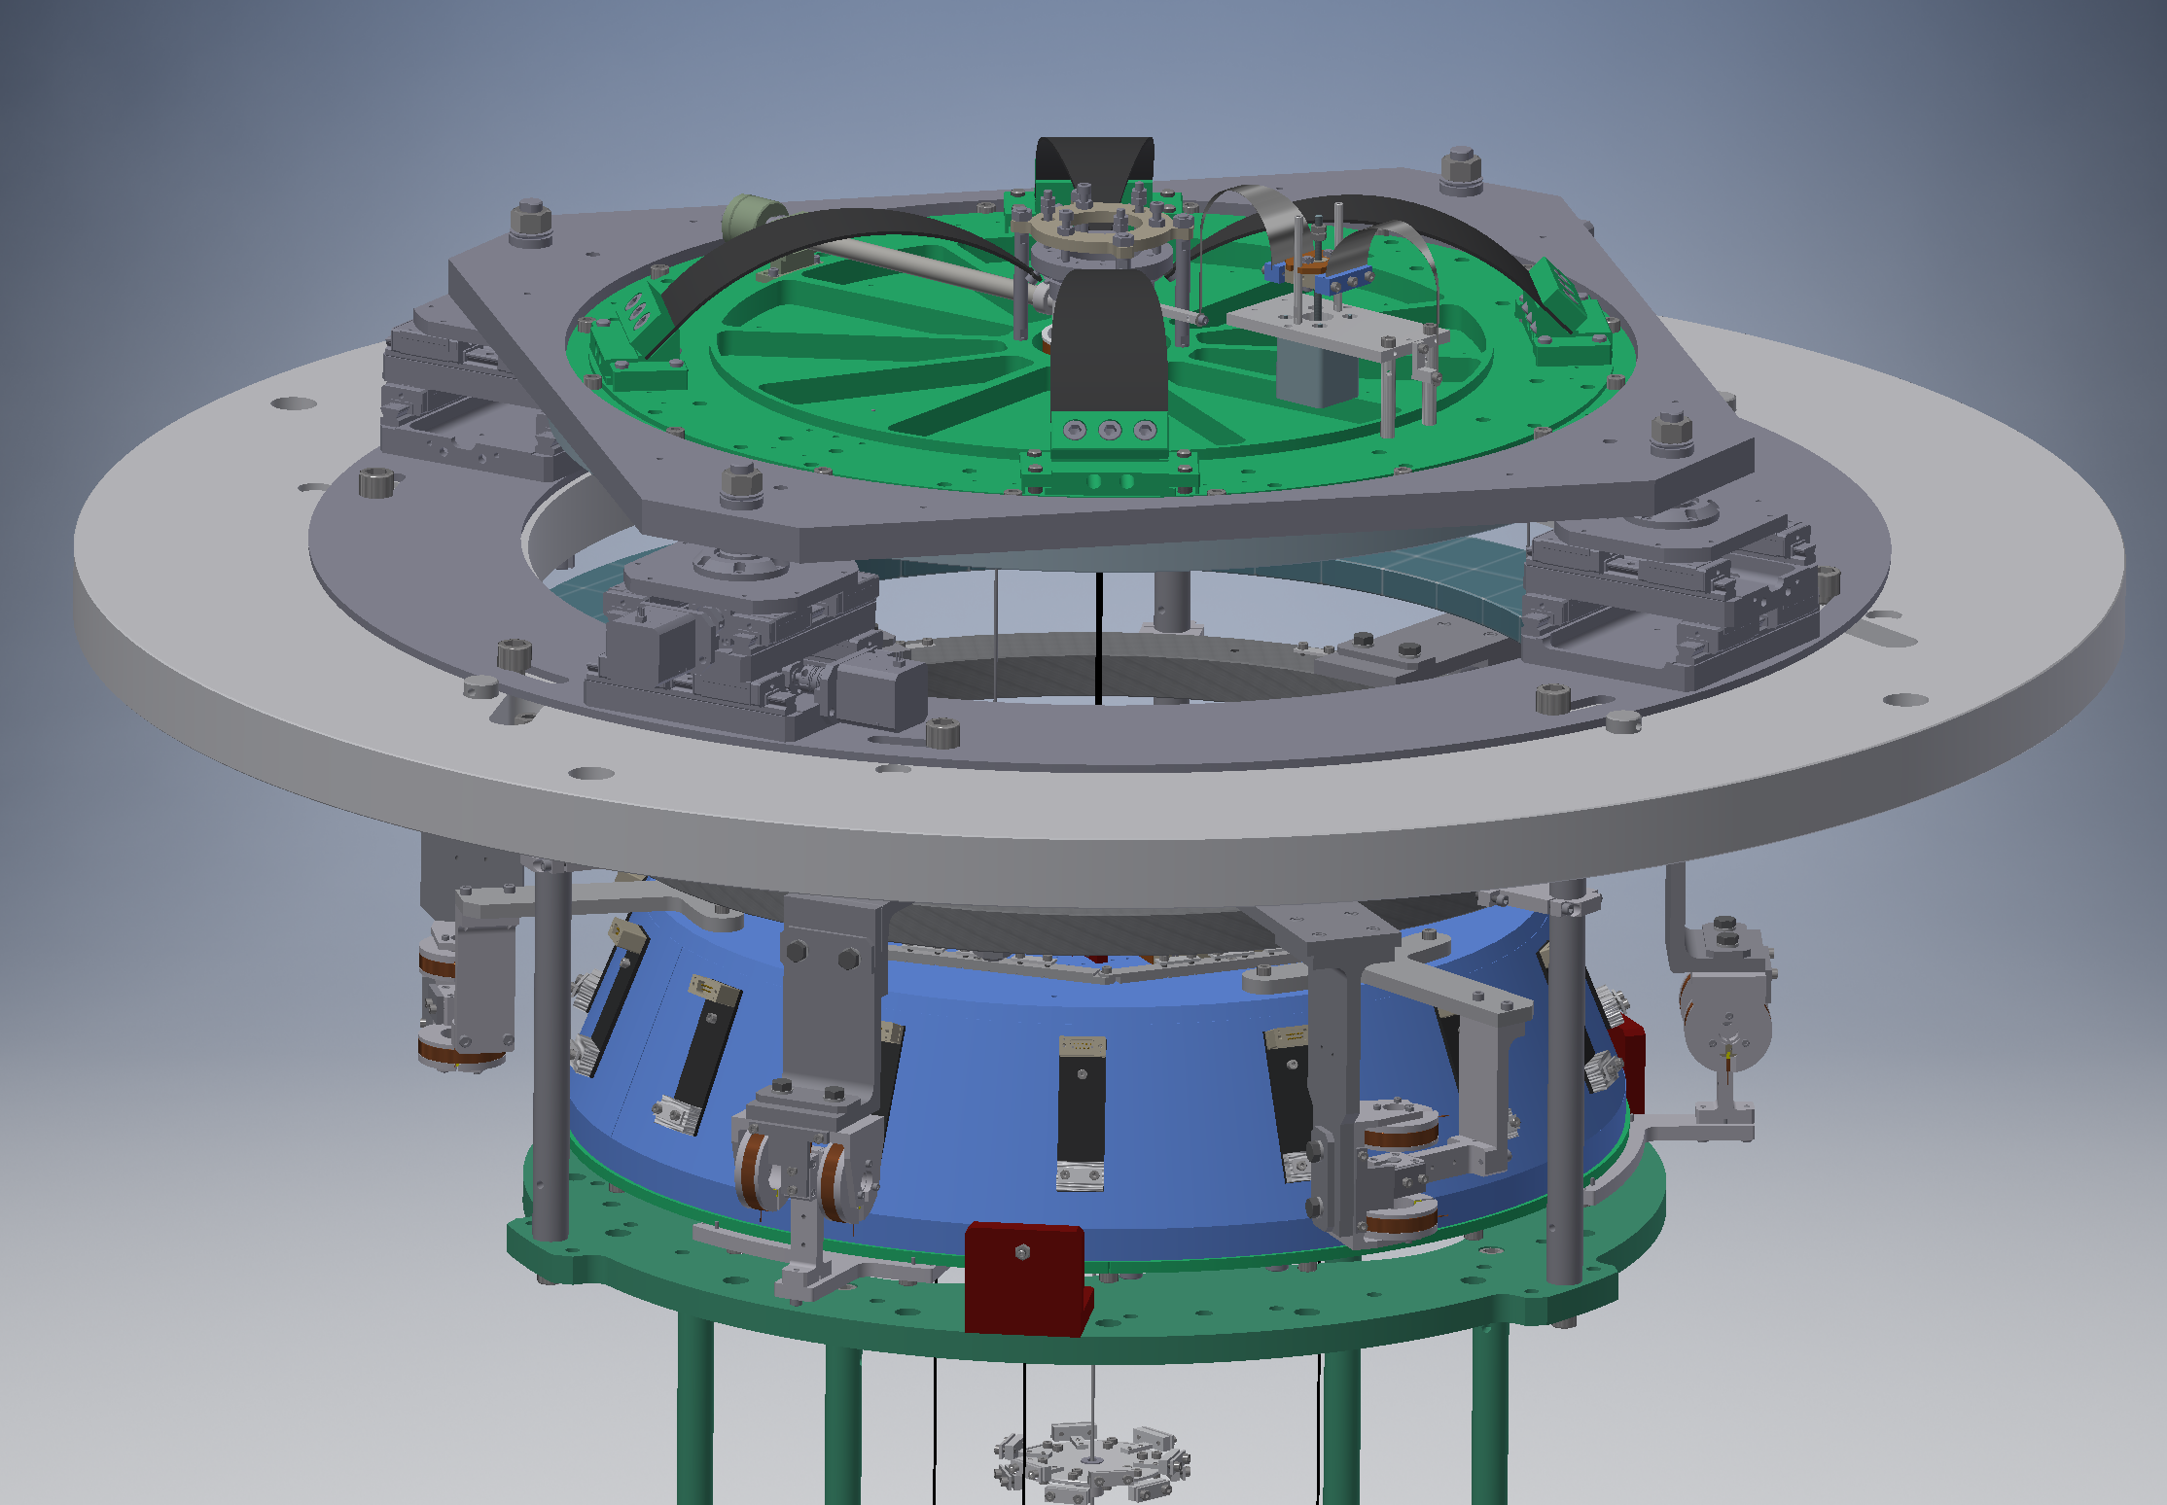
Fishing Rod

Slide 5
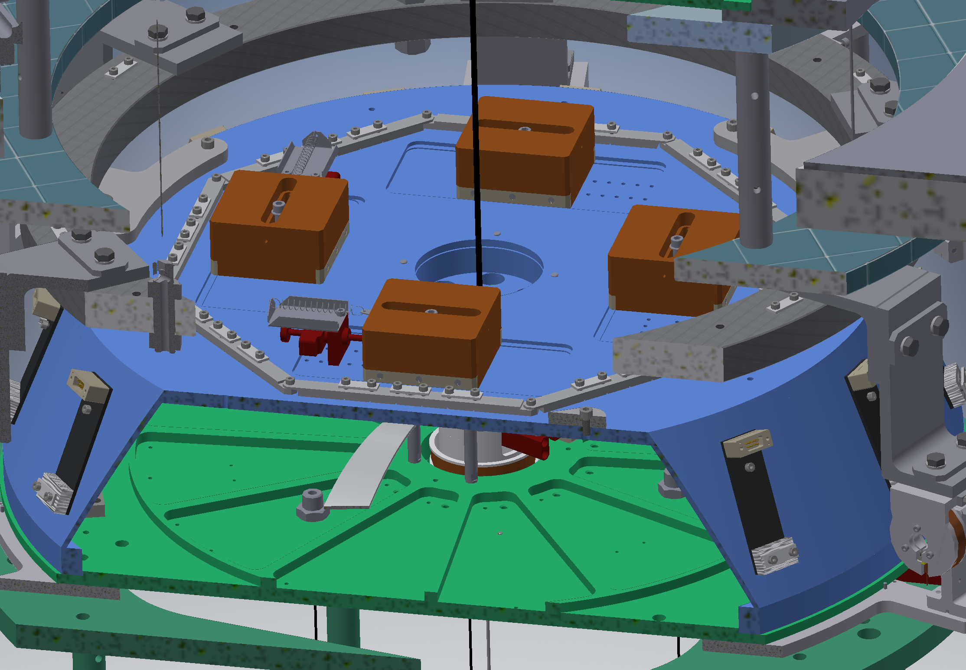
Bottom Filter Moving Masses

Slide 6
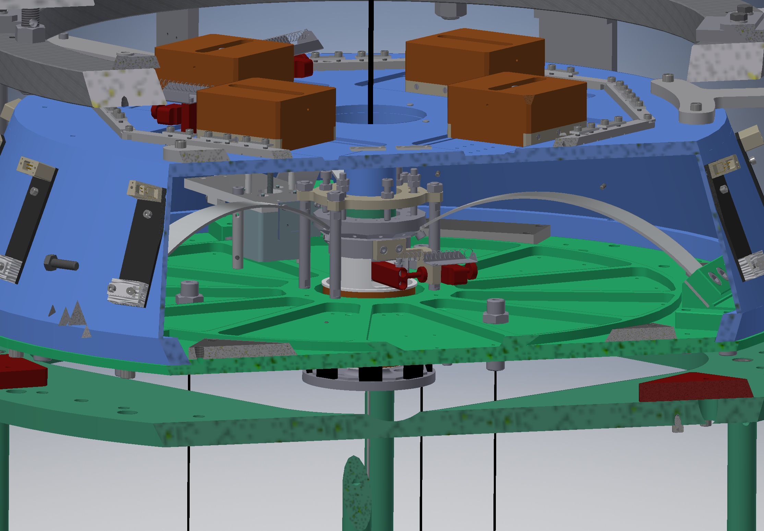
Bottom Filter Yaw Rotation Mechanism

Slide 7
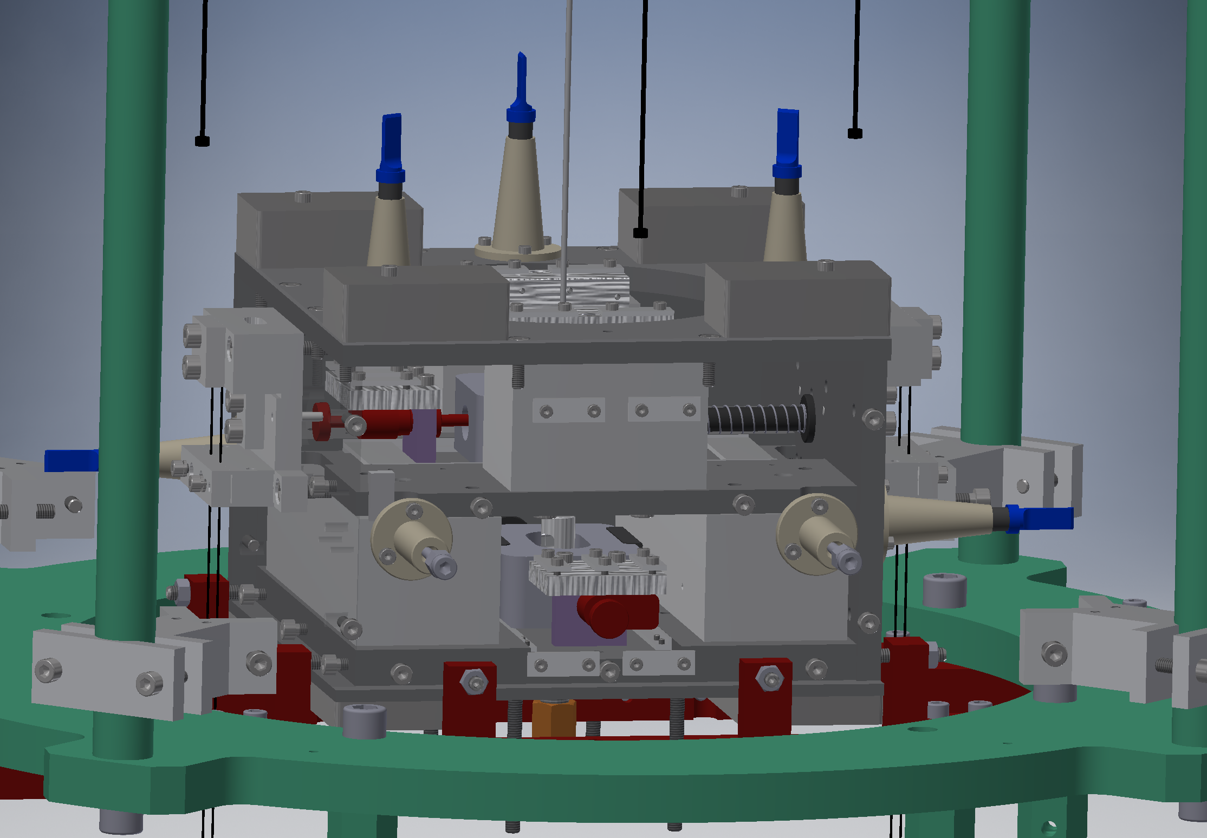
IM Moving Masses

Slide 8
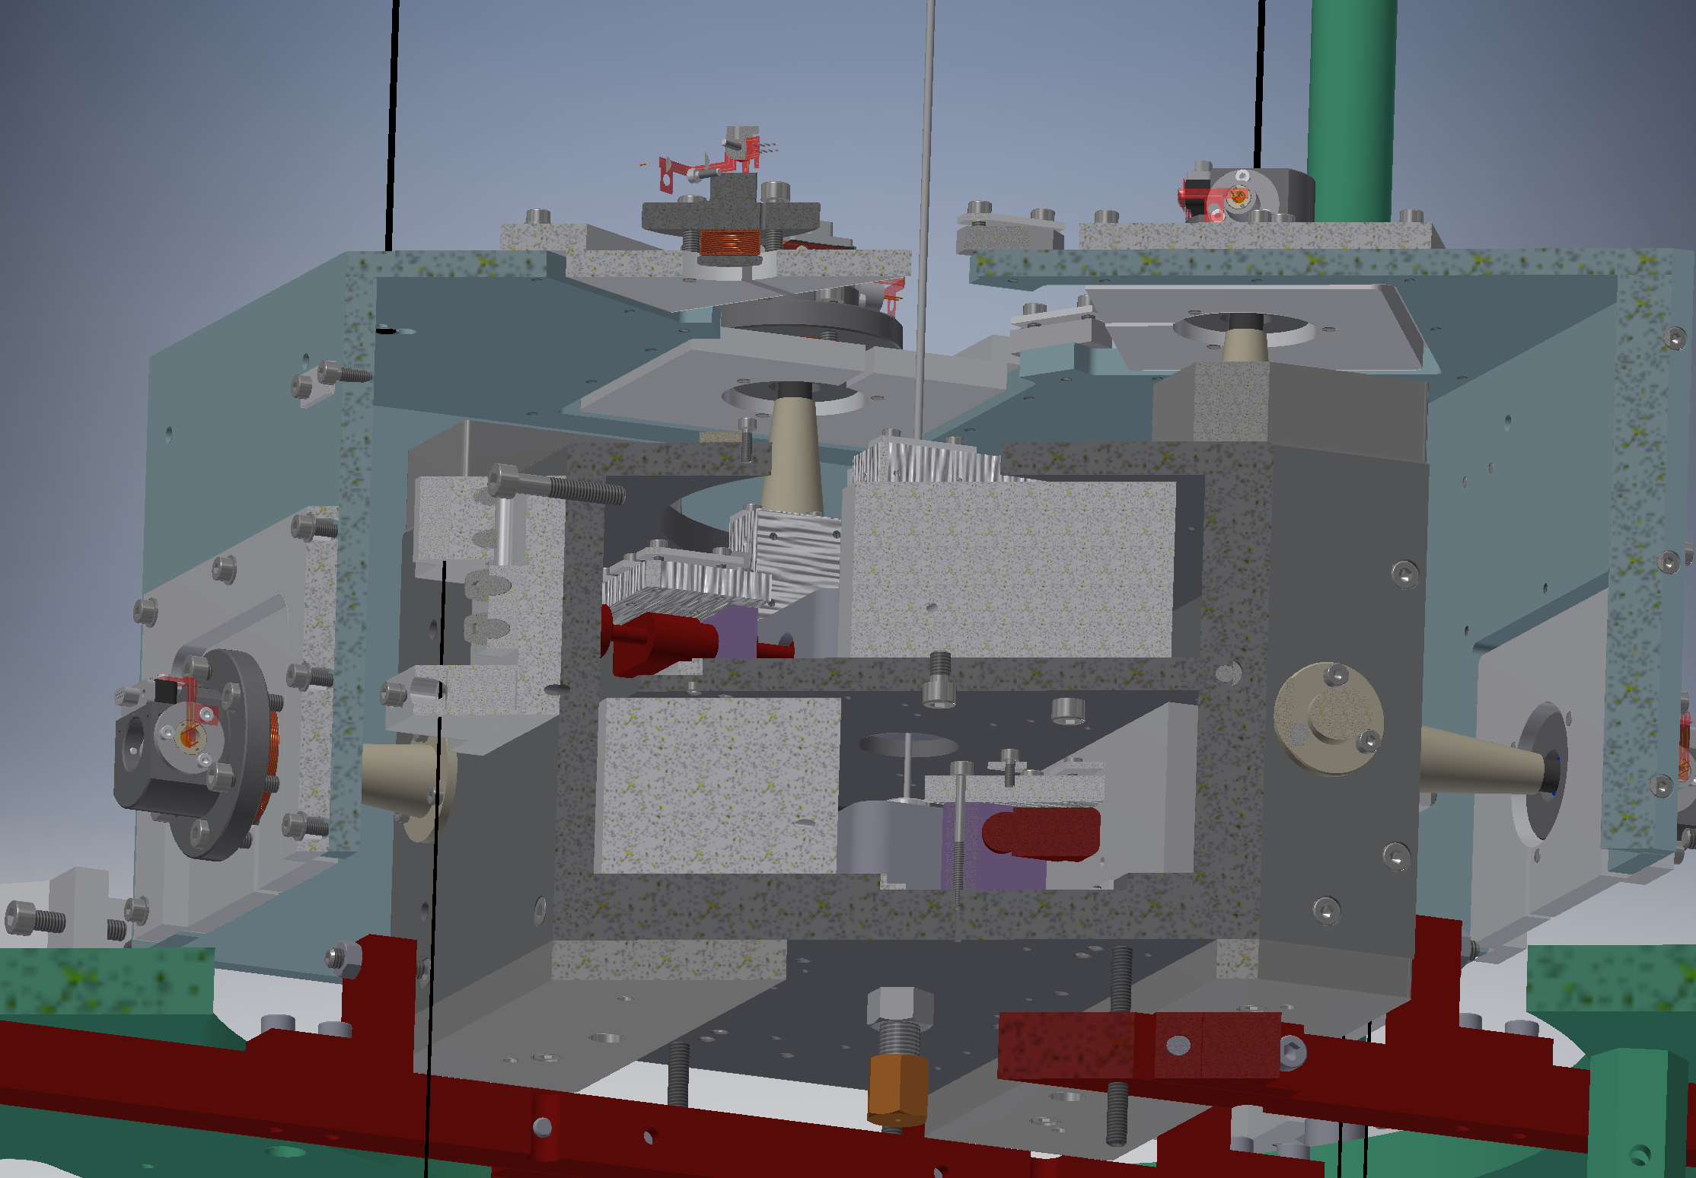
IM OSEMs

Slide 9
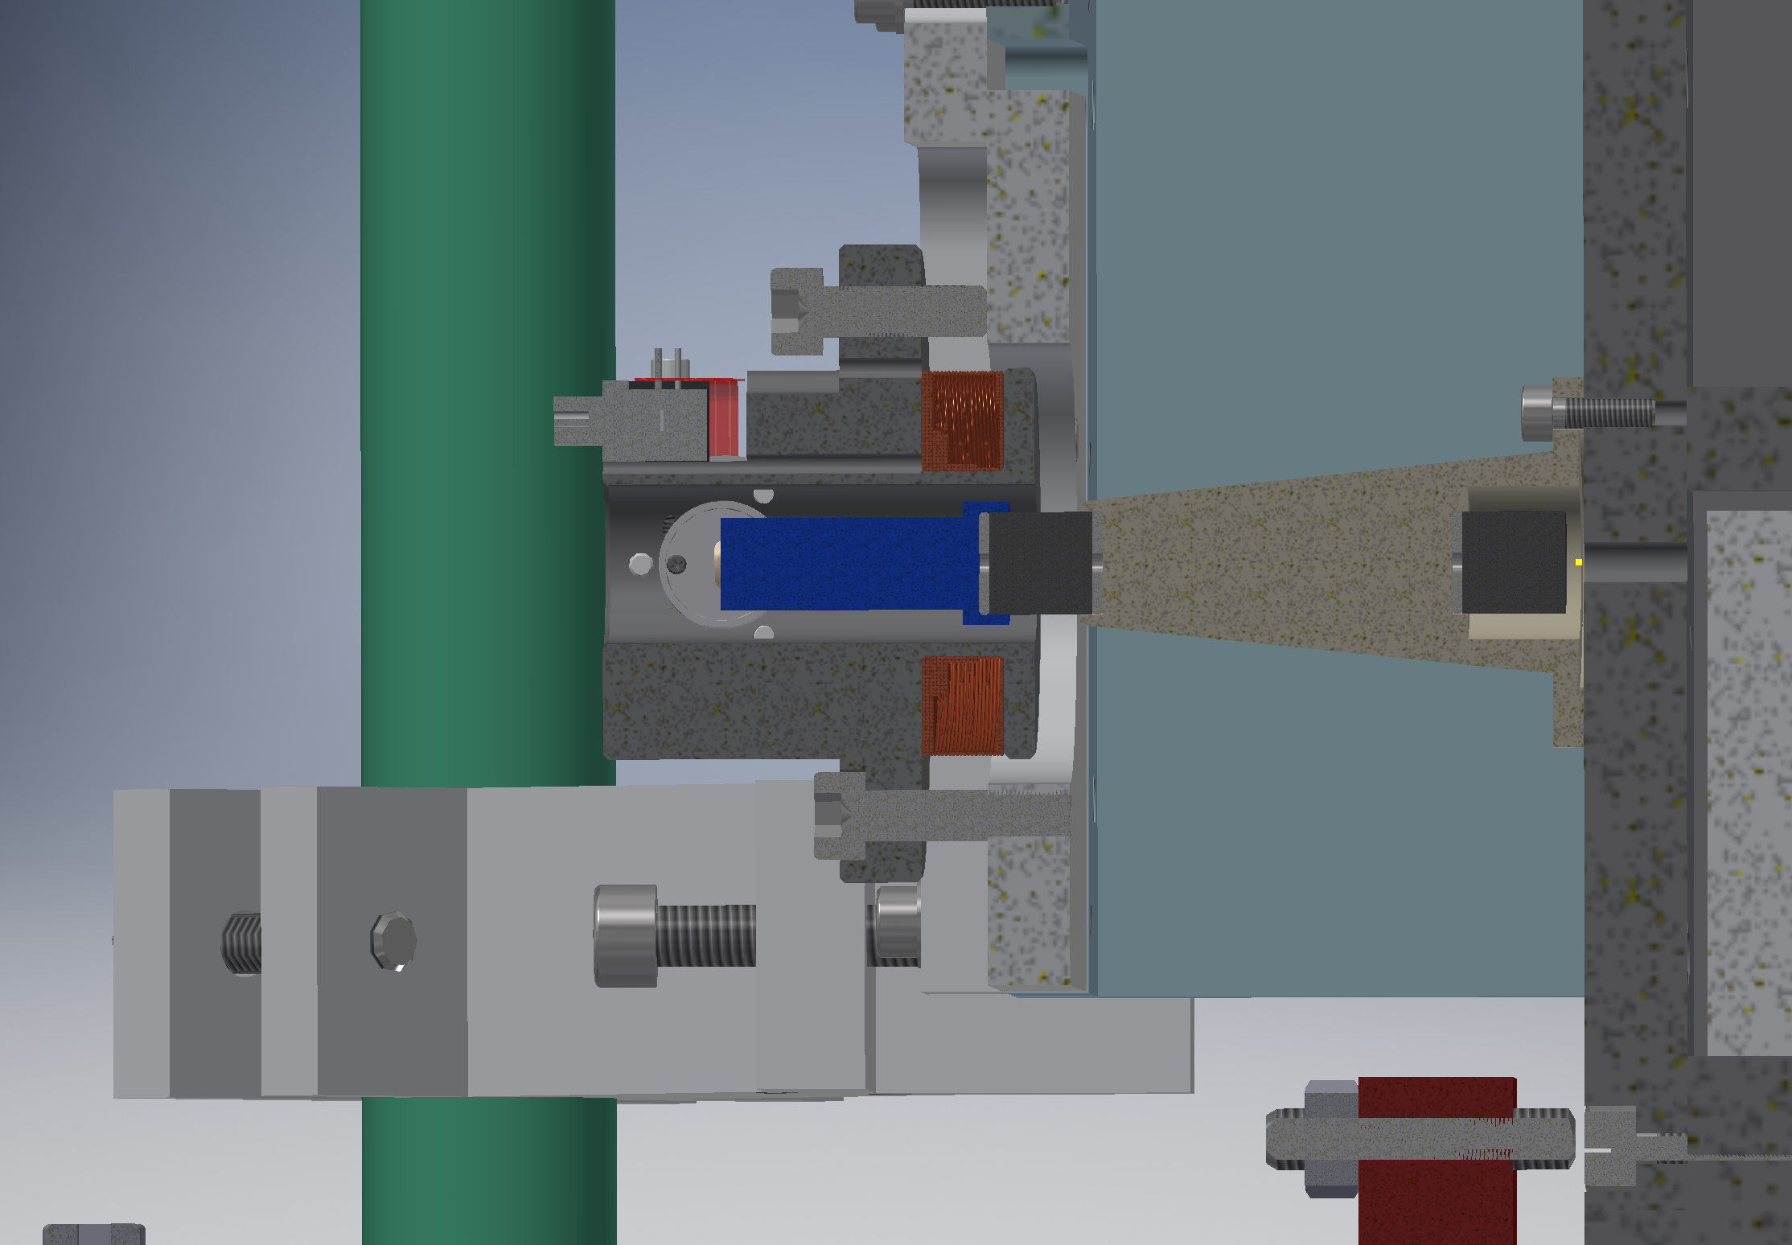
PD/LED
OSEM flag

Slide 10
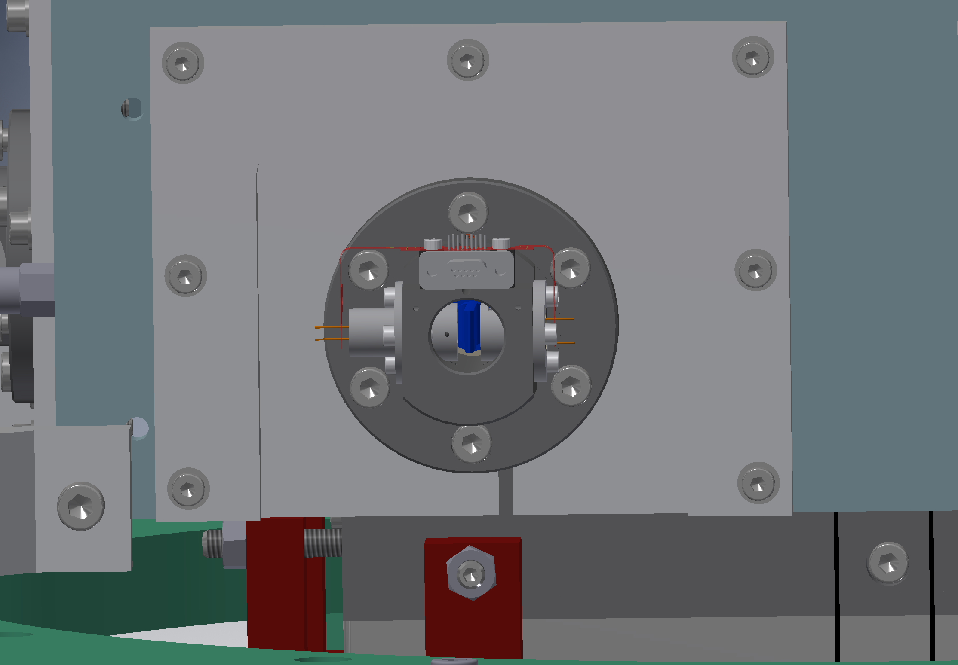

Slide 11
PRM
Strange TF => A magnet came off of the mirror surface
klog: 8255 (Feb. 28 2019)
We don’t know why it happened
3 magnets survived
Enough number of DoFs => just leave it as is
PRM tilted => IM OSEM adjustment
PRM is mis-aligned in Yaw by a large amount to disable the PRC and reflect the beam to a beam dump
This requires the IM OSEM flags to be centered very well
Something happend during the adjustment
BF tilted and SF GAS went up
We don’t know what happened

Slide 12
PRM
Current status
PRM is in an OK state except that there is a small strange peak in the IM vertical TF (klog: 8371)
PRM can be mis-aligned with the reflected beam going to the beam dump
We will try to perform in-situ gluing of the fallen magnet

Slide 13
PR2
It has been OK except that a channel in the LVDT driver for the BF damper was broken
It was found that 2 magnets came off (klog: 8516)
The incident seems to have happend on 3/19(Tue) around 6PM when no one was around the suspension
There was an accidental large excitation of the suspension on 3/17 (klog: 8435). Could this be the cause ?

Slide 14
PR2
Plan
This time, only 2 magnets are remaining
Not enough DoFs for the mirror control
VIS team designed an in-situ gluing jig
The jig is under production
expected delivery on April 2nd (Tue)
We will perform a test of the jig with the TAMA prototype
Actual gluing will happen from April 4th (Thu)
We will probably do both PR2 and PRM
Access to the AR side is poor for PRM

Slide 15
PR3
PR3 mirror orientation jumps in Pitch by more than 10mrad from time to time
The jump happens when the suspension gets a large vertical kick
This made it very difficult to adjust the OSEM positions
klog: 8350
Currently the PR3 is in a good state
Vertical kick happens when the DC feedback to the GAS filters is cut suddenly by tripped watchdog.
We need to modify the watchdog implementation in the digital system
Aso is working on it.

Slide 16
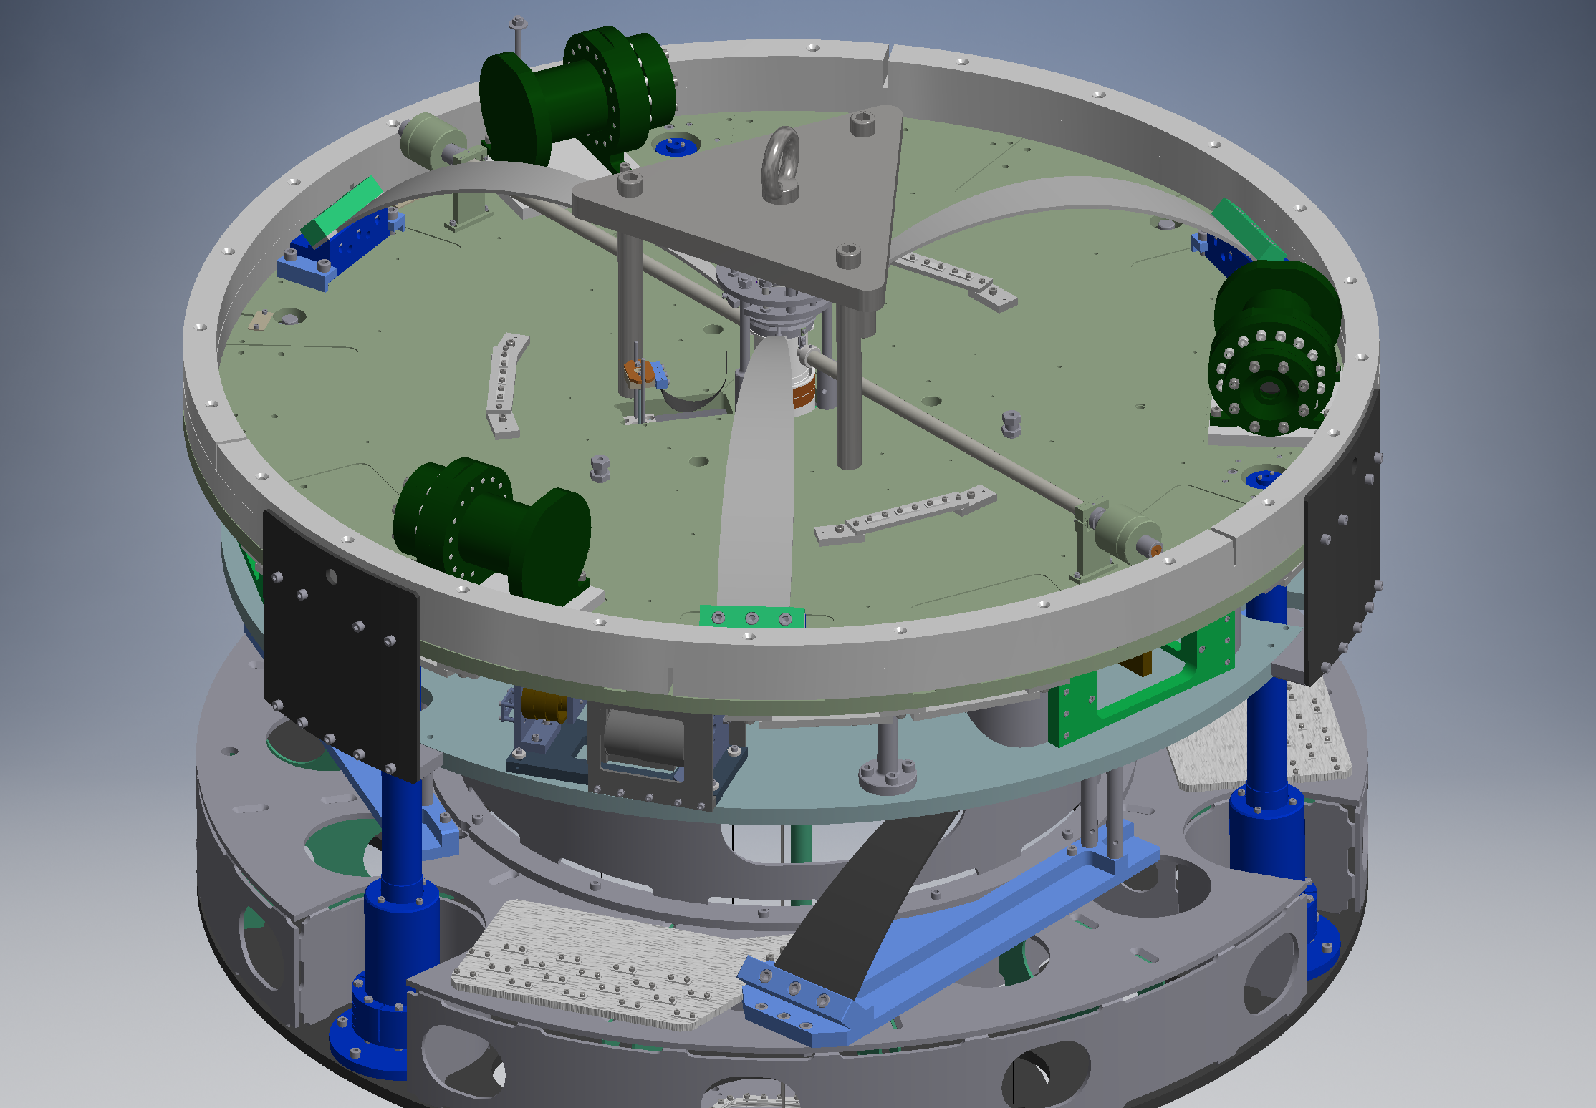
Fishing rod

Slide 17
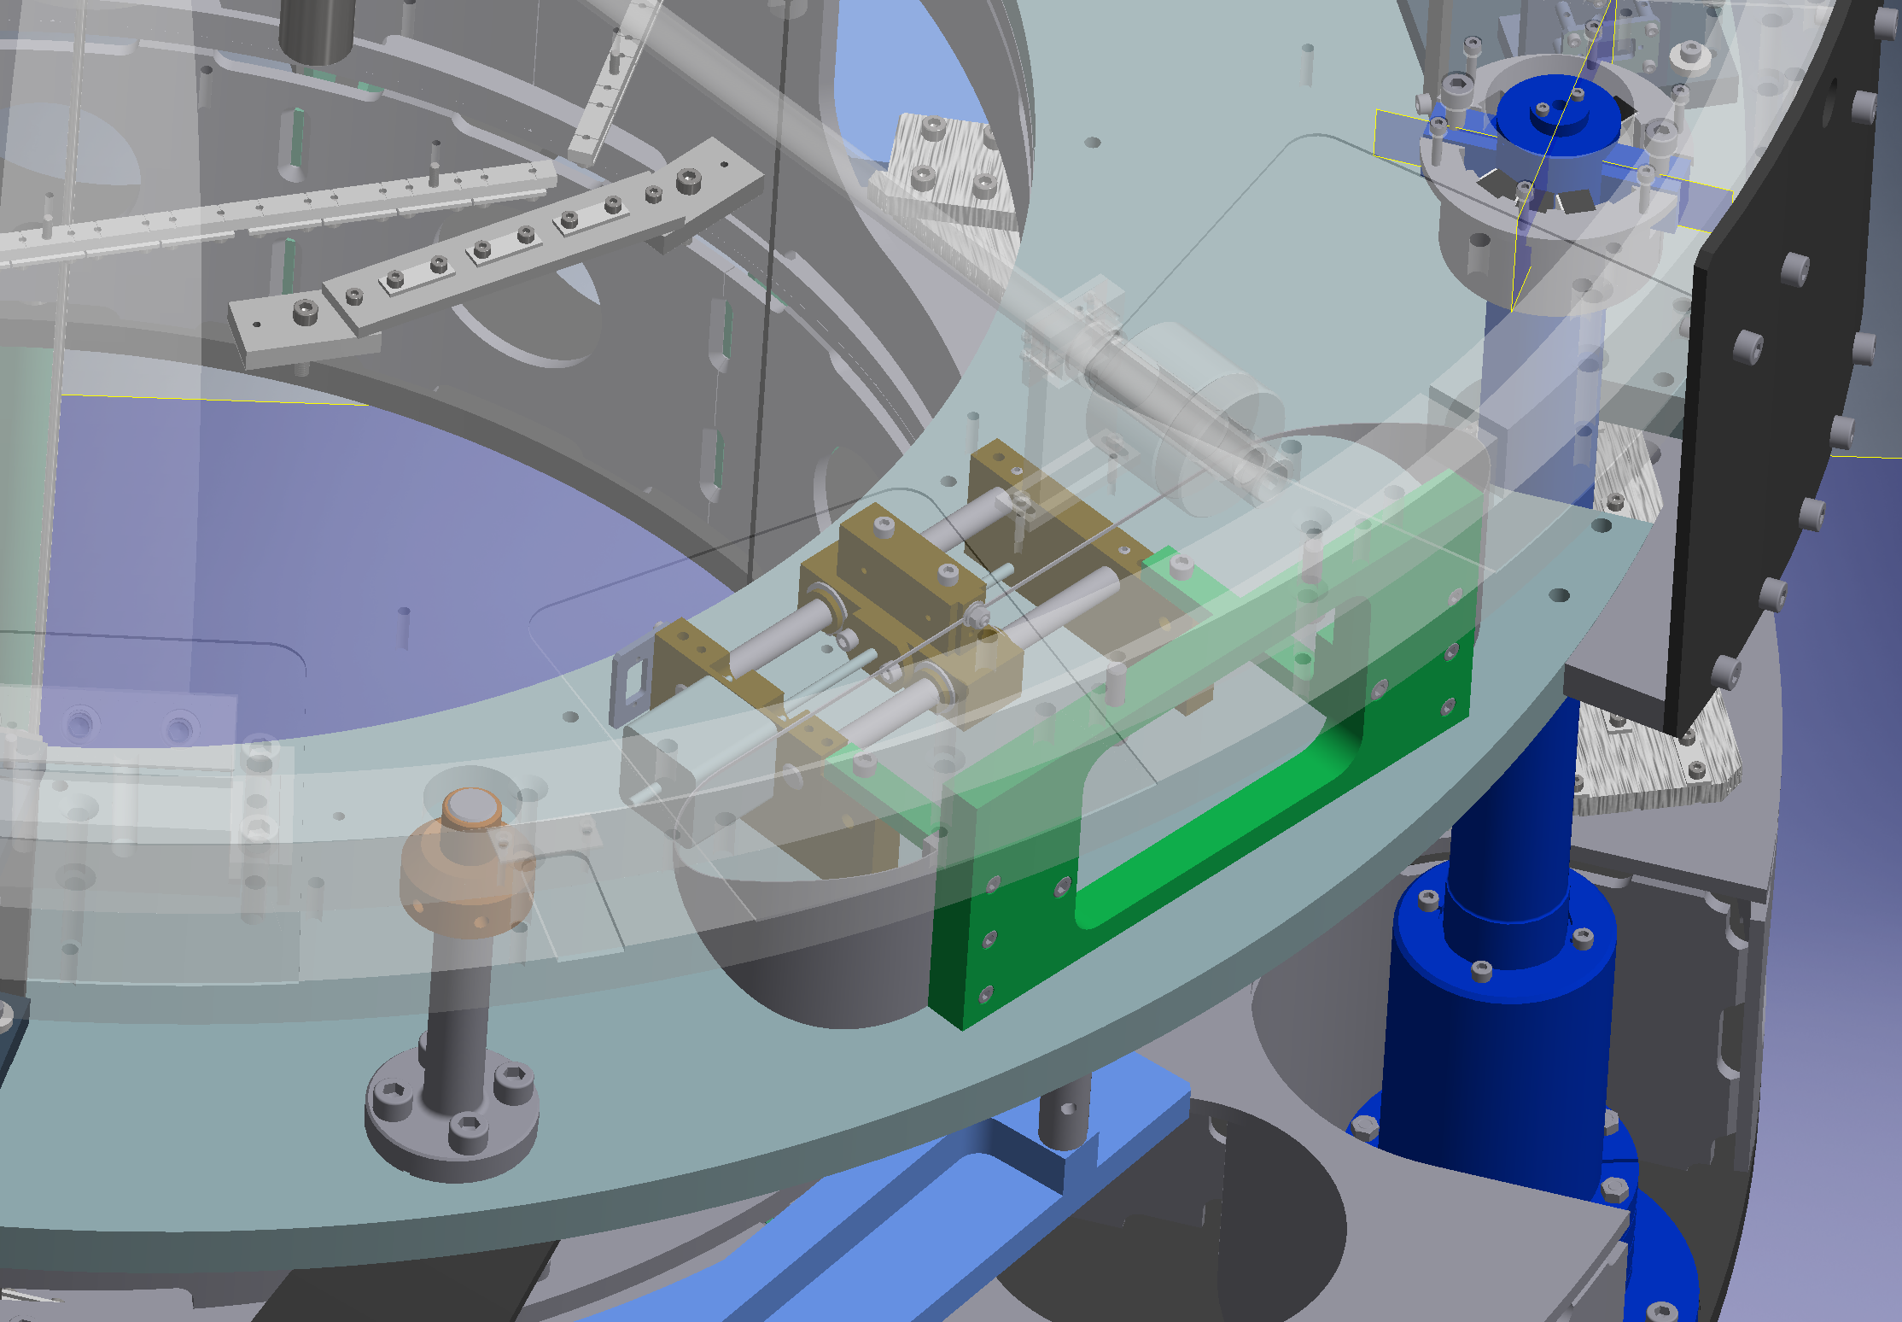
Horizontal Fishing Rod

Slide 18
BS
After the BS alignment, the IM OSEMs had large Yaw offset
Type-B team tried to off load them by moving the TF Yaw actuator manually
Then something touched in the payload part.
Opening the lower part, we found that IRM touches EQ stops
klog:8369
The EQ stops were set with a wrong IP position
The BS IP was tuned to a very low resonant frequency of 39mHz
Probably due to the temperature change, it went unstable just before the vacuum pump down (klog:8480)
We fixed it by detuning the IP to 80mHz (this is the designed value)

Slide 19
SRM
There was an accidental large kick of IP during a TF measurement
IP DC position shifted => could not fully recover due to a F0 yaw motor problem
Opened vacuum => found that the IM was touching EQ stops
Fixed the yaw motor problem by a channel swap
Then we were able to release IM from the EQ stops (klog: 8257)
SRM IM exhibited a large drift in Yaw
Probably, it was caused by some cables relaxing the strain
Recently the drift has slowed down to 25nrad/min (klog:8495)

Slide 20
ETMY
F1-F3 GAS are stuck
fishing rods are too weak for ETMY
IP horizontal sliders do not work ?
They work now
A pair of cables for CRY coil shorted somewhere
Vacuum open => the problem disappeared
During the installation, the cable may have been damaged by the F1 accidentally sitting on it
The electric connection check at the time showed the cable was fine
Changed the pair to be used within the cable just in case
F0 vertical coil-magnet actuator does not work now
Mechanically, F0 GAS is fine
Resistance of the coil seen from the outside is fine
Geophones got noisy suddenly
Will check the above two problems on Apirl 2nd

Slide 21
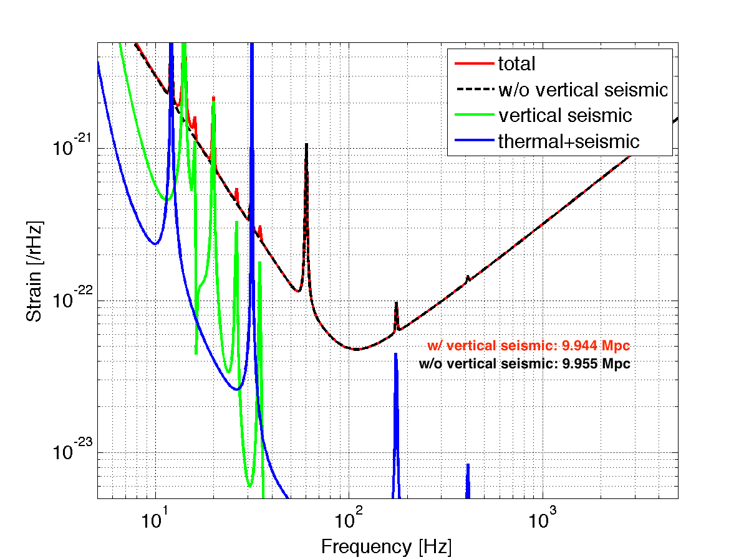
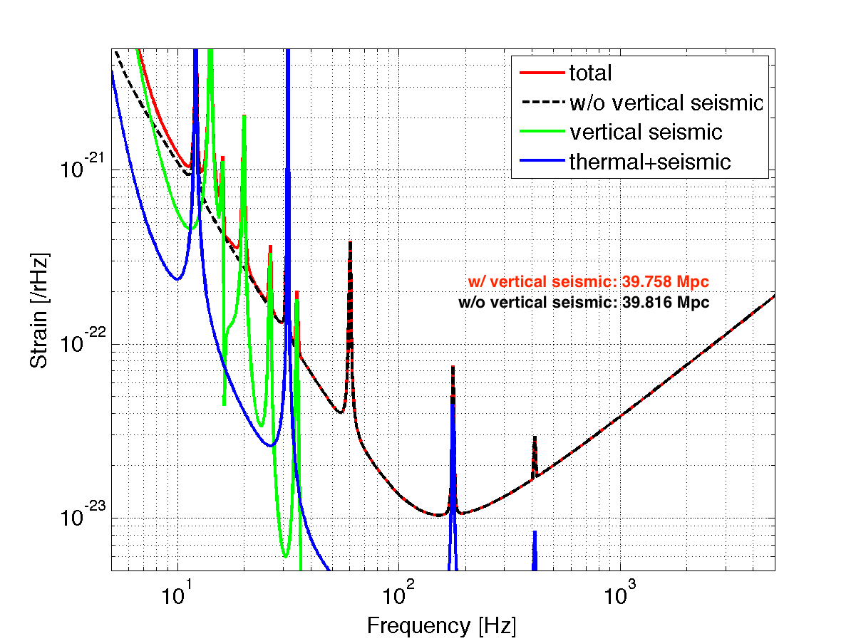
40Mpc
10W input
SRM: R=70%
Excess Noise = (aLIGO)x4
10Mpc
1W input
No SRM
Excess Noise = (aLIGO)x12

Slide 22
ITMY
One of the accelerometers is not working now
No inertial damping at this moment
Need to check the accelerometer driver

Slide 23
ETMX
After the release of the CRY payload, the height of the GAS filters were wrong
In collaboration with the CRY group, we adjusted the GAS filter vertical positions so that the mirror height is at the designed position
LVDT signal generator operated with wrong settings
Fixed
New signal generator cards for LVDTs delivered
They should avoid this kind of mistake

Slide 24
How to avoid problems in the future
Make sure to check everything before installation, vacuum pump down, etc
Rapid problem identification with better status monitor, regular check up
Better watchdog for avoiding kicks
Software: Aso is working on it
Hardware: Tanaka-san’s watchdog with gentle signal termination
Too many faulty electronics
LVDT boards
Stepper motor drivers
Coil drivers
Need investigations on why they are failing

