Slide 1
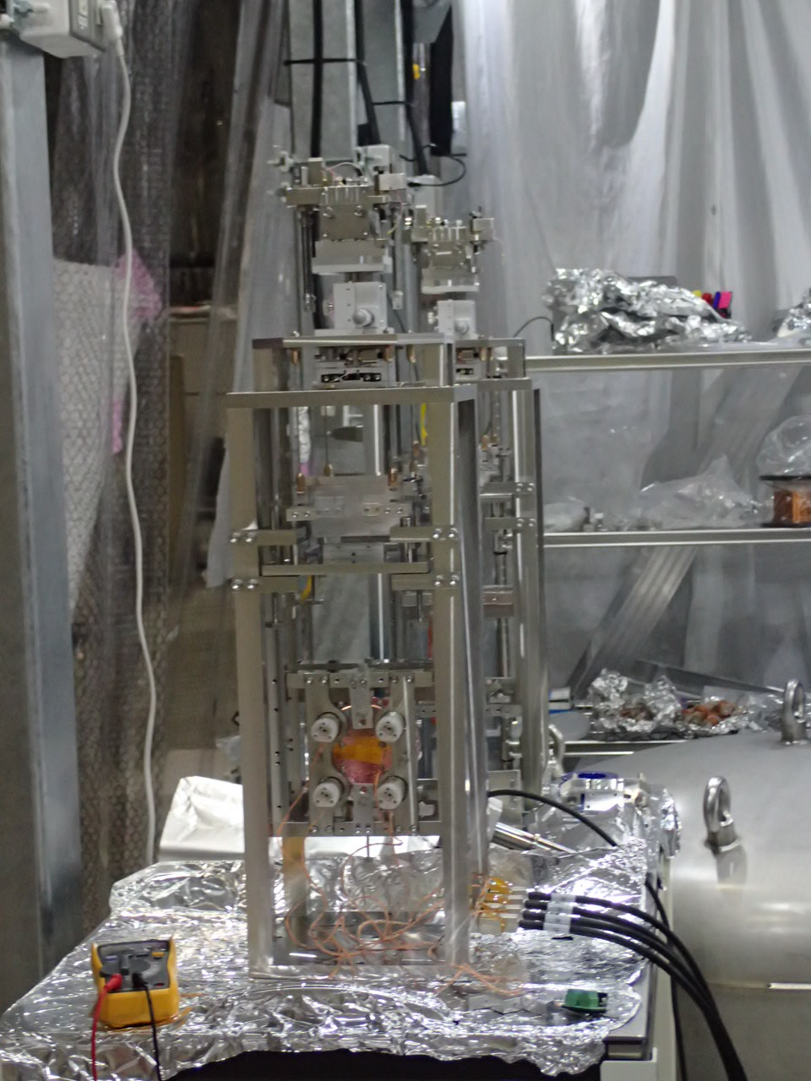
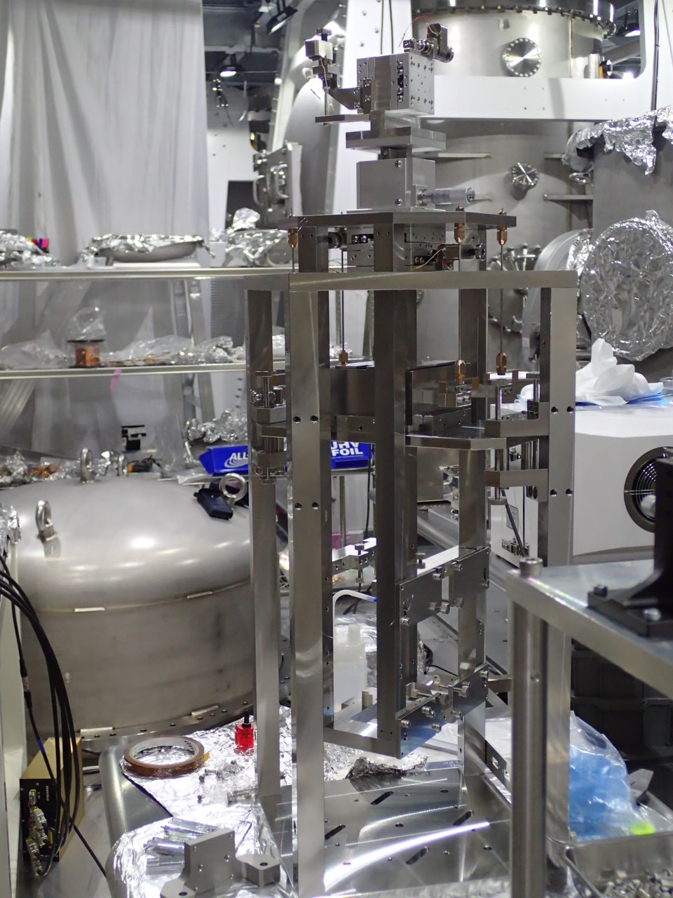
Current status of OMMT/OSTM
OMMT2
OMMT1
OSTM
Naoko Ohishi Nov. 26th 2018

Slide 2
Type-C works in 2018:
Apr: Design
May: MCo visual inspection
Jun-Jul: IMMT1/2 IM screws changed
Aug: Ordered mechanical parts (OMMT)
Sep: Ordered remaining parts (OSTM)
From the mid Oct: started work in the tunnel
2 weeks for OSEM test with help from four B4 students of Toyama University; Kaihotsu-san, Mori-san, Ito-san and Kuromiya-san (2 days each) and Mark-san, Yamamoto-san, Kokeyama-san about digital system and great help from K. Arai-san (3days).

Slide 3
tested 17 OSEMs
Results:
http://klog.icrr.u-tokyo.ac.jp/osl/uploads/6828_20181102130917_characteristicsofosem.pdf
http://klog.icrr.u-tokyo.ac.jp/osl/?r=7074

Slide 4
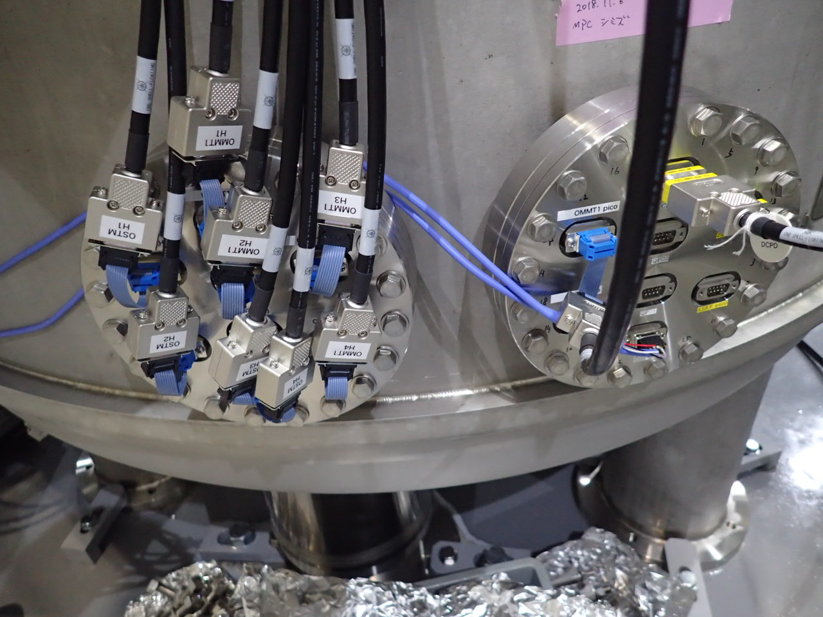
In addition, Ito-san and Shimizu-san(Mirapro)helped cabling

Slide 5
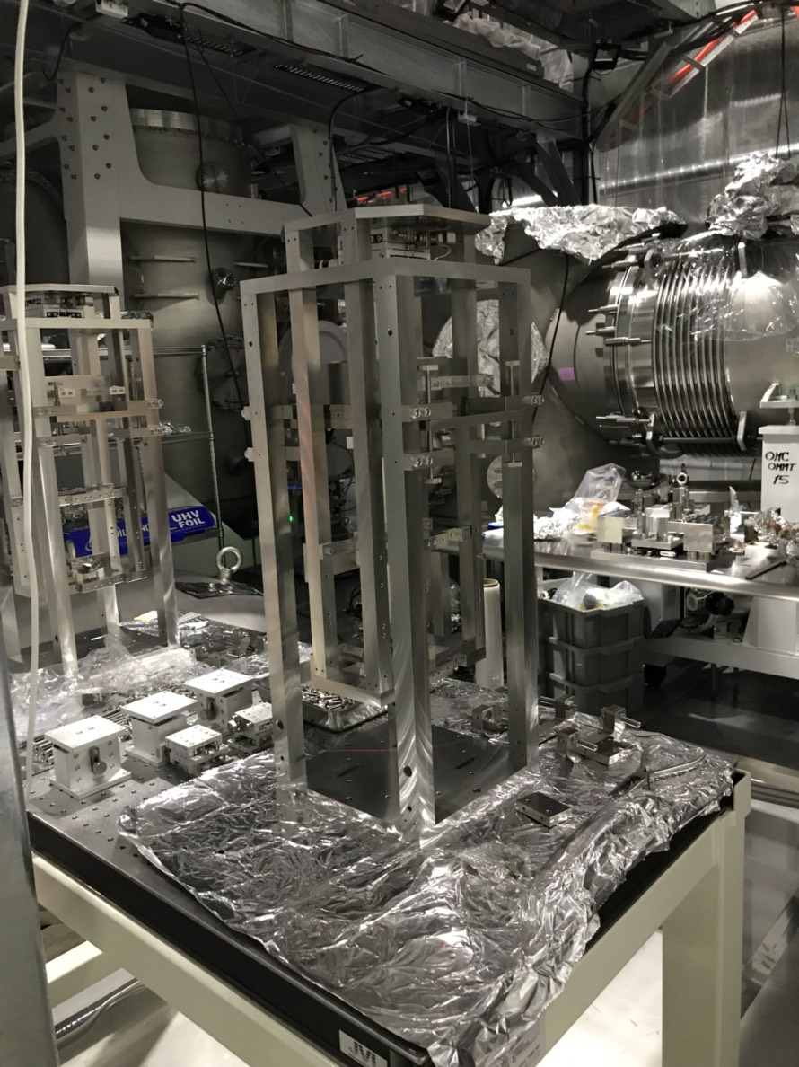
From 5th to 14th Nov : Assembled mechanical parts
Horio-san(B4) and Tsuda-san(M1) came from Tohoku-gakuin university.
They assembled mechanical parts and set tungsten wires.
We found some problems. Samejima-san(MESCO) repaired them really quickly but we still needed to reproduce two kind of mechanical parts to finish assembly.

Slide 6
In parallel, glued standoff and magnets on OMMT1/2 mirrors.

Slide 7
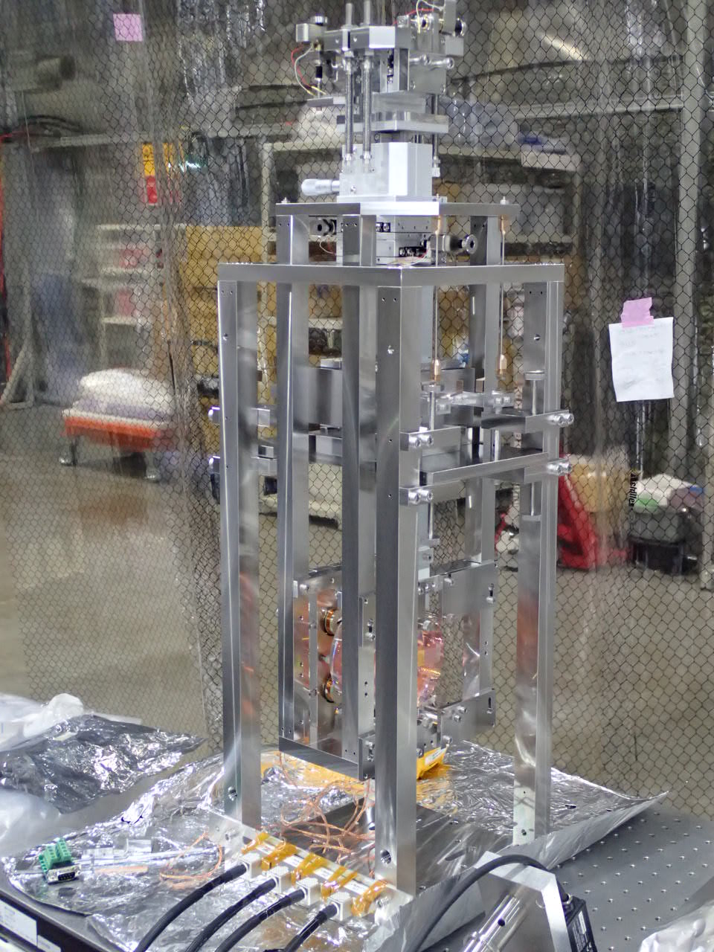
Last week(19th-22th) OMMT1 assembled
All the parts came on Monday.
Ito-san(21, 22th) and Kaihotsu-san(22 and 23th) came to help.
R. Takahashi-san also joined from Wed(30min) and Thu.
Miyakawa-san helped to make OSTM model.
So we completed assembly and took transfer function.

Slide 8
OMMT1 transfer function

Slide 9
This week:
Mori-san (Tue, Wed), and Kuromiya-san(Thu, Fri) will come.
Tsuda-san, and Horio-san will work on Tue, Wed and Thu.
I hope that R. Takahashi-san also joins us.
Remaining works:
OSTM glueing
OMMT2, and OSTM assembly (half a day for each)
Transfer Function measurement…
Lock, install and release in the vacuum chamber.

Slide 10
Next week
Peel first contact away and finish.
Status Summary
OMMT1 transfer function measured outside the vacuum.
Check TF in Tue and Install in Wed.
OMMT2 will be assembled(Tue; Tsuda-san, Horio-san) and will measure TF.
Installation (Thu).
OSTM glueing(Ohishi), set in suspension in Wed(R. Takahashi-san), measure TF on Thu(Kuromimya-san)
Installation (Fri).

