Slide 1
Type B status (May 20 – Aug.25)
Ryohei Kozu
on behalf of VIS Type B group
Notes:
Hello everybody, I'm Ryohei Kozu from Univ. of Tokyo.Today ,I would like to present VIS Type B suspensions Status on behalf of the group.

Slide 2
Index
Overview
Updates(May 20th – Aug. 25th )
Schedule & Tasks
Notes:
Here is a index of today's topics.First, I would like to present the overview of VIS for good understanding.Next, I will present the updates from May; last F2F meeting to August.Finally, I would like to summarize the current states of Type B suspensions and show schedules.

Slide 3
Index
Overview
Updates(May 20th – Aug. 25th )
Schedule & Tasks
Notes:
First, "overview".

Slide 4
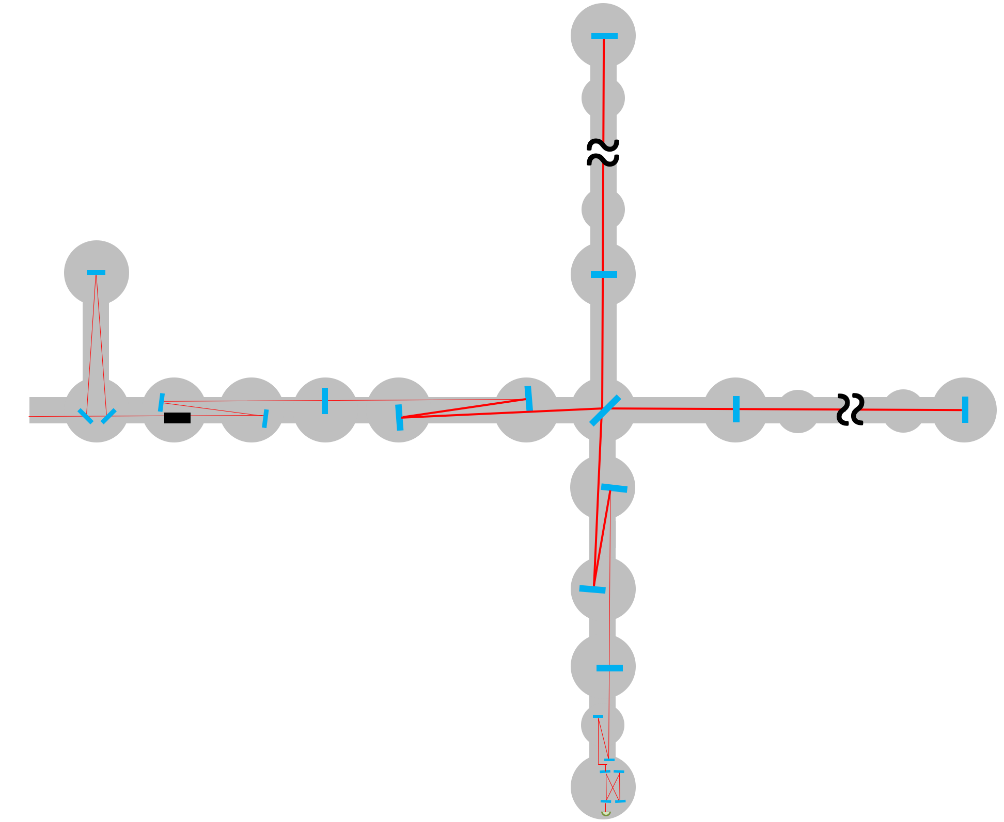
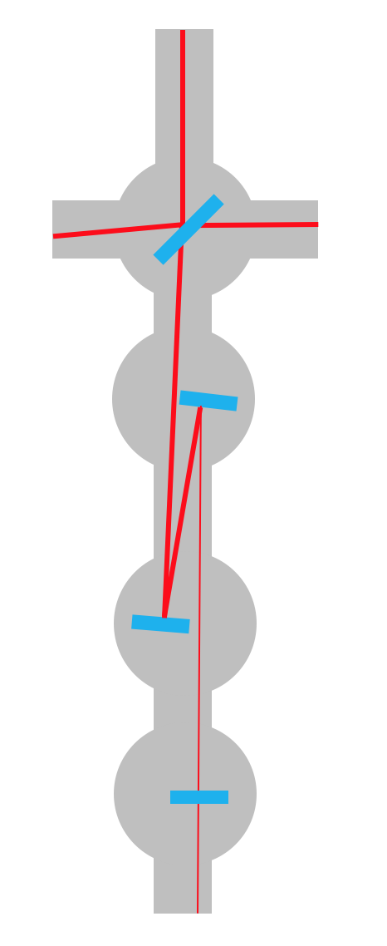
VIS
Type A
Type B
Type Bp
Type C
Type B
BS
SR2
SR3
SRM
Notes:
This is the overview of VIS. The pink squares represent Type A suspensions.The yellow squares represent Type B suspensions. The light green represent Type Bp.The light blue squares represent Type C.And we have 4 Type B suspensions: BS, SR2, SR3 and SRM.

Slide 5
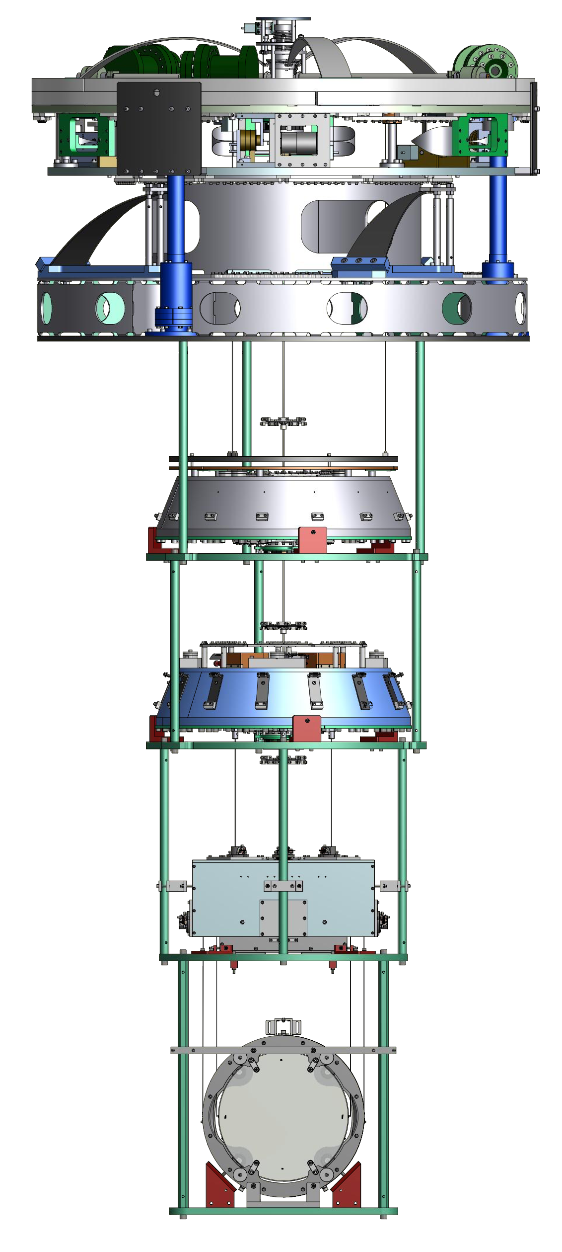
Type B SUS.
Top Filter(TF/F0)
Inverted Pendulum(IP)
Pre-Isolator(PI)
Standard Filter(SF/F1)
Bottom Filter(BF)
GAS Filter
3.1 m
Intermediate Mass(IM)
Intermediate Recoil Mass(IRM)
Payload
Test Mass(TM)
Recoil Mass(RM)
Notes:
Here is the overview of a Type B suspension.Type B is a 5th stage suspension. We have three IPs, three GAS filters and one payload.

Slide 6
Index
Overview
Updates(May 20th – Aug. 25th )
Schedule & Tasks
Notes:
Next, I will present the updates from May to August.

Slide 7
Broken Blades of SR2 & SR3
Notes:
First of all, a sad event occurred in Feb. Blades for PI of SR3 and SR2 were broken. So we changed the schedule. At that time, we concentrated on SR2 and then we shifted to SR3 first. Although we designed new blades, they were weak and the capacity was lighter than we thought. So we needed to calibrate many times and it made delay for two weeks.

Slide 8
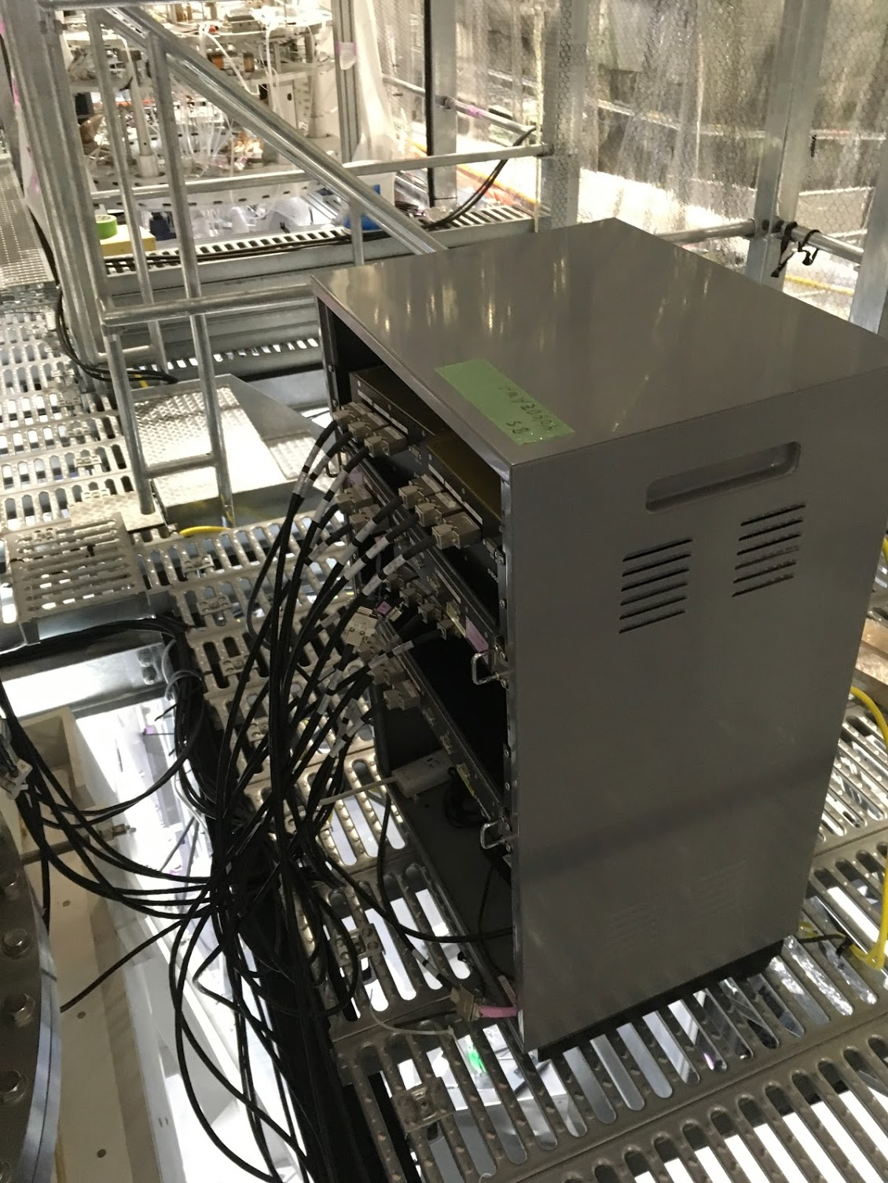
Main updates for BS
Re-cabling and installation of a rack with Yokozawa-san
OSEM satellite box was changed
Notes:
{Re-cabling}
In mechanical part, we tried recabling with Yokozawa reason for re-cabling is
1. Various length of D-sub cable are used and there were many D-sub D-sub connection.
2. Too complicate cabling path. (if we need the additional study, its complicatedness will make it difficult.)
OSEM satellite box because the noise flow was too high.(The capacitance in the feedback impedance was changed. klog:4749)

Slide 9
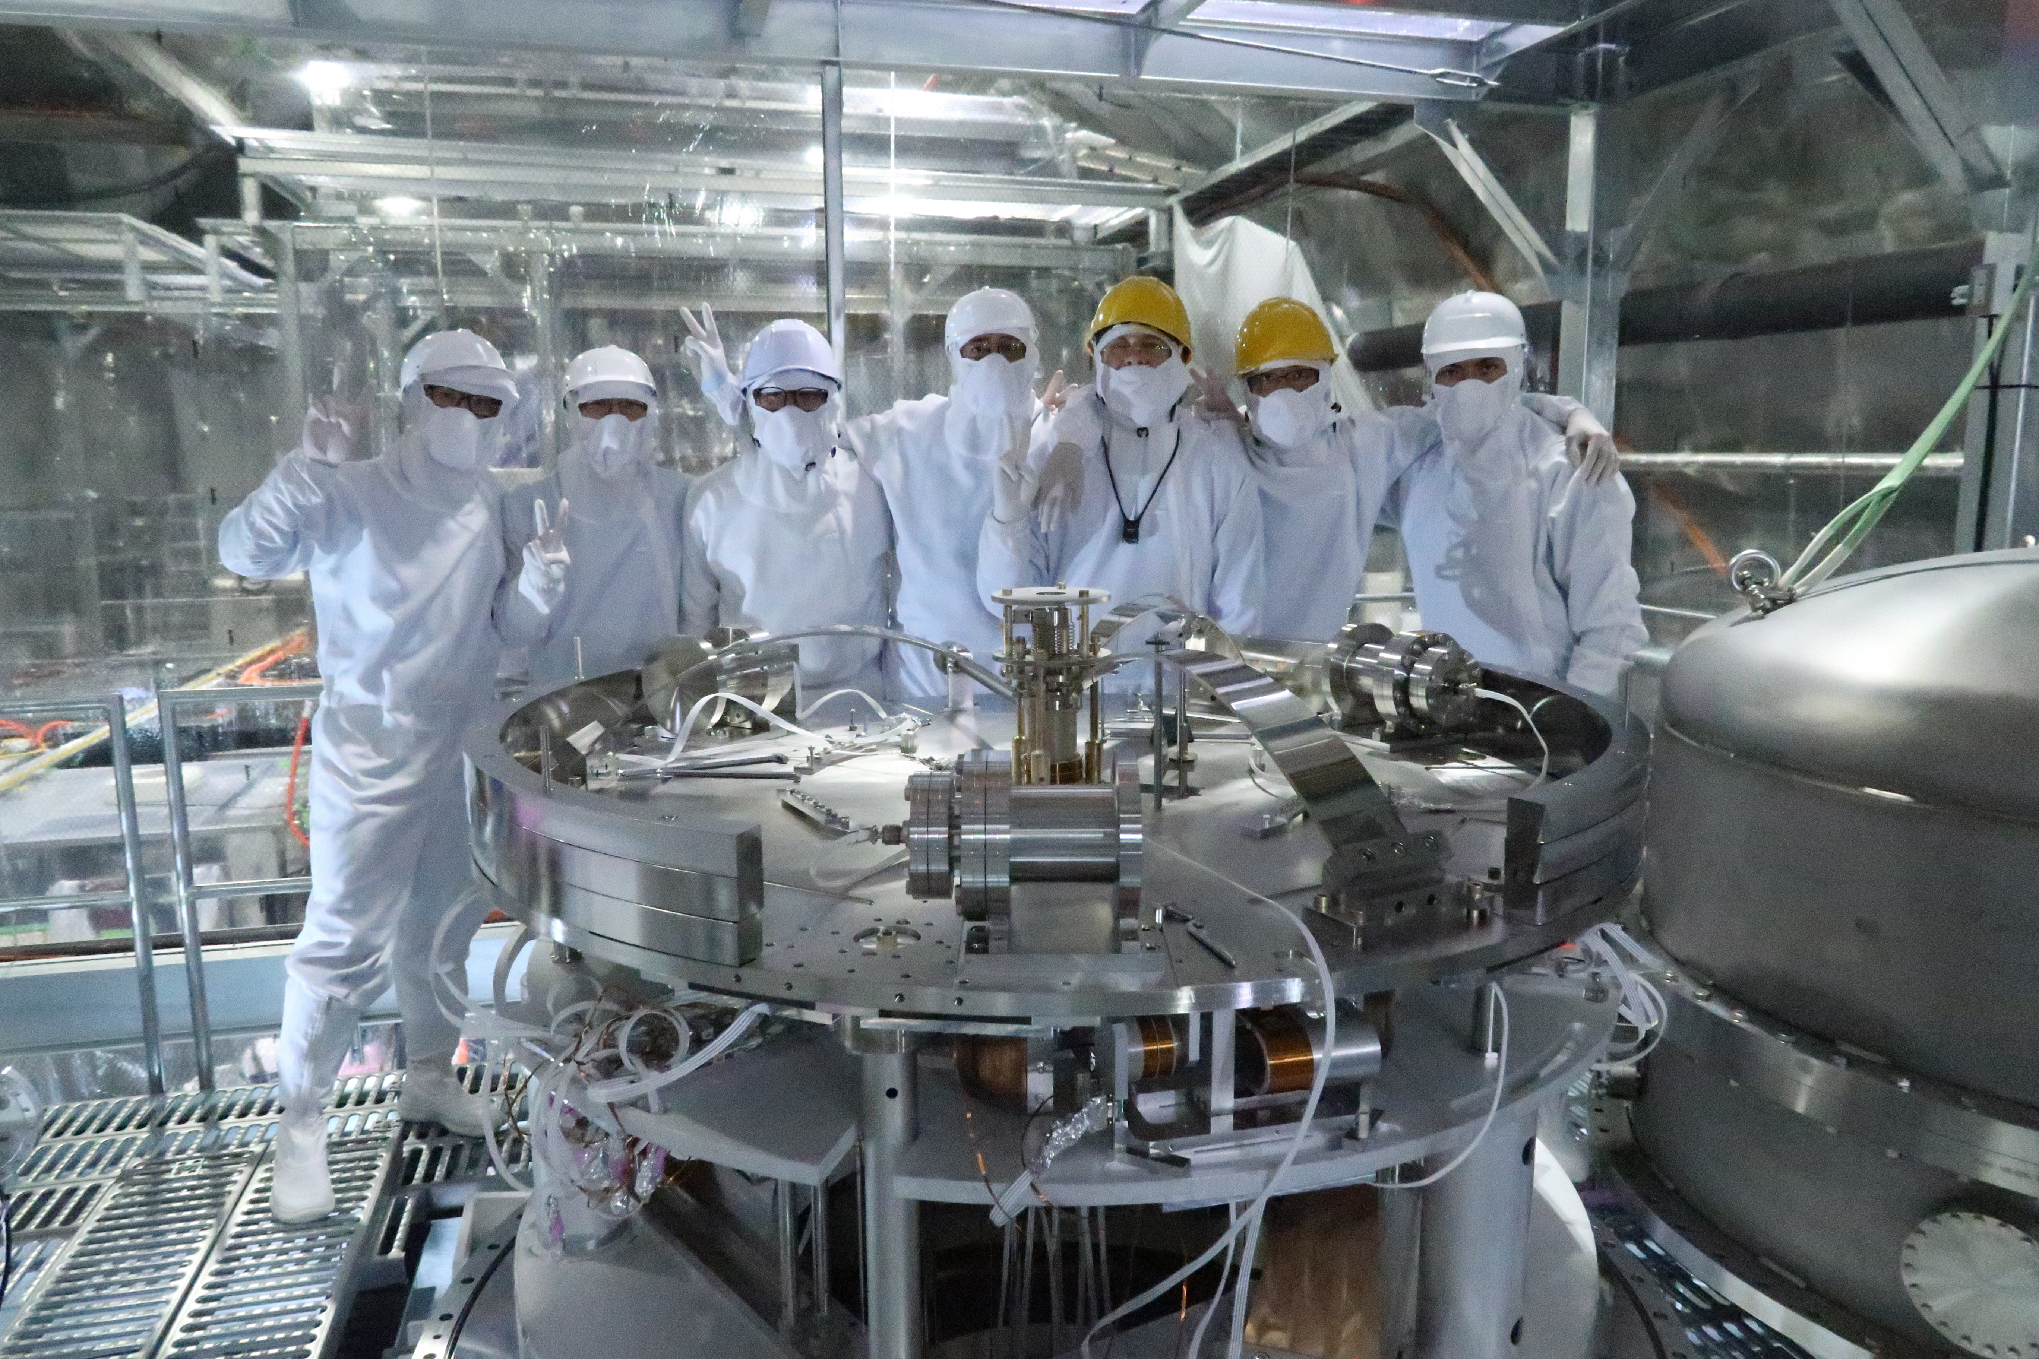
SR3
ongoing
Study of the decay time of torsion mode of the entire chain
Closing the control loops of the different DOFs.
Install PI Yaw stepper motor
Successful Installation of SR3!!
Notes:
We finished the installation of SR3. But of course there are many tasks to complete.For example, studying of the decay time of torsion mode of the entire chain, since we had to modify the magnetic damper (MD) and copper ring,because of the mass budget issue explained before (new blades were weaker than expected).And also the characterization of the other modes.

Slide 10
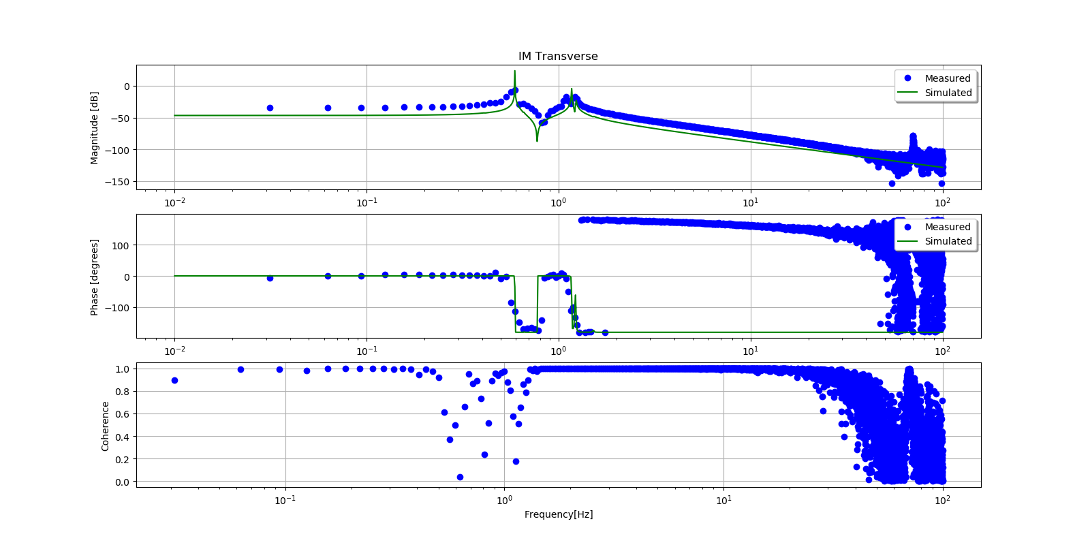
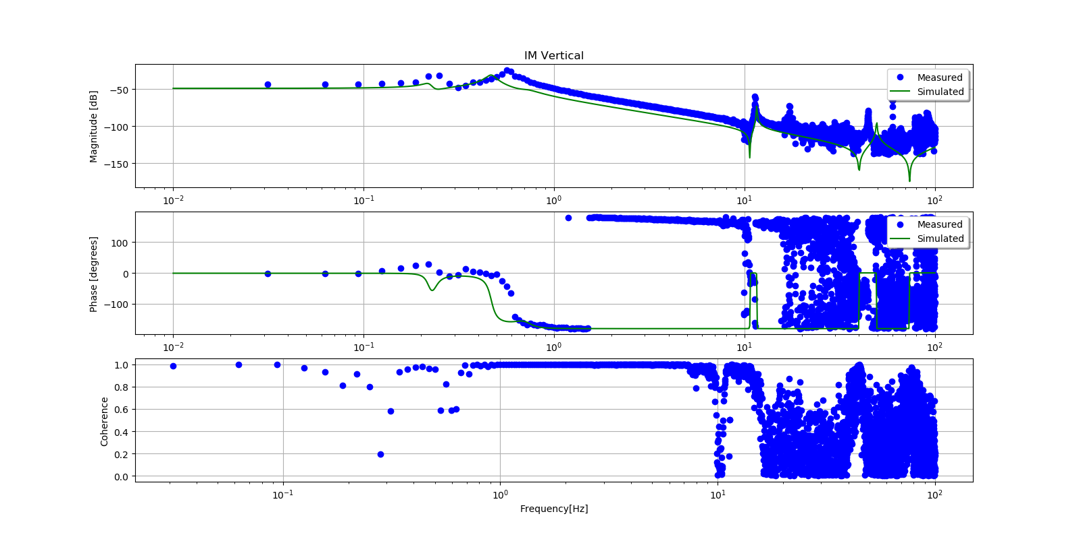
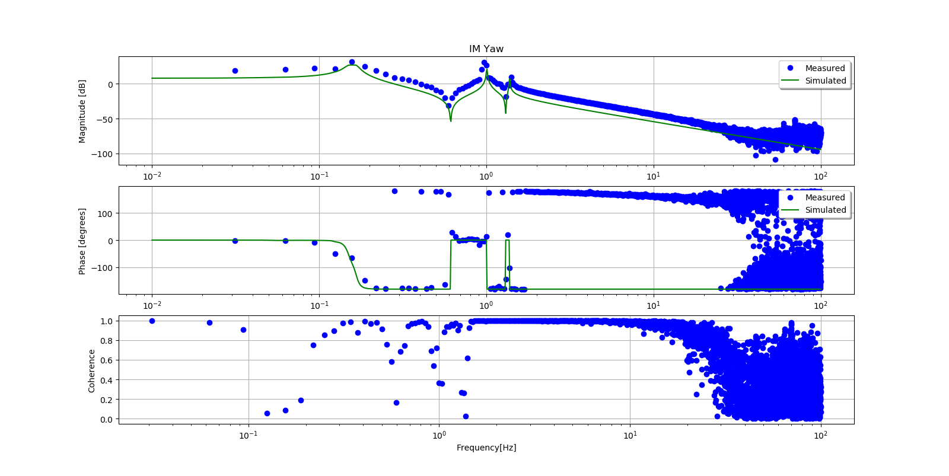
SR3 Transfer Functions(IM)
L2L
T2T
V2V
Y2Y
Notes:
Here are some of Transfer functions from SR3.But we haven't characterized all system of SR3.Although we measured main TF, the sumcon Model is from CAD. So we need to update it to compare with model and SR3.

Slide 11
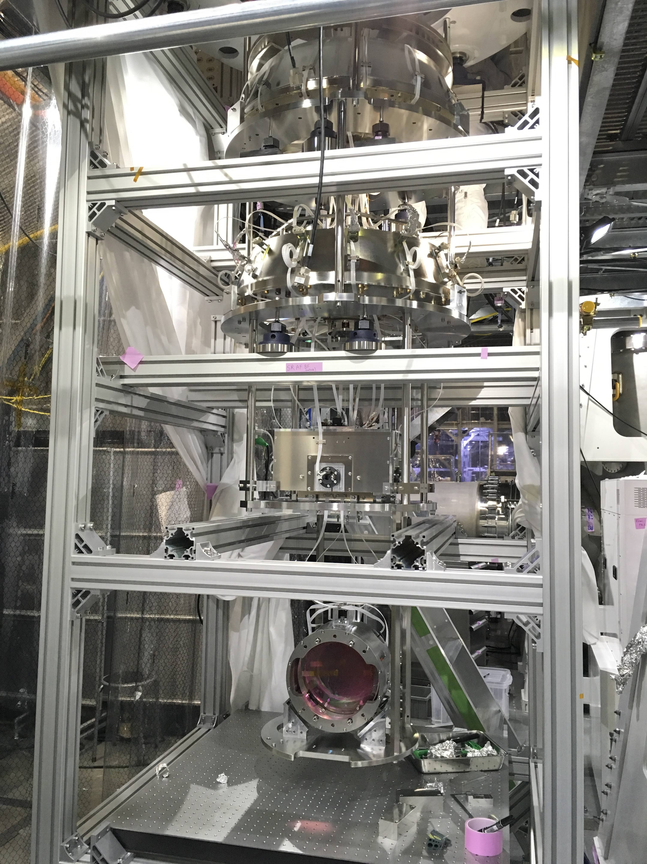
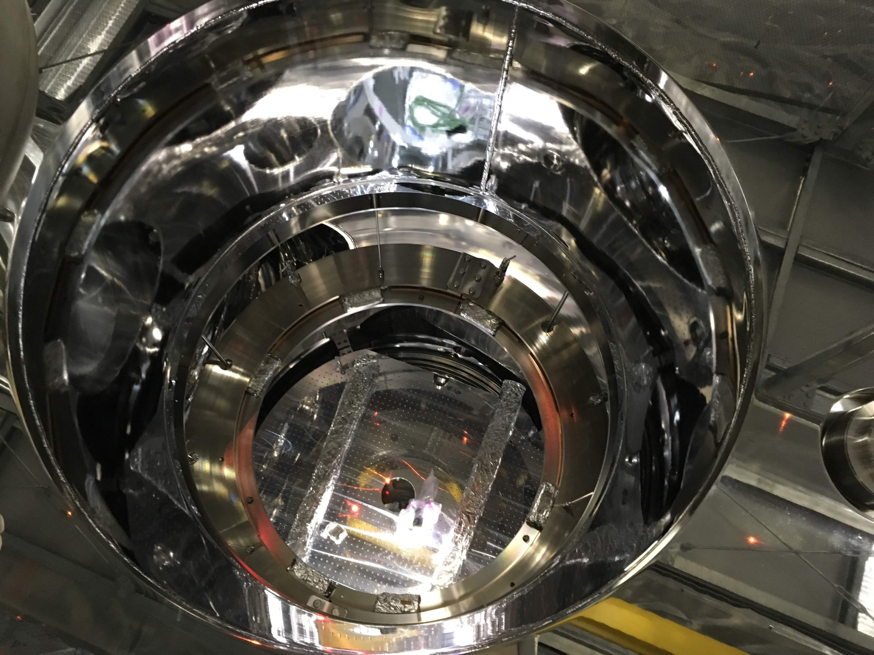
SR2 installation
Ready to install SR2 !!!
SF/...
BBD and LBB
PI/…
Notes:
Now we are ready to connect all in-air cables and check the all signals from the sensors, take TFs to check overall behavior of the SUS.And then we can crane the suspension inside the tank.

Slide 12
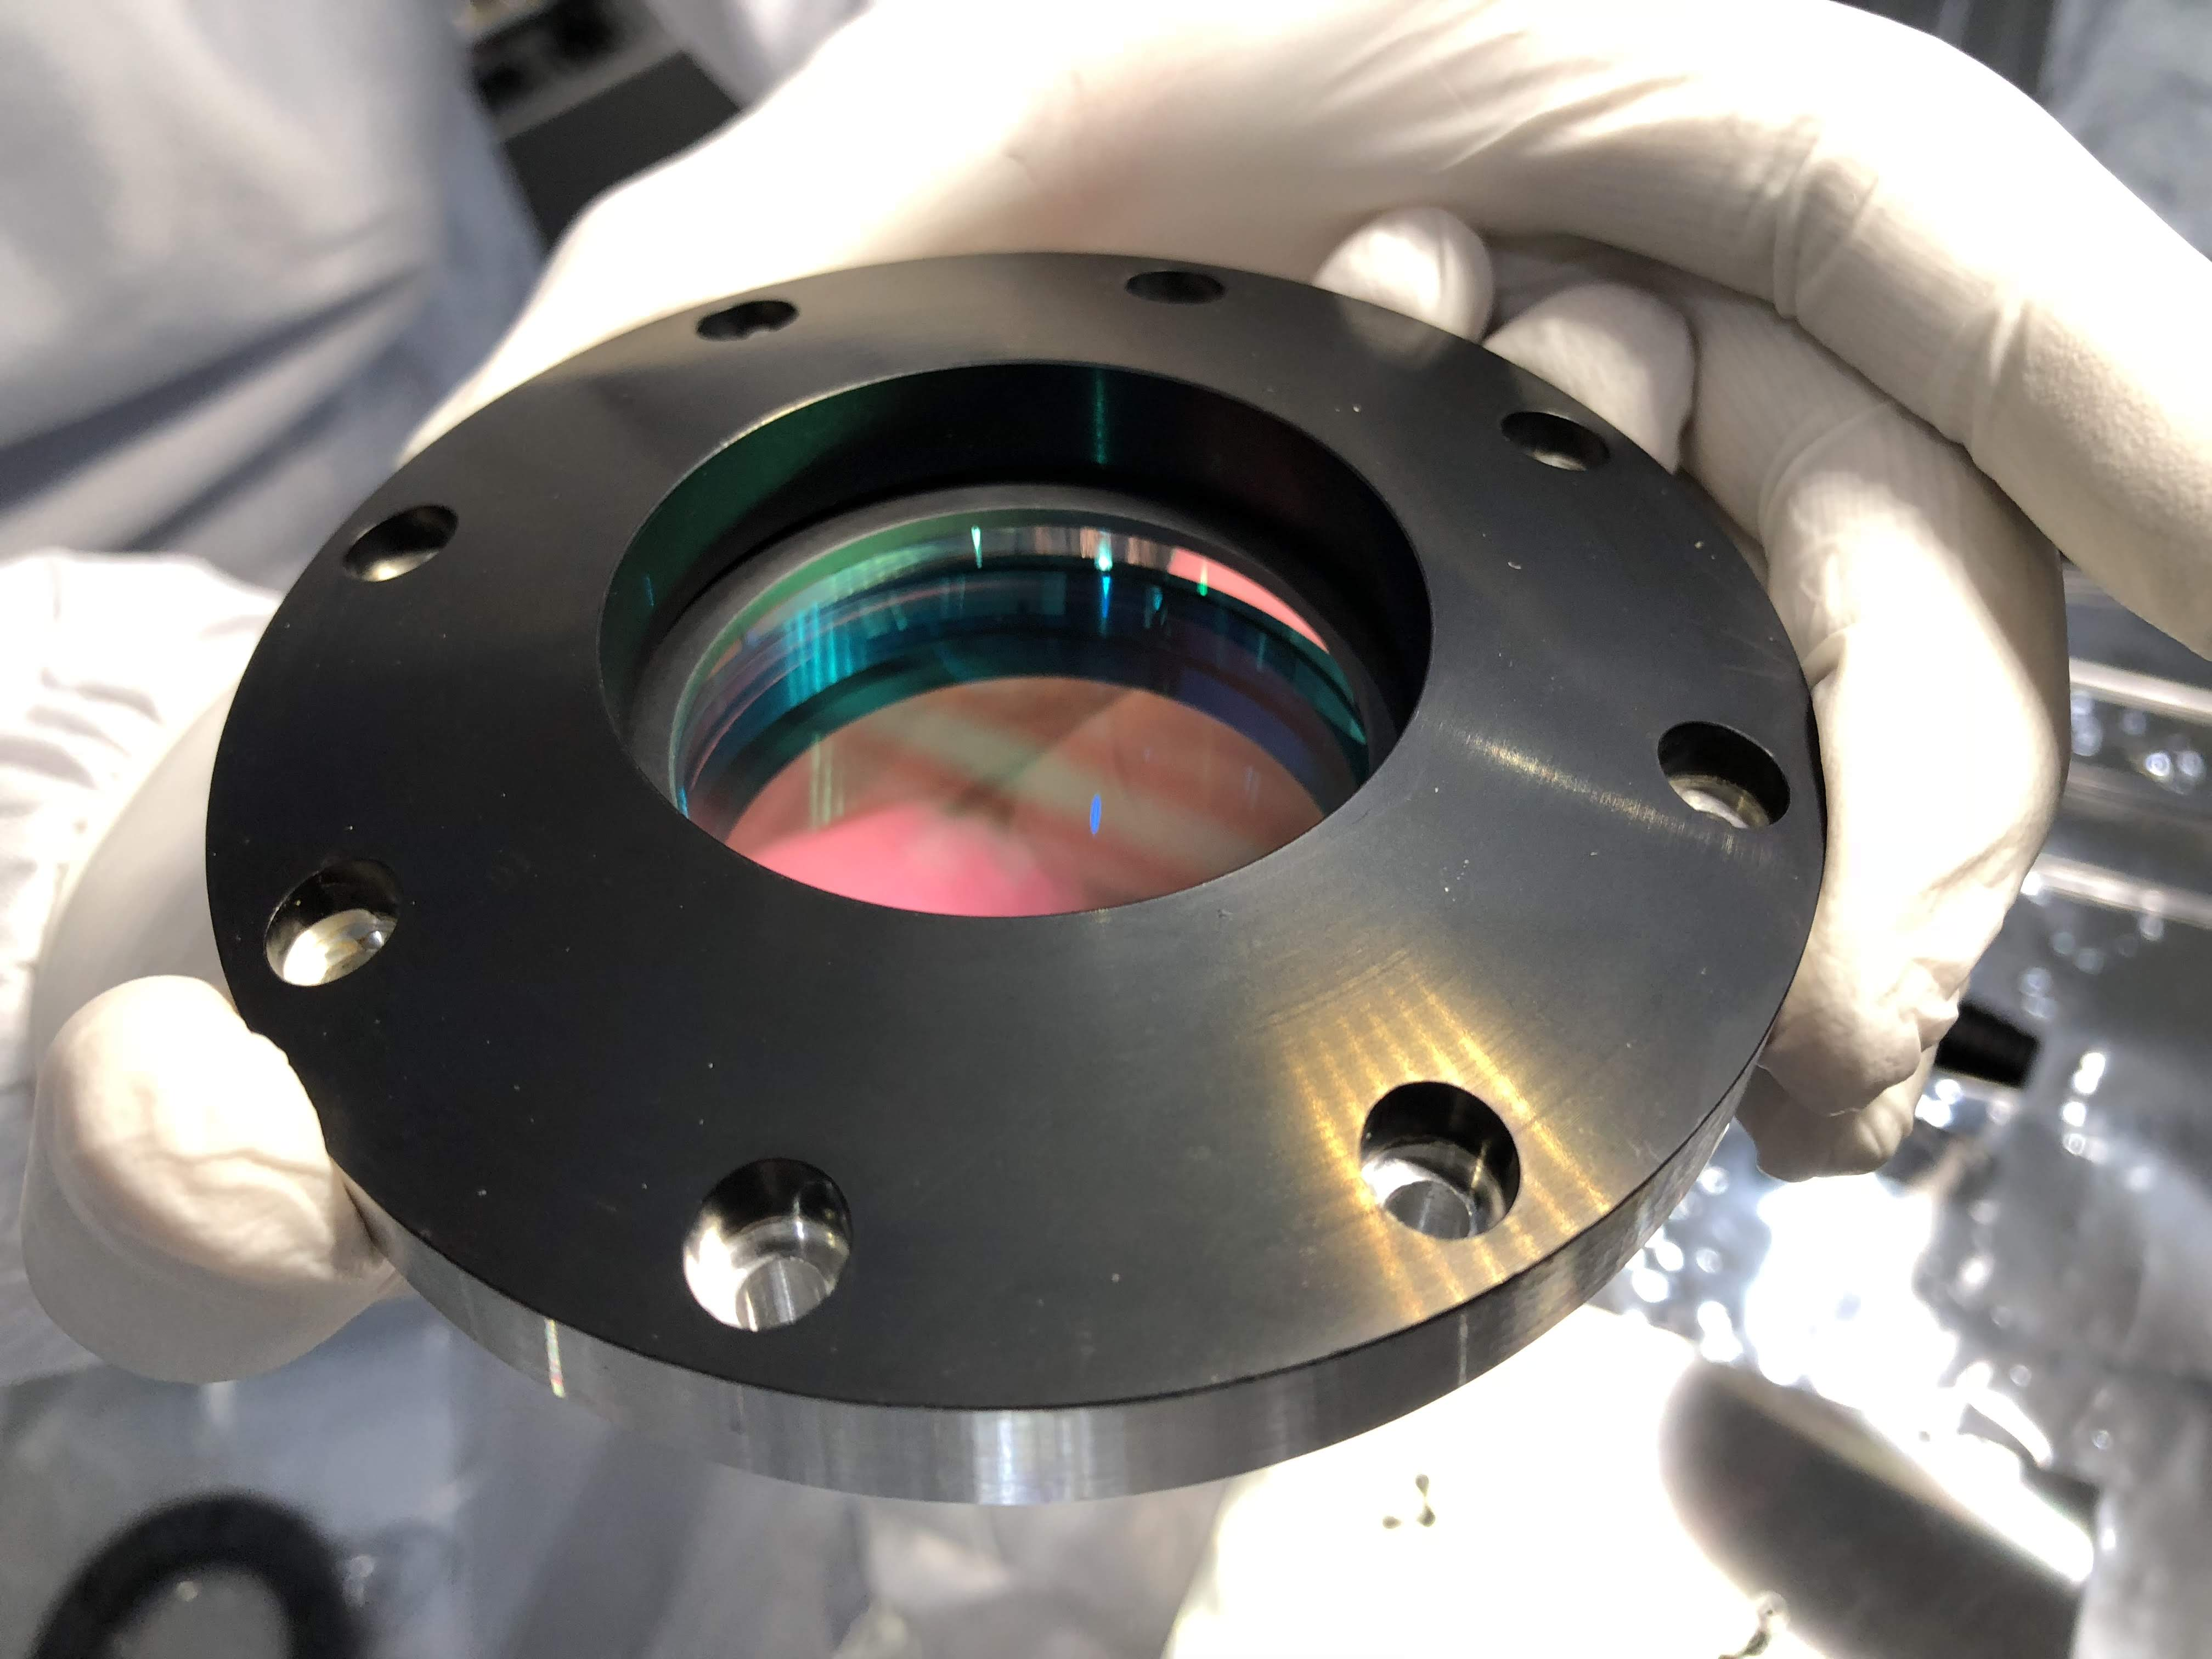
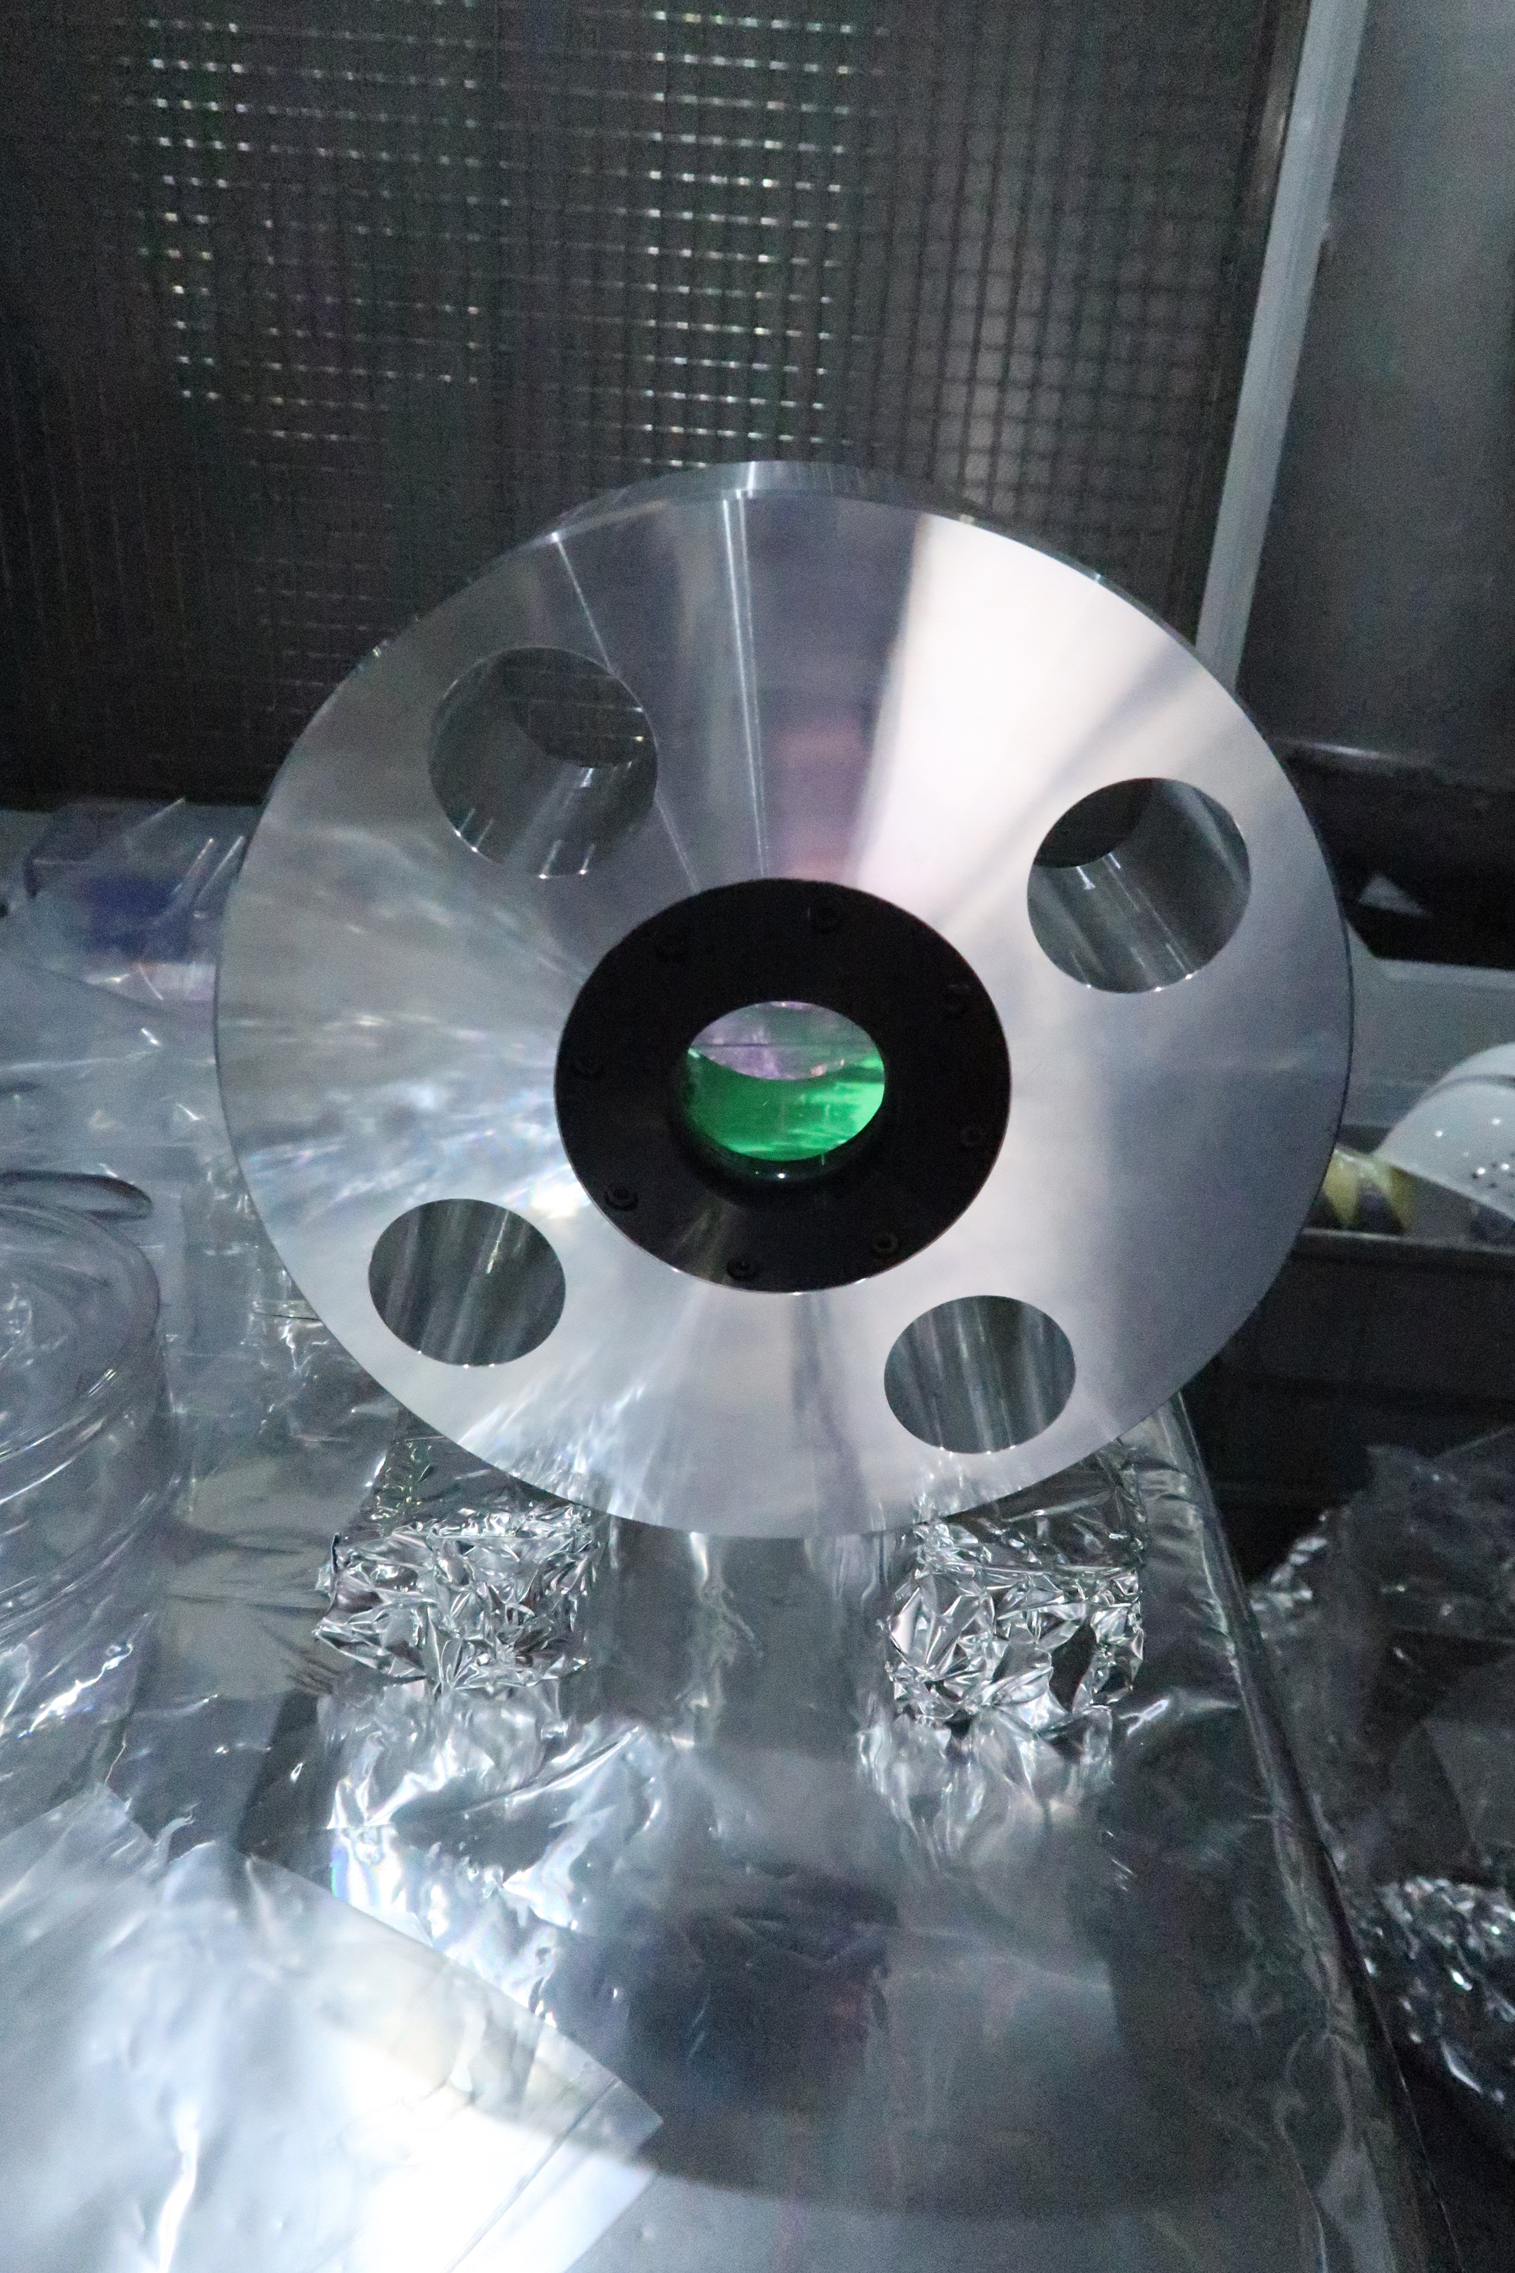
Metal mass and SRM
SRM Mirror
Glued wire-breakers
SRM Metal Mass
Notes:
These are photos of the metal mass and SRM optics.This is a metal mass with a temporary SRM and thanks to this, we can change the optics easily.Now we are planning to use this until the end of O3 and after O3, we will reinstall a new mirror. (If I am not correct I apologize)

Slide 13
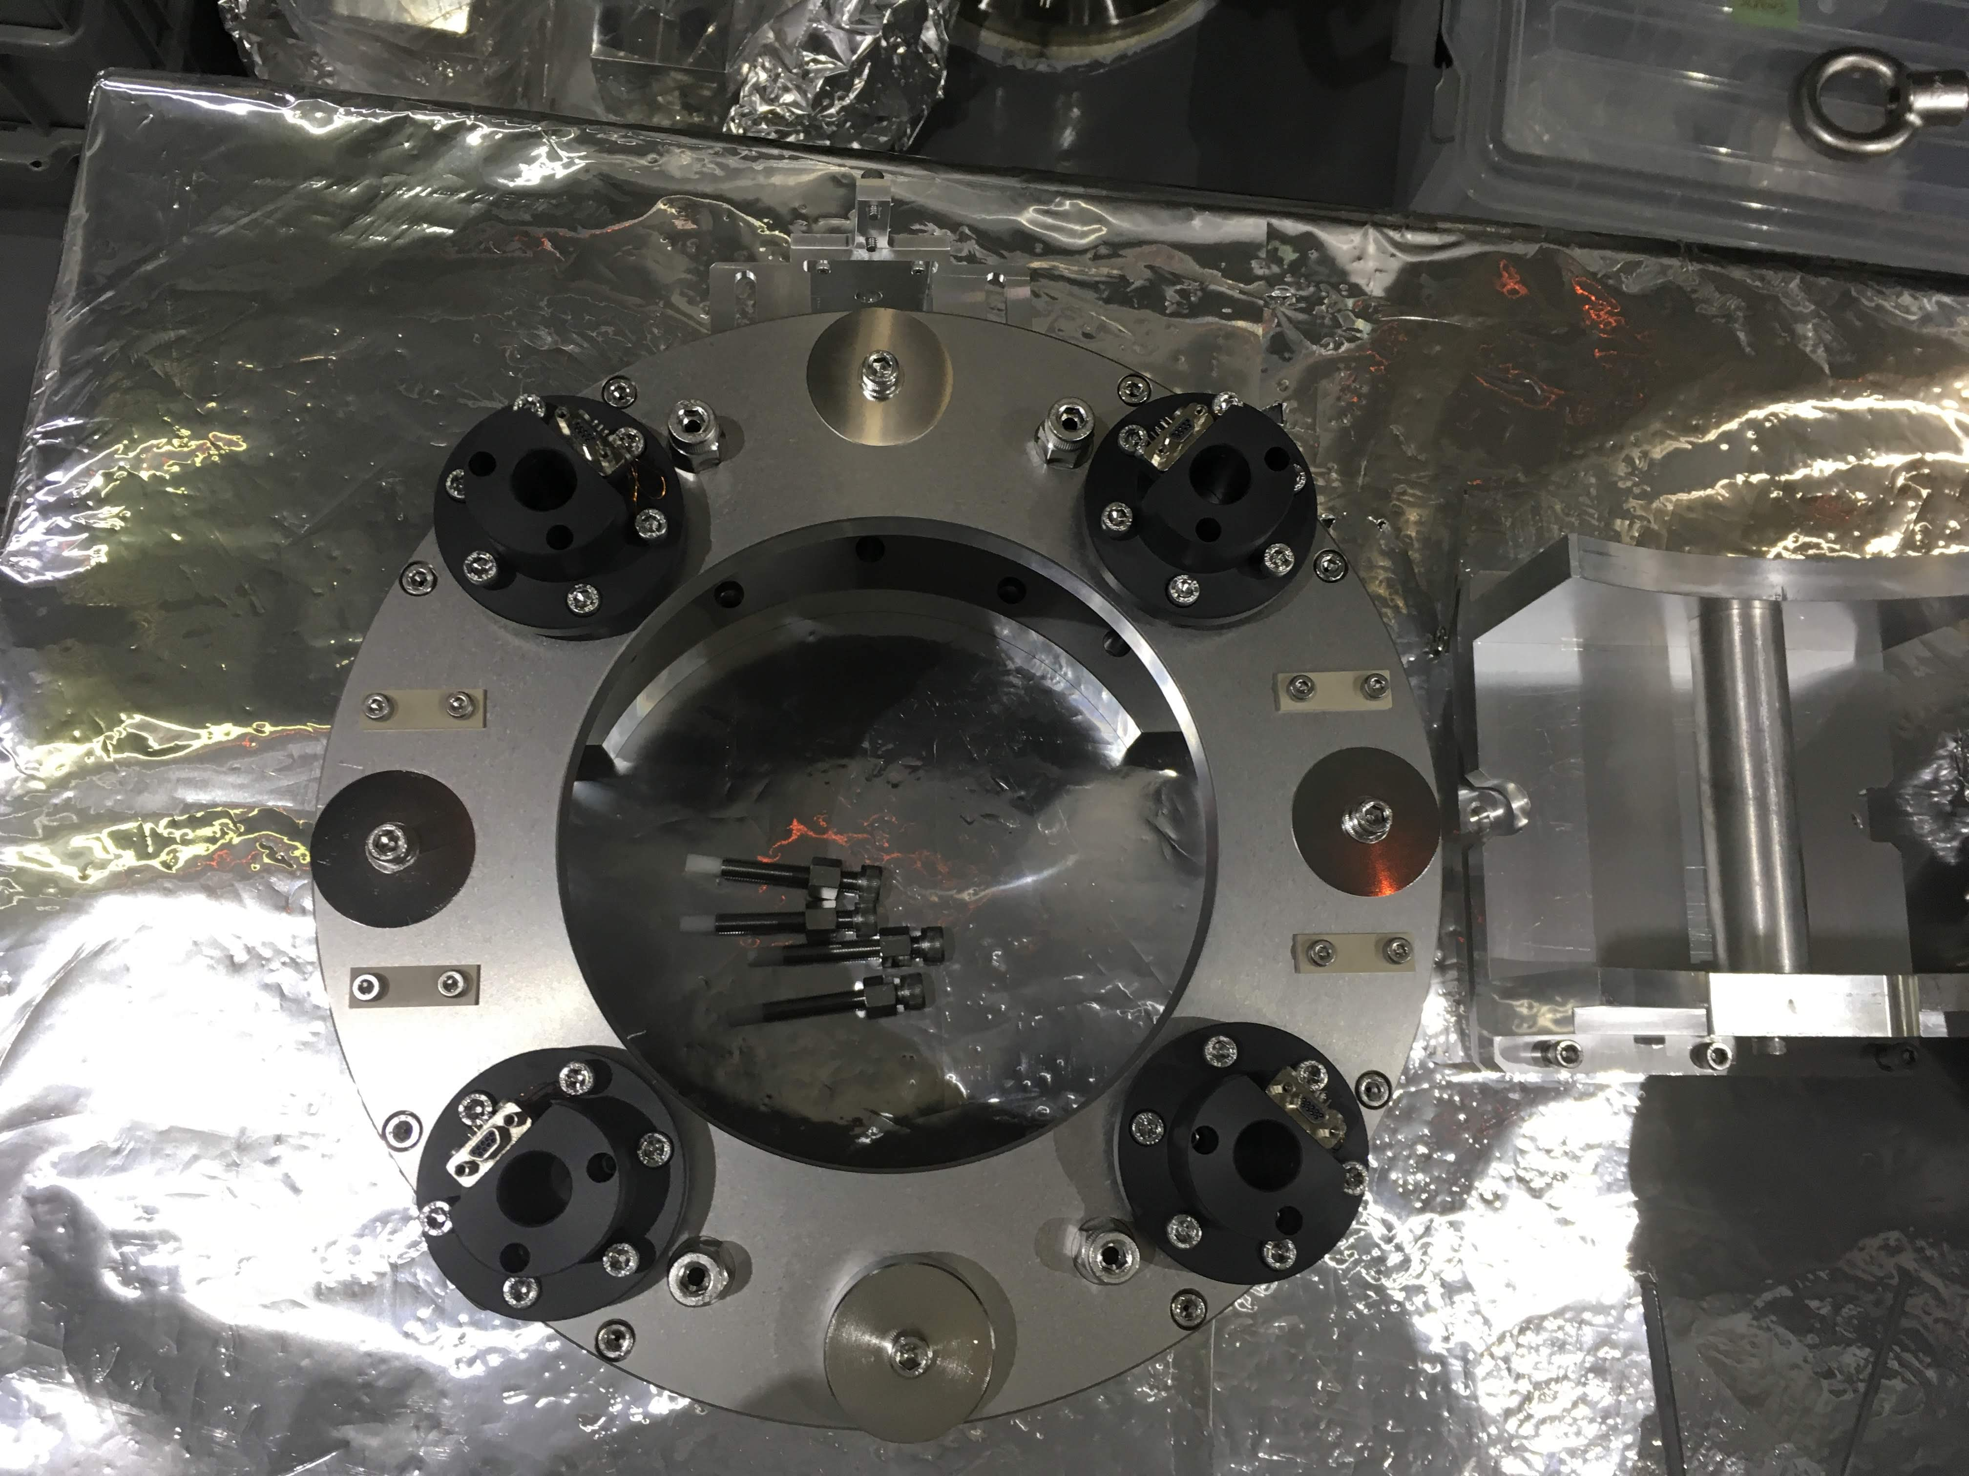
Hanged SRM payload
Suspended Test Mass
Assembled Recoil Mass
Notes:
We finished setting up IM and RM and thanks to Mark and Hirata-san, we also finish hanging the SRM Test Mass and SRM Recoil Mass.{To do}After this, it is needed to assemble two more OSEMs and calibrate 6 OSEMs and check noise levels.And we need to rebuild F0 of the SRM PI.(We need to set blades and calibrate)

Slide 14
Index
Overview
Updates(May 20th – Aug. 25th )
Schedule & Tasks
Notes:
Finally, I would like to summarize the current states of Type B suspensions and present schedules.

Slide 15
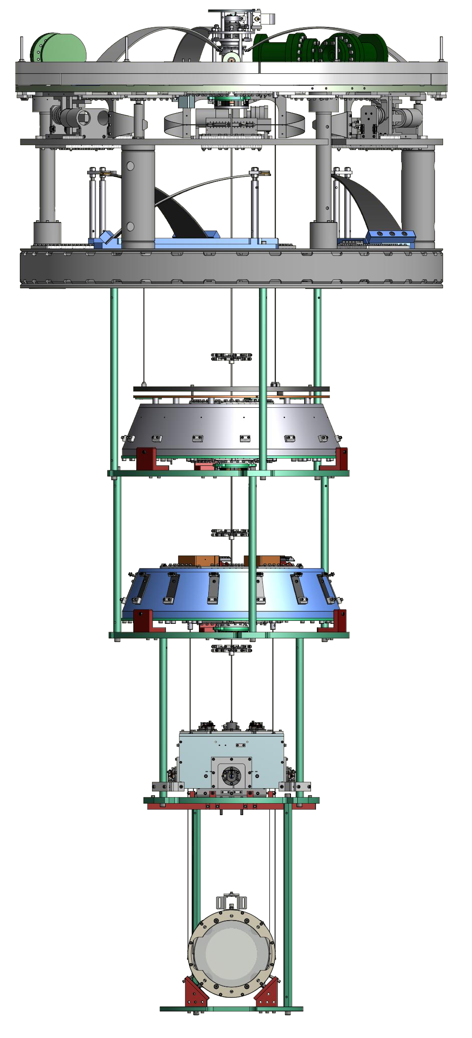
Current Status
SR2
SR3
BS
Installed
Installed
SRM
assembled
assembled
Notes:
Here is the current states of Type B suspensions. Beam Splitter and SR3 are installed and our tasks are to characterize

Slide 16
Next Stage
 | SRM | SR2 | SR3 | BS
Characterization (TFs, Q, noise)
Diagonalization (Sensor, Actuator)
Damping Filter
Filter tuning for Obs. phase
Not yet
Not yet
Ongoing
Ongoing
Not yet
Not yet
Not yet
Ongoing
Not yet
Ongoing
Ongoing
Done !
Ongoing
Ongoing
Ongoing
Ongoing
Notes:
Here is the table about characterizations.Since Details are presented by Fujii-san in a poster session, I skip this.

Slide 17
Previous Schedule
May | Jun. | Jul. | Aug. | Sep. | Oct. | Nov. | Dec. | Jan.
SR3
SRM
Now
Notes:
Here is a previous schedule.

Slide 18
Current state
May | Jun. | Jul. | Aug. | Sep. | Oct. | Nov. | Dec. | Jan.
SR2
SR3
SRM
Now
Notes:
And this is a current state. As I mentioned, because of the broken blades, the installation is about two weeks behind schedule.So we updated the schedule.

Slide 19
Updated Schedule
May | Jun. | Jul. | Aug. | Sep. | Oct. | Nov. | Dec. | Jan.
Characterization
Characterization
SR2
Characterization
SR3
Decay time & Q factor of DOFs etc …
SRM
Now
Notes:
Here is an updated schedule. In our plan, we will finish the installation of SR2 in the end of August and we will install SRM in Oct.

Slide 20
Tasks
Hardware
Software
Installation of SR2
Installation of SRM
Take full TFs
Implementing of BIO for Stepper Motors
Testing of sensor blending for PI
Characterization of installed suspensions
Optimization of servo filters and Guardian implementation
Solving bugs of BIO models
Notes:
I picked up main tasks.

Slide 21
Thank You
Notes:
Thank you

