Slide 1
Narrow Angle Baffle PD

Slide 2
Feed through flange
In-vac D-Sub
shell (male)
P2
J1
J3
P1
J2
J4
J3-J4-P4
JGW-D1605239
1.1m
P3
BIO
2.1m
DB9
DB9
DB9
Universal WTF
2m
P5
JGW-D1302087
J5
DB15
2.5m
1.5m
Transimpedance
Amp.
NAB
A-chamber

Slide 3
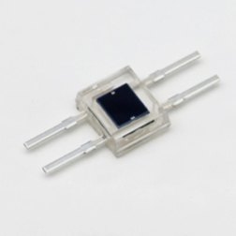
Cabling diagram from the in-vac D-Sub shell to the transimpedance amplifier box
PD: Hamamatsu S2833-01
Transimpedance value: 100k Ohm, 1M Ohm, 10M Ohm (selectable)

Slide 4
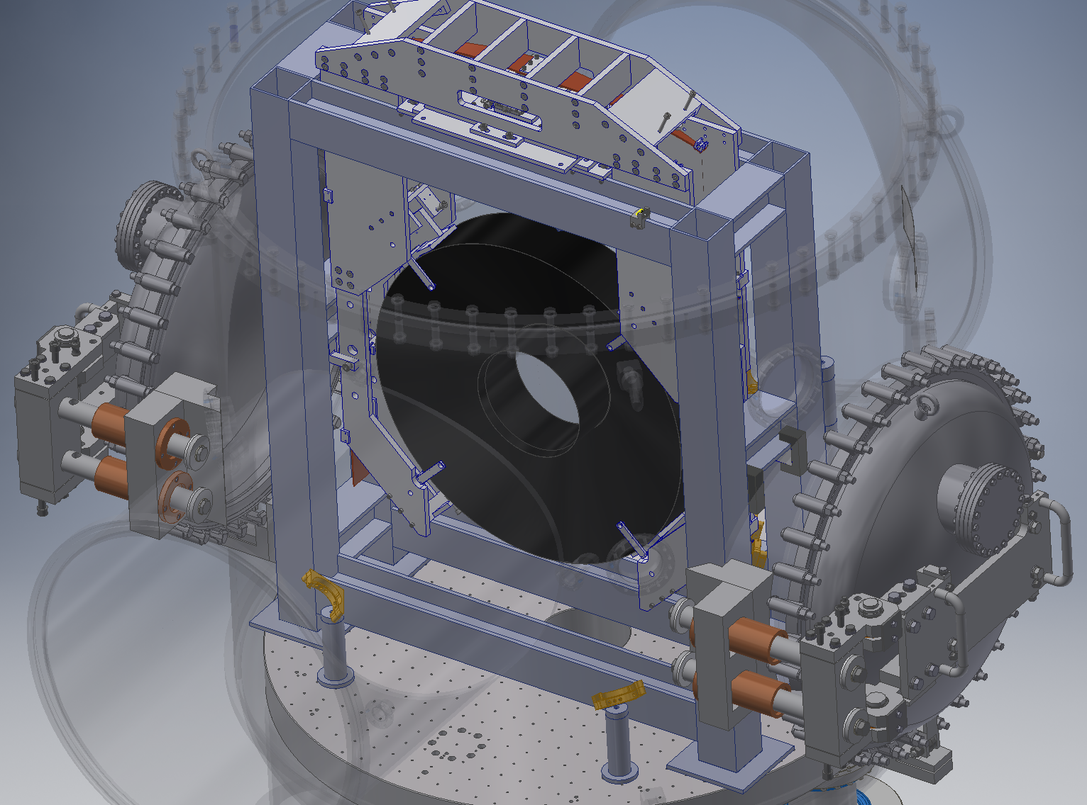
PTFE D-Sub cable
Feed through flange
Kapton cables
(実際にはフレームの裏側を通す)

Slide 5
Copper pipe
(CU-115484 or CU-115444)
PD
S2833-01
Kapton cable
(twisted? pair)
Casode
Anode
To D-Sub shell
Cut

Slide 6
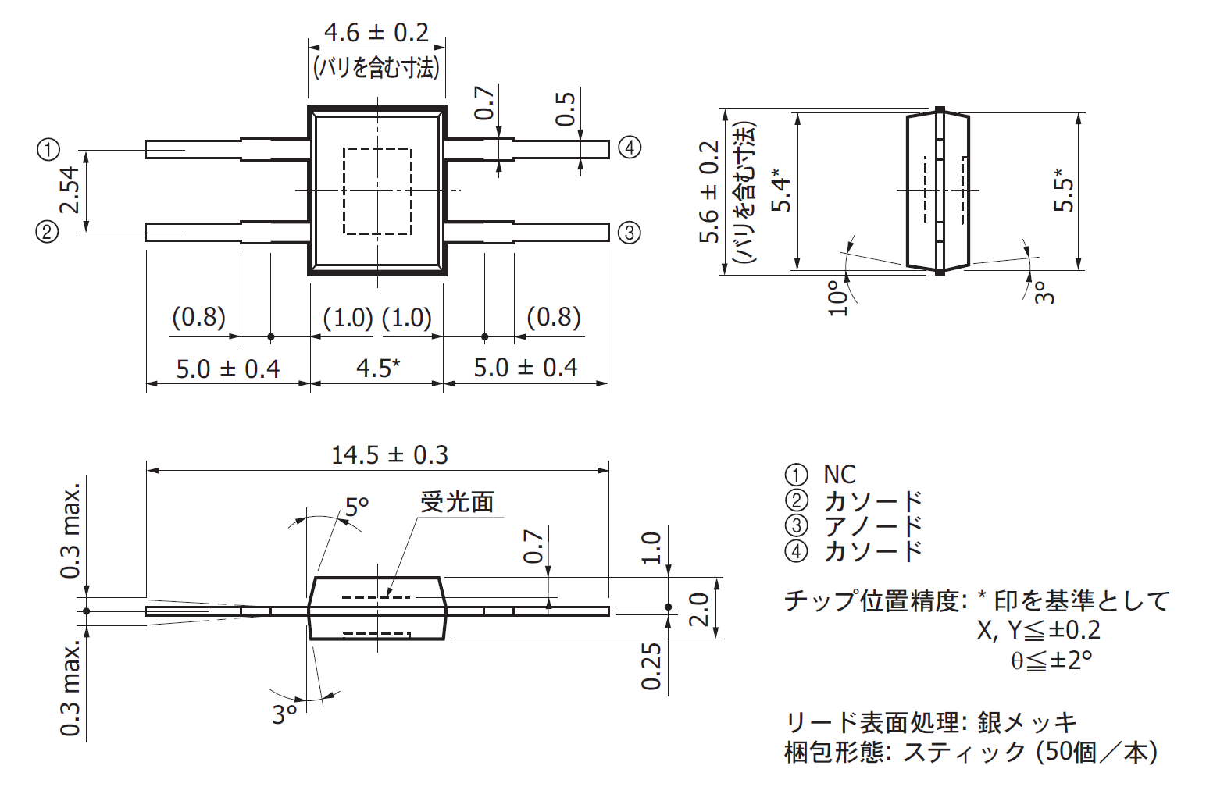
HAMAMATSU S2833-01

