Slide 1
Narrow Angle Baffle PD

Slide 2
In-vac D-Sub
shell
Feed through flange
P1
P2
P3
J3-J4-P4
JGW-D1605239
DB9
BIO
DB9
DB9
Universal WTF
P5
JGW-D1302087
DB15
Transimpedance
Amp.
NAB
A-chamber

Slide 3
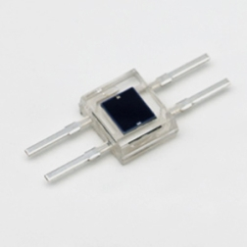
Cabling diagram from the in-vac D-Sub shell to the transimpedance amplifier box
PD: Hamamatsu S2833-01
Transimpedance value: 100k Ohm, 1M Ohm, 10M Ohm (selectable)

