Slide 1
Commissioning in phase 1
G1808254-v1
Kiwamu izumi
For the commissioning team (it’s you all!)
KAGRA f2f at Osaka city univ. (May 18th 2018)

Slide 2
CONTENTS
Review of the interferometer control
Issues that are identified
Future

Slide 3
CONFIGURATION
Pilot
mirror
3 km
Intentionally
misaligned
~1 W at IMC input

Slide 4
Slide by
Y. Enomoto
JGW-G1808217

Slide 5
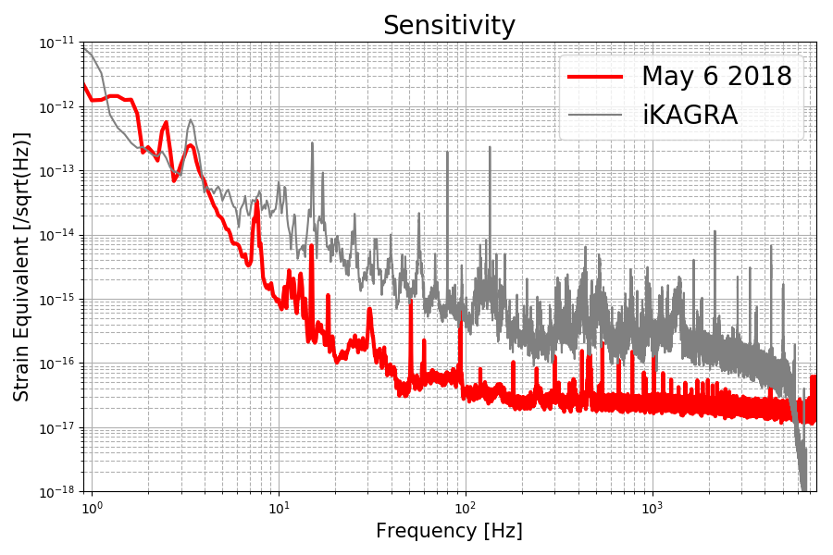
NOISE

Slide 6
NOISE BUDGET
Angular control noise
PD dark noise

Slide 7
CHACTERISTICS
High visibility (~ 99%, klog 4775)
  ETMs are balanced in their properties i.e., curvature and reflectivities including the BS’s splitting ratio.
ETM position asymmetry not well quantified (klog 4960)
  Measured to be 3.4(5) – 4.5(7) m while design = 3.3 m
  Needs to assess severity from P.O.V. of interferometer control.
F1 modulation depth (klog 4876)

Slide 8
LENGTH CONTROL
UGF ~ 50 Hz.
Feedback to BS TM and IM stages
with xover at ~ 0.1 Hz
Farady
Pick-off
Photo
detector
Digital filter

Slide 9
ALIGNMENT CONTROL
-1
-1
Only yaw

Slide 10
ALIGNMENT CONTROL (contn’d)
Manual fine adjustment ~ every half a day
No global control on ETMY angle
  Optical level local control was good enough
ETMX needed a global control
  Servoing to optical lever had a long term drift issue (~ a day)
  Global control lets ETMX follow ETMY
  Seemingly worked fine

Slide 11
QUALITATIVE ARG. ON ALIGNMENT
Things became stable once under vacuum.
  Smaller number of manual adjustment for suspension alignment
EXA temporary PD as seen by gigE cam
Several different sensors helped us understanding the alignment condition.
  VIS local sensors, optical levers, Tcams, gigE-cams and baffle PDs.

Slide 12
HUNTING SOME NOISE
Slide by
Y. Enomoto
JGW-G1808217

Slide 13
ISSUES THAT ARE IDENTIFIED

Slide 14
PR3 SLIPPING
See logs 3634 and 3780.
PR3 found to be off in angle in pitch by 10 mrad.
Associated with a power-down of IO chassis.
  Best guess is a jolt onto the mirror bringing the mirror to another stable point.
Temporarily circumvented it by mechanically locking the mirror to its recoil mass.
No indication of another slippage so far.

Slide 15
PR3 SLIPPING (contn’d)
Similar events was observed with PR2 which remained no issues since Nov. 2017
See also JGW-G1707405 by Shoda-san.
VIS group is incorporating Virgo’s technique to address this issue for SRs.

Slide 16
DAC GLITCHES
Observed in ETMY, PRs 2 and 3, and BS controllers.
Klog 4254

Slide 17
DAC GLITCHES (contn’d)
No real solution so far.
Reducing the sampling rate (16 -> 2 kHz) reduced the glitch rate to an OK-level.

Slide 18
BRIGHT SPOTS
ETMX Tcam image, klog 4767
ETMY Tcam image

Slide 19
ETMY BAFFLE PDs
Unable to bring the interferometer beam to the upper two PDs.
Needs to assess what went wrong.

Slide 20
OTHER ISSUES
PR3 optical lever glitches.
Lots of challenges in ETMY local control
Brute-force coherence (BRUCO) not ready in time
How do we spot anomalous suspension drift and glitches?
etc.

Slide 21
FUTURE

Slide 22
REMOTE PARTICIPATION
A number of us actually reside afar
  VIS experts at Mitaka, MIF experts at Hongo, Detchar experts all around Asia…
Their remote participation for commissioning activities is a key to increase our productivity
High demand for rapid communication with the crew on site.
Aso-san is addressing the communication part of it by introducing remote participation systems.
  Zoom remote system, TeamSpeak, …
By N.Kijbunchoo

Slide 23
SUMMARY
Overall, commissioning was successful.
A number of issues are identified.
Remote participation seems another key.

