Slide 1
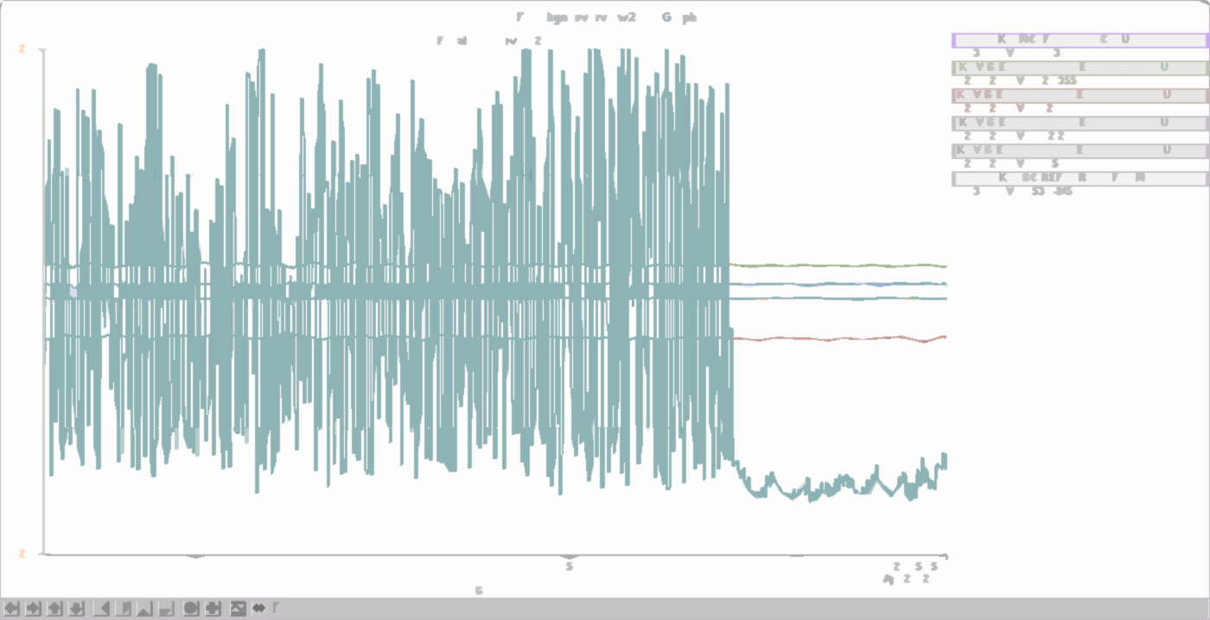
KAGRA: Status and Near Term Plans
JGW-G1808217-v1
Y. Enomoto and K. Izumi for the KAGRA collaboration
GWADW2018 on May/12/2018 at Alyeyska resort

Slide 2
Very brief introduction of KAGRA

Slide 3
What we said in GWADW2017
GWADW2017
TODAY
In the middle of the bKAGRA phases
Phase 1 concluded
with one ETM cooled, instead of two
Gearing up towards making KAGRA online during O3
Slide by O. Miyakawa

Slide 4
Major news since GWADW2017
KAGRA expressed the intention to possibly join O3.
ETMs are now sapphire mirrors with 15-m suspension system.
ETMY had been maintained at a cryogenic temperature 18K.
The phase-1 run was conducted (Apr.28-May.6).
Intensive hardware installation underway
All three PR suspensions are installed and actively damped.
The BS suspension are installed and actively damped.
The PCAL in-air optics at both ends are in place.
The beam reducing telescope (BRT) at EY is installed.
A cooling test of the wide angle baffle (WAB) concluded.
and more..

Slide 5
Cryogenic payloads installed!
Cool pictures of cryogenic payloads will be here.

Slide 6
How KAGRA looks like now
Interferometer optical layout will be here, with graphical indications showing what are already installed and what are being installed.

Slide 7
Issues that are spotted during Phase 1
A number of issues were identified. None of them seem to be a showstopper.
ETMY angular fluctuations seem big and bigger than ETMX
=> Electronics wires may be touching some part of the cryogenic shield
=> A modification was made for ETMX which so far doesn’t show such behavior. The same modification will be applied to ETMY.
Three (out of five) ETMY GAS filter stages were found to be mechanically touching.
=> Two of them will be released shortly after venting the chamber.
ETMX mirror accumulated dust on the surface after a vent-cycle.
=> we are thinking of in-situ cleaning (e.g., first contact)
Suspension digital systems show occasional DAC glitches coinciding with sudden increase of CPU load.
=> Reducing the sampling rate from 16 kHz to 2 kHz reduced the rate of glitches.
=> Investigation continues.

Slide 8
Deciding on interferometer configuration for O3
As KAGRA expressed the intention to possibly join O3, we have been consolidating the installation/commissioning schedules in great detail.
We need to determine what interferometer configuration we should aim for e.g., Virgo’s strategy of not using SRM for giving more commissioning days.
Focused discussion on whether or not we give up signal-recycling.
=> This doesn’t accelerate the installation schedule of SRM suspension.
=> A blank SRM optic already ordered, anyway.
Focused discussion on whether or not we switch to FPMI
=> FPMI appeared to be a good fallback plan in case we cannot make it to RSE in time.
=> In this case, PRM will be deliberately misaligned and SRM will be either blank optic or misaligned.

Slide 9
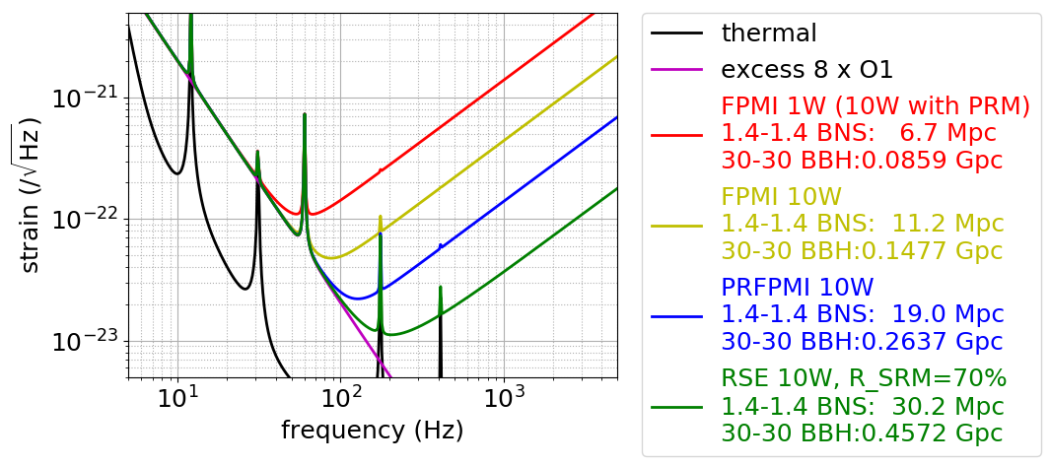
Sensitivity estimations for various configs.
Assumptions:
Excess low freq. noise (8times LIGO’s O1 noise) and low PSL power (10 W)
JGW-T1808172-v3

Slide 10
The scenario
KAGRA executive office has just approved the suggestion on the 9th of May that
“We should keep ‘RSE scenario’. At the same time, we should often check preparation status for RSE components and judge to select FPMI due to insufficient preparation; checking points are every end of Sep/2018, Dec/2018 and Mar/2019. The ‘PRFPMI’ was deleted from the option “
The consensus for this strategy will be made in the coming KAGRA face-to-face meeting (May. 18-20)

Slide 11
Near term plan
# The graph below will be replaced with a more audience-friendly one.

Slide 12
Do not miss the KAGRA-related talks!
Y. Enomoto on Phase 1 run (in a minute)
K. Somiya on KAGRA+ (Mon.)
Y. Michimura on optimization of IFO parameters (Mon.)
S. Miyoki on experience with underground facilities (Tue.)
E. Capocasa on filter cavity experiment at TAMA (Wed.)
T. Miyamoto on local control of KAGRA ETM suspensions (Thur. )
K. Hasegawa on mirror contamination (Thur.)

