Slide 1
How to use generateTemplate
By KGWG DAS team
Hyung Won Lee, Chunglee Kim, Yeong-Bok Bae, Jeongcho Kim
Date 11 Dec. 2017

Slide 2
Content
A single waveform generation function
How to use it
Example run
Sample output

Slide 3
A single waveform generation function
/kagali/waveform/src/KGLWaveforms.c
void KGLDefaultFDWaveformArray( //begin{proto}
KGLStatus *status, /**< [in, out] kgl status pointer */
KGLWaveformModelParams * params, /**< [in] waveform model parameters to print */
double complex *hp, /**< [out] calculated h_plus value array */
double complex *hc, /**< [out] calculated h_cross value array */
double *f, /**< [in] the given frequency value array */
int n_start, /**< [in] start index of frequency values */
int n_end, /**< [in] end index of frequency values */
int N, /**< [in] number of frequency values */
KGLFDWaveform func /**< [in] actual waveform function pointer for a single frequency */
) //end{proto}

Slide 4
What it does
Calculate a FD waveform for given approximant and frequency range
f : frequency array to be calculated for f[0] to f[N_h-1] actual waveform is calculated from f[n_start] to f[n_end]
params : KGLWaveformModelParams pointer containing all necessary information to calculate waveform
N : total size of array for hp, and hc(=n_end-n_start+1)
hp, hc : complex double array for output waveform

Slide 5
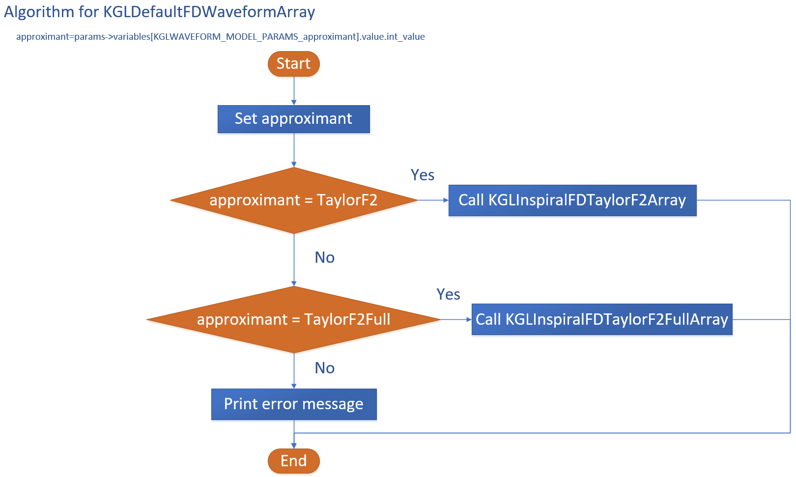

Slide 6
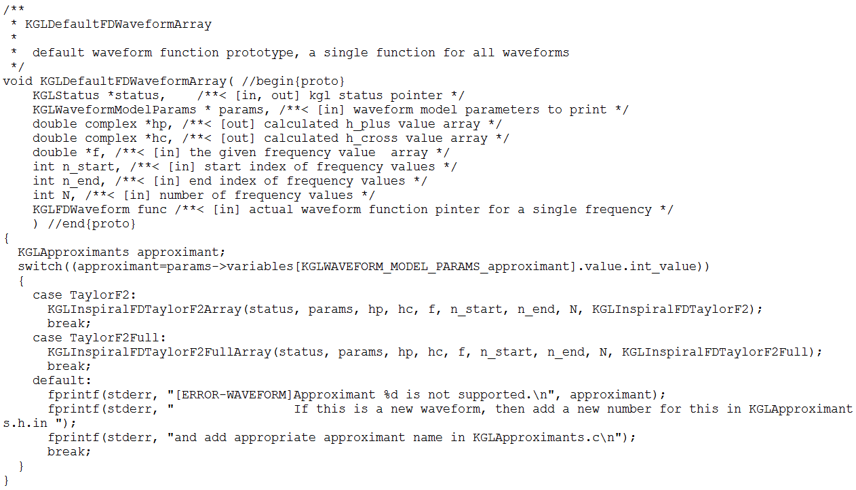

Slide 7
General procedure to use it
Include headers
Set appropriate values for KGLWaveformModelParams
Allocate frequency array and assign values
Allocate arrays for hp and hc
Call KGLDefaultFDWaveformArray function
Save result (hp and hc) or do something you want

Slide 8
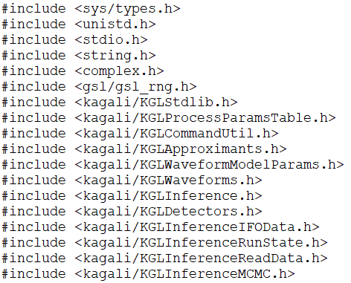
Headers needed

Slide 9
generateTemplate application
Location : kagali-v0r4a/kagaliapps/cbc/mpisrc
Purpose : show how to generate a given waveform
Branch : mcmc

Slide 10
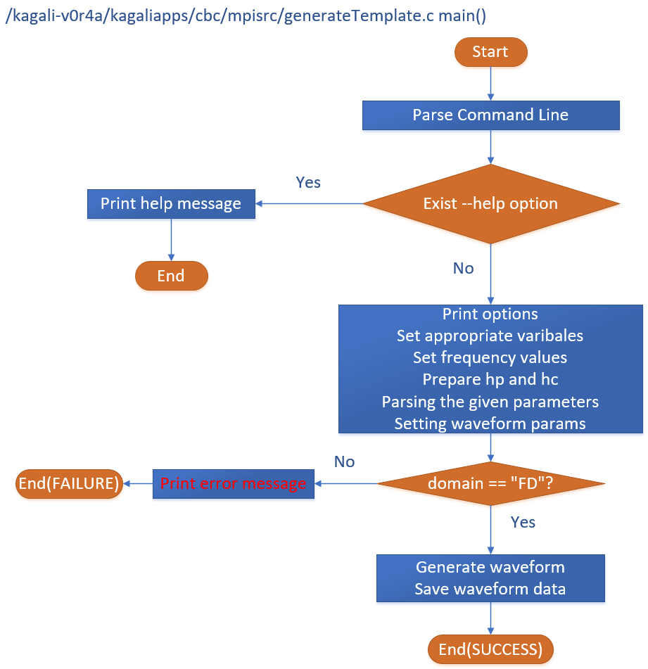
Algorithm

Slide 11
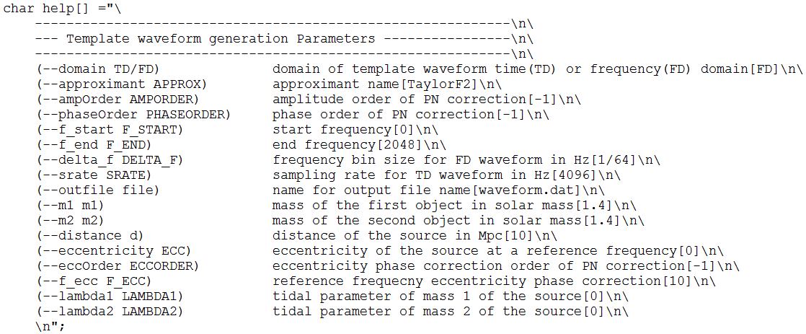
Options of generateTemplate application
One can see this option by generateTemplate --help

Slide 12
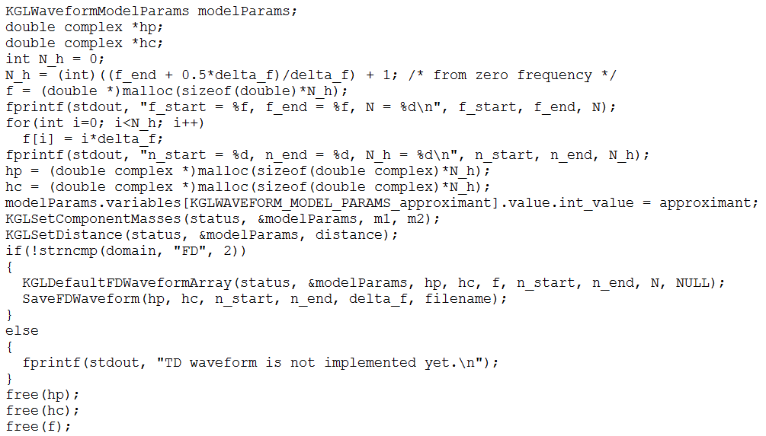
Part of main code of generateTemplate application
Prepare variables
Set model params
Calculate waveform and save

Slide 13
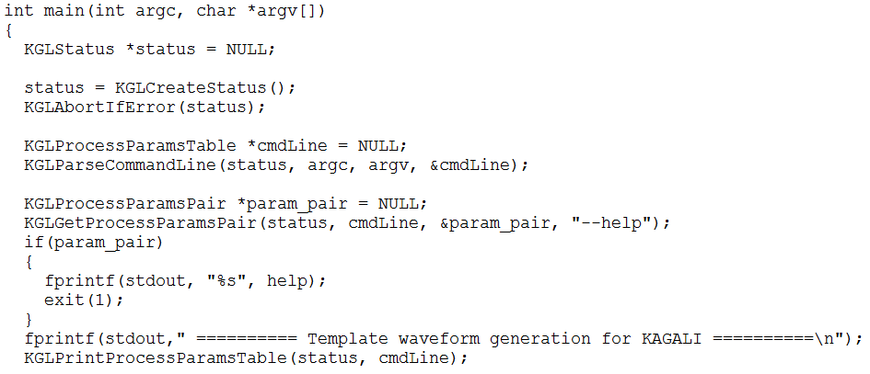
Parse command line options

Slide 14
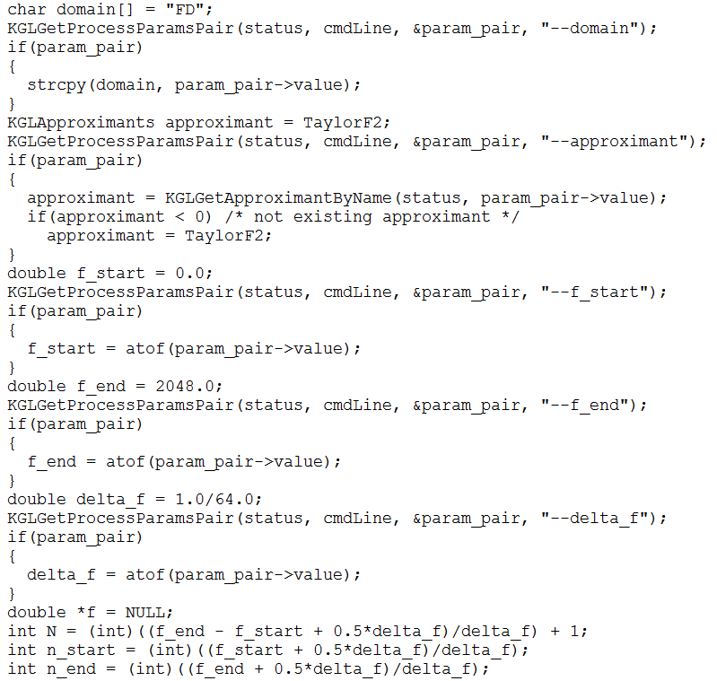
Set appropriate variables 1

Slide 15
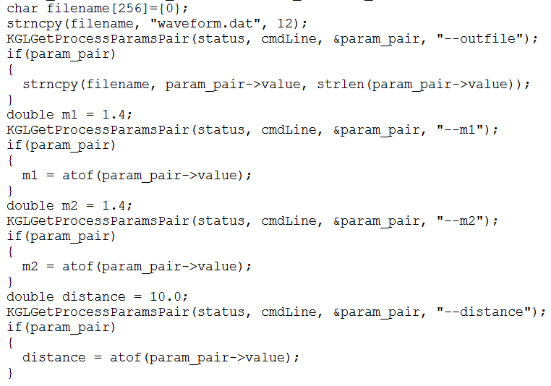
Set appropriate variables 2

Slide 16
Allocate memories
KGLWaveformModelParams structure has values in SI unit
KGLSetComponentMasses : set masses given in solar unit and set also chirp mass and eta
KGLSetDistance : set distance given in Mpc unit
defined in /kagali/waveform/src/KGLWaveformModelParams.c

Slide 17
Generate waveform and save

Slide 18
Example run
run.sh script

Slide 19
Sample run output

Slide 20
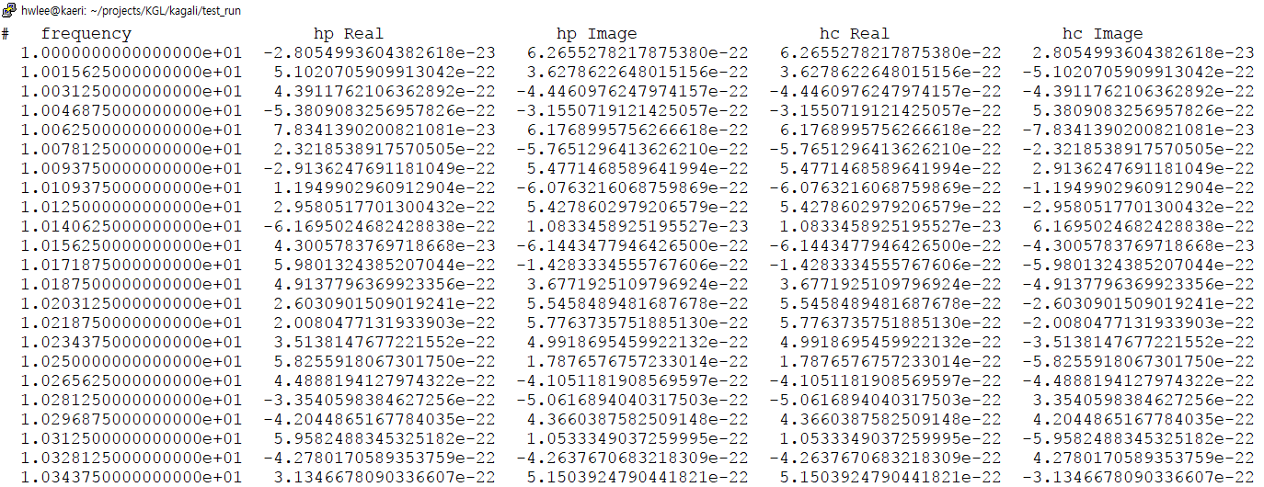
Sample output(waveform.dat)

Slide 21
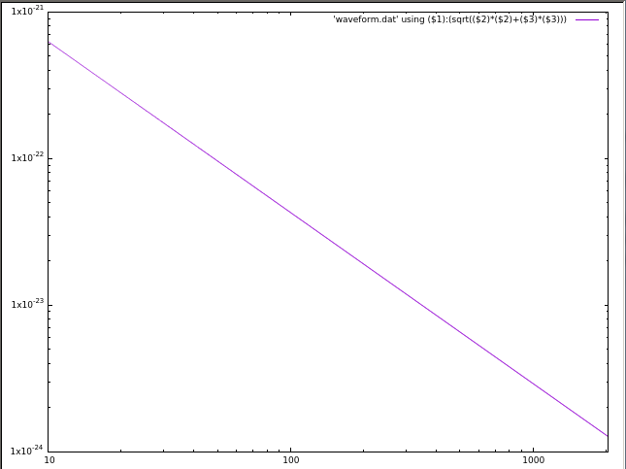

Slide 22
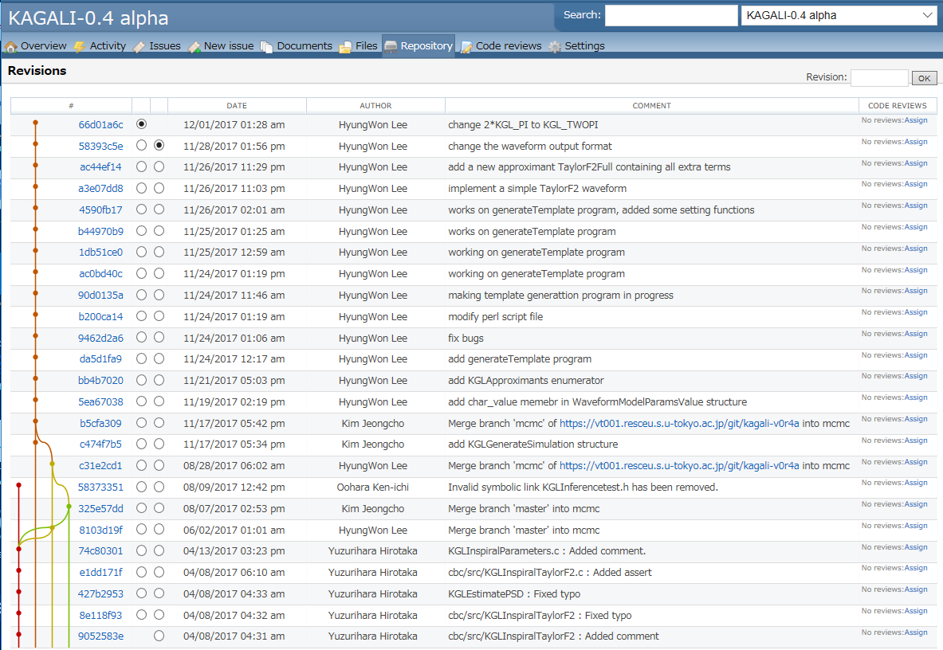
Repository Snapshot

Slide 23
What has been done
generateTemplate
Make a simple application to generate data for the given waveform

Slide 24
What to do
generateTemplate
Add options, --strain, --ifo K1/L1/H1/V1, --gps GPS
Generate strain data for given template at given observatory and time (Jeongcho will implement)
inferenceMCMC
Parallel tempering MCMC parameter estimation for CBC signal
Implementation for likelihood calculation
Likelihood function : Young-bok Bae will implement

Slide 25
Discussions

