Slide 1
Basic Data Type for KAGALI PE
By KGWG DAS team
Hyung Won Lee, Chunglee Kim, Yeong-Bok Bae, Jeongcho Kim
Date 20 Nov. 2017

Slide 2
Overall Idea
Use a single structure pointer passing to waveform function
Use a union data type containing all types of necessary data types for waveform calculation
Parameter estimation algorithm implementations and overall management : Hyung Won Lee and Chunglee Kim
Waveform implementation : Jeongcho Kim
Likelihood function implementation : Yeong-Bok Bae
All other necessary functions : all of us based on the necessity

Slide 3
KGLWaveformModelParamsType
Defined in KGLWaveformModelParams.h.in
Role
Enumerator for all possible data types
Currently defined data types
char, int, int64, uint, uint64, float, double, double complex, string(char *), void pointer

Slide 4
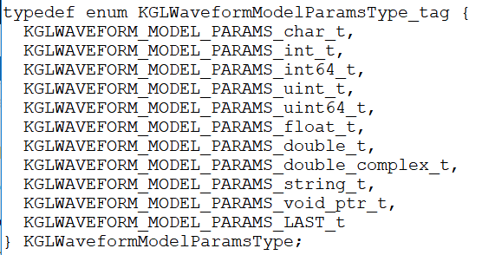
KGLWaveformModelParamsType

Slide 5
KGLWaveformModelParamsValue
Defined in KGLWaveformModelParams.h.in
Role
Unified a single data type for waveform model parameter values
Currently defined field values
char_value, string_value, int64_value, uint_value, uint64_value, float_value, double_value, double_complex_value, void_ptr_value

Slide 6
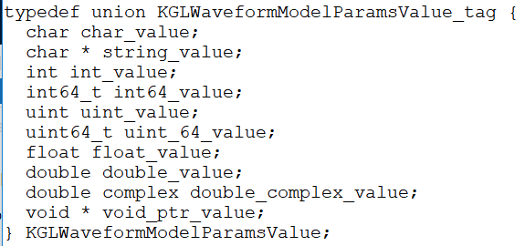
KGLWaveformModelParamsValue

Slide 7
KGLWaveformModelParamsIndex
Defined in KGLWaveformModelParams.h.in
Role
Index for physical parameters in parameter array
Currently defined field values

Slide 8
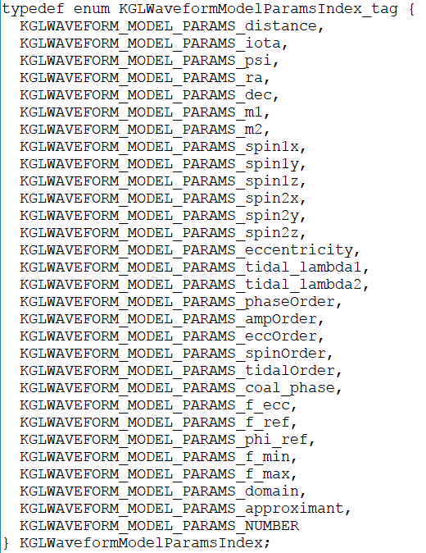
KGLWaveformModelParamsIndex

Slide 9
KGLWaveformModelParamsItem
Defined in KGLWaveformModelParams.h.in
Role
Actual parameter value and name
Currently defined field values

Slide 10
KGLWaveformModelParams
Defined in KGLWaveformModelParams.h.in
Role
Array of all parameters
Currently defined field values

Slide 11
Waveform function pointers
KGLFDWaveform
KGLFDWaveformArray
Defined in KGLWaveforms.h.in

Slide 12
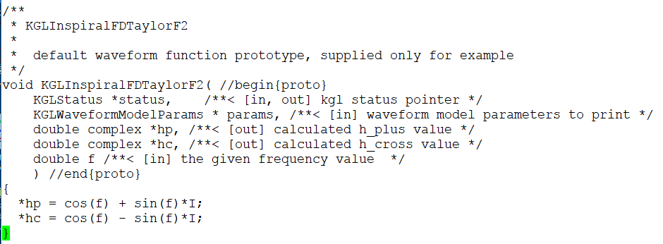
KGLInspiralFDTaylorF2
KGLInspiralFDTaylorF2.c

Slide 13
What to do
generateTemplate
Make a simple application to generate data for the given waveform
Possibly useful for search pipeline
Generate temple banks
inferenceMCMC
Parallel tempering MCMC parameter estimation for CBC signal
Minimum implementation of lalsuite
Include only one wave for inspiral TaylorF2 including extended parameters, eccentricity, tidal, etc.

Slide 14
Discussions
how to utilize data read lib and a waveform lib from inference lib

