Slide 1











Development of frequency dependent squeezing for future upgrades of KAGRA
K. Arai, Y. Aso, M. Barsuglia, E. Capocasa, M. Eisenmann, R. Flaminio, Y. Guo, M. Leonardi, M. Marchiò, L. Pinard, P. Prat, R. Schnabel,
K. Somiya, M. Tacca, R. Takahashi, D. Tatsumi
KAGRA F2F Toyama - 2017 August 30th

Slide 2
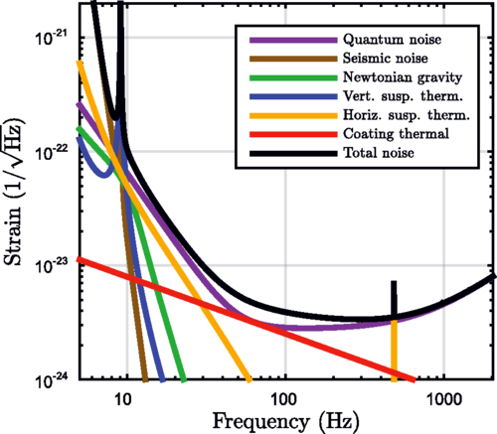
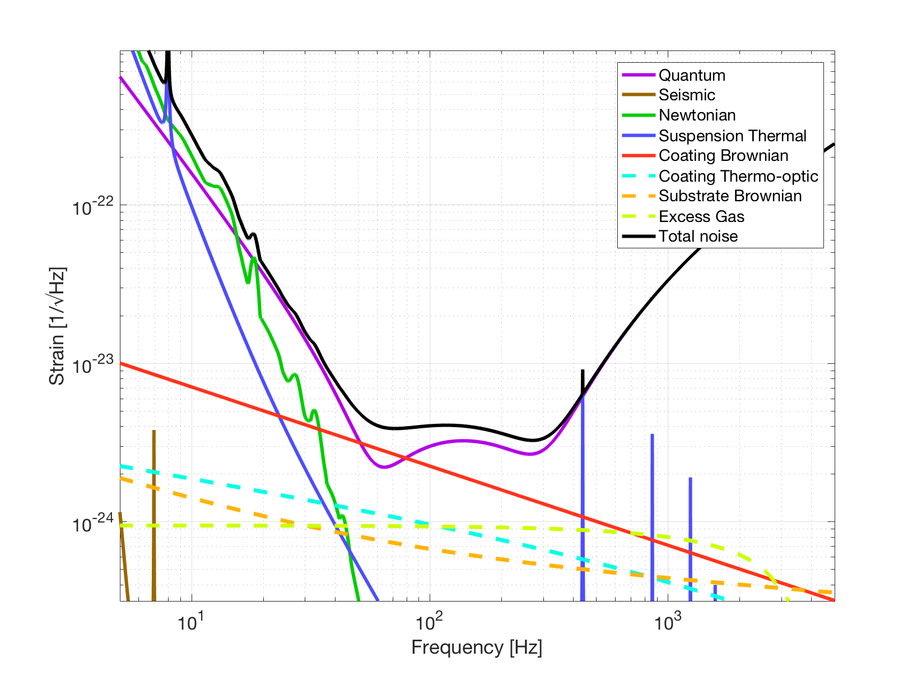
Motivations
Second generation gravitational-wave interferometers sensitivity limited by quantum noise over a large fraction of the frequency bandwidth (KAGRA even more than Virgo and LIGO due to cryogenic operations).
KAGRA
aLIGO
AdV

Slide 3
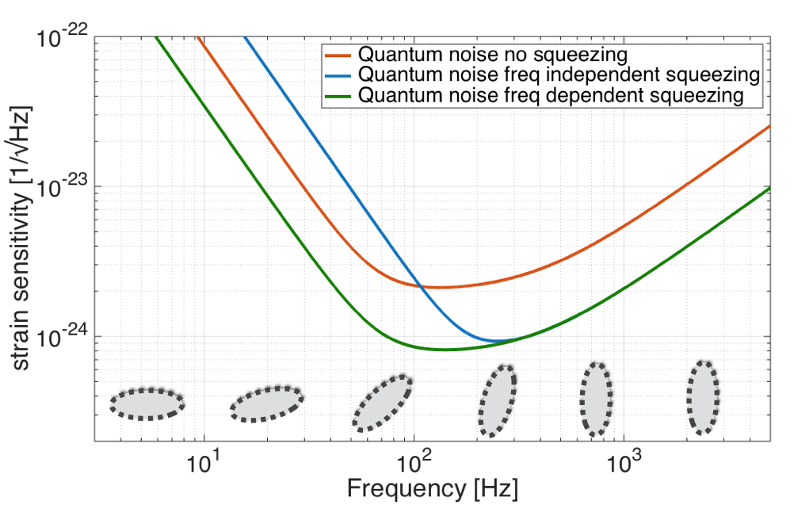
Context
Operation with squeezed light demonstrated with GEO [1] and LIGO [2].
BUT squeezed light increases radiation pressure at low frequencies.
Need for frequency dependent squeezing (now included in the upgrade plans for Advanced LIGO and Advanced Virgo)
- Frequency dependent squeezing demonstrated first in the MHz region [3] and recently in the kHz bandwidth [4]
[1] H. Grote et al., Phys. Rev. Lett. 110, 2013 - [2] LSC, Nature Photonics 7, 2013 - [3] S. Chelkowsky et al., Phys. Rev. A 71, 2005 [4] E. Oelker et al., Phys. Rev. Lett. 116, 2016

Slide 4
Filter Cavity Optical Design
Squeezing ellipse rotation at a frequency of 70 Hz [5]
9 dB vacuum squeezed source
300 m length
Study of the mirrors flatness requirements: target 80 ppm of round trip losses (losses less important for longer cavities)
[5] E. Capocasa et al., Phys. Rev. D 93, 2016 - [6] P. Kwee et al., Phys. Rev. D 90, 2014

Slide 5
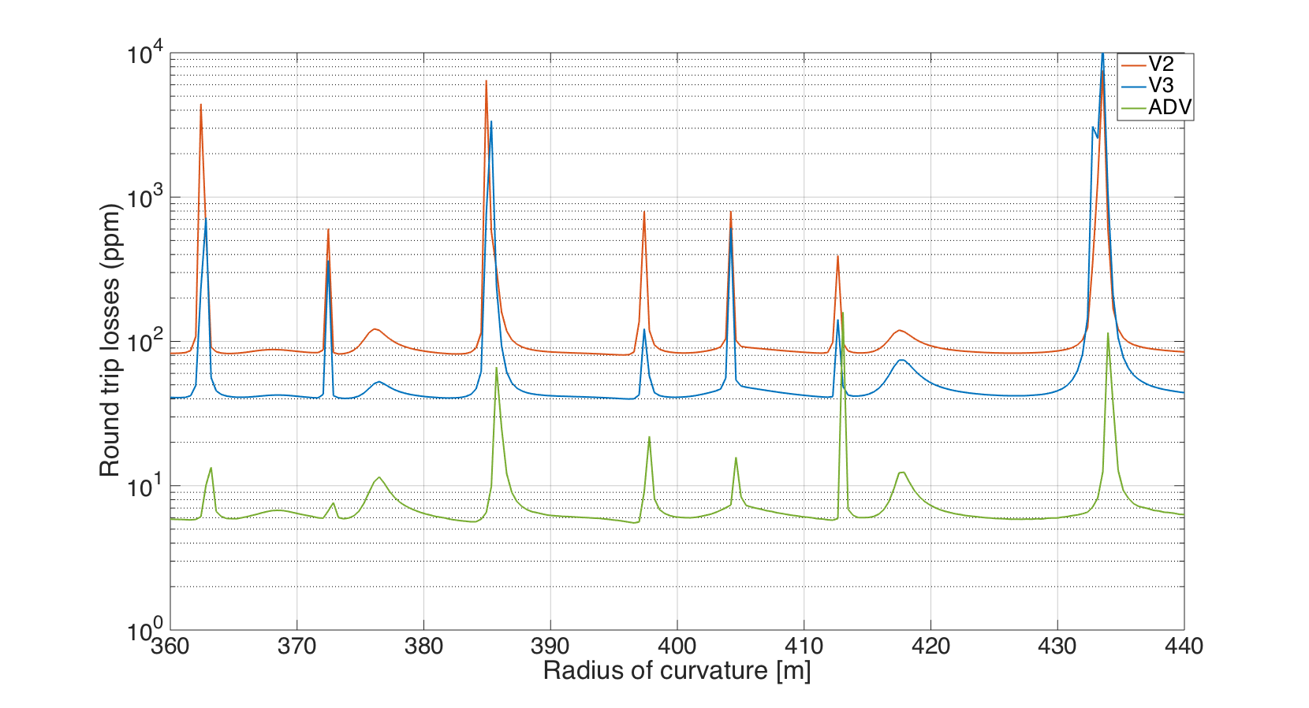
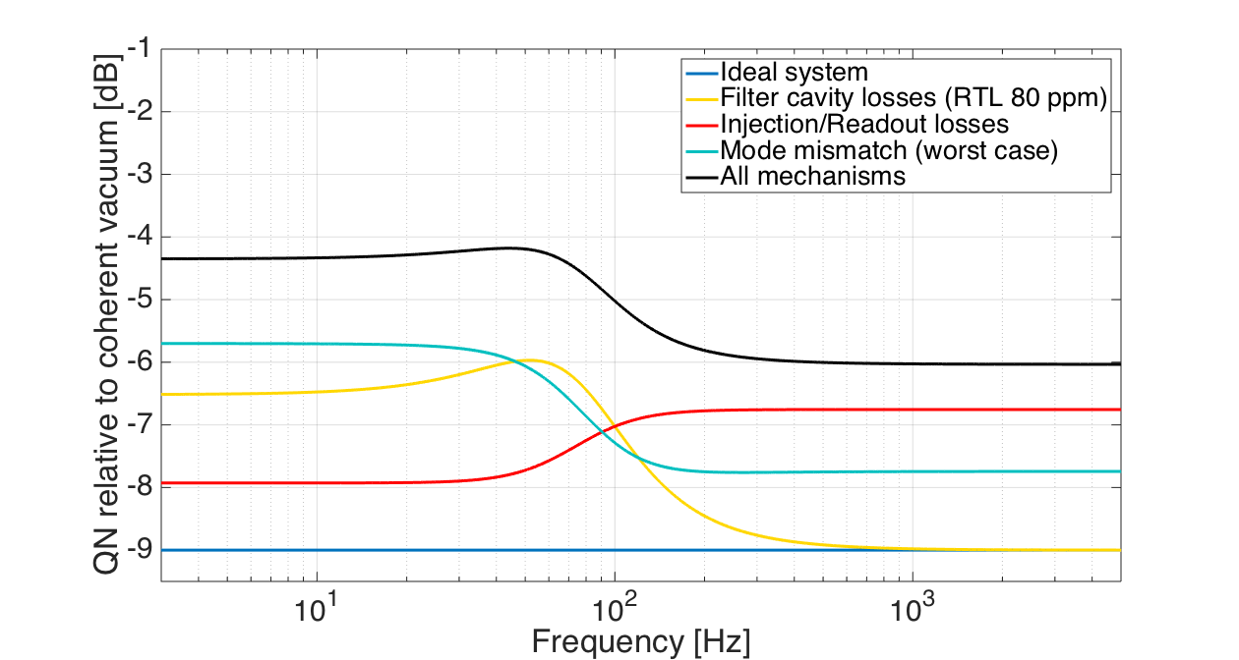
Filter Cavity Optical Design
Squeezing ellipse rotation at a frequency of 70 Hz [5]
9 dB vacuum squeezed source
300 m length
Study of the mirrors flatness requirements: target 80 ppm of round trip losses (losses less important for longer cavities)
Squeezing degradation budget [6]
80 ppm
41 ppm
5.7 ppm
RMS
[nm]
RMS
[nm]
RMS
[nm]
diameter[m]
0.05 | 1.23 | 1.36 | 0.27
0.01 | 0.81 | 0.53 | 0.18
diameter[m]
[5] E. Capocasa et al., Phys. Rev. D 93, 2016 - [6] P. Kwee et al., Phys. Rev. D 90, 2014

Slide 6
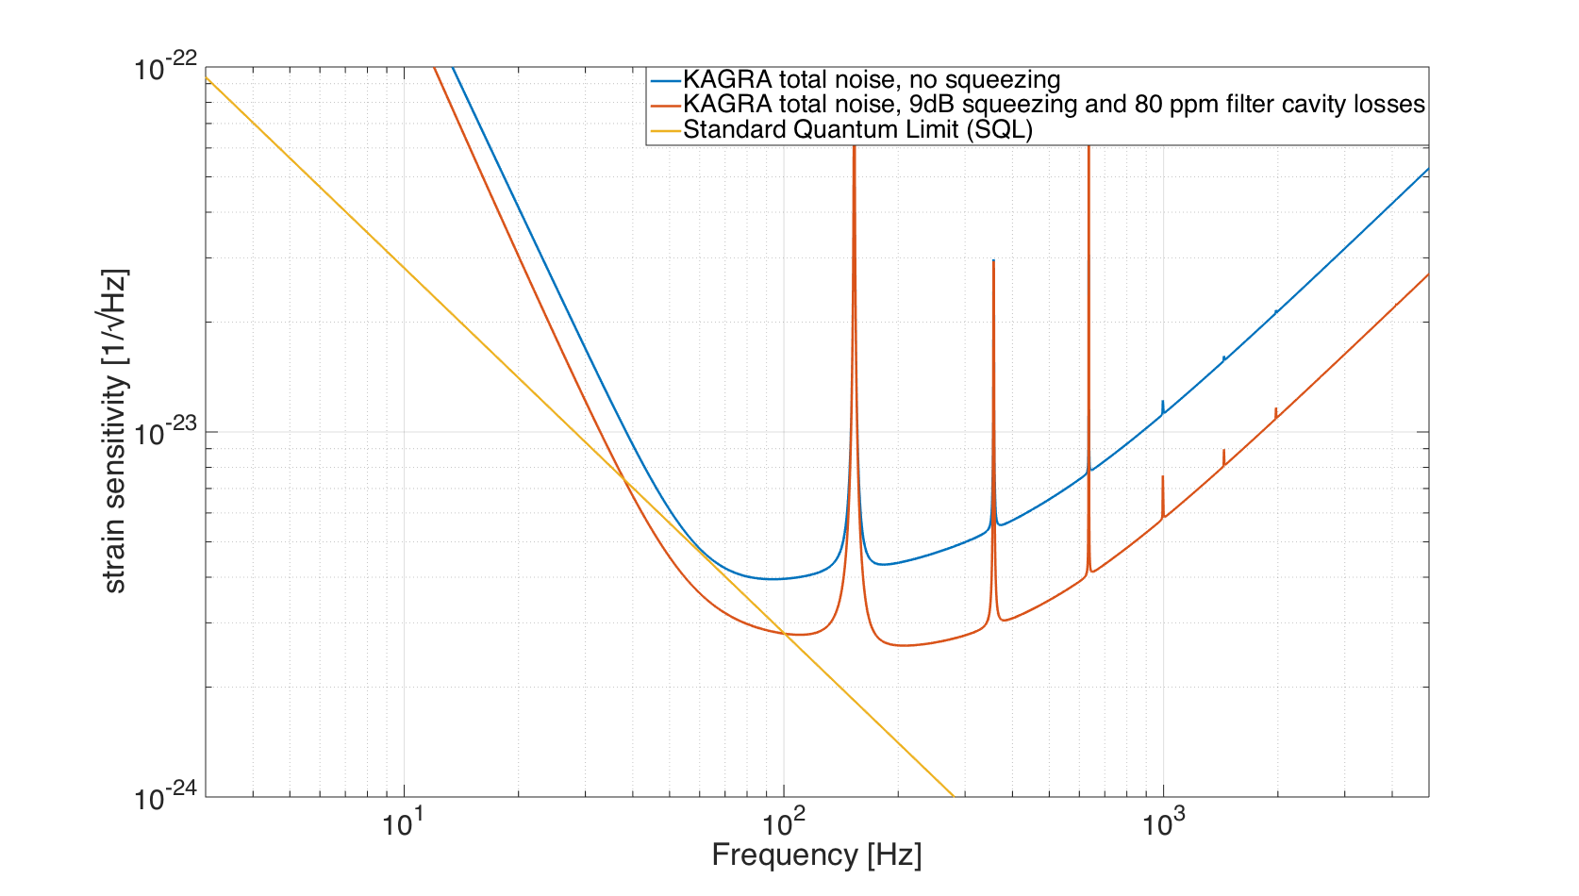
Impact on the KAGRA Sensitivity

Slide 7
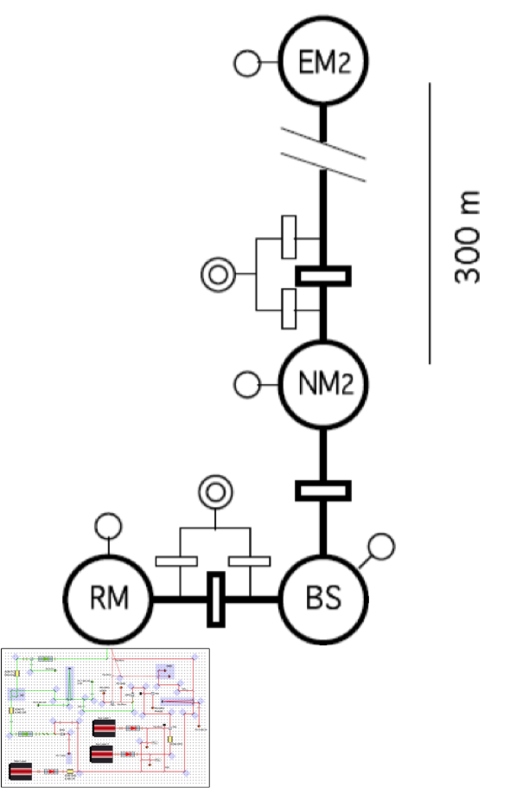
Frequency dependent squeezing @ NAOJ
300 m Filter Cavity
- TAMA infrastructure unused after the big earthquake
- 300 m cavity length
- Interest in the NAOJ group
- Project approved in April 2015
- Use as much as possible of the TAMA infrastructure and equipment
Faraday Isolator, Mode-Matching & Folding Mirrors
Vacuum Squeezed Source

Slide 8
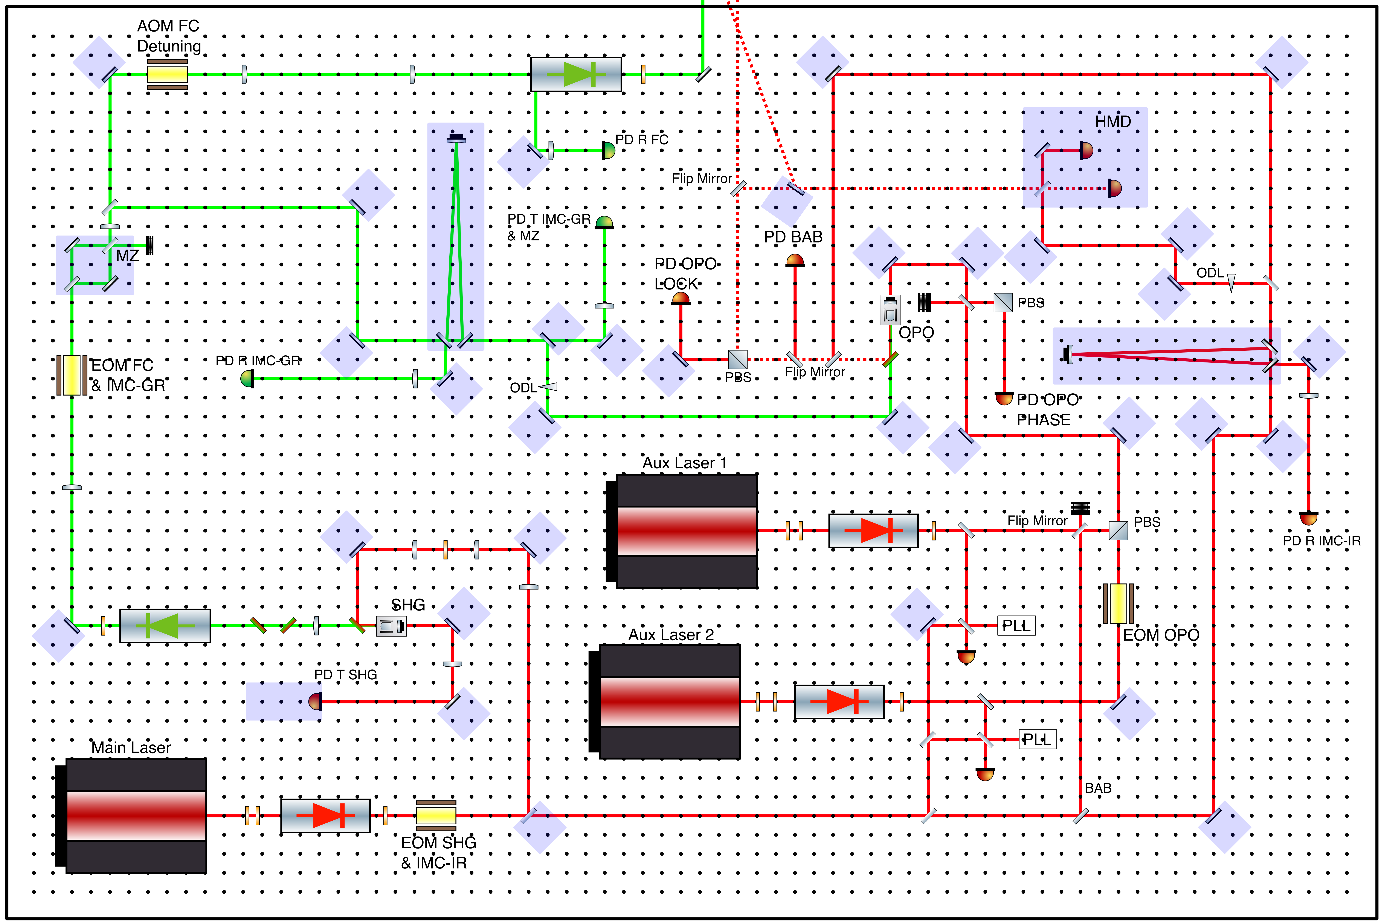
Vacuum Squeezed Source Layout
- Based on GEO and Advanced Virgo design
- Green beam from the SHG used to pump the OPO and to control the filter cavity

Slide 9
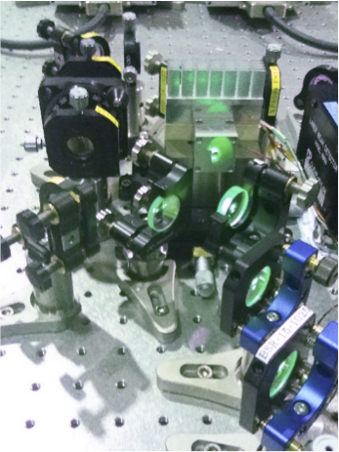
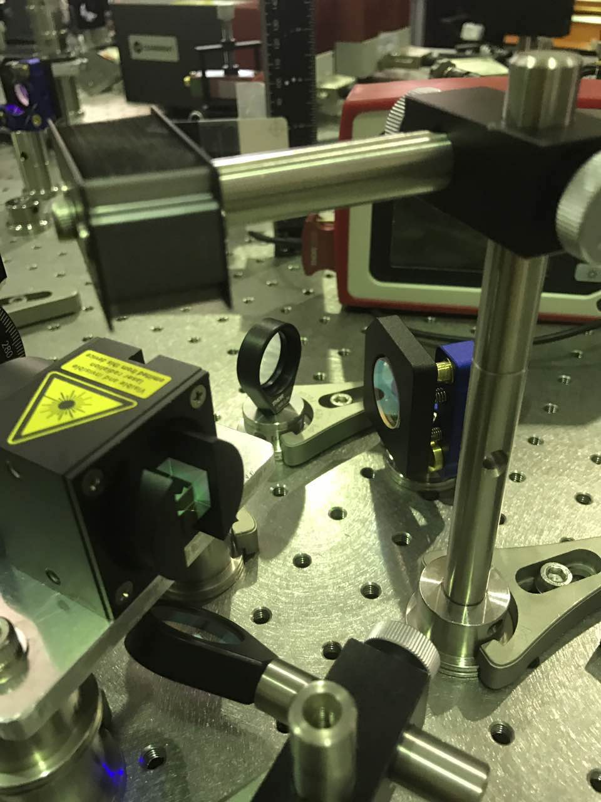
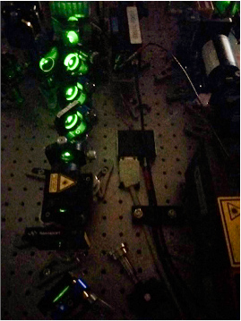
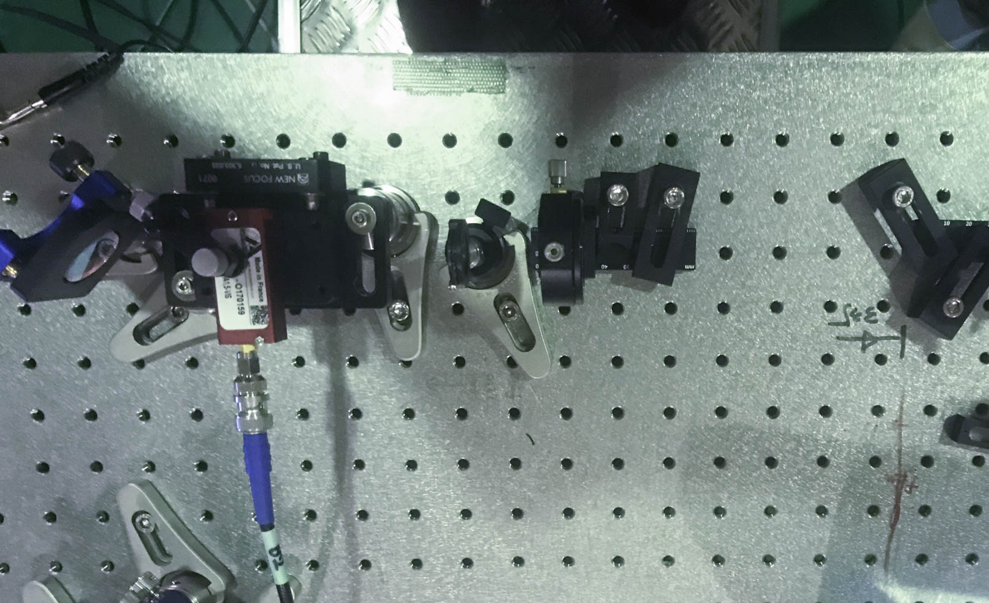
Vacuum Squeezed Source Layout
- Second Harmonic Generator (SHG) installed
- Optical components (mirrors, lenses, EOM, AOM, Faraday Isolator) of the beam path towards mode-matching telescope and the cavity installed
Green FI
Filter Cavity AOM
SHG
Filter Cavity FI

Slide 10
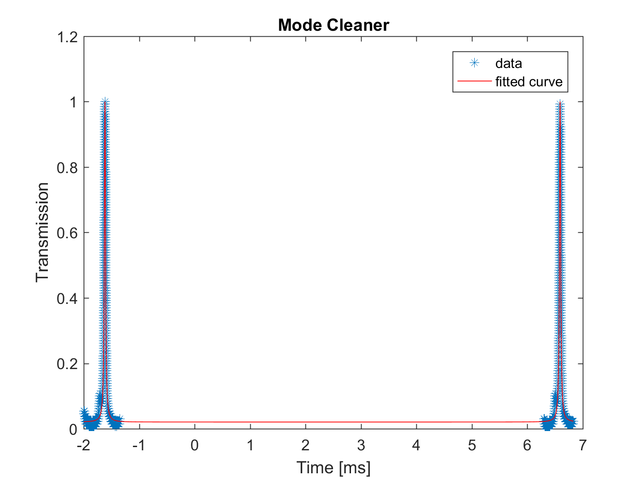
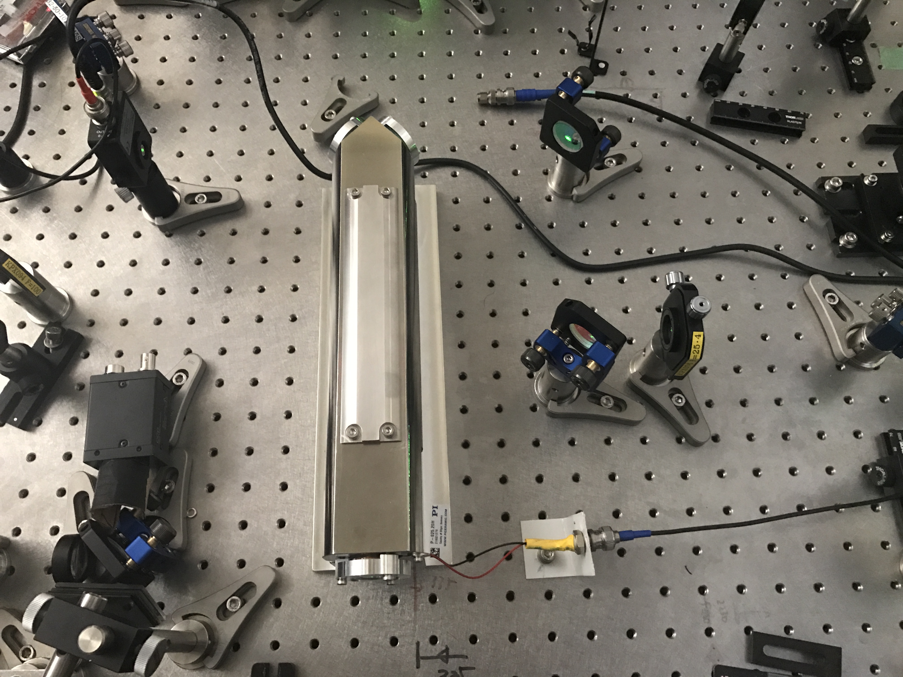
Vacuum Squeezed Source Layout
Green Mode Cleaner assembled and characterised:
first rough estimation of the finesse
design of the telescope for the matching in progress
Finesse
theoretical = 313-522
measured = 316

Slide 11
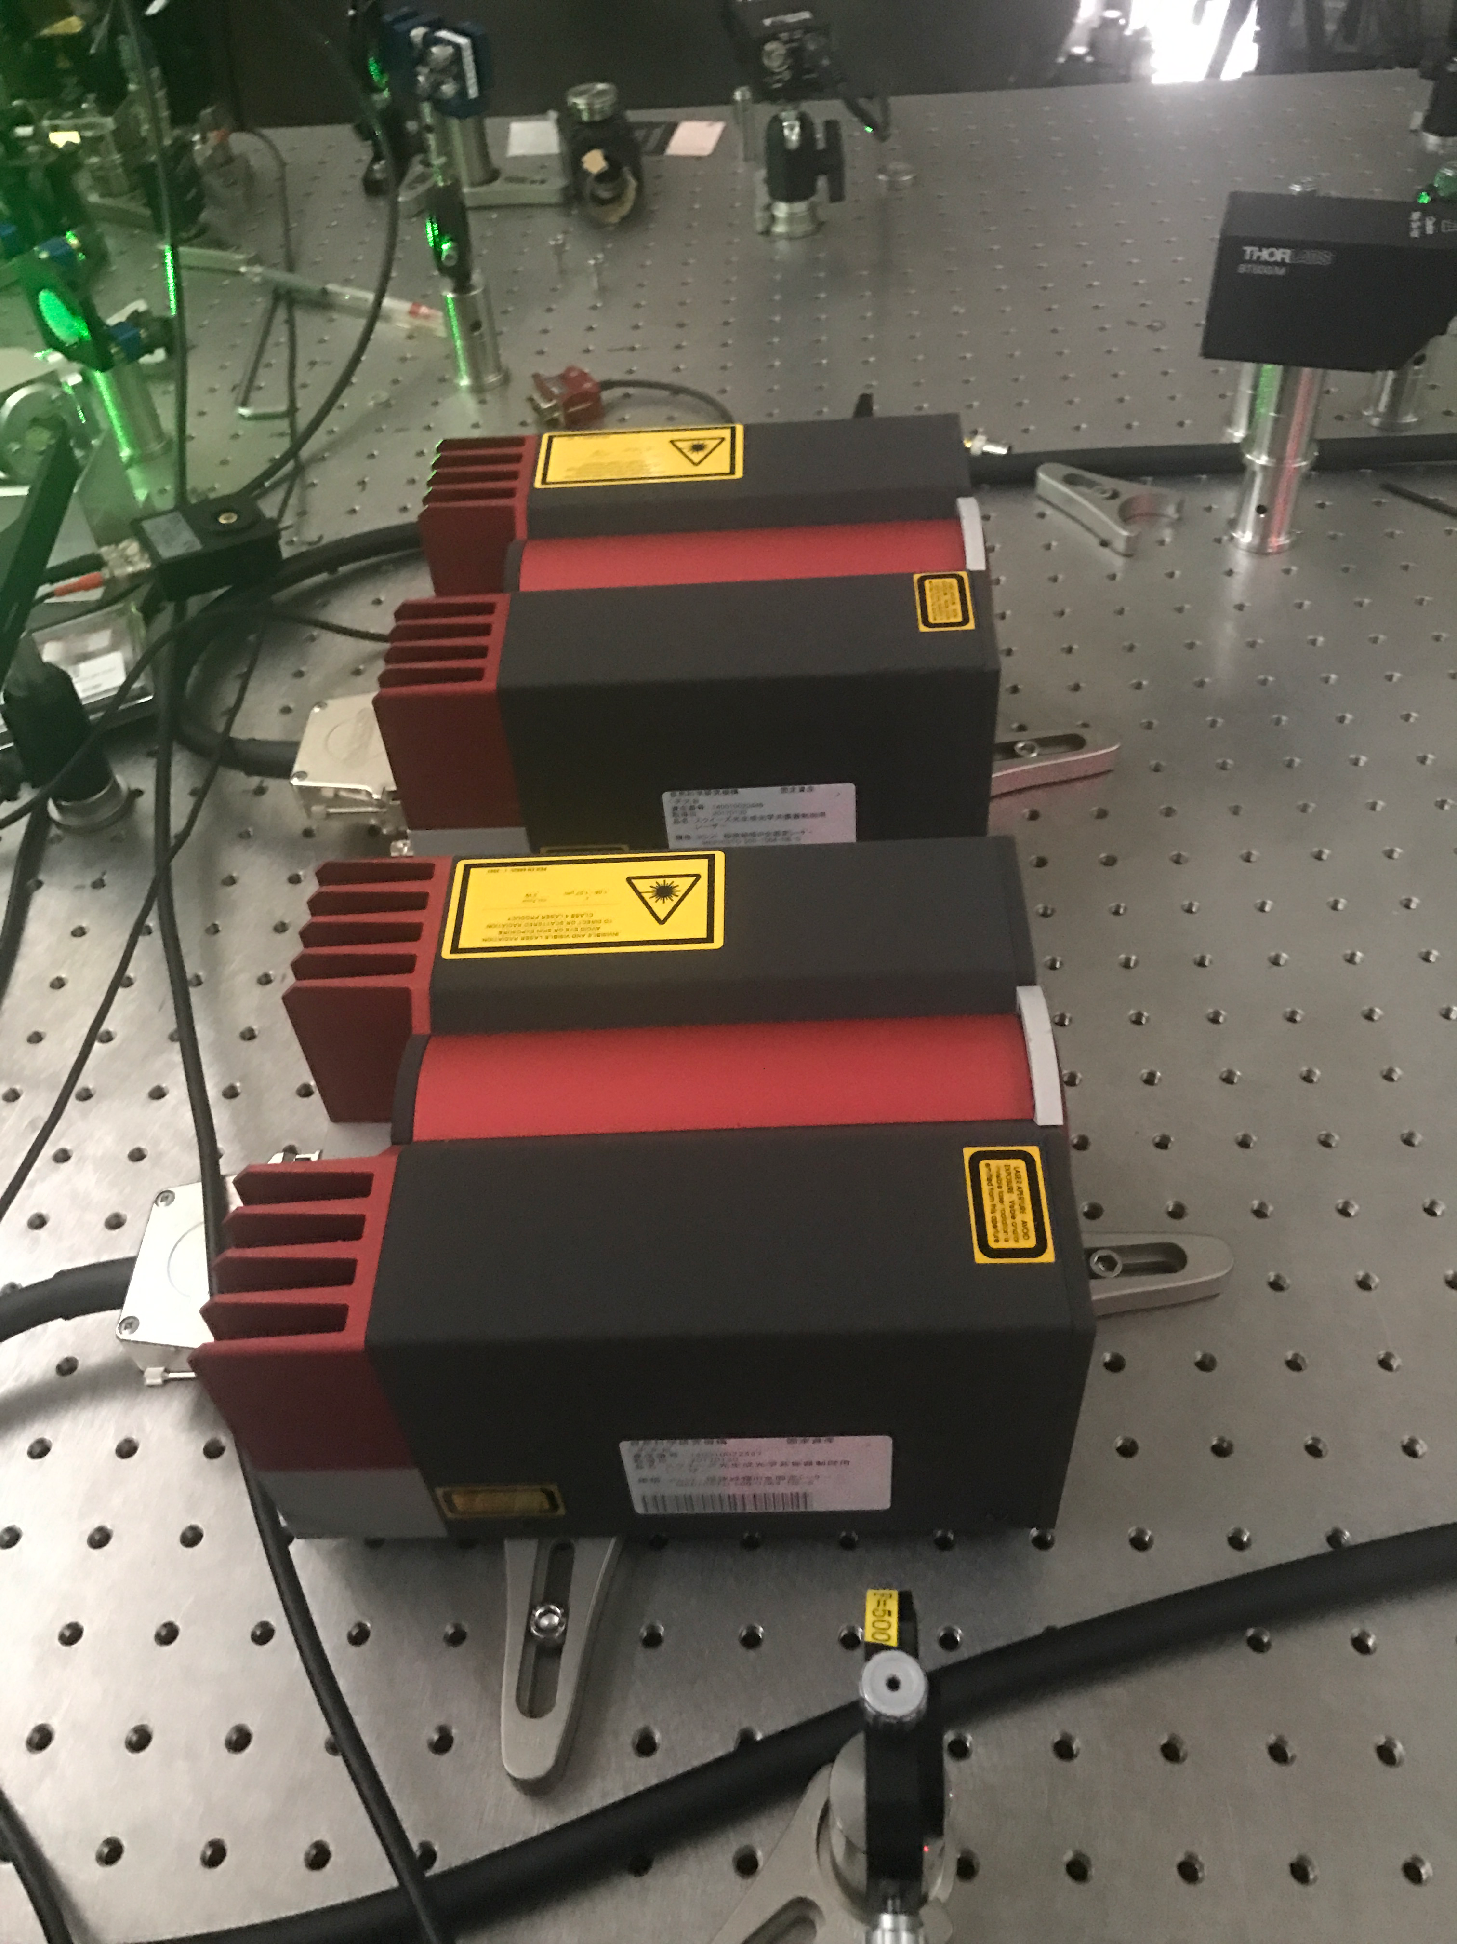
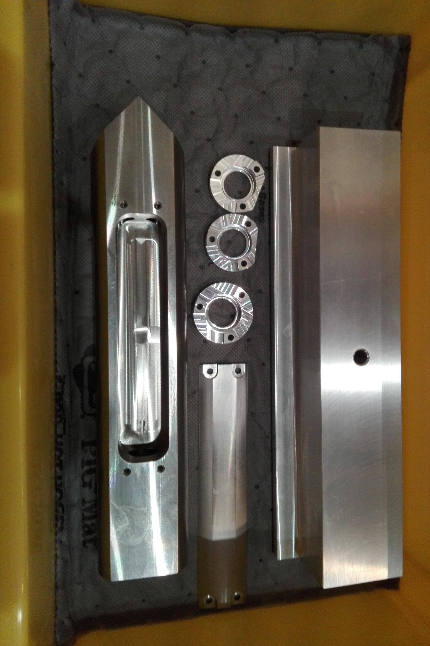
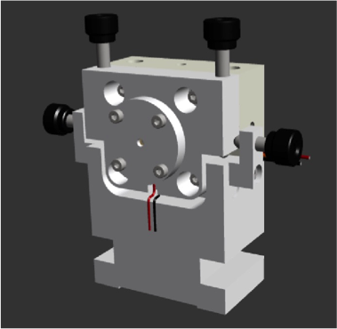
Vacuum Squeezed Source Layout
Infrared path:
lasers purchased
mode cleaner ready to be assembled and installed
OPO cavity mechanical components in production
PLL and Homodyne detector development and assembly to be done

Slide 12
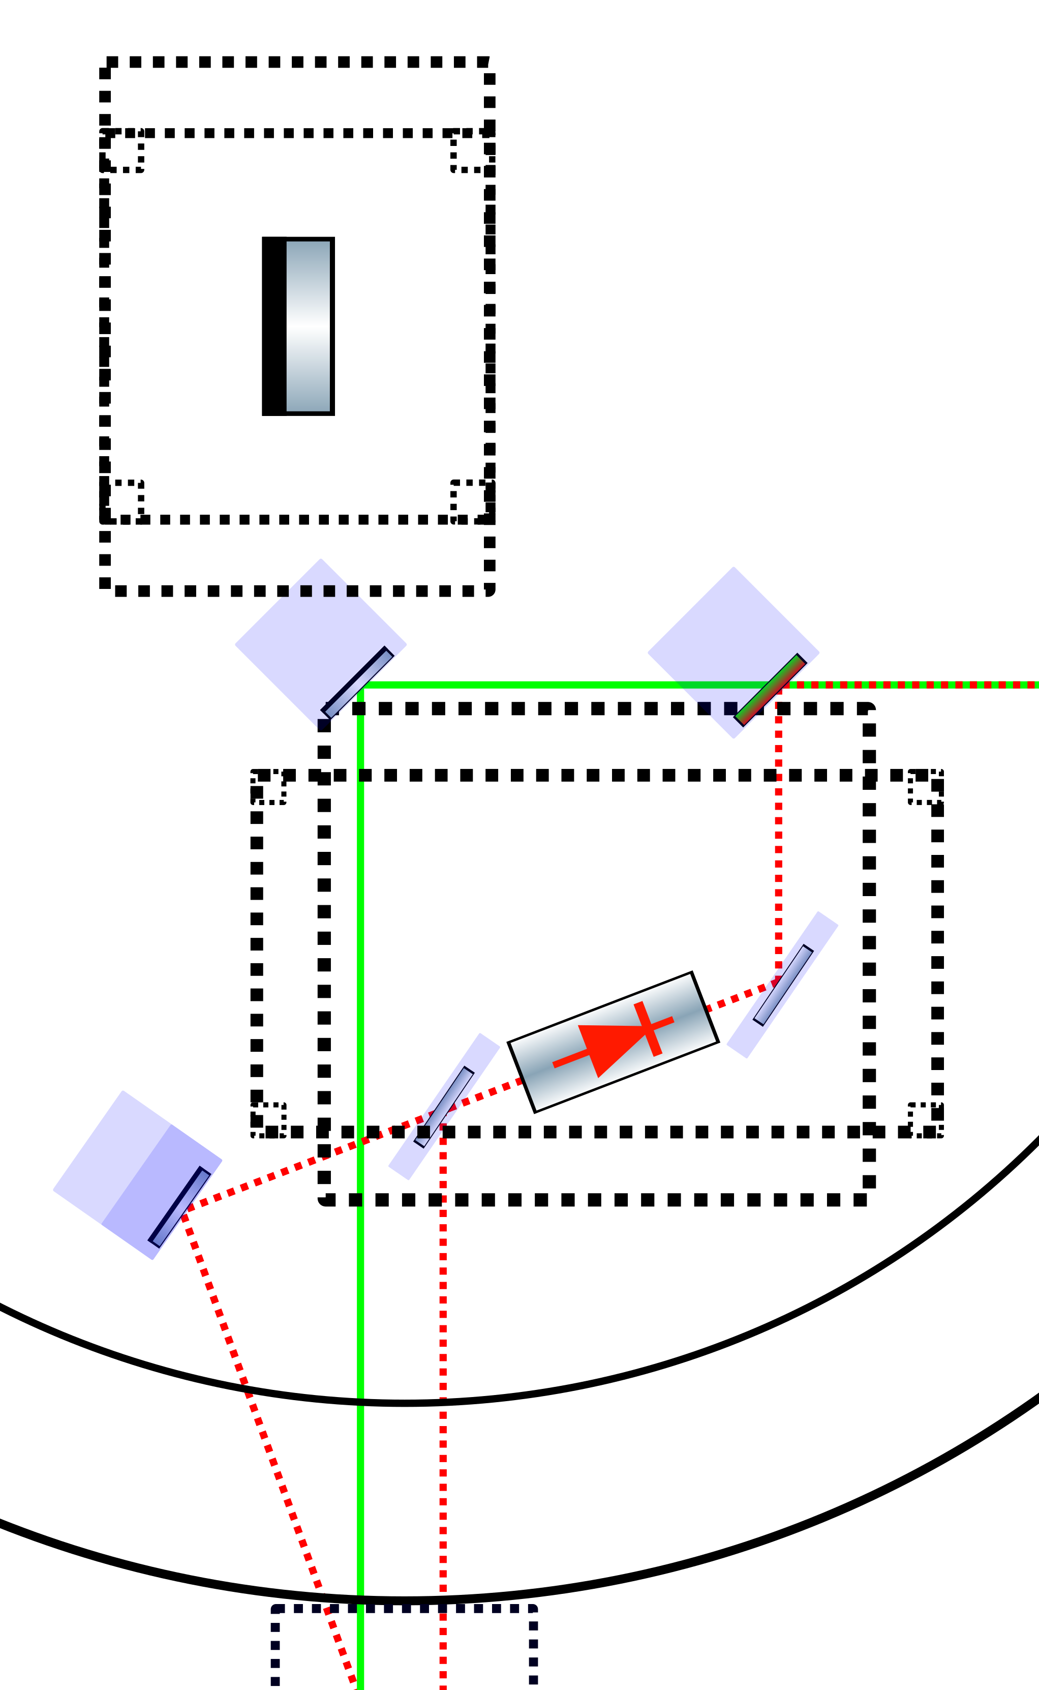
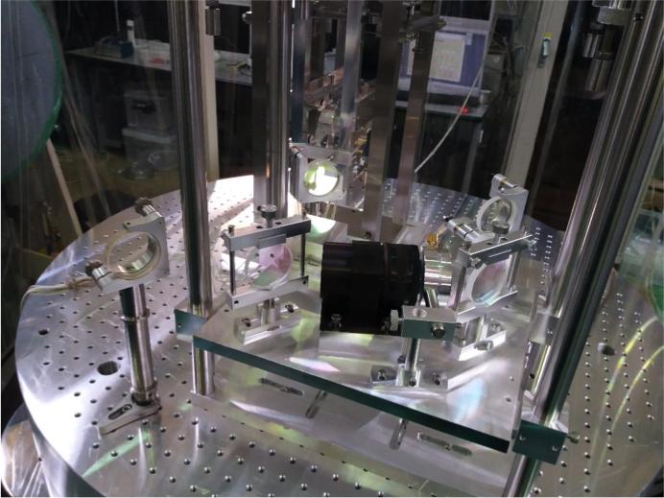
Faraday Isolator & Mode-Matching Telescope
Green and IR beams recombination
Faraday Isolator from TAMA

Slide 13
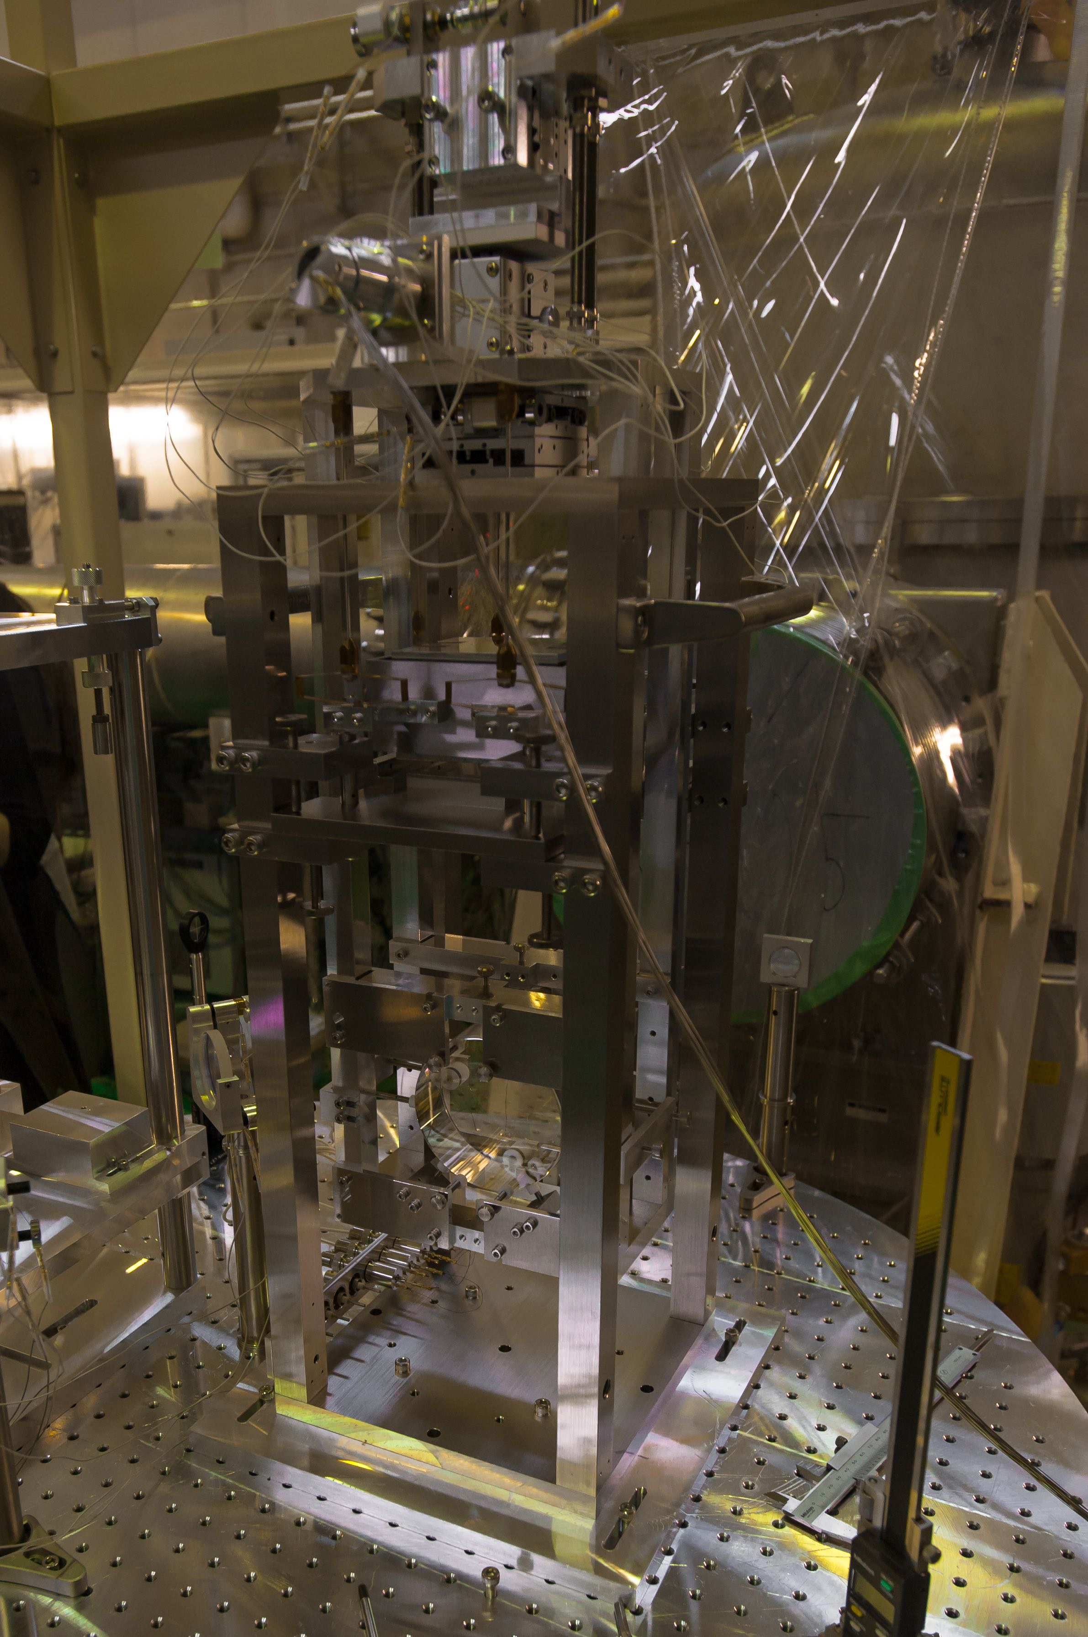
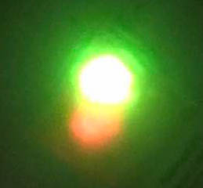
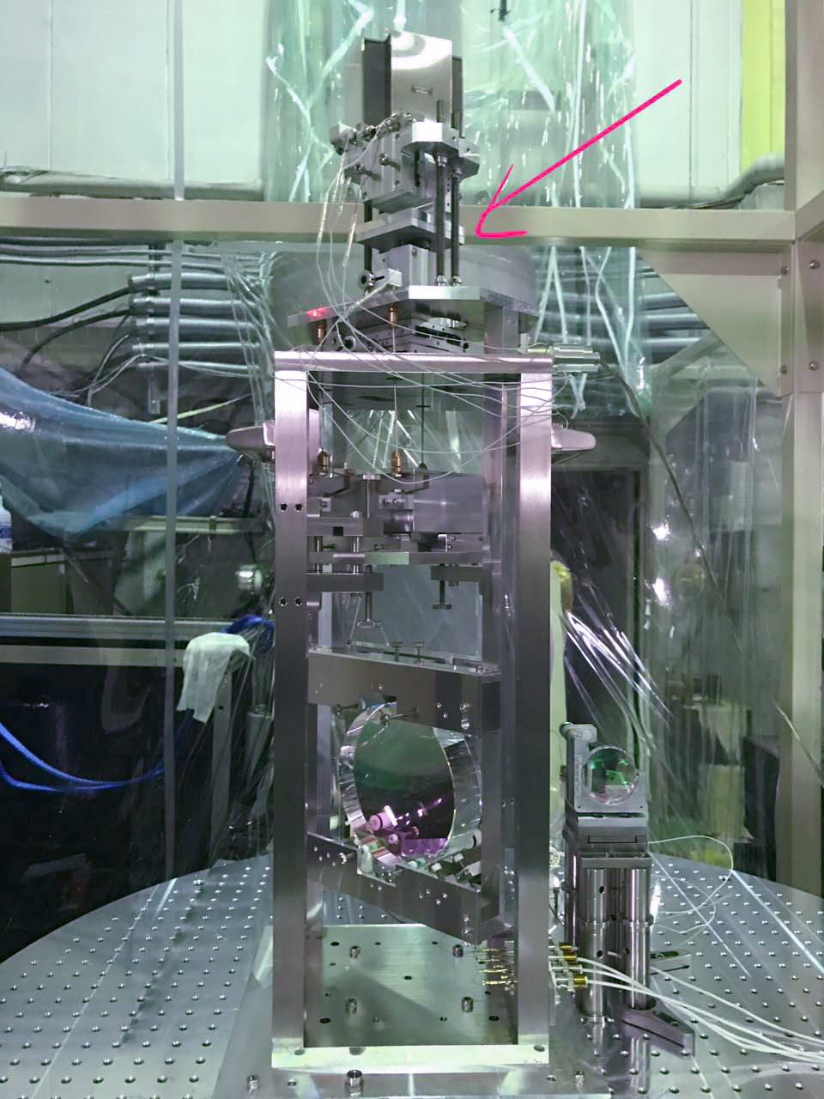
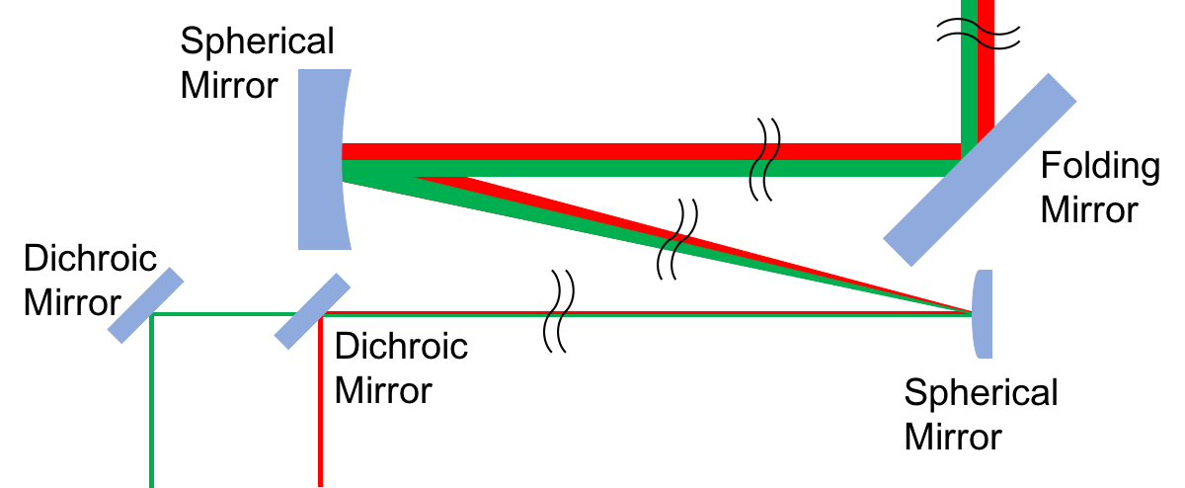
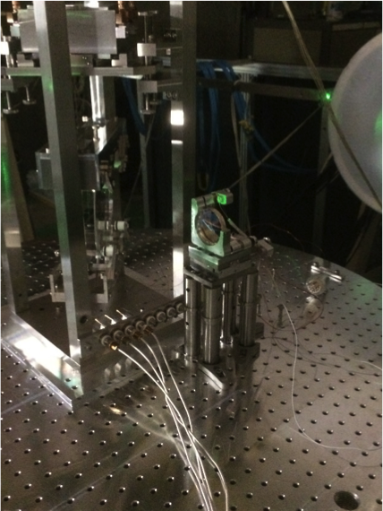
Faraday Isolator & Mode-Matching Telescope
@ 300 m

Slide 14
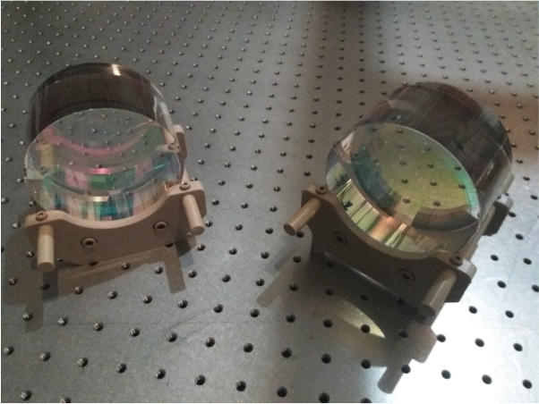
Filter Cavity Mirrors
Diameter = 10 cm
Thickness = 6 cm
Beam Radius ~ 1 cm
Dichroic coating: green for control and IR
IR Finesse = 4500
Green Finesse = 270

Slide 15
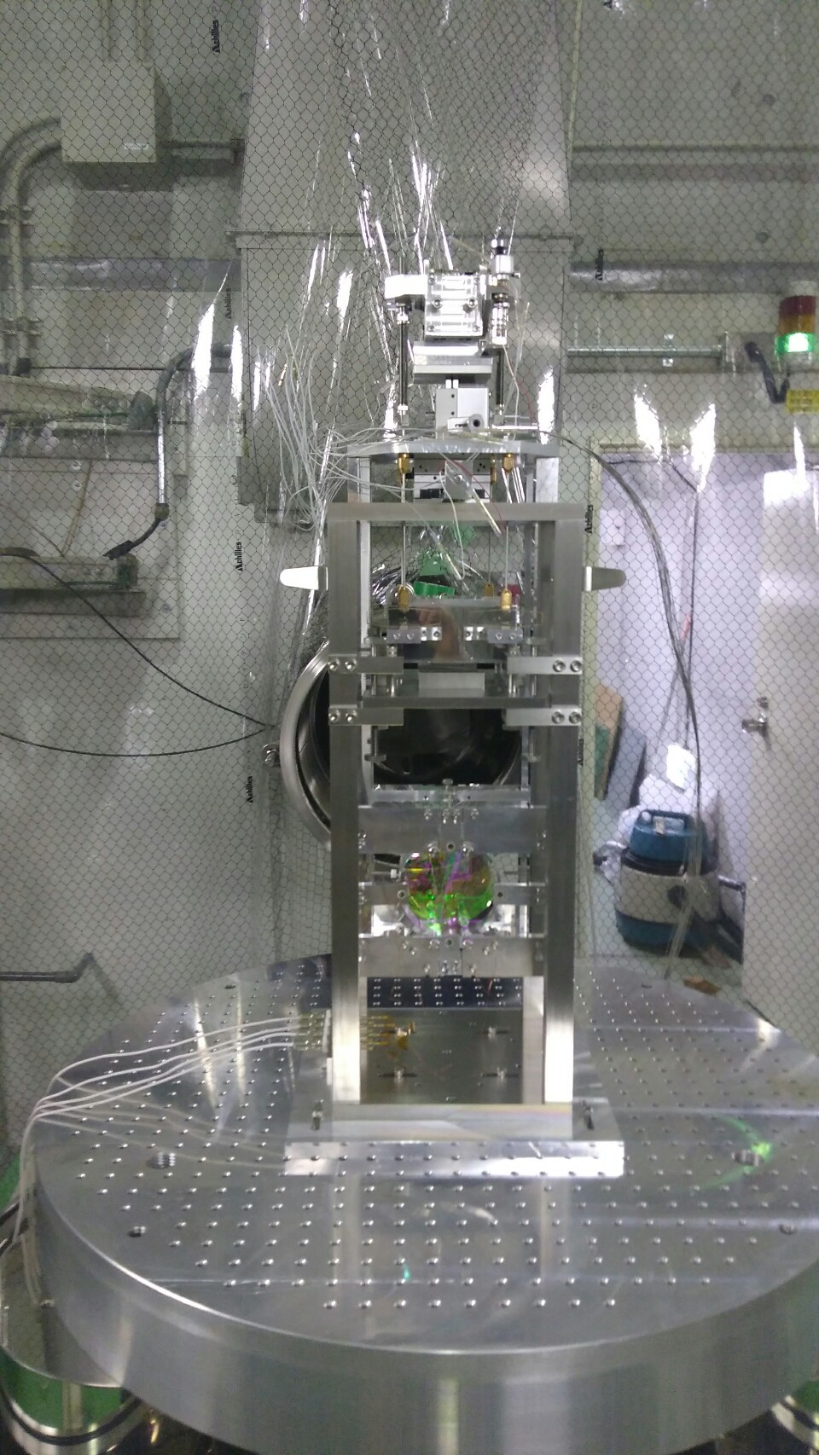
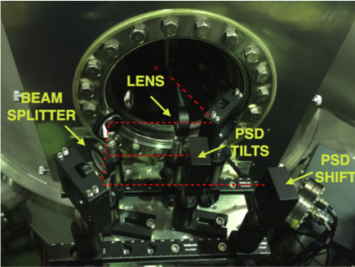
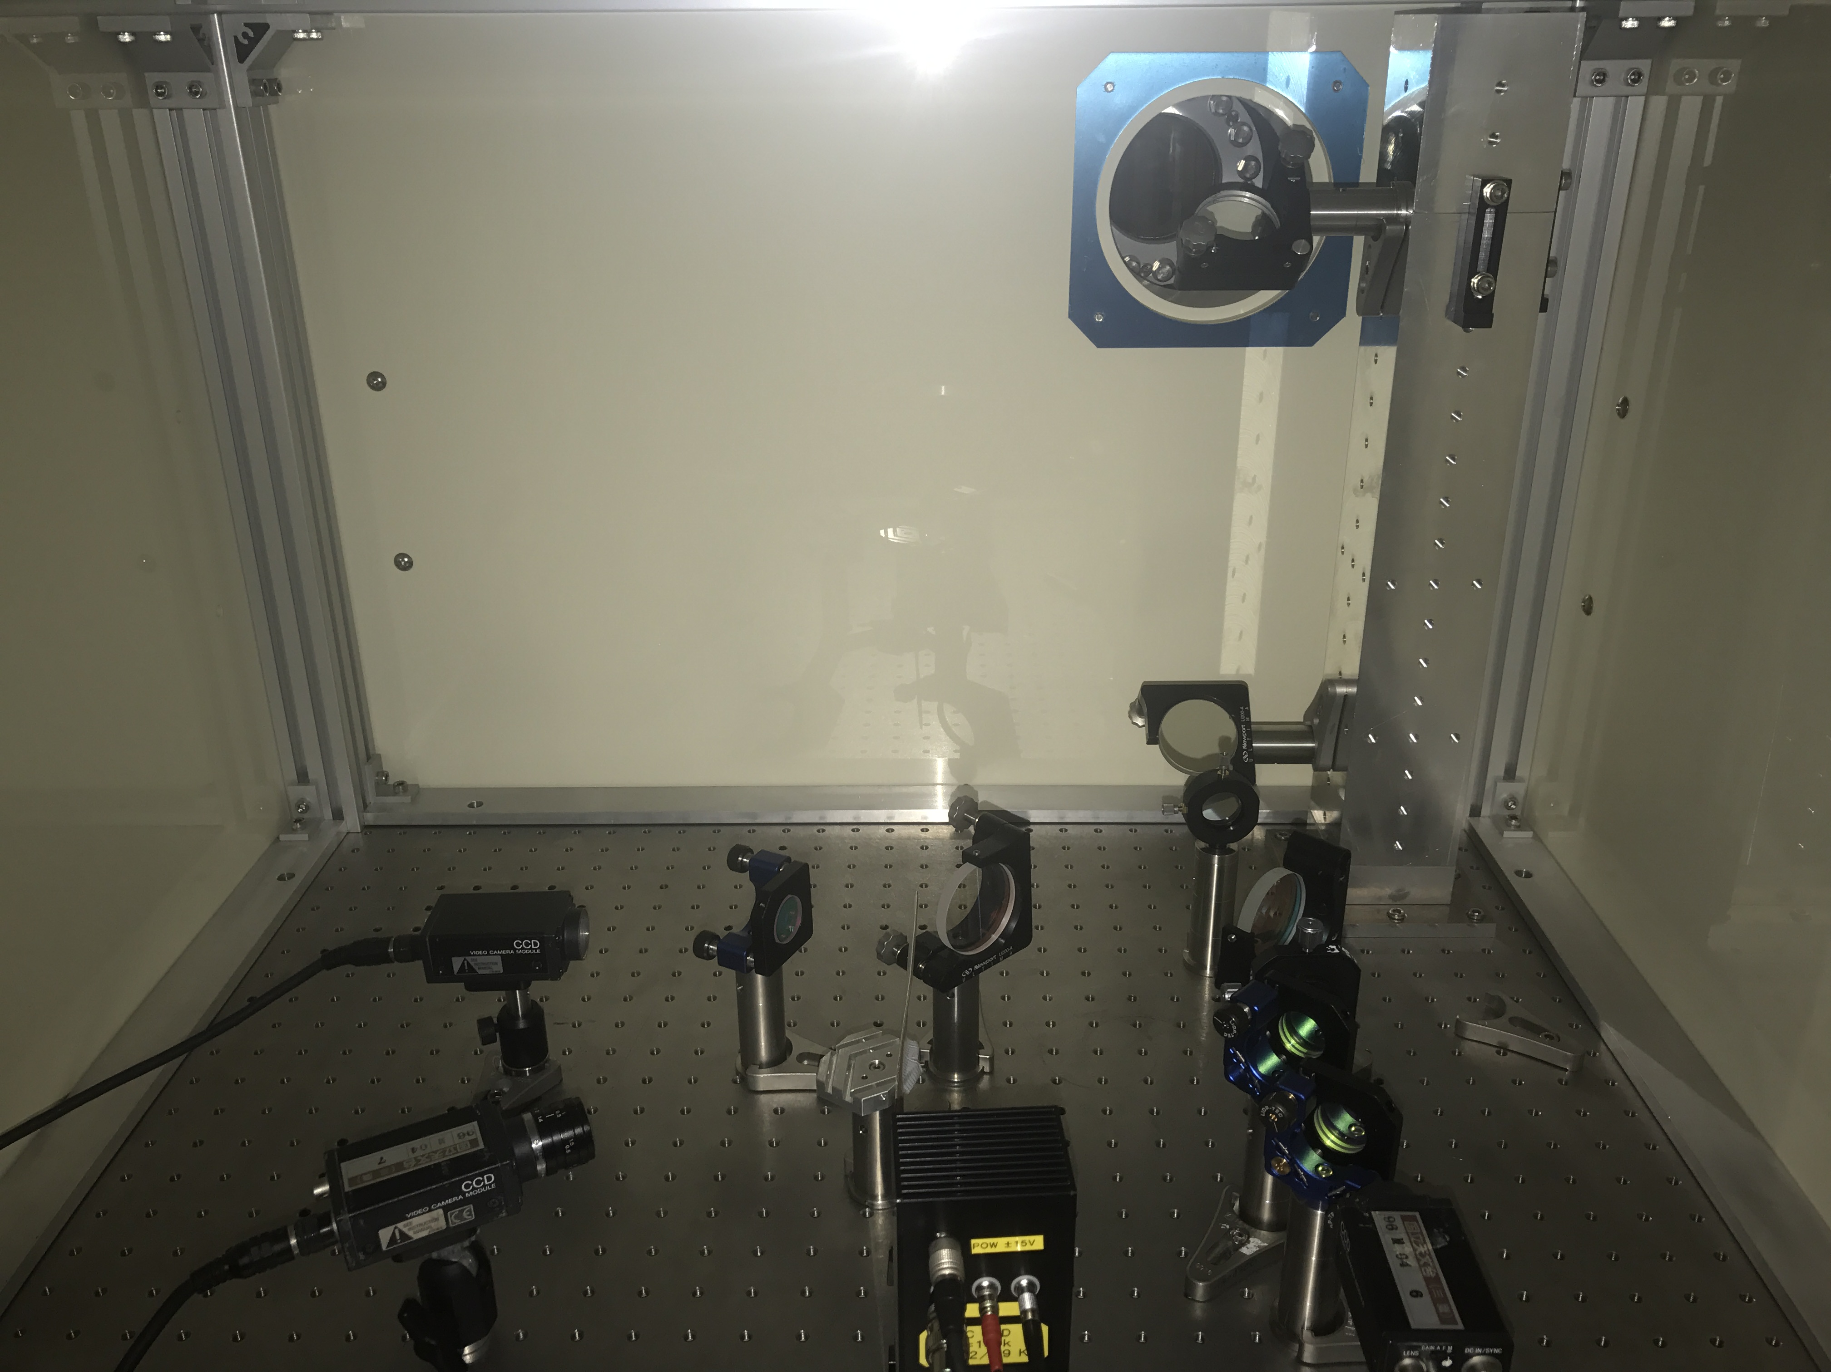
Filter Cavity
- Input and end mirrors suspended with double pendulum suspensions
- Virgo-like suspensions local control system installed
- Auxiliary optics installed
Suspension Control System
End Station Auxiliary Optics
Cavity End Mirror

Slide 16
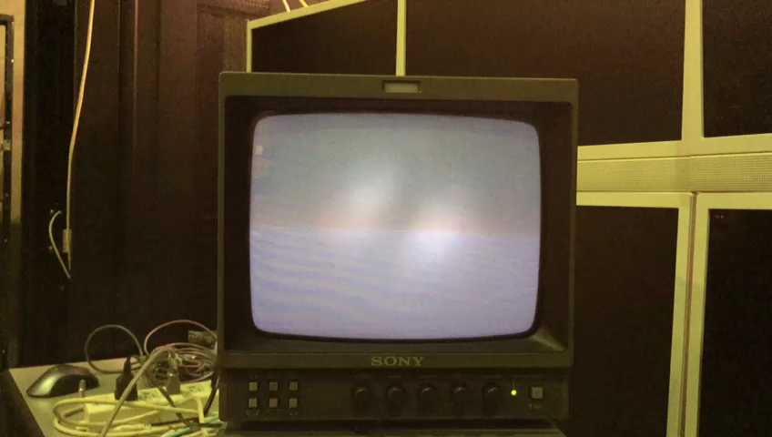
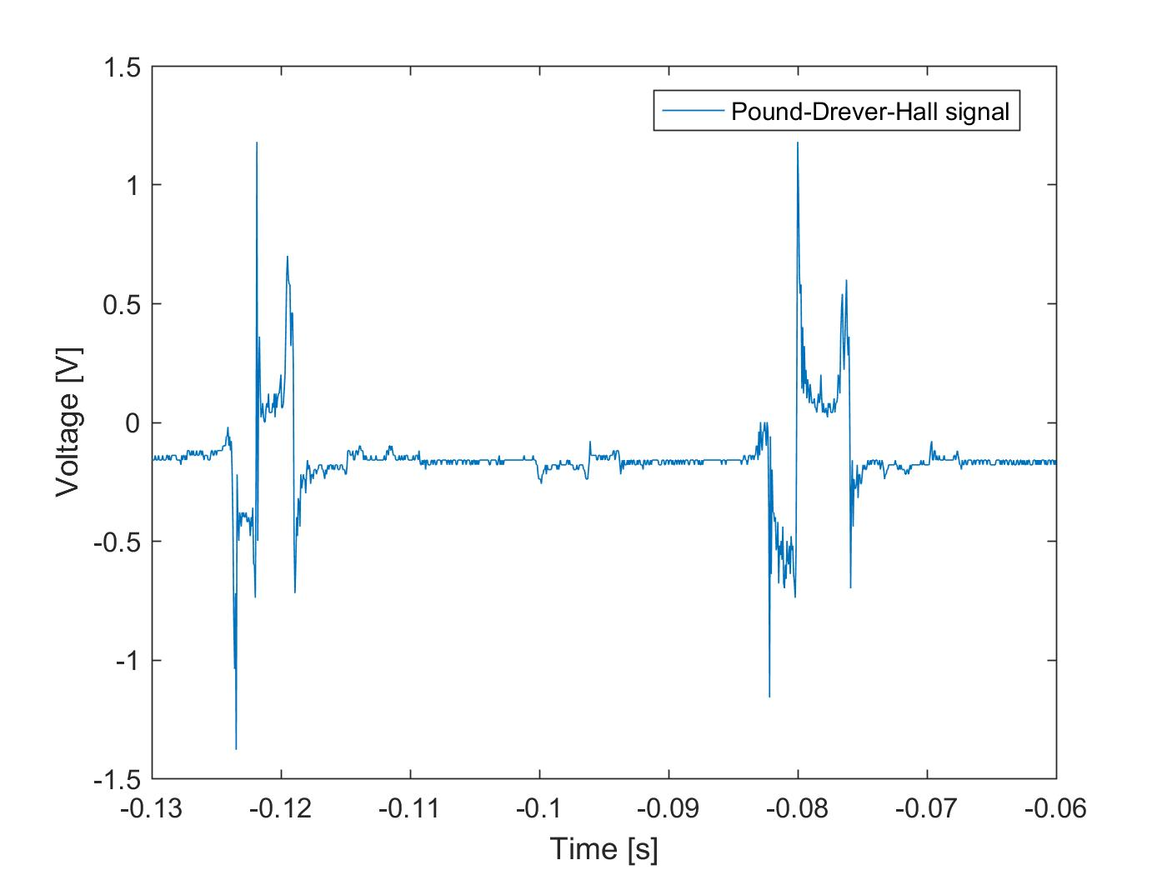
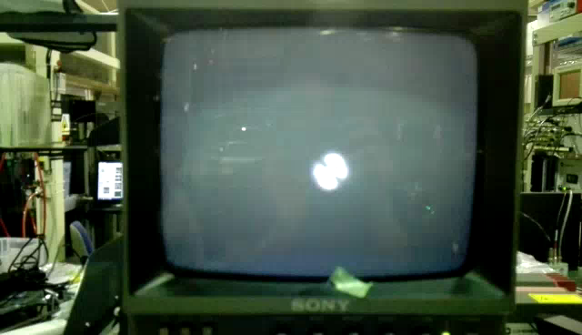
Filter Cavity
Vacuum in the cavity
Cavity controlled (aligned and locked) with the green beam
IR flashes superposed with the green ones
Cavity Transmitted Power
Cavity locking in green
PDH
IR flashes superposed with green

Slide 17
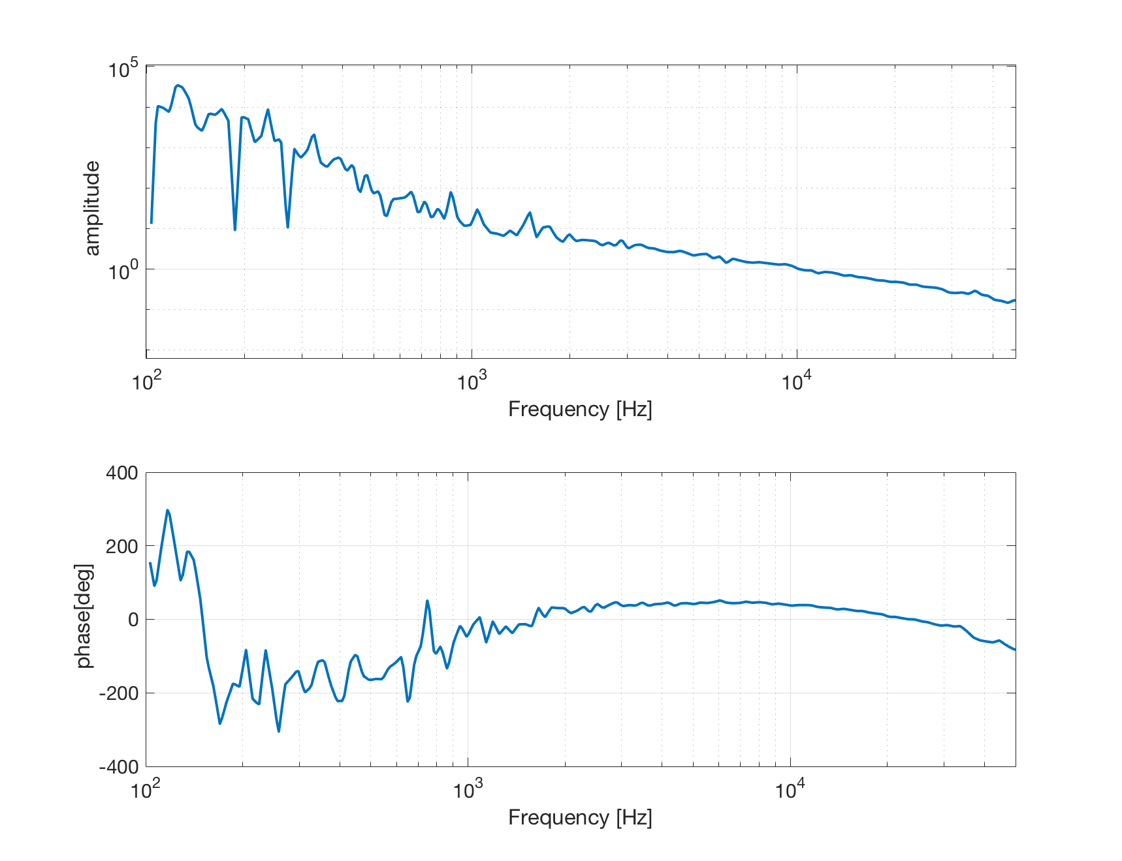
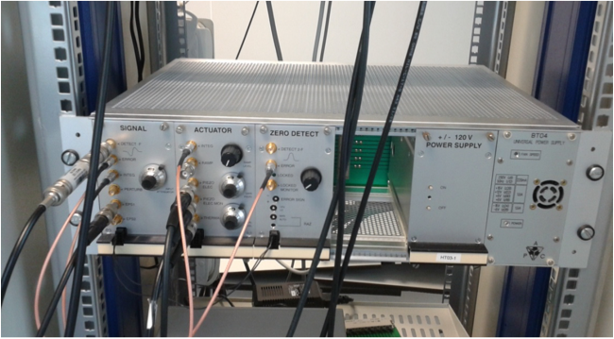
Filter Cavity
Analog Servo to lock the frequency of the laser to the length of the cavity
Cavity Open Loop Transfer Function
UGF = 10 kHz
Cavity locked using the green beam
Phase Margin ~ 40 deg
Shift the frequency of the green using an AOM to have the green and the IR resonant at the same time in the cavity

Slide 18
Conclusions
Squeezed source:
  Second Harmonic Generator installed
  Green Mode Cleaner characterized
  Optical components of the beam towards the filter cavity installed
Faraday Isolator and Mode Matching Telescope:
  Mirrors suspended, locally controlled and aligned
  Green and IR beams recombined
Filter Cavity:
  Cavity aligned and locked

Slide 19
Next Steps
Squeezed source:
  IR mode cleaner ready to be assembled and installed
  OPO mechanical cavity in production
  PLL and Homodyne detector development and assembly to be done
Filter Cavity:
  AOM fine tuning to simultaneously lock the IR and the Green
  Automatic alignment control system
Inject Squeezed Vacuum into the Filter Cavity

