Slide 1
Status of PLL system of ALS
Shogo Kambara, Yoshiki Moriwaki, Kazuya Yokogawa, Satoshi Yoshioka, Tatsunari Sawada, Shuhei Miyata
University of Toyama
f2f meeting@ University of Toyama

Slide 2
Contents
ALS
PLL system
Fiber noise
Experiment of PLL system

Slide 3
Arm Length Stabilization (ALS)
PDH
PD
40Mhz
EOM
PLL
SHG
AOM
Optical fiber
Laser 2
PD
PR2
BS
X-Armcavity
Laser 1
PR3

Slide 4
PLL system
Synthesizer
40MHz
To Arm cavity
PLL
PZT
Green Laser
PD
Single-mode fiber
Beatnote
To Michelson
Main Laser

Slide 5
PLL system
Synthesizer
Using a optical fiber for beatnote
Easy aligment
To save space of PSL table
40MHz
To Arm cavity
PLL
PZT
Green Laser
PD
Single-mode fiber
Beatnote
To Michelson
Main Laser

Slide 6
PLL system
Synthesizer
Using a optical fiber for beatnote
Easy aligment
To save space of PSL table
40MHz
To Arm cavity
PLL
PZT
Green Laser
PD
Problem
Noisy
Single-mode fiber
Beatnote
To Michelson
Main Laser

Slide 7
PLL system
Synthesizer
Using a optical fiber for beatnote
Easy aligment
To free up space of PSL table
40MHz
To Arm cavity
PLL
PZT
Check the fiber noise
Green Laser
PD
Problem
Noisy
Single-mode fiber
Single-mode fiber
Beatnote
To Michelson
Main Laser

Slide 8
Measurement of fiber noise
I measured power of beam for 10 minutes

Slide 9
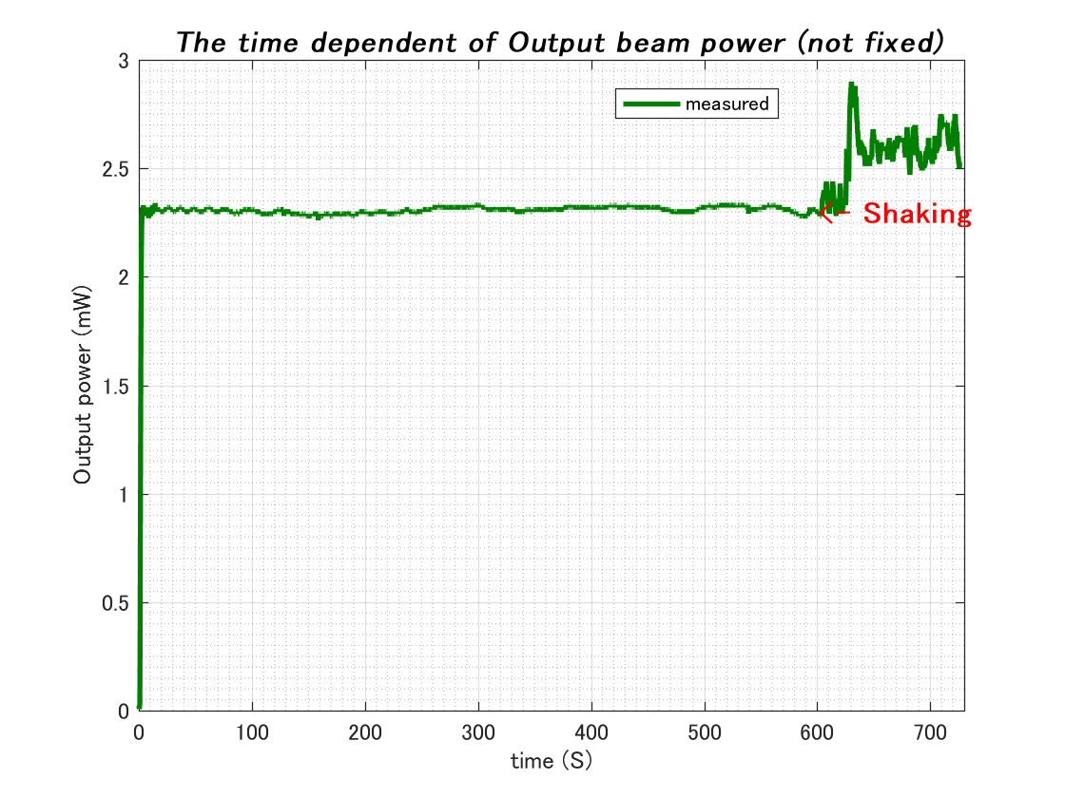
Notes:
Transmittance

Slide 10
Summary
When optical fiber is shaked, the poralization of beam is rotating
Future work
I will use POLARIZED WAVE HOLDING OPTICAL FIBER which is more stable.

Slide 11
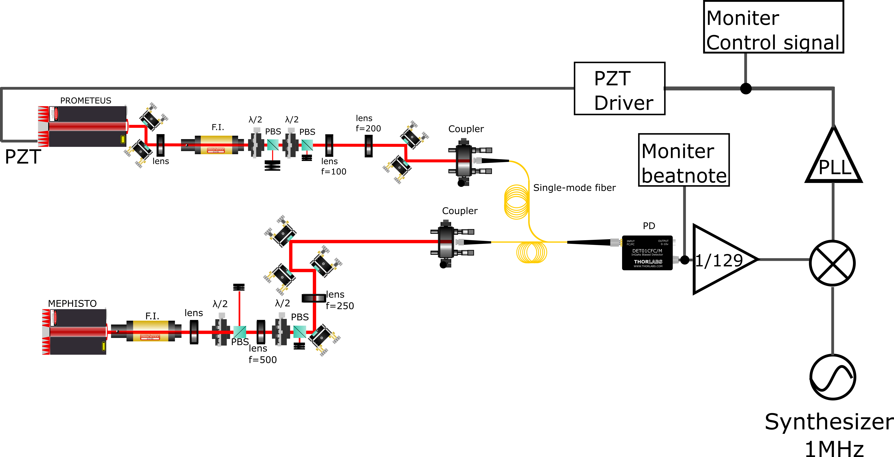
Experiment of PLL system
Beatnote
Frequency divider
Beatnote is locked at 129MHz

Slide 12
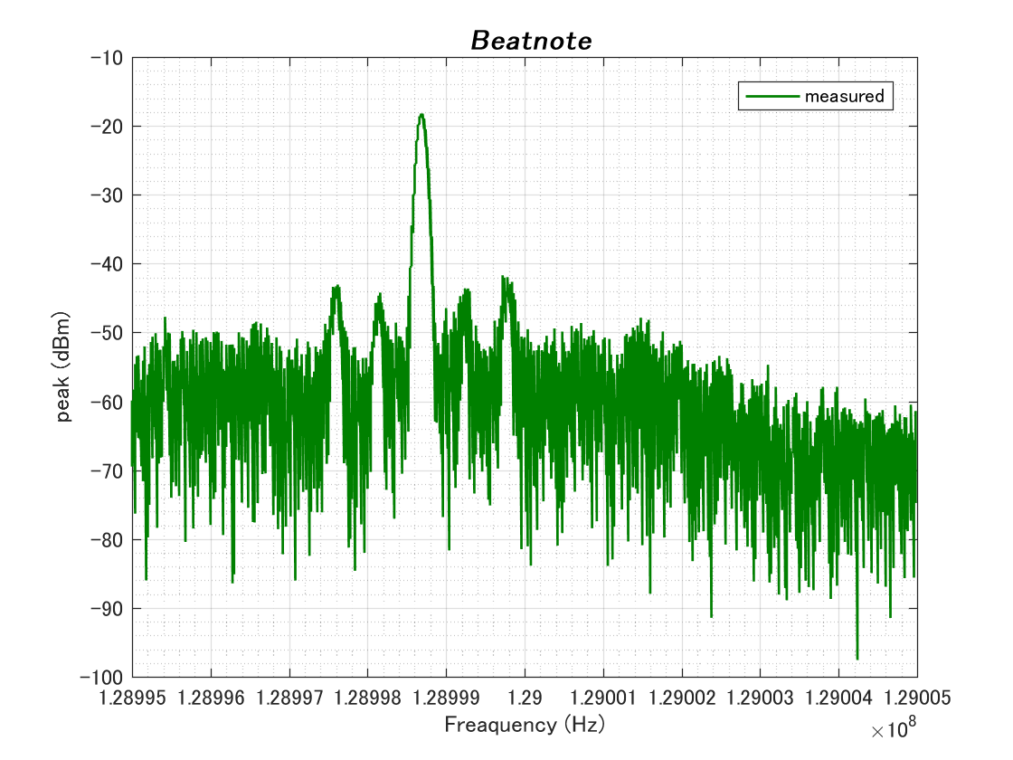
Result
Unlock
Unlock
FWHM:100Hz
128.998680MHz
10MHz
Lock!
180s
Feedback signal to PZT (1MHz/V)
Beatnote

Slide 13
Summary
We maintain frequency locking for 3 minutes.
Line width is about 100Hz.
The position of peak is shifted 1.3kHz from 129Mhz
What are these sideband？
Future work
I will upgrade the filter circuit of PLL for long time locking.
I will calculate the requirement of PLL system
Notes:
upgrade

