Slide 1
Type B Installation Status
Yoichi Aso (slides by Mark Barton)
KAGRA Extended Chiefs Meeting, 5/15/2017
JGW-G1706717-v1

Slide 2
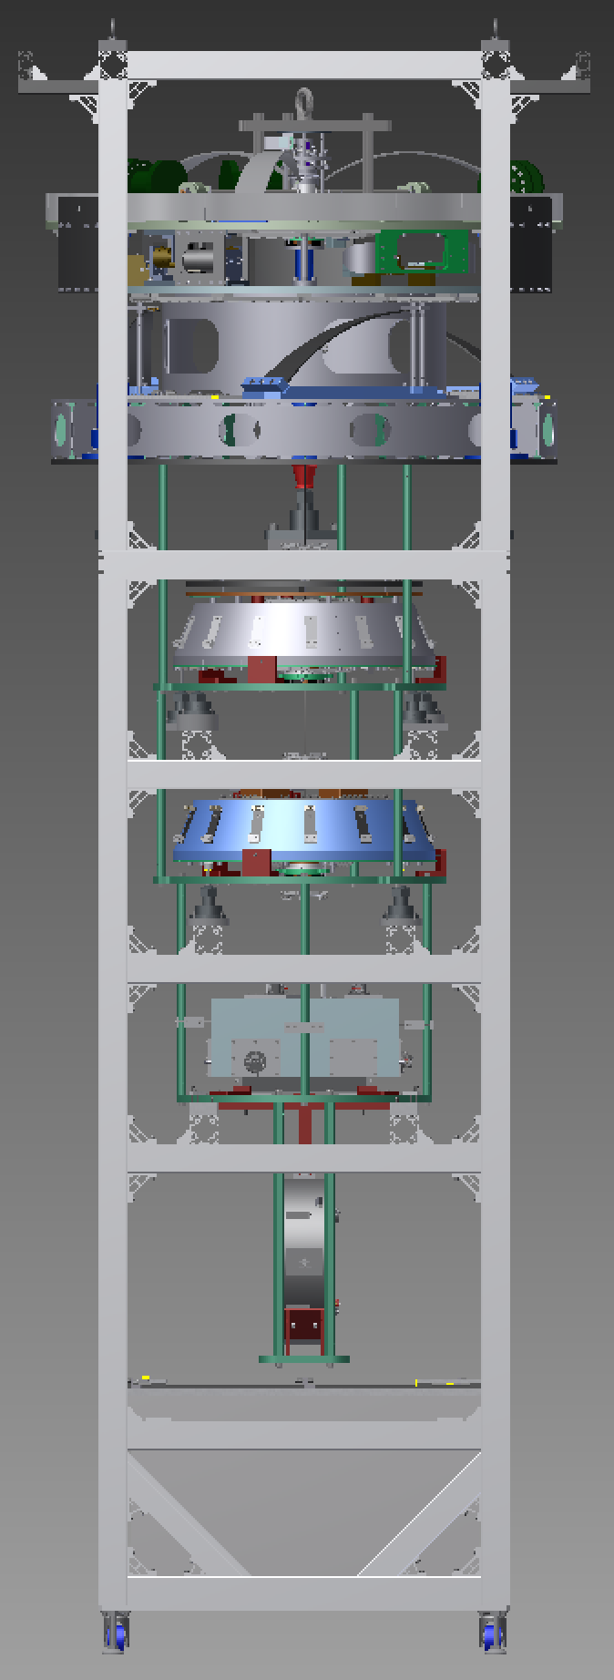
Scope
(F0)
PI
(IP)
One BS suspension
Three SR suspensions (SR2, SR3, SRM)
Each has
Preisolator (PI) with Inverted Pendulum table (IP) and GAS filter (F0)
Standard Filter (SF) and damper ring
Bottom Filter (BF)
Intermediate Mass (IM) and Intermediate Recoil Mass (IRM)
Optic (a.k.a., TM) and Recoil Mass (IM)
Lower breadboard, blade springs, and damper rings.
SRx payload (TM/RM/IM/IRM) is similar to PRx – BS payload is unique
SF
BF
IM/IRM
Optic/RM

Slide 3
Team
Core team
Mark Barton – leader, NAOJ, physicist
Fabian Peña-Arellano – NAOJ, physicist
Naoatsu Hirata – NAOJ, engineer
Enzo Tapia San Martin – NAOJ, electrical engineer
Additional help from
Yuhang Zhao – Beijing Normal U via ICRR
Kazuya Yokogawa – Toyama U
Yuya Kuwahara – U Tokyo
Yingtang Liu – ICRR
Perry Forsyth – ANU
Koki Okutomi, Keiko Kokeyama, real time model
Ryutaro Takahashi – NAOJ, large purchases
Naohisa Sato – NAOJ, PI testing

Slide 4
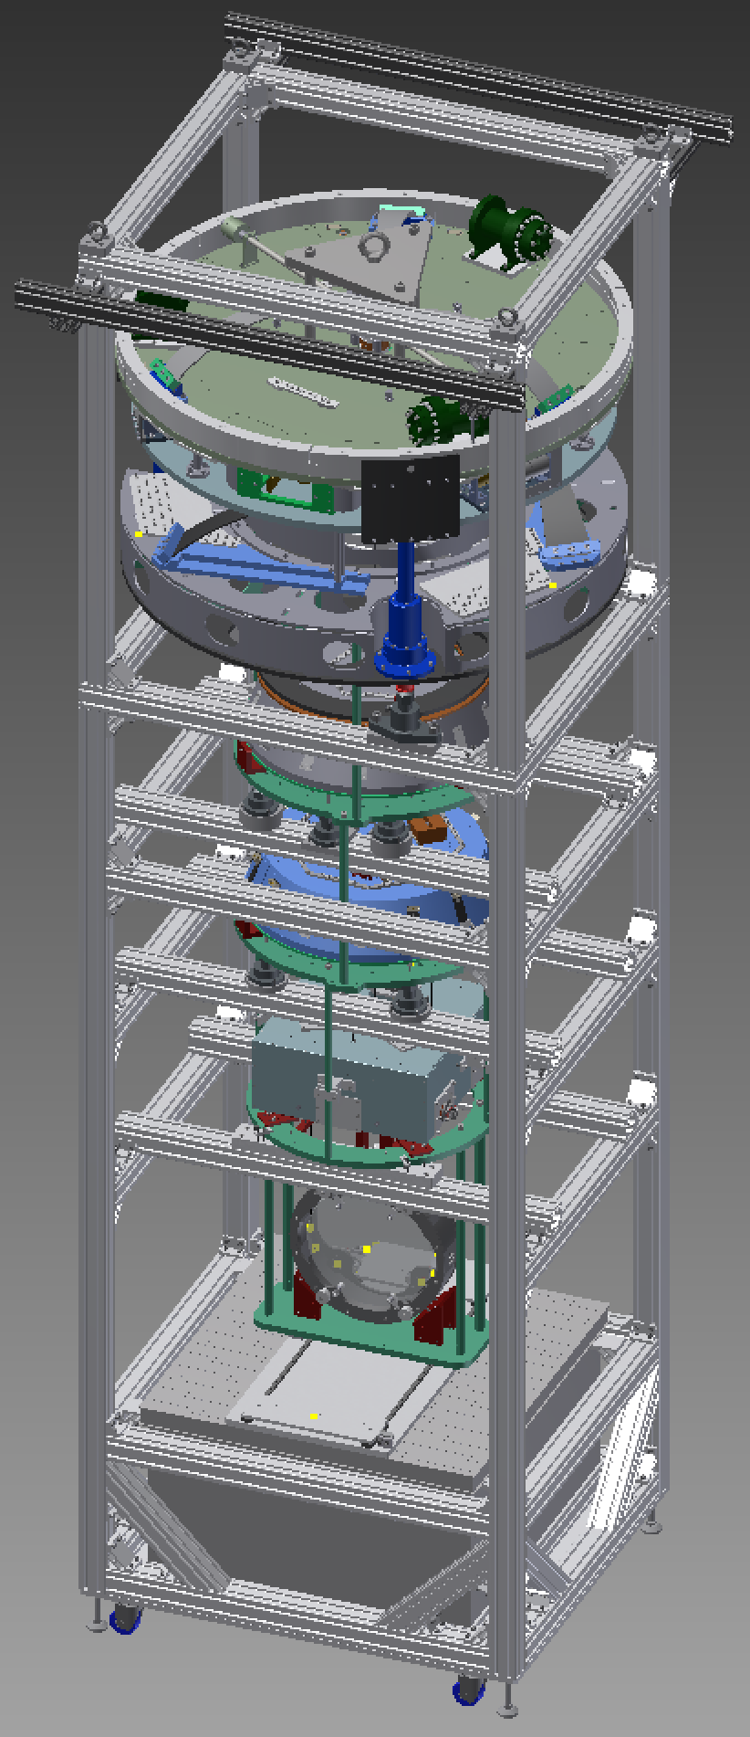
Installation Procedure
Assembly frame based on versions for TAMA Type B test and PR3 test.
Even more use of jacks to raise and lower sections independently (for hooking of maraging rods) without galling of screws in security structure.
IM is now supported from main frame while BS and RM are hung from it – no separate hanging frame.
Frame has extensions to hold cloth cover clear of PI.
Frame has been constructed on the +Y side of the BS tank.
SRx version will be near-identical.
Documents:
E1605505 - BS mirror gluing
E1604817 - BS payload
E1504235 – BS main procedure

Slide 5
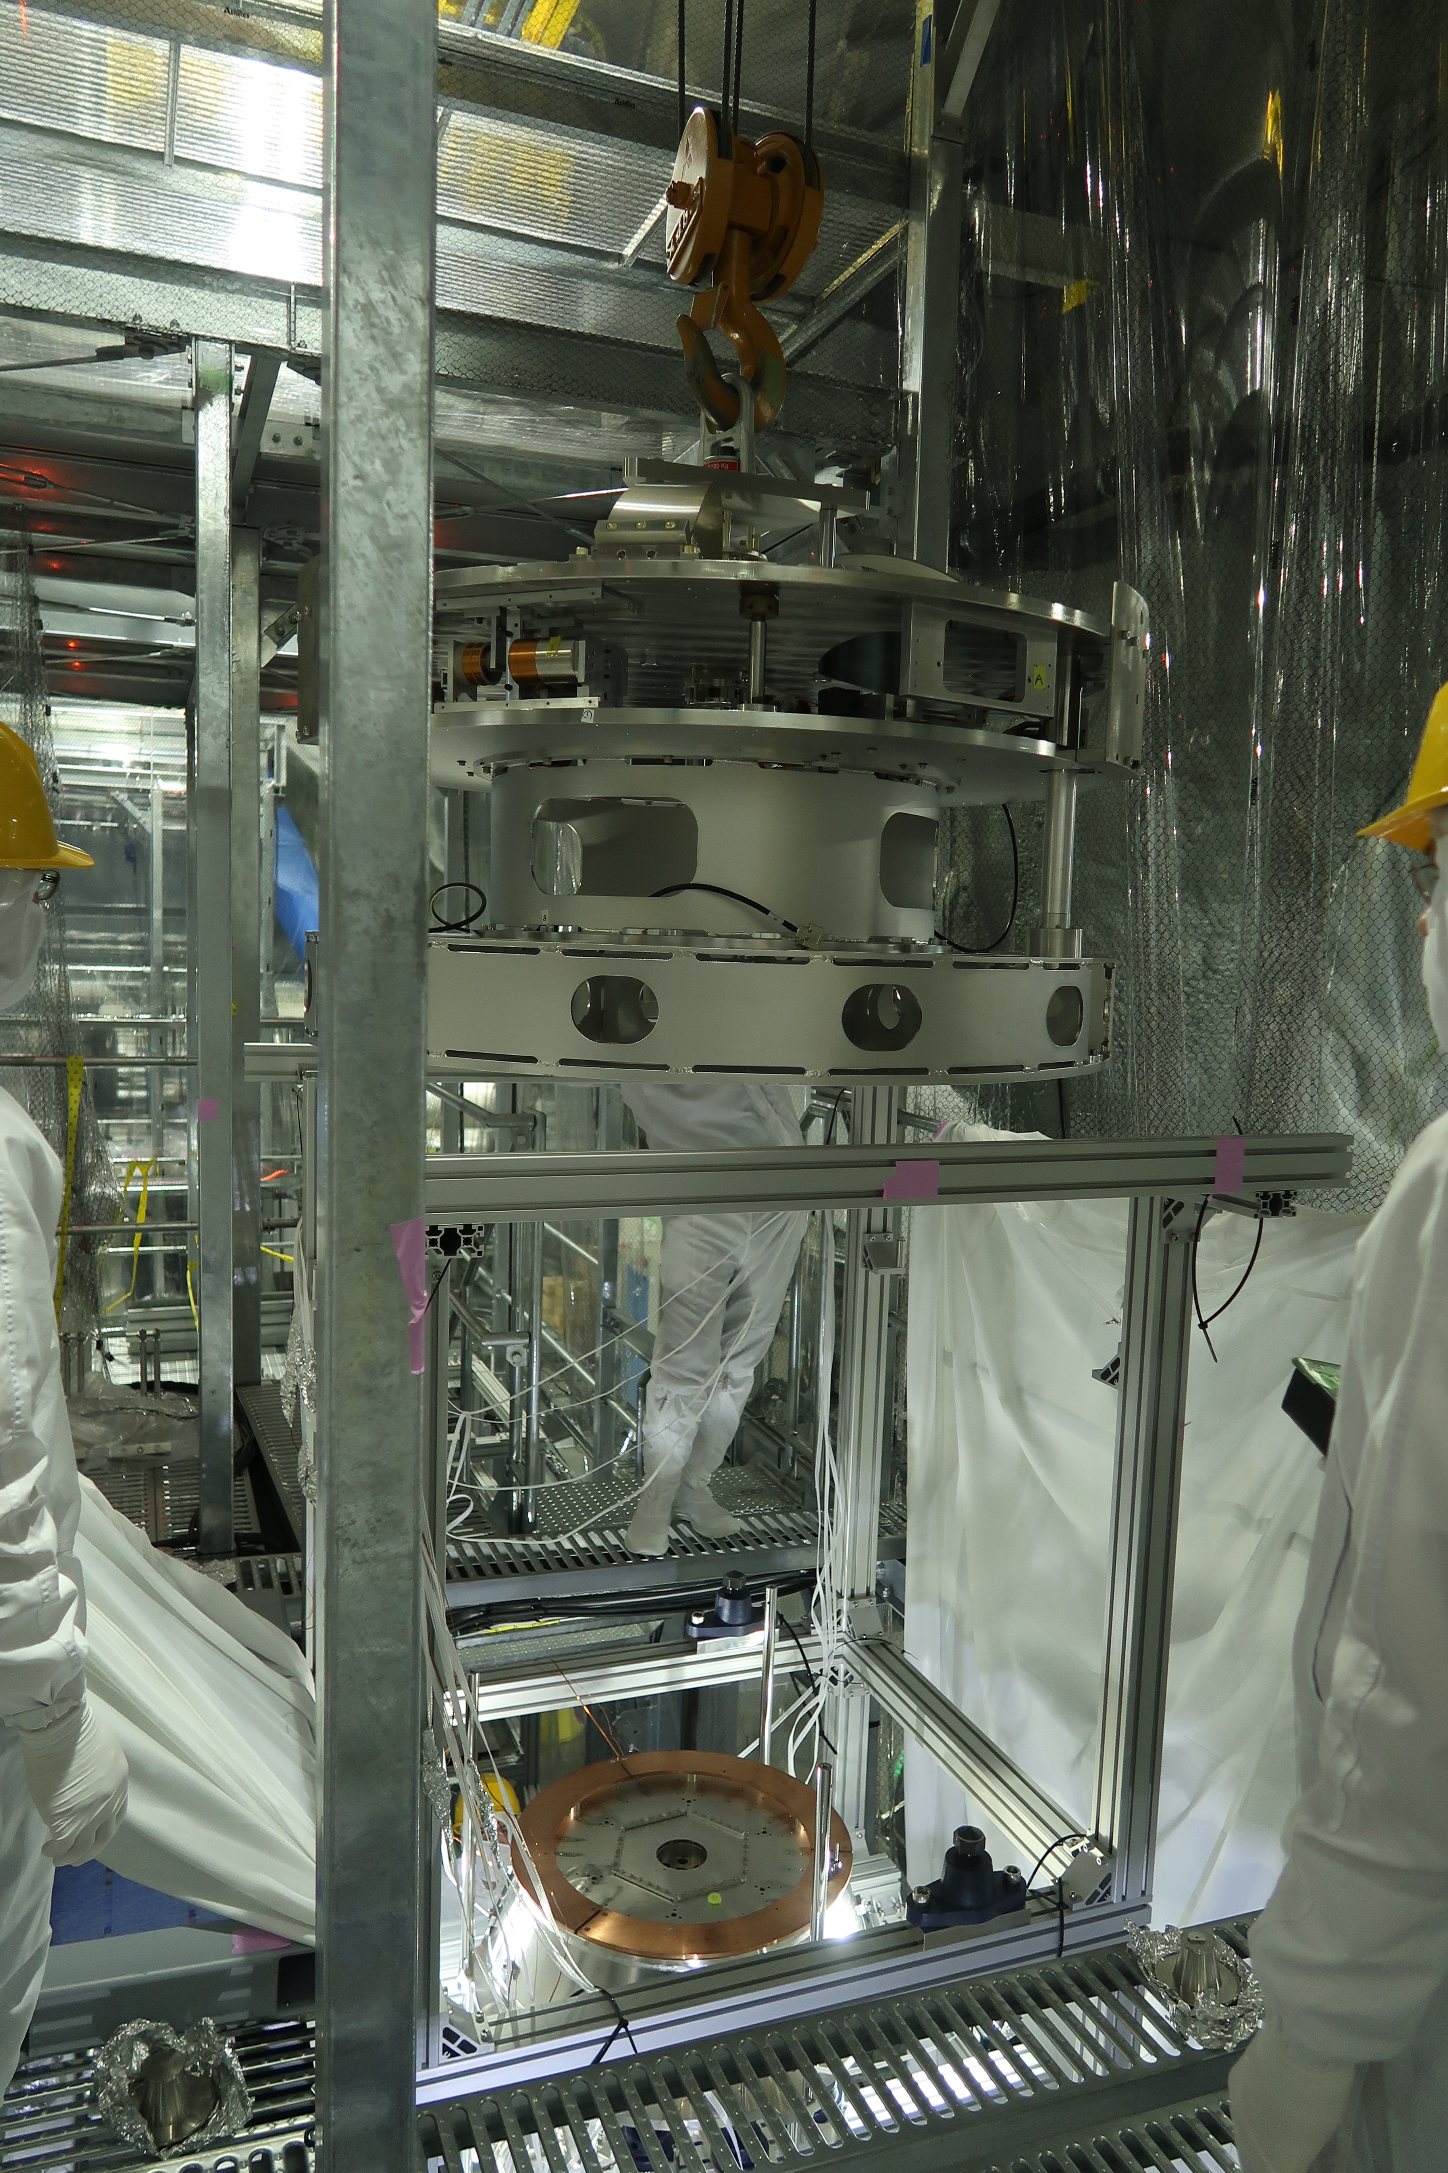
Current Status - BS
All parts are in hand except final BF/SF ballast masses (being designed).
Test hang with dummy BS is ongoing.
Considerable delays due to technical issues.
PI has been installed in assembly frame, with SF/BF/IRM/IM/RM/BS hanging from it.
Rack and in-air cabling done.
New stub flags and coil-only OSEMs delivered.

Slide 6
Current Status - SRx
Have parts for SR2 and SR3 payloads (i.e., the ones originally intended for iKAGRA).
Ready to order in new financial year:
Payload parts for SRM (being ordered jointly with PRM – Type Bp)
Fasteners for three SRx.
Modifications of some parts based on lessons learned from BS/PR3.
Two new RM.
Being prepared for ordering:
Second assembly frame.
Additional in-vacuum cables, OSEMs, and pico and stepper drivers.
SF and BFs are pre-assembled.
PI stages are on order from Nikhef but need setup/testing – Sato-san of Type A group is helping.

Slide 7
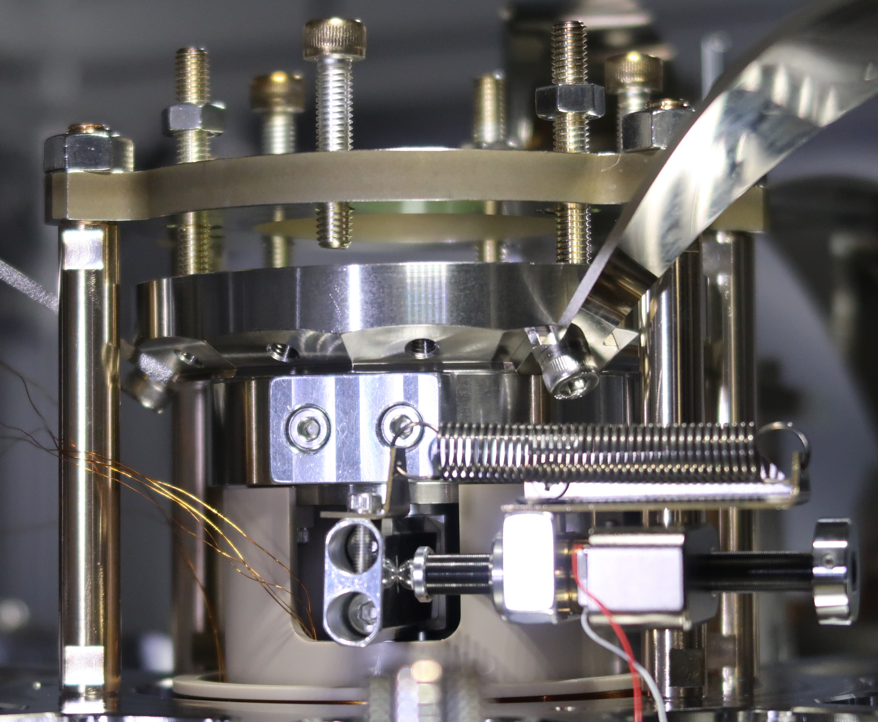
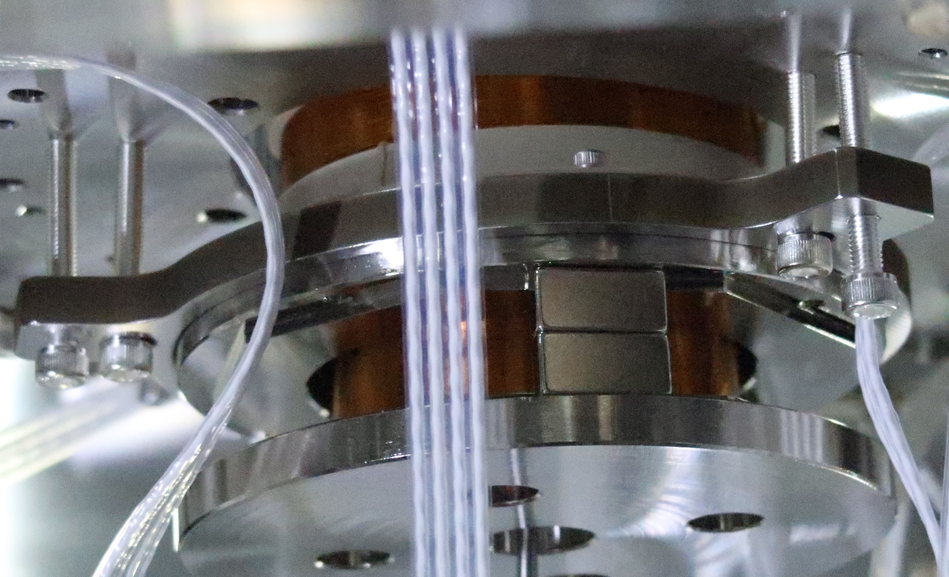
Technical Issues 1 – BF
BF had multiple problems (drop in load capacity, increase in frequency, tilted keystone).
These were thought to have been fixed or worked around.
Unfortunately, it seems to have lost another increment of load capacity and no longer fully supports the IM/RM/BS.
For the BS Test Hang, we have locked the keystone.
Before the real BS installation we will do a complete rebuild.

Slide 8
Technical Issues 2 – SF ballast
The SF GAS spring was quite strong, requiring a lot of ballast in the BF.
The PI GAS spring was quite weak (at least as measured by G&M), and with the heavy BF seemed to require a negative amount of ballast in the SF.
Fortunately the PI was a few kg stronger than reported and we can save another 3.3kg by removing one of the three segments of the Cu damper on the SF.

Slide 9
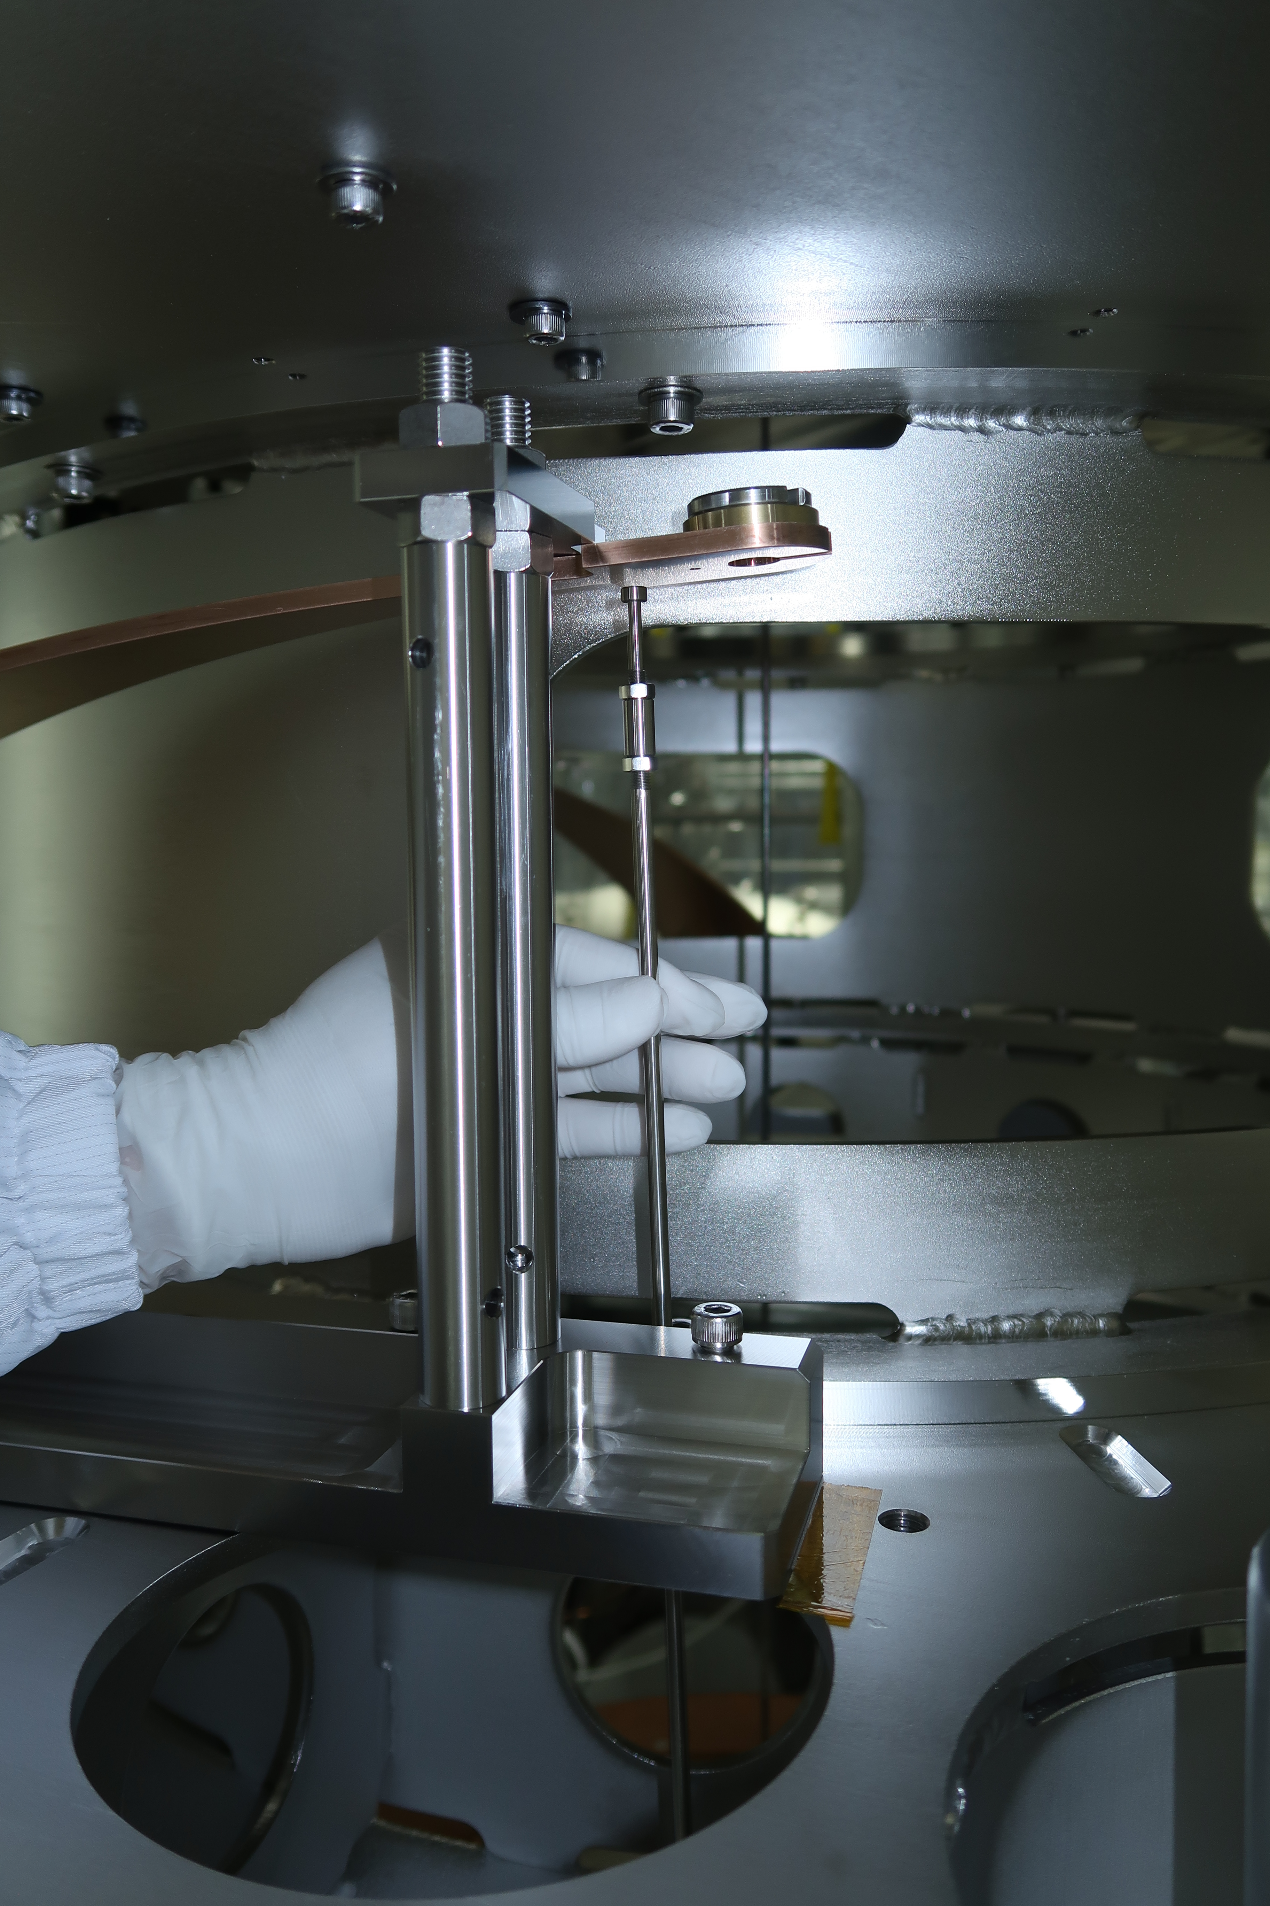
Technical Issues 3 – Lower Breadboard Blades
The blades supporting the LBB had two different problems due to mistakes in Promec drawing :
Holes for clamp screws were Ø11 mm instead of Ø12 mm -> we already got them drilled out.
Blades were 21 mm too long, so maraging rod didn’t align with hole in PI bottom section -> we will add a new hole further from the tip.

Slide 10
Schedule
now
3 months
2017
FY2017
2018
FY2018
About 5 weeks delayed relative to January schedule, but we hope to make up some time by skipping some time-consuming TF tests in the BS Test Hang.

Slide 11
Schedule/Manpower Issues
Four people just barely enough.
Hirata-san has done a big chunk of SR procurement (quotes for third payload etc) but lots still to do.
Lots of SR preassembly still to do – PIs, RM, IM, IRM, optics.
Lots of SR documentation still to do.
Hirata-san has been able to come to the site recently, but will soon be occupied with SR procurement.
Schedule assumes significant help from Type A team in construction and testing of PIs.
Aso-san has arranged for students to help: Zhao, Yokogawa, Kuwahara, Liu, Forsyth, but manpower is still limiting.
Could use a digital systems expert – Kokeyama-san and Okutomi-kun have helped (thanks!), but lots to do.

