Slide 1
KAGRA PLC System Overview
Yoichi Aso@Chief Meeting
2017/5/1

Slide 2
About the name
We have been calling this system “Instrument Control System” or 「機器制御」
This name is very generic, vague and confusing (does not tell what it does).
I’d like to propose to call this particular system “The KAGRA PLC system”.
This system is implemented with PLC (Programmable Logic Controller).
This system implements several functions
Monitoring, Control, Interlock, etc
It is better not to call it with its functions (instrument control)
The common foundation of this system is PLC. Therefore, it is clearer to call it “The KAGRA PLC system”.
KAGRA has no other PLC based system to my knowledge.

Slide 3
Y-End PLC CPU
Conceptual System Layout
I/O Unit
KAGRA
CDS Network
I/O Unit
EPICS Translator
Clients
I/O Unit
Network Repeater
Unit
I/O Unit
I/O Unit
Every 100m
I/O Unit
Center Area
PLC CPU
I/O Unit
I/O Unit
I/O Unit
I/O Unit
I/O Unit
I/O Unit
X-End PLC CPU
Network Repeater
Unit

Slide 4
Explanation of the system layout
There are 3 CPUs, center, X-end and Y-end
Each CPU has its own I/O boards
Remote I/O units are connected to the CPUs through a dedicated TCP/IP network
The network repeater units are installed at the middle of each arm
The CPUs communicate with some of the I/O units through the repeater
All the information collected by the I/O units are sent to one of the CPUs.
Each CPU can implement interlock logics to automatically shutdown connected instruments in case of emergency
End CPUs send all the collected information to the center CPU
The EPICS translator talks to the center CPU with PLC’s HTTP interface
The EPICS translator converts all the information collected by the center CPU to EPICS PV
The converted EPICS PVs are broadcasted to the KAGRA CDS network
Client computers can access to these PVs through the CA protocol
KAGRA frame builder should be able to collect these PVs and store the trend data

Slide 5
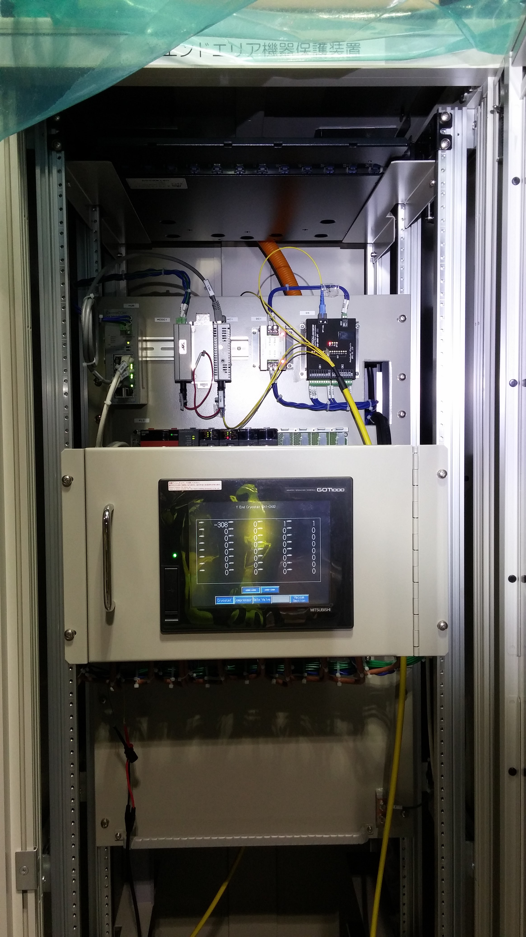
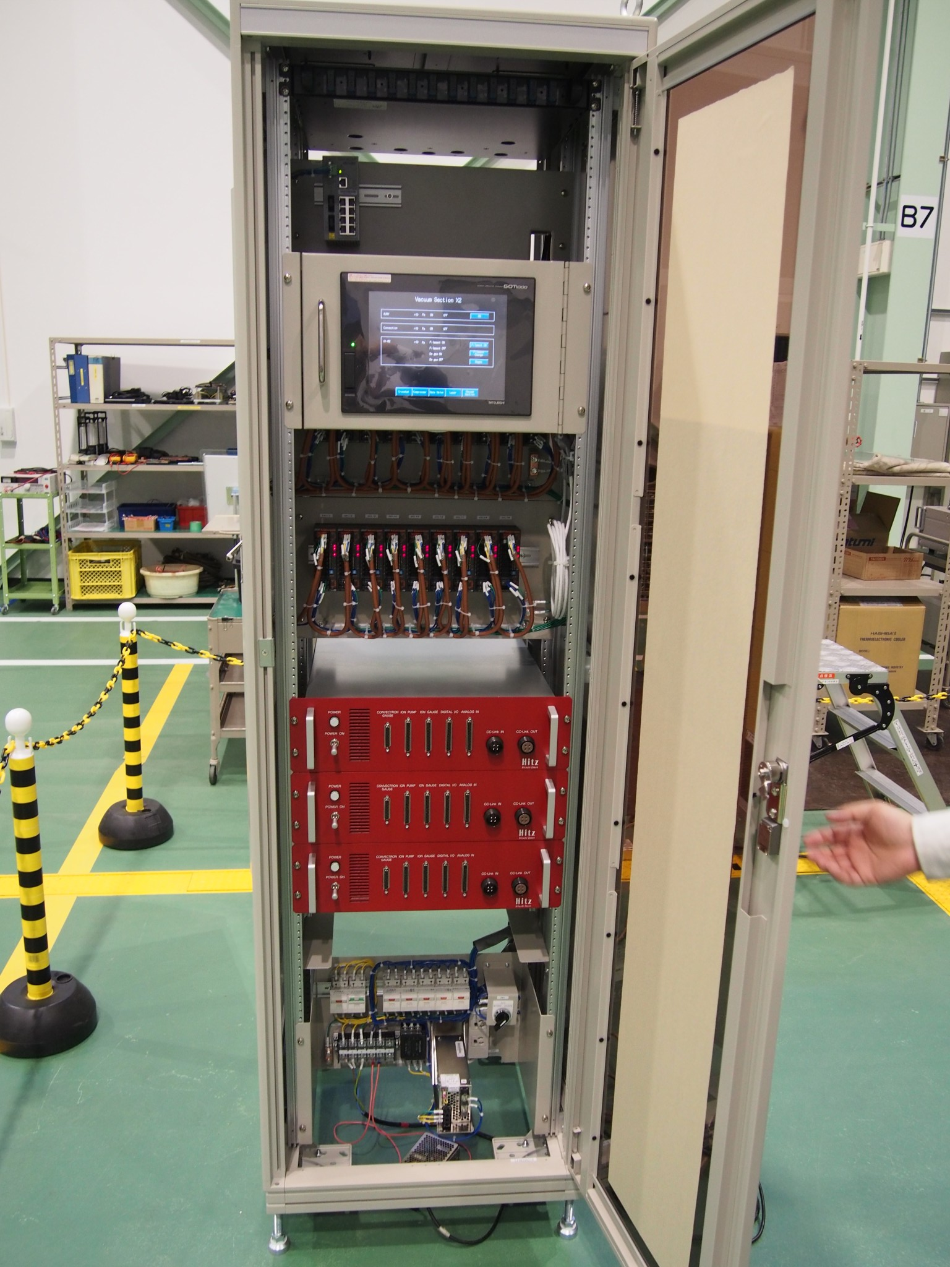
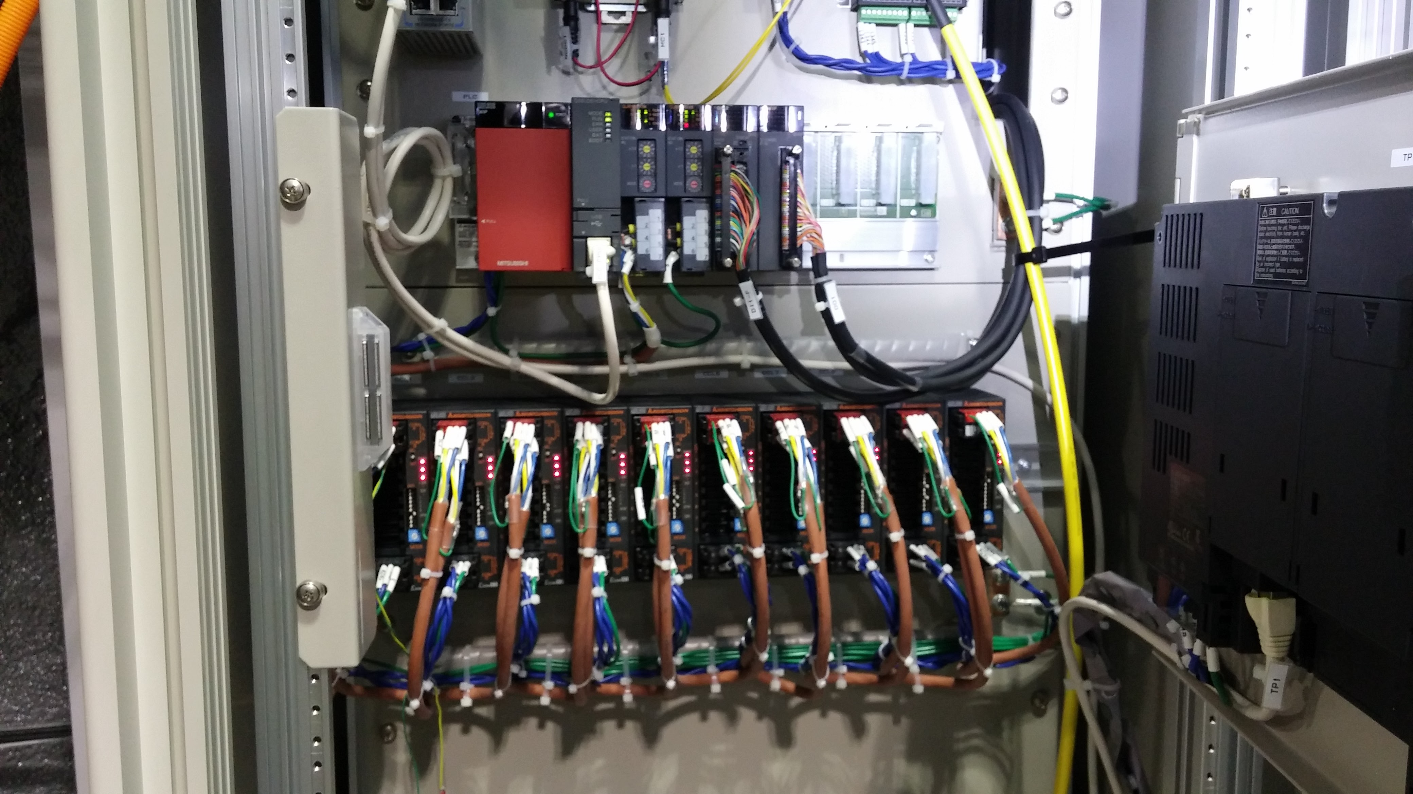
CPU rack
Y-End
Center
Monitor Screen
Open
PLC I/O Units

Slide 6
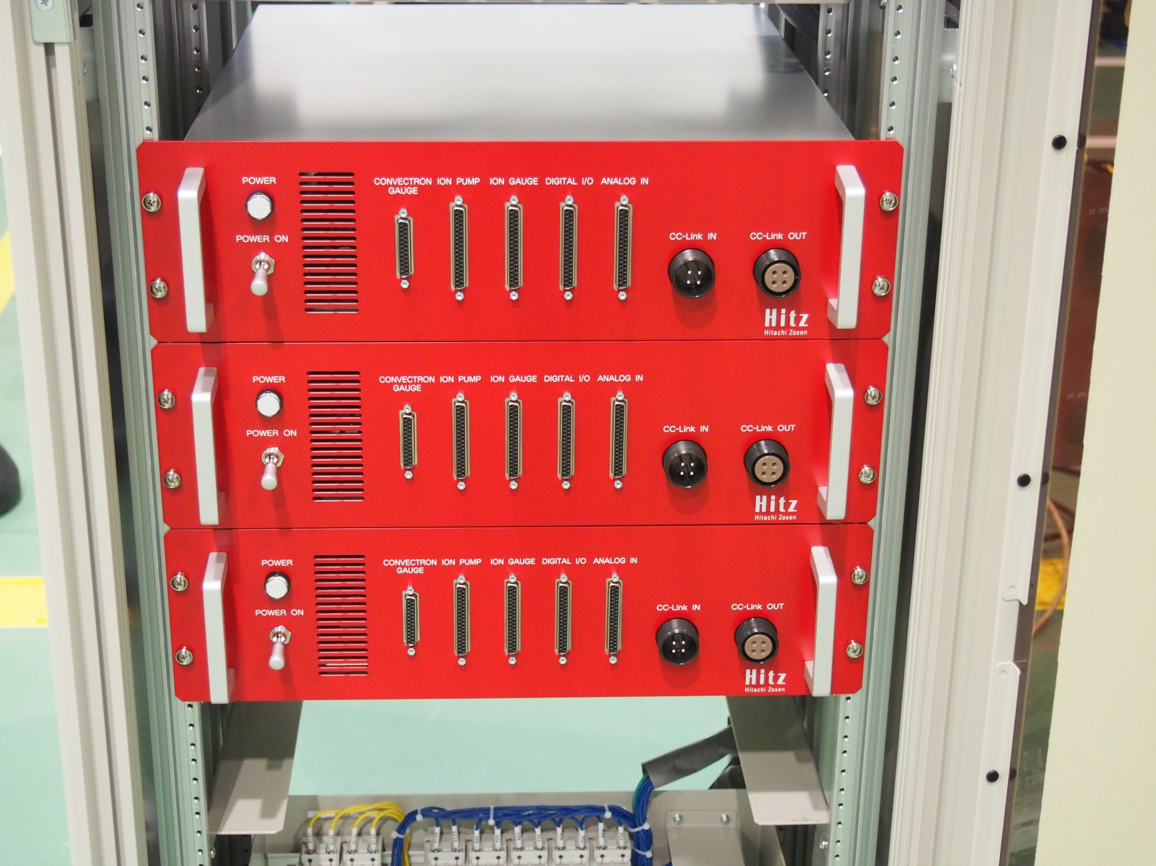
I/O unit
3 units shown
D-Sub interface ports
Assuming specific models of vacuum gauges, pumps
May need to change the wirings

Slide 7
Center Area CPU Rack
ADC: 152ch
Digital Input: 64ch
Digital Out: 32ch
End Area CPU Rack
ADC: 80ch
Digital Input: 32ch
Digital Out: 32ch
ADC: 10V-10V Differential 16bit
Digital Input: 24V DC, plus common isolation with photo-couplers
Digital Output: Relay Outputs
(Internally, relay terminals are connected to
PLC digital output modules with open-drain
outputs, isolated with photo-couplers)
Remote I/O Unit
ADC: 16ch
Digital Input: 16ch
Digital Output: 16ch

Slide 8
Interlock logic
Sample logics are implemented in the PLC CPU
Concrete specifications of the vacuum and cryogenic instruments were not available at the time of the development of the PLC system
The sample logics assume certain models of vacuum and cryogenic instruments, which may not be the same as actual KAGRA hardware
Interlock outputs
There are several relay outputs to perform emergency shutdown of critical
KAGRA components
Laser shutdown
Close the large gate valves
Triggering the interlock
When certain conditions are met, the interlock is triggered to perform the emergency shutdown
Vacuum gauge readings get higher than a threshold value

Slide 9
Possible extensions
The KAGRA PLC system can be modified or extended in several ways.
Interlock logic
Implemented with the software on the PLC CPU. It is relatively easy to change.
Asking Hitachi Zousen is one way. Another way is to update the software by
ourselves.
Adding more I/O channels
There is still some space to add more PLC I/O modules, though the center
Area rack is congested.
Implement the laser safety interlock
with the extension of the PLC system ?

Slide 10
References
As built documents by Hitz (JGW-T1503712)
http://gwdoc.icrr.u-tokyo.ac.jp/cgi-bin/private/DocDB/ShowDocument?docid=3712
KAGRA network diagram (JGW-D1503778)
http://gwdoc.icrr.u-tokyo.ac.jp/cgi-bin/private/DocDB/ShowDocument?docid=3778
MELSEC PLC (sequencer) web page
http://www.mitsubishielectric.co.jp/fa/products/cnt/plc/

