Slide 1
Type B Status
Mark Barton
KAGRA f2f Meeting, 3/29/2017
JGW-G1706384-v1

Slide 2
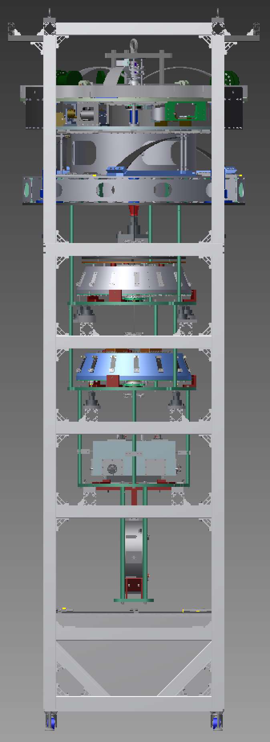
Scope
(F0)
PI
(IP)
One BS suspension
Three SR suspensions (SR2, SR3, SRM)
Each has
  Preisolator (PI) with Inverted Pendulum table (IP) and GAS filter (F0)
  Standard Filter (SF) and damper ring
  Bottom Filter (BF)
  Intermediate Mass (IM) and Intermediate Recoil Mass (IRM)
  Optic (a.k.a., TM) and Recoil Mass (IM)
  Lower breadboard, blade springs, and damper rings.
SRx payload (TM/RM/IM/IRM) is similar to PRx – BS payload is unique
SF
BF
IM/IRM
Optic/RM

Slide 3
Team
Core team
  Mark Barton – leader, NAOJ, physicist
  Fabian Peña-Arellano – NAOJ, physicist
  Naoatsu Hirata – NAOJ, engineer
  Enzo Tapia San Martin – NAOJ, electrical engineer
Additional help from
  Yuhang Zhao – Beijing Normal U via ICRR
  Kazuya Yokogawa – Toyama U
  Yuya Kuwahara – U Tokyo
  Yingtang Liu – ICRR
  Perry Forsyth – ANU
  Koki Okutomi, Keiko Kokeyama, real time model
  Ryutaro Takahashi – NAOJ, large purchases
  Naohisa Sato – NAOJ, PI testing

Slide 4
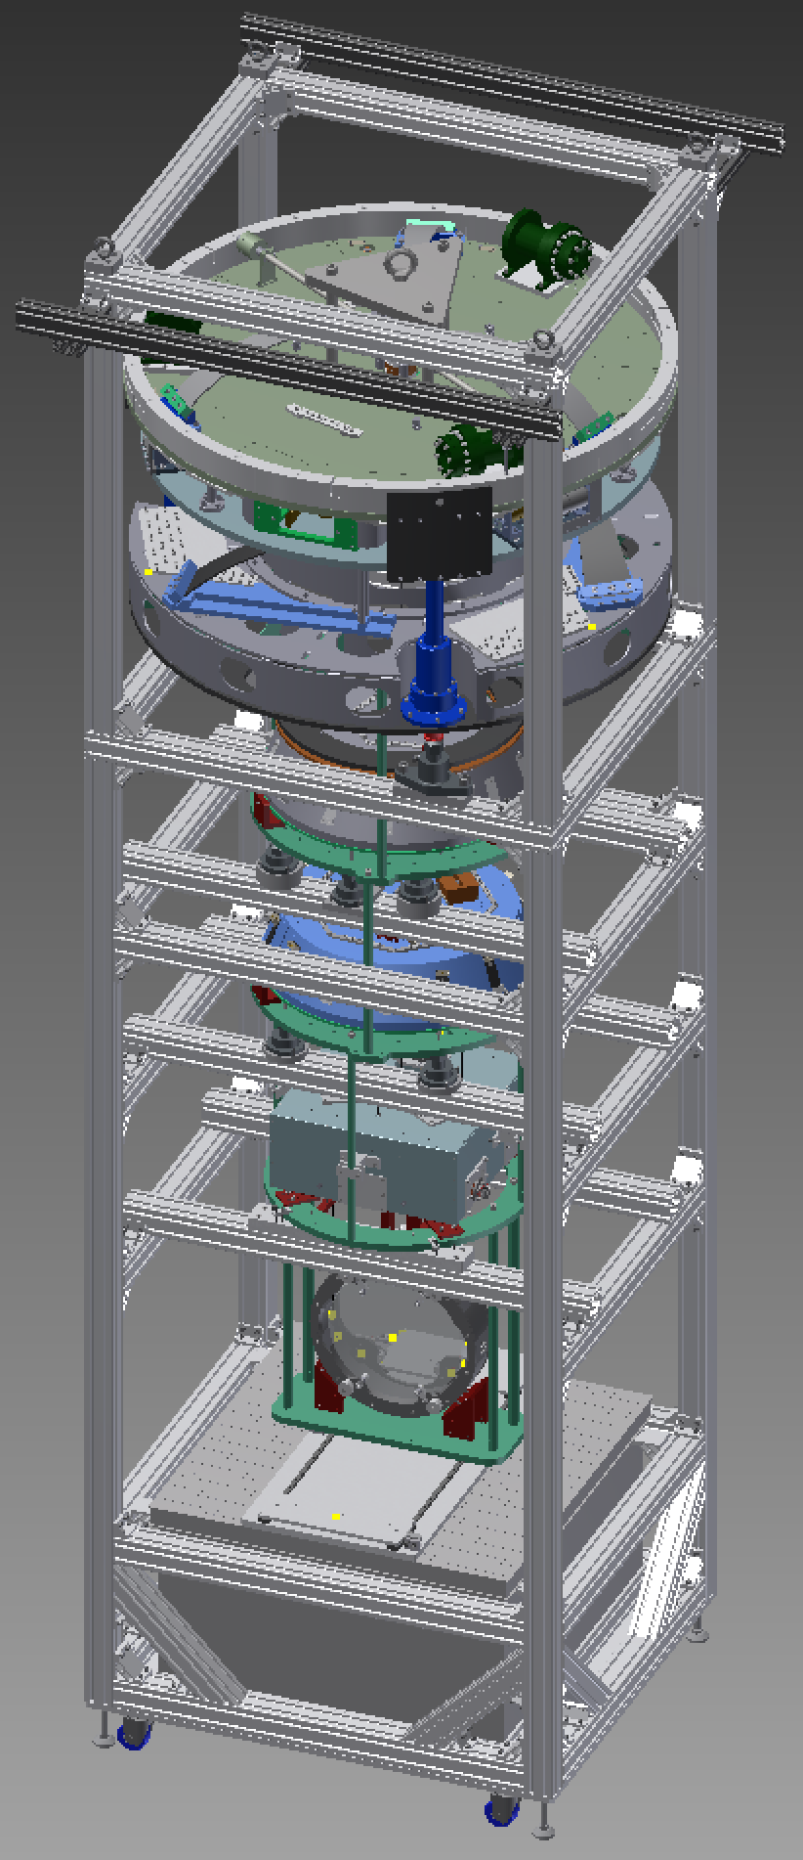
Installation Procedure
Assembly frame based on versions for TAMA Type B test and PR3 test.
Even more use of jacks to raise and lower sections independently (for hooking of maraging rods) without galling of screws in security structure.
IM is now supported from main frame while BS and RM are hung from it – no separate hanging frame.
Frame has extensions to hold cloth cover clear of PI.
Frame has been constructed on the +Y side of the BS tank.
SRx version will be near-identical.
Documents:
  E1605505 - BS mirror gluing
  E1604817 - BS payload
  E1504235 – BS main procedure

Slide 5
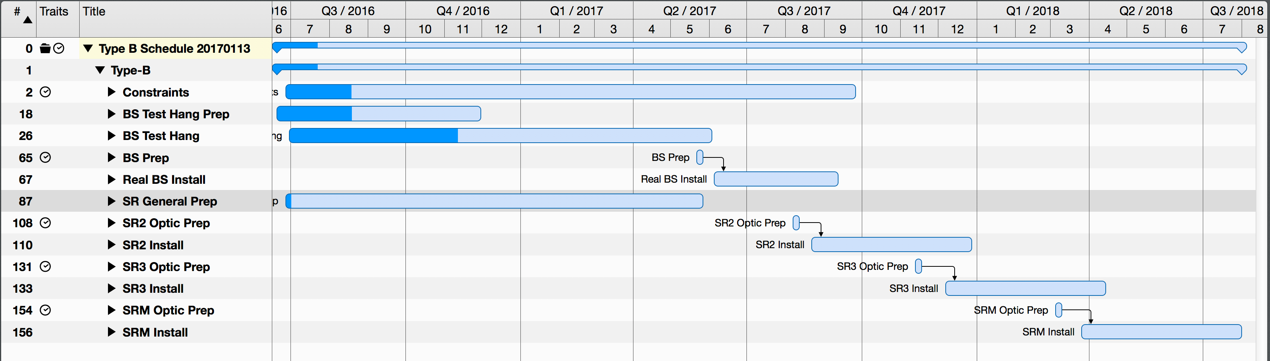
Schedule
now
3 months
2017
FY2017
2018
FY2018

Slide 6
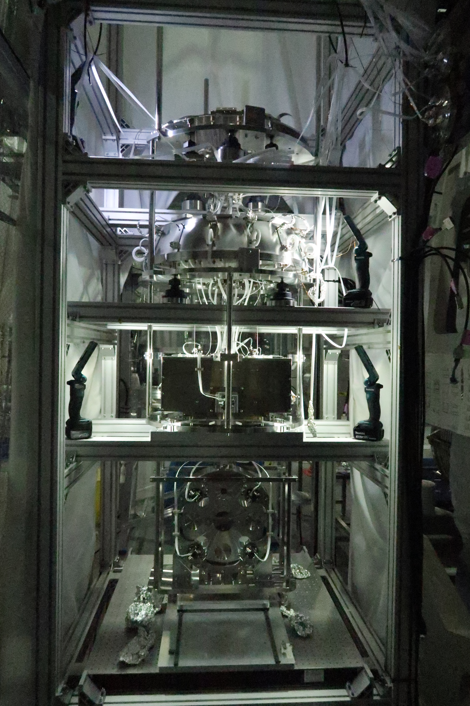
Current Status - BS
All parts are in hand except:
  Final BF/SF ballast masses (being designed).
  New stub flags for BS and matching OSEMs (being redesigned).
  Some new OSEM cables (better lengths).
  Geophone cables (vacuum compatible version).
Test hang with dummy BS is ongoing.
Considerable delays due to technical issues with BF and IM, now believed solved.
SF now installed, with BF/IRM/IM/RM/BS hanging from it.
Rack and in-air cabling done.
PI preparation well underway.
PI is to be moved to second floor of cleanbooth in week of 4/2, and installed shortly thereafter.

Slide 7
Current Status - SRx
Have parts for SR2 and SR3 payloads (i.e., the ones originally intended for iKAGRA).
Ready to order in new financial year:
  Payload parts for SRM (being ordered jointly with PRM – Type Bp)
  Fasteners for three SRx.
  Modifications of some parts based on lessons learned from BS/PR3.
  Two new RM.
Being prepared for ordering:
  Second assembly frame.
  Additional in-vacuum cables, OSEMs, and pico and stepper drivers.
SF and BFs are pre-assembled.
PI stages are on order from Nikhef but need setup/testing – Sato-san of Type A group is helping.

Slide 8
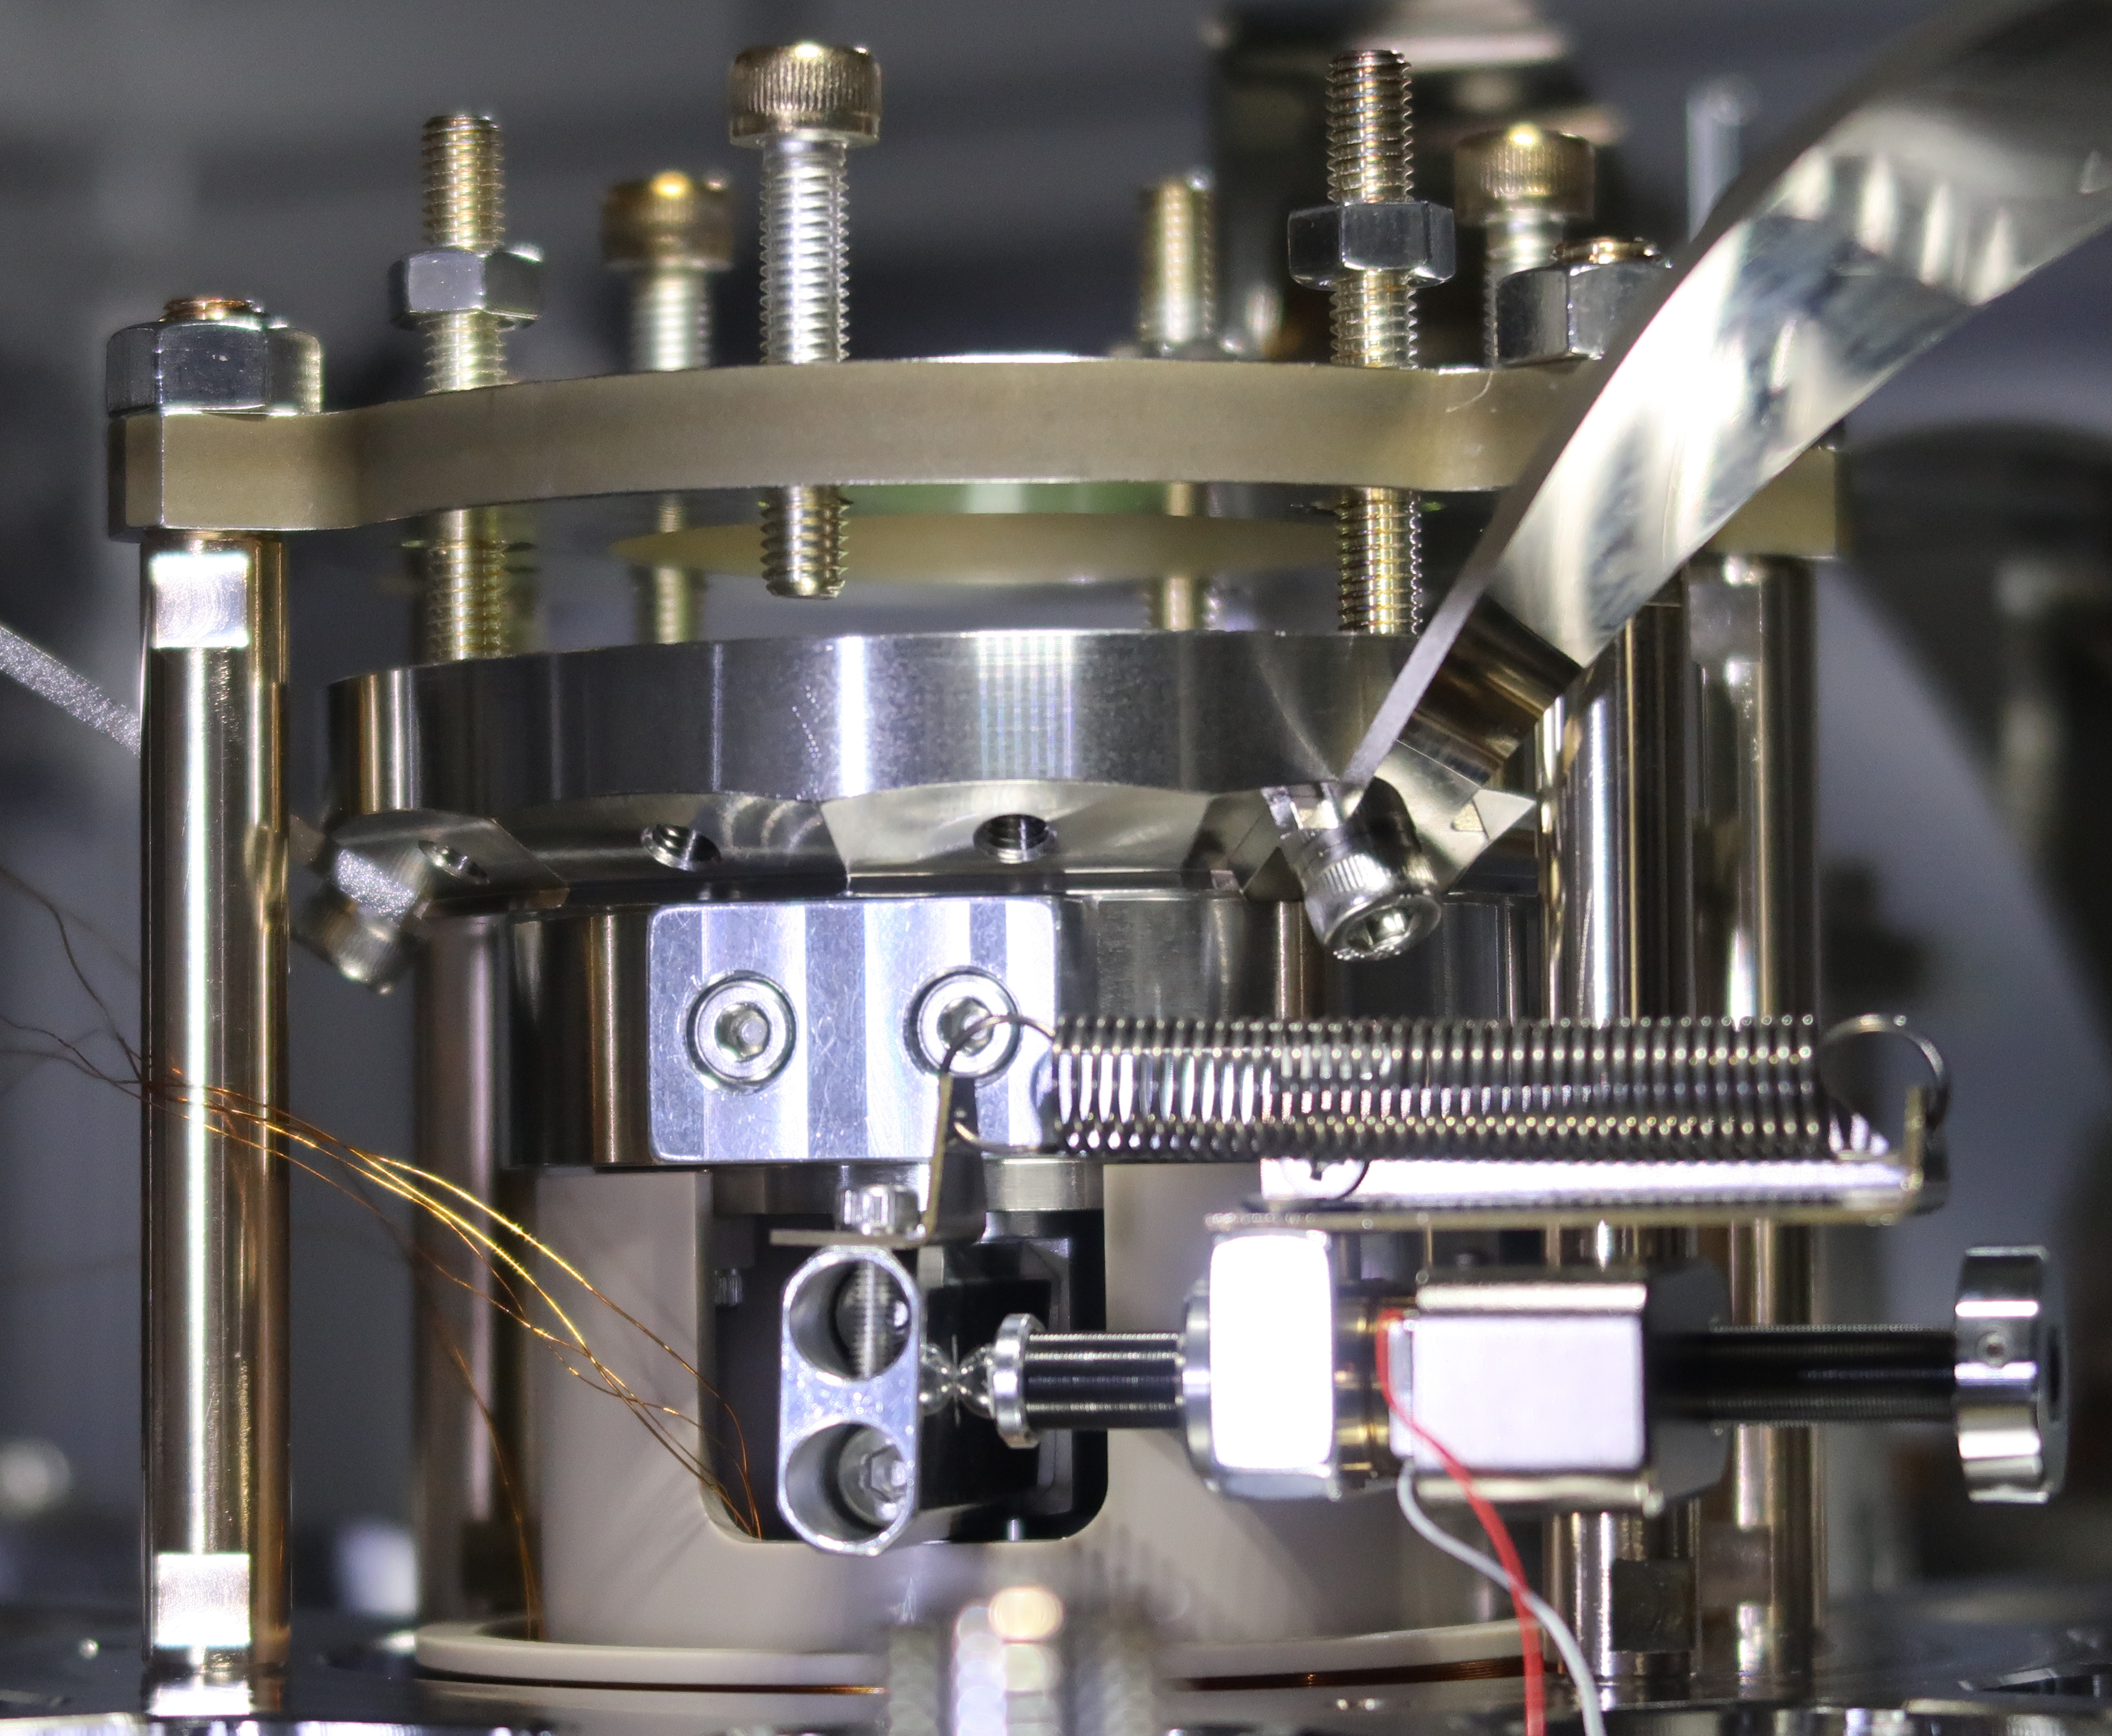
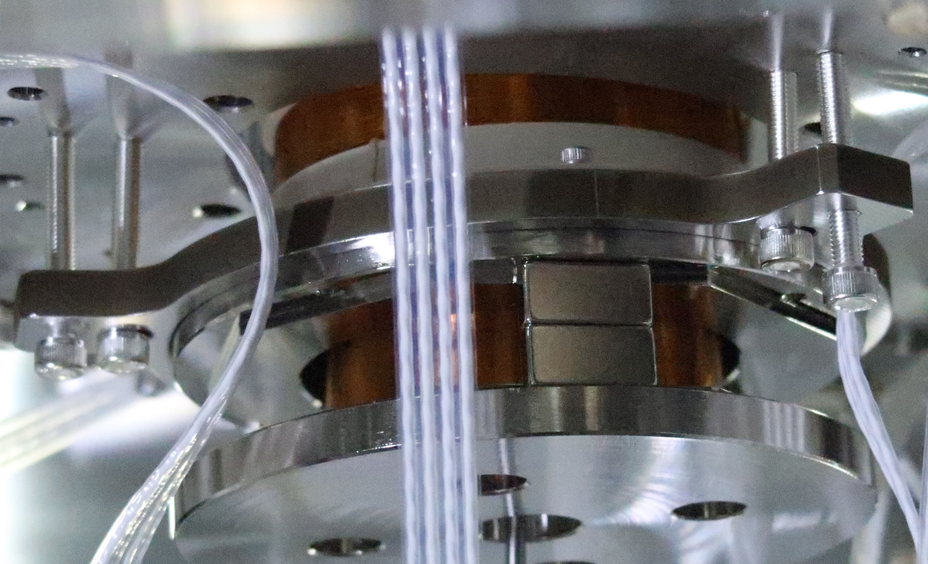
Technical Issues 1 – BF Keystone Tilt
BF keystone was tilted by ≈10-15 mrad.
Caused the BF-IM maraging rod to be off-center, making the BF hang with a large pitch.
Caused interference at the LVDT yoke.
Thought to be due to uneven blade strength in combination with low number of blades (3) in custom design for BS.
Bounce frequency also high (0.6 Hz) relative to measurement at Mitaka (0.4 Hz).
Fixed by
  Adjusting blades in/out to put top of keystone off-center but rod suspension point more central.
  Tilting yoke to match keystone (and LVDT coil)
Target bounce frequency (<0.4 Hz) was also recovered.
Ugly, but good enough for real BS install.

Slide 9
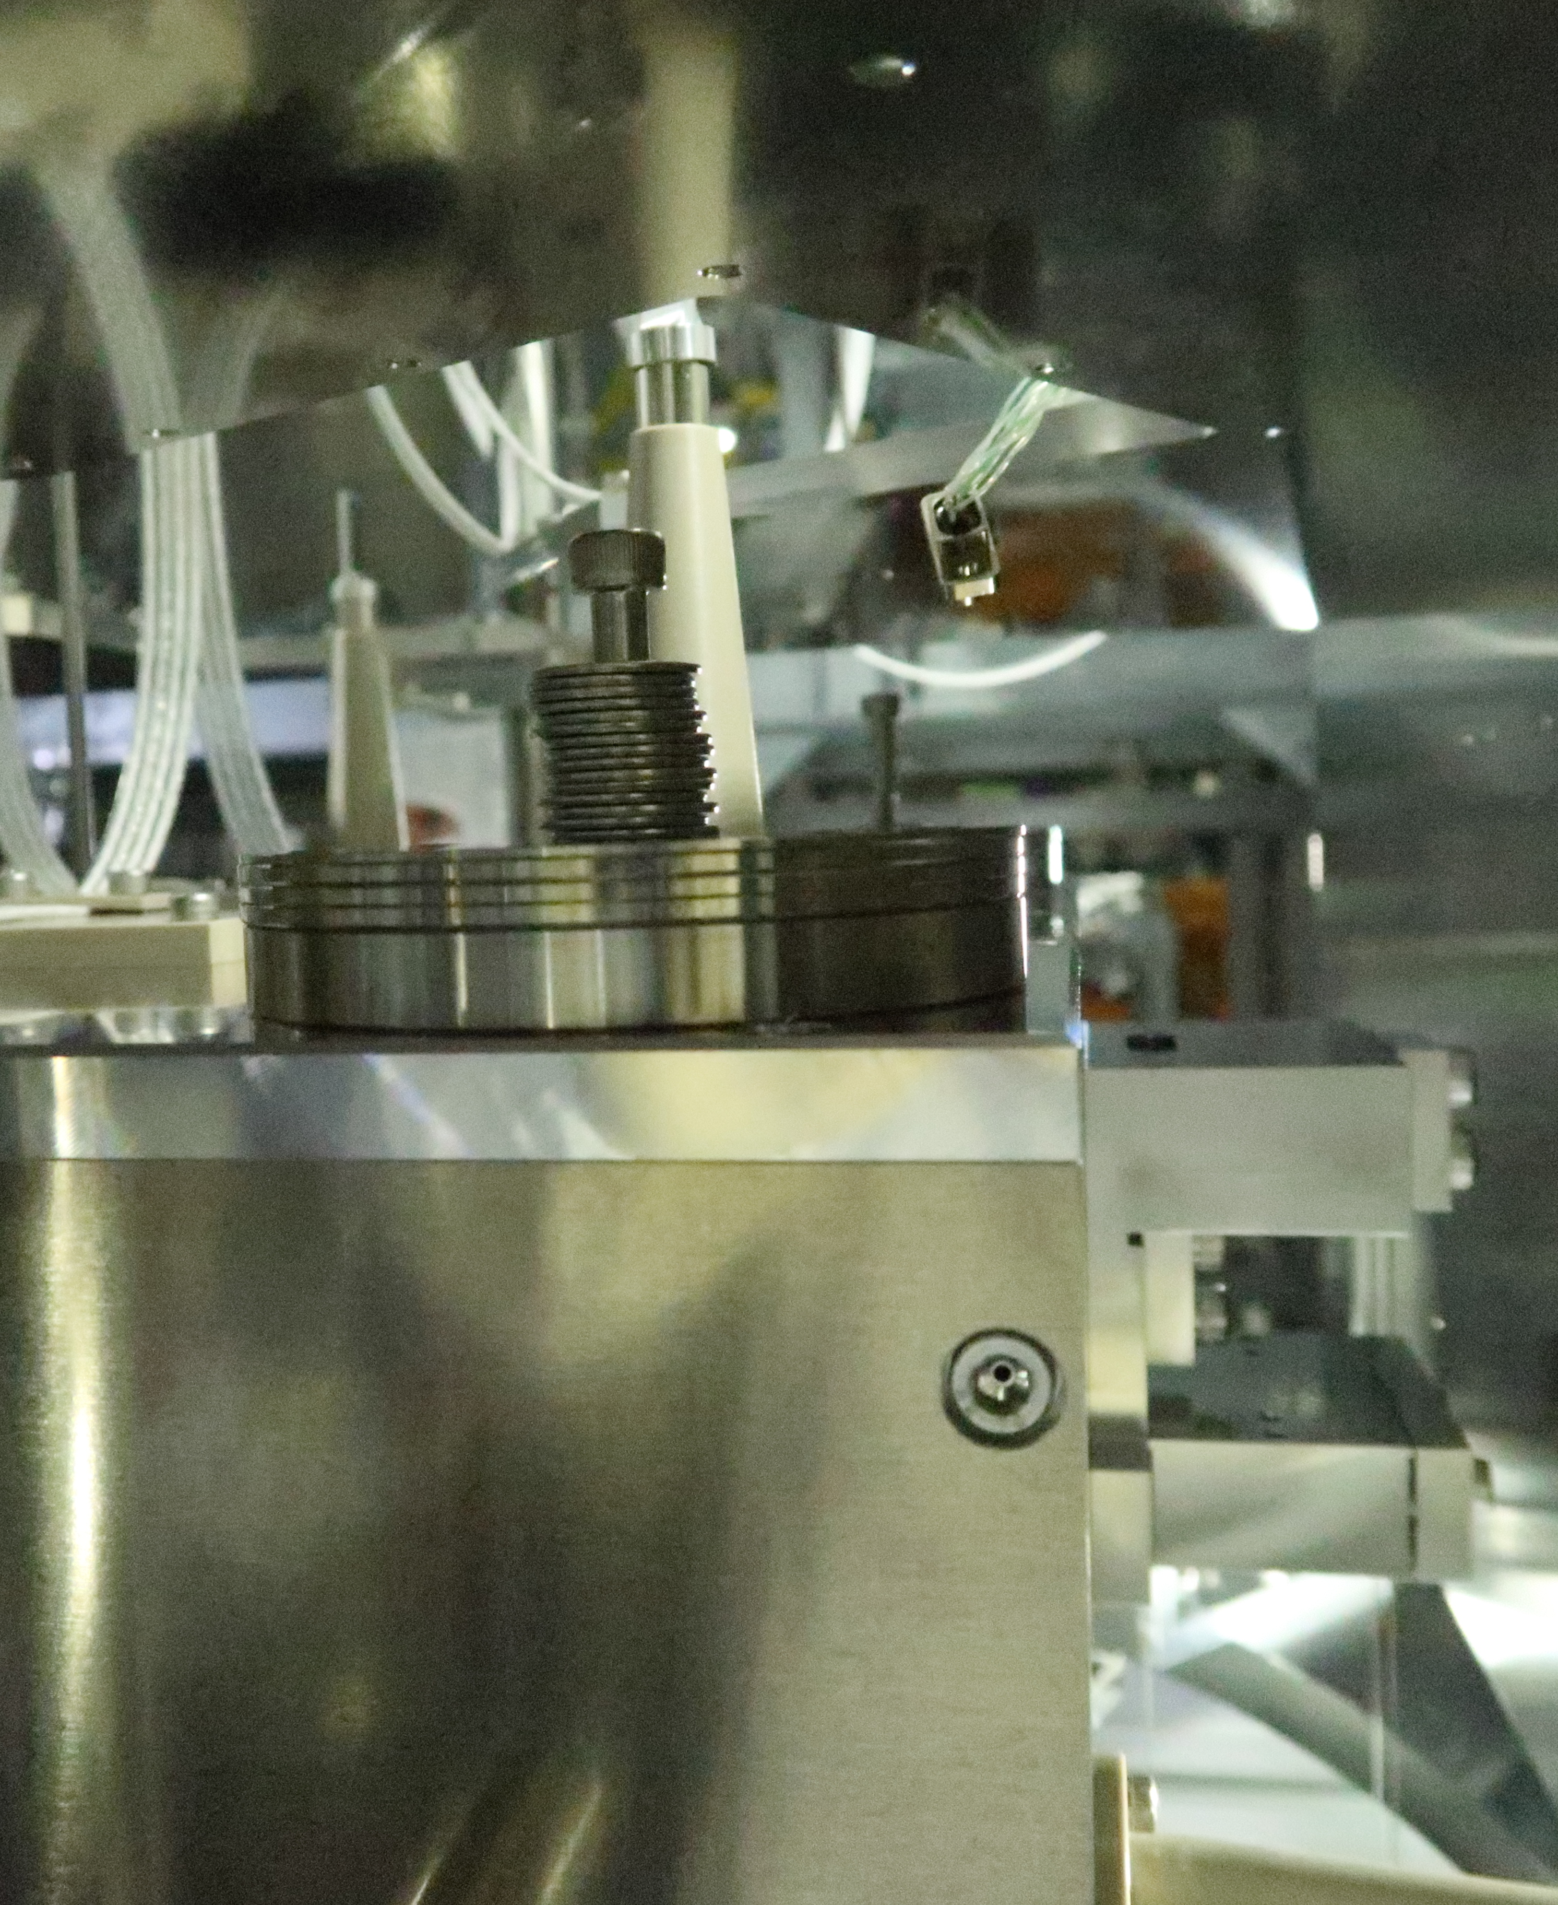
Technical Issues 2 – IM instability
IM was hard to keep balanced.
  Trimming of IM in pitch and roll was possible but difficult.
  Pitch/roll would change by large amounts when IM was set down and picked up again.
  IRM had to be partly disassembled to re-trim the IM.
  Much time wasted.
  IM turned out to be stable only in a narrow range of pitch/roll where the COM was over the head of the BF-IM maraging rod.
  Moved large disk ballast masses from top to bottom to lower COM and make IM unconditionally stable

Slide 10
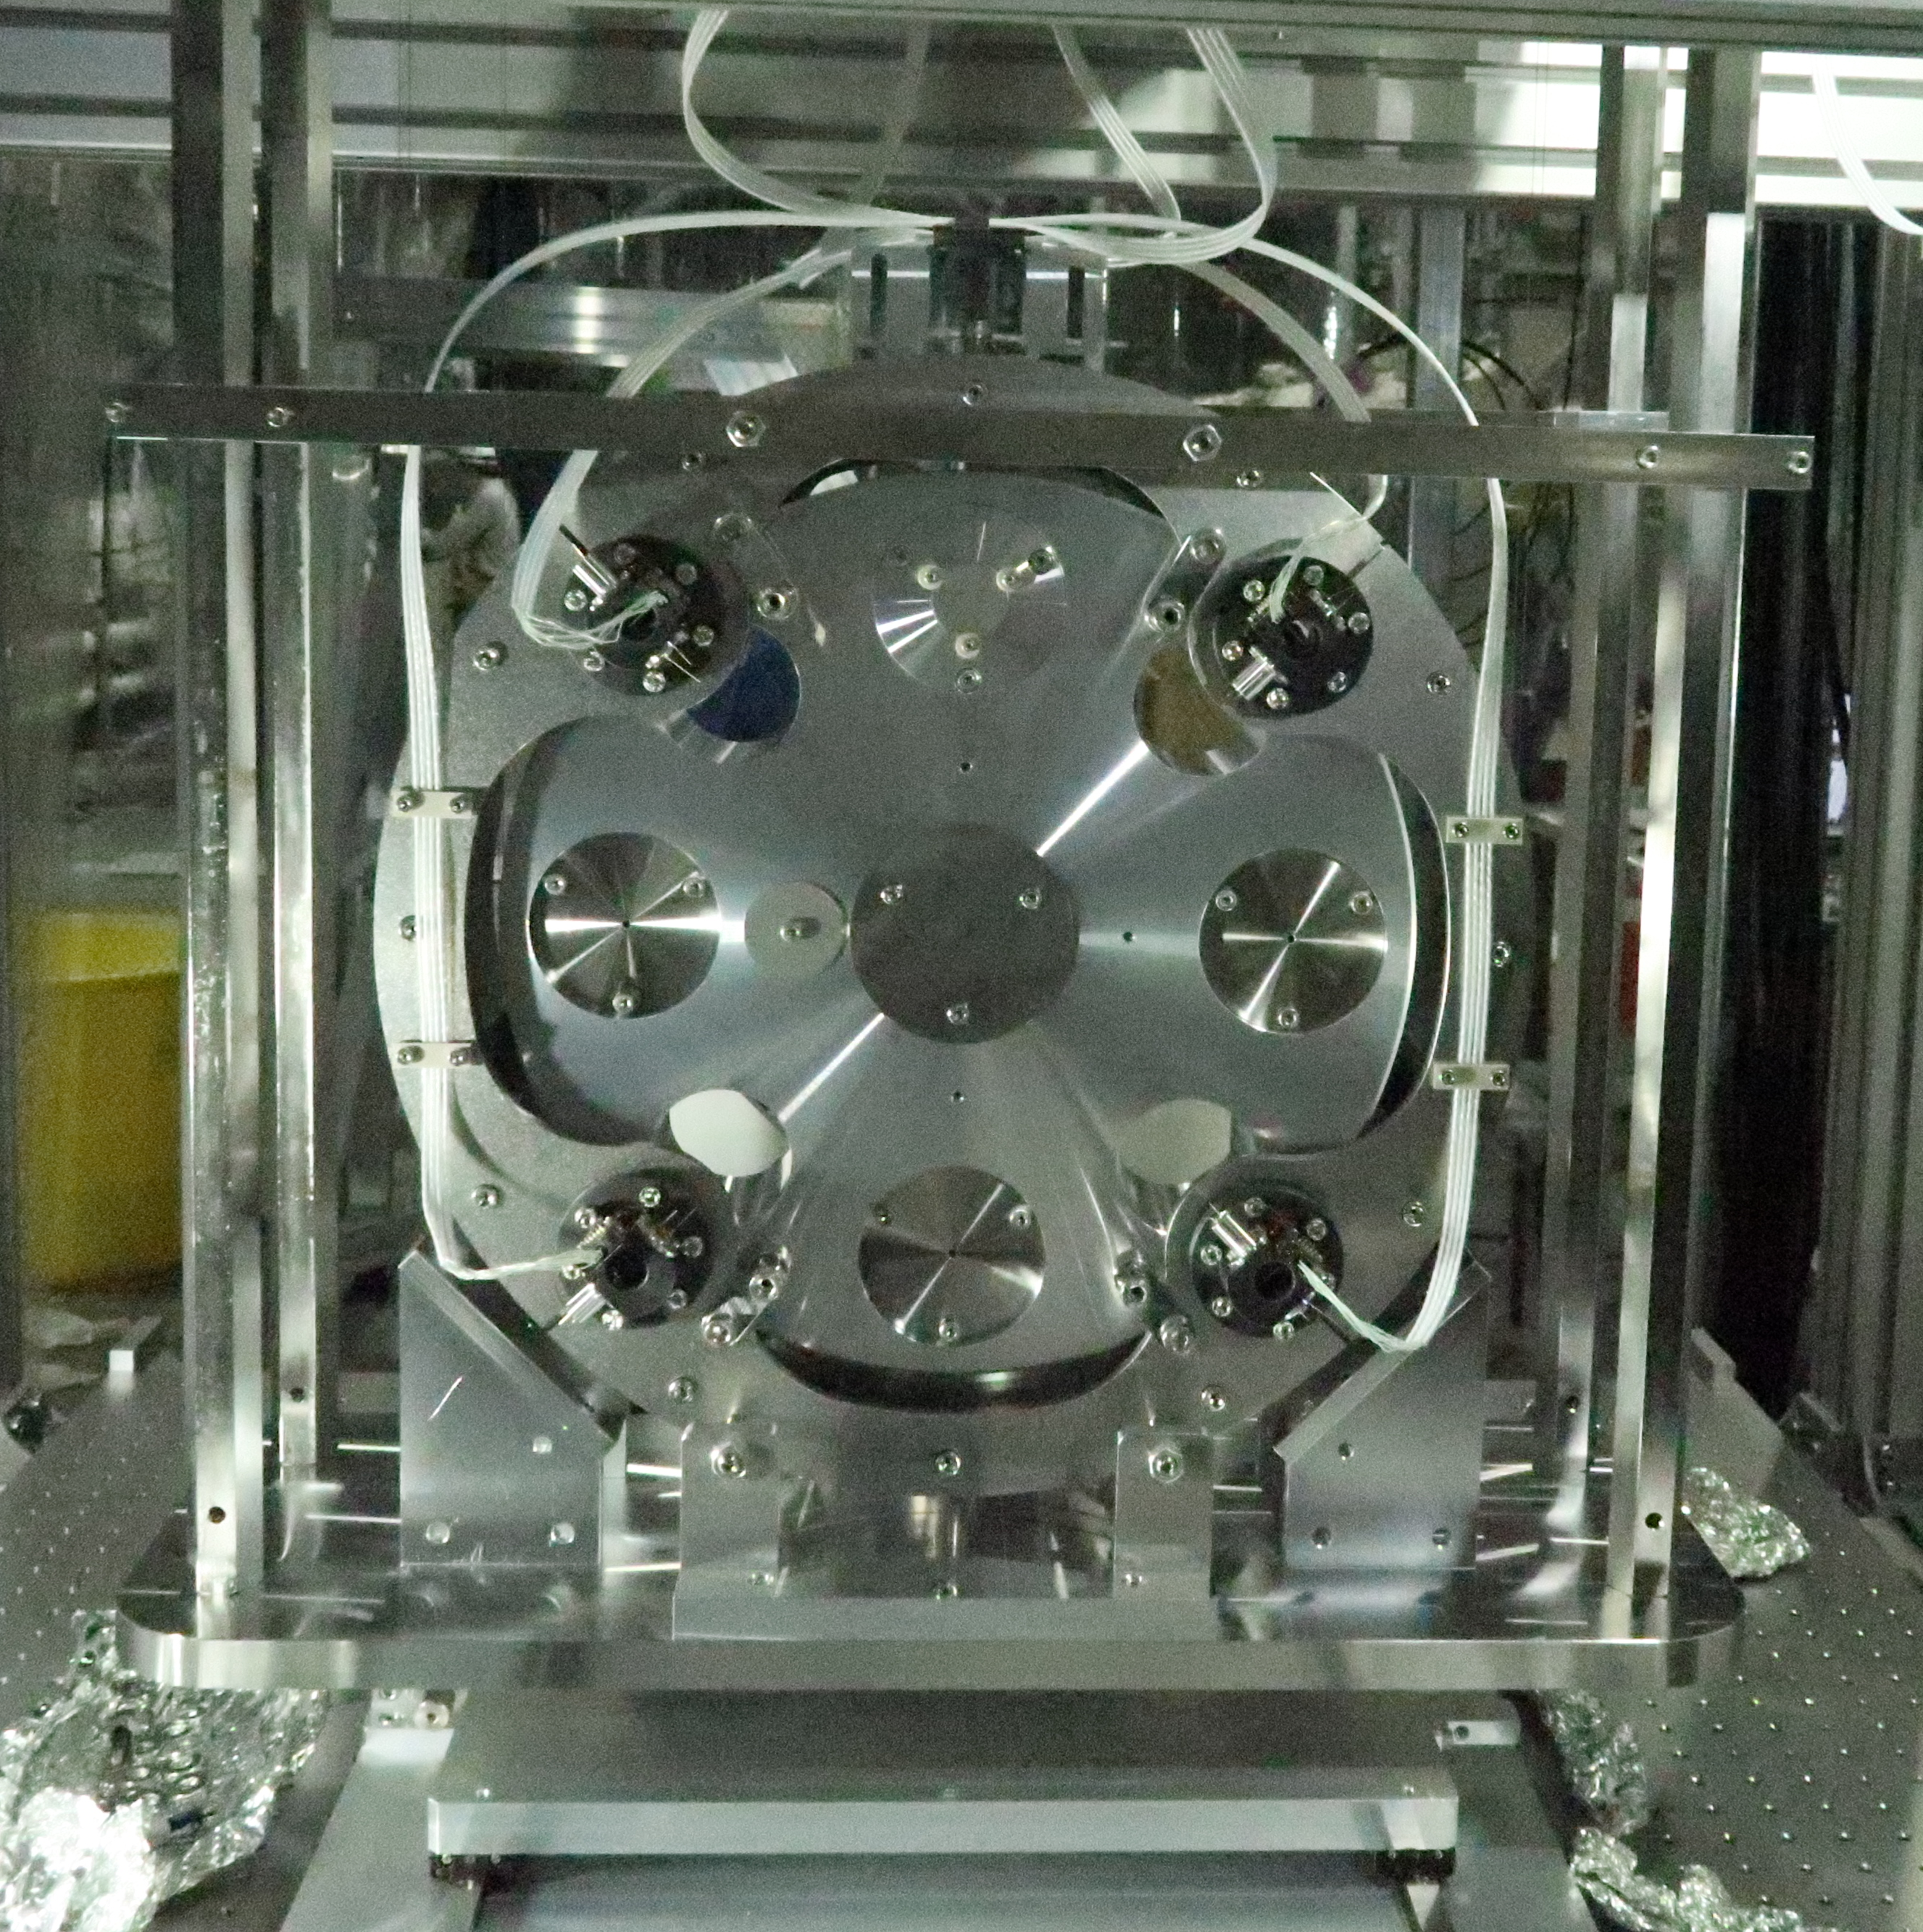
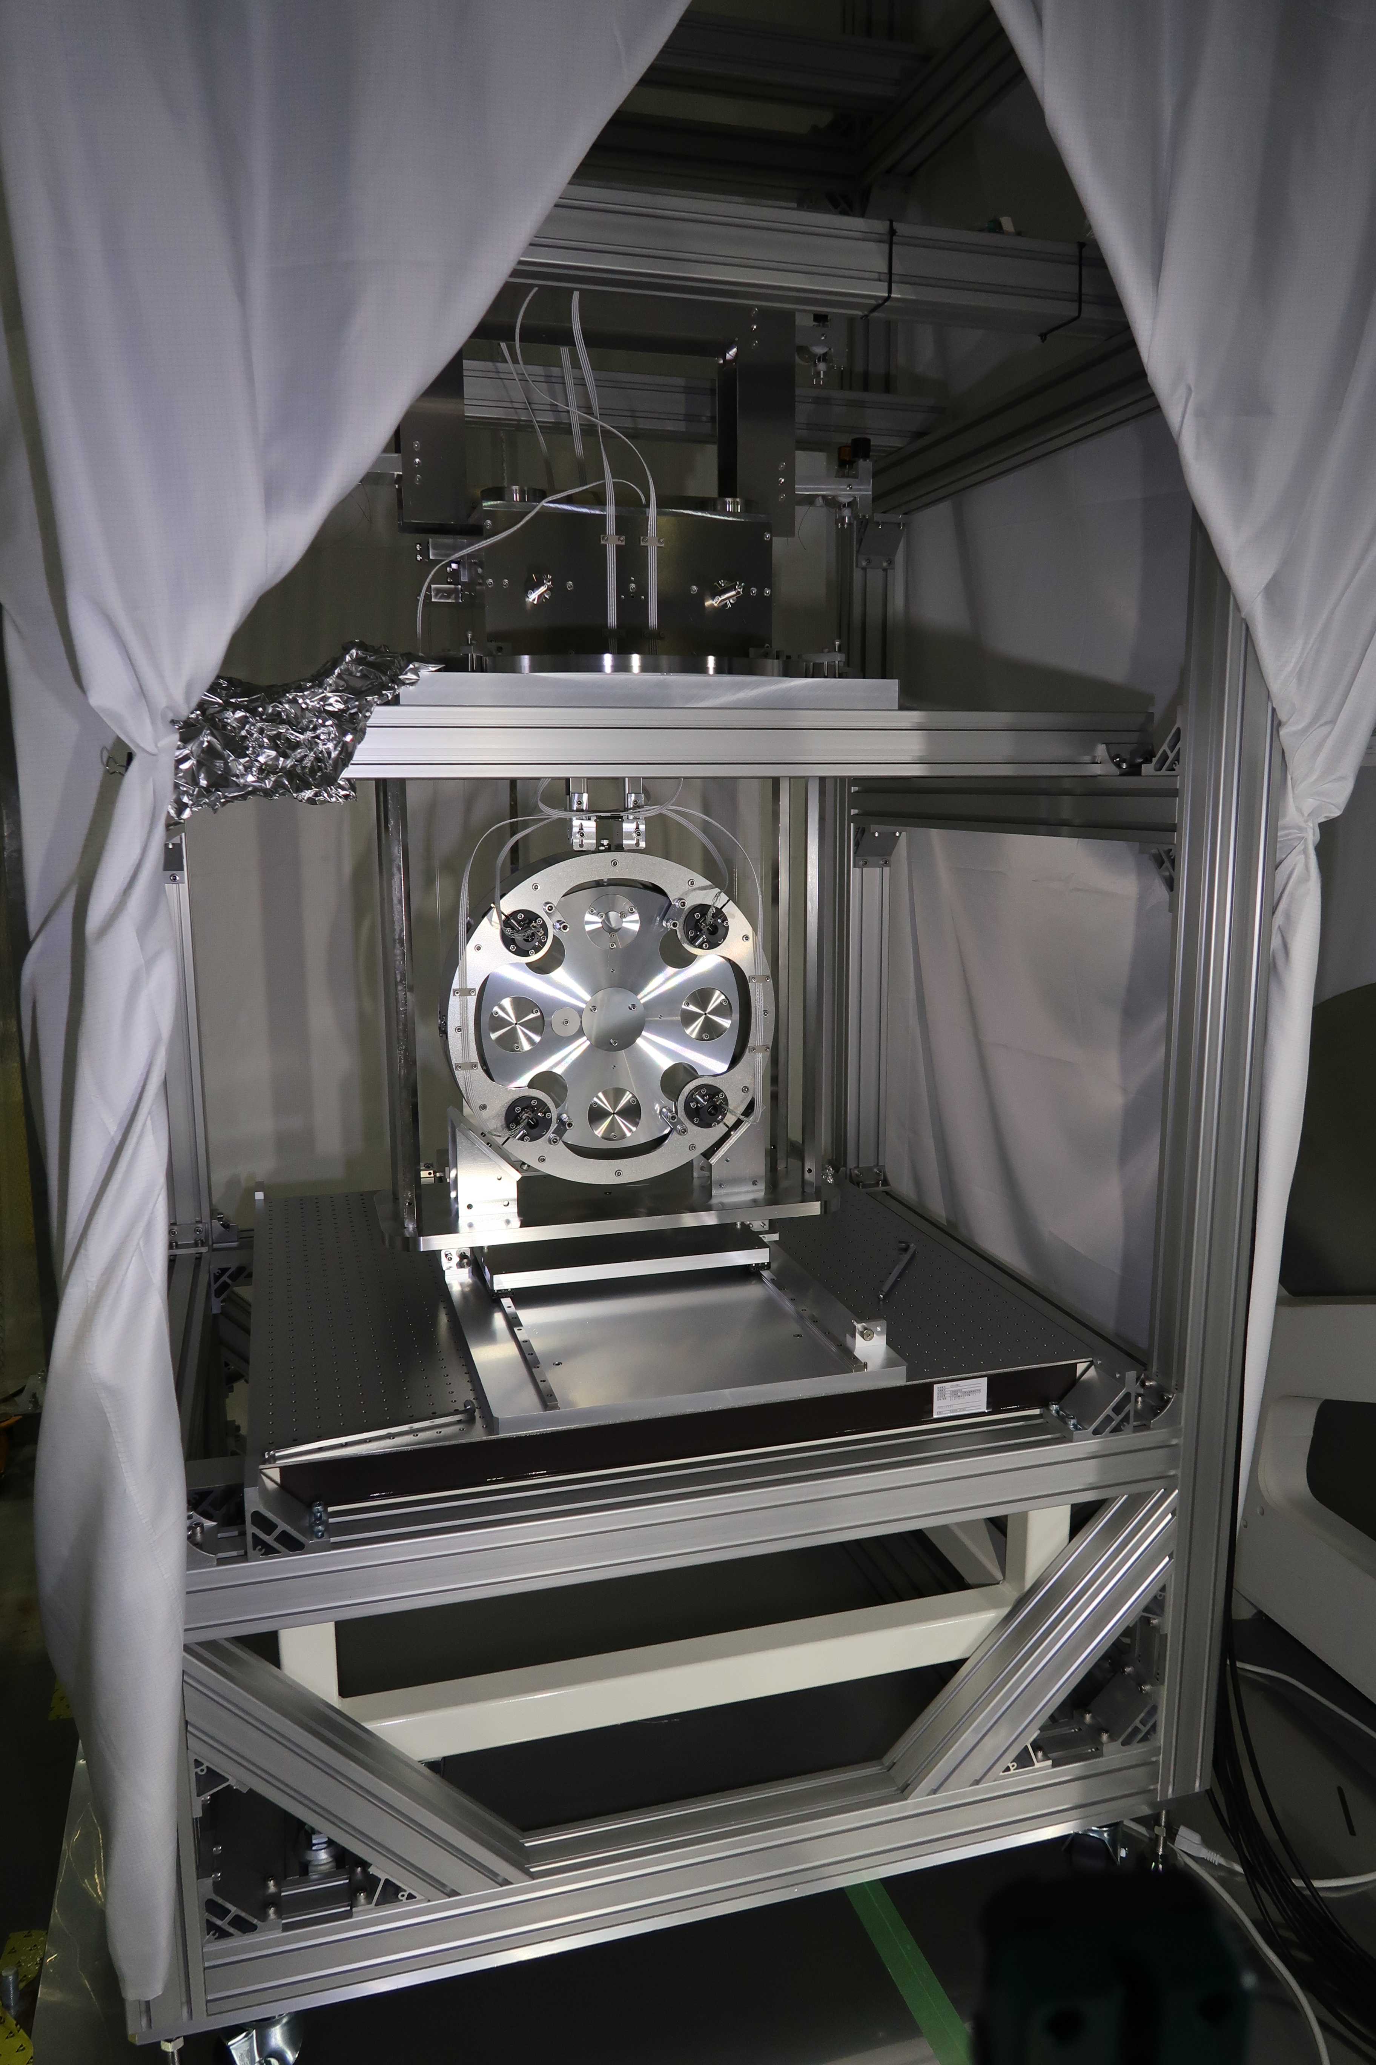
Improvements 1 – New EQ Stops for RM
  Original design had nothing to stop the RM/BS from toppling over in pitch
  Fabian designed additions to the security structure to fix this.

Slide 11
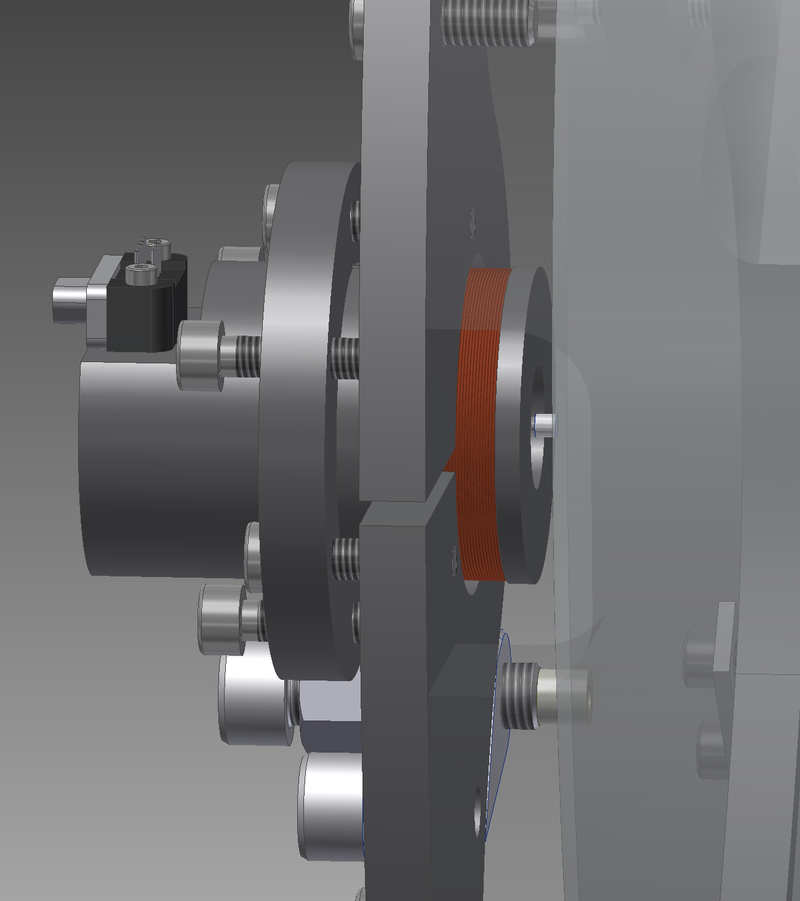
Improvements 2 – New stub flags
Original flags had long tips for shadow sensor.
High risk of damage to flag/OSEM/BS with original OSEMs.
Long flags do work adequately with wide-mouthed OSEMs but plan is to use a stub flag (actuation only) for additional protection.
Aso-san has done a design, including OSEM, flag and gluing jig.
Will be used in the final BS installation.
Similar design underway for SR.
Mirror Box Middle Plate

Slide 12
Schedule/Manpower Issues
Four people just barely enough.
  Hirata-san has done a big chunk of SR procurement (quotes for third payload etc - thanks!) but lots still to do.
  Lots of SR preassembly still to do – PIs, RM, IM, IRM, optics.
  Lots of SR documentation still to do.
  Hirata-san has been able to come to the site recently, but will soon be occupied with SR procurement.
  Schedule assumes significant help from Type A team in construction and testing of PIs.
  Aso-san has arranged for students to help: Zhao, Yokogawa, Kuwahara, Liu, Forsyth, but manpower is still limiting.

