Slide 1
Status of The KAGRA Project
2017/3/15@LVC Meeting at Hilton Pasadena
National Astronomical Observatory of Japan
Yoichi Aso
On Behalf of The KAGRA Project

Slide 2
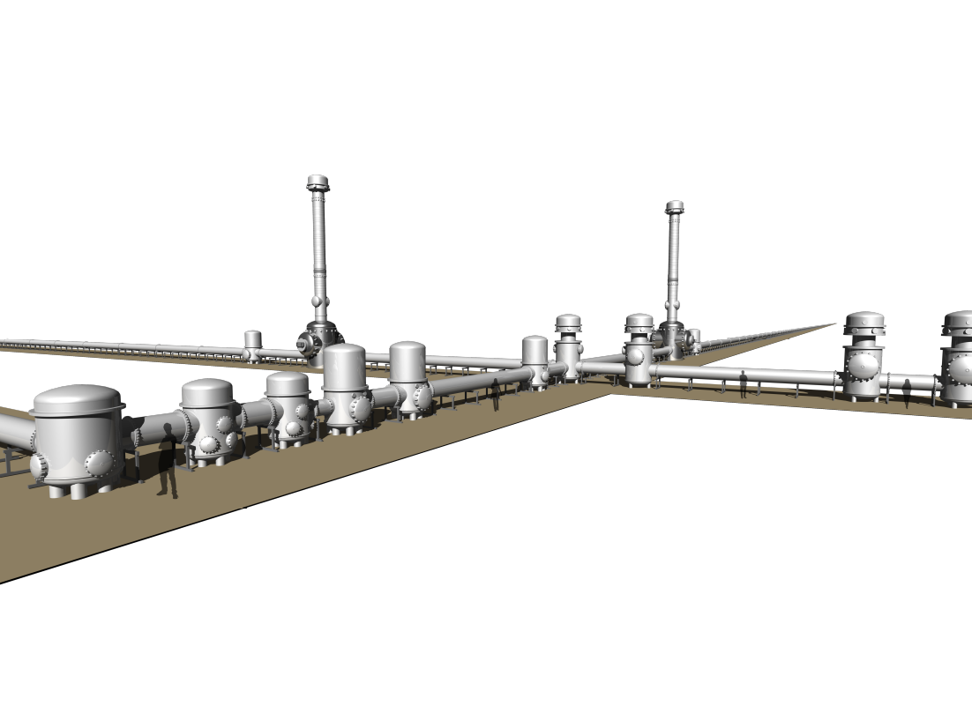
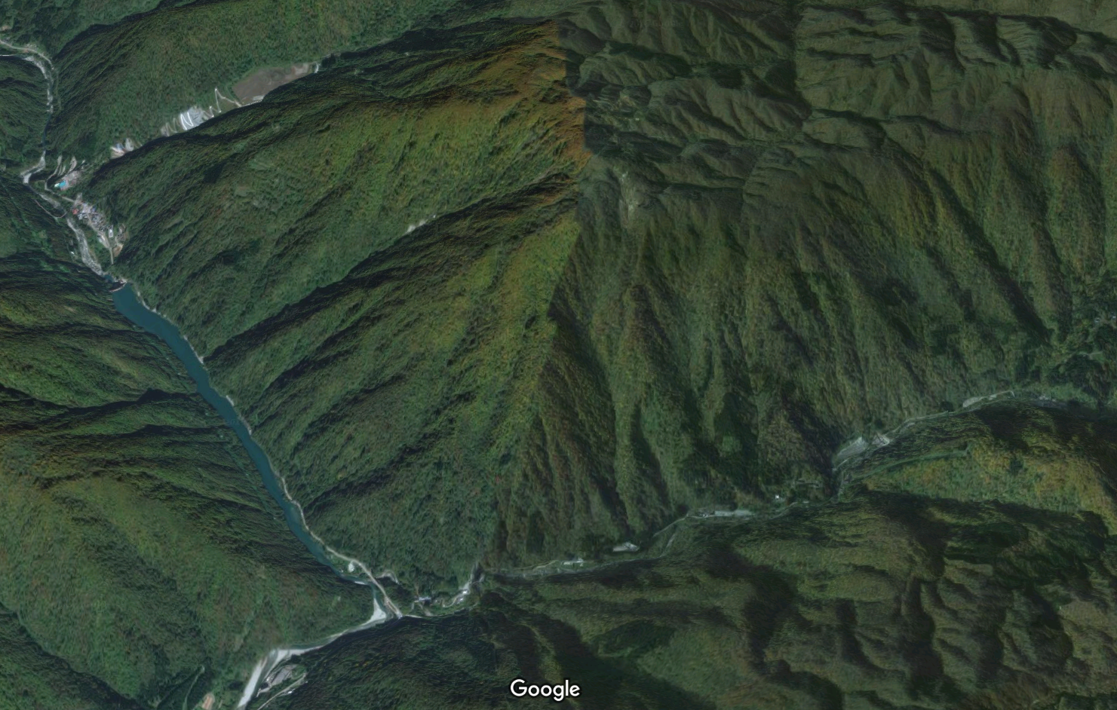
The KAGRA Project
About 300 collaborators
Over 30 Japanese institutes, over 40 international institutes

Slide 3
KAGRA Baseline Configuration
BRT
ETMY
Type-A (cryogenic)
Mode Cleaner
Type-B
Type-Bp
PRM
ITMY
PR2
Type-C
IMMT
ITMX
ETMX
BRT
Others
IFI
BS
PR3
Output Optics
SR2
OMMT
SR3
OFI
SRM
OMC
Output
Optics
OST

Slide 4
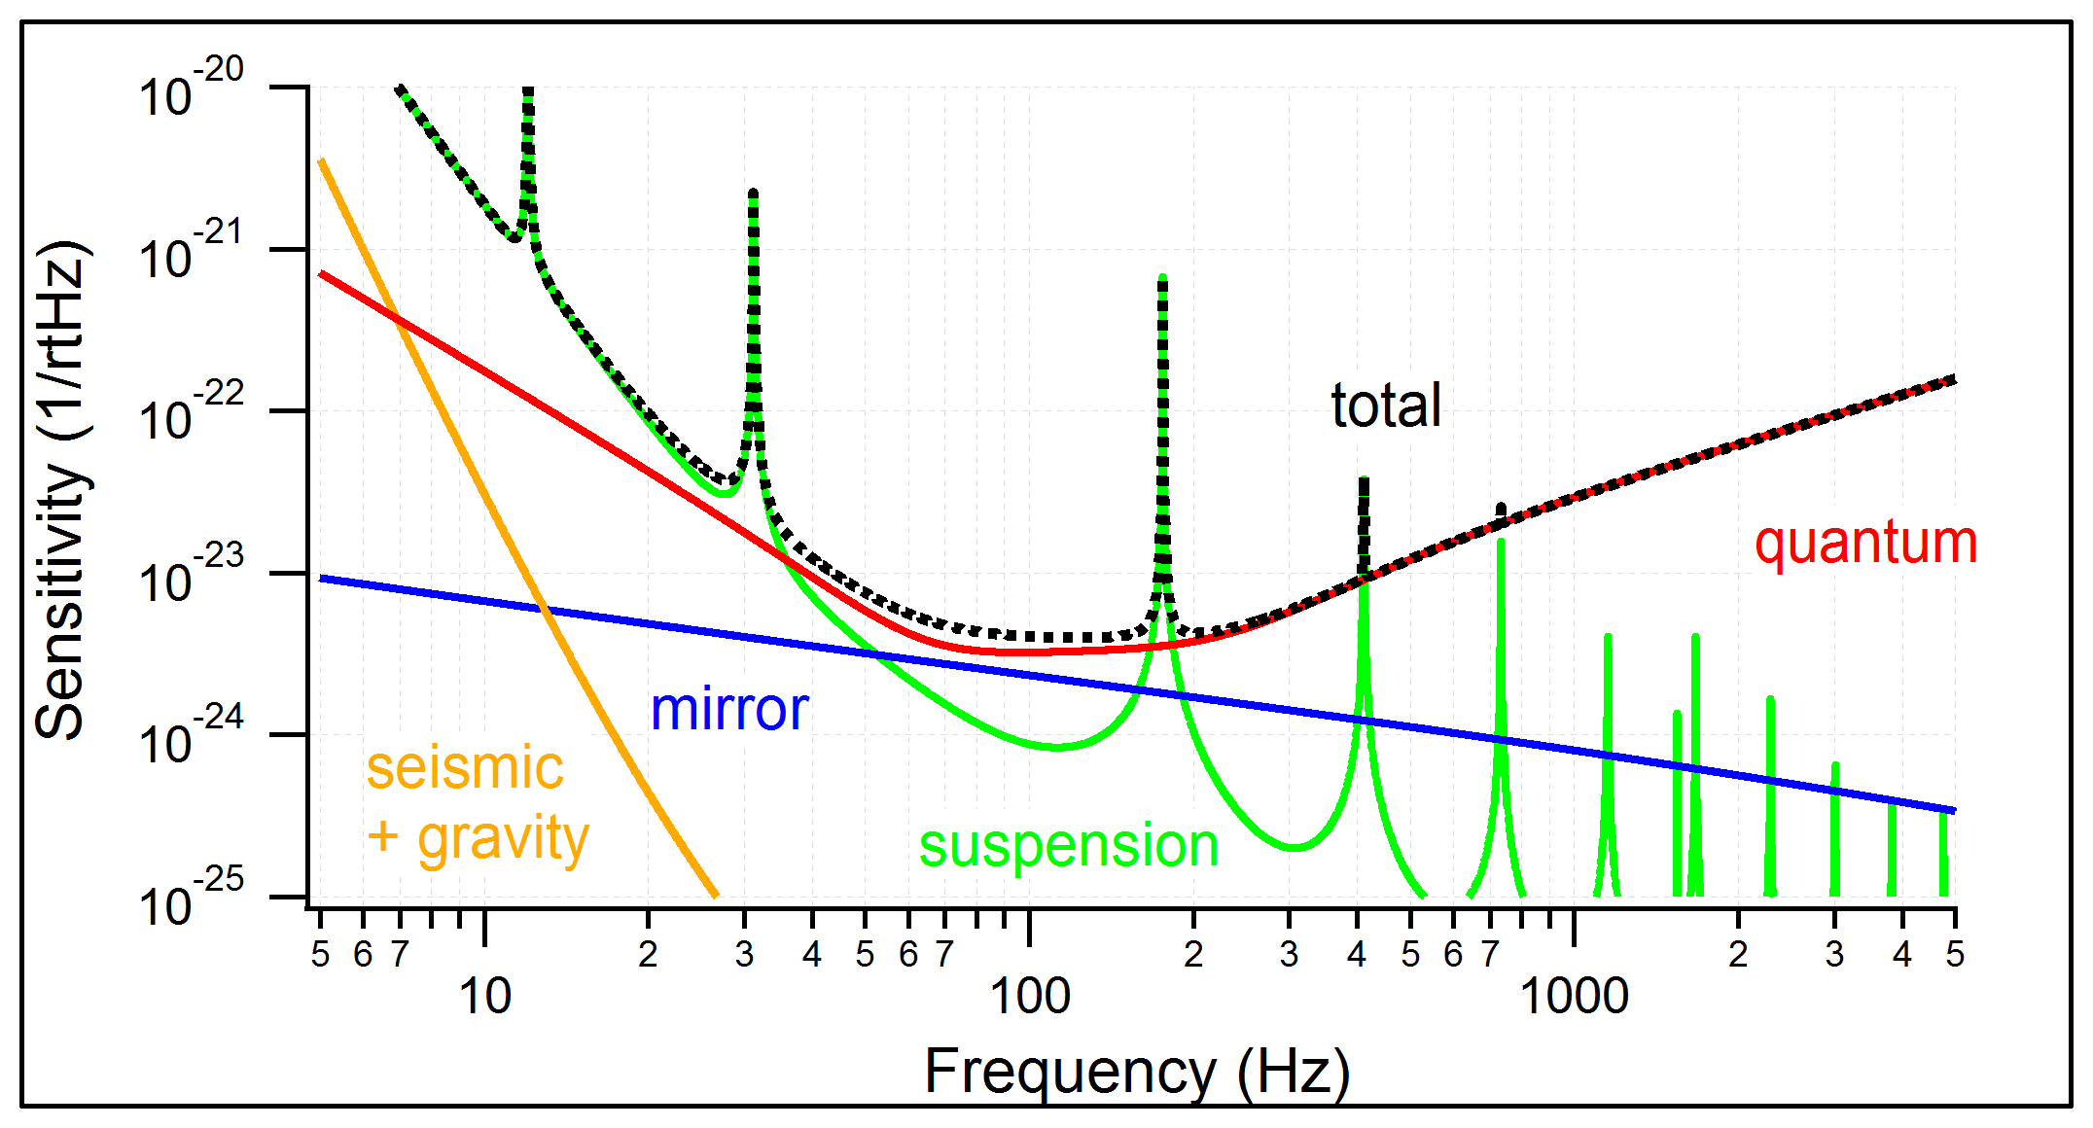
KAGRA Baseline Sensitivity
NSNS Range = 151Mpc

Slide 5
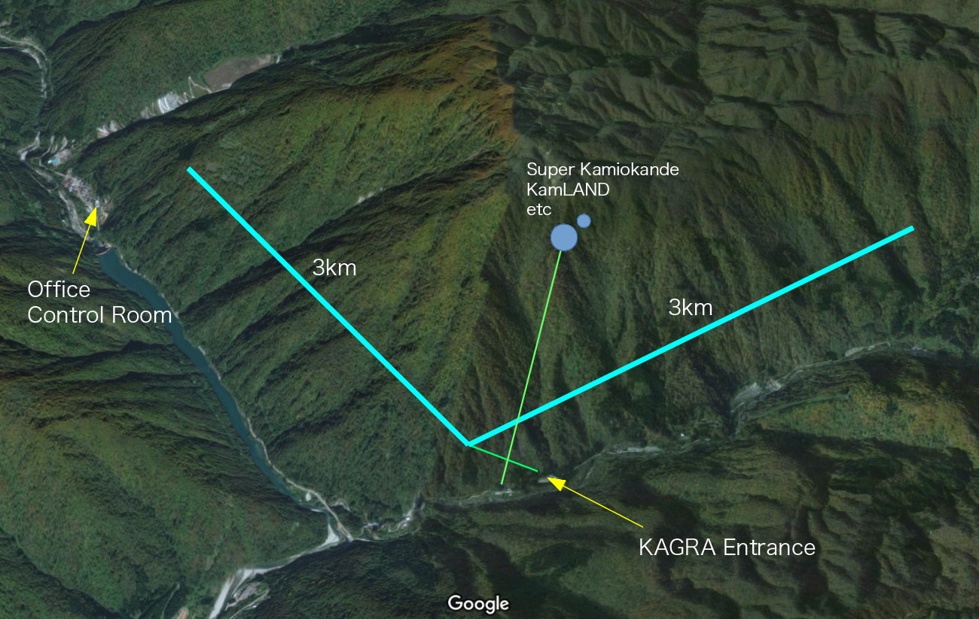

Slide 6
Roadmap
2016 |  |  |  | 2017 |  |  |  | 2018 |  |  |  | 2019 |  |  |  | 2020
Suspension installation
Cryogenics development
Cryo. payload installation
Cryo. payload upgrade
Cool down
Cool down
IFO upgrade
Noise hunting
Initial KAGRA
Michelson at room temp.
Test run
Phase 1
Michelson at cryogenic temp.
Test run
Phase 2
RSE at cryogenic temp.
Test run
Phase 3
RSE at cryogenic temp.
Observation run
6

Slide 7
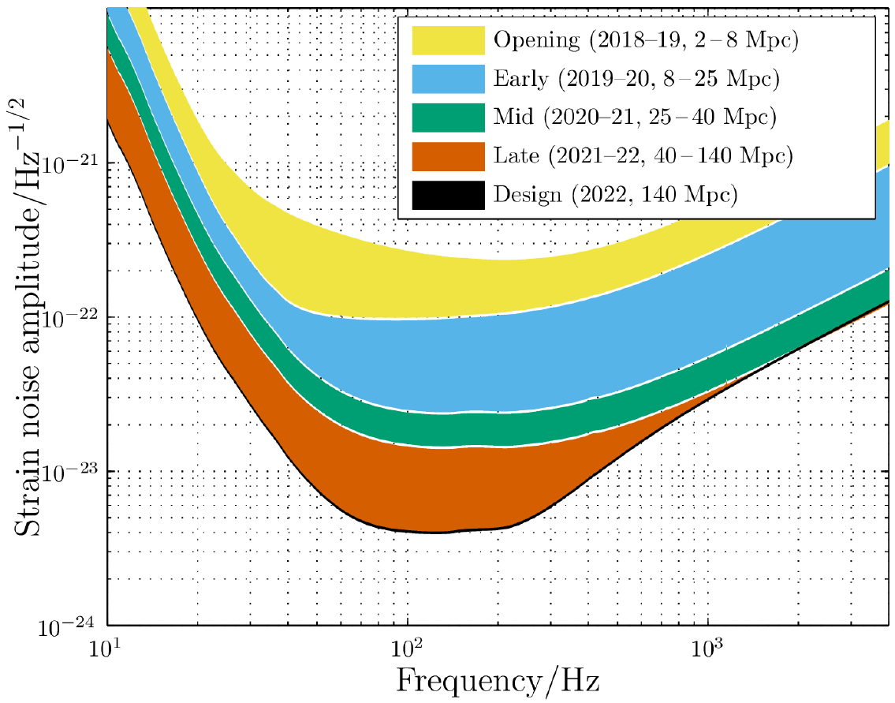
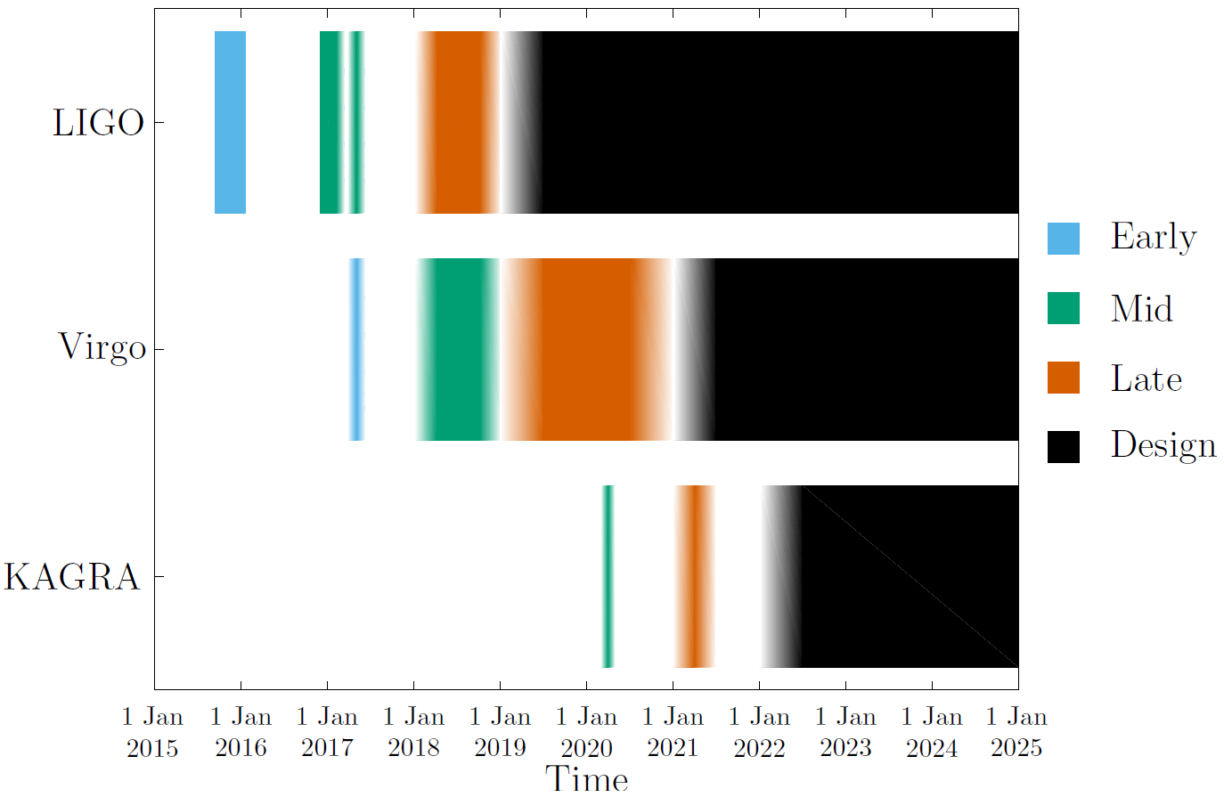
Observation Scenario
Under discussion

Slide 8
Initial KAGRA (iKAGRA)
ETMY
Mode Cleaner
Type-Bp’
Type-C
PR2
Others
ETMX
IMMT
Fixed
IFI
BS
PR3
GW signal
Michelson (mid-fringe lock -> RF readout)
Room Temperature
Temporary Suspensions/Mirrors

Slide 9
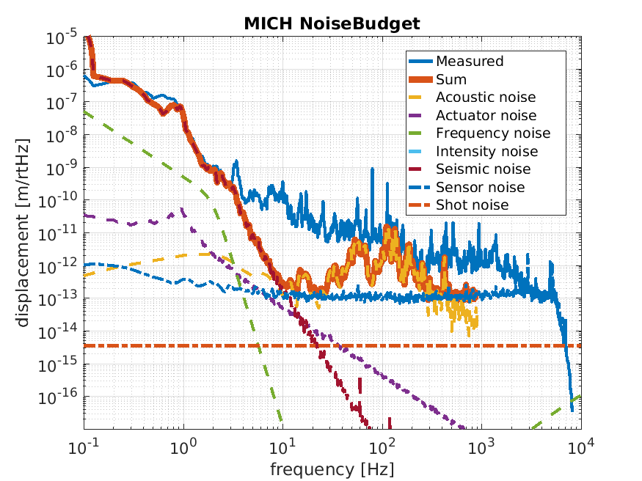
iKAGRA Test Run
March 25 – April 25, 2016
Main Purpose
Test of the KAGRA facility
Gain experience in underground work
Only 3km arms were under vacuum
Strong beam clipping by optical windows

Slide 10
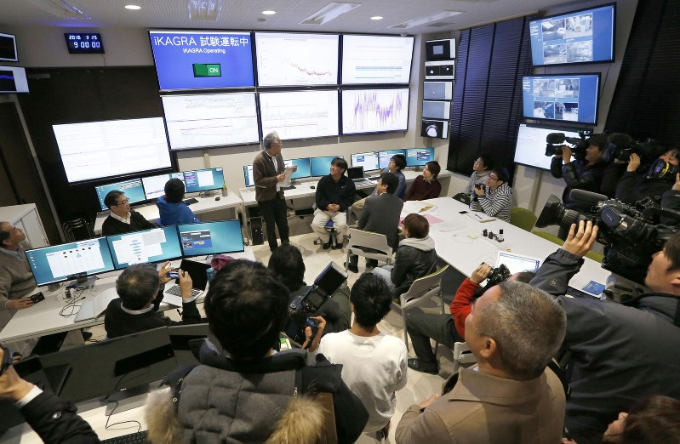
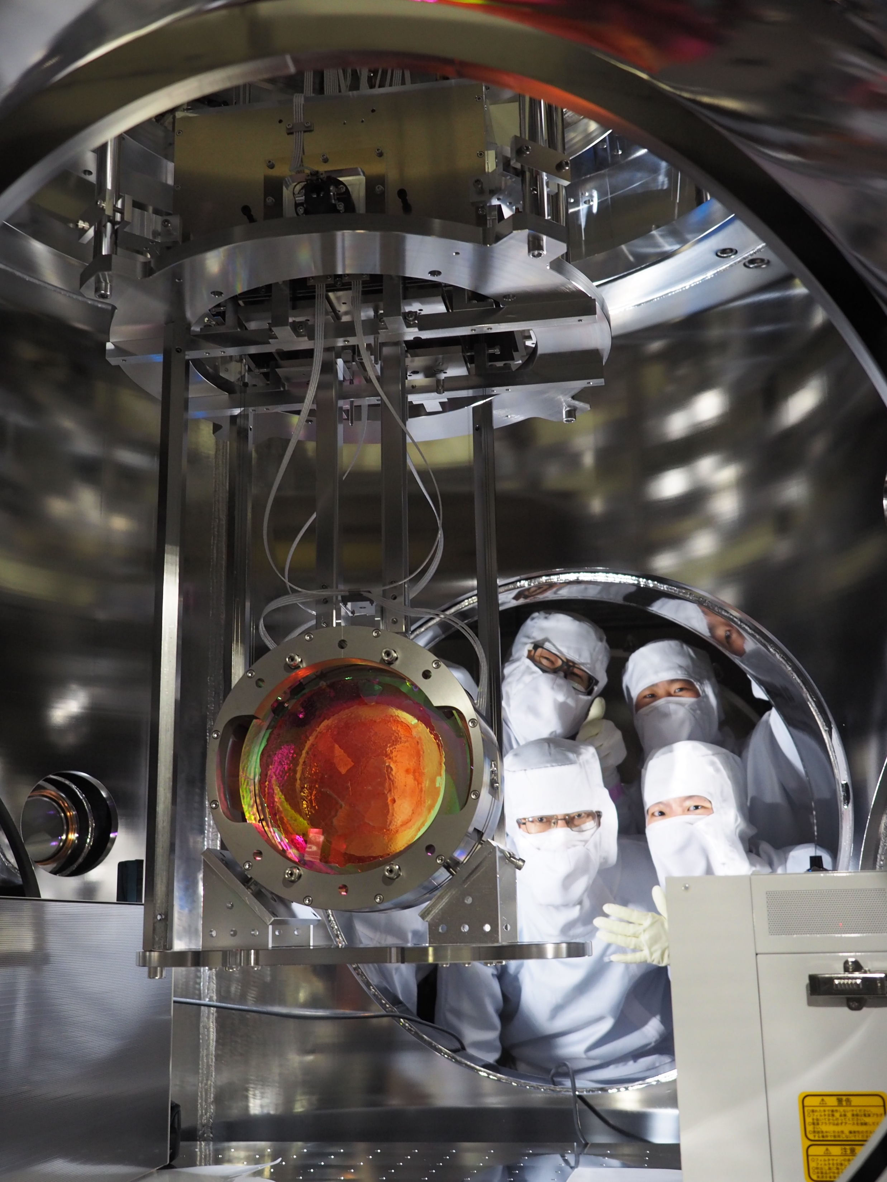

Slide 11
bKAGRA phase 1
BRT
ETMY
Mode Cleaner
PRM
PR2
IMMT
ETMX
BRT
IFI
BS
PR3
SR2
Cryogenic Michelson Interferometer
Full scale suspensions
High power compatible input optics
SR3
GW signal
Start operation by the end of March 2018

Slide 12
bKAGRA phase 1 schedule
2017 |  |  |  |  |  |  |  |  |  | 2018
3 | 4 | 5 | 6 | 7 | 8 | 9 | 10 | 11 | 12 | 1 | 2 | 3
PR Mirrors
BS
SR3
SR2?
ETMX
Type-A
ETMY
Type-A
ETM Coating
Suspension
Prep.
ETMY
Cryo-Payload
ETMY
Cool down
ETMX
Cryo-Payload
ETMX
Cool down
PSL Upgrade
IMC
MICH alignment
Lock

Slide 13
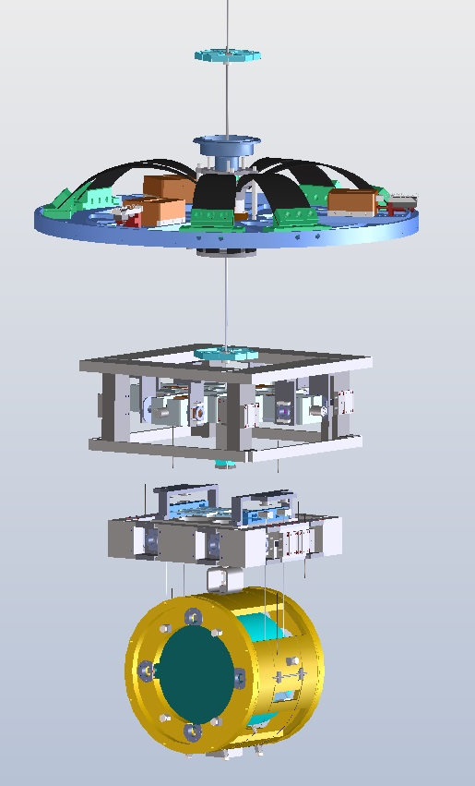
Type-A + Cryogenic Suspension
Cryo-Payload
14m
Type-A
(room temp.)

Slide 14
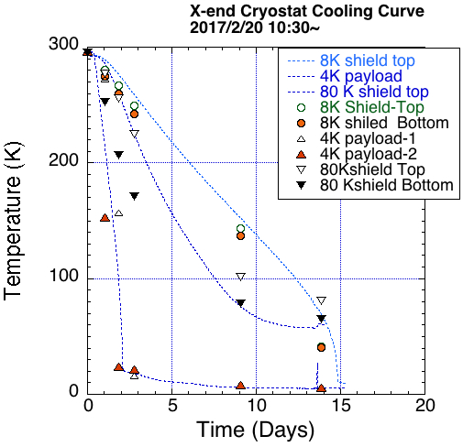
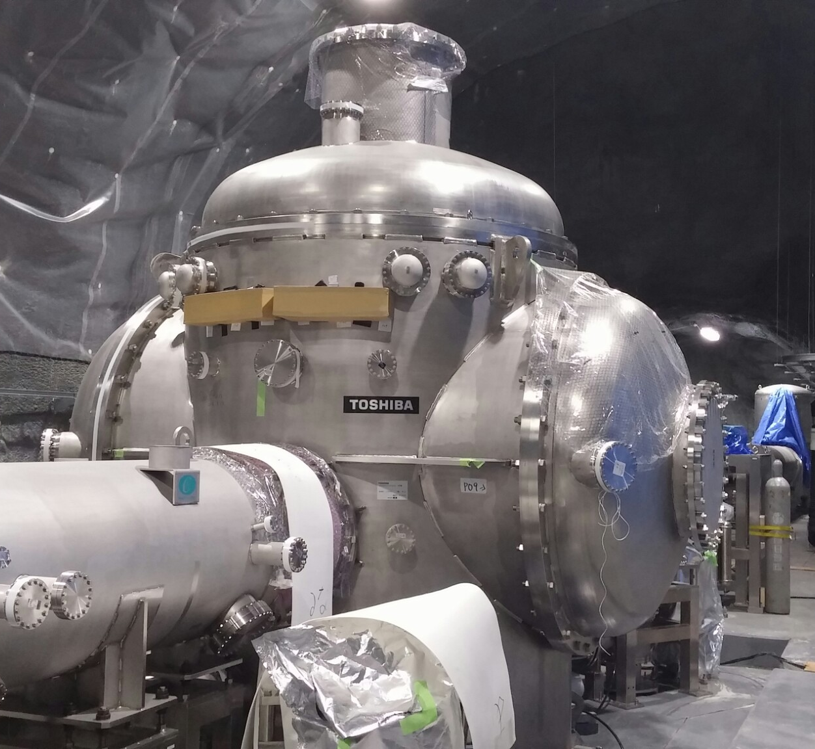

Slide 15
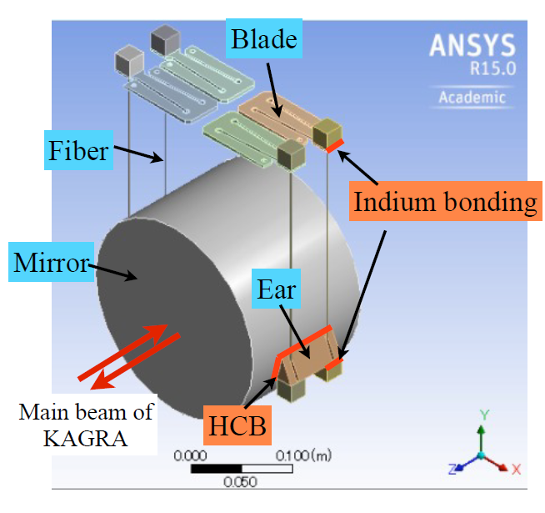
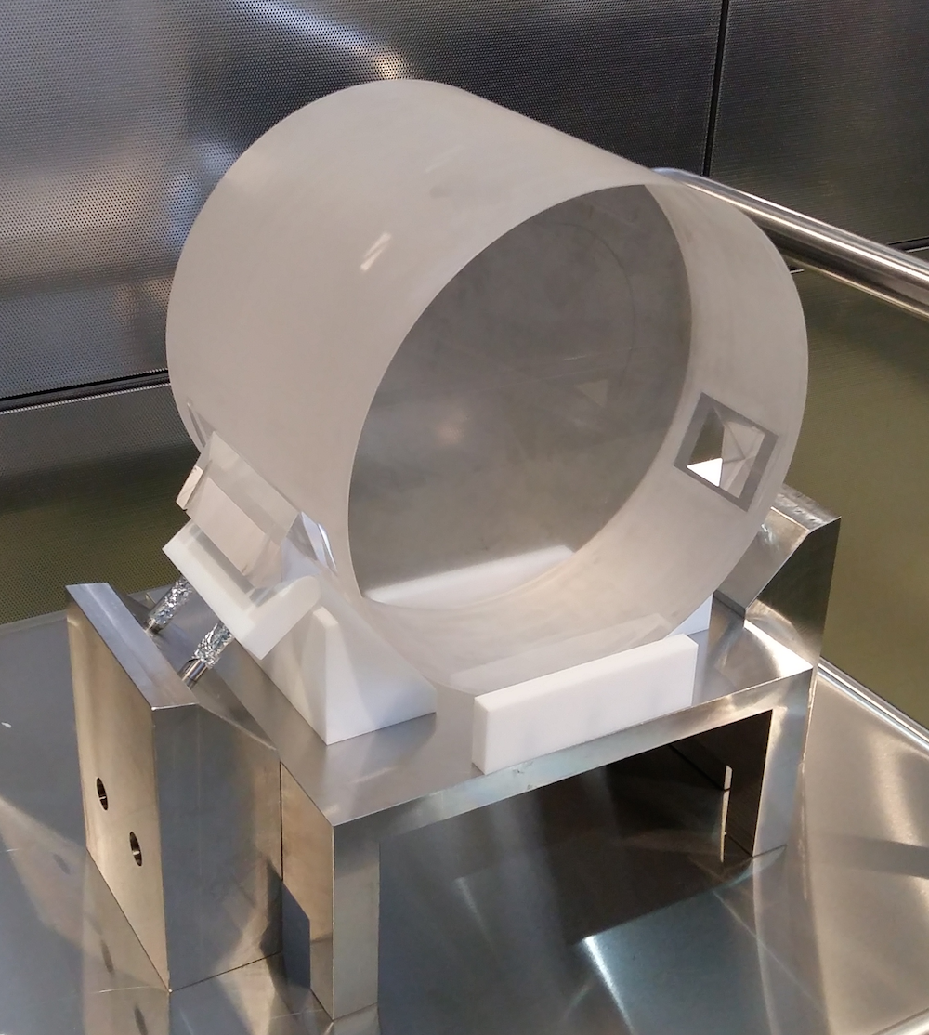
Hydro-Catalysis Bonding Test
Entire weight was
supported by HC bonded ears
Passed 15-day endurance test
From the presentation by Kieran Craig@5th ELiTES Meeting

Slide 16
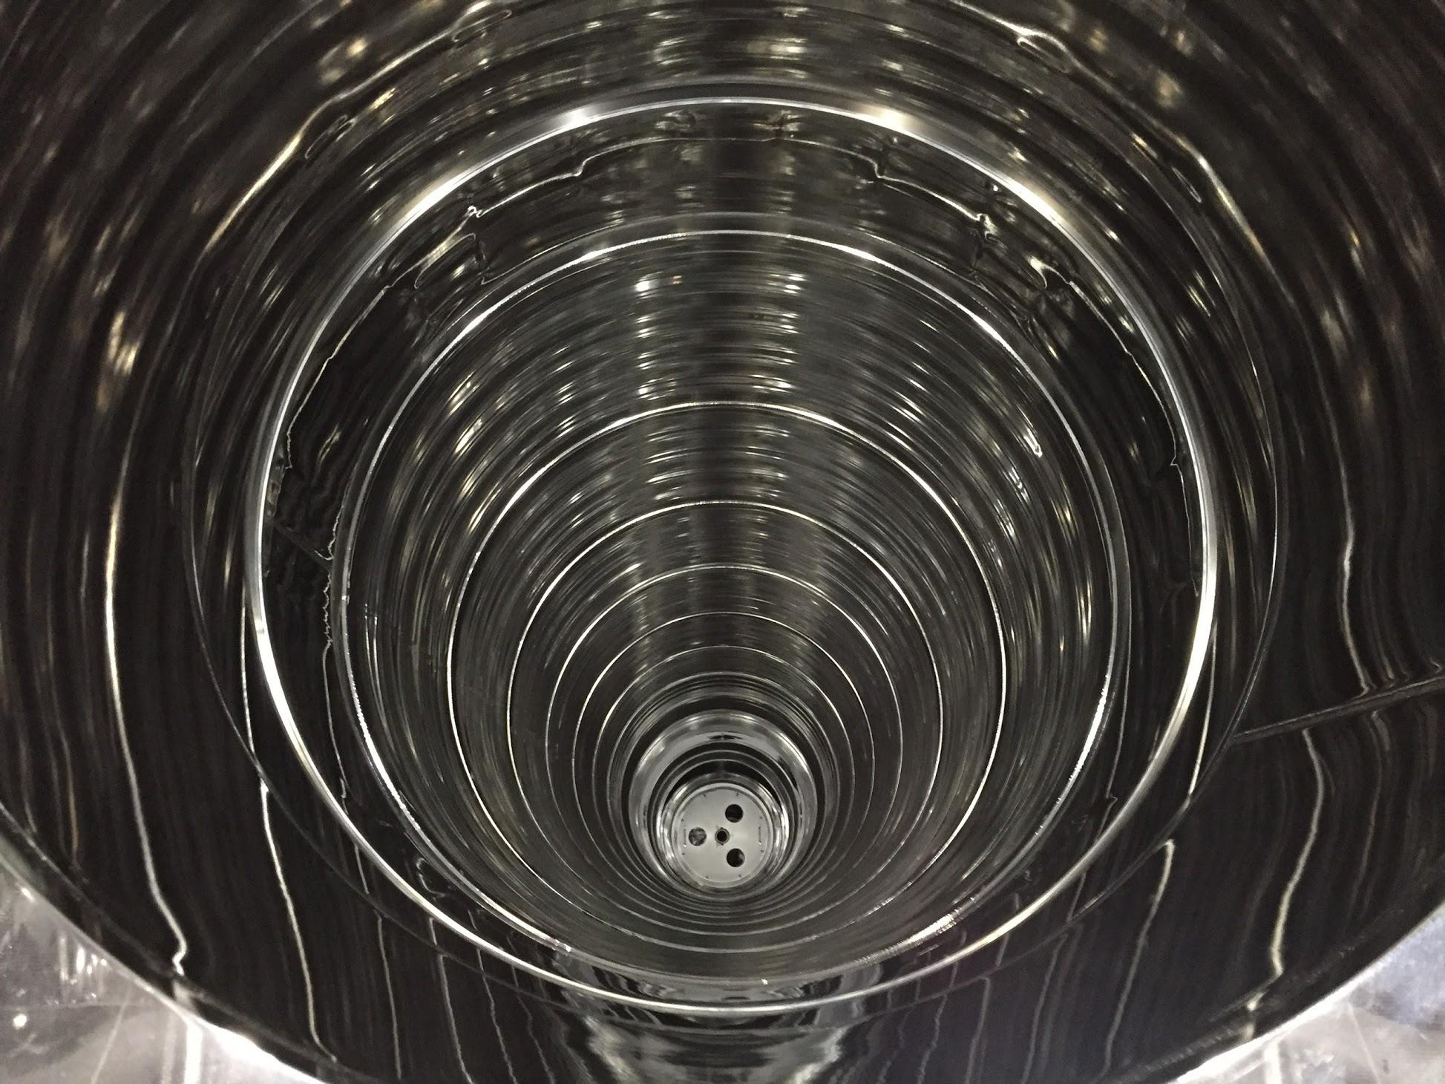
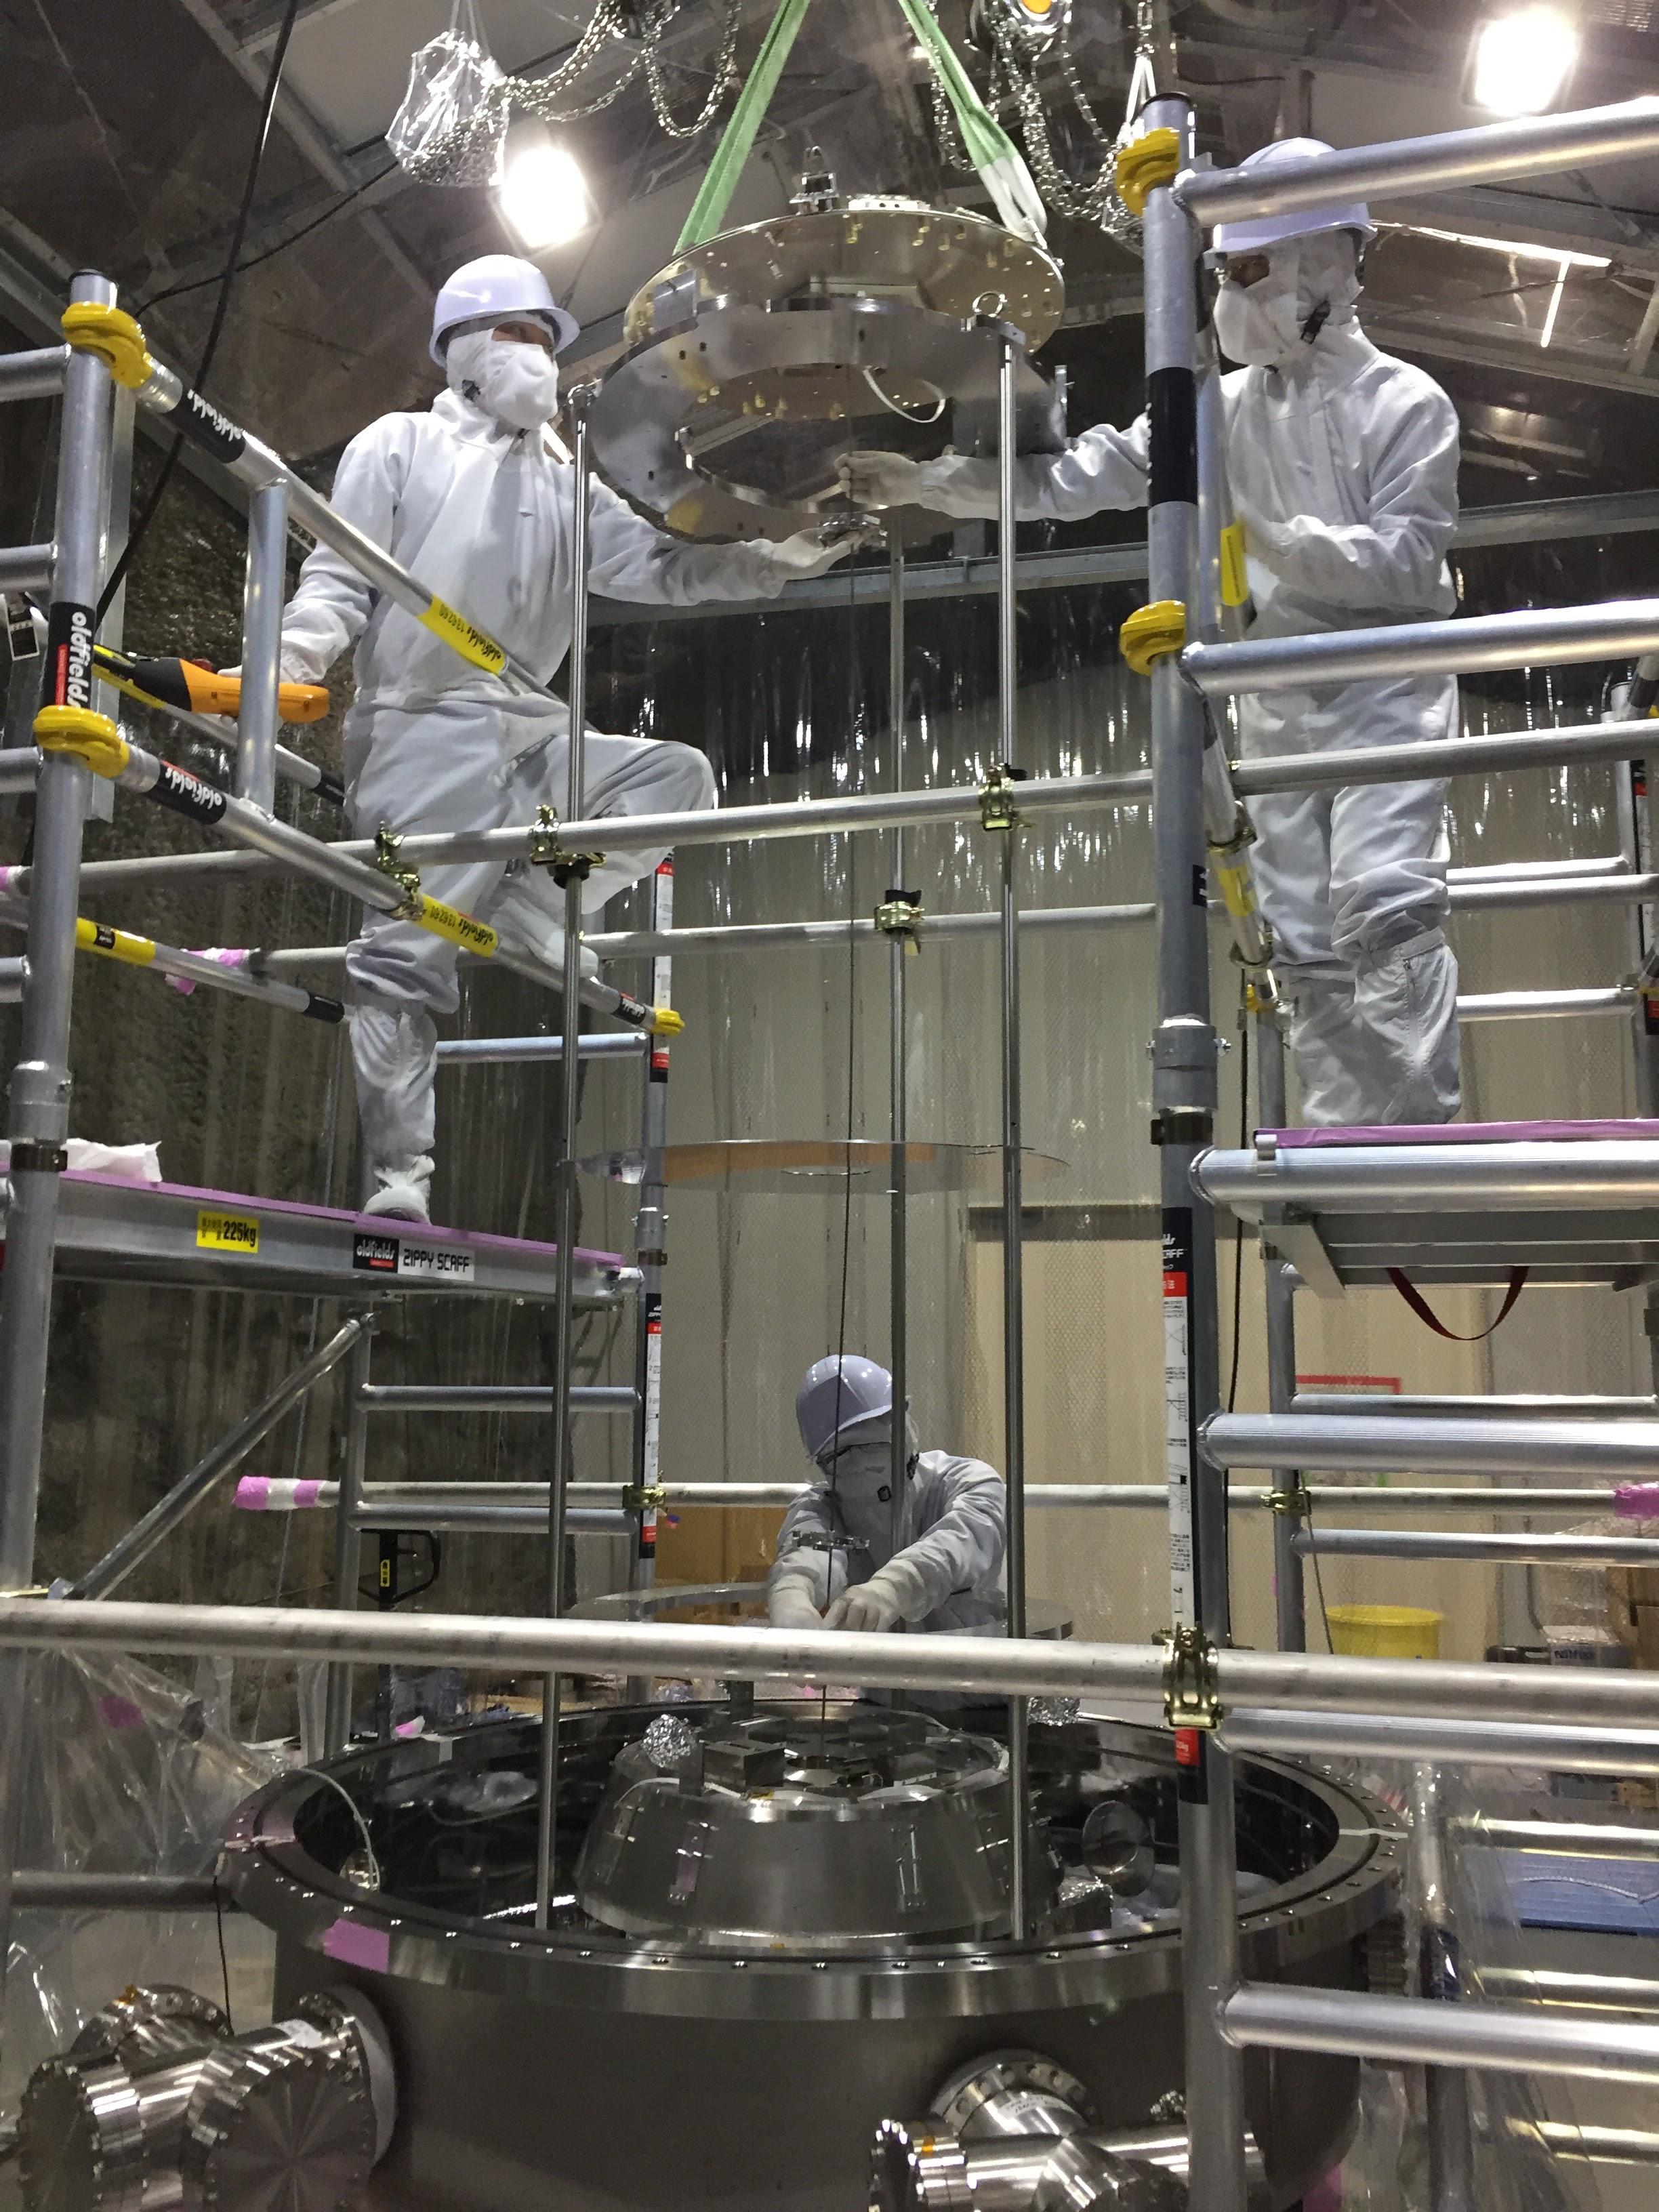
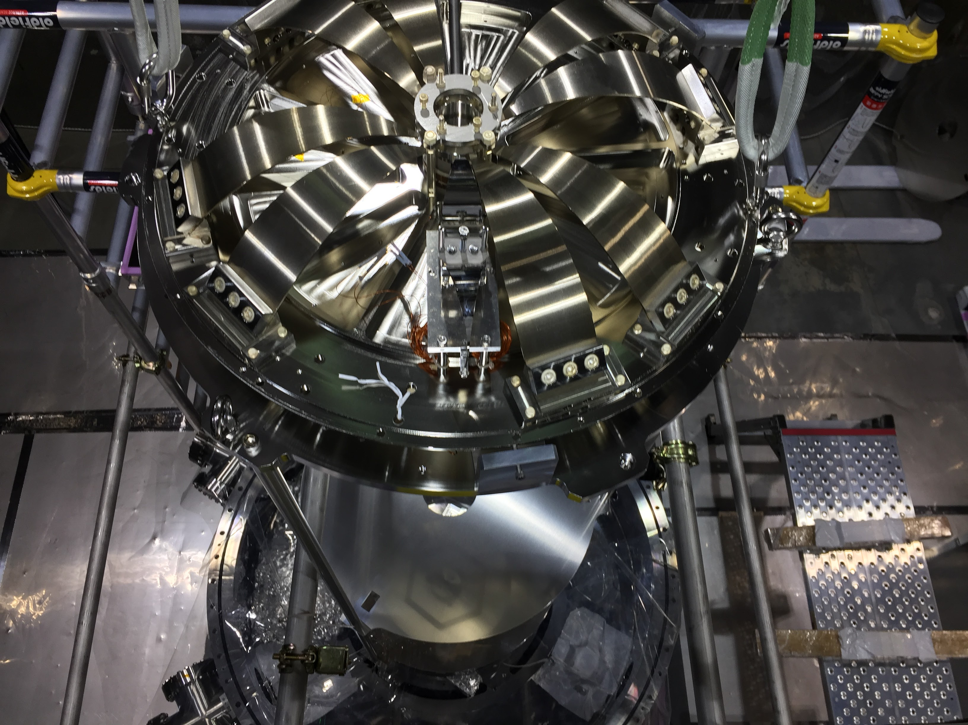
Type-A Suspension Installation

Slide 17
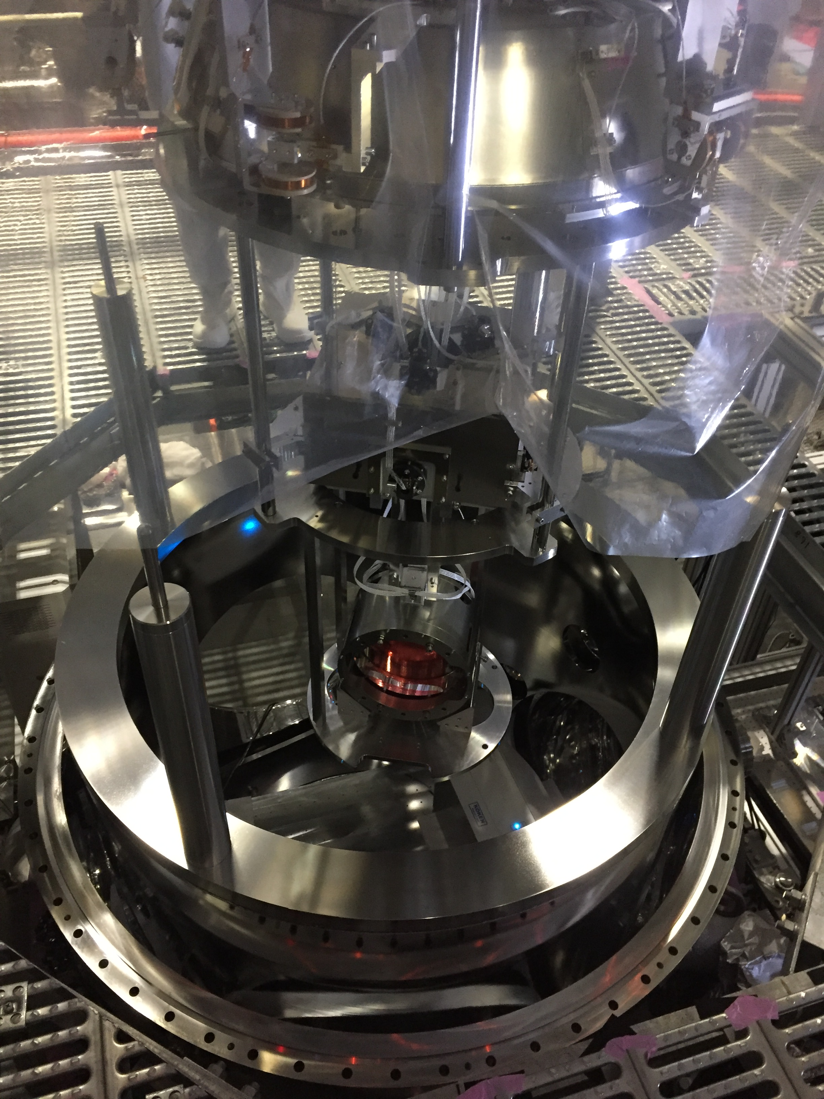
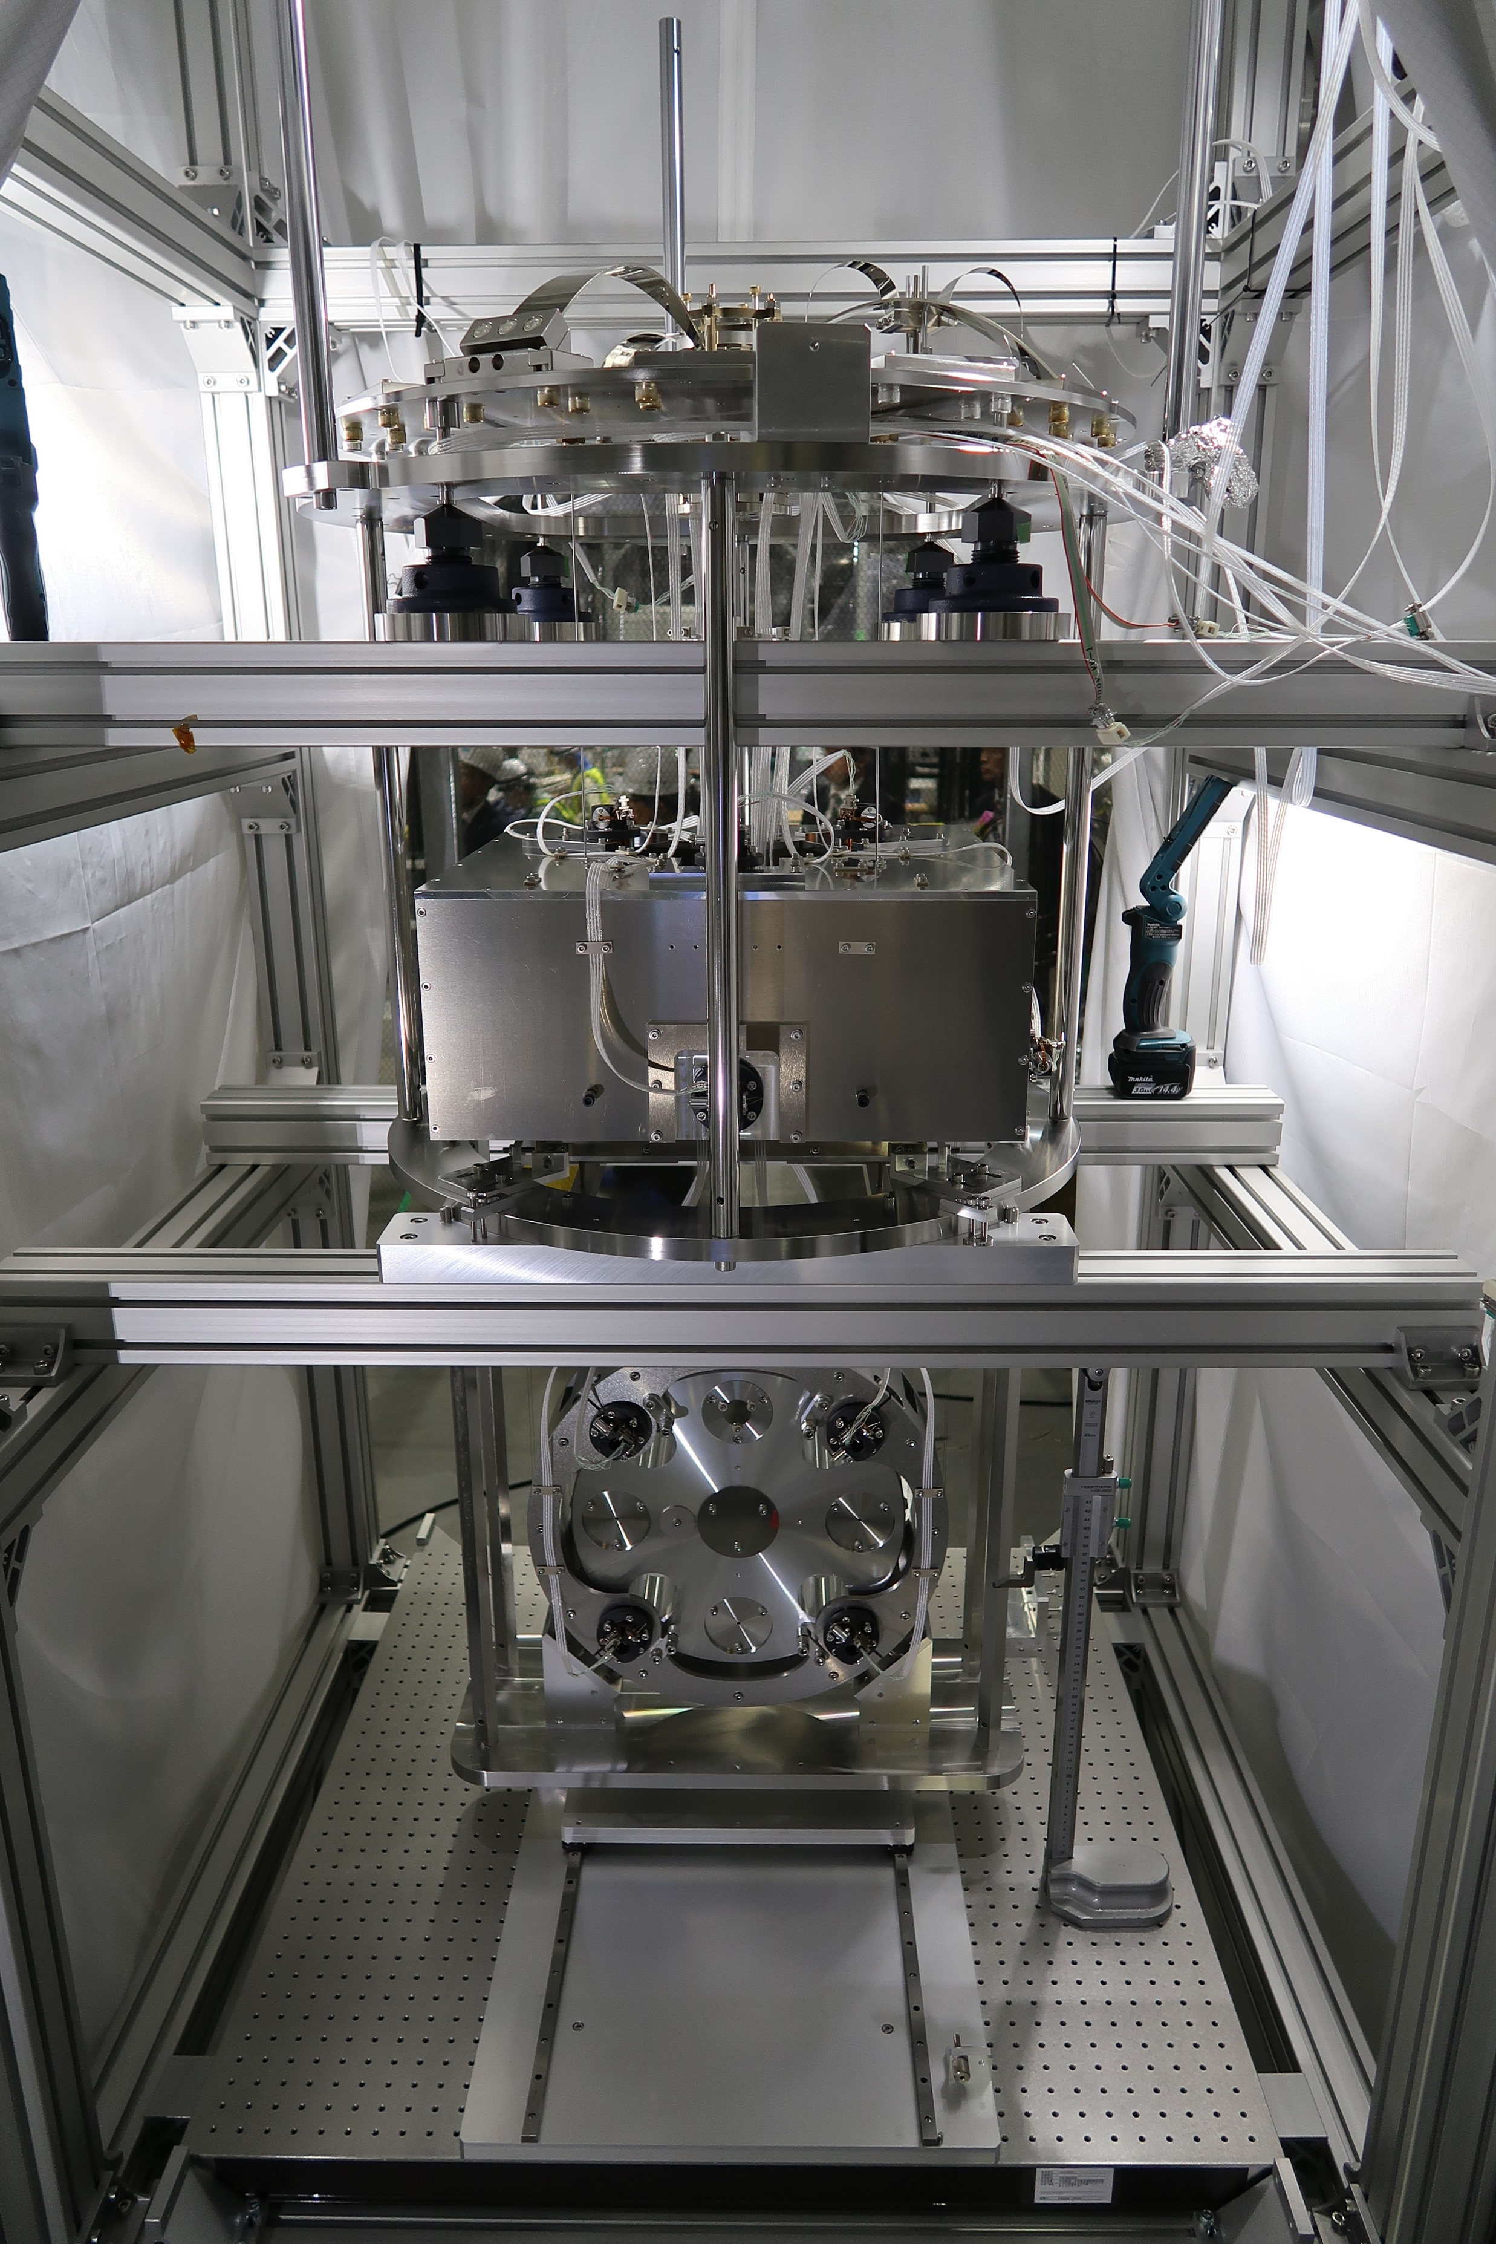
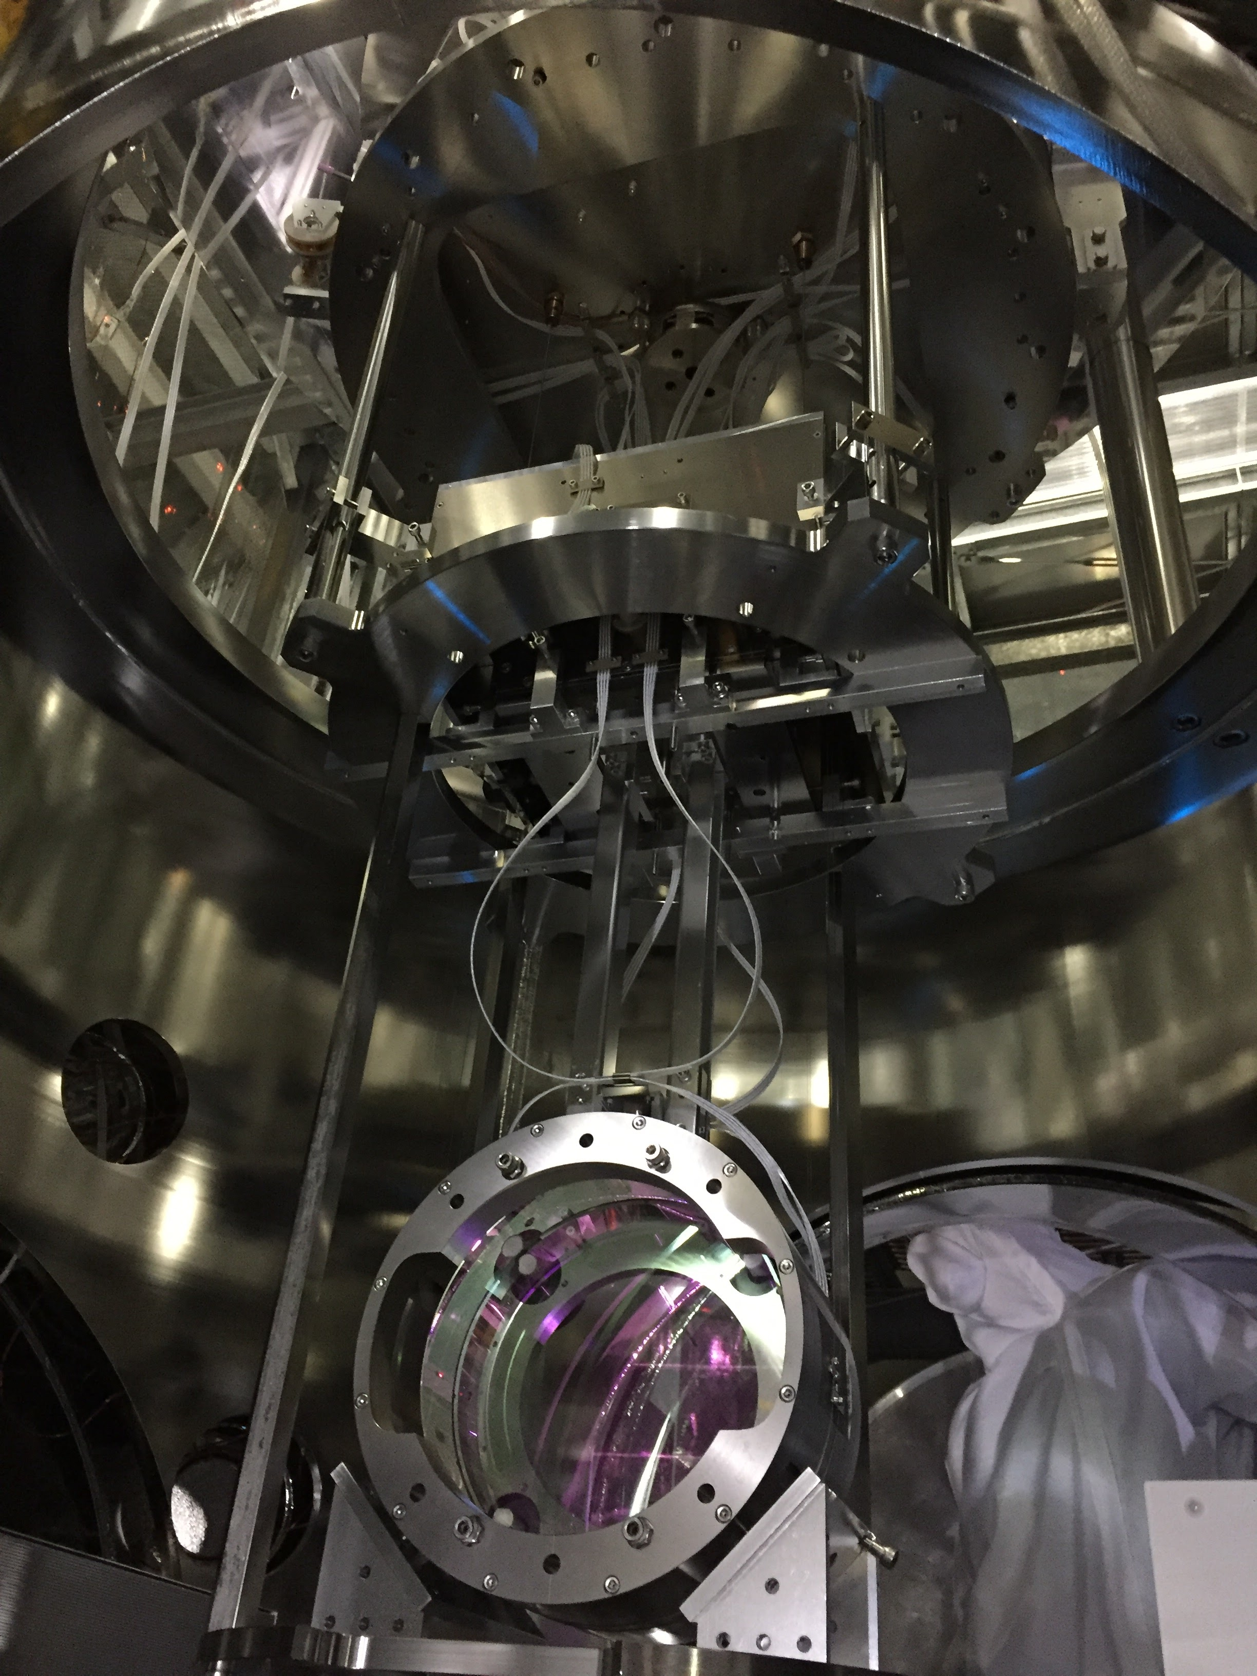
BS and PR Suspensions

Slide 18
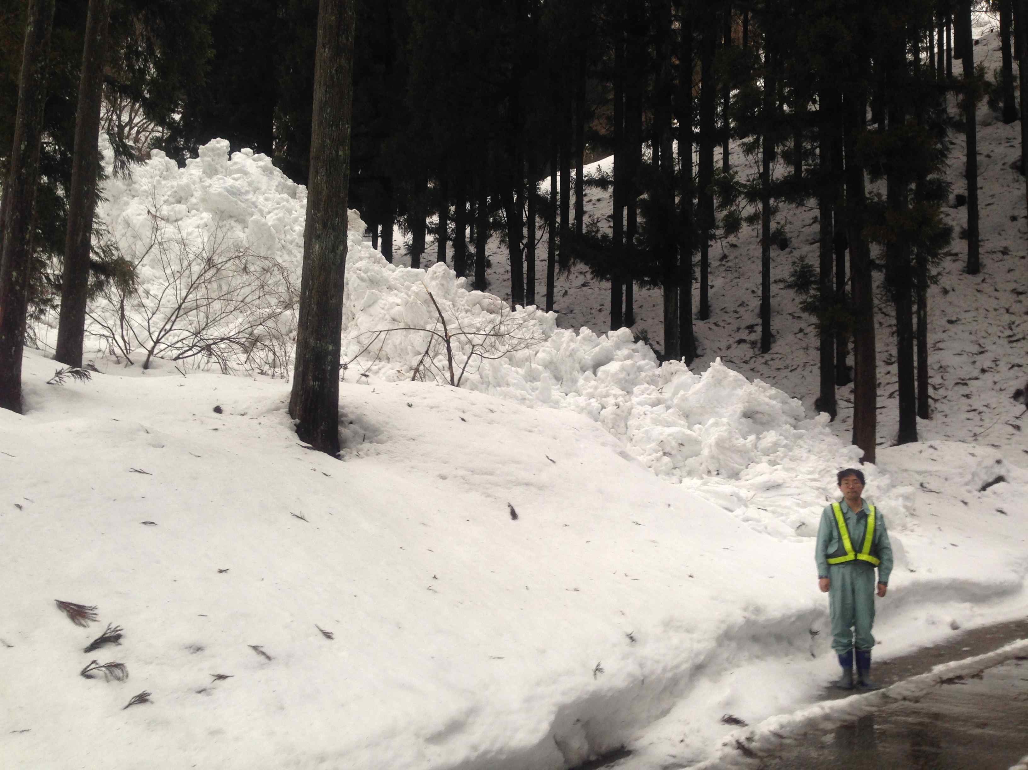
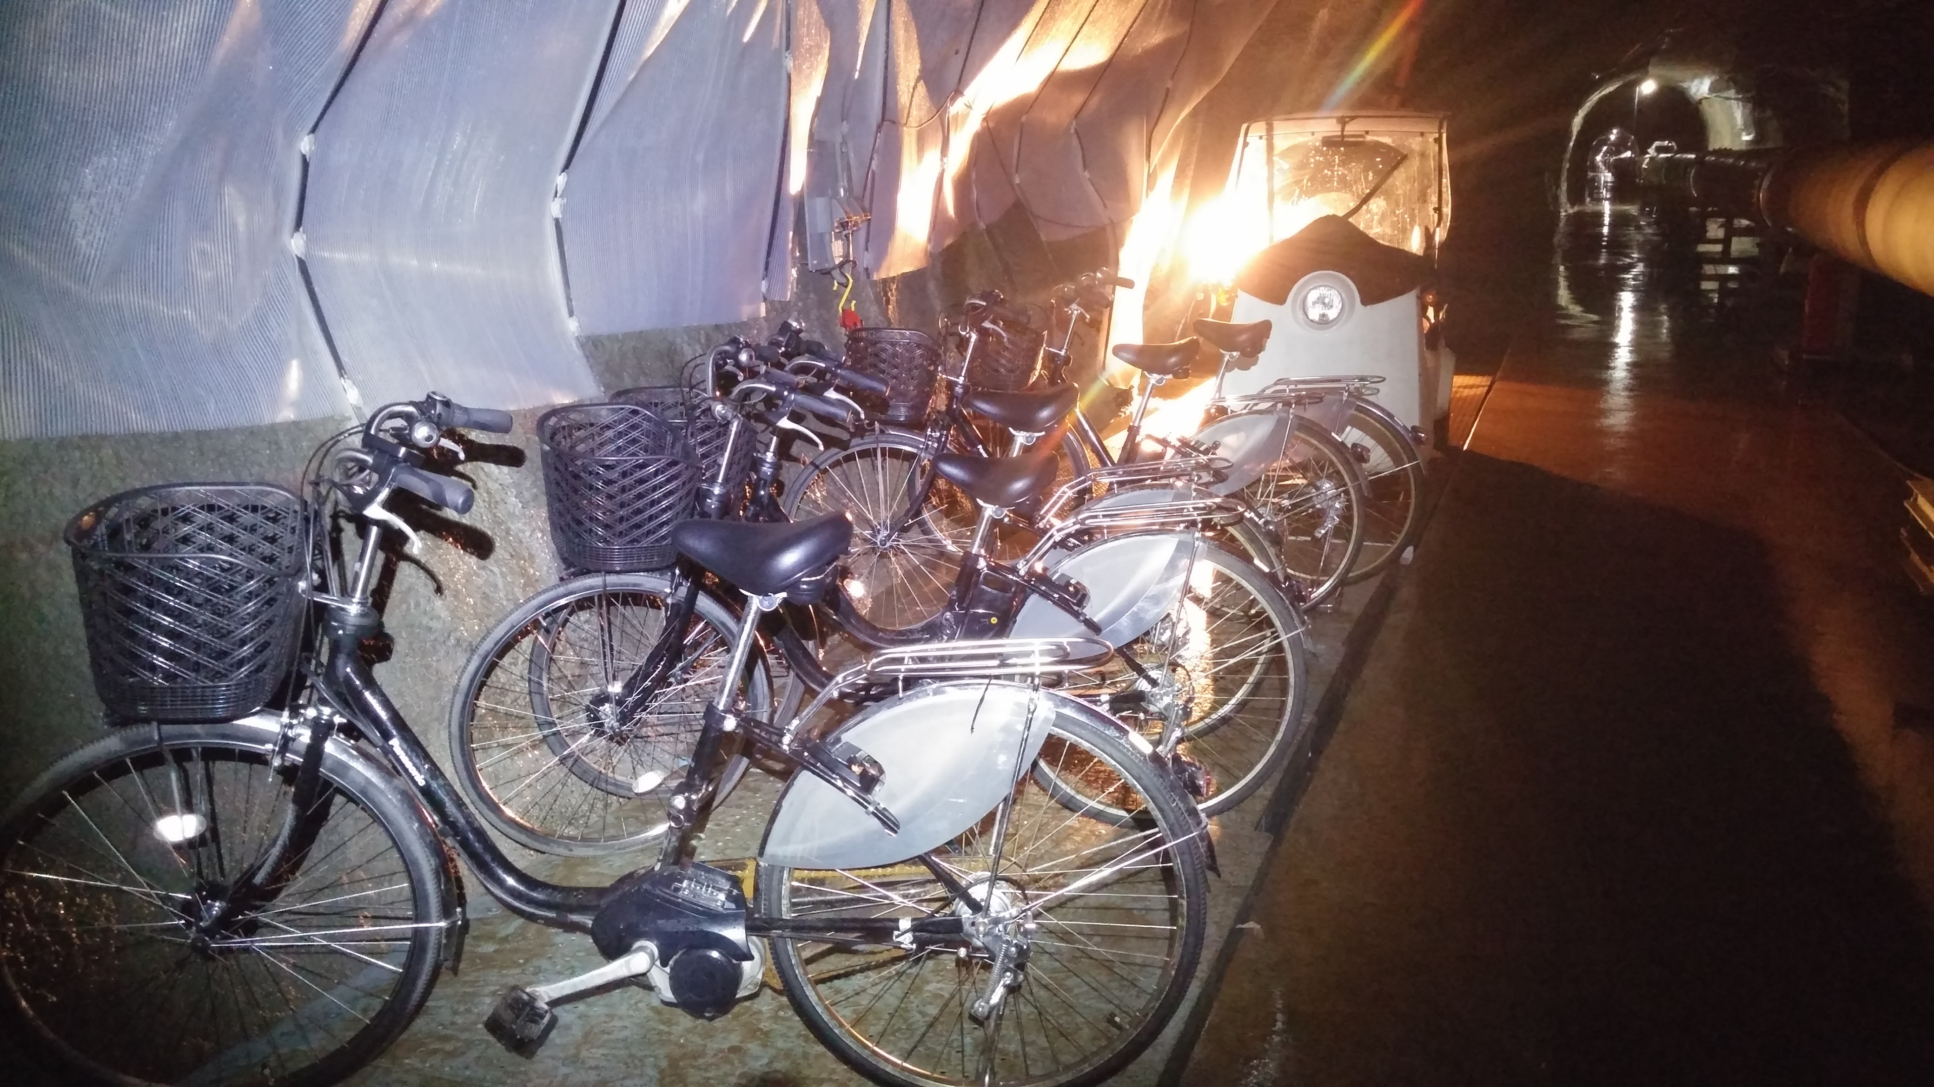
Life is not so easy
Avalanche

Slide 19
Thank you very much for your help
Just to name a few …
Digital system (LIGO)
Timing delivery system (LIGO)
Mirror substrates (LIGO)
Optics characterization (LIGO)
Electronics design (LIGO, Virgo)
Design ideas, advice on suspensions (Virgo)
Inverted Pendulum (Virgo/NIKHEF)
Many ideas (all the GW community)

