Slide 1
Room Temperature
Vibration Isolation Systems of KAGRA
2017/2/10@ELiTES Meeting in Toyama
National Astronomical Observatory of Japan
Yoichi Aso

Slide 2
KAGRA Vibration Isolation Systems
BRT
ETMY
Type-A (cryogenic)
Mode Cleaner
Type-B
Type-Bp
PRM
ITMY
PR2
Type-C
IMMT
ITMX
ETMX
BRT
Others
IFI
BS
PR3
Output Optics
SR2
OFI
OMMT
SR3
SRM
OMC
Output
Optics
OST

Slide 3
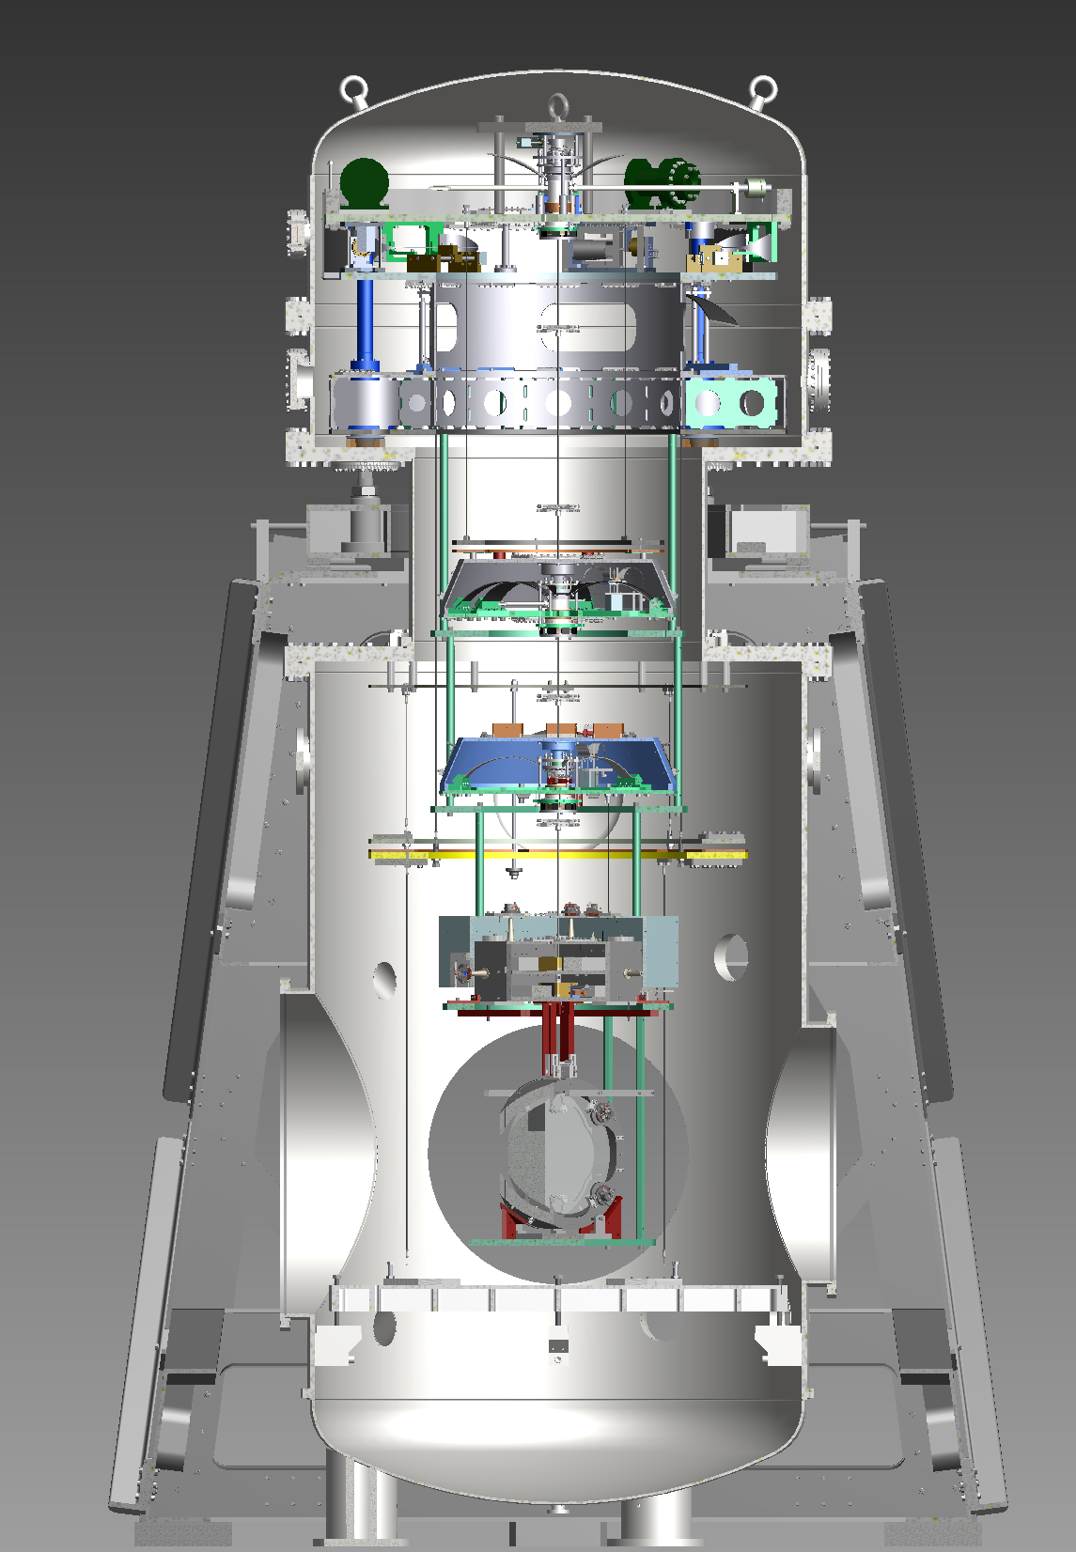
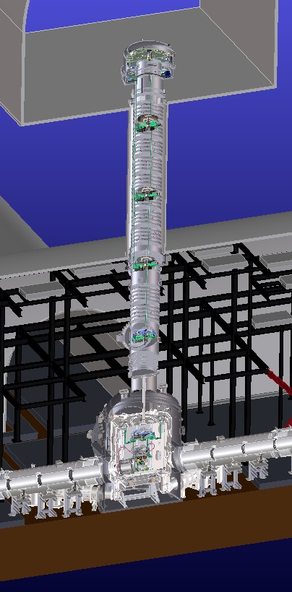
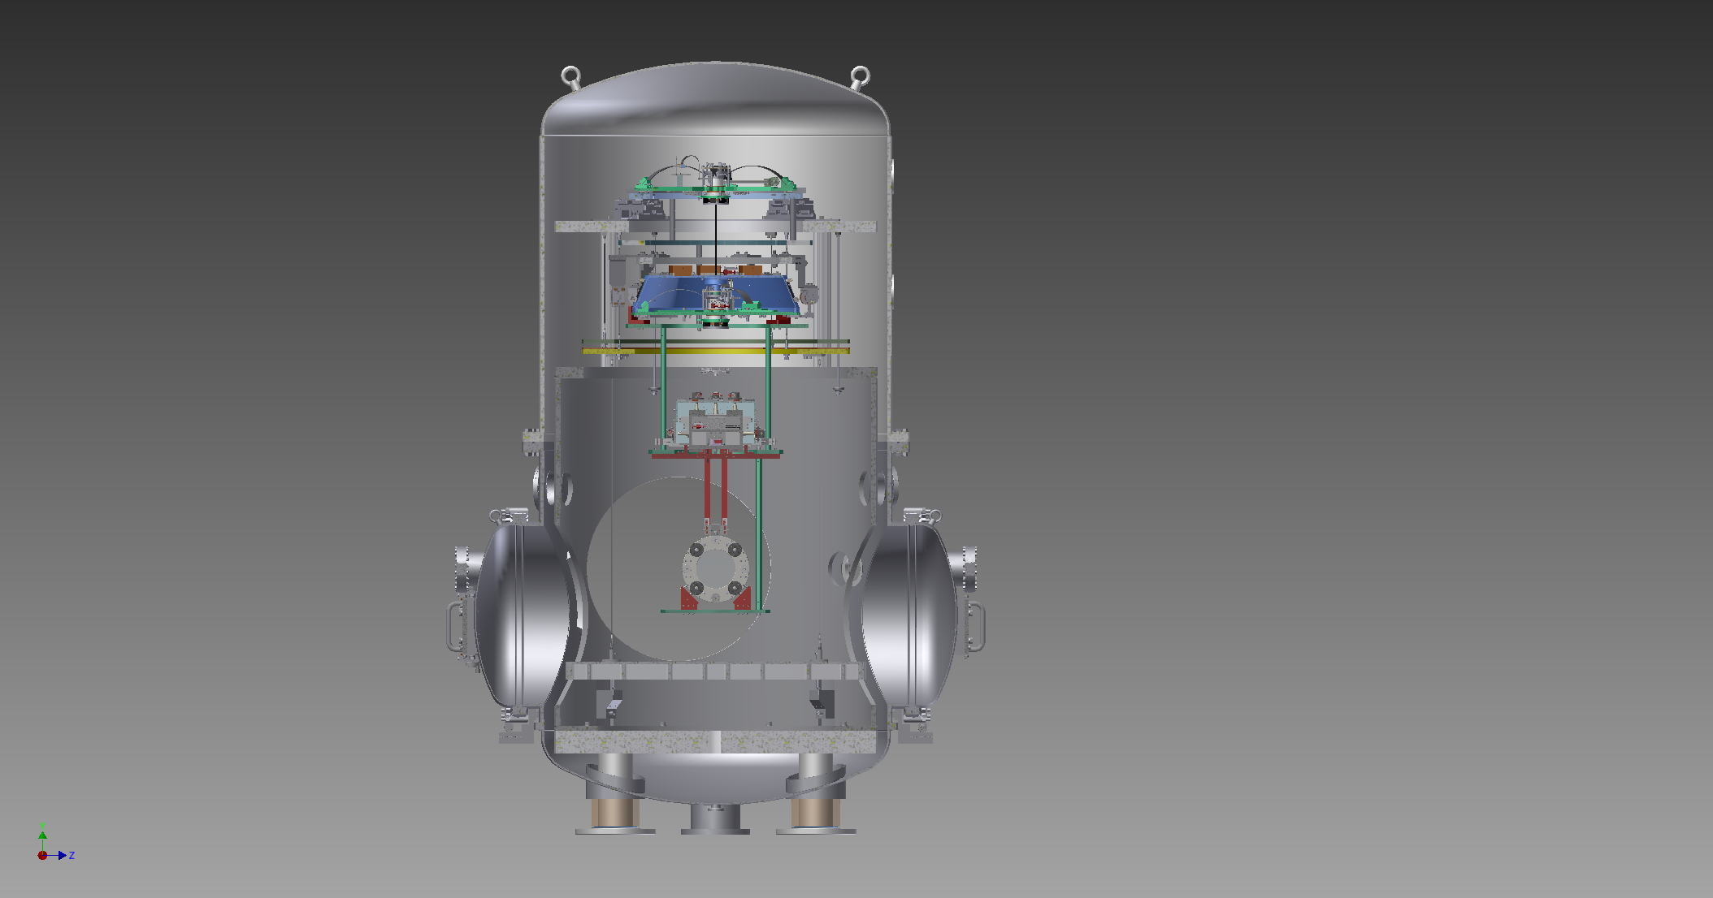
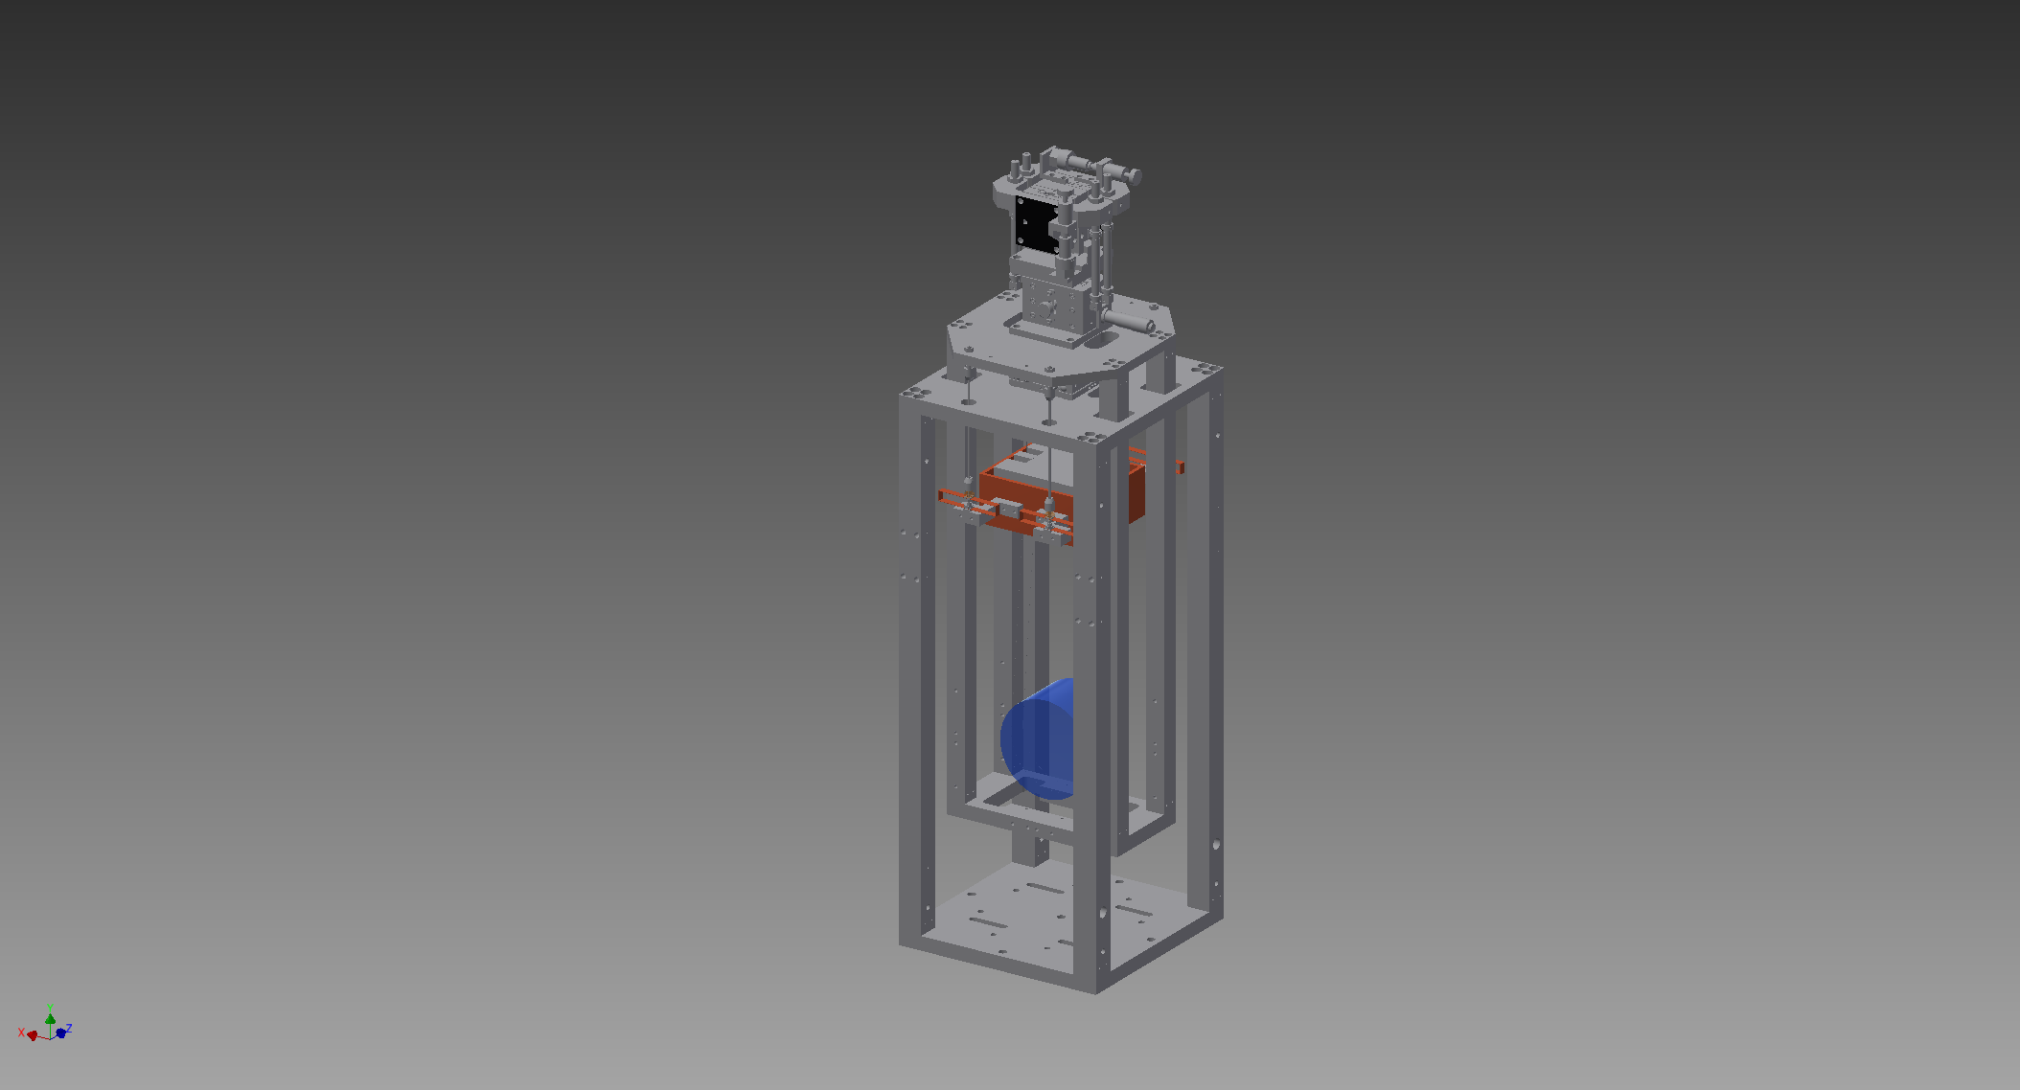
KAGRA Suspension Types
Type-A
Type-B
Type-Bp
Type-C

Slide 4
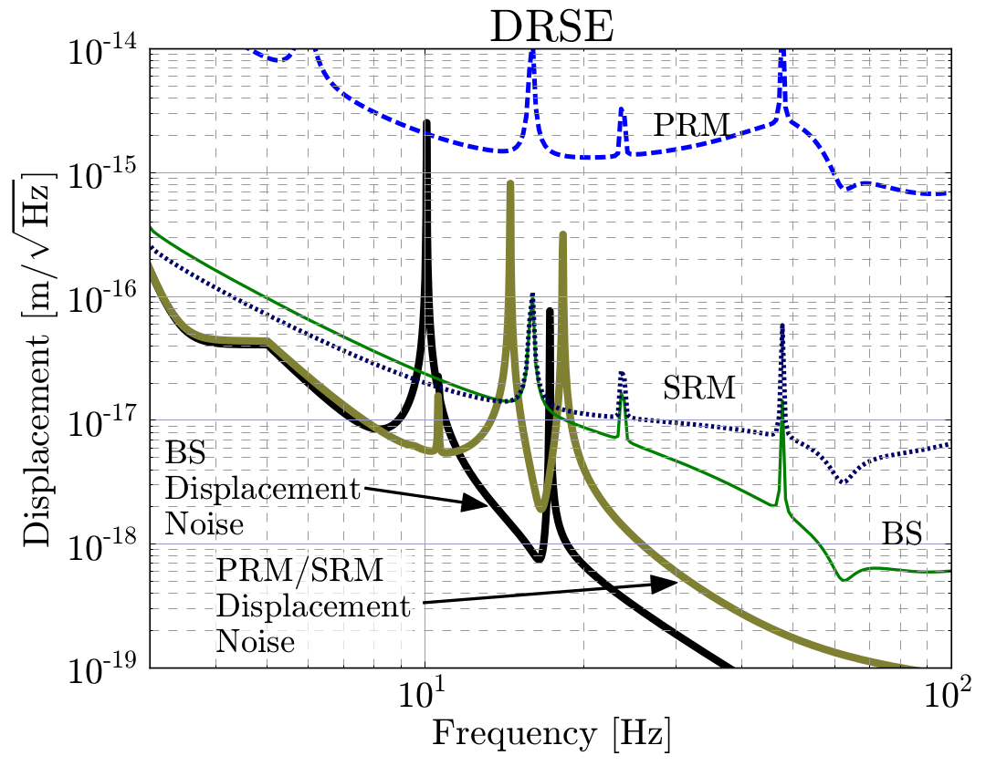

Seismic Isolation Requirements
X10 safety factor
RMS Speed $<≈$ 1um/sec

Slide 5
Type-C
Based on TAMA suspension
Installed on a passive vibration
isolation stack
Used for small mirrors
  Input Mode Cleaner
  Mode Matching Telescope
  Steering mirrors

Slide 6
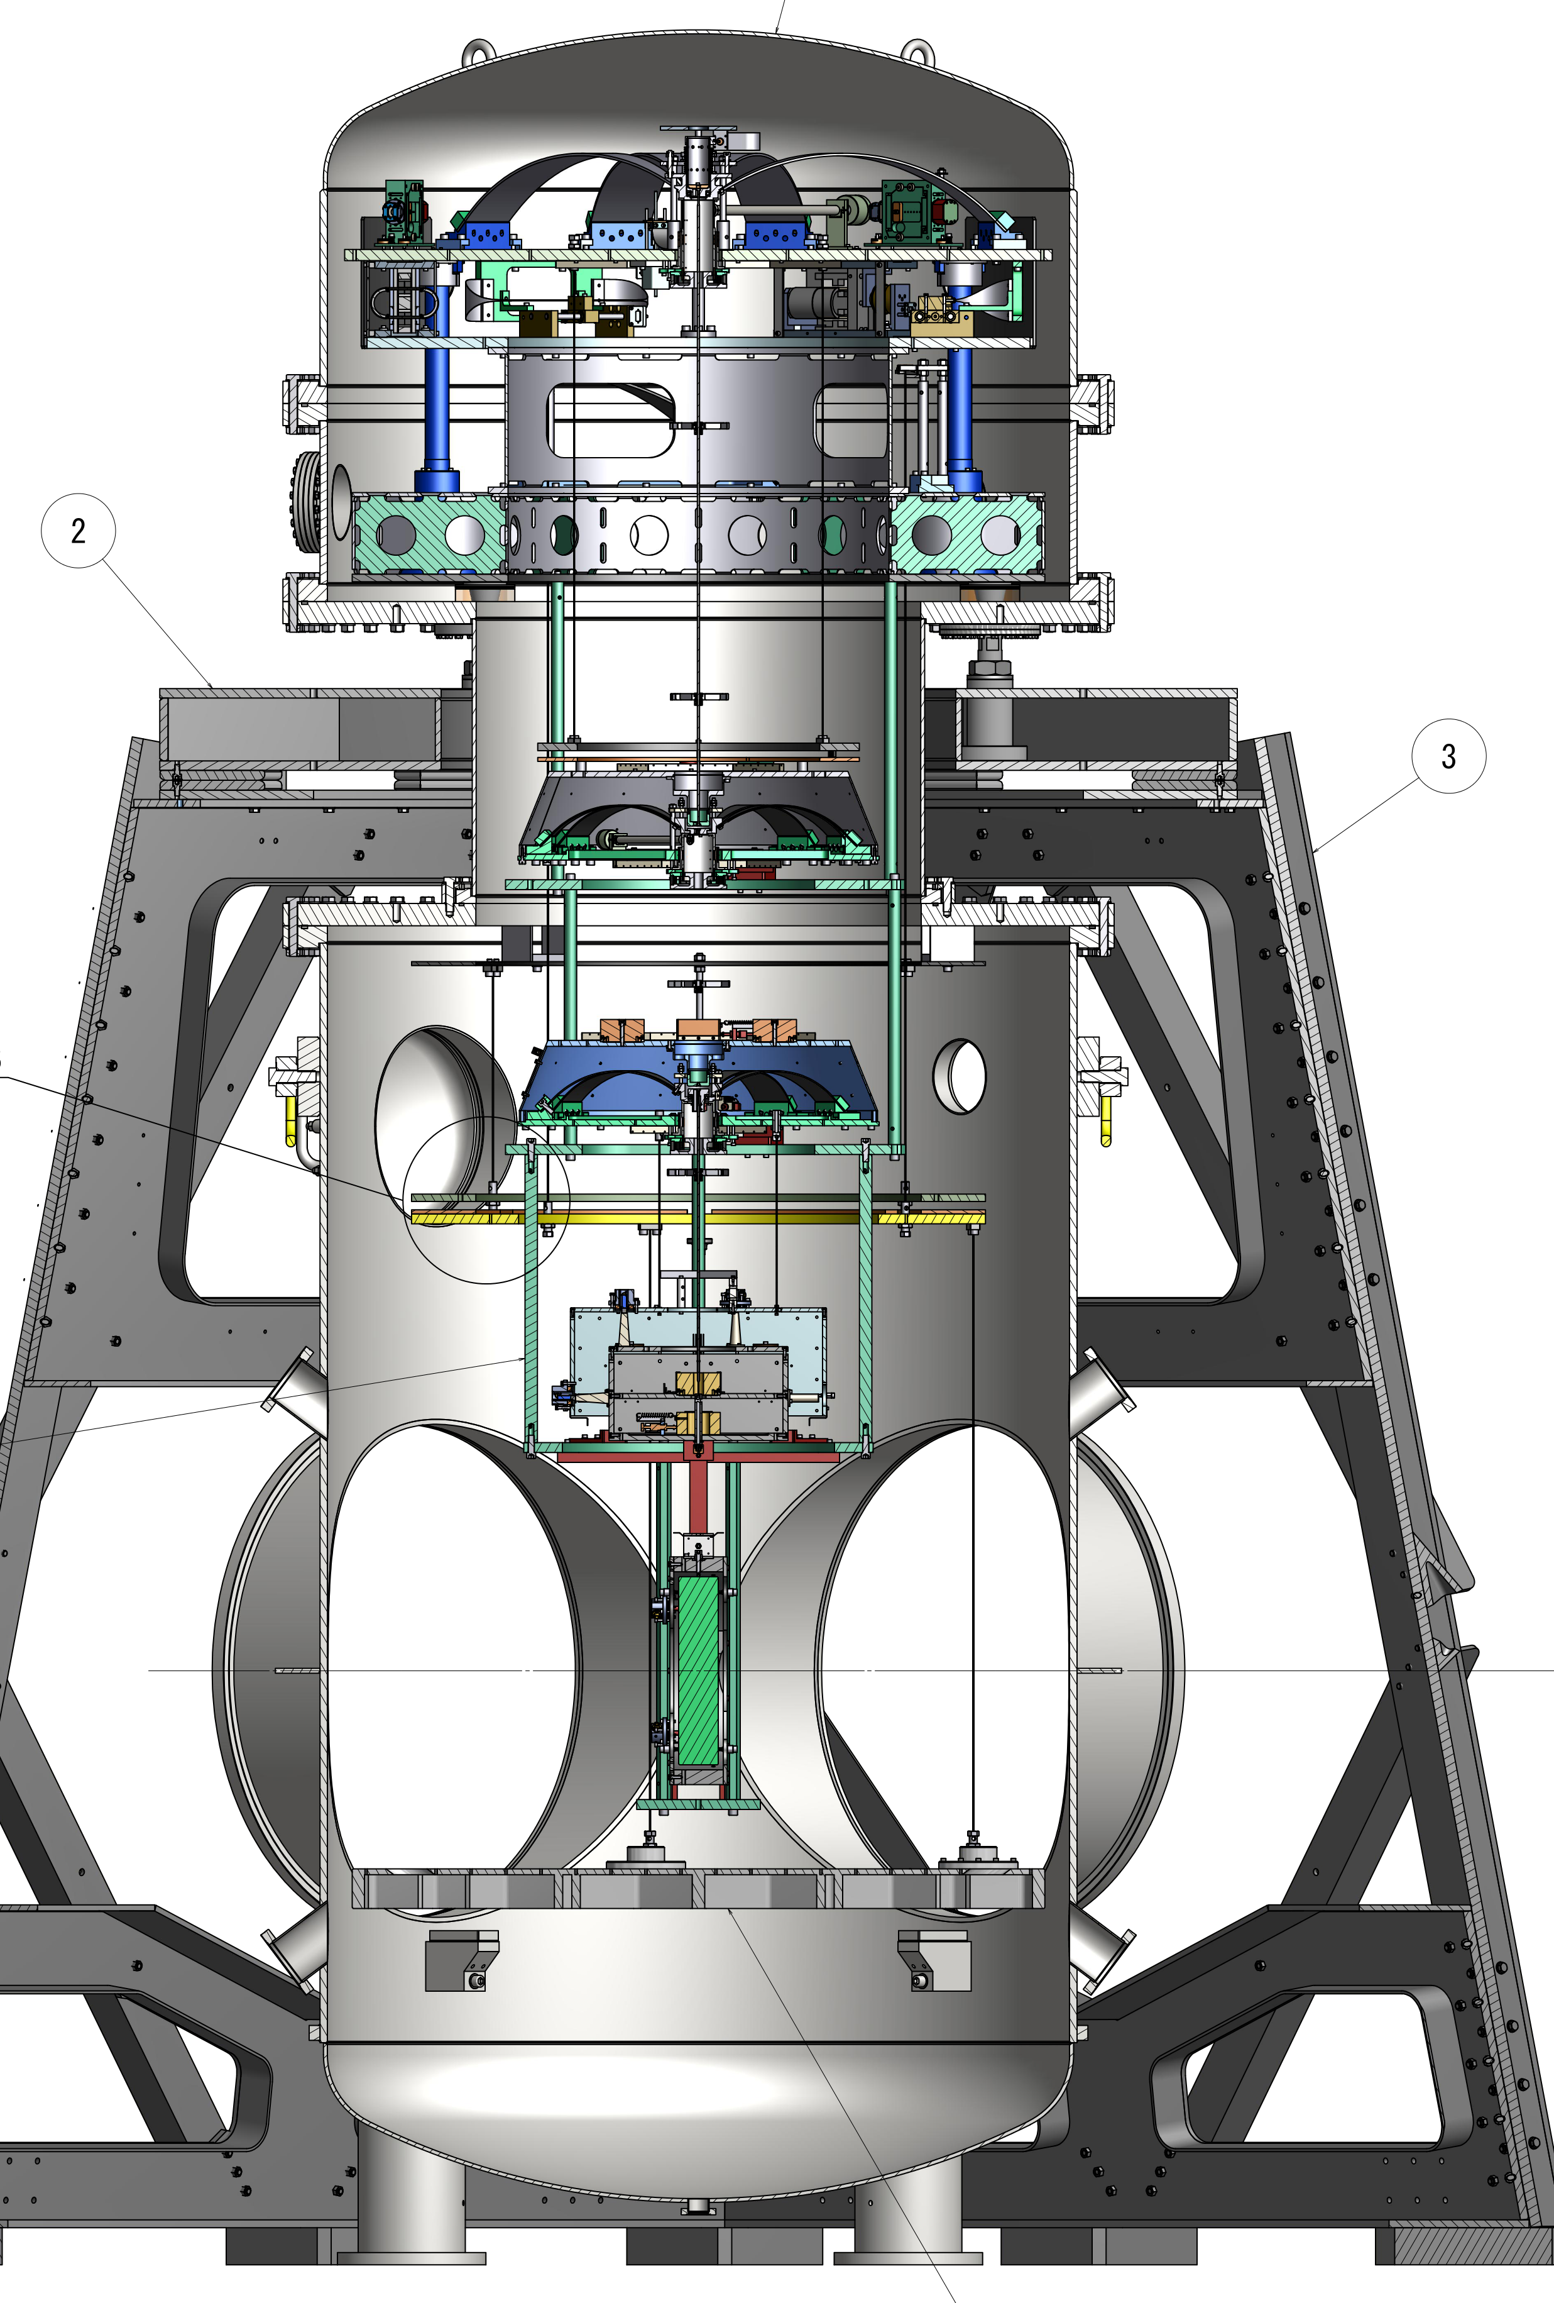
Type-B
Medium sized suspension system
Used for critical IFO mirrors
  BS
  SRC mirrors

Slide 7
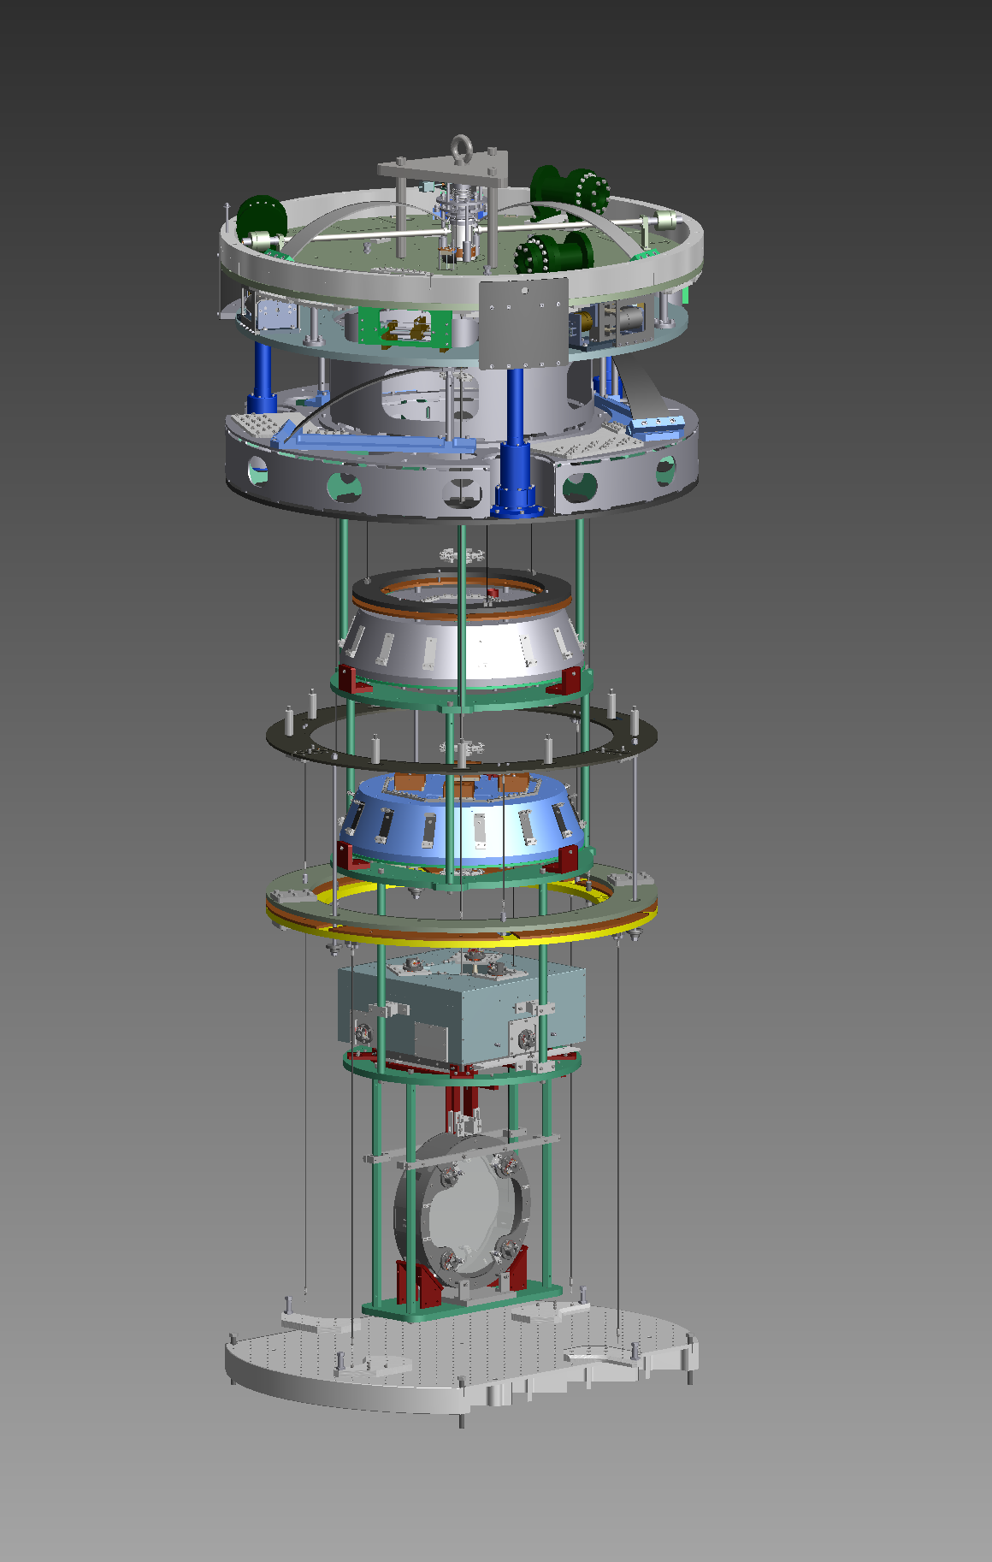
Pre-Isolator
Standard Filter
Bottom Filter
Intermediate Mass
Mirror + Recoil Mass

Slide 8
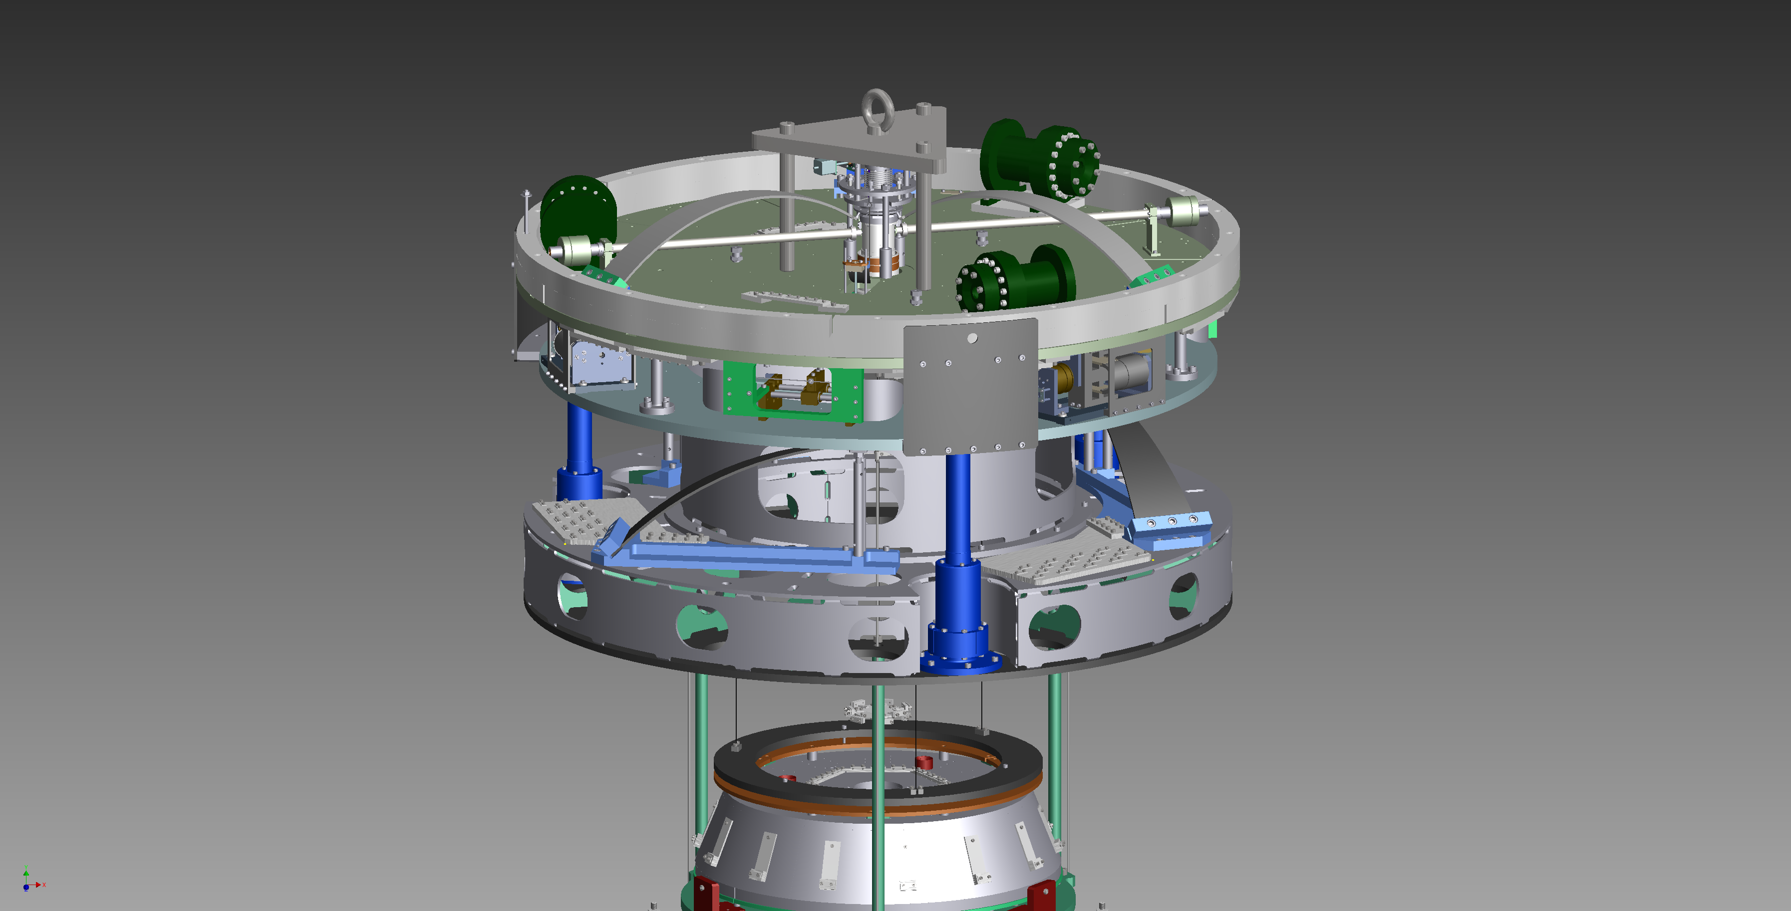
Pre-Isolator

Slide 9
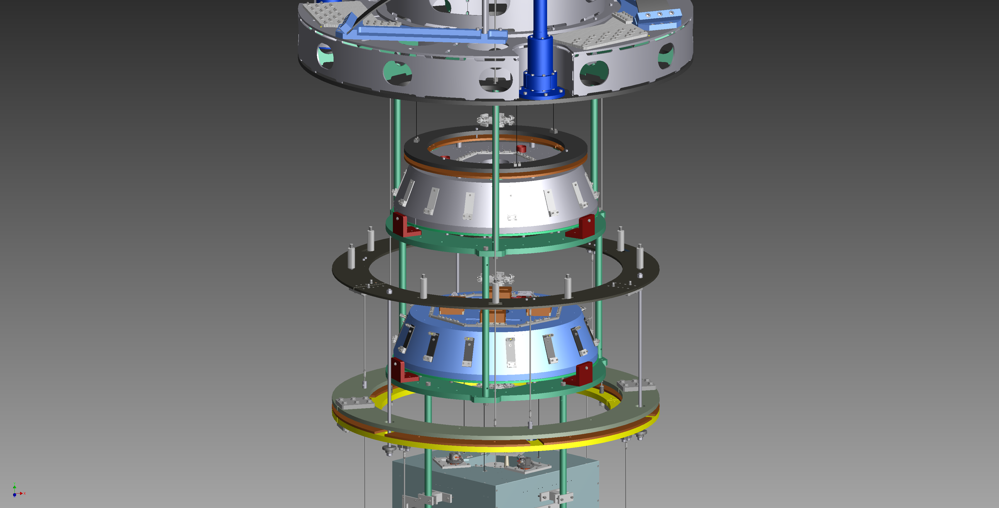
GAS Filter Stages

Slide 10
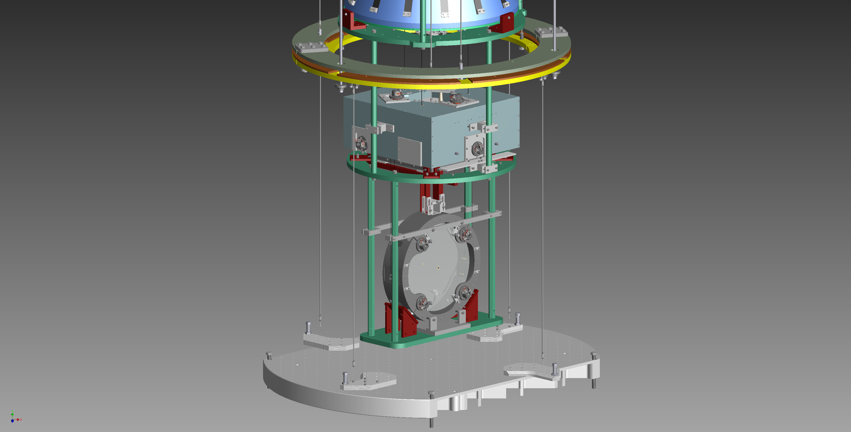
BS Payload

Slide 11
Type-Bp
Simplified version of Type-B
No IP
Used for PRC mirrors

Slide 12
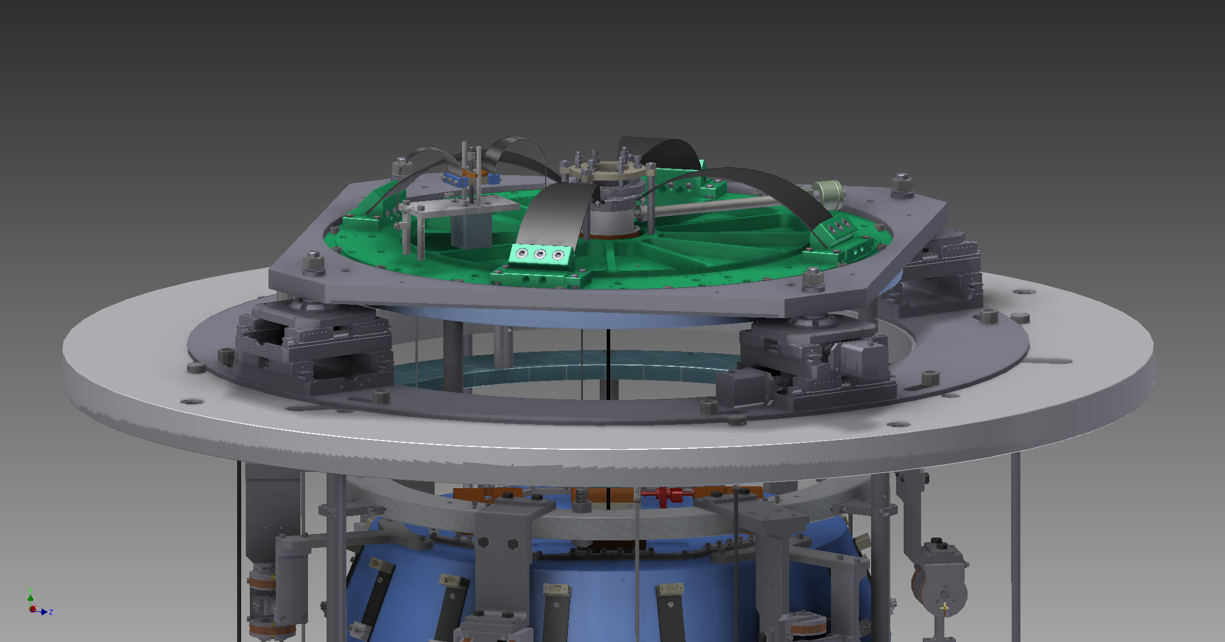
Type-Bp Top Part

Slide 13
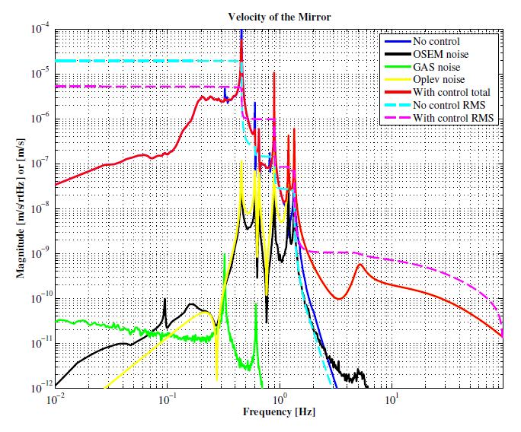
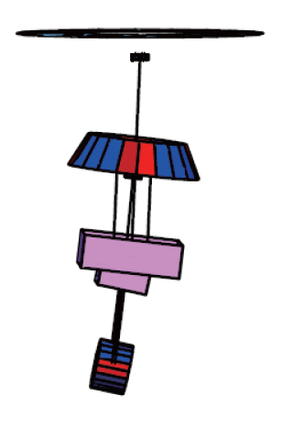
No IP -> Some modes cannot be damped

Slide 14
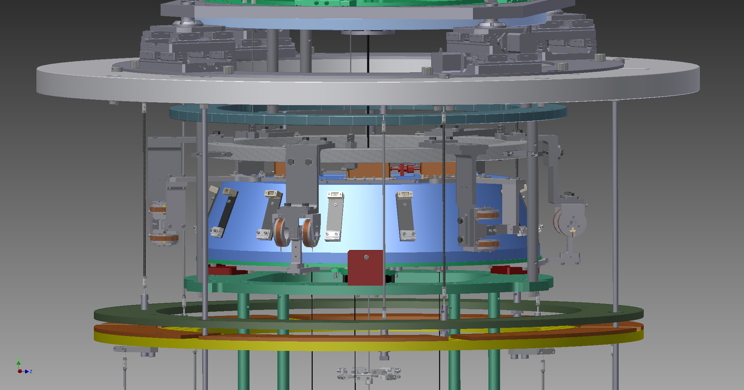
Type-Bp Bottom Filter

Slide 15
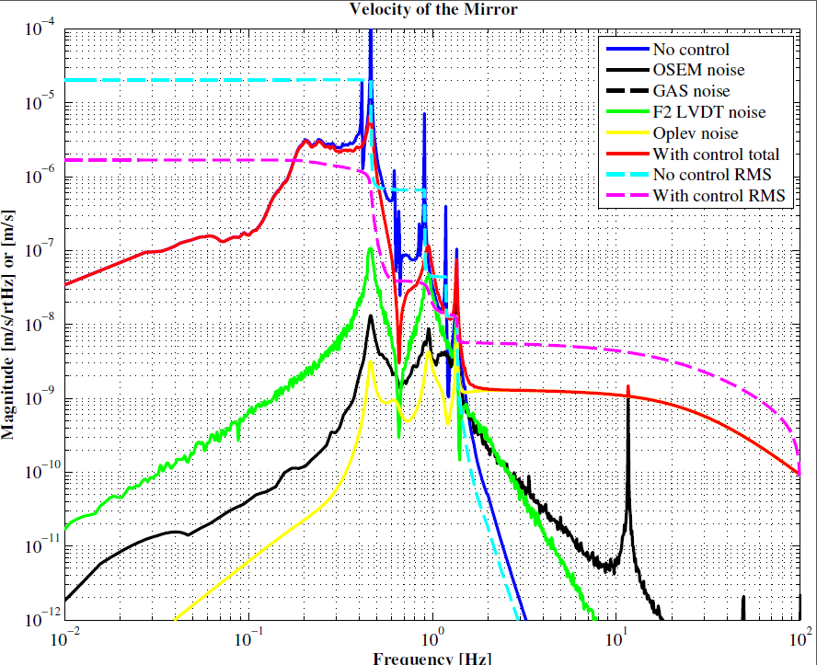
Bottom Filter Damping
Damped
RMS < 2um/sec

Slide 16
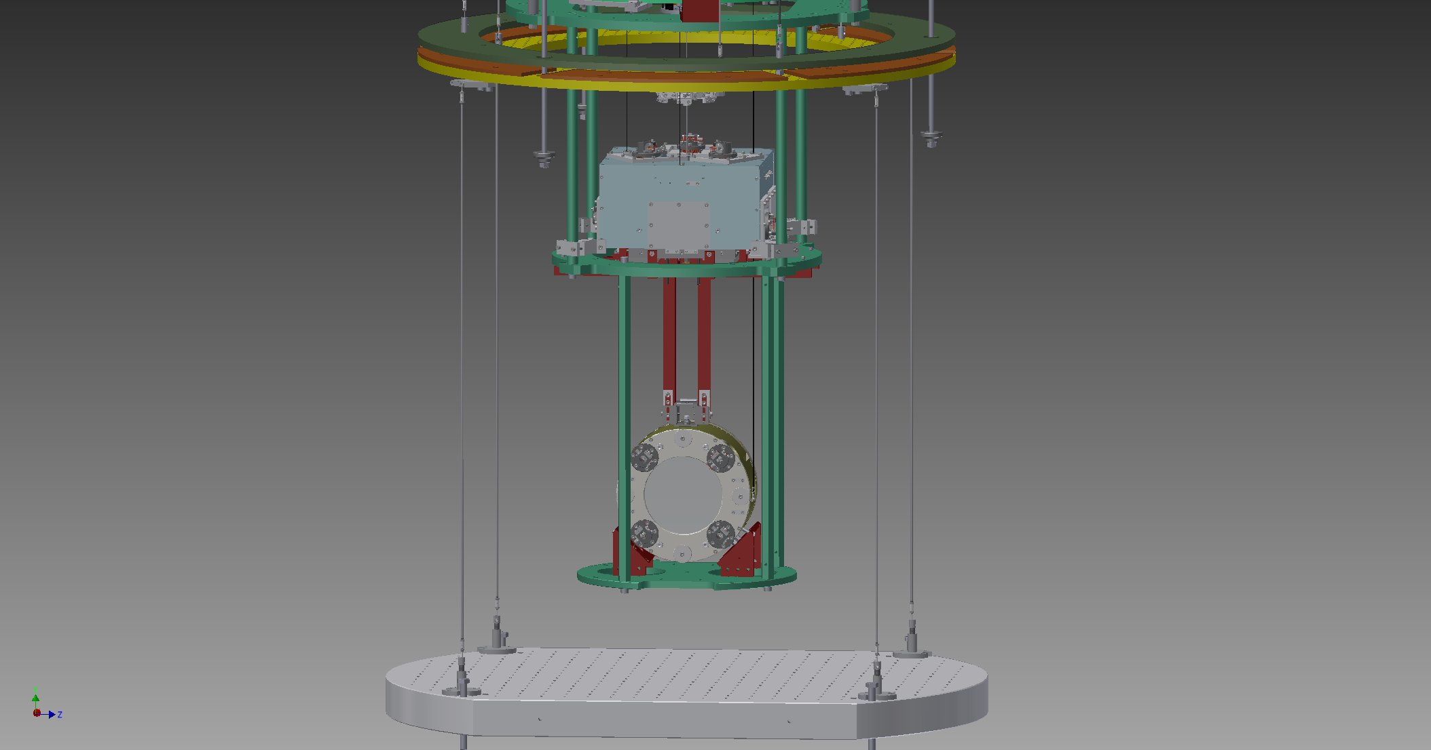
Type-Bp Payload

Slide 17
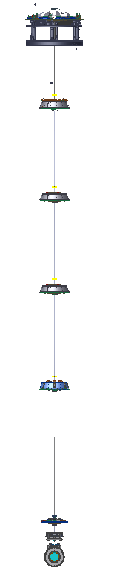
Type-A
The longest suspensions in KAGRA
Connected to the cryogenic paylaod
Used for test masses
14m

Slide 18
Recent Topics

Slide 19
iKAGRA (2016/3 – 2016/4)
ETMY
Mode Cleaner
Type-Bp’
Type-C
Others
PR2
ETMX
IMMT
Fixed
IFI
BS
PR3
Only One Large Suspension: PR3

Slide 20
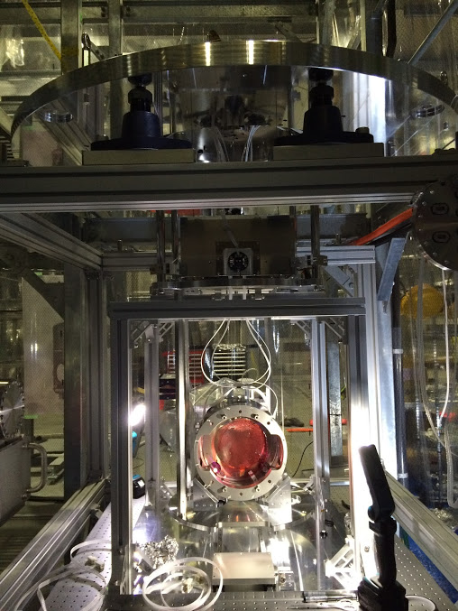
Type-Bp’
Omit Standard Filter

Slide 21
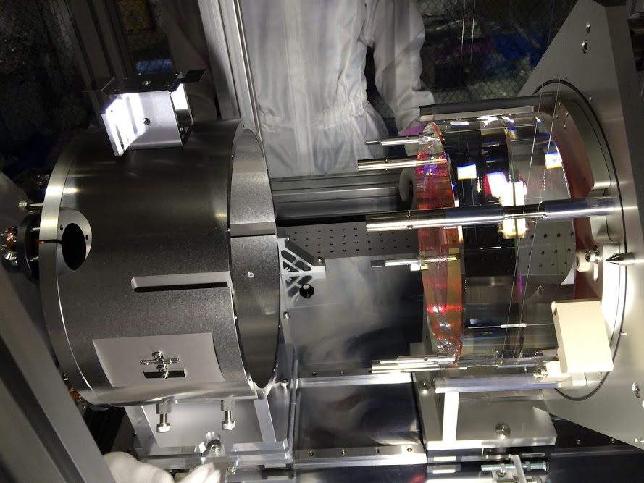
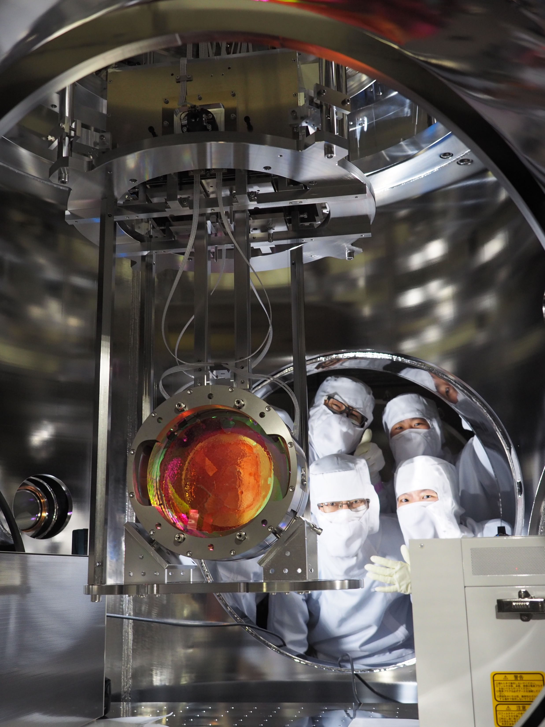
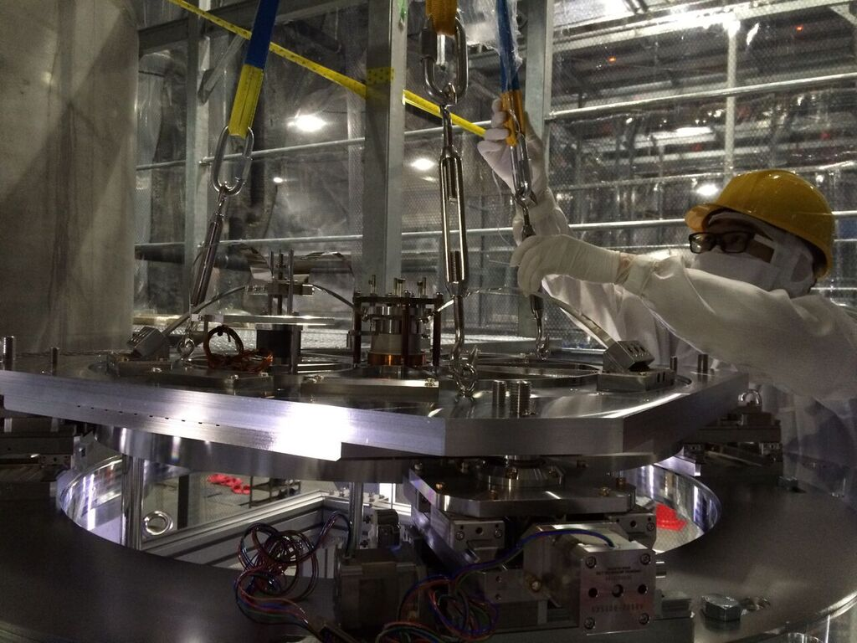
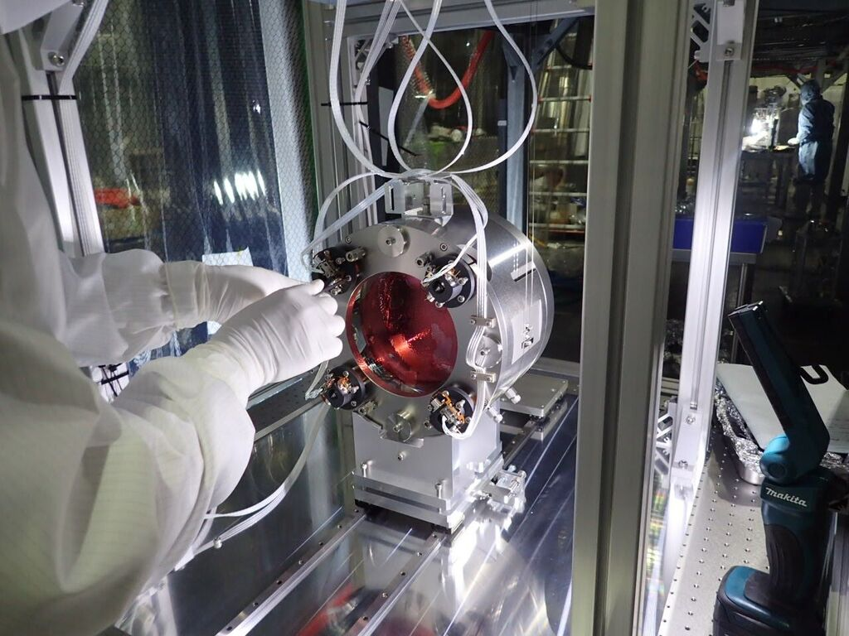

Slide 22
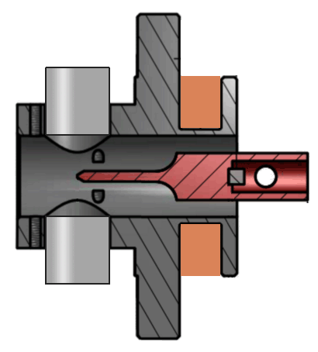
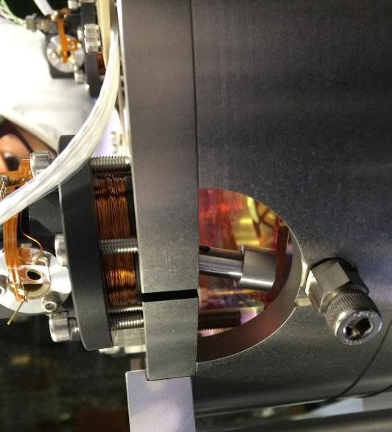
Long Flag Problem
Easily Broken
OSEM

Slide 23
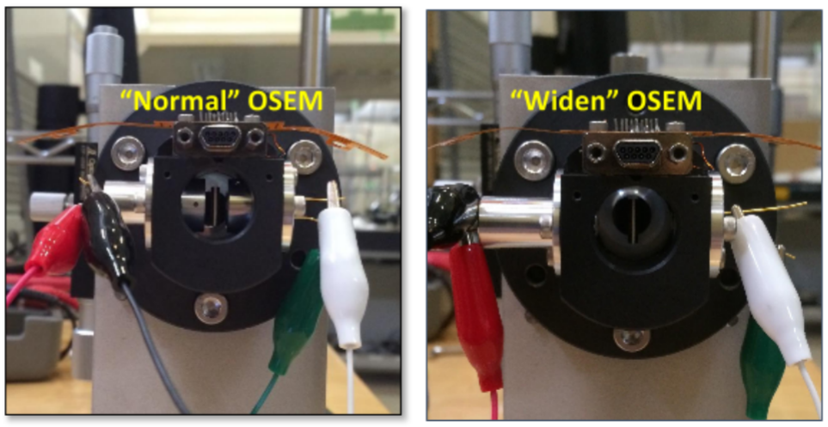
Wider Opening OSEM

Slide 24
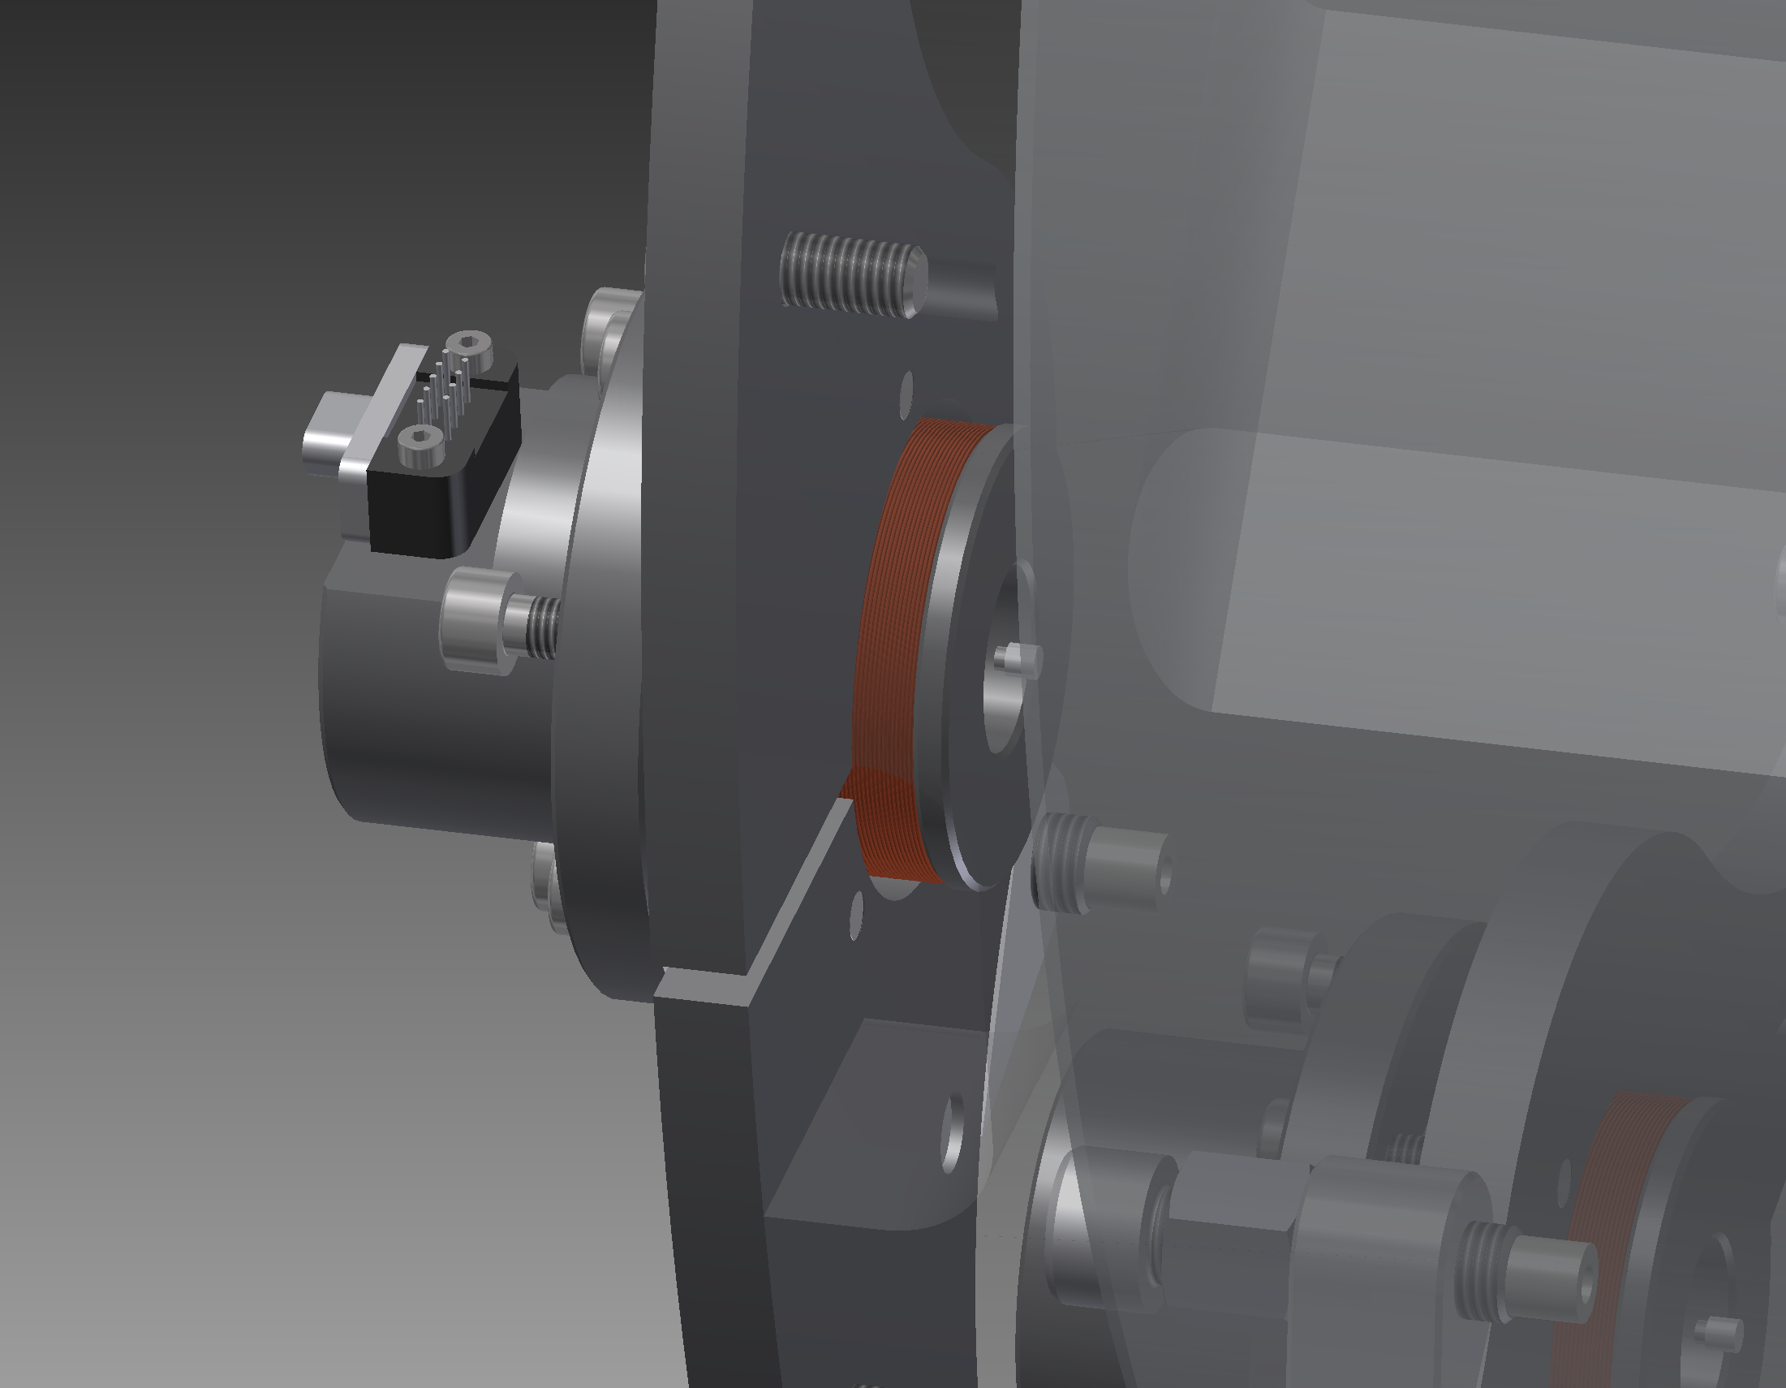
Smaller Magnet Base
No sensing of motion
Use OpLev also for
length sensing

Slide 25
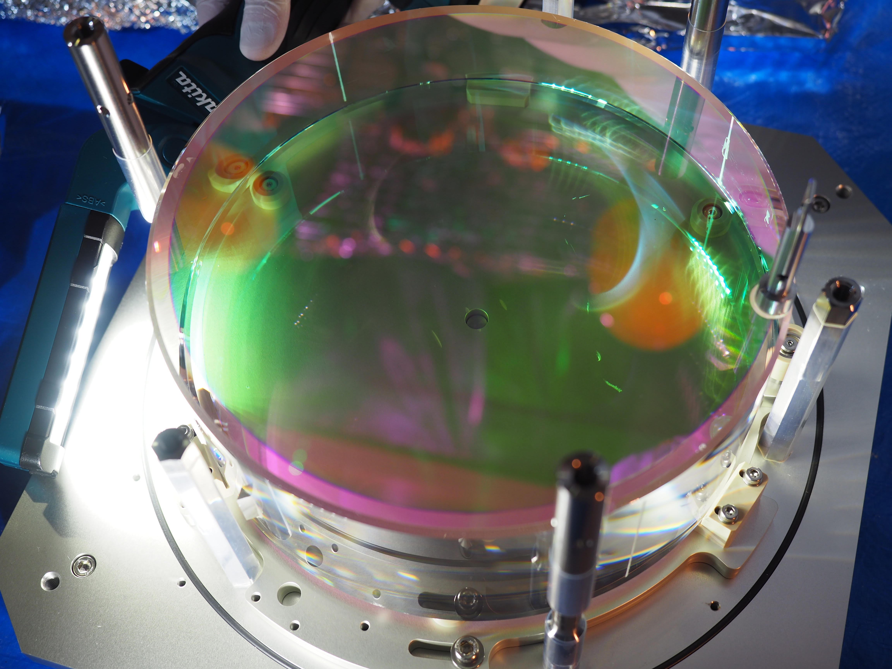
PR3 mirror accident
Crack
Scratches on the HR surface
Disassembly of
the iKAGRA suspension
PR3 mirror damaged

Slide 26
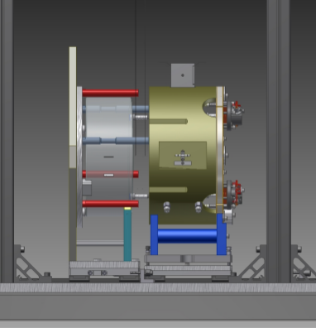
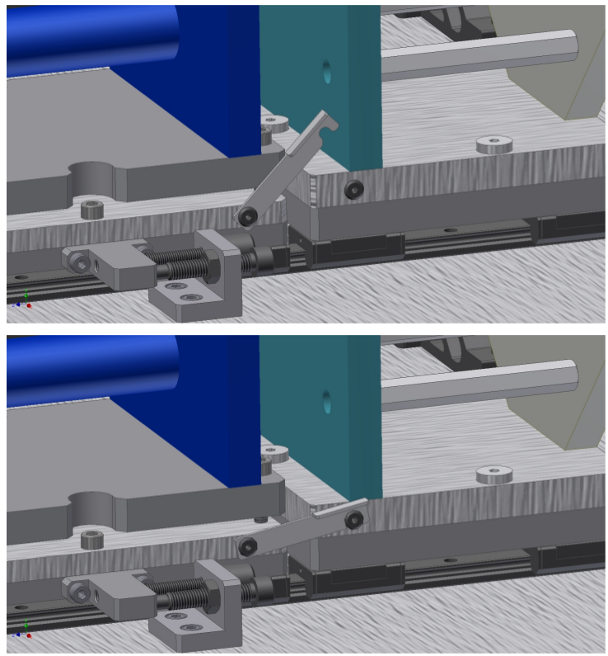

Slide 27
Current Status
Type-Bp
Test installation using a dummy mirror
Type-B
Test installation using a dummy mirror
Type-A
Started installation at the Y-End

Slide 28
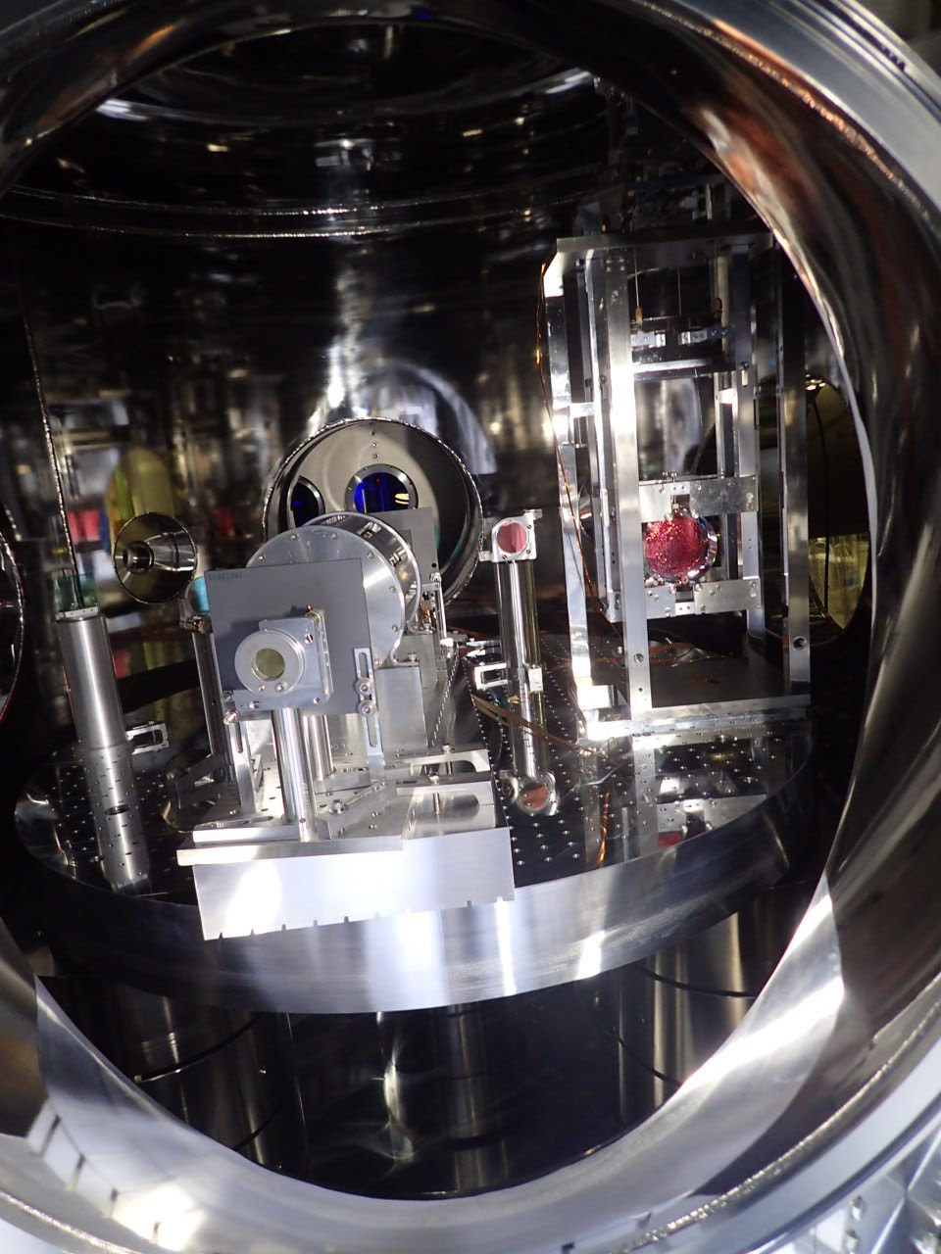
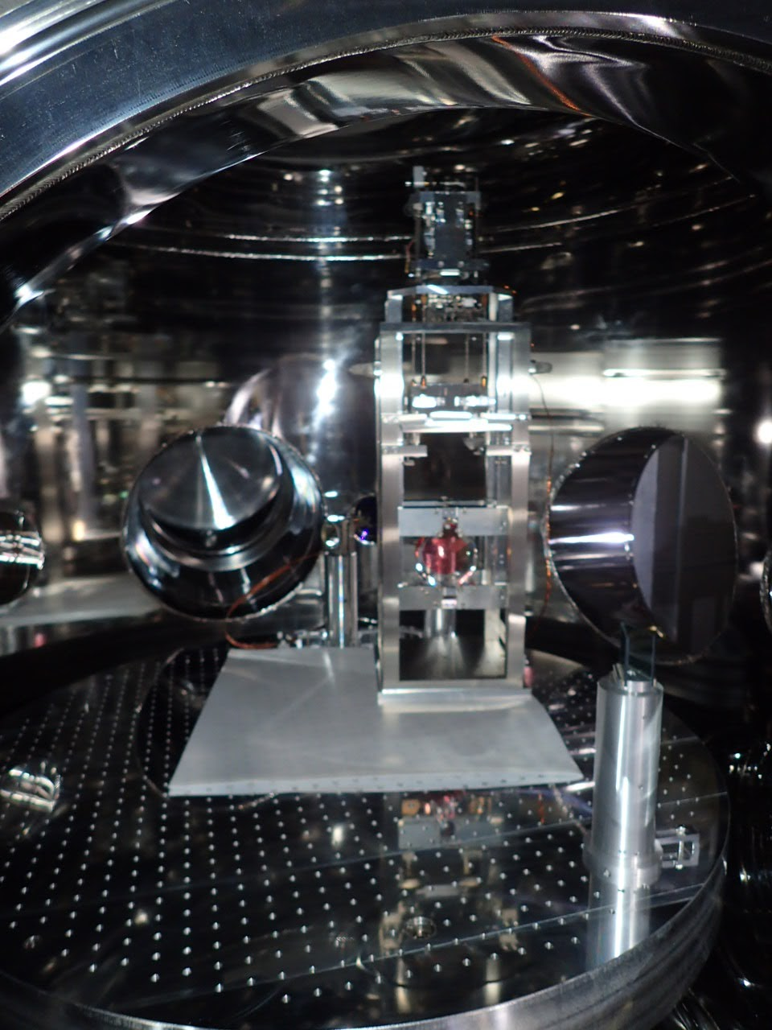

Slide 29
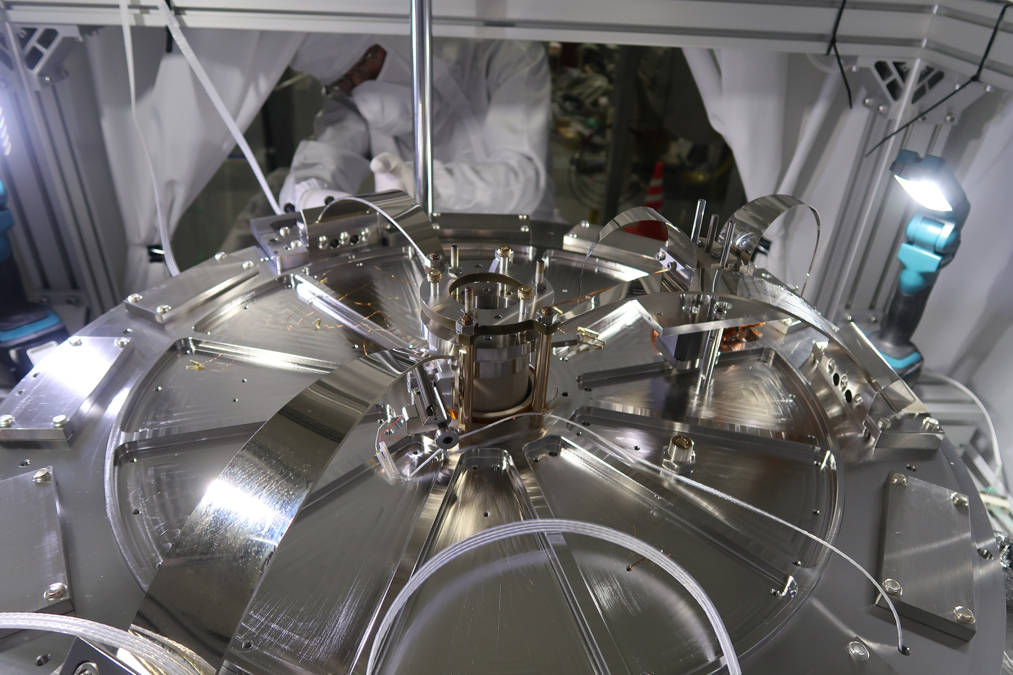
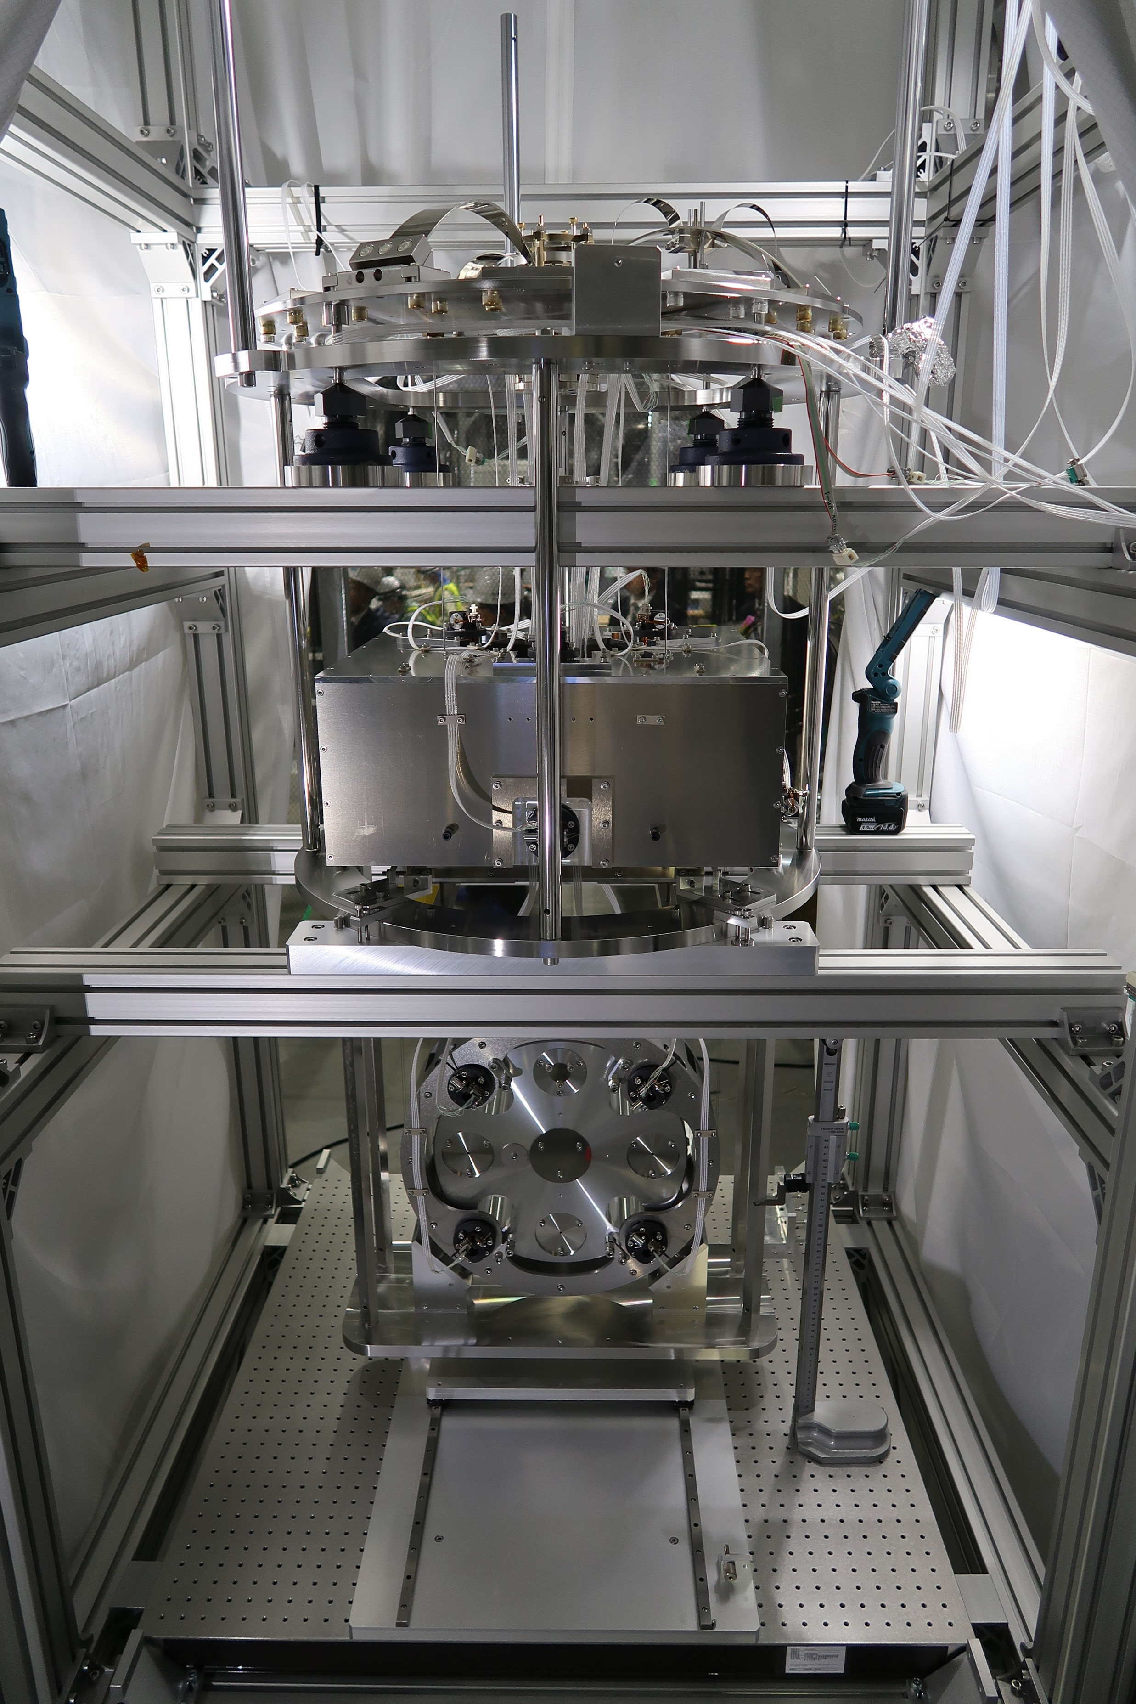

Slide 30
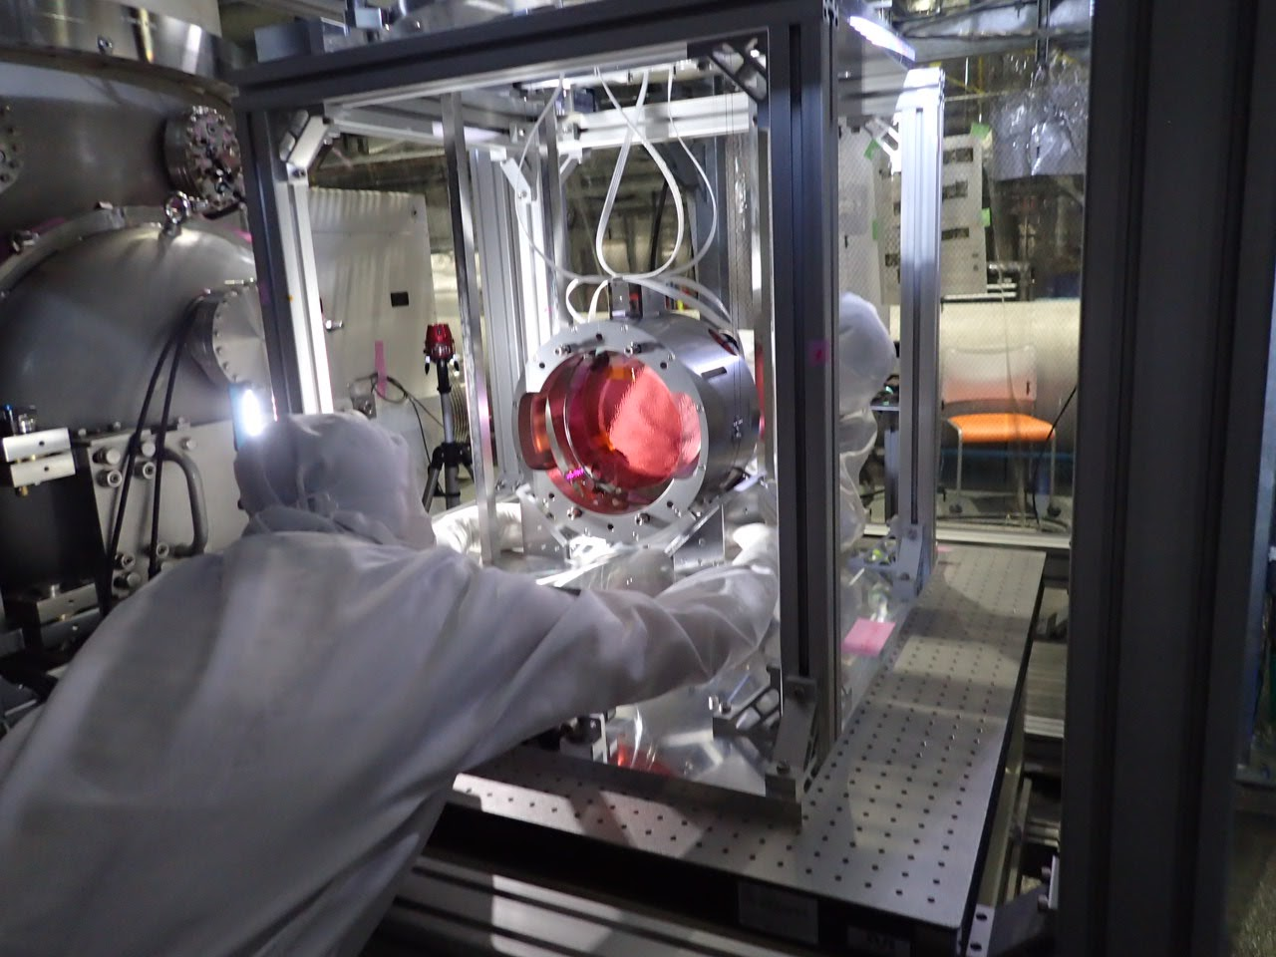
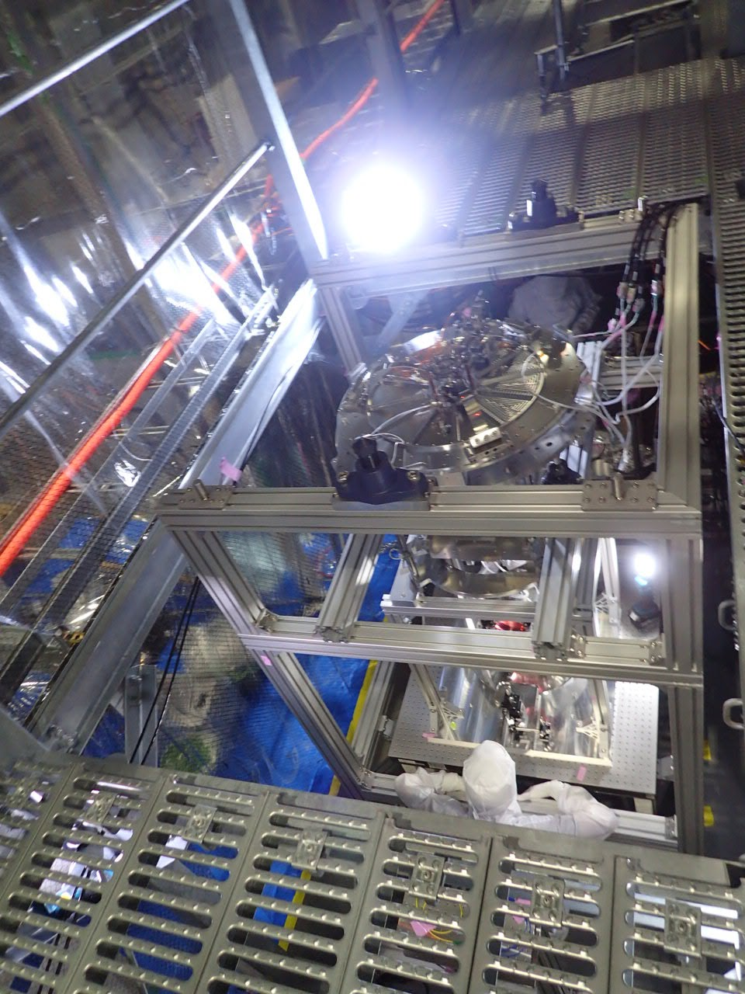

Slide 31
Schedule for bKAGRA phase 1
Cryogenic Operation
 | 2017 |  |  |  |  |  |  |  |  |  |  | 2018
 | 2 | 3 | 4 | 5 | 6 | 7 | 8 | 9 | 10 | 11 | 12 | 1 | 2 | 3
Type-A
Type-B
Type-Bp
ETMY
ETMX
BS Test
BS Install
SR3
SR2 ?
PR3 Test
PR3
PRM
PR2
Tuning

