Slide 1
Assembly of the KAGRA 4-fiber sapphire prototype suspension
Kieran Craig^{A}，Rahul Kumar^{B}，Ayako Hagiwara^{B}，Takahiro Miyamoto^{A}，Toshikazu Suzuki^{B}，Takayuki Tomaru^{B}，Kazuhiro Yamamoto^{A}
A – ICRR
B - KEK
2016 September 22
The meeting of Physical Society of Japan
@Kihana campus, University of Miyazaki, Miyazaki, Miyazaki

Slide 2
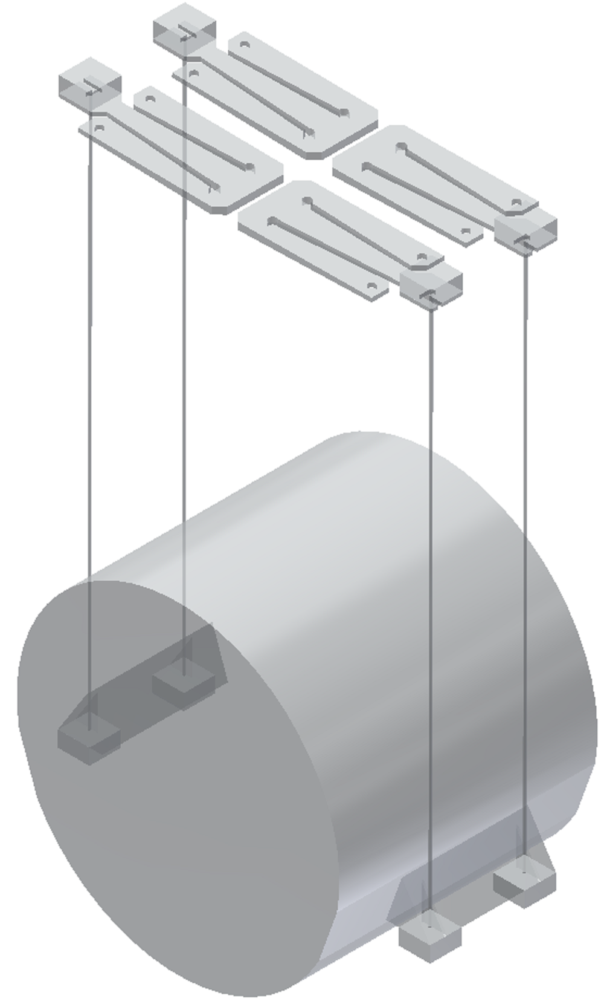
The KAGRA Cryogenic Payload
Here, only sapphire parts of suspension shown
Sapphire parts:
Top: blade springs
Clamped to intermediate mass
Middle: fibers
Bottom: Ears and mass

Slide 3
The KAGRA Cryogenic Payload
Joints need high strength, high thermal conductivity, low thermal noise
Indium will be used at fiber nail heads
Not load bearing
HCB will be used for joining ears to mass

Slide 4
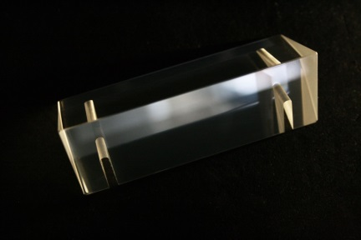
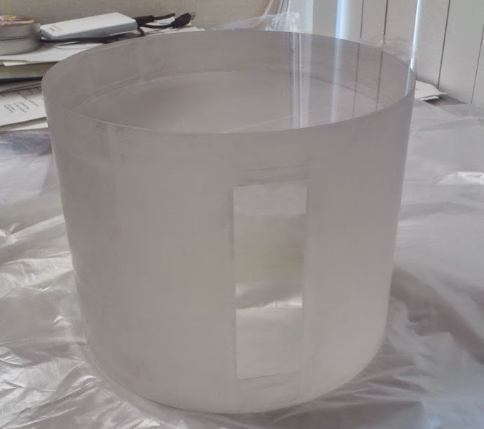
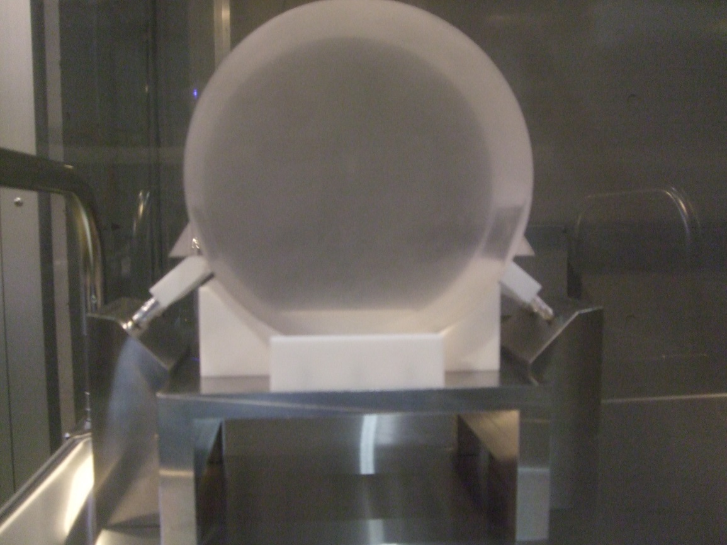
Prototype
In this time, we apply HCB between sapphire cylindrical bulk as dummy of mirror and sapphire ears.
Sapphire ear
Sapphire bulk as dummy mirror
4
4
4
4
4
4
4
4
4

Slide 5
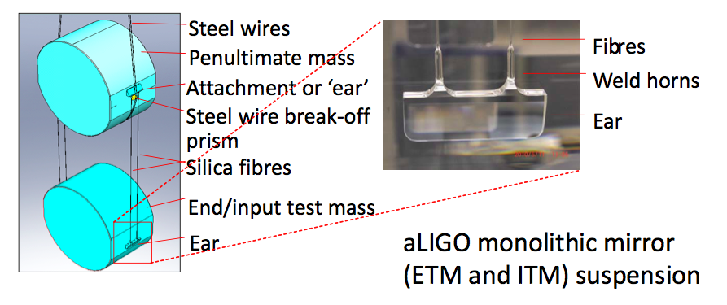
What is HCB?
Important point: after bonding, parts essentially become one piece.
Cannot separate after bond has set
Ear positioning during bonding very important!
Bonding surfaces must be very flat in order to achieve strong bond

Slide 6
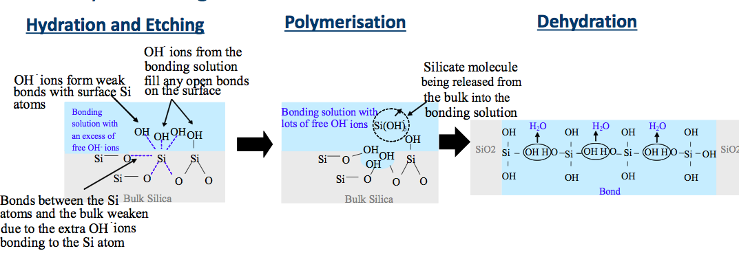
What is HCB?
HCB uses NaOH, KOH or Na₂SiO₃ solution to bond
Can bond silica based material as well as metal oxides
Hydroxide catalysis bonding (HCB) was first used by the gravity probe B experiment
Operation at 2.5K in UHV
HCB also used by Adv. LIGO and Adv. Virgo

Slide 7
How do we do HCB?
HCB must be done in clean room (Virgo: ISO3)
Simplified “LIGO style” HCB procedure is as follows:
Rub bonding surfaces with cerium oxide paste and rinse with De-Ionised water (twice)
Rub bonding surfaces with sodium bicarbonate and rinse with DI water (twice)
Rinse surfaces with DI water followed by methanol
Apply bonding solution (1:6 sodium silicate to DI water)
Place pieces together for bonding
Position must be checked before bond sets
Virgo uses different procedure

Slide 8
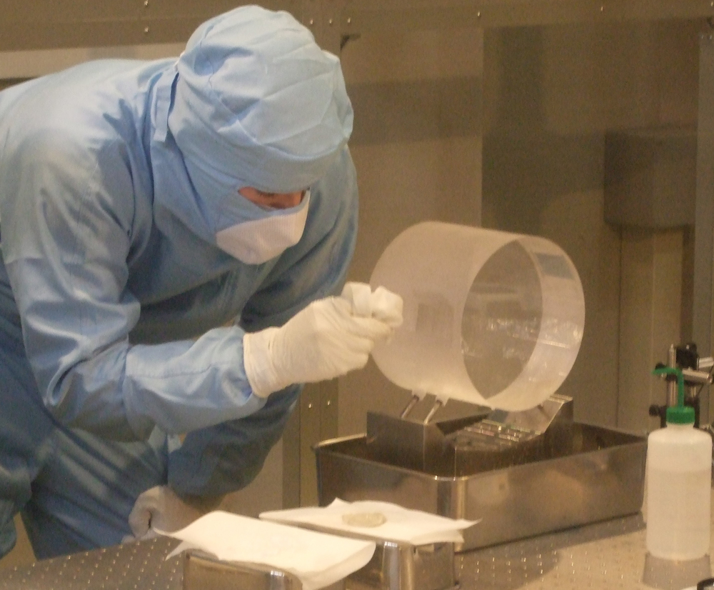
Mass Cleaning
Flat cuts are cleaned to give a hydrophilic surface before the bonding
Cleaning should be carried out under ISO 3 or better

Slide 9
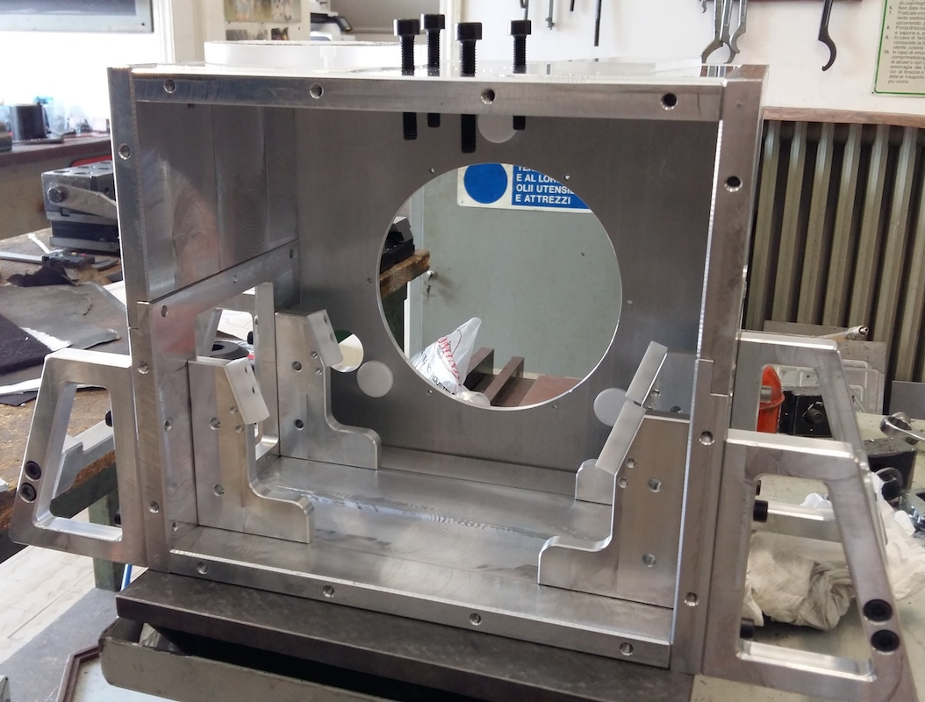
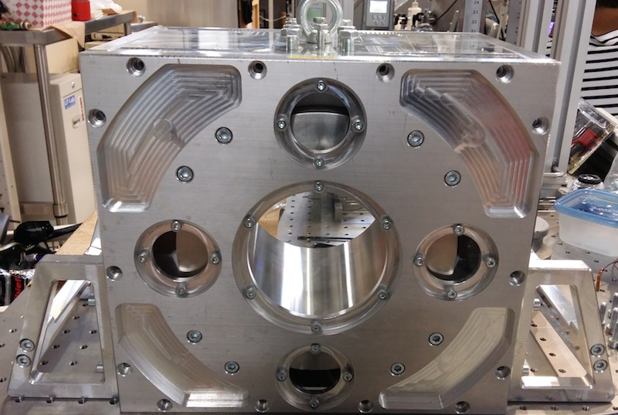
Bonding Jigs for KAGRA mirrors
Ear position very important for suspensions
KAGRA will use similar jig to Adv. Virgo
KAGRA bonding jigs developed in collaboration with U. Perugia

Slide 10
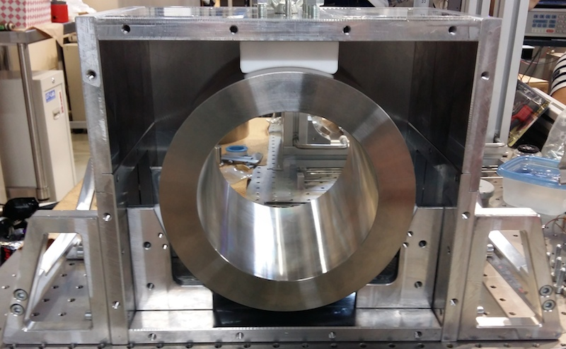
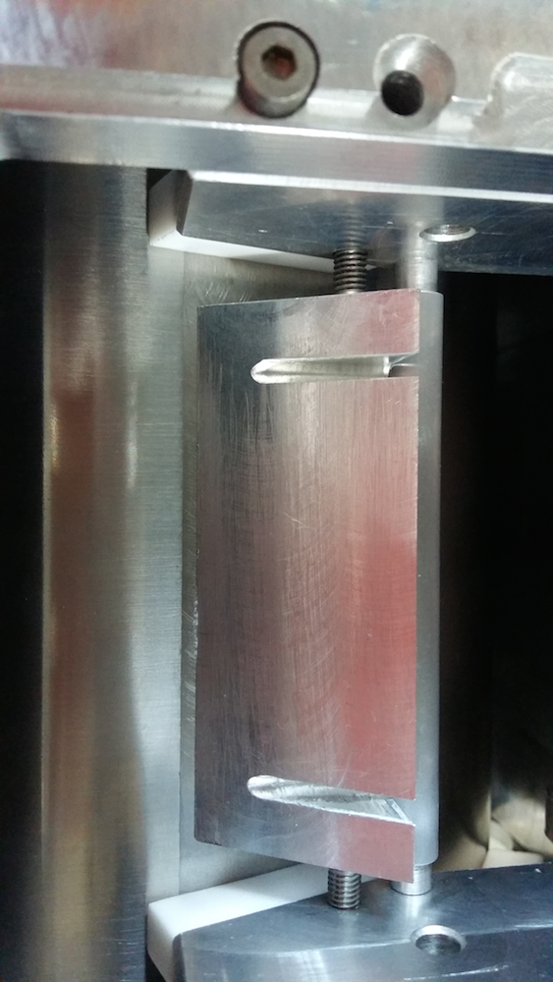
Bonding Jigs for KAGRA mirrors
Mirror is pressed on all sides by teflon
The box is rotated to rest on the handles during bonding
Handles parallel to mirror flats
Ear fixed in all degrees of freedom during bonding

Slide 11
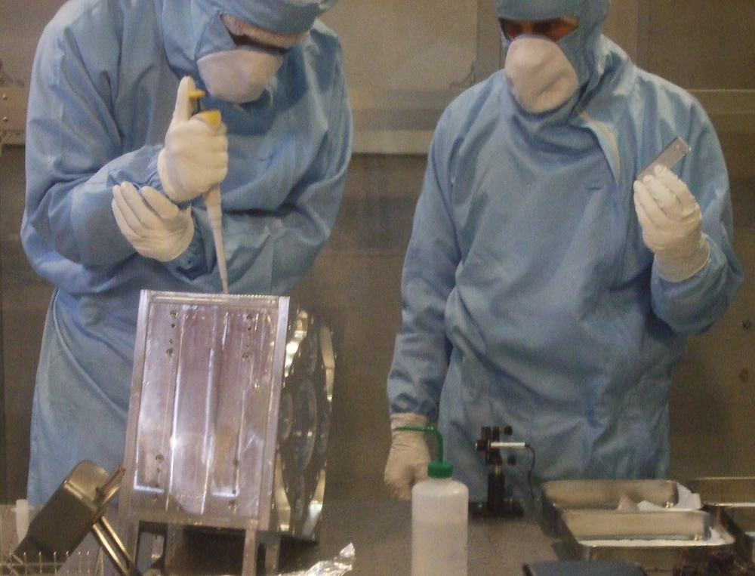
Bonding
Photo: bonding solution being applied, while the ear is prepared

Slide 12
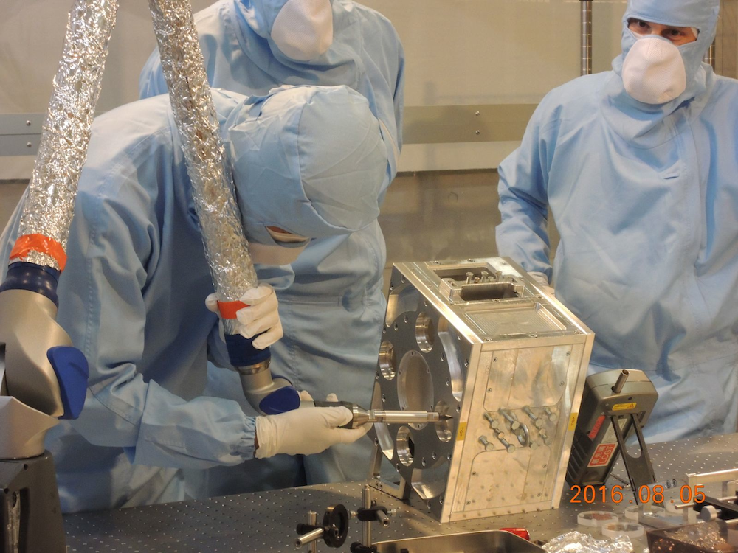
Checking ear position – 2hrs after bonding
Faro arm system used to check the position of the ear

Slide 13
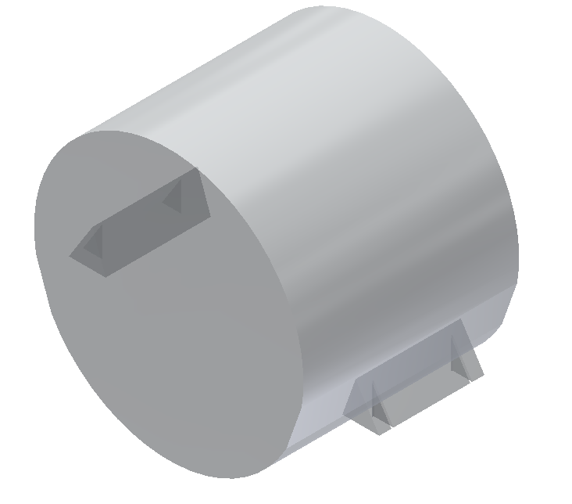
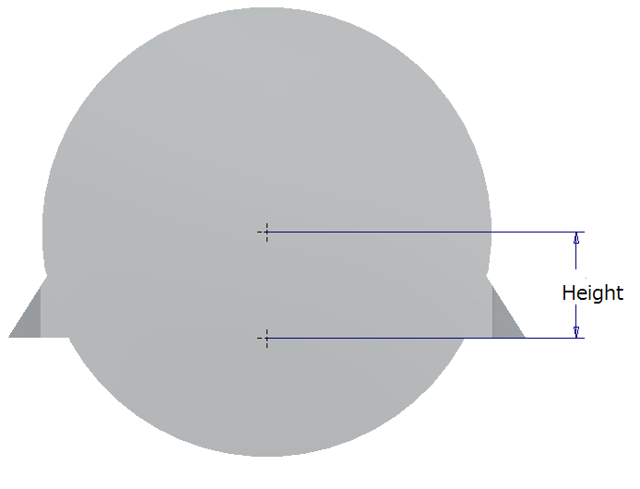
Degrees of freedom
The position of each ear with respect to three degrees of freedom was measured
Optical axis
longitudinal
position
Vertical position
tilt

Slide 14
Results
In all degrees of freedom, the position of the ears met requirements imposed by fiber thickness the differences in fiber lengths
However, it is important to test the strength of the bond
Strength testing began on 16/09
Entire mass is supported by ears alone

Slide 15
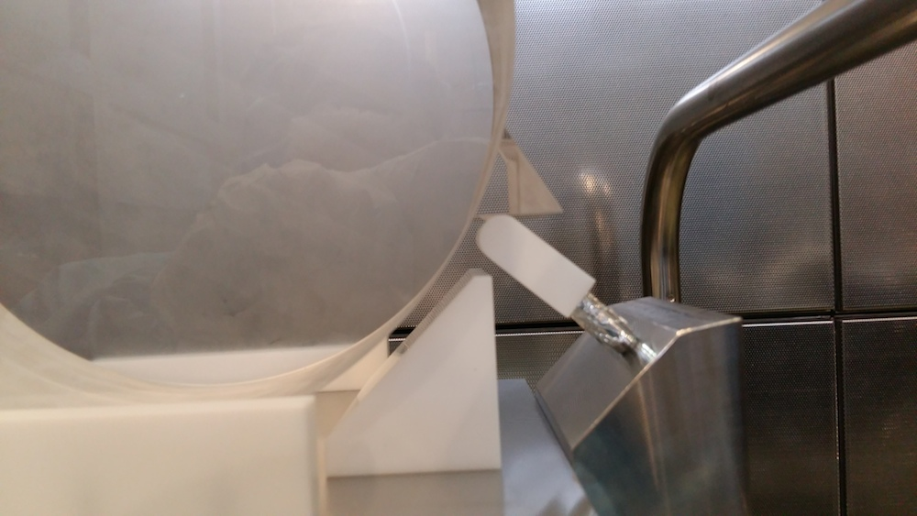
Strength testing
Ear supported by Teflon covered jig
Testing lasts for 2 weeks

Slide 16
Conclusions
The KAGRA mirrors will feature HCB bonding as part of the suspension
Sapphire ears have been successfully bonded onto a prototype sapphire mass
The positioning met requirements
Bond strength is currently under verification
The thermal conduction through these bonds will be tested in an all-sapphire suspension at KEK

Slide 17
Acknowledgements
NAOJ/ATC: Akutsu-san, Hirata-san, Mitsui-san
KEK: Enami-san, Araki-san
SK Service Co: Shimizu-san
University of Tokyo ISSP Workshop
University of Perugia Workshop
Glasgow: Marielle van Veggel
Other members of Cryo-payload

Slide 18
Any questions?
Thanks for your attention

Slide 19
Supplemental slides

Slide 20
How do we do HCB?
HCB must be done in clean room (Virgo: ISO3)
Simplified “LIGO style” HCB procedure is as follows:
Rub bonding surfaces with cerium oxide paste and rinse with De-Ionised water (twice)
Rub bonding surfaces with sodium bicarbonate and rinse with DI water (twice)
Rinse surfaces with DI water followed by methanol
Apply bonding solution (1:6 sodium silicate to DI water)
Place pieces together for bonding
Position must be checked before bond sets
Virgo uses different procedure

Slide 21
What is HCB?
HCB uses NaOH, KOH or Na₂SiO₃ solution to bond
Can bond silica based material as well as metal oxides
Hydroxide catalysis bonding (HCB) was first used by the gravity probe B experiment
Operation at 2.5K in UHV
HCB also used by Adv. LIGO and Adv. Virgo

Slide 22
Results
Optical axis position (AR to triangle surface):
Ear 1 (bonded on 5/8): (41.9±0.1)mm
Ear 2 (bonded on 12/8): (42.27±0.05)mm
Design value: (42±0.1)mm
Ideal value: 42.2mm
(Mass design thickness: 164mm
Mass actual thickness: 164.4mm)

Slide 23
Results
Ear height:
Ear 1 (5/8):47.5-47.6mm
Ear 2 (12/8): 47.3-47.8mm
The acceptable variation
is determined by the
variation in fiber length:
1mm! However, we aim
To minimise this for the ETM

Slide 24
Results
Ear tilt
Ear 1 (5/8):0.3mrad
Ear 2(12/8): 6.6mrad
Both flat cuts have tilt, which
propagated as an error onto
only one side. This must be
considered for the ETM.

Slide 25
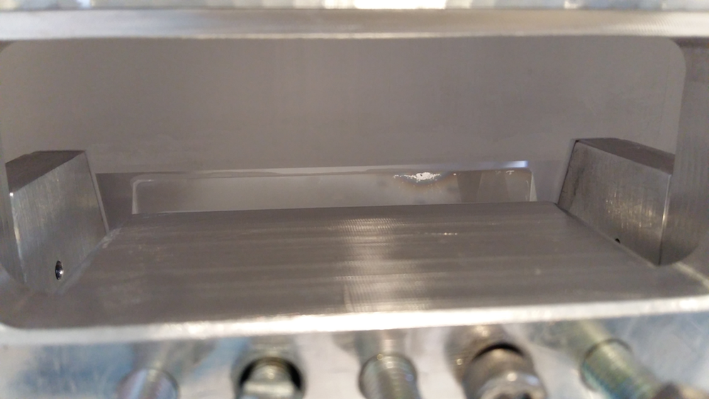
First Ear - bubbles
Ear bonded on 5/8 developed bubbles during curing
Ear was checked on 5/8 and 12/8 and no bubbles were found
Bubbles first observed 1.5 weeks after bonding
Cause to be investigated

Slide 26
Future work
HCB Curing will finish mid-September
Strength testing of the bonds will finish in late September
High resolution 3D position measurements should be made
The mass will be suspended for thermal conductivity/fiber Q measurements
New jigs for ETM under development

Slide 27
Future work
There are many differences between the mass used and the ETMs
A bulk will be prepared for a final bonding test to be carried out before the first ETM bonding
An array of bonding and suspension tests are planned between now and bonding and suspending ETMY

Slide 28
Bonding Jigs for KAGRA mirrors
Ear position very important for suspensions
KAGRA will use similar jig to Adv. Virgo
KAGRA bonding jigs developed in collaboration with U. Perugia

Slide 29
Bonding Jigs for KAGRA mirrors
Mirror is pressed on all sides by teflon
The box is rotated to rest on the handles during bonding
Handles parallel to mirror flats
Ear fixed in all degrees of freedom during bonding

Slide 30
Metal Mass Jig Testing
Optical Axis positioning:
First 43.0183+/-0.06 43.0154+/-0.01
Second 42.9346+/-0.04 43.0176+/-0.02
Third 42.9227+/-0.06 42.9996+/-0.03
Design value 42mm
Spacers were trimmed by 1mm after this!

Slide 31
Metal Mass Jig Testing
Ear height tests
First 46.78+/-0.01 46.82+/-0.05
Second 46.88+/-0.03 46.88+/-0.07
Third 46.97+/-0.06 46.98+/-0.1
Positions are reproducible to 0.1mm. However, offset from design value of 48mm.

Slide 32
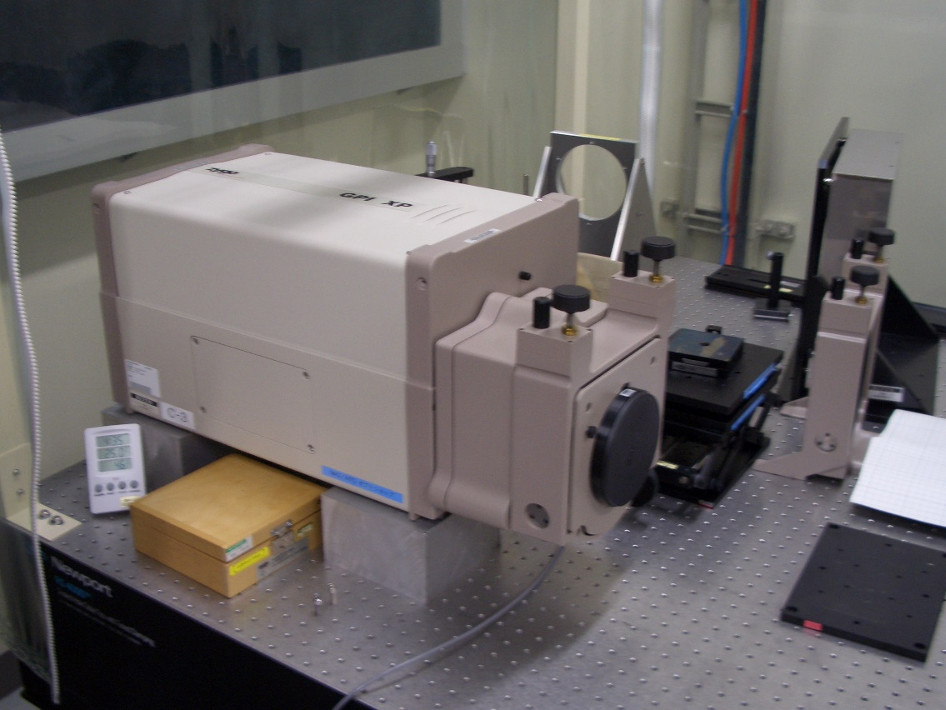
Surface figure measurements were done at
Advanced Technology Center in
National Astronomical Observatory of Japan
http://www.nao.ac.jp/en/project/atc.html
Zygo GPI Laser Interferometers
Light source: He-Ne(632.8nm)
Object size： <100 mm in diameter

Slide 33
Surface A

Slide 34
Surface B

Slide 35
Prism: N1

Slide 36
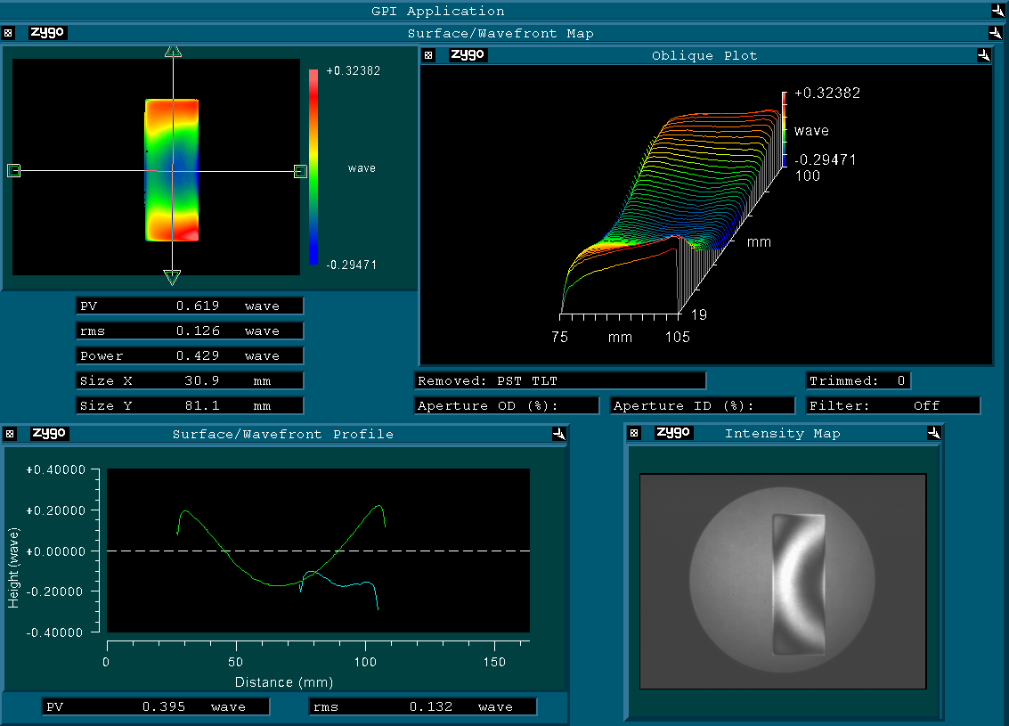
Prism: N2

Slide 37
Future work/Schedule
ETM Box under design – will be fabricated during September
ETM sized metal mass for glue tests 16/10
Prototype mirror suspension tests up to 16/12
HCB using glass plates/prisms 17/1
HCB using sapphire plates/prisms 17/2
Suspension tests 17/2 17/3
Dummy bulk bonding 17/4
Dummy mirror suspension 17/5

Slide 38
Future work/Schedule
Clean room preparation (Toyama) 17/4
HCB –ETMY 17/6
Curing 17/7
Strength testing 17/7
Suspension 17/8

