Slide 1
Optical configuration of GIF
Chambers and optics are located in expanded areas.

Slide 2
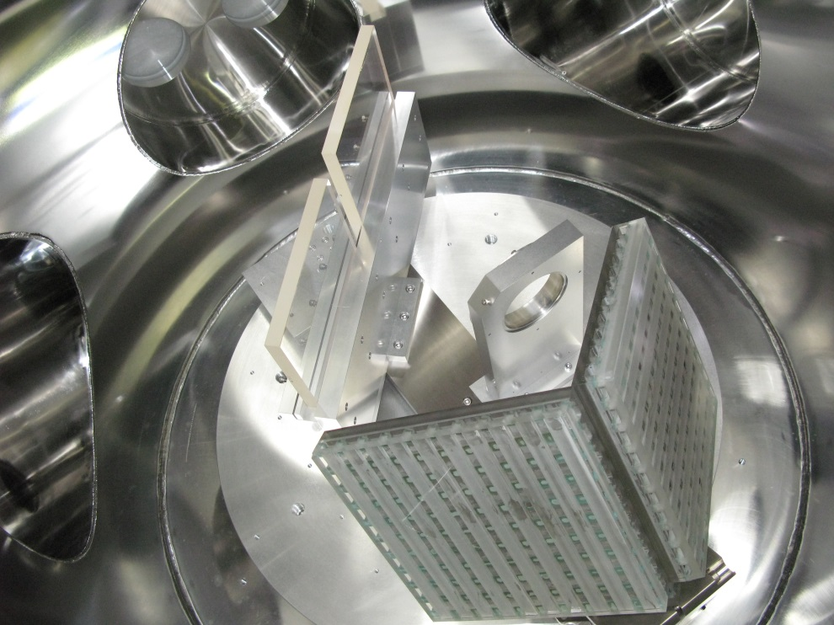
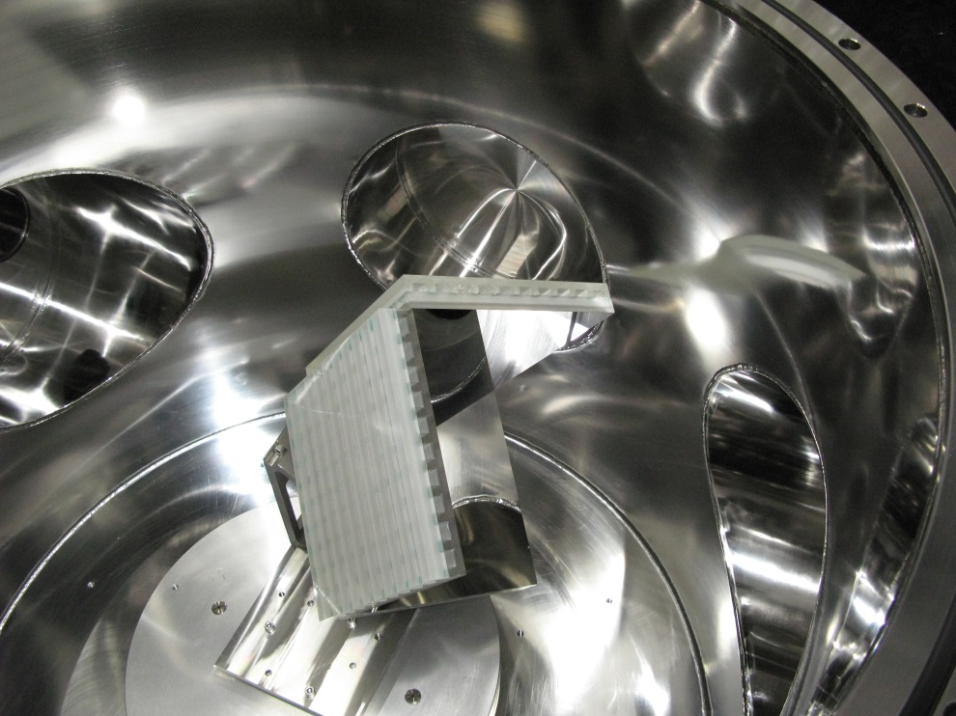
Beam splitters and retro reflectors
Optics in front tank
Retroreflector in end tank

Slide 3
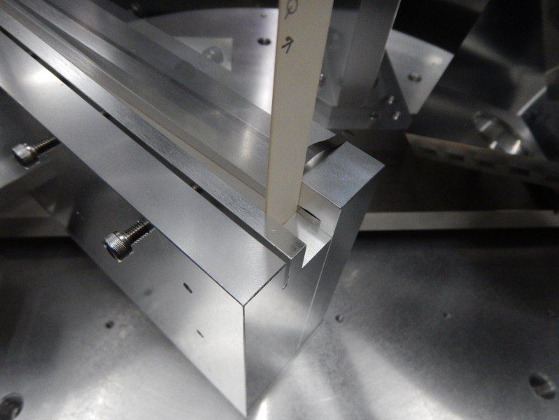
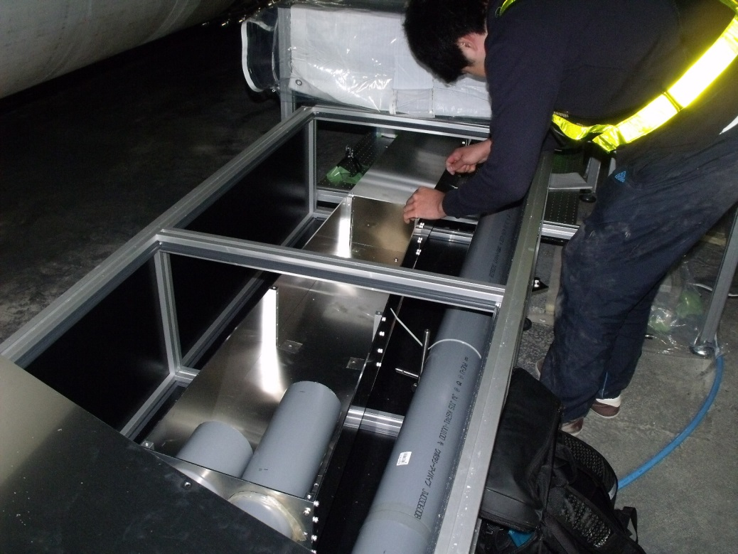
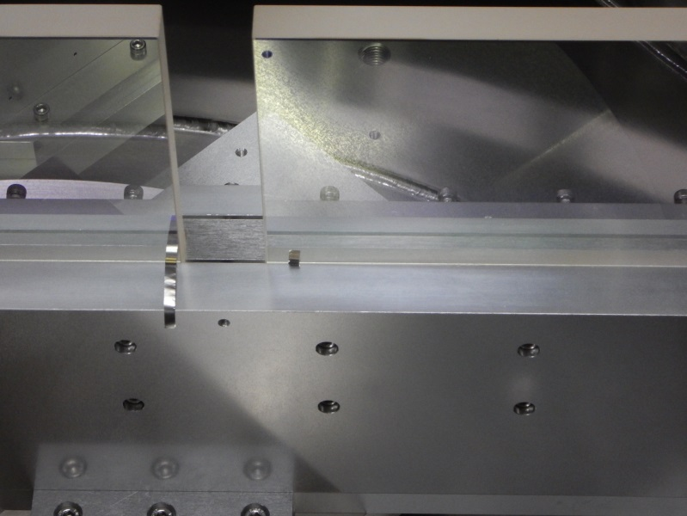
Guide pipes to reduce atmospheric fluctuation (left) and shim plates inserted into the beam splitters to adjust wave front (right).

Slide 4
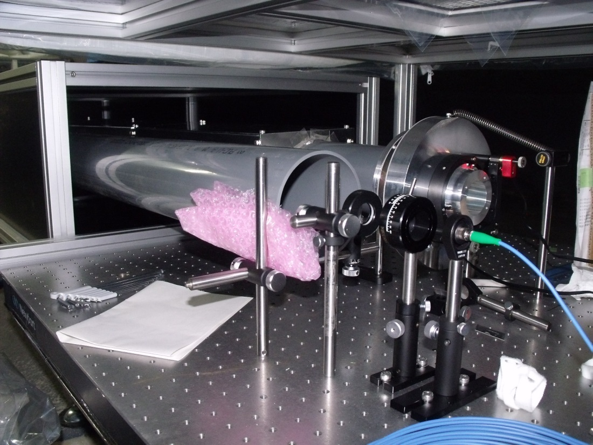
Input optics (left) and interferometer fringe (right).

Slide 5
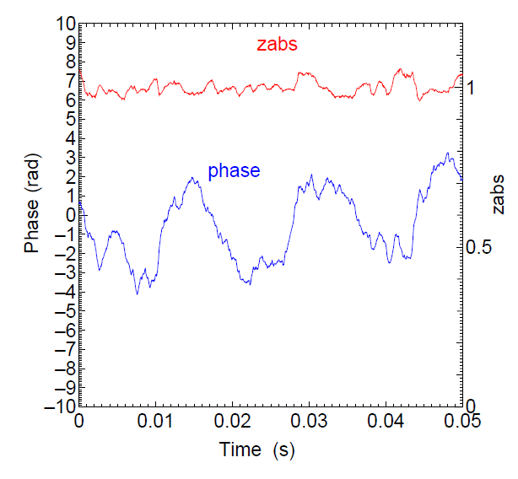
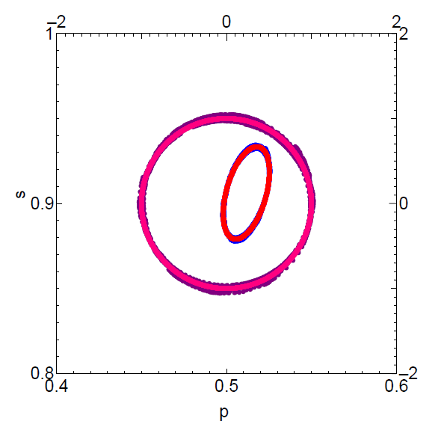
Interferometer signals detected by two (p and s) photo detectors (left). Elliptical Lissajous (left, red) from the quadrature interferometer was normalized into circular one (left, pink) and optical phase was successfully obtained (right). The waveform likely indicates fluctuation of the laser frequency.
2016/7/20 16:05:01～

Slide 6
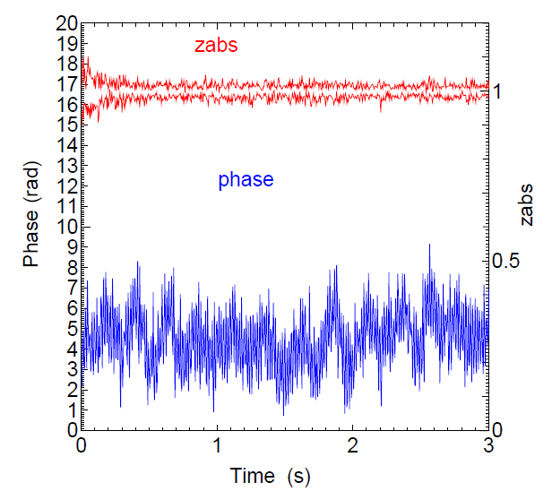
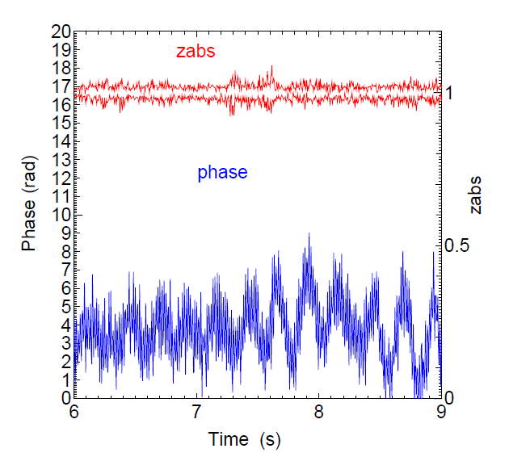
Optical phases for 3 seconds. One radian in phase corresponds to 42nm in displacement or 2.8x10⁻¹¹ in strain. Zabs indicates radial distance from the origin of the normalized coordinate, showing quality of the normalization; zabs around unity (right vertical axis) shows ideal normalization.
2016/7/20
16:05～

