Slide 1
Type B Installation Plan
Mark Barton
KAGRA Extended Chiefs Meeting, 7/4/2016
JGW-G1605348-v2

Slide 2
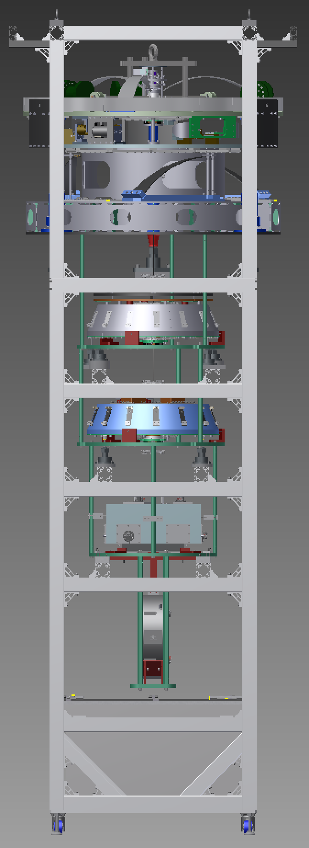
Scope
One BS suspension
Three SR suspensions (SR2, SR3, SRM)
Each has
Preisolator (PI) with Inverted Pendulum table (IP) and GAS filter (F0)
Standard Filter (SF) and damper ring
Bottom Filter (BF)
Intermediate Mass (IM) and Intermediate Recoil Mass (IRM)
Optic (TM) and Recoil Mass (IM)
Lower breadboard, blade springs, and damper rings.
SRx payload (TM/RM/IM/IRM) is similar to PRx – BS payload is unique
(BS)

Slide 3
Team
Core team
Mark Barton – leader, NAOJ, physicist
Fabian Peña-Arellano – NAOJ, physicist
Naoatsu Hirata – NAOJ, engineer
Additional help from
Ryutaro Takahashi – NAOJ, large purchases
Naohisa Sato – NAOJ, PI testing – to be confirmed

Slide 4
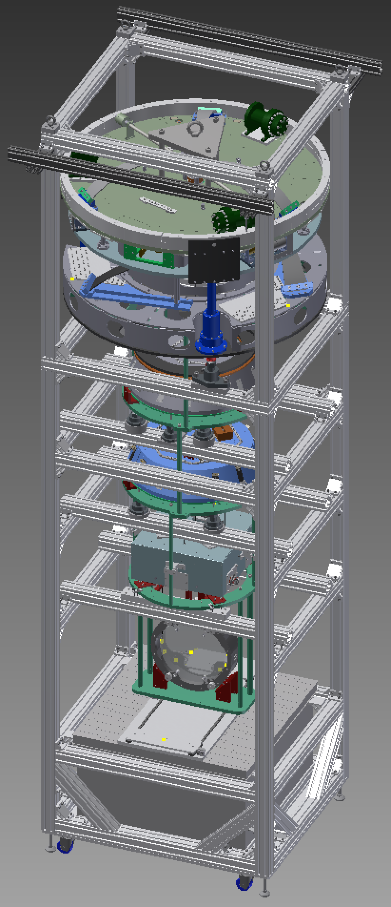
Installation Procedure
Assembly frame based on versions for TAMA Type B test and PR3 test.
Even more use of jacks to raise and lower sections independently (for hooking of maraging rods) without galling of screws in security structure.
IM is now supported from main frame while BS and RM are hung from it – no separate hanging frame.
Frame has extensions to hold cloth cover clear of PI.
Frame will be constructed on the +Y side of the BS tank from today.
SRx version will be near-identical – need to decide whether to save money (use BS frame) or time (make another).

Slide 5
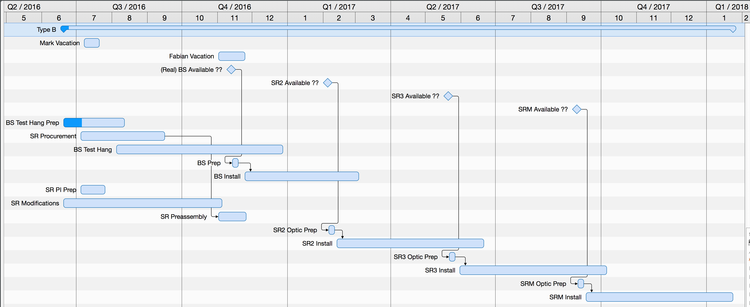
Schedule

Slide 6
Current Status - BS
Have essentially all parts and fasteners for BS except:
A few in-vacuum cables (on order; should arrive in good time)
Blades for lower breadboard (on order; should arrive in good time)
Wide-mouthed OSEMs.
RM, IM, IRM, BF and SF have been pre-assembled.
Dummy BS was prepared (gluing of flags, prisms) but will need to be redone (problems with quantity of glue).
Assembly frame for BS will be constructed this week
Payload assembly procedure written (JGW-E1604817)
Overall assembly procedure about half written (JGW-E1504235).
BS test hang with dummy BS will begin ≈7/25.

Slide 7
Current Status - SRx
Have parts for SR2 and SR3 payloads (i.e., the ones intended for iKAGRA).
Need payload parts for SRM (as well as for PRM – Type Bp)
Need fasteners for three SRx.
Need additional in-vacuum cables and OSEMs.
Need to modify some parts based on lessons learned from BS/PR3.
Want to use sapphire prisms as for BS, but will need to modify RMs. Machining test in progress at NAOJ ATC to see if feasible.
SF and BFs are pre-assembled, but need some (re-)testing.
PI stages are on order from Nikhef but will need setup/testing – hope to get some help from Sato-san of Type A group or TBD.

Slide 8
Technical Issues
BS flag/prism gluing
Need to solve problem of correct amount of glue.
Need to improve technique for using fixtures.
Need to re-solve for glass optic.
Prisms
Sapphire prisms on PR3 failed.
New prisms are larger, better polished and cut at a different angle to the optic axis of the sapphire, so should be stronger.
Sapphire prisms are being used in the test hang, but might still have issues.
SR recoil masses will need to be remachined to allow larger prisms – might warp – test in progress.
OSEMs vs. OLs for optic position sensing.
Flags with tips for OSEM shadow sensors are easy to break.
VIRGO uses OLs that sense position (accuracy low, but good enough)
Akutsu-san is designing a VIRGO-style OL; also wide-mouthed OSEMs.
Plan is to attempt BS test hang with full flags. If OLs work well or full flags get broken, can use stub flags with magnets but no tips (impossible to break).

Slide 9
Schedule/Manpower Issues
SR Procurement/Preassembly
Lots of SR procurement still to do – extra payload, fasteners, cables
Lots of SR preassembly still to do – PIs, RM, IM, IRM, optics
Lots of SR documentation still to do
May need to hold off on BS test hanging to get SRs in better shape.
SR assembly frame
Current schedule assumes one frame.
A second frame would be expensive but could allow some parallel work, especially if issues/holdups arise.
Filter remeasurement
Hirata-san has been double-checking the load capacities of all the filters (including Type A).
Takes one day per week at NAOJ, currently Wednesday – awkward for work at Kamioka.
PI Preparation
Schedule currently assumes significant help with PI setup from Type A group.

