Slide 1
KAGRA Status
The 1st International Meeting on KAGRA @ KISTI
Takayuki TOMARU
High Energy Accelerator Research Organization (KEK)

Slide 2
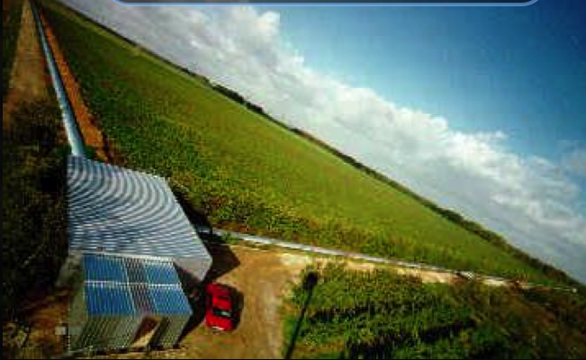

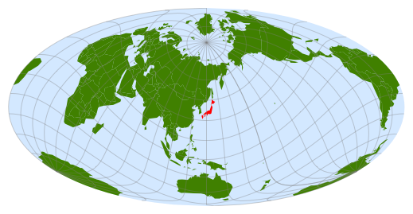
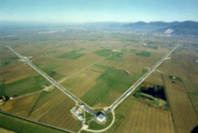
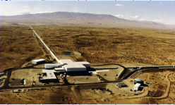

2nd Generation GW Observation Network
GEO-HF (Hanover), 600m
aLIGO (Livingston), 4km
aVIRGO (Pisa), 3km
aLIGO (Hanford), 4km
LIGO India
KAGRA (Kamioka), 3km
200Mpc
Our Galaxy
Magellan
Andromeda
Virgo Cluster Hercules Cluster

Slide 3
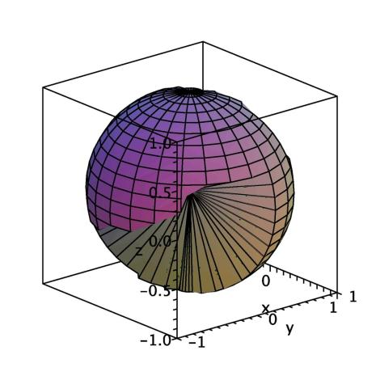
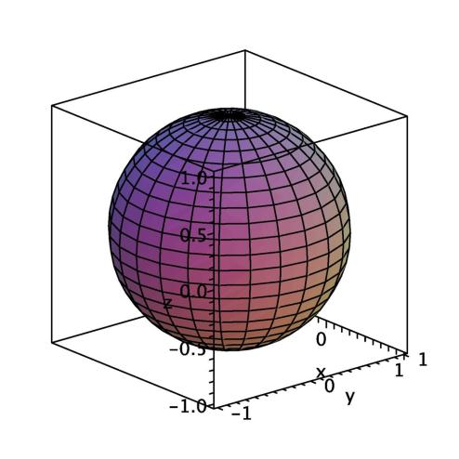
Why do we need a GW telescope in Asia?
Sky Coverage and Duty Time
B. F. Schutz
N. Kanda
H + L + V
H + L + V + K
When maximum sensitivity of a telescope with best observation angle defines as 1.0
 | Sensitivity in whole Sky-Average | Rate of Duty Time | Exposure Ave. Sens. x Duty time
Only one | 0.45 | - | -
H+L+V | 1.3 | 51% | 0.67
H+L+V+K | 2.0 | 82% | 1.4
x 2!

Slide 4
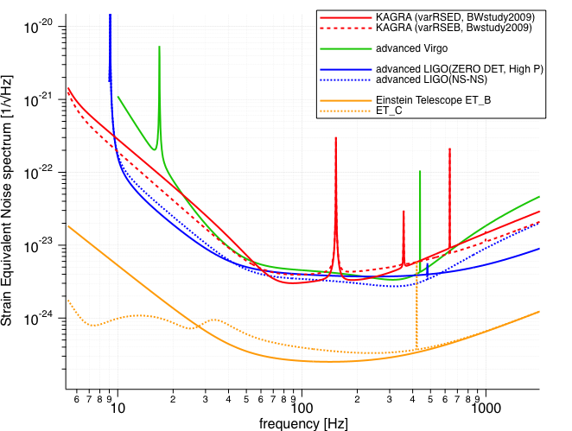
Sensitivities of 2nd & 3rd Generation GW Telescopes
Comparable
sensitivities

Slide 5
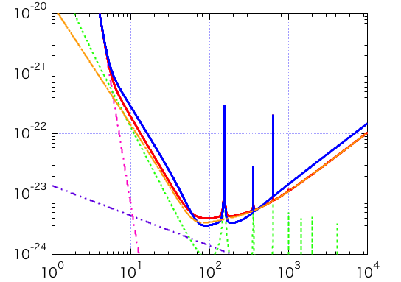
Noise Budget of KAGRA
h ~ factor x 10⁻²⁴ [/√Hz] for observation band
Underground
Broadband RSE operation
Detuned RSE operation
Seismic noise
Radiation Pressure Noise
Strain Sensitivity [1/rHz]
Photon Shot Noise
Suspension thermal noise
Mirror thermal noise
+ coating thermal noise
Cryogenic
Frequency [Hz]

Slide 6
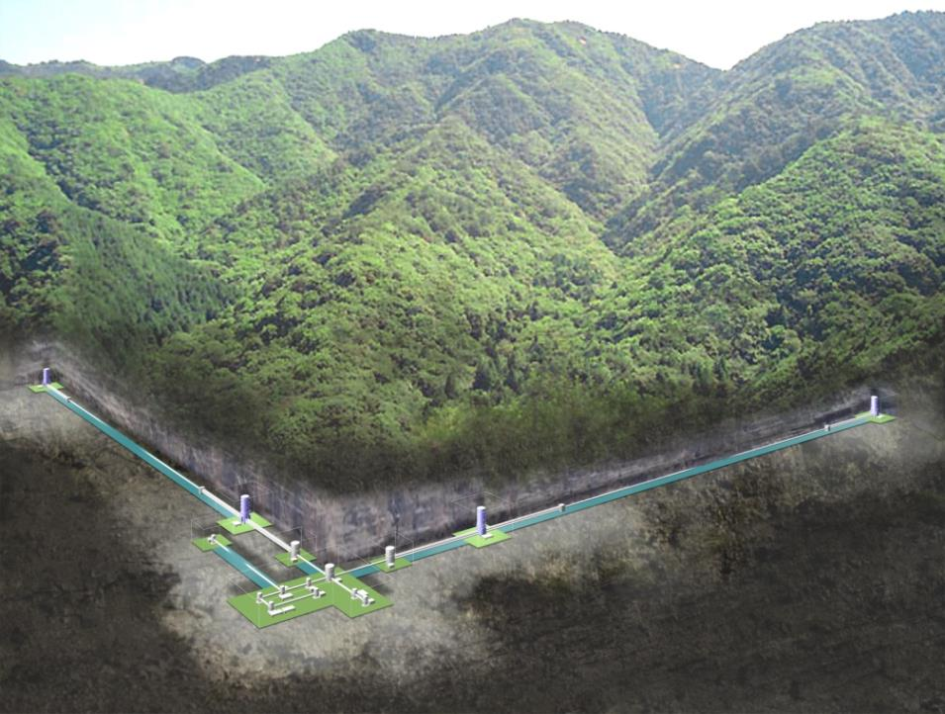
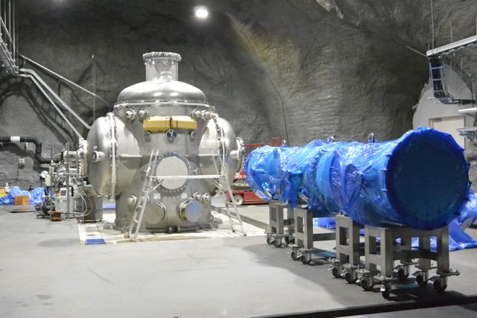
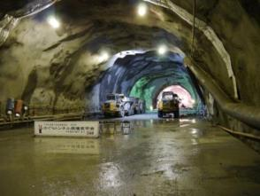
Cryogenic Mirror System
Features in
KAGRA
Underground

Slide 7
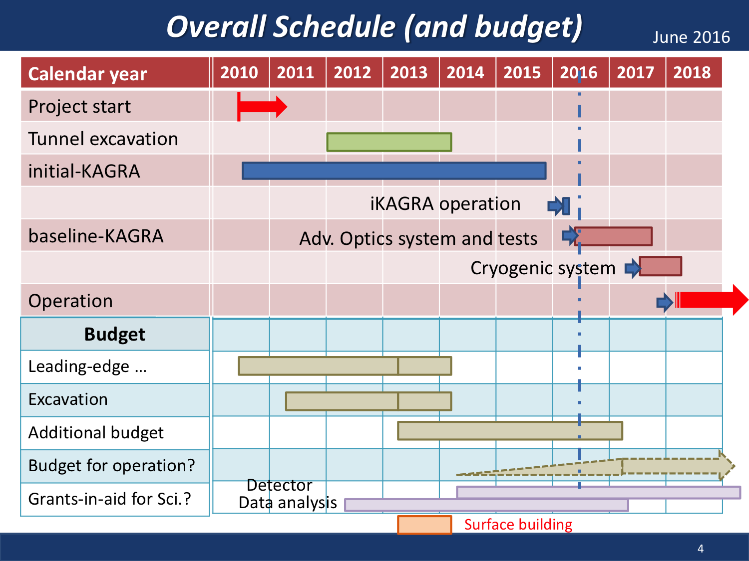

Slide 8
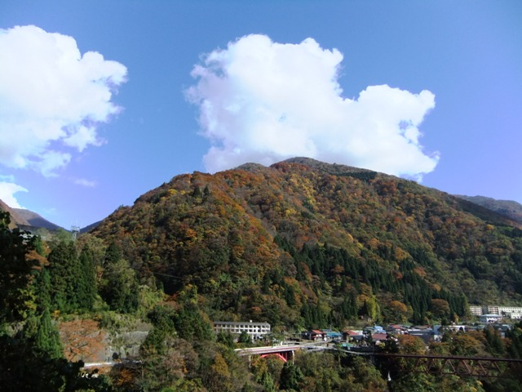
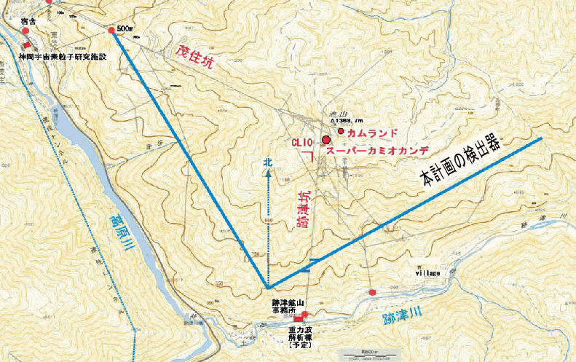
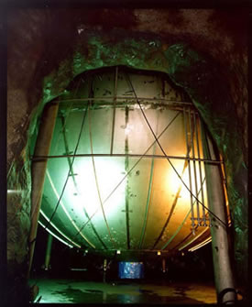
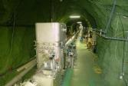
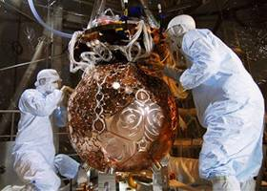

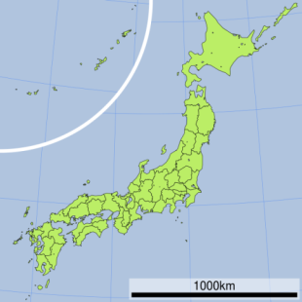
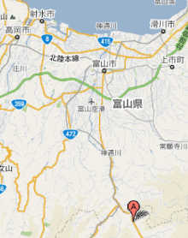
KAGRA Location
Mt. Ikenoyama
Mozumi Entrance
Kamland
CLIO
1000m underground
3km
KAGRA
XMASS
Super-
Kamiokande
3km
Toyama airport
Kamioka◎
◎Tokyo
50min.
by car
Shin-atotsu Entrance

Slide 9
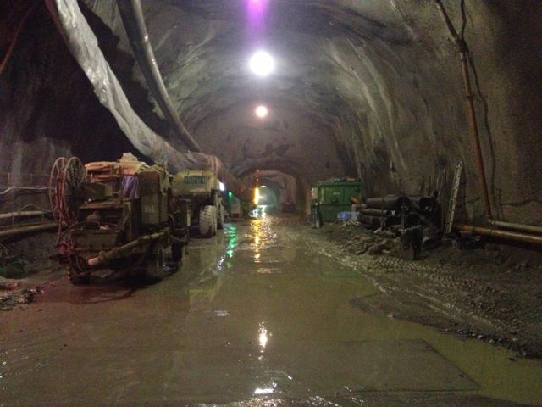
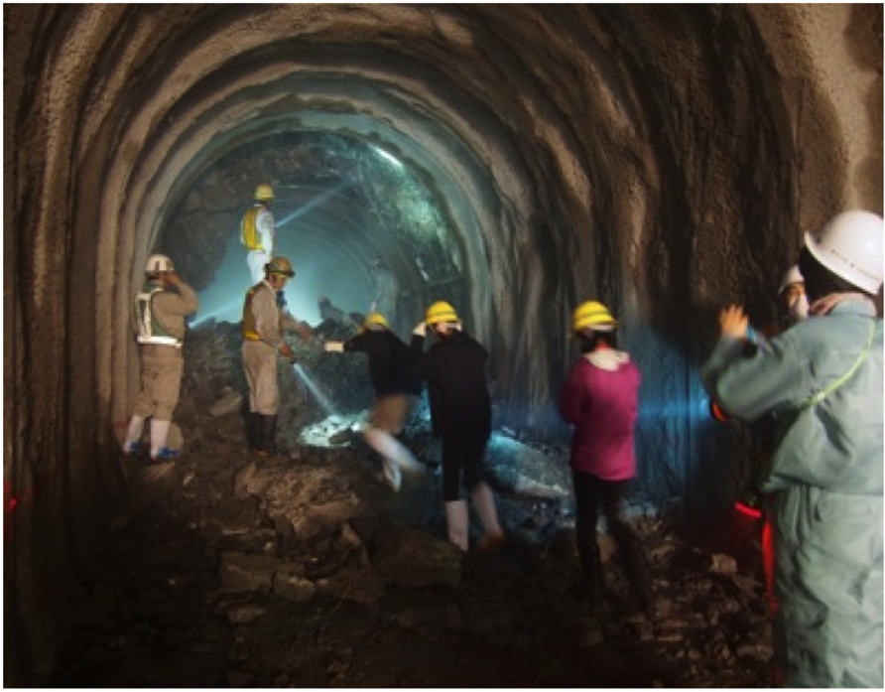
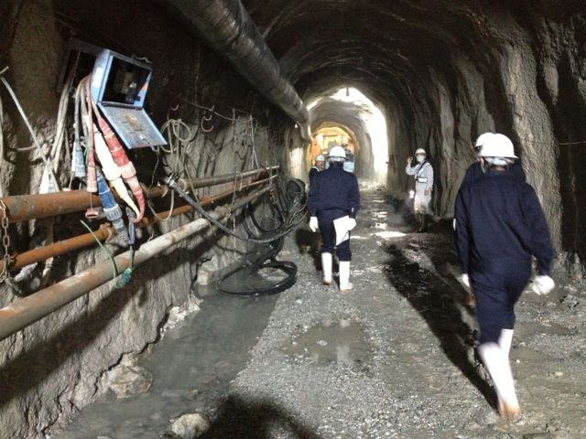
Tunnel excavation was
done at Mar. 2014
7km tunnel in total
9

Slide 10
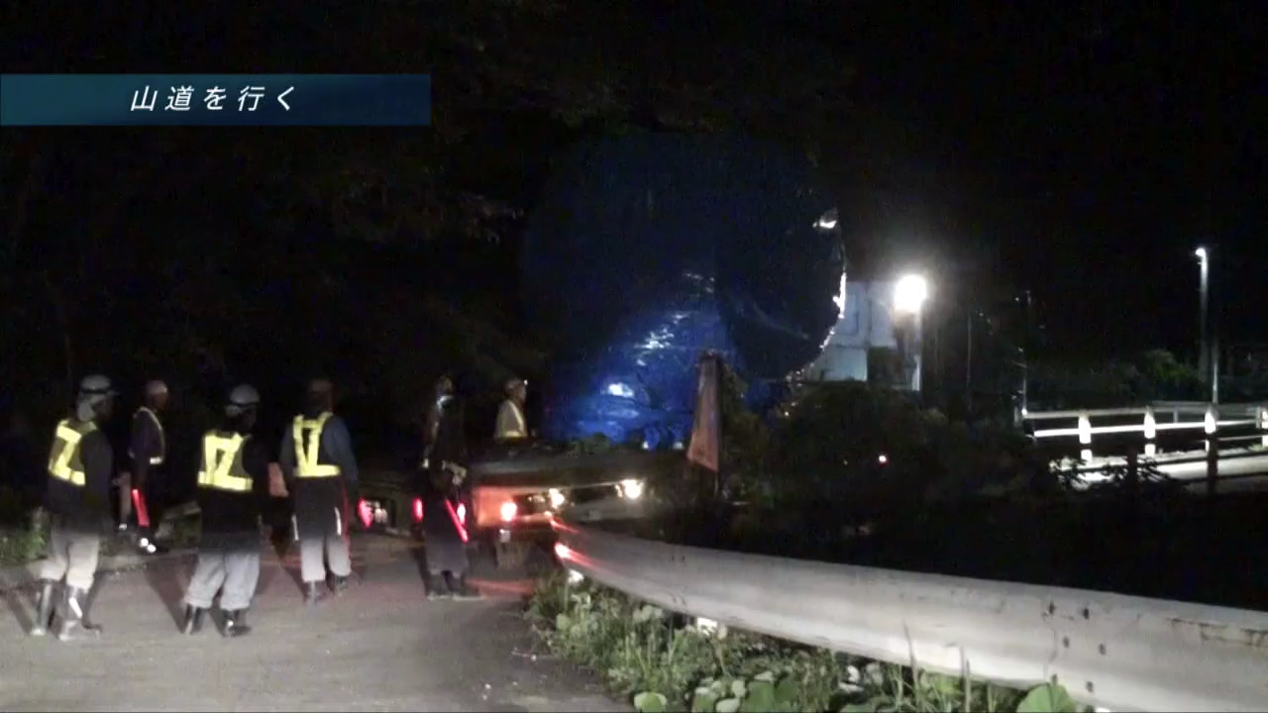
Cryostat Installation
Aug. 14, 2014
<- First device installation
Search KAGRA on YouTube

Slide 11
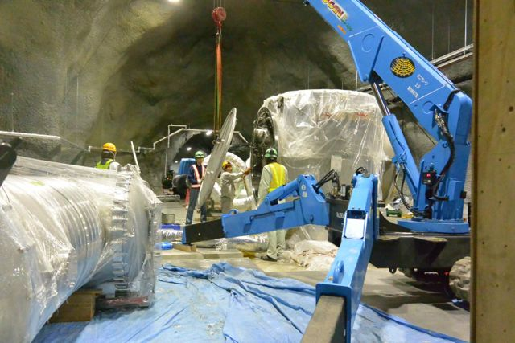
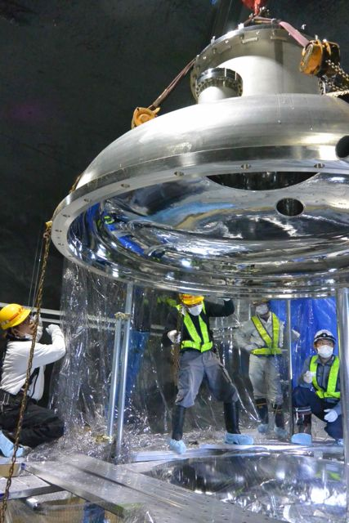
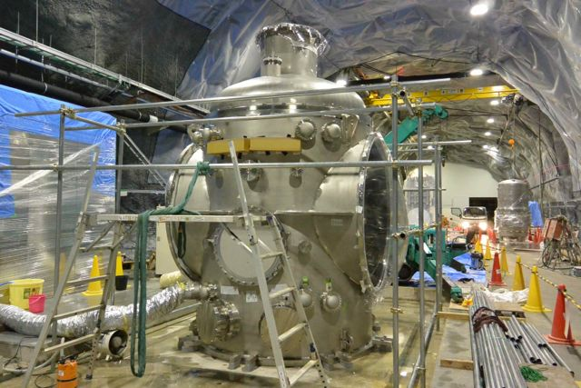
Cryostat Assembly
4.3m
Assemblies of all of main cryostats
has been done.
2.6m

Slide 12
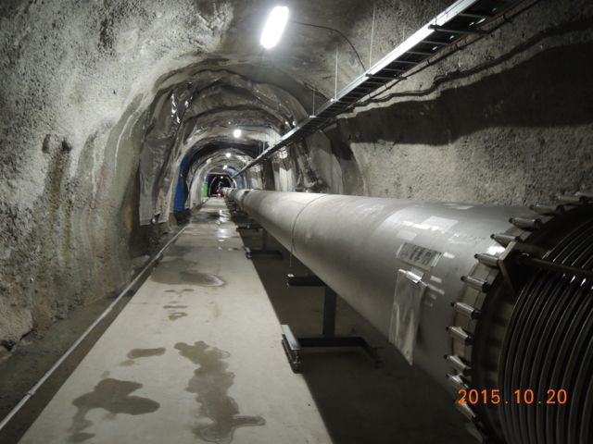
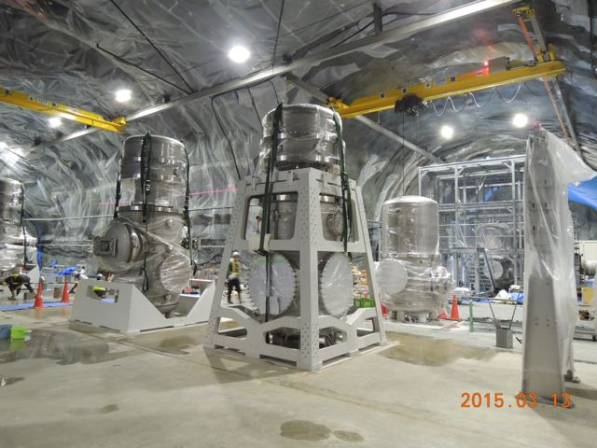
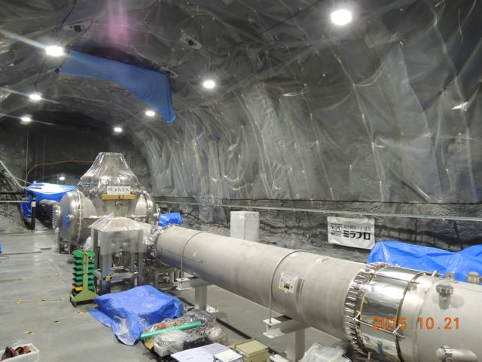
Vacuum Tubes and Tanks Installation
Beam tubes: φ800mm x12m x 478
Mode cleaner and BS tanks
Cryostat
Most of vacuum tubes and tanks has been
installed, and the installation will be
completed in this year.
Cryogenic Duct
Beam Duct
We also confirmed no vacuum leakage;
< 1x10⁻¹⁰ [Pa m³/sec]

Slide 13
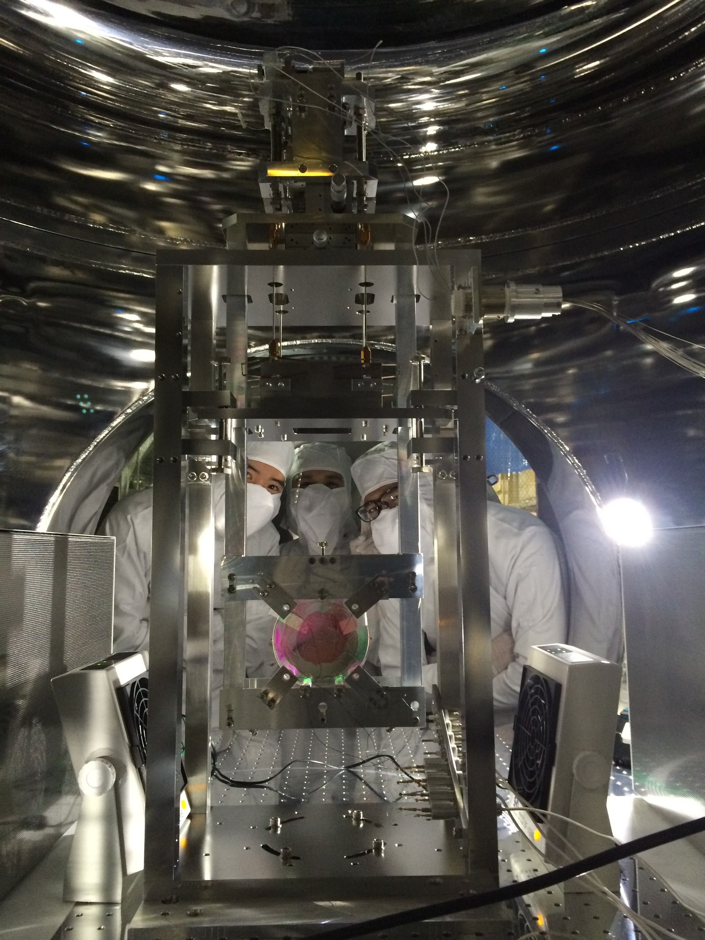
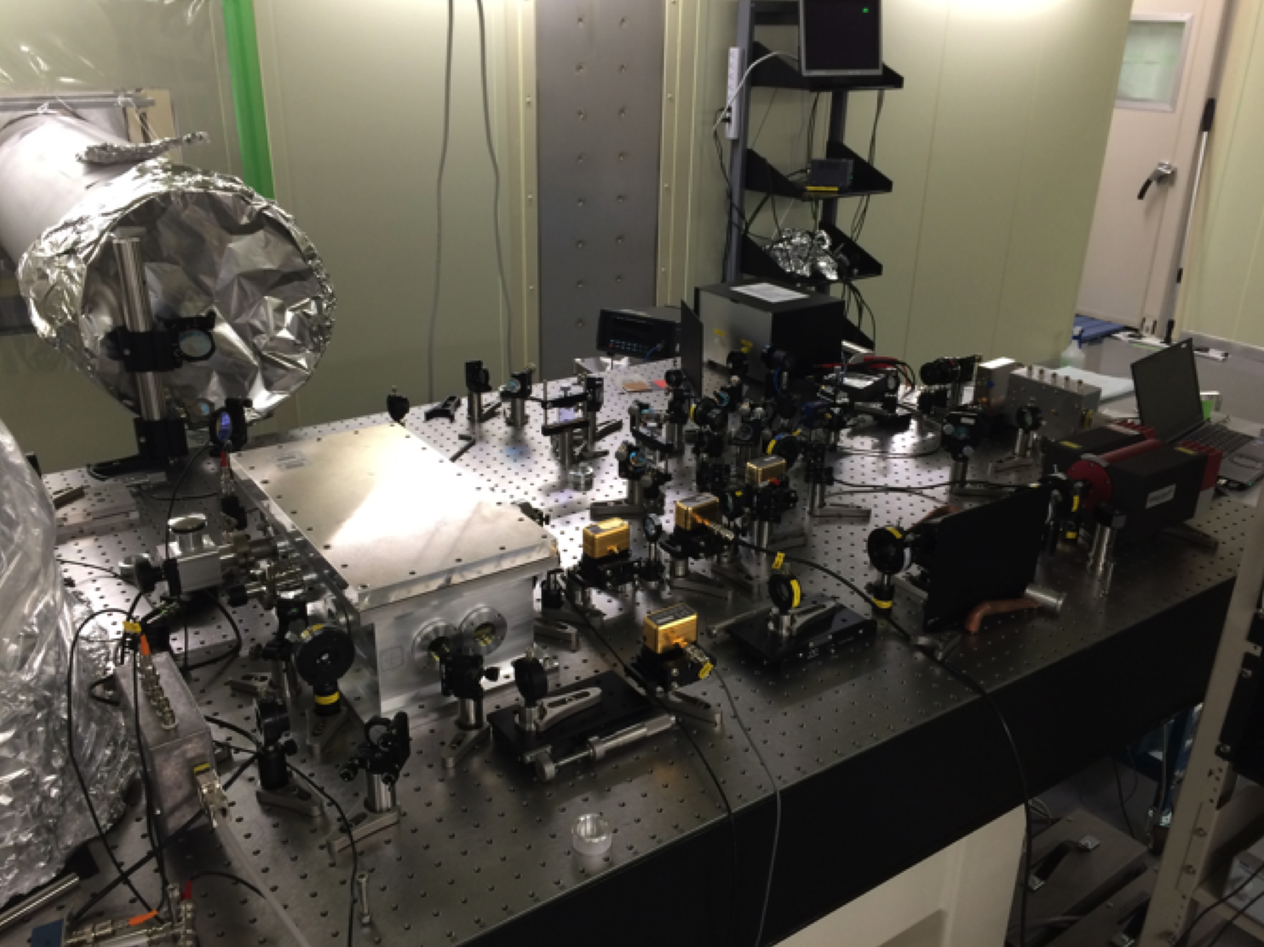
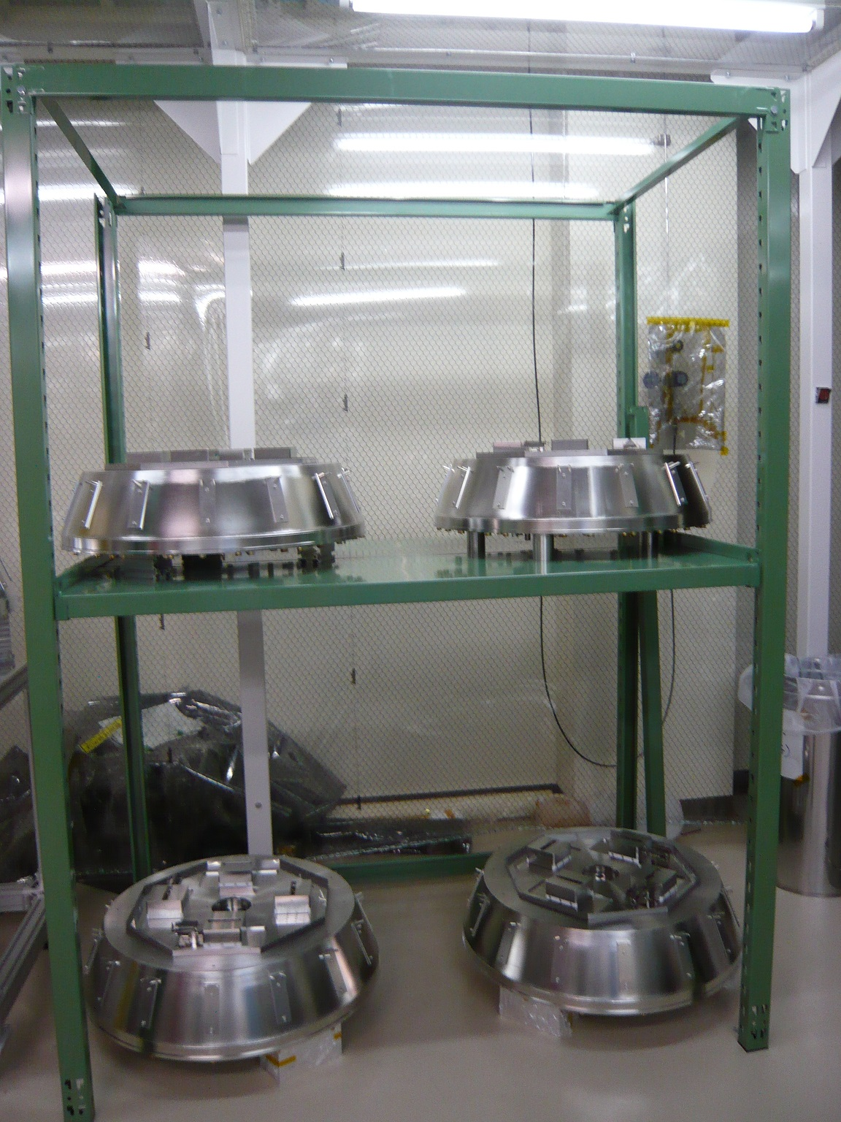
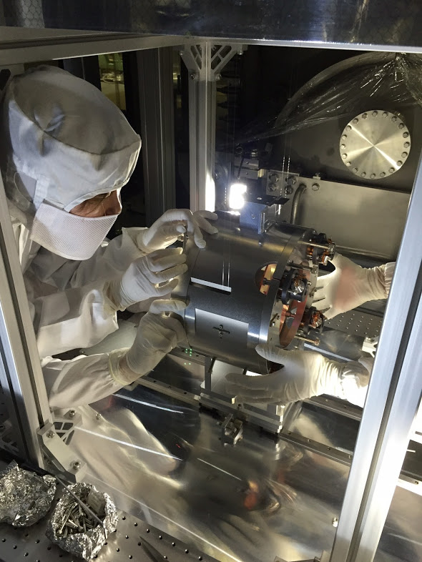
Installation of Input Optics & Vibration Isolators
Details: Nakano and Takahashi
Laser bench
1st mirror (for mode cleaner) was installed
in Oct. 2015.
GAS filters

Slide 14
First critical milestone
iKAGRA operation

Slide 15
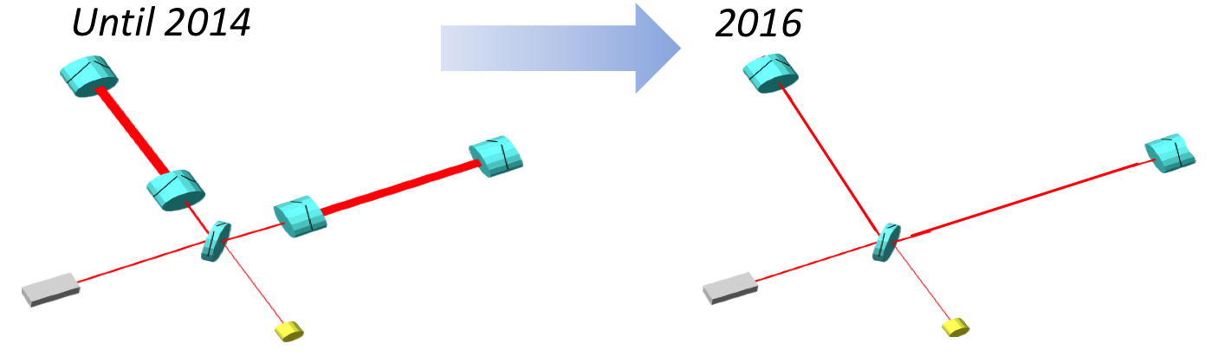
Hard Landing of iKAGRA
Test observation by Fabry-Perot Michelson
interferometer at room temperature
Test operation by simple Michelson
interferometer at room temperature
Even if interferometer configuration is very simple, we can check
• Laser transmission through 3km beam ducts.
• Installation procedures
• Facility Issues
• Control electronics
• Data storage and transfer
• etc…

Slide 16
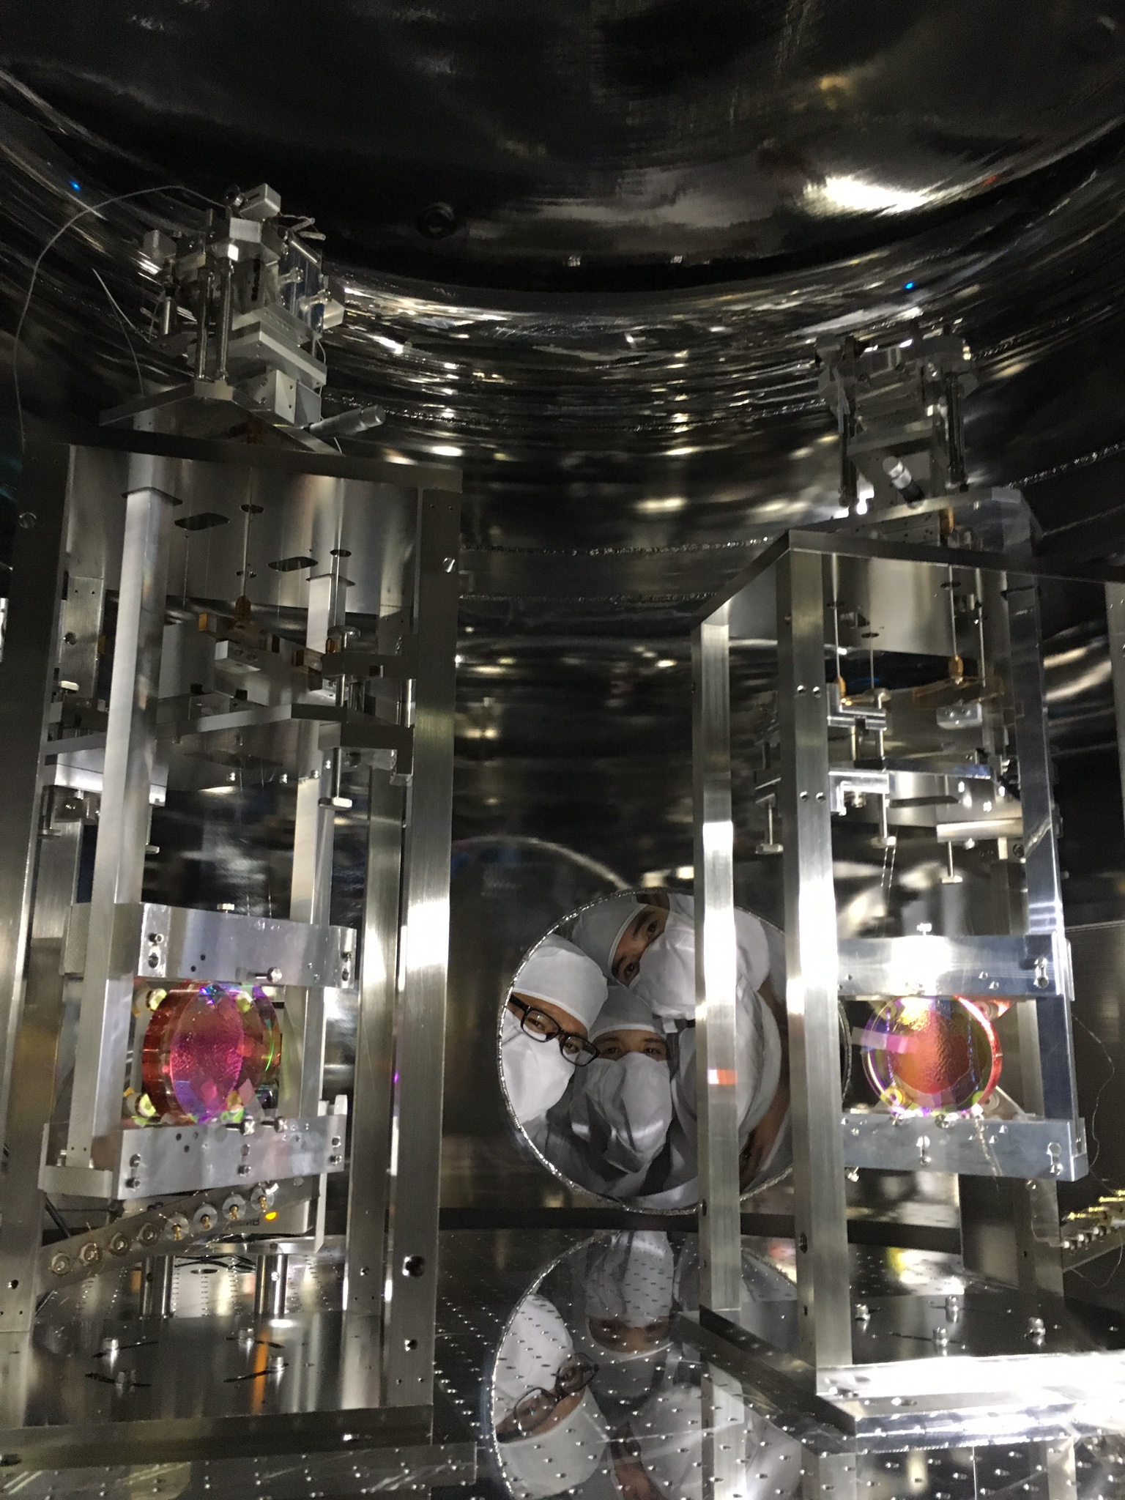
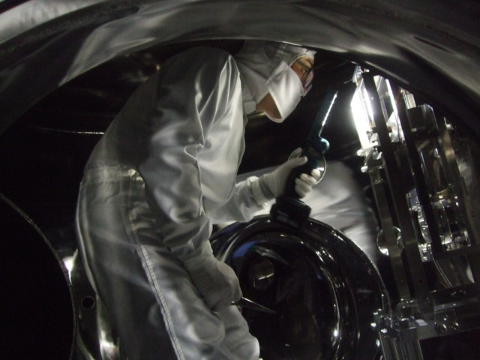
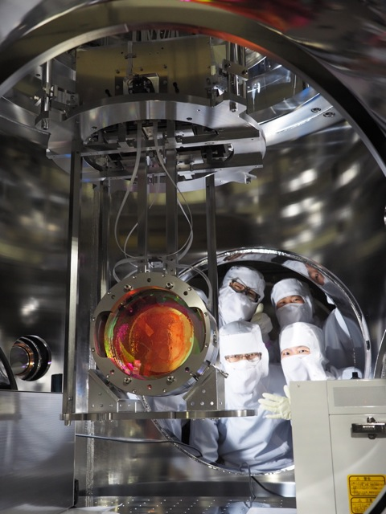
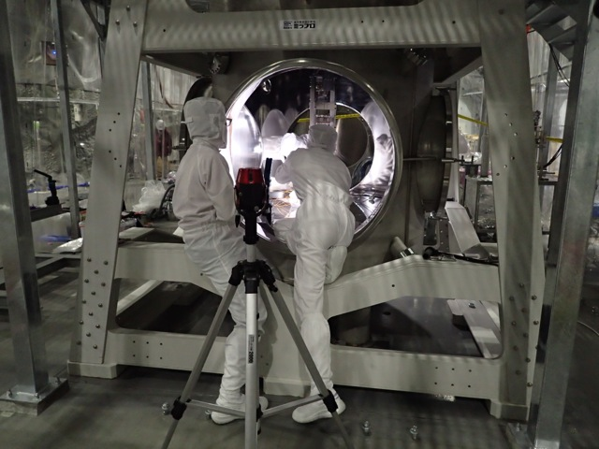
iKAGRA commissioning milestones
160621_SAITO
EYC
Mar. 3 – 24: Interferometer commissioning
Mar. 18 : Michelson was locked.
Dec. 11: MC was ready
Nov. 11: IFI installed
ETM
Oct. 11: MC mirror
was suspended
Y-arm
Feb. 19: ETMX & ETMY were suspended.
(TAMA mirrors & suspensions)
MC
PR
IO
BS
EXC
X-arm
ETM
Jun. 9: PSL beam quality check
Feb. 25: PR3 was suspended.
Feb. 25: PR2 was installed.
SR
Feb. 8: BS was suspended.
(CLIO BS)
Type-B
Type-Bp

Slide 17
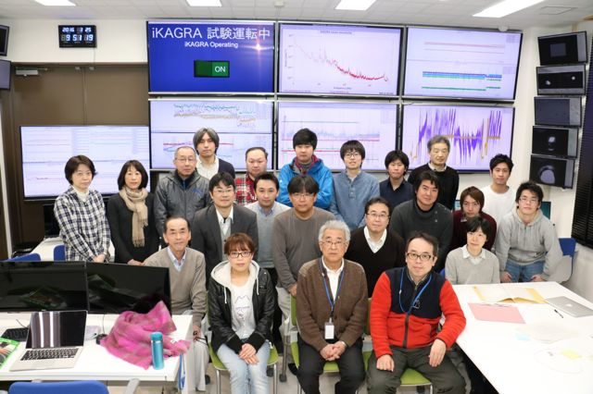
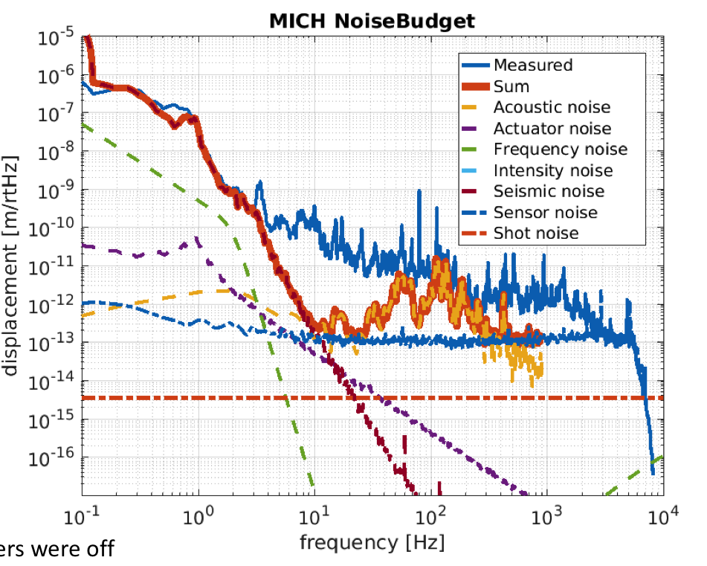
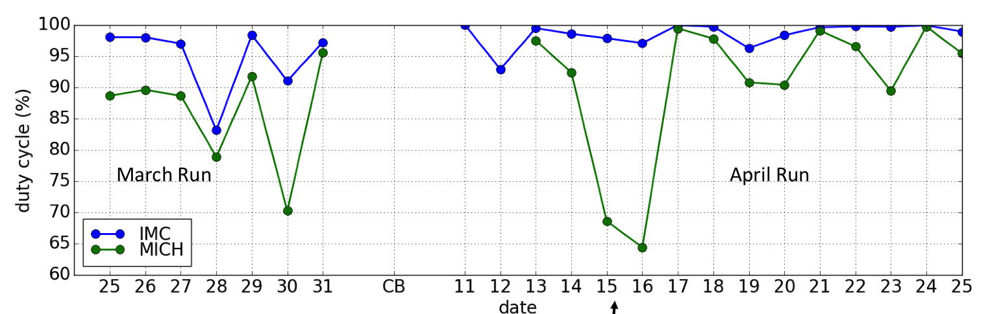
Mar. 25: iKAGRA operation was started.
iKAGRA 1st run: Mar. 25 - 31, 2016
iKAGRA 2nd run: Apr. 11 - 25, 2016
Typical Sensitivity
Duty Factor
1st run: 85.2%
2nd run: 90.4%
Injection test -> Yokozawa
Detector Characterization -> Hayama

Slide 18
Learning from iKAGRA
* Assembling mirror and suspension took longer time than expected.
  Full fit-check was only done during assembling.
  Re-designing/re-making of components were necessary during assembling.
  Small components, jigs and tools were insufficiently prepared, in advance.
  Installation manual was not fully prepared before working.
* Performance of the suspension system were not fully reviewed/examined.
  Although a prototype of VIS Type-B was tested, it was done in Summer of 2015. There was not enough time to feed-back to the on-site machine.
  Matching test of control system was done just before operation.
* Cleaning of floors/chambers took longer time than expected.
  Water drop/spring caused delay of starting booth filter operation, and further contaminated floor/chamber/booths.
  Cleanliness-keeping manual for in-booth work was not fully prepared.
* Task sharing was ambiguous during installation and commissioning.
  Cleaning, Chamber closing, Preparation of tools/bolts, Beam handling, , ,
* Manpower was insufficient, especially in the beginning stage.
  Not only for installing work, but also for delivering components, preparing the work-space, operating crane/heavy-machine, , ,
Details of iKAGRA will be presented by Kokeyama-san

Slide 19
Toward bKAGRA
Based on the experience of iKAGRA, we plan to proceed
bKAGRA in 3 steps.
Phase-1 : Operation of a 3km cryogenic Michelson
interferometer (-2018. 3).
Phase-2 : Operation with full configuration:
cryogenic and RSE (2018.4 – 2019 1Q??)
Phase-3 : Commissioning and Observation run
(2019 2Q ??-)

Slide 20
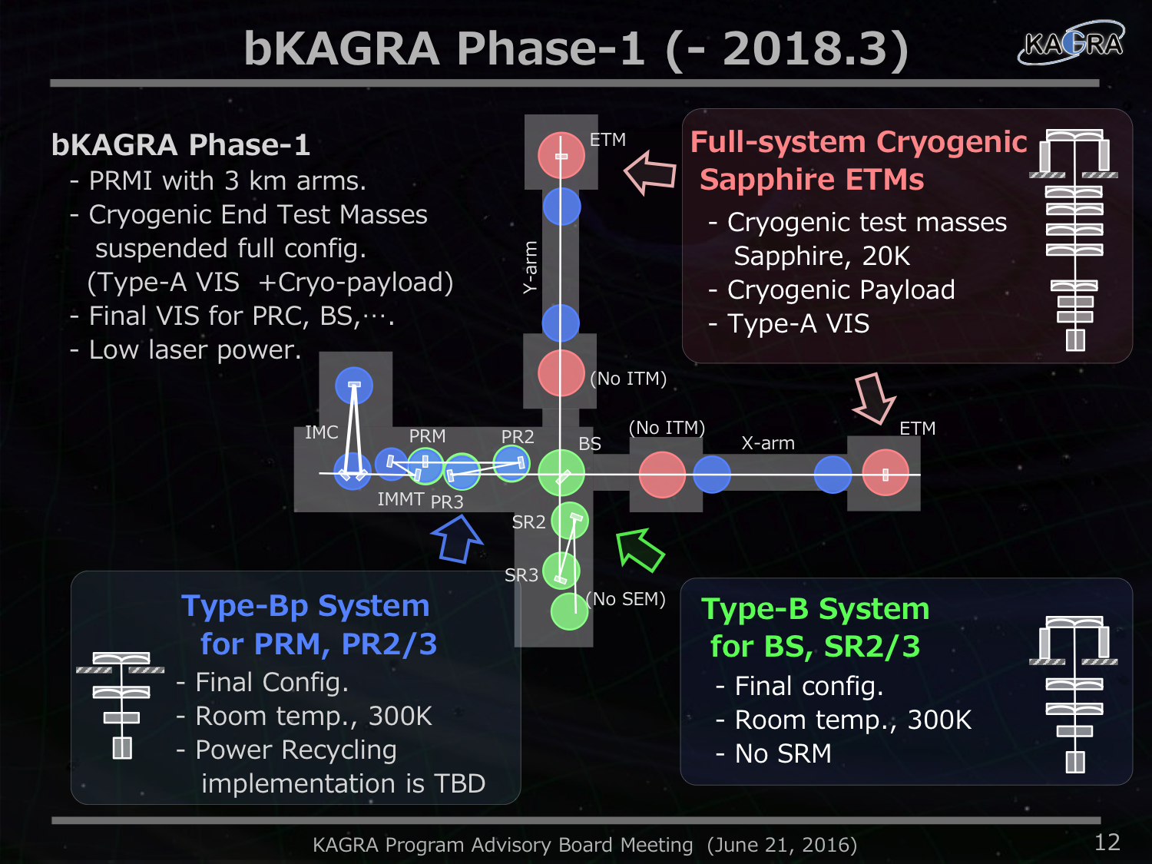

Slide 21

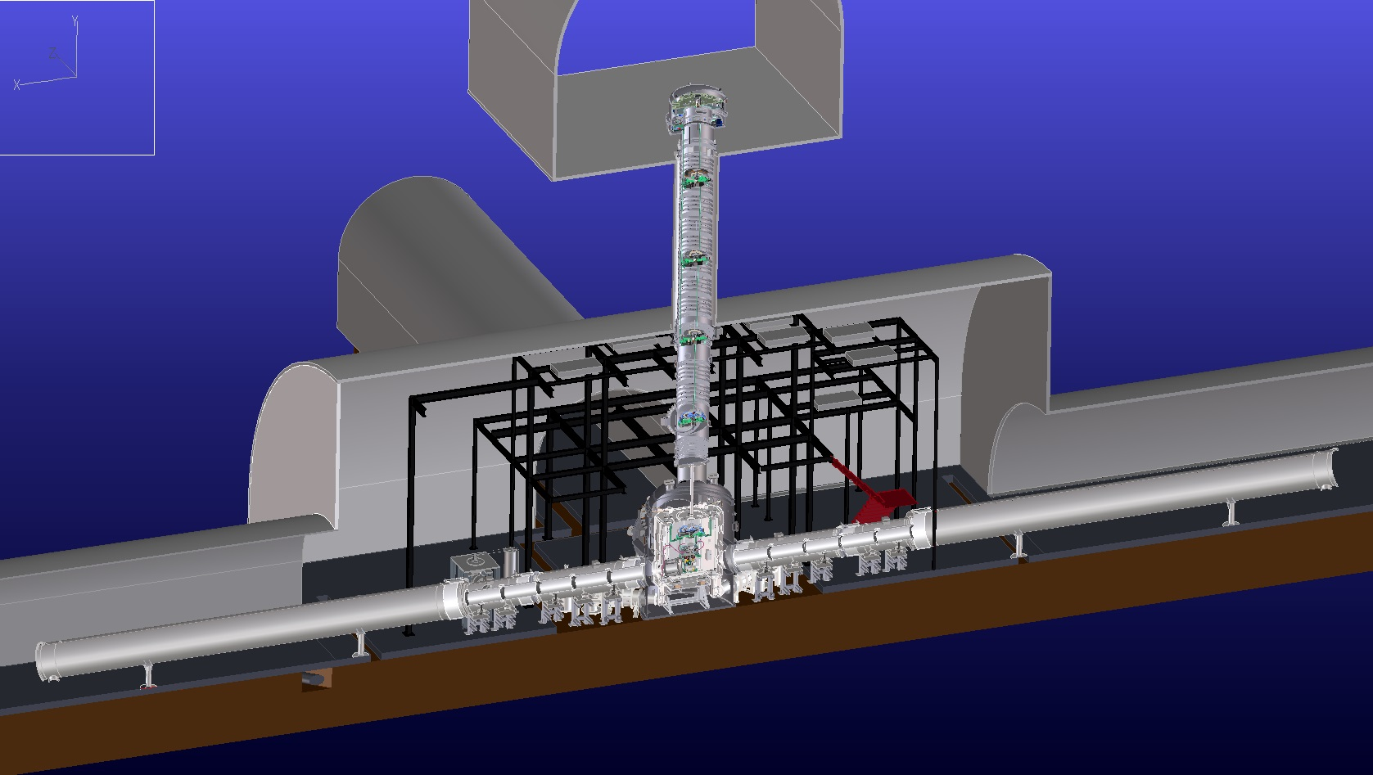
Main Mirror Suspension
Main mirror parts
Frame-Free Suspension
Upper Floor
We excavate upper-floors
and vertical holes for
Vibration Isolation System.
Base of the VIS is put
on the upper-floor
Type-A: Takahasi-san’s talk
Type-A suspension:
4-stage GAS filters
@ room temperature
14m
Bottom Floor
Arm tunnel
Cryogenic Payload

Slide 22
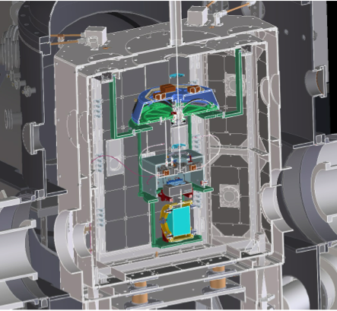
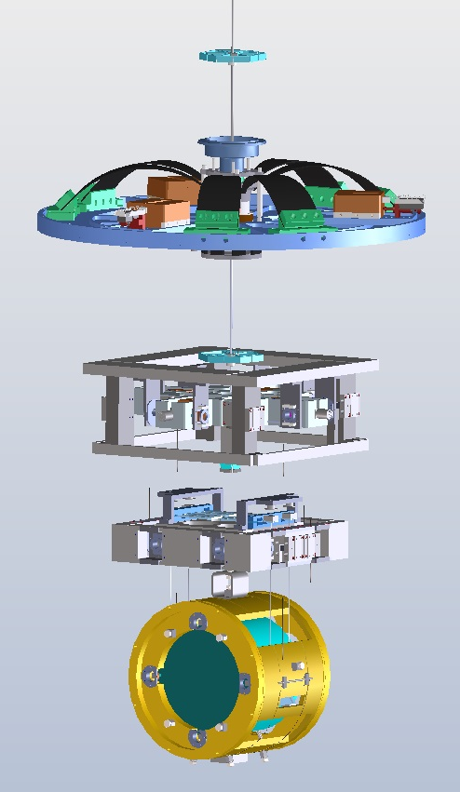
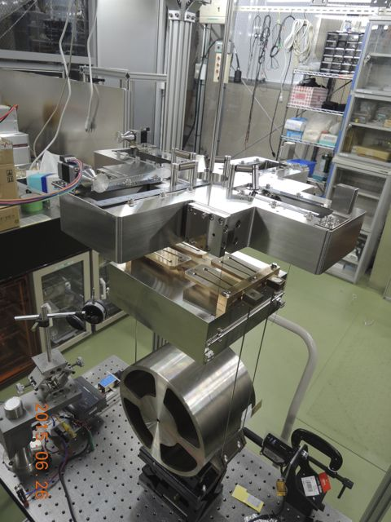
Cryogenic Payload
Under developing
in KEK and ICRR
Cryostat
Type-A
Platform
Marionette &
Recoil mass
Intermediate mass
& recoil mass
Mirror &
Recoil mass
Cryogenics Talks
-> Kumar, Miyamoto,
Ushiba and Craig
Prototype Cryo-Payload

Slide 23
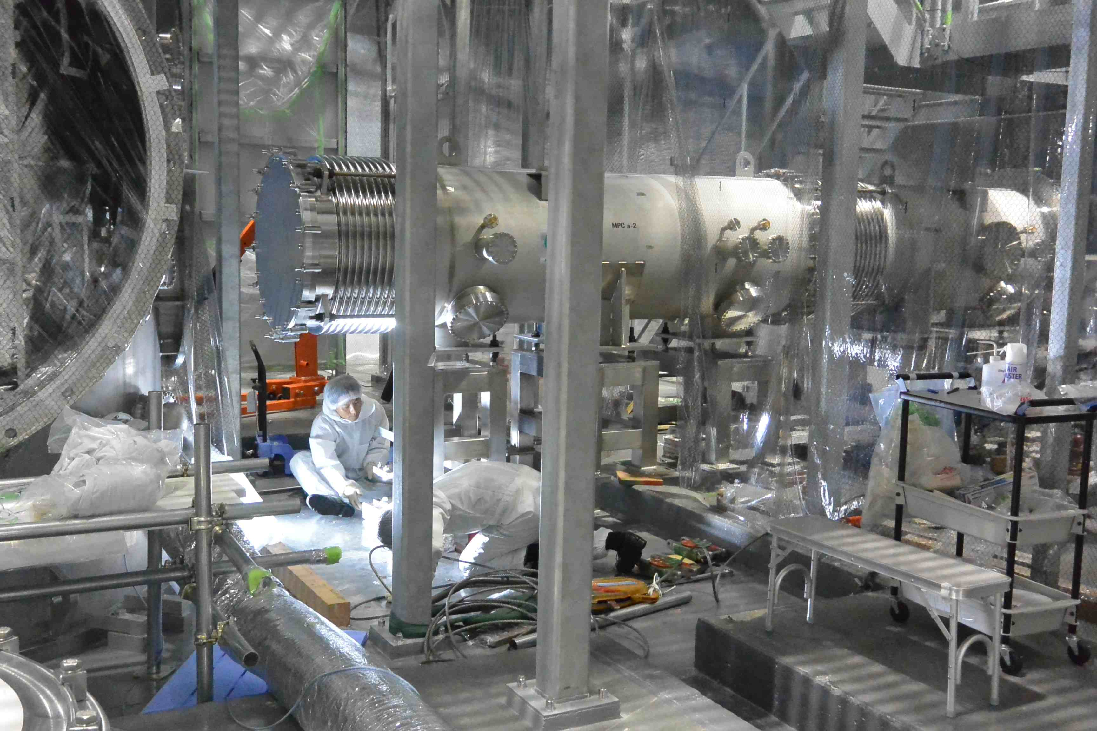
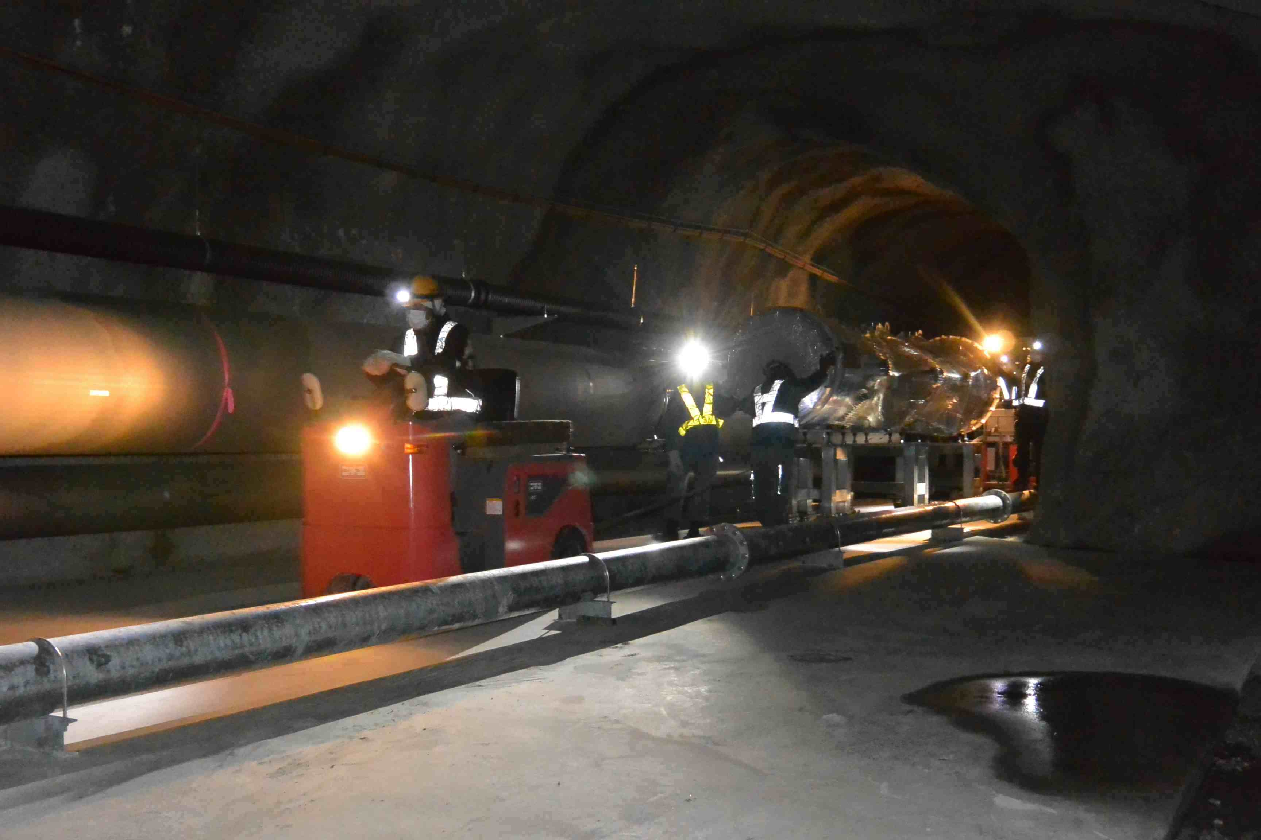
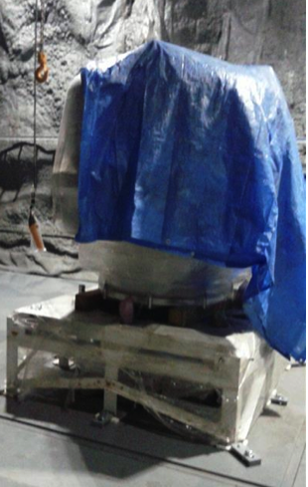
We have already rushed toward bKAGRA
X-end cryostat assembly (done at last week)
Inverted pendulum for Type-A suspension
Vacuum chamber
for Type-A

Slide 24
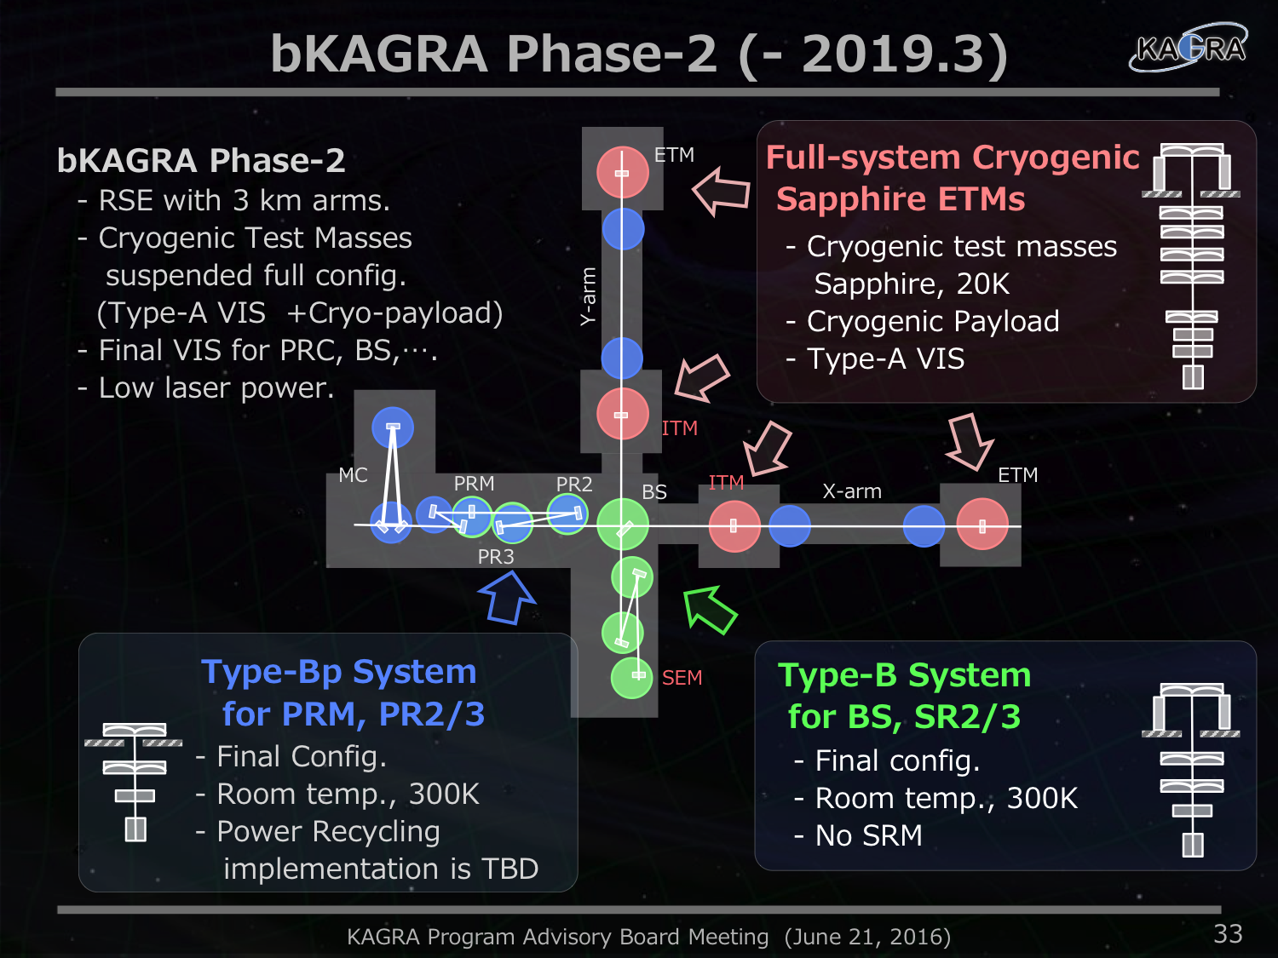

Slide 25


Slide 26
Summary
• KAGRA is a new 2nd generation GW interferometer under
construction in Japan.
• Cryogenic mirror system and underground site is the most
advanced features in KAGRA.
• iKAGRA test operation was done in Apr. 2016.
We learned a lot of issues from this experience toward
bKAGRA.
• bKAGRA will be proceed in 3 steps. First phase will be
cryogenic Michelson and first run must be done by Mar. 2018.
• bKAGRA phase-2 will be full configuration and will start
around 2019.
• We will be a part of global GW observation network around then
and will lead new age of GW physics and astronomy together.

