Slide 1
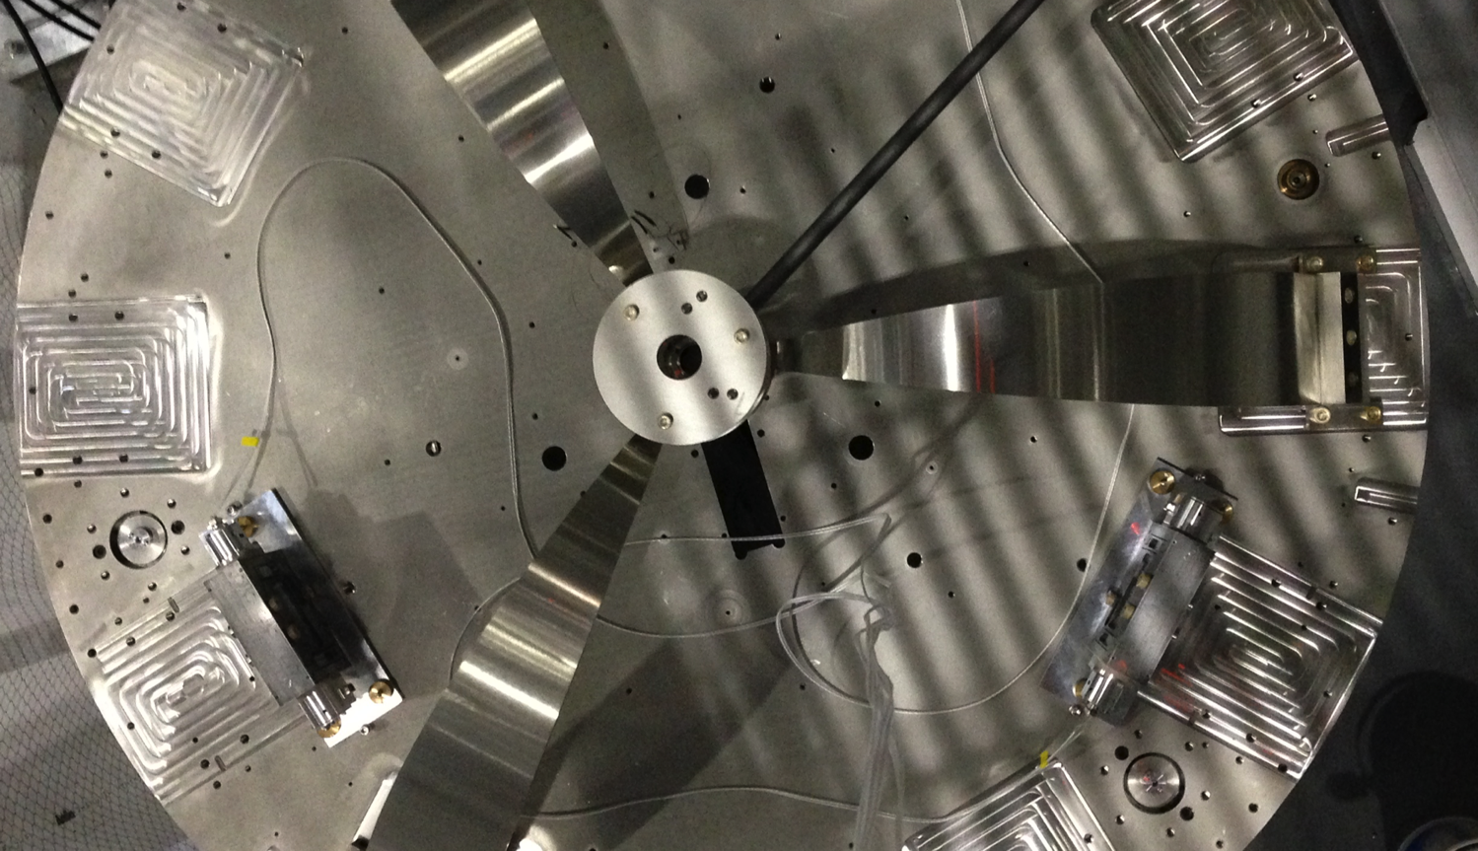
Monolithic Accelerometers on the Inverted Pendulum: status report
NAOJ GWPO Meeting, April 21st, 2016

Slide 2
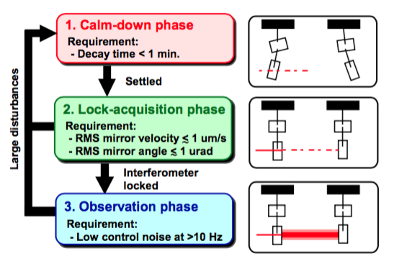
Reducing the velocity starts at the top
Damping of the modes in the
chain up until the payload is done
at the top stage
Modes give rise to more rms velocity, so have to be damped
The position towards the ground has to be controlled, without introducing the mircroseism

Slide 3
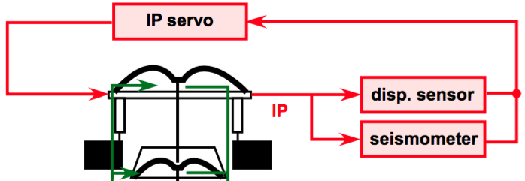
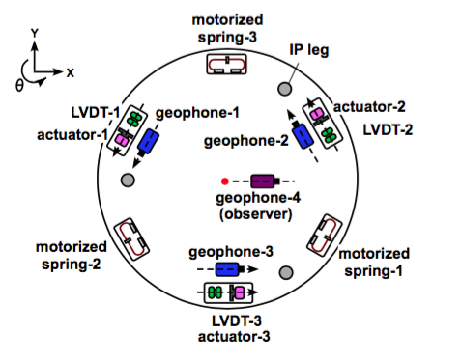
The Inverted Pendulum stage control
= LVDT
= Geophone/ Accelerometer
LVDTs and Seismometers (here geophones) are in ‘pin-wheel’ configuration and signals are in geometrically reconstructed
to x,y and yaw

Slide 4
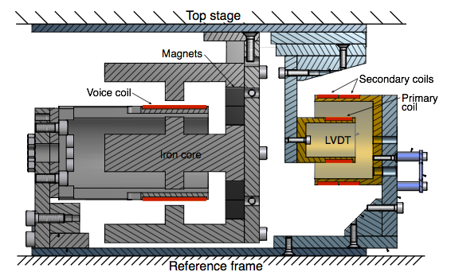
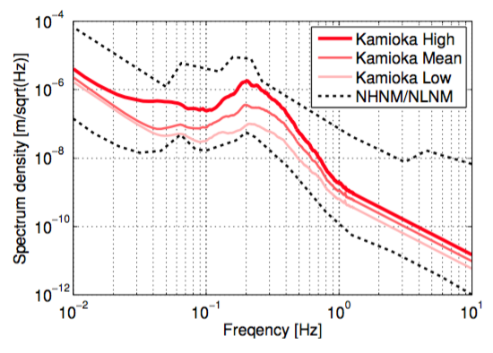
LVDTs also ‘measure’ ground motion
Ground
Most of the ground velocity rms comes from the microseism
Measuring the ground and subtracting it, is not foreseen in KAGRA
so one has to find another way

Slide 5
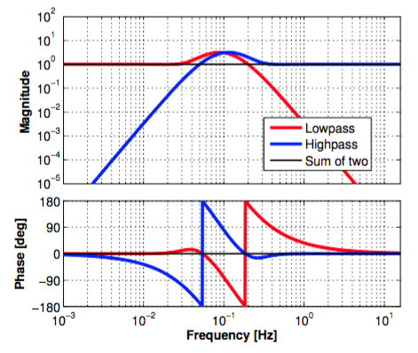
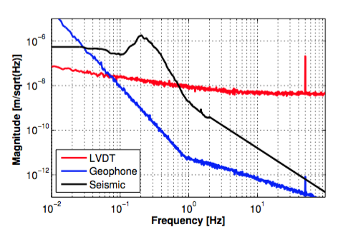
LVDT and Seismometer are blended
For example, for 0.1 Hz LVDT blending filter still has > 0.1 magnitude at the microseism
Lowering blending frequency can only be done if the seismometer is good enough

Slide 6
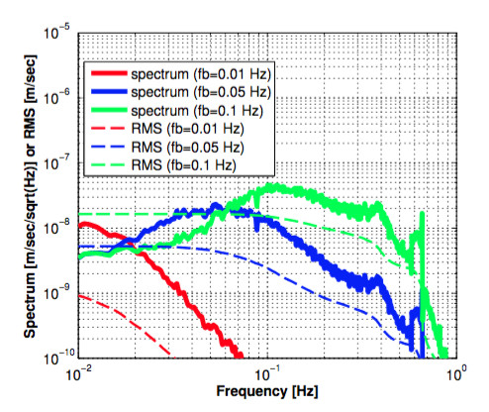
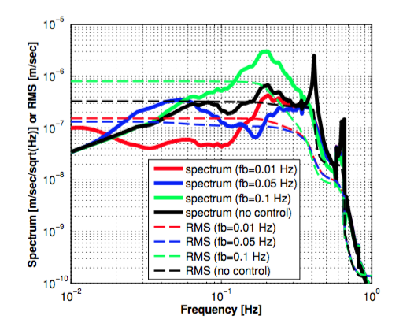
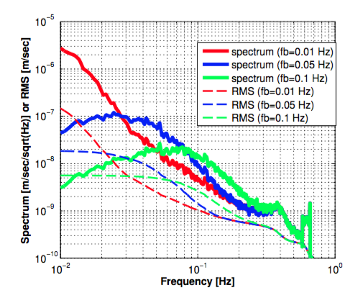
Seismometer noise can spoil performance
Strange behavior 0.15-0.3 Hz
LVDT
Geophone
Different seismometer?

Slide 7
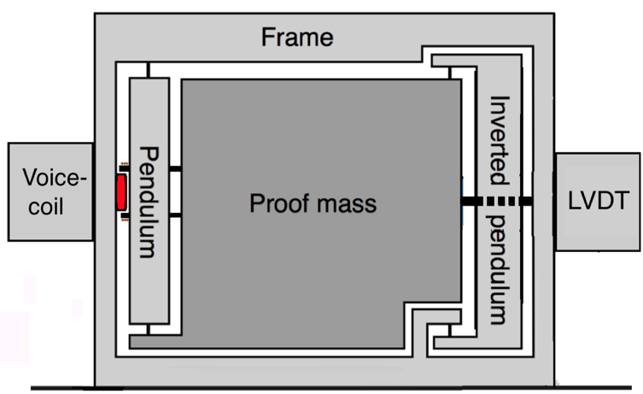
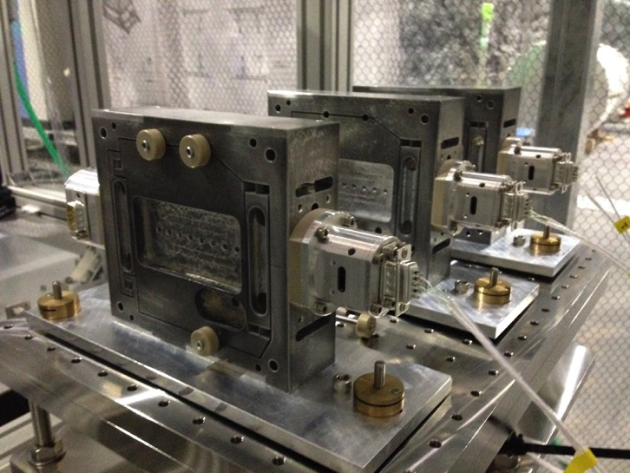
The LVDT Monolithic Accelerometer
Because of inverted pendulum, natural frequency is low
Displacement of the mass is read out by LVDT
A coil-magnet actuator is used to calibrate the sensor

Slide 8
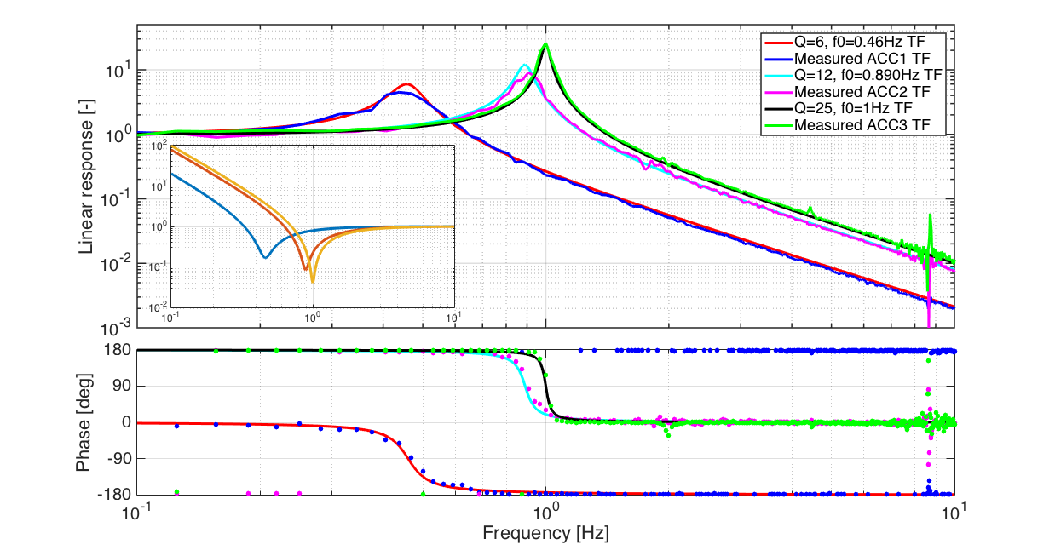
Accelerometer f₀ and Q determination

Slide 9
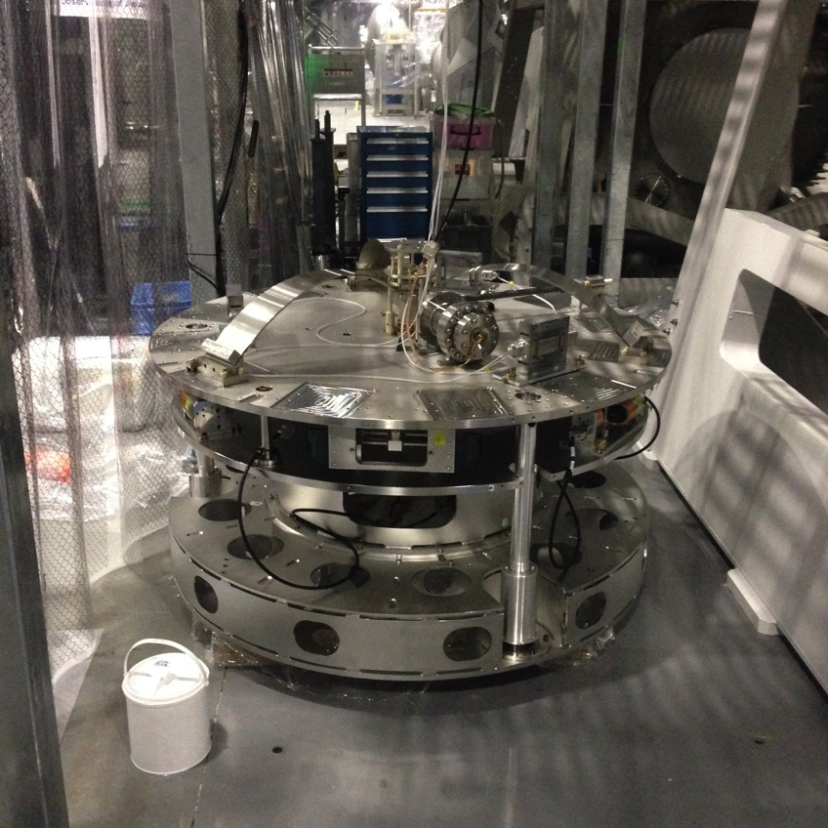
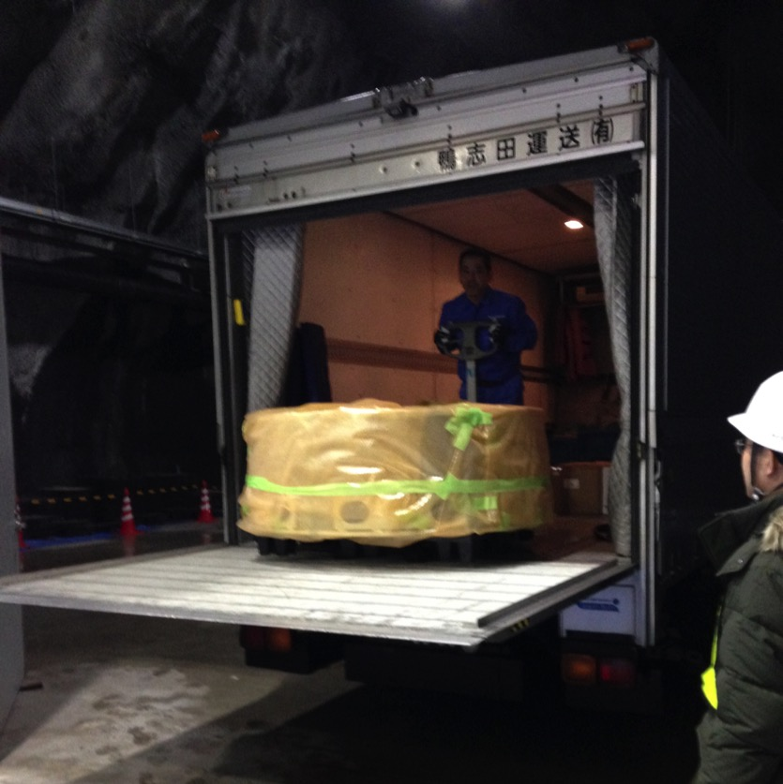
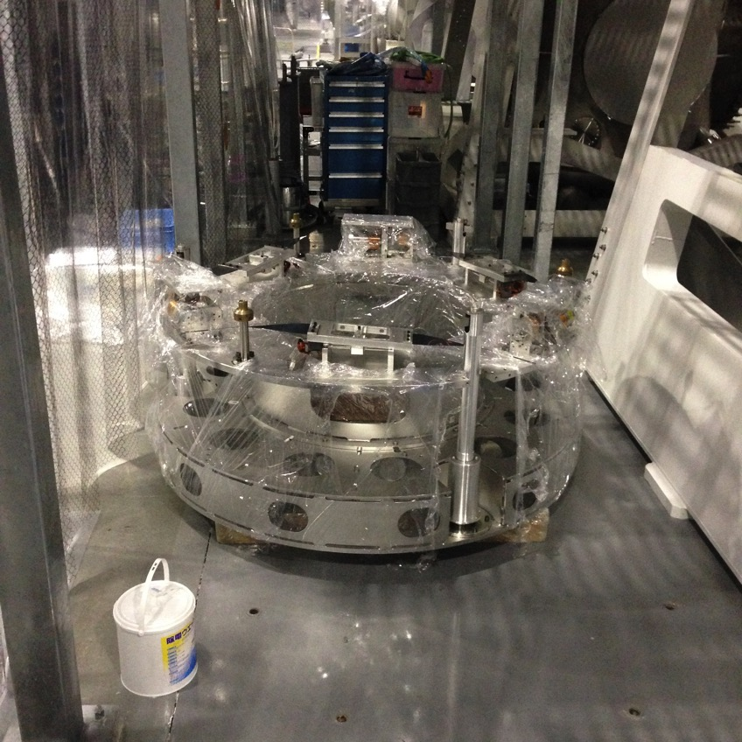
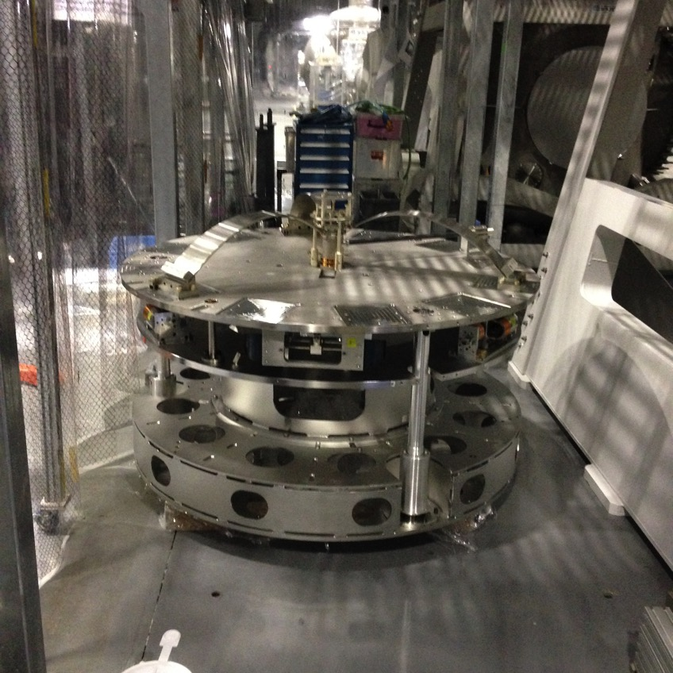
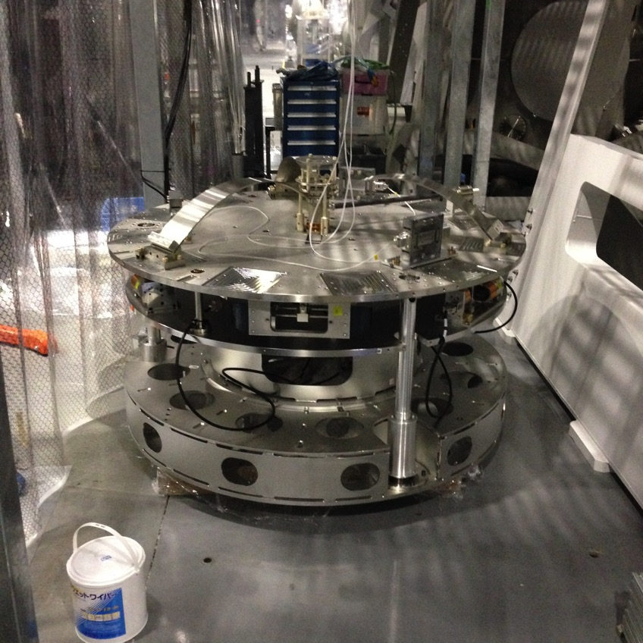
Putting the parts together…

Slide 10
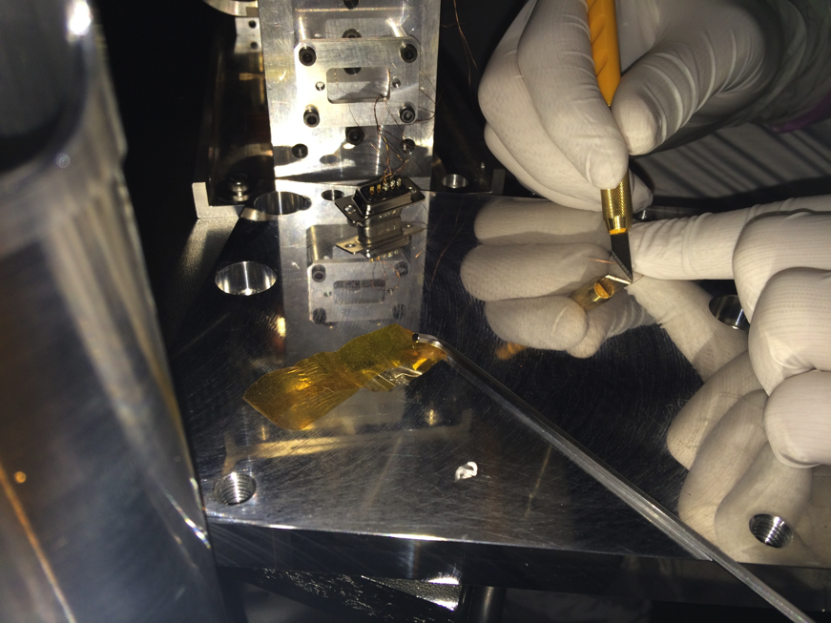
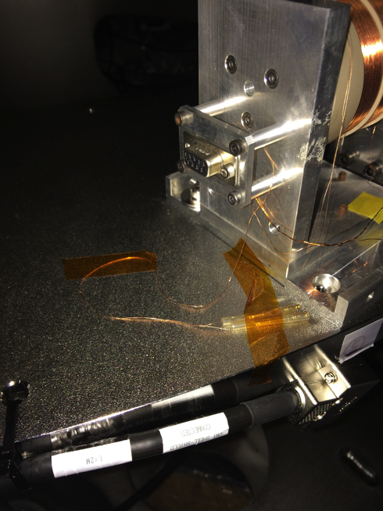
2 LVDTs were found damaged…
… and an attempt was made to repair them in situ
But, in the end, LVDT 1 and LVDT 3 were not working → Shipped all to company 2016.04.08

Slide 11
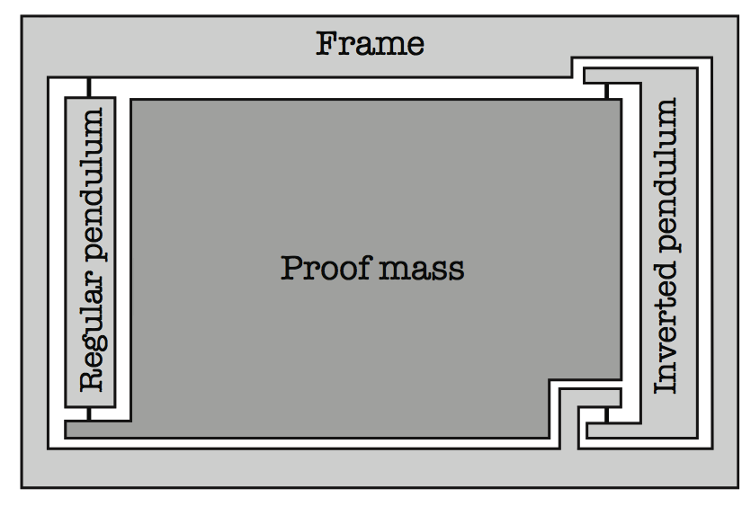
Determining the V/mm conversion
gα
Alessandro calibrated all accelerometers two years ago:
All had G_{LVDT} ~ 60 V/mm
α
Settings now at KAGRA give G_{LVDT} ~ 110 V/mm
This has to be verified by tilt calibration
INA103 amp:

Slide 12
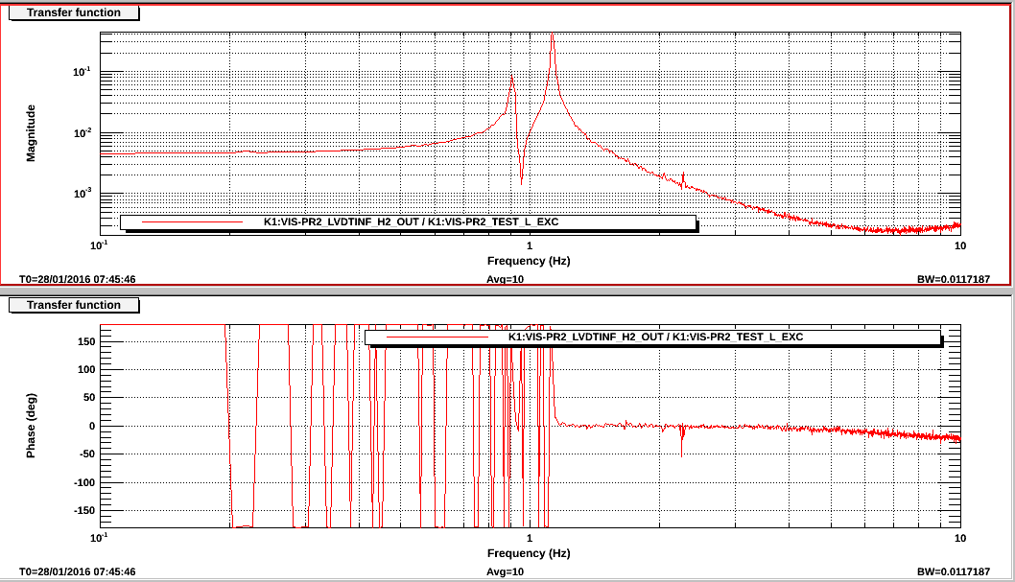
TF measurement of unloaded IP
Y
L/T

Slide 13
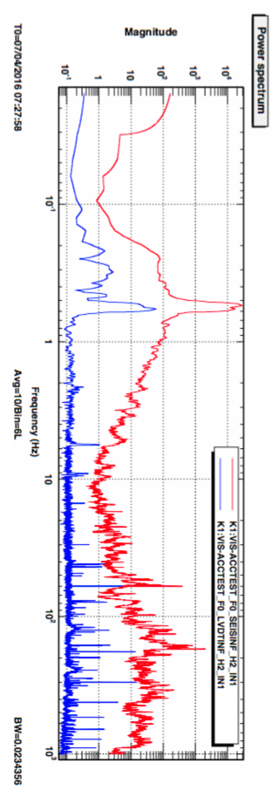
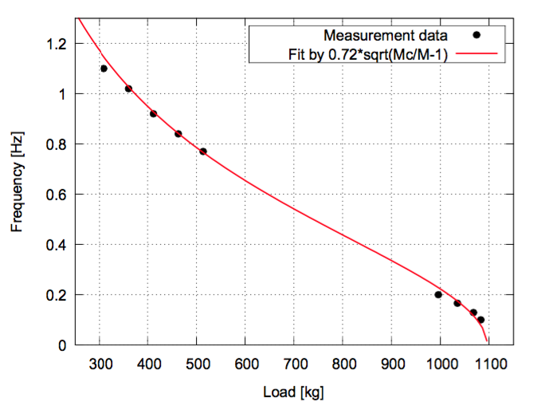
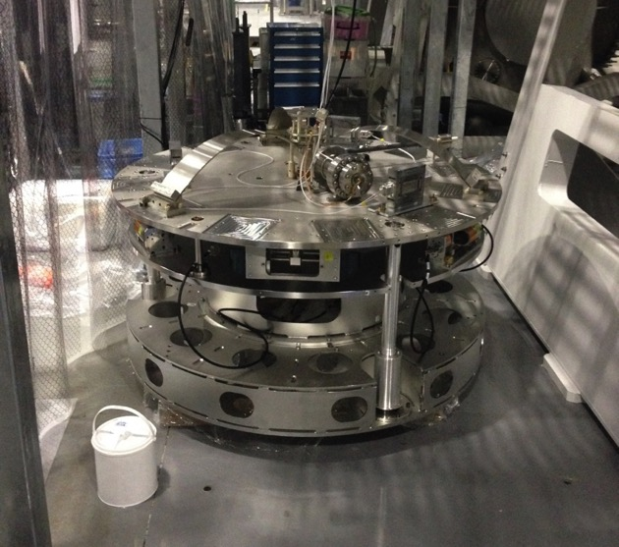
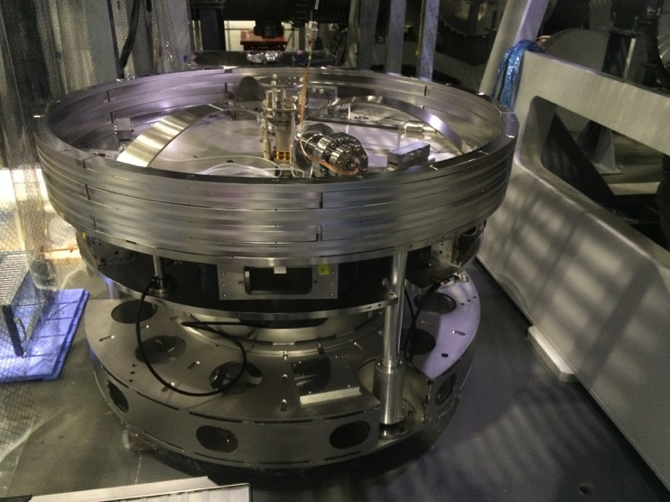
Loading the IP with tuning masses
On 2016.04.08, Takahashi-san and Fujii-kun loaded the IP:
Current f_{IP} status
Adding 230 kg gave f_{IP}= 540 mHz
Takanori had about 720 kg for f_{IP}= 540 mHz and about 1070 kg for f_{IP}= 80 mHz

Slide 14
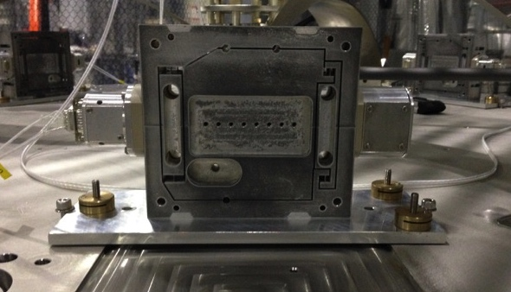
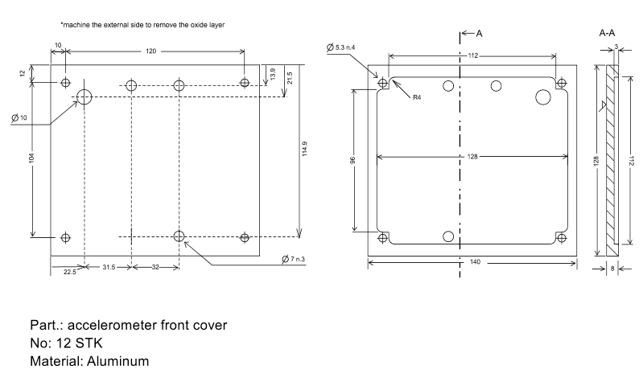
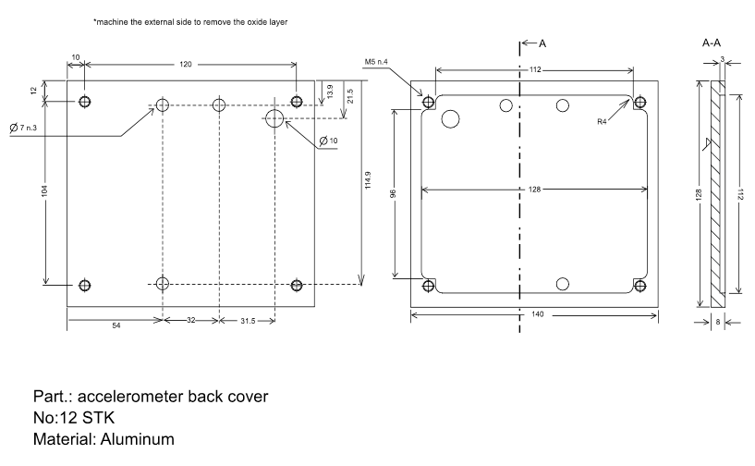
Accelerometers need air shields
Clean booth air flow

Slide 15
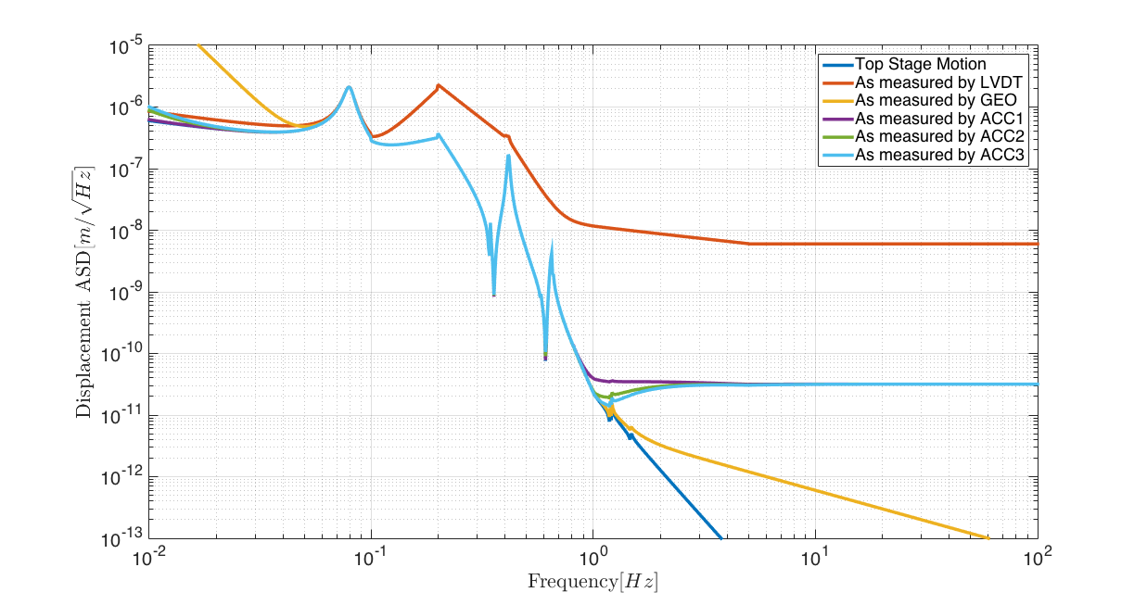
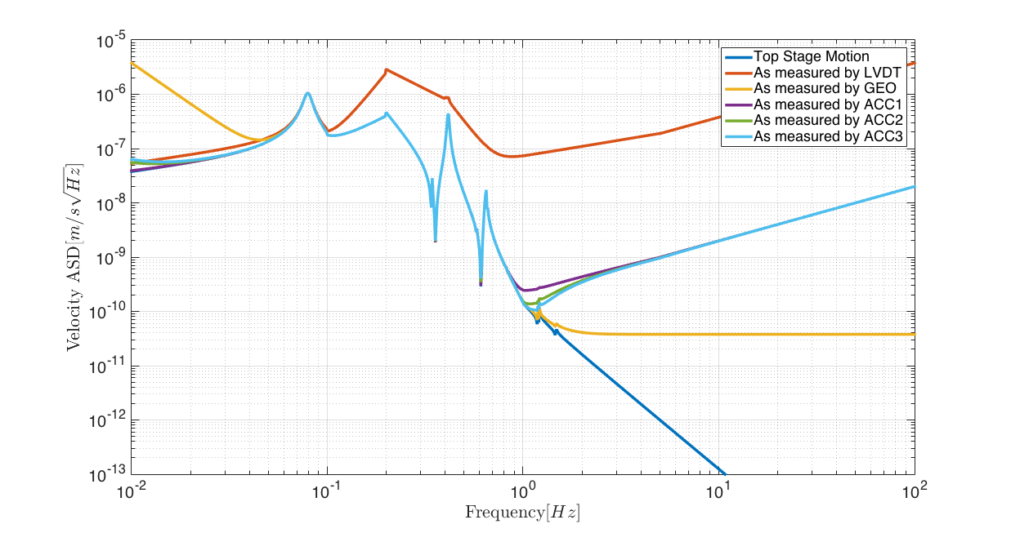
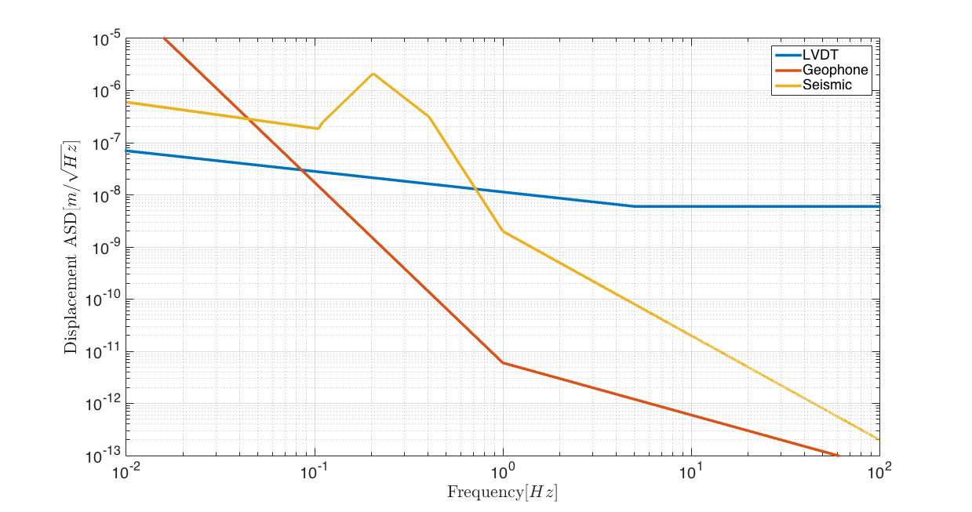
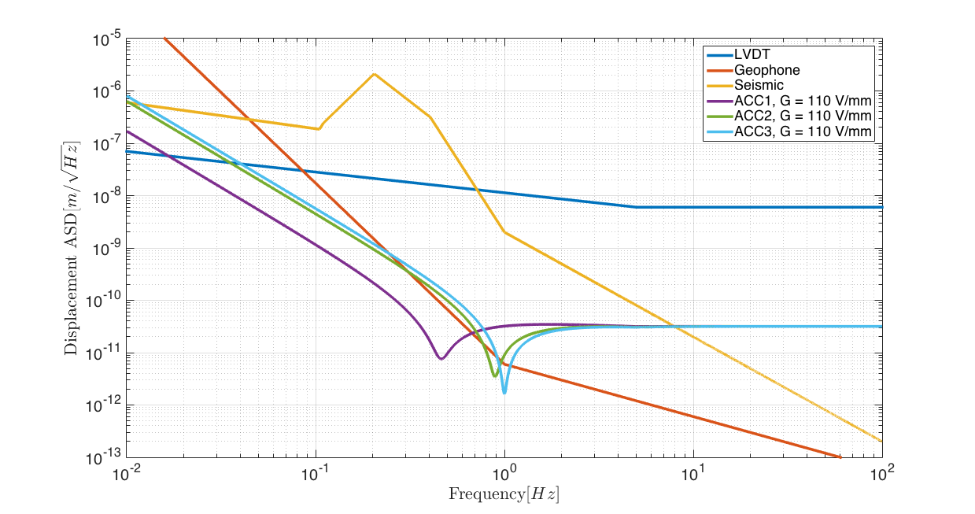
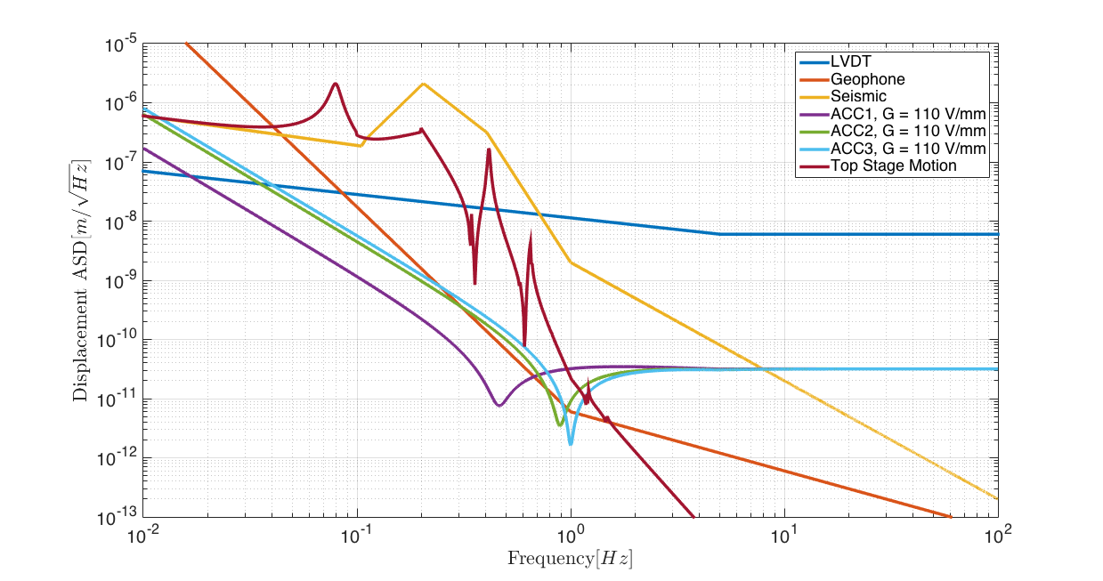
Accelerometers vs. Geophones

Slide 16
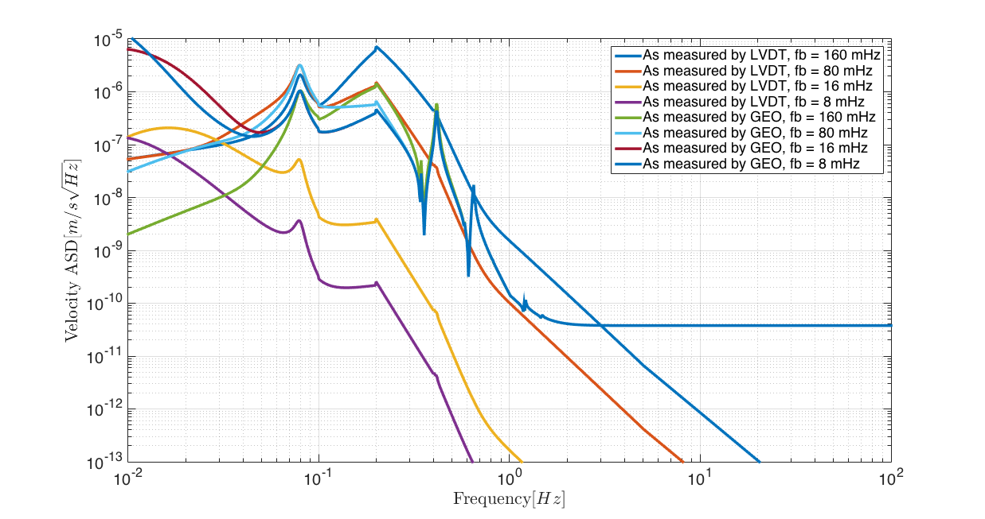
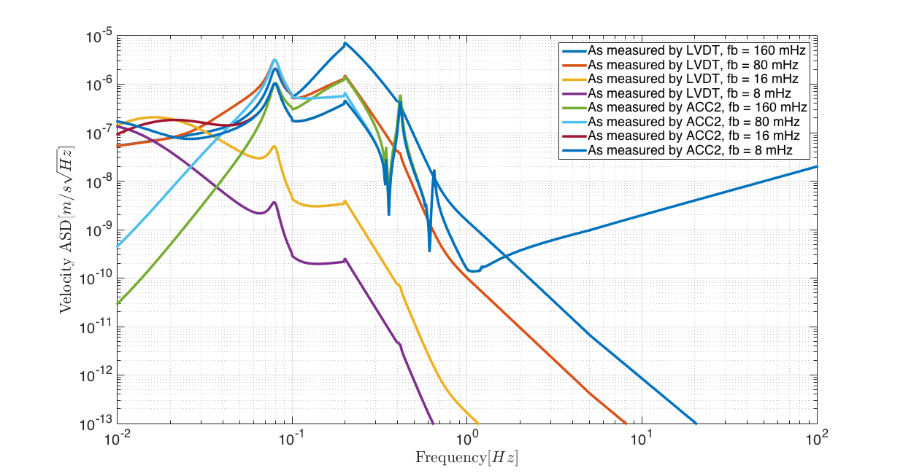
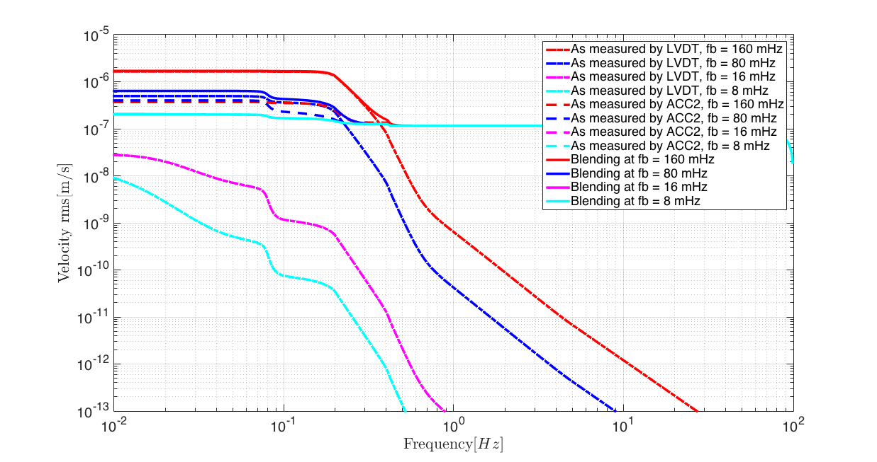
Blending lower with GEOs and ACCs
Blending at ~20 mHz already seems to be enough

Slide 17
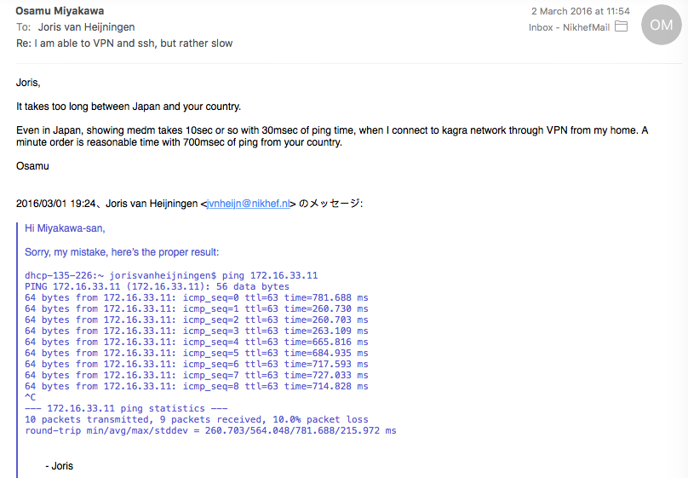
I can’t measure remotely
Luckily, there’s
can help on site
Thanks everyone!

Slide 18
After iKAGRA, let’s get a working set-up!
Congratulations on the progress on iKAGRA!
After 2nd observation run: - all LVDTs are at a company for repair and return in May
- IP is loaded with tuning masses
- tilt calibration still has to be done to verify the 110 V/mm
Meanwhile, I’ll try to simulate more the expected performance of the accelerometers
when used in-loop to see if some tweaking (e.g. gain) is necessary
Maybe LVDTs could be less noisy? Now above 10 nm/rtHz below 1 Hz

Slide 19
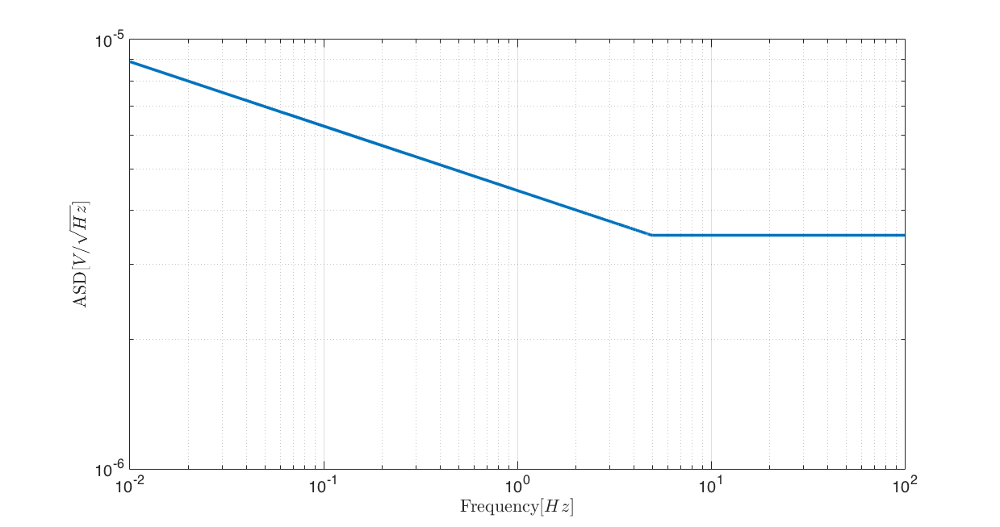
ADC noise model

Slide 20
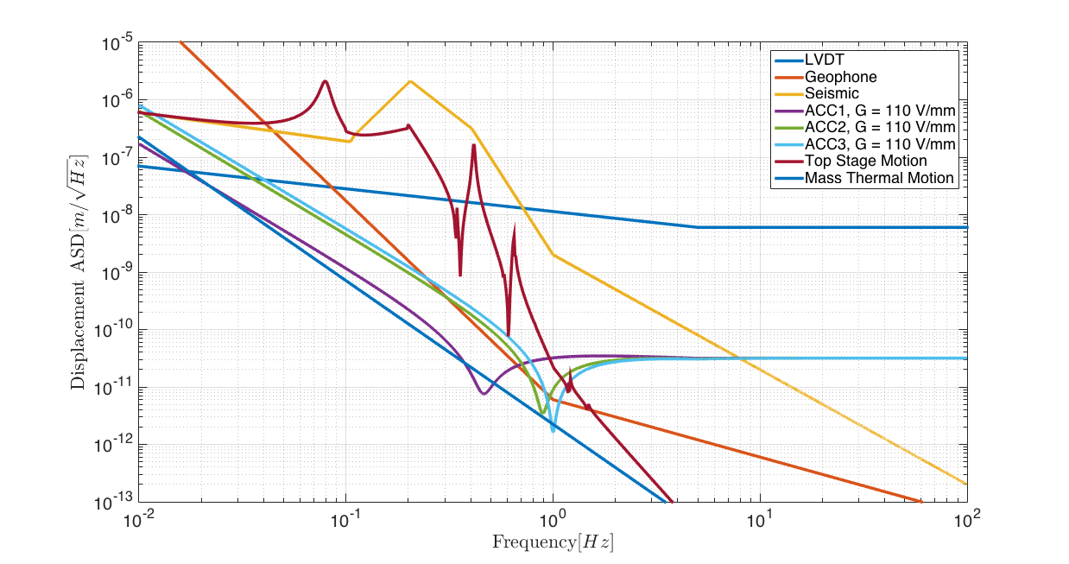
Mass thermal noise in air

