Slide 1
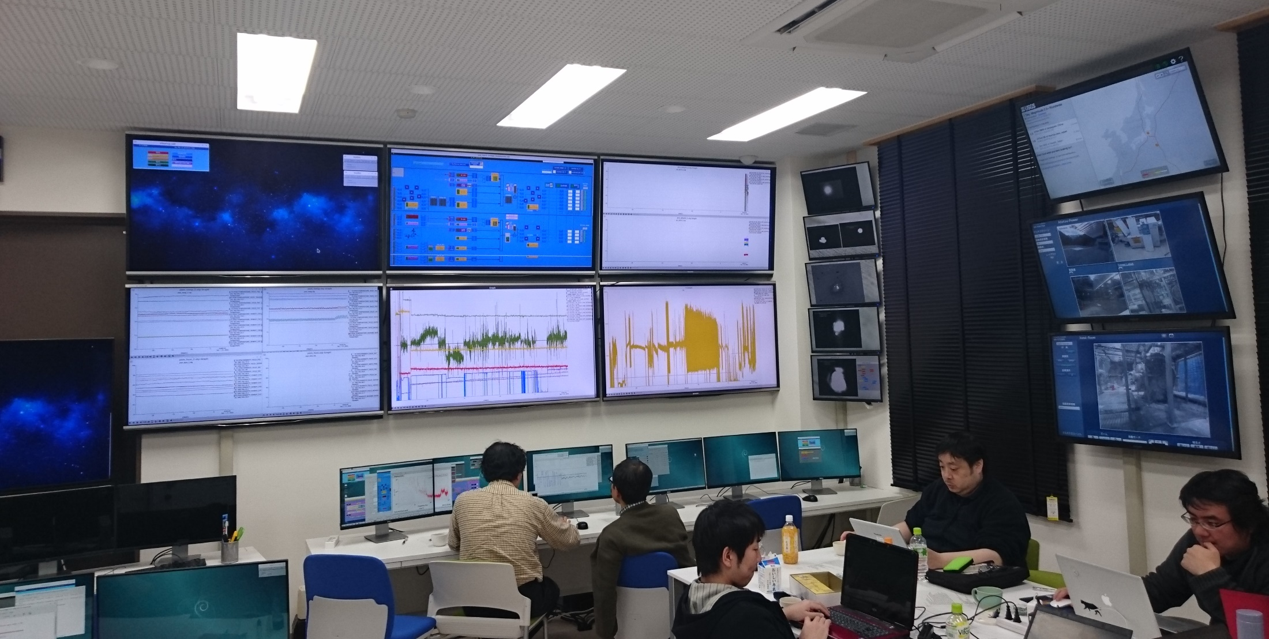
KAGRA Control Room Appearance (tentative)
This is control room for KAGRA.
Earthquake Info
Main Monitors
CCD Monitor
Live View
Main Monitor: You can check interferometer condition, temperature, humidity in KAGRA site.
CCD Monitor: You can check output of CCD cameras.
Earthquake Info (USGS website): You can monitor earthquakes around Japan.
Live View: You can see live views in KAGRA site.

Slide 2
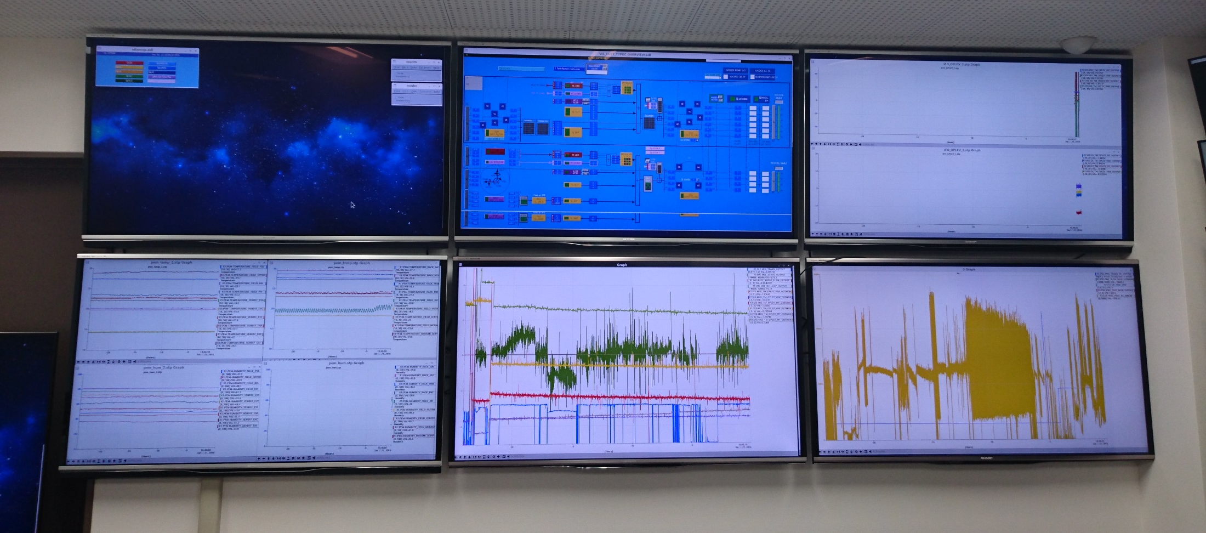
Main Monitors
MC Control Monitor:
Control settings
in mode cleaner
OptLev (PR3, BS, EX, EY):
Optical lever signals in PR3 (power recycling mirror), BS (beam splitter), EX (X end mirror), and EY (Y end mirror)
Temperature: Local-temperatures in KAGRA site
MC OptLev, MC Trans: Optical lever signals in MCi, MCe, and MCo. And MCe transmitted signal
LSC refl: Interference signal
Humidity: Local humidities in KAGRA site

Slide 3
CCD Monitor
PMC trans:
Transmitted signal from pre-mode cleaner
MCe
MCE trans:
Transmitted signal from end mirror in Mode cleaner
MCi
MCe
MCF refl:
Reflection signal from input mirror in Mode cleaner
Pre-mode cleaner
Mode cleaner
Y end mirror
EX trans:
Transmitted signal from X end mirror
EY trans:
Transmitted signal from Y end mirror
IFO refl:
Interference signal
PR3
BS
X end mirror
Michelson interferometer

