Slide 1
Cryogenics Subgroup Report
Feb. 22, 2016
KAGRA F2F meeting @Kashiwa
Takayuki TOMARU, KEK

Slide 2
Preparation Status of Cryogenic Pendulum
Tomaru, Miyamoto, Hagiwara, Suzuki
2. Preparation Status of Sapphire Suspension
Yamamoto, Tanaka, Kumar, Craig
3. Sapphire Prototype Suspension & Assembly Jigs
Craig, Kumar
4. Cryostat
Kimura, Tomaru, Suzuki
5. Schedule

Slide 3
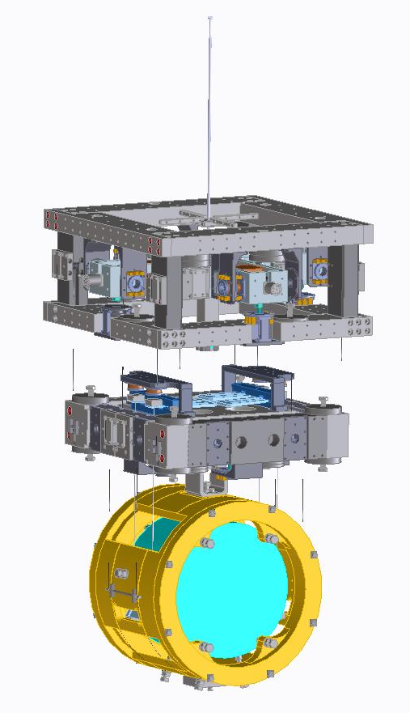
1. Preparation Status of Cryogenic Pendulum
1st Practical Cryogenic Payload is under fabrication in VIC Co.
• Marionette
2 Moving Mass
6 Actuators & Sensors
• Marionette Recoil Mass
• Intermediate Mass
6 Actuators & Sensors
4 Damping Coil for vertical springs
• Intermediate Recoil Mass
• Dummy Mirror (by KEK)
4 Actuators
• Mirror Recoil Mass
(low magnetism Stainless Steel)
3D CAD model
Marionette
Intermediate
Mass
Fabrication will be done at end of this Mar.
Mirror
CAD sets:
We have already haven prototype payload which is not including Marionette recoil mass
and Intermediate recoil mass.

Slide 4
Procurement Schedule
Category | Items | 2015 | 2016
Mirror懸架部品 | 鏡アクチュエータコイル | 4個 | 16個
 | 懸架SUSワイアー | 10m | 50m
Mirror Recoil Mass |  | 1 | 3
IM部品 | 中間マス(IM)製作 | 1 | 3個
 | サファイア板バネのダンピング用コイル | 4個 | 16個
 | CuBeブレード | 4 | 0
 | OpLev用鏡、ホルダー | 1 | 4
IM リコイルマス 一式 | 中間リコイルマス(IMRM)製作 | 1台 | 3台
MT一式 | マリオネット(MT)製作 [1+4式] | 1 | 3台
 | MTローカルセンサー ・アクチュエータ | 8個 | 32個
 | MTのMoving Mass(MM)用モータ、ドライバ | 2個 | 8個
 | MTのMoving Mass （Cu） | 4 | 12個
 | Moving Mass用ボールネジ, ベアリング等 | 2 | 8
 | IM-プラットフォーム(PF)間 Ti6Al4V 吊ロッド | 2本 | 6本
MT リコイルマス 一式 | MTリコイルマス製作 | 1 | 4
組立ジグ | 鏡とRMの位置決め治具 | (支給) | 4個
 | 鏡とファイバー、ブレード位置決めジグ | 0 | 4
 | 懸架系ホルダー | 0 | 4個
電気系 | ケーブル束ね治具 | 2個 | 8個
 | IM部コネクタ | 3個 | 12個
 | 4芯ポリイミド被覆ケーブル(高真空用) [1700m] | 1巻 | 0
Category | Items | 2015 | 2016
その他 | 実験機器ラック | 4台 | 0
 | 簡易クリンブース(現場作業用) | 0 | 4台
 | 鏡を持つための治具 | 0 | 1台
 | 低温懸架をクライオスタットにインストールするための設備 | 0 | 1台
 | 部品保管用のデシケーター | 2台 | 0
 | CMM | 1 | 0
 | パネルラック | 1
 | 温湿度計 | 1 | 0
 | 傾斜計 | 2
 | ロードセル |  | 1
 | クリーンブース用ジャッキ | 4台
Platform | 差動トランス | 1個 | 4個
 | アルミナ製スラストベアリング | 2個 | 4個
 | PF回転用ステッピングモータ | 1個 | 4個
 | PF用CuBe板バネ材料•加工 | 6枚 | 20枚
 | PF用CuBe板バネの曲げ治具、材料•加工 | 4個 | 0
 | フィシングロッド板バネ | 1個 | 4個
 | フィッシングロッド用モータ | 1個 | 4個
 | PFのMM用W合金錘 | 3個 | 12個
 | 懸架系マス表面の黒化処理 | 0 | 24部品
 | PF構造体製作 | 1個 | 4個
 | 常温BF-低温PF間のTi6Al4Vロッド | 1 | 6本
 | 常温防振部とのケーブル接続コネクター | 2個 | 8個
 | 低温懸架保護フレーム | 1台 | 4台
 | 低温懸架部品精密洗浄 | 0 | 1式

Slide 5
Done
• Mechanical design
• Prototype fabrication
• Resonant frequency measurement of prototype
• Test fabrication of 5N purity Al heat link
• Setup of cryostat for payload test in KEK
Still Testing
• Mechanical simulation (~50%)
• Test fabrication of 6N purity Al heat link (~80%)
• Local sensor developments at cryogenic temperature (~50%)
• Ball screw test at cryogenic temperature for moving mass (70%)
• Design of assembly jigs (50%)
Not Yet
• Control Electronics
• black coating w/o magnetism
• Design of installation jigs
• Optical Lever
• Platform design

Slide 6
2. Preparation Status of Sapphire Suspension
Procurement of parts of KAGRA sapphire suspension
(except for mirrors themselves)
Almost half numbers of sapphire parts were ordered in this fiscal year.
Final parts will be delivered by July 2016.
Delivery is on time.
Items | CAD No. | 2015 | 2016 | 2015 comments
サファイアブレード | KAGRA-Cryo-mec-051-03 | 8 | 8 | ２セット分
サファイアワッシャー | KAGRA-Cryo-mec-051-01 | 16 | 48 | 1セット分
サファイアロッド | KAGRA-Cryo-mec-14-01 | 24 |  | 2セット分+テスト用, 鏡上のマグネットベース
ネールヘッド付ファイバー
Investigation of delivered products
Geometrical shape of sapphire ears : OK (So far) by Kazuhiro Enami (KEK)
Flatness of bonding surface with mirror is in progress. by Akitoshi Ueda (NAOJ)
We think extra sapphire fibers are necessary (They could be broken).
6
6
6
6
6
6
6

Slide 7
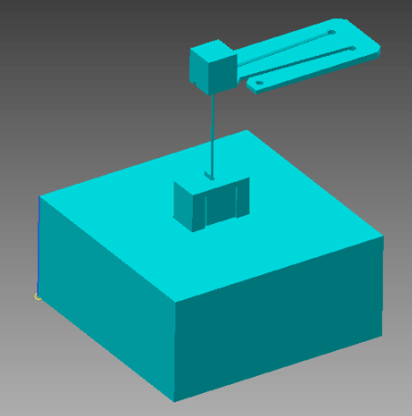
Test by using one fiber prototype
Simpler prototype (easier assembly)
Short cooling time
Sapphire blade spring
Sapphire fiber
145.3mm
6kg sapphire mass
(1/4 of KAGRA mirror)
145.3mm
D. Chen, H. Tanaka
67.5mm
Heat load test is in progress.
Large temperature difference (about 10K) between blade spring
and its support was found.

Slide 8
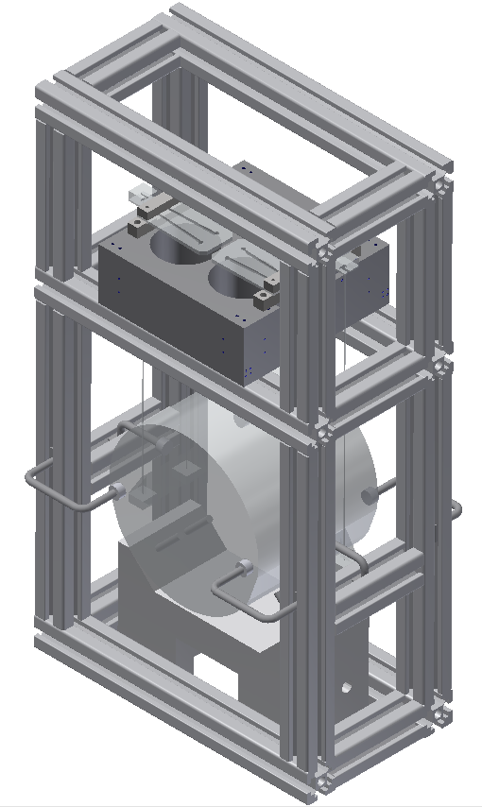
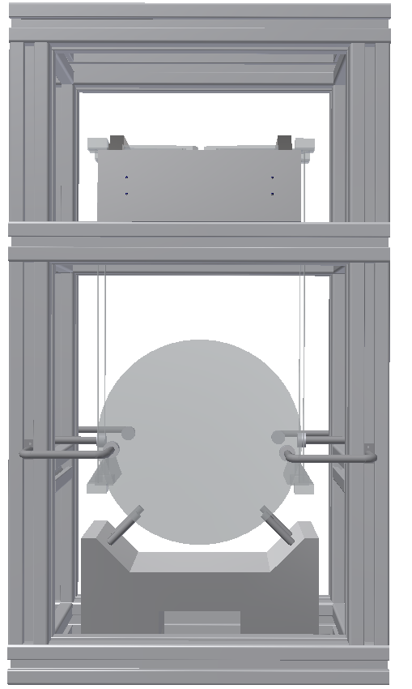
3. Sapphire prototype suspension & Assembly Jigs

Slide 9
Sapphire prototype suspension
Assembly frame designed and built
Earthquake stops assembled
Intermediate mass, and blade spring clamps assembled
Next step: HCB bonding ears to test mass
Assembly of full suspension (including indium bonds in suspensions)

Slide 10
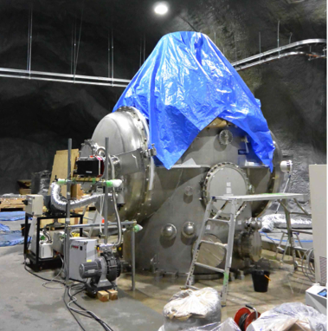
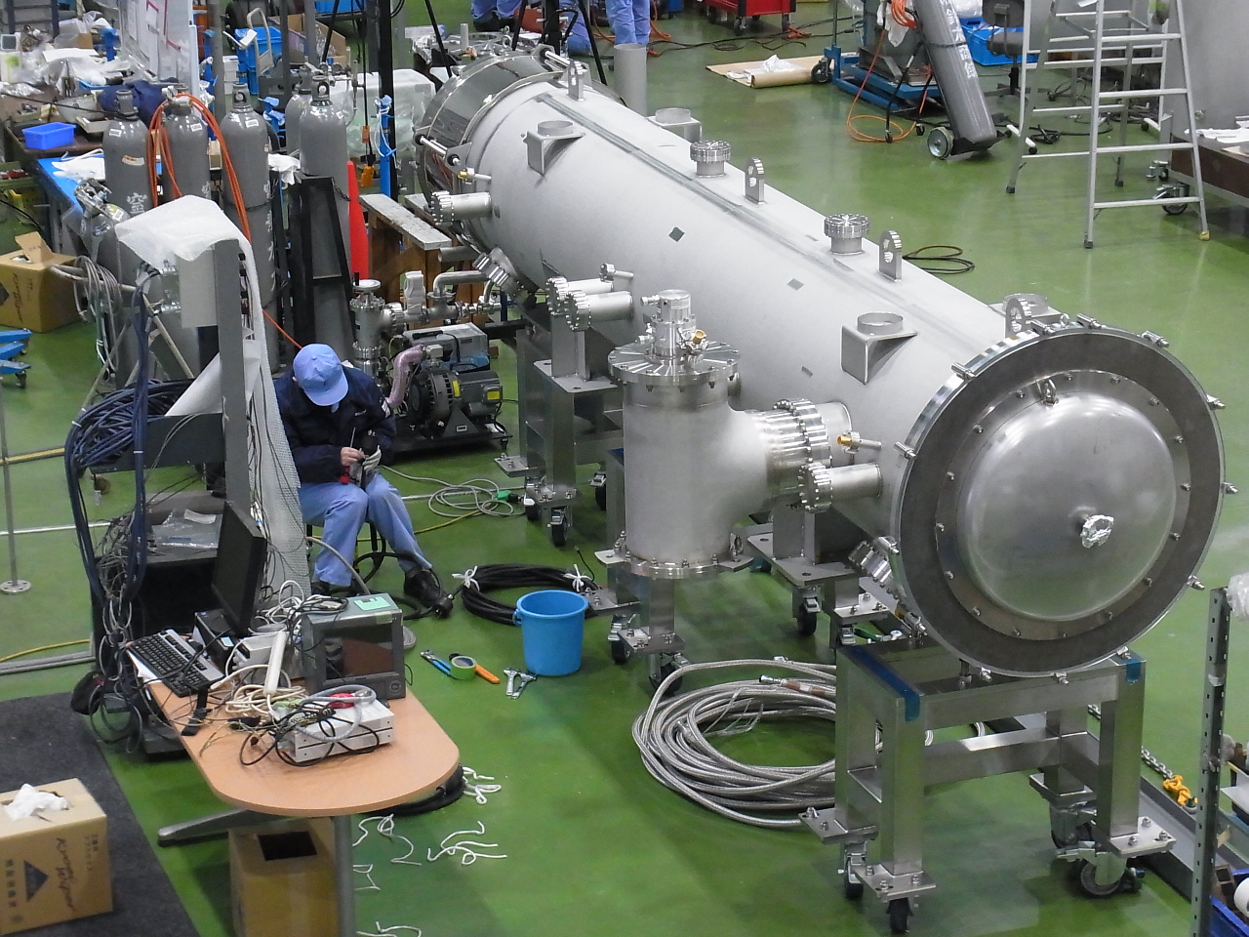
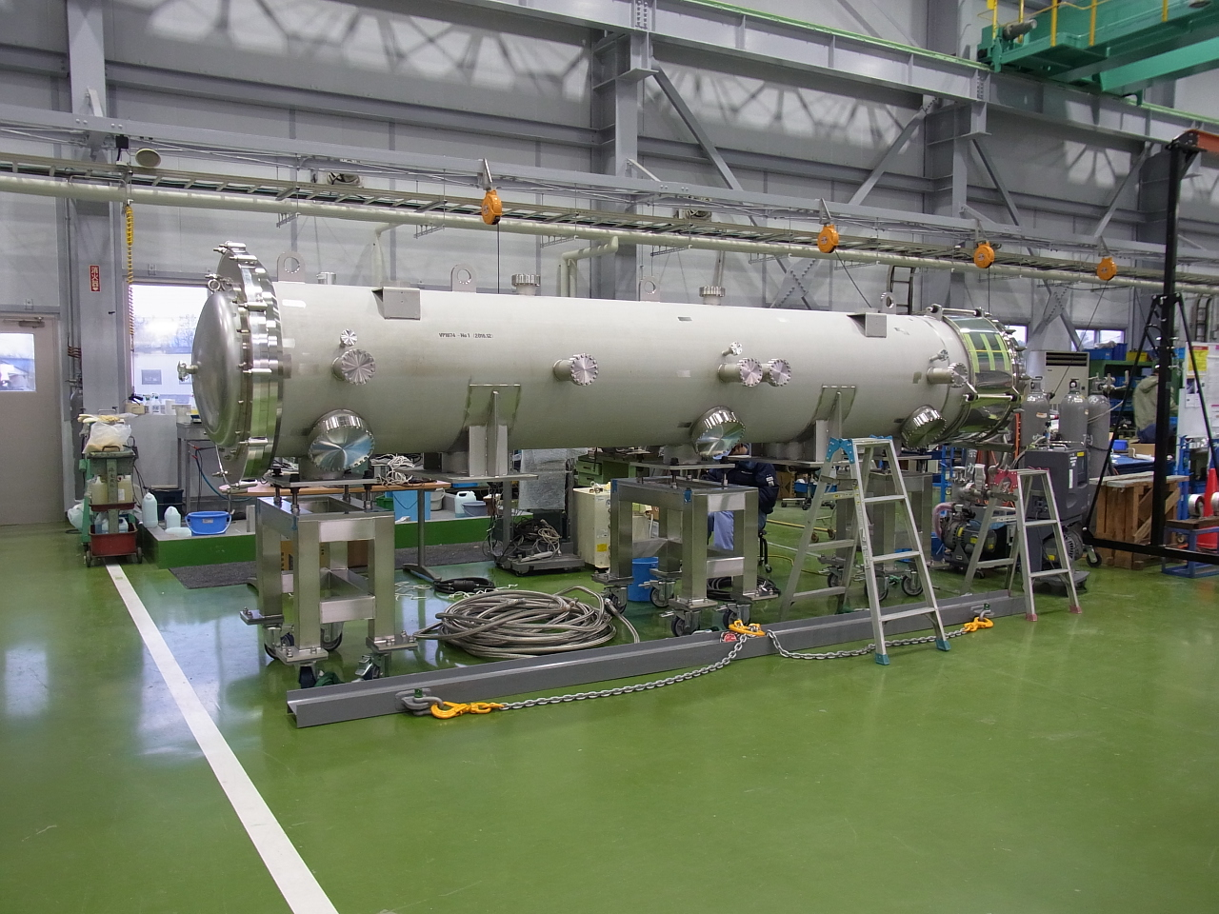
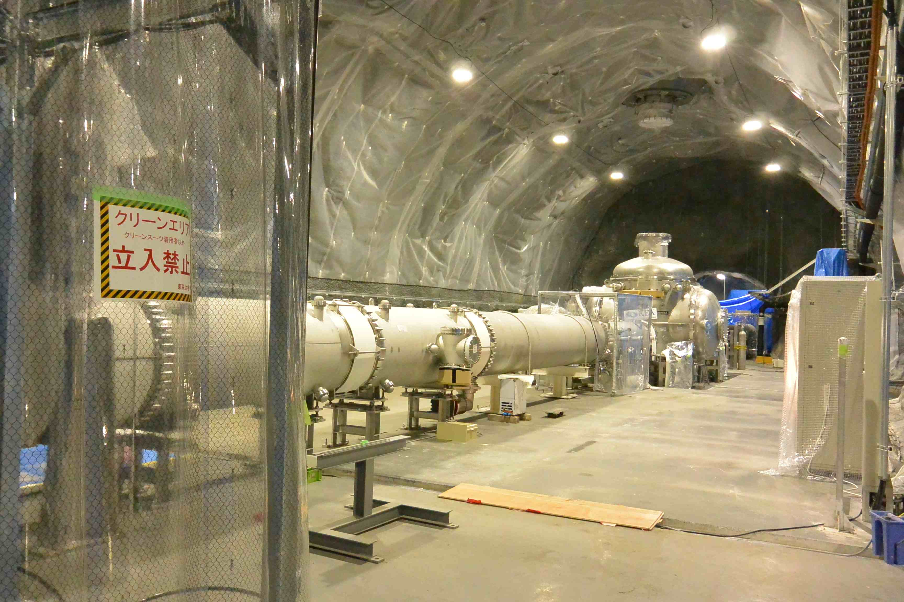
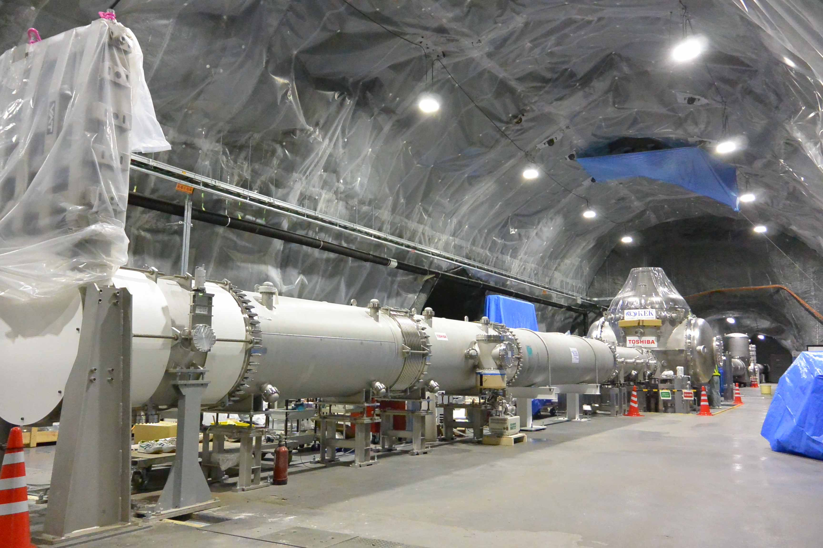
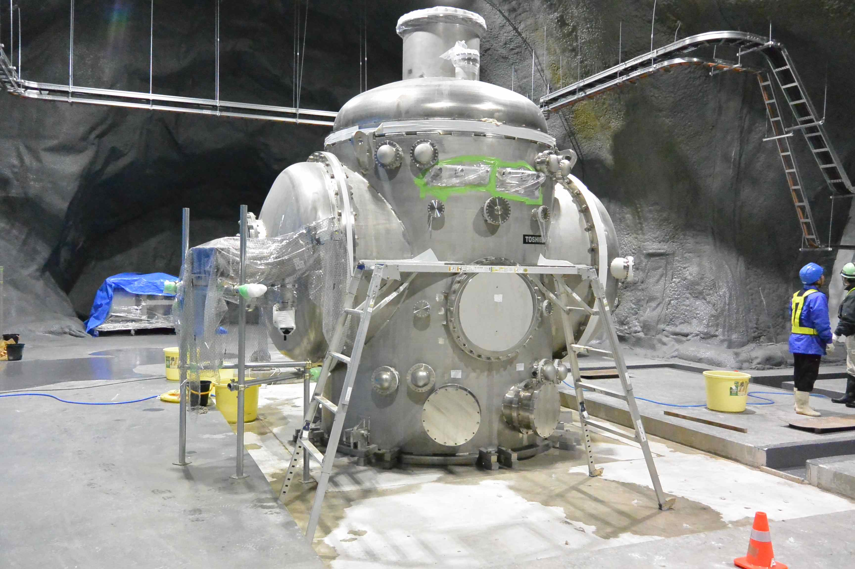
4. Cryostat
Last two duct shields will be delivered
at the end of Mar.
Four duct shields at both ends will be
installed soon after iKAGRA.
Then assembly of cryostats will be done
at the same time.
EYC
3 km
Preparation for performance test
of duct shiled
IYC
EXC
IXC
BS
3 km

Slide 11
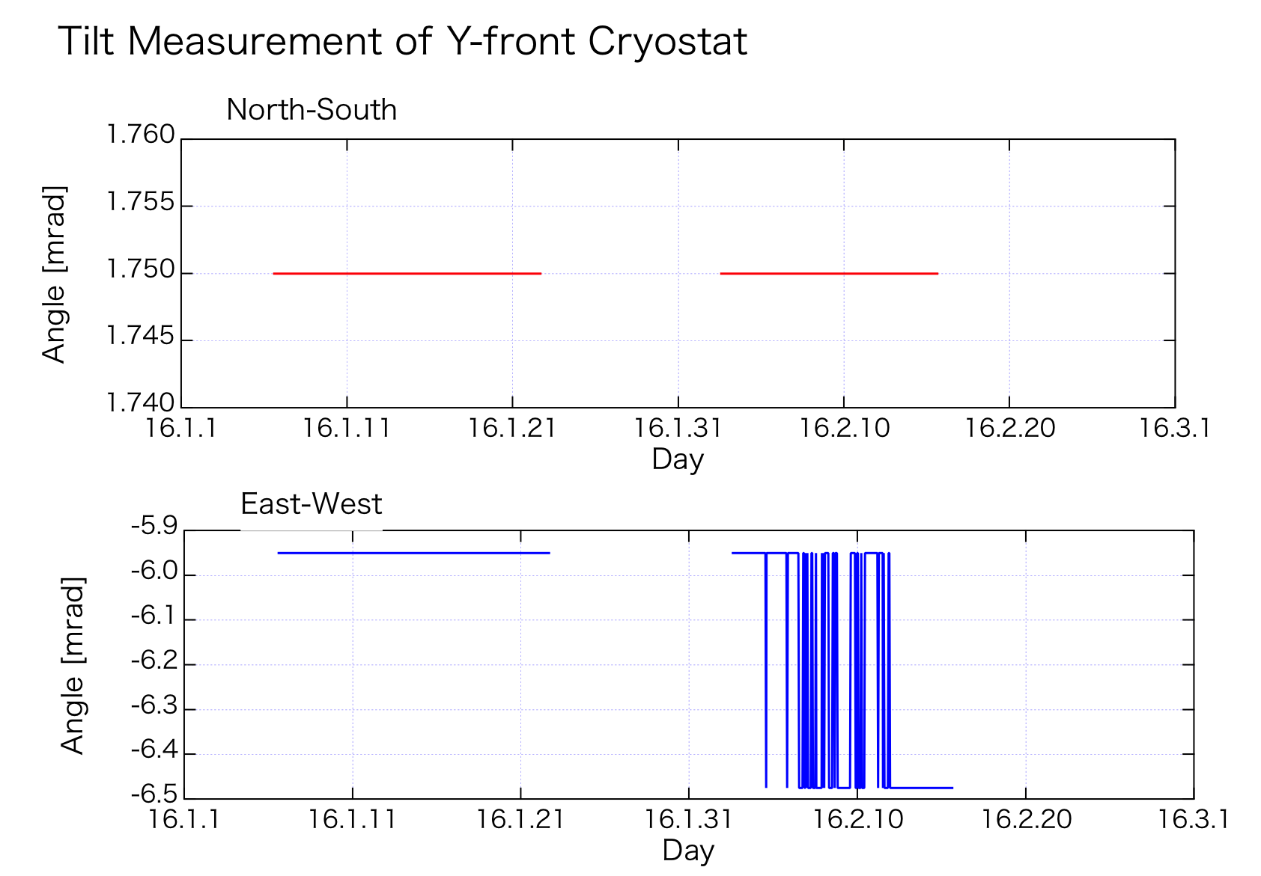
Re-alignment of the cryostats will be done at Mar.
We lost data beween Nov. and Dec. since PC trouble, but it didn’t change from above.

Slide 12
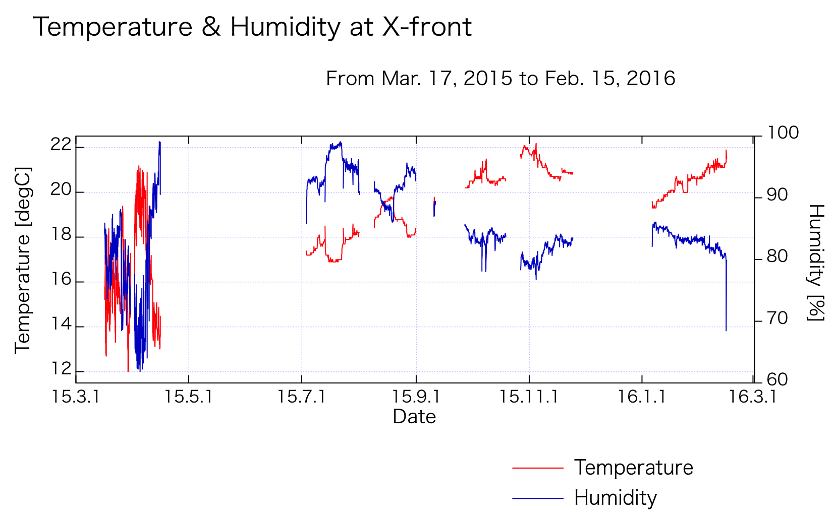

Slide 13
5. Schedule
 | 2016 |  |  |  |  |  |  |  |  |  |  | 2017 |  |  |  |  |  |  |  |  |  |  |  | 2018
 | 2 | 3 | 4 | 5 | 6 | 7 | 8 | 9 | 10 | 11 | 12 | 1 | 2 | 3 | 4 | 5 | 6 | 7 | 8 | 9 | 10 | 11 | 12 | 1 | 2 | 3
Cryo-Payload No.1 Fab.
Cryo-Payload No. 1 Assembry
Cryo-Pay. No. 1 test
Local Sensor Test & Impro.
Cryo-Pay. Proto. improvement
Cryo-Paylaod No. 2, 3, 4 Fab.
Cryo-Paylaod No. 2, 3, 4 Assem.
Cryo-Pau. No. 2-4 test
Heat Link Fab.
Platform Design & Fab.
Assembly Jig Design
Indium Bonding Test
Sapphire Fiber Fab.
Sapphire Proto. Assembly
HCB to ETM
ETM sapphire assembly & test
HCB to ITM
ITM sapphire assembly & test
Assemble Sapphire to Pay. 1
Assemble Sapphire to Pay. 2 - 3
EXC cryostat assembly
EYC cryostat assembly
IXC cryostat assembly
IYC cryostat assembly
Water Chiller Fab. & Inst.
Cryostat Cool & Vib. Test
Pay. Install. Tooles Design
Pay. Install. Tooles Fab.
Cryo-Payload Inst. to EXC
Cro-Payload Inst. to EYC
Cro-Payload Inst. to IXC
Cro-Payload Inst. to IYC
EXC Pay. Cool Down
EYC Pay. Cool Down
IXC Pay. Cool Down
IYC Pay. Cool Down
Pendulum
Platform Design & Fab.
Depend on
Mirror Delivery
Sapphire Suspension
Payload Assembly
Depend on
Clean Both
Cryostat
Installation
Cool Down

Slide 14
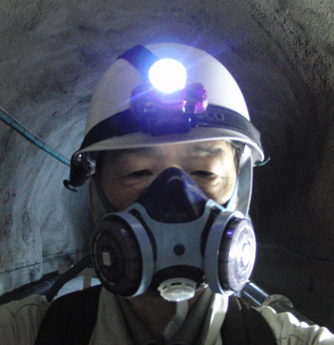
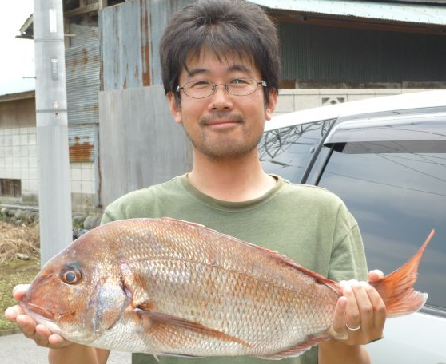
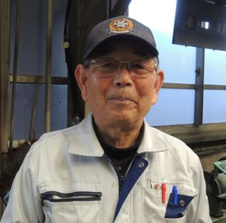
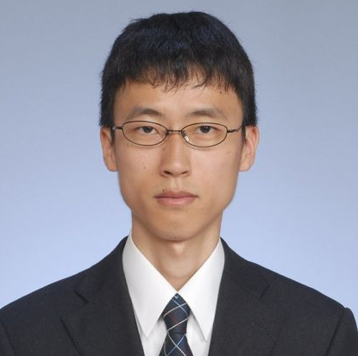
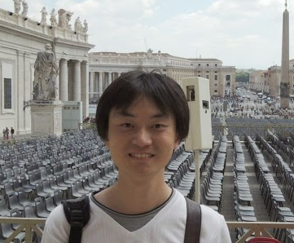
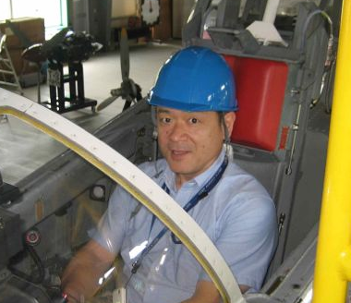
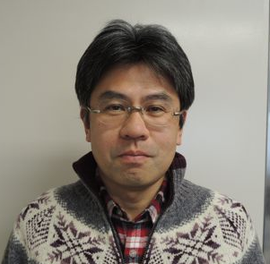
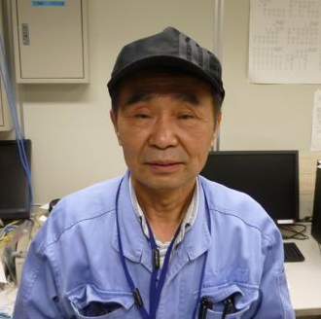
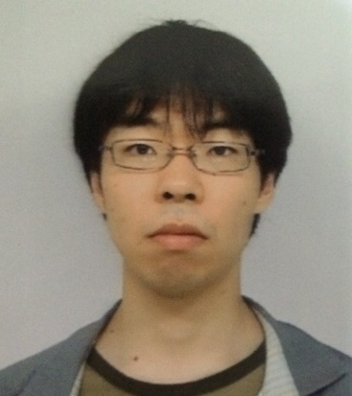
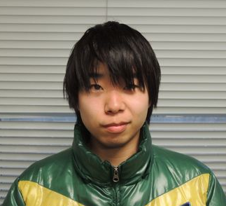
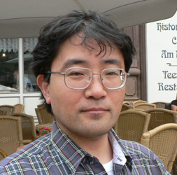
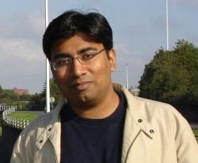
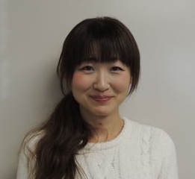
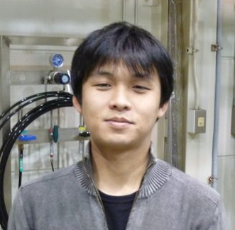
KAGRA Cryogenics Group
@ Feb. 2015
Toshikazu SUZUKI
Chief
KEK, Prof.
Takayuki TOMARU
Cryo-Payload
KEK, Assoc. Prof.
Shinichi TERASHIMA
Machining
KEK, Technical Staff
Yusuke SAKAKIBARA
Cryostat, Scattering
ICRR, Grad. Student
Dan CHEN
Cryo-Payload, Q
ICRR, Grad. Student
Nobuhiro KIMURA
Cryostat sub-chief
KEK, Assoc. Prof.
Tatsuya KUME
Surveying, Alignment
KEK, Assoc. Prof.
Iwao MURAKAMI
Welding, Assembly
KEK, Technical Staff
Hiroki TANAKA
Cryo-Payload, Q
ICRR, Grad. Student
Takahiro MIYAMOTO
Cryo-Payload
ICRR, Grad. Student
Kazuhiro YAMAMOTO
Cryo-Payload sub-chief
ICRR, Assist. Prof.
Rahul KUMAR
Simulation, Payload
KEK, PD
Ayako HAGIWARA
CAD
KEK, Technical Staff
Suguru TAKADA
Cryogenics
NIFS, Assist. Prof.

Slide 15
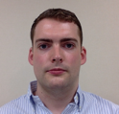
KAGRA Cryogenics Group
@ Apr. 2016
Haino-san & Vocca-san
joined
-4 + 3 = -1 people
Toshikazu SUZUKI
KEK, Prof.
Takayuki TOMARU
Chief, Cryo-Payload
KEK, Assoc. Prof.
Shinichi TERASHIMA
Machining
KEK, Technical Staff
Need some of
• Man power
(not helper but expert)
• Money
• Time
Nobuhiro KIMURA
Cryostat sub-chief
KEK, Assoc. Prof.
Hiroki TANAKA
Cryo-Payload, Q
ICRR, Grad. Student
Takahiro MIYAMOTO
Cryo-Payload
ICRR, Grad. Student
Kazuhiro YAMAMOTO
Cryo-Payload sub-chief
ICRR, Assist. Prof.
Rahul KUMAR
Simulation, Payload
KEK, PD
Ayako HAGIWARA
CAD
KEK, Technical Staff
Suguru TAKADA
Cryogenics
NIFS, Assist. Prof.
Kieran Craig
Cryogenic Payload
ICRR, PD

Slide 16
Back Up

Slide 17
Schedule 1
By March 2016 : Development of jigs for HCB
By May 2016 : Development of indium bonding
By July of 2016 : Procurement
of all sapphire parts
By August 2016 : Assembly and test of prototype
September 2016 : Hydroxide Catalysis
Bonding (ETM) is applied.
By March 2017 : Assembly and test
of sapphire suspension (ETM)
17

Slide 18
Schedule2
April 2017 : Hydroxide Catalysis
Bonding (ITM) is applied.
By June 2017 : Assembly and test
of sapphire suspension (ITM)
August 2017 - February 2018 : Installation of cryogenic payloads
(2 months for one payload)
September 2017 – August 2018 : Cooling
18

